Slide 1
What is Big Data ?
Big data is a term for data sets that are so large or complex that traditional data processing application software is inadequate to deal with them.
3 V’s of Big Data
Volume
Velocity
Variety

Slide 2
Distributed File System and HADOOP
File System – Algorithm by which files are organized on the disk
Hadoop – Apache Hadoop is a framework that allows for the distributed processing of large data sets across clusters of commodity computers using a simple programing model.

Slide 3
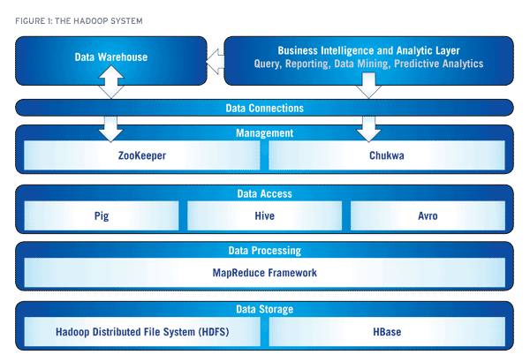
HADOOP Eco System

Slide 4
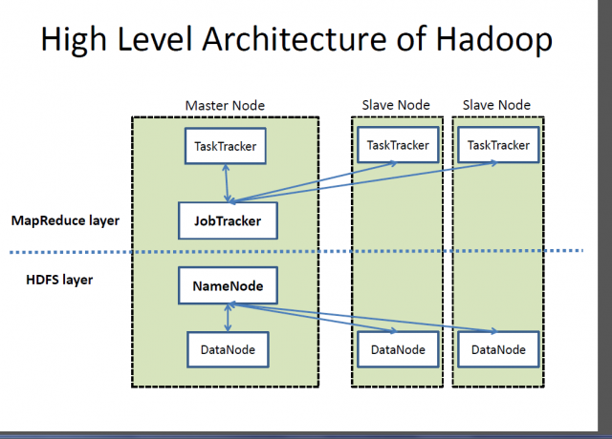

Slide 5
Areas Where HDFS is not suitable
Low latency data access
Lots of small files
Multiple writer, arbitrary file modification

Slide 6
Job.jar/xml
Name Node
Job tracker
Client
Secondary name node / Meta data
Data of 200MB
Input split (a,b,c,d)
Meta data
USER
Data node,
Task Tracker &
Map (a)
Data node,
Task Tracker &
Map (b)
Data node,
Task Tracker &
Map (c)
Data node,
Task Tracker &
Map (d)
Job tracker
Task tracker
Input splits
Meta data
Secondary name node
Map
Job.jar
Replication
Data node,
Task Tracker &
Map (b)
Data node,
Task Tracker &
Map (a)
Data node,
Task Tracker &
Map (b)
Data node,
Task Tracker &
Map (a)
Data node,
Task Tracker &
Map(c)
Data node,
Task Tracker &
Map (d)
Data node,
Task Tracker &
Map (d)
Data node,
Task Tracker &
Map (c)
HDFS Cluster

Slide 7
Differences
Space allocation
Programing paradigm

Slide 8
Word count problem in MapReduce
Apache Hadoop™ was born out of a need to process an avalanche of big data. The web was generating more and more information on a daily basis, and it was Google | 64 -> Map1
becoming very difficult to index over one billion pages of content. In order to cope, Google invented a new style of data processing known as MapReduce. A year after | 64 -> Map2
published a white paper describing the MapReduce framework, Doug Cutting and Mike Cafarella, inspired by the white paper, created Hadoop to apply these concepts | 64 -> Map3
to an open-source software framework to support | 8 -> Map4

Slide 9
Input file of 200MB
Input split 1
Input split 2
Input split 3
Input split 4
Record reader 1
Record reader 2
Record reader 3
Record reader 4
Text input format
Key value Text i/p
Sequence file i/p
Sequence file as test i/p
(Byte offset , entire line.. an )
(0, Apache … an)
(54, ava.. … )
(.., more…..)
(Apache, 1)
(Hadoop, 1)
(™, 1)
…
Map 1
Map 2
Map 3
Map 4
Combiner 1
Combiner 2
Combiner 3
Combiner 4
Combines all duplicates
Shuffler 1
Shuffler 2
Shuffler 3
Shuffler 4
Reducer1
Reducer 2
Reducer 3
Reducer 4
Result

