Slide 1
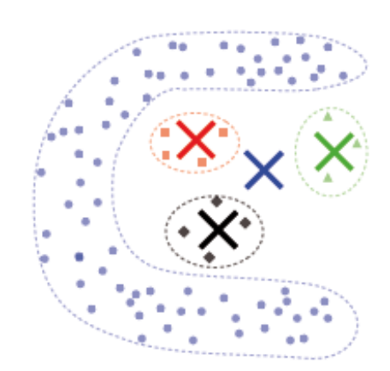
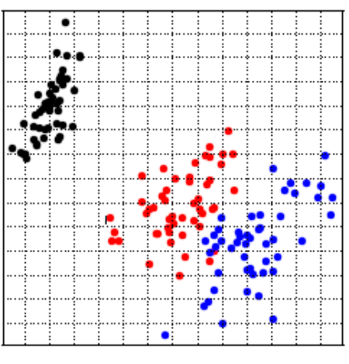
Cluster Analysis:
Validation, Visualization, Outlier
Notes:
Vorlesung 7: Visualisierung von Multiparameter Daten

Slide 2
Outline
Introduction
Visualization of Clustering Results
Validation of Clustering Results
Outlier detection
Bernhard Preim

Slide 3
Validation
An analyst may try clustering techniques and parameterizations. How does she know whether the results are good? What are failures of clustering?
False negatives (FN). Essential structures not detected.
False positives (FP). Determined clusters not meaningful.
Clustering result may contain both FNs and FPs.
In addition to a global assessment, individual clusters analyzed, w.r.t. specific boundaries.
Validation measures consider individual clusters and compose a global score based on (weighted) combinations of individual results.
Bernhard Preim

Slide 4
Validation
If a gold standard is available, e.g., a consensus how experts manually cluster the data → compare clustering results to this gold standard.
If no (convincing) gold standard available, use cluster purity measures
Silhoutte coefficient
Centroid measure
Grid-based measures
Selection of cluster purity measures challenging! Depending on the within and between class factors, some measures are not valid.
Bernhard Preim

Slide 5
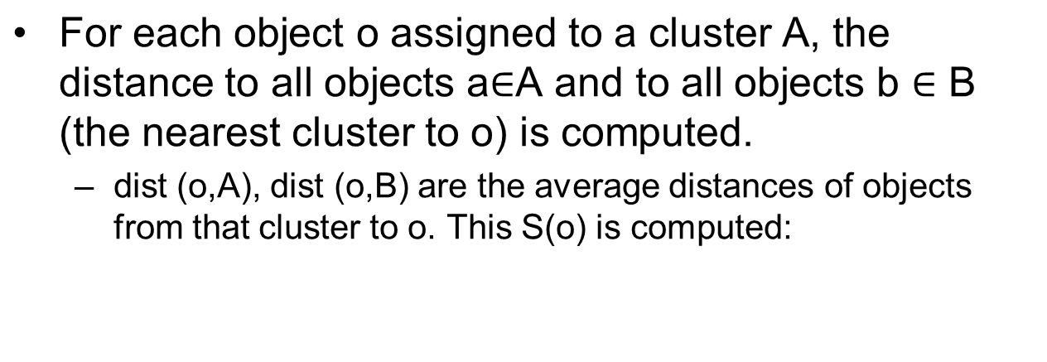
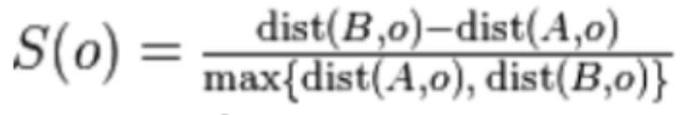
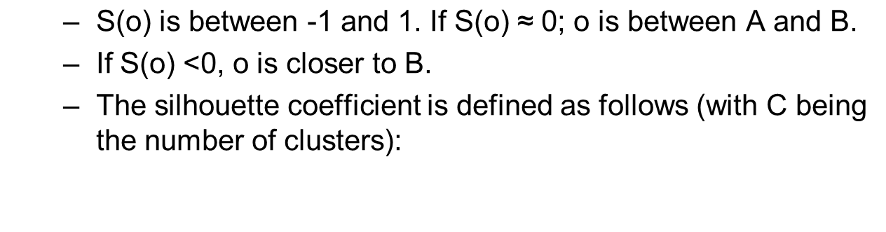
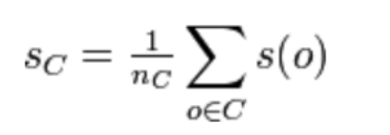
Validation: Silhouette Coefficient
Bernhard Preim

Slide 6
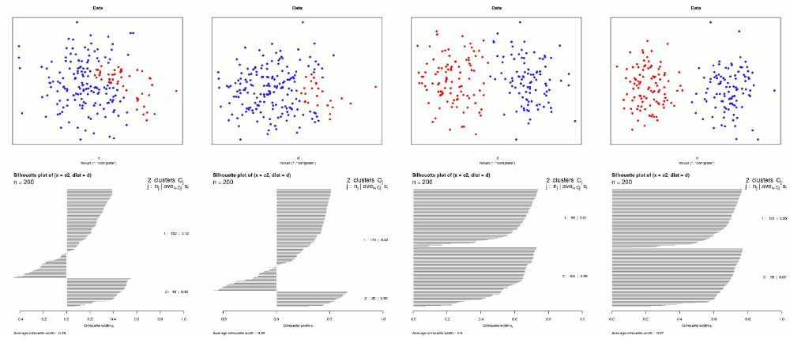
Validation: Silhouette Coefficient
Clustering measures used to optimize clustering, e.g. by starting the algorithm again with different parameters or by starting stochastic algorithm again (with the same parameters).
1: 0.12
2: 0.42
1: 0.22
2: 0.56
1: 0.61
2: 0.59
1: 0.66
2: 0.67
Data and silhouette plots of different data sets. (From Wikimedia, Creative Commons Attribution-Share Alike 3.0 Unported)
Bernhard Preim

Slide 7
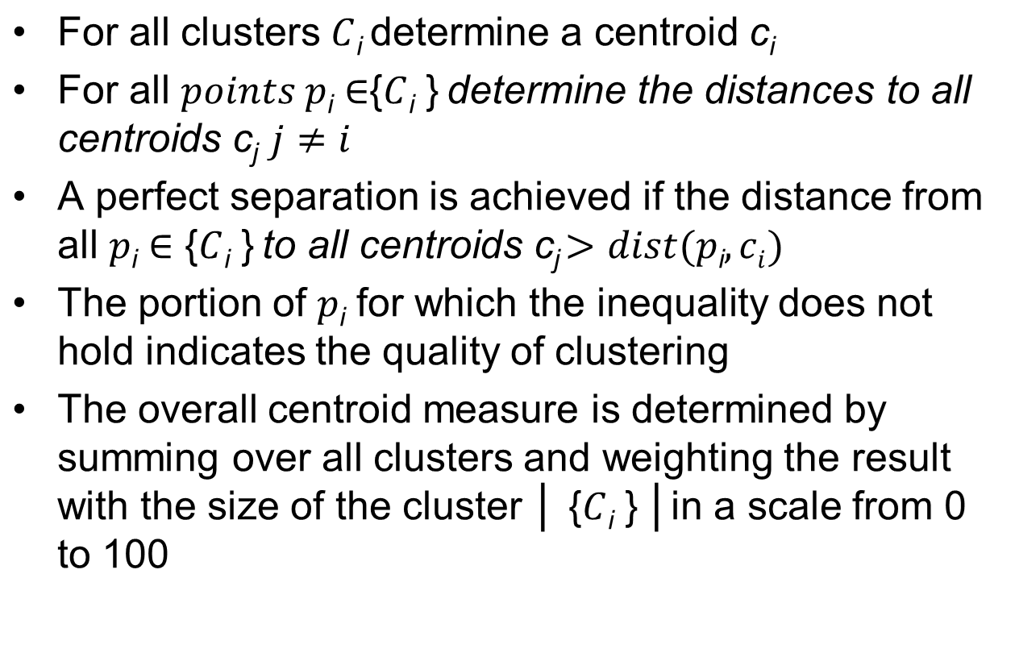
Validation: Centroid-Based Measure
Bernhard Preim

Slide 8
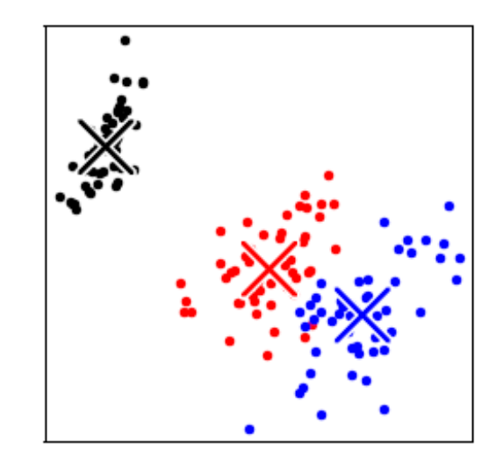
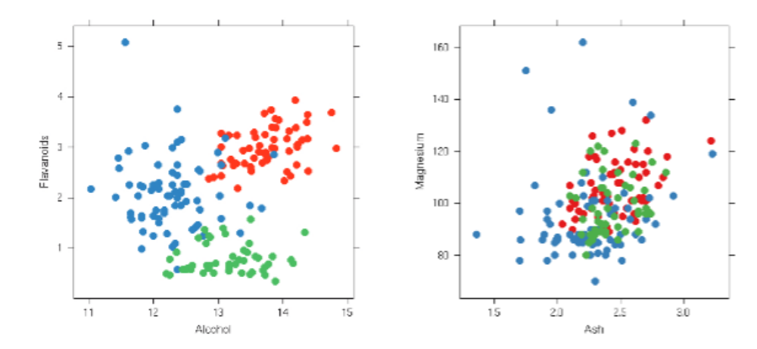
Validation: Centroid-Based Measure
Left: Clustering results in three clusters. Centroids shown as X (From: Sedlmaier, 2012)
Middle and right: Clustering with good (90) and bad centroid measure (49) (From: Sips, 2009)
Bernhard Preim

Slide 9
Validation: Centroid-Based Measure
Centroid measure
Low values for narrow and curved clusters;
High values for convex compact shapes.
Low values for split and interwoven (spatially not coherent) clusters.
Relatively robust against different sizes, densities and numbers of clusters.
Banana-shaped (curvy, narrow) cluster: centroid outside of the cluster. Although the clustering result is perfect, the centroid measure produces a very low result (From: Sedlmaier, 2012).
Bernhard Preim

Slide 10
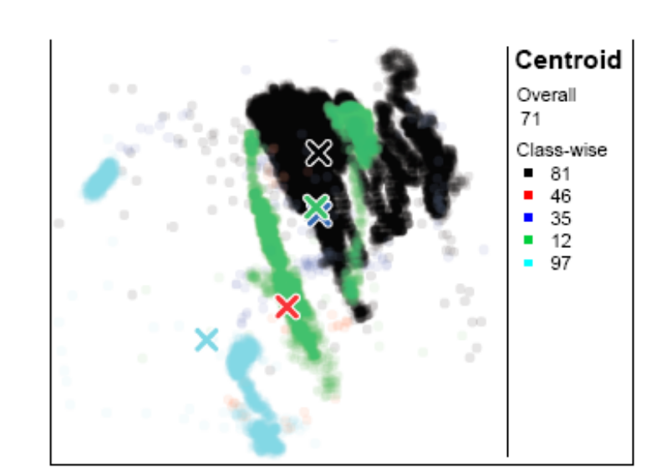
Validation: Centroid-Based Measure
Split green cluster has a very low centroid value altough experts rated it as correct (From: Sedlmaier, 2012)
Bernhard Preim

Slide 11
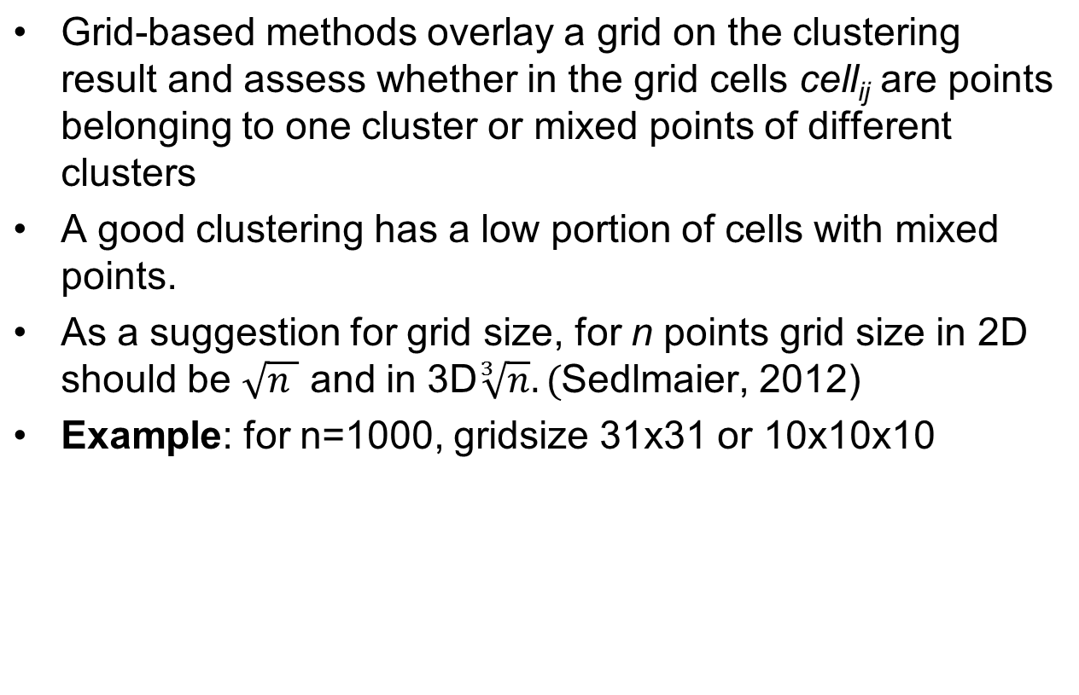
Validation: Grid-Based Method
Evaluation of clustering with a grid method (From: Sedlmaier, 2012)
Bernhard Preim

Slide 12
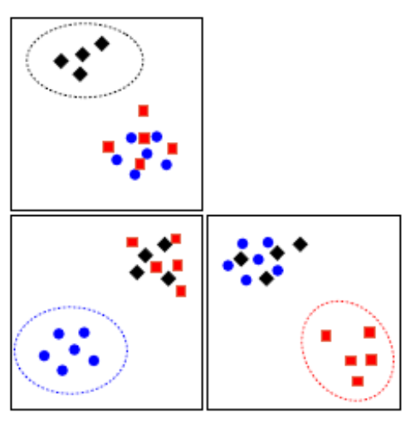
Validation
Centroid- and Grid-based quality can be assessed also for 3D clustering results shown in a 3D scatterplot
For higher dimensional clusters → scatter plot matrices (SPLOM)
Good visual separation when each cluster is clearly separated in at least one scatterplot.
Evaluation of clustering in a SPLOM (From: Sedlmaier, 2012)
Bernhard Preim

Slide 13
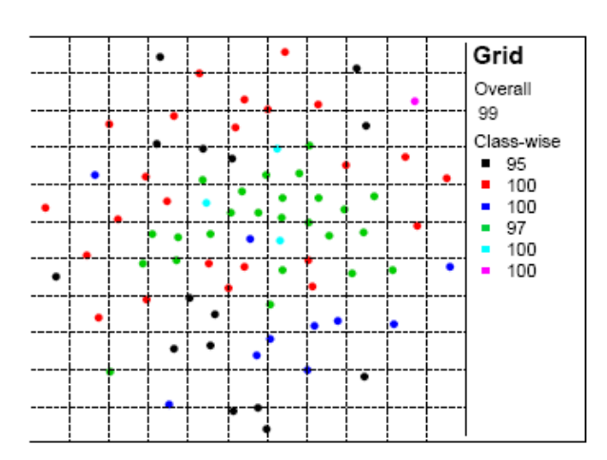
Validation
Grid-based measure more robust against split clusters and non-convex shapes
Influence of the grid resolution: With a too low resolution the results are positive even in case of bad clusters.
Grid size must be chosen such that typically several points are in one cell.
Good grid measure misleading due to the low resolution (From: Sedlmaier, 2012).
Bernhard Preim

Slide 14
Validation
Validation measures may be used to determine number of clusters for k-Means, k-Medoids, fuzzy c-means → for a range of values, e.g. n within [2,20], validation measures determined and parameter n chosen that leads to best measures.
Problem: validation measures may depend on the number of clusters; some grow or decrease monotonically with n.
If validation measures are very similar for n₁ and n₂ (numbers of clusters) → prefer the lower number
Bernhard Preim

Slide 15
Visualization of Clustering Results
High-level tasks
„support an active process of discovery as opposed to passive display“ (Fua, 1999)
Interactive Visualization of clusters serves to (Cao, 2011)
Interpret clusters
Evaluate clusters (is the grouping correct?)
Refine clusters (merge or split clusters, add or remove elements, change parameters or even algorithms)
Bernhard Preim

Slide 16
Visualization of Clustering Results
Visualization tasks (in more detail):
For 2D data, hard clustering:
  Show data distribution, provide statistical properties per cluster and indicate per point to which cluster it belongs, show all attributes or a user-selected subset
For 2D data, fuzzy clustering
  Show data distribution and indicate per point the probability of belonging to a certain cluster
Optional additions
  Display representatives per cluster
  Local regression lines per cluster
For HD data, project the points such that distances are roughly preserved after projection in 2D/3D
Bernhard Preim

Slide 17
Visualization of Clustering Results
Visualization Techniques:
Early Techniques,
Glyphs,
Scatterplots (2D, 3D)
Parallel Coordinates Plot (PC plot)
Isolines
Enhanced Dendograms
Bernhard Preim

Slide 18
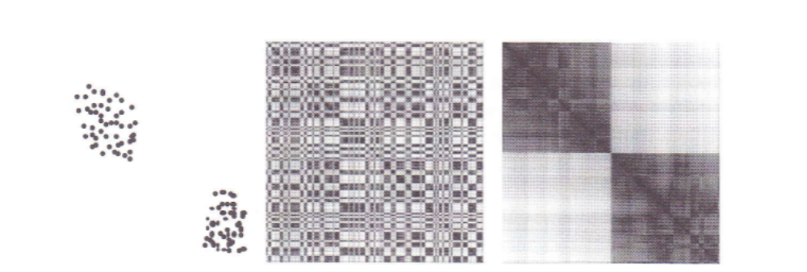
Early Visualization Techniques
Distance matrix re-ordered according to the 2 clusters.
(From: Hathaway, 2003)
Visualization of clustering results for verification of plausibility [Rohlfs, 1970], [Ling, 1973].
Clustering result is plausible, if the distance matrix (based on the chosen distance measure) re-ordered according to cluster membership makes clusters clearly visible (Ling, 1973).
Distance mapped to darkness.
Bernhard Preim

Slide 19
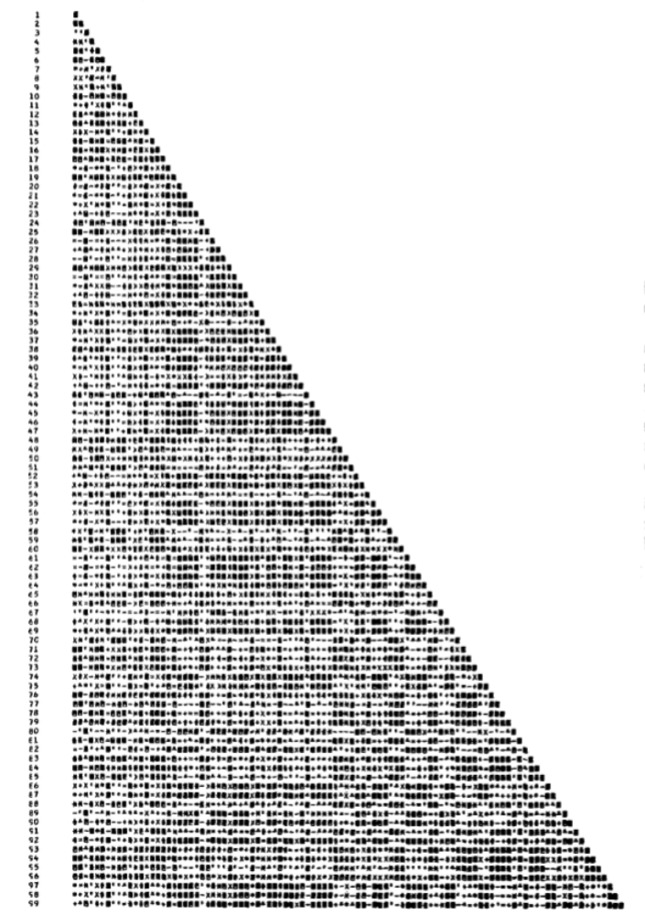
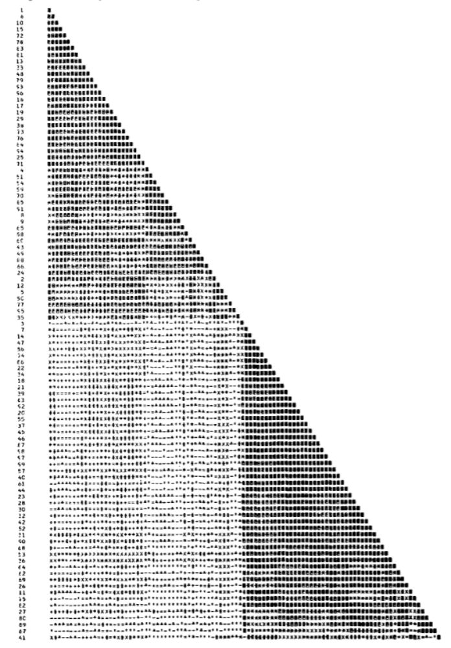
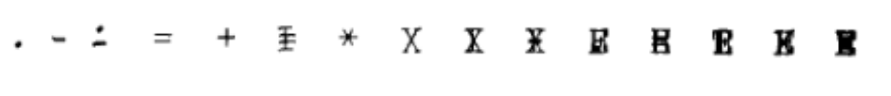
Early Visualization Techniques
Before and after re-ordering the distance matrix. The generated two clusters lead to a clear separation in the matrix (From: Ling, 1973)
The „color scale“
Bernhard Preim

Slide 20
Visualization of Clustering Results: Glyphs
Design guidelines for glyphs (from Cao,2011):
Support multiple levels of visual exploration, e.g. features, points (feature vectors), subclusters, clusters
Provide consistent encodings
  Normalize data, e.g. to (0,1) ranges
Design glyphs that are perceived as similar if the underlying data (size of the cluster, …) are similar
Provide interaction to explore the visualization and refine the clusters
Bernhard Preim

Slide 21
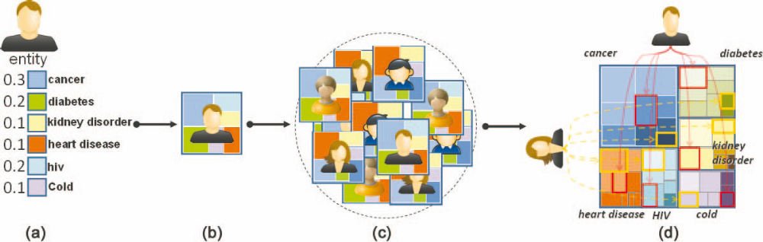
Visualization of Clustering Results: Glyphs
Dynamic icon-based visualization of Clusters (Cao, 2011)
Glyphs depict various attributes (size, shape, color) → useful for cluster visualization
Treemaps depict hierarchies → useful for hierarchical clusters. Based on regrouping cluster elements by feature type. (From: Cao, 2011, see also video)
Bernhard Preim

Slide 22
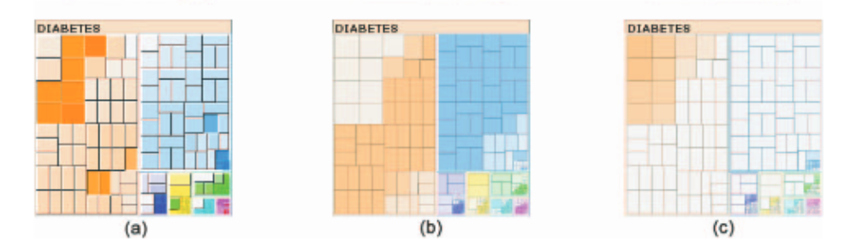
Visualization of Clustering Results: Glyphs
(From: Cao, 2011)
Three color scales for cluster visualization.
Left: Color indicates cluster quality. High saturation for good quality.
Middle: Color indicates co-occurrence of the current diseases with others (could be relevant for epidemiology data)
Right: Domination cue: Color indicates how strongly the selected disease dominates (multimorbid patients).
Bernhard Preim

Slide 23
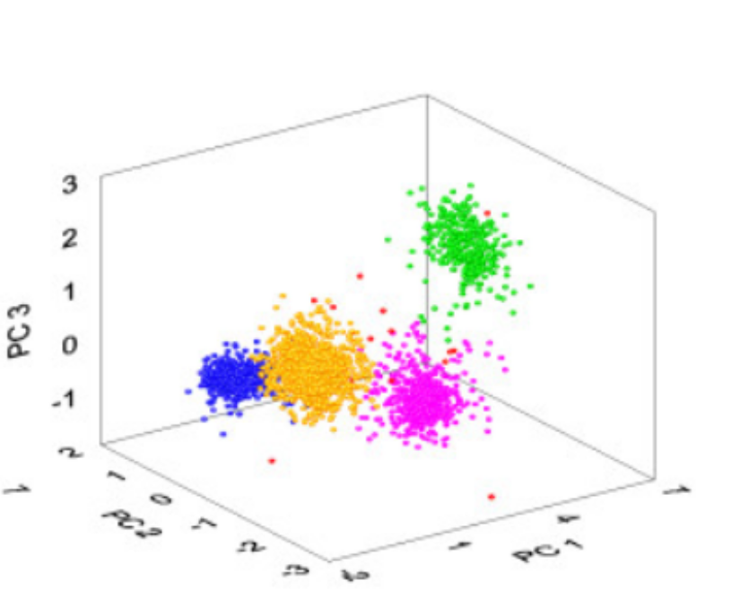
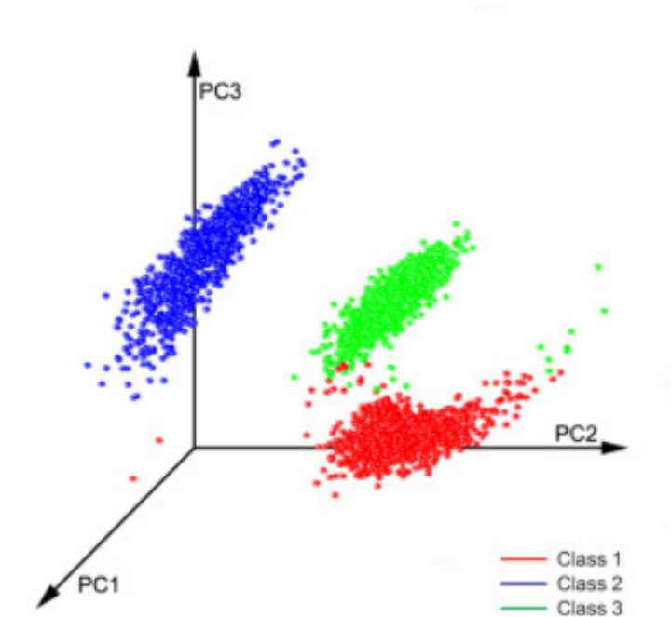
Visualization: Scatterplots
Unique colors encode memberships to clusters
Does not scale for many clusters (up to a dozen)
(From: Oliynuk,2012)
Bernhard Preim
Notes:
How many colors can be perceived as unique?
Vorlesung 7: Visualisierung von Multiparameter Daten

Slide 24
Visualization: Scatterplots
Requires a projection to 2D or 3D space, e.g. with multidimensional scaling or PCA
The resulting view depends on
  parameters of the clustering and
  projection technique.
For temporal clustering: animated scatterplots may reveal the dynamics of cluster formation, merging and splitting.
  Careful temporal control necessary
Bernhard Preim

Slide 25
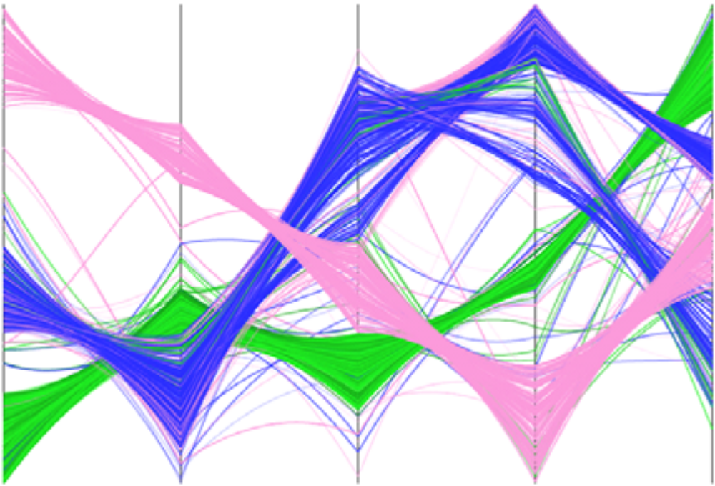
Visualization of Clustering Results: PC plots
Visualization of clustering results in parallel coordinates with edge bundling (Zhou, 2008).
No projection is involved (full information available); color indicates cluster membership.
Bernhard Preim
Notes:
Look at the lines and study which of them are drawn uninterrupted and which are partially hidden? You may infer a drawing sequence. Think about a meaningful interaction to control this drawing sequence that clearly influences the perception and interpretation.
Vorlesung 7: Visualisierung von Multiparameter Daten

Slide 26
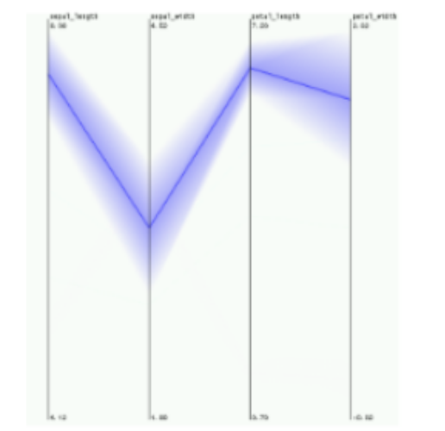
Visualization of Clustering Results: PC plots
Parallel coordinates may be enhanced with
edge bundling,
proximity colors,
opacity adjustment and
curved lines
to avoid clutter and to reveal cluster structure.
One cluster (4 dimensions) in parallel coordinates with opacity mapped to distance from centroid
(From: Fua, 1999)
Bernhard Preim

Slide 27
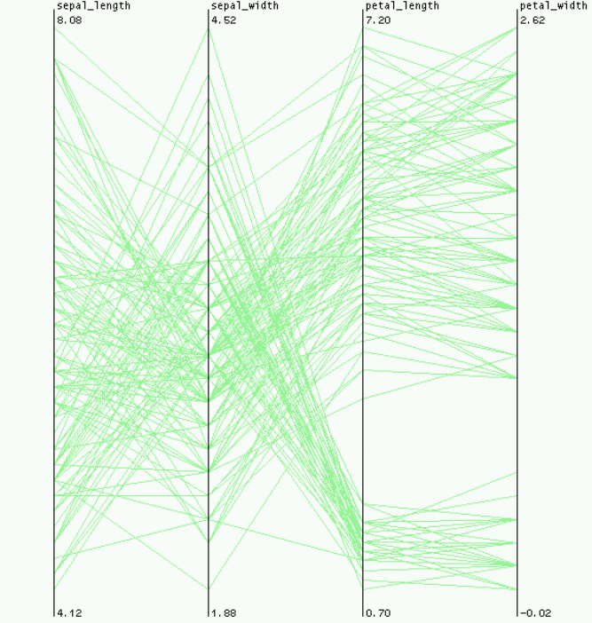
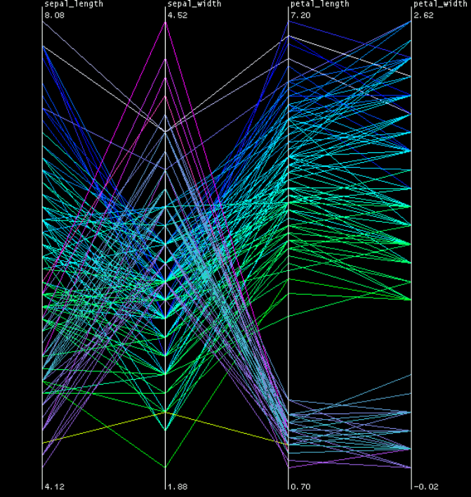
Visualization of Clustering Results: PC plots
Proximity-based coloring: Hues encode cluster membership. Discrimination of clusters hampered in case of many intersecting lines from different clusters (From: Fua, 1999)
Bernhard Preim

Slide 28
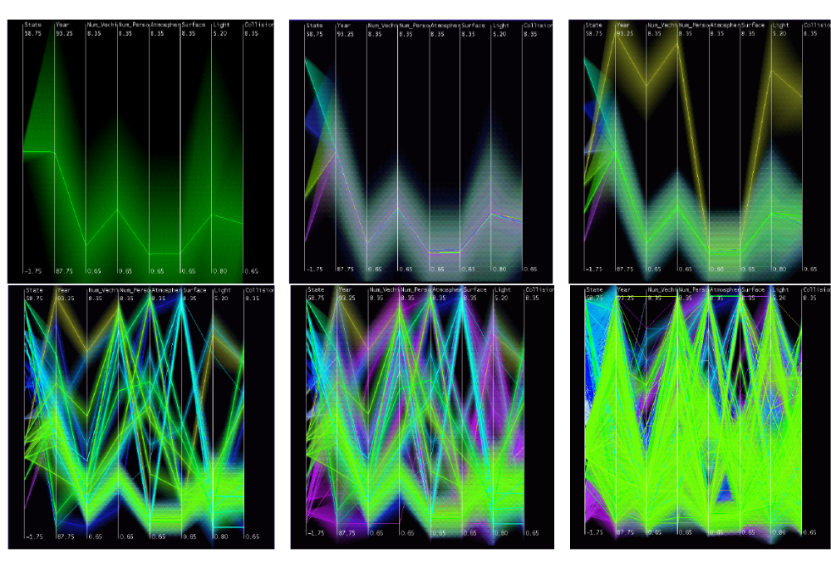
Visualization of Clustering Results: PC plots
Parallel coordinates for displaying hierarchical clustering results. Hierarchy enables aggregation.
Clusters at different levels enable multiscale exploration
From top left to bottom right: Root level, inter-mediate clustering levels and leaf nodes.
Fatal accident dataset with 230,000 datasets. Dimensions:
#vehicles involved, #persons involved, #drunk_drivers, speed_limit (From: Fua, 1999)
Bernhard Preim

Slide 29
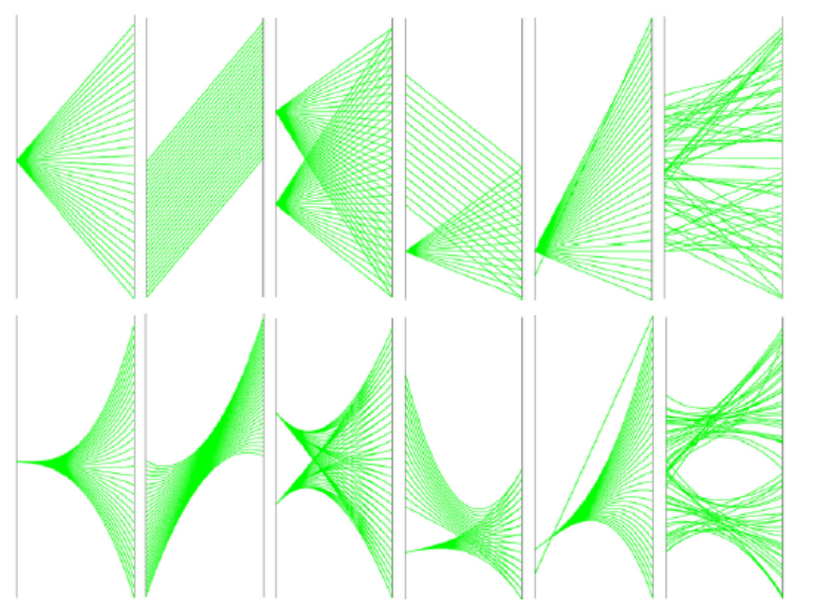
Visualization of Clustering Results: PC plots
Visual separation according to cluster results supported by bending lines (explain edge bundling).
Bending: result of an energy optimization with gravitation and curvature terms and user-adjustable weighting
Gravitation term: attracts nearby lines
Curvature term: avoids excessive bending
Top row: conventional linear combinations.
Bottom row: after energy optimization clutter is strongly reduced (From: Zhou, 2008)
Bernhard Preim

Slide 30
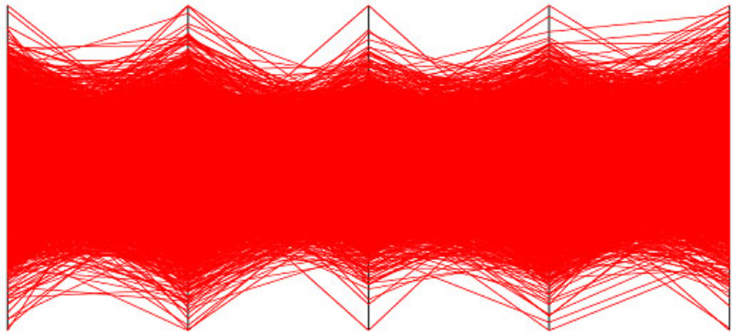
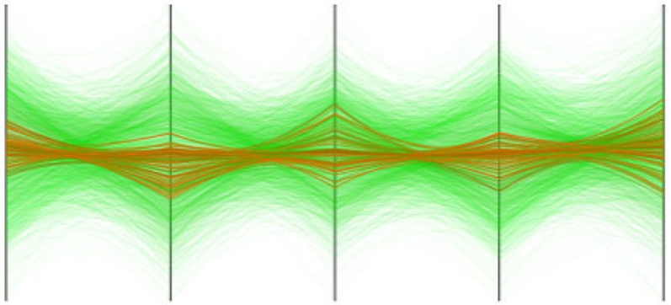
Visualization of Clustering Results: PC plots
Conventional PC Plot (3848 datasets) and with color and opacity optimization to reveal clusters (From: Zhou, 2008)
Bernhard Preim
Notes:
We discussed scalability several times: Here, opacity and color enhance scalability considerably.
Vorlesung 7: Visualisierung von Multiparameter Daten

Slide 31
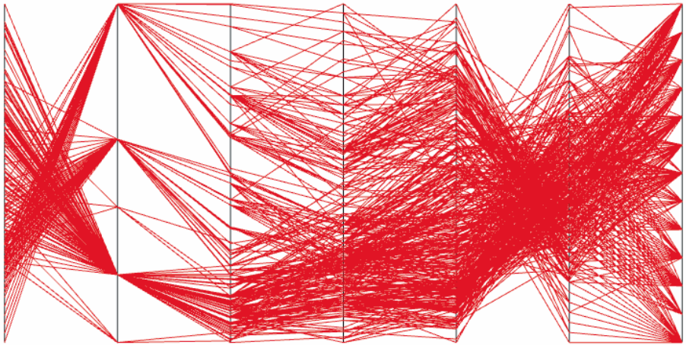
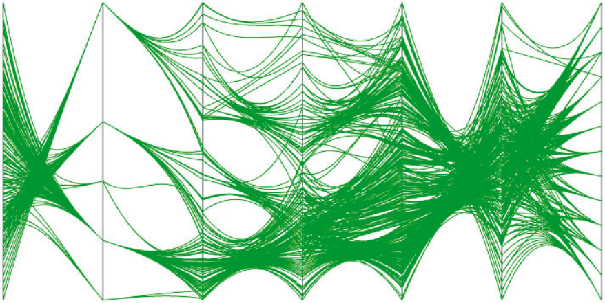
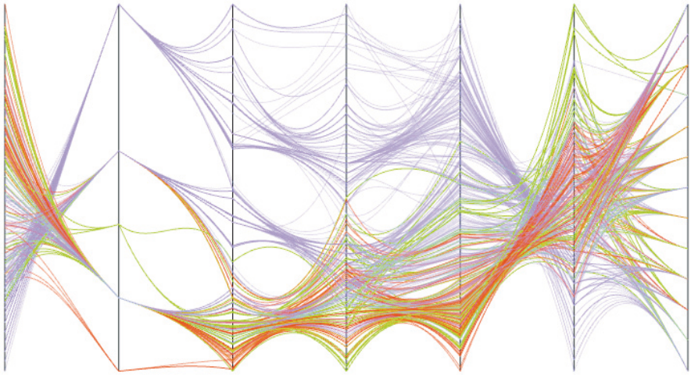
Visualization of Clustering Results: PC plots
392 datasets with 7 dimensions (car dataset) Original PC Plot.
Energy minimization to support visual clustering.
Additional use of proximity colors. (From: Zhou, 2008)
Bernhard Preim
Notes:
The combination of color, transparency and edge bundling strongly supports scalability. Interaction (filtering, emphasis of selected lines) further supports scalability.
Vorlesung 7: Visualisierung von Multiparameter Daten

Slide 32
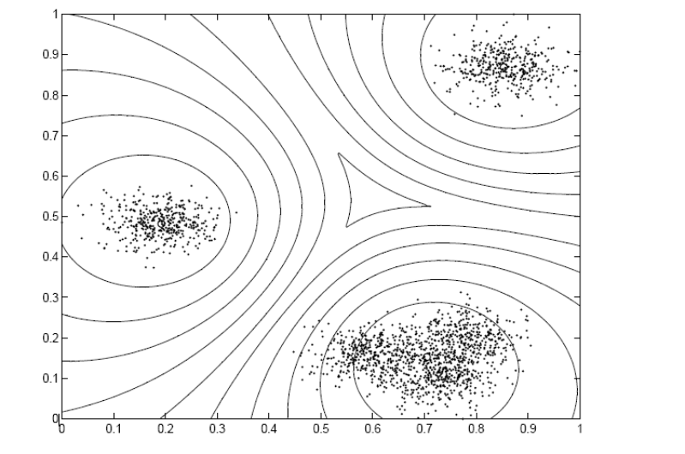
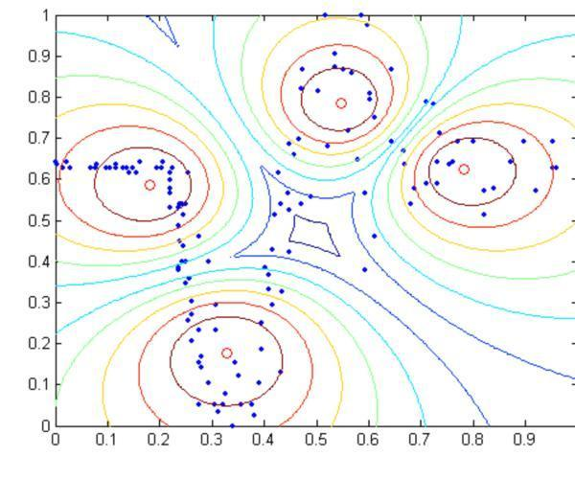
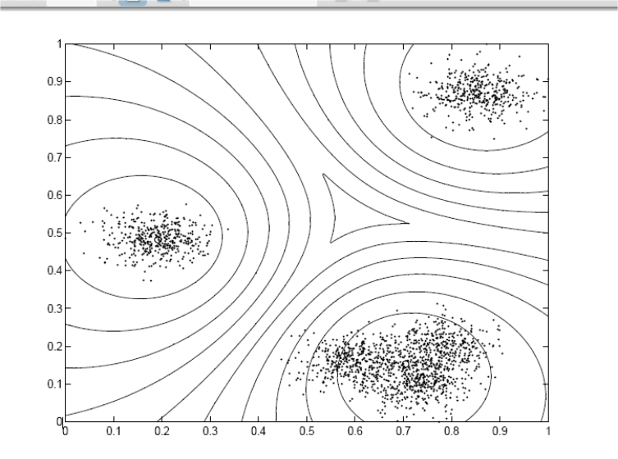
Visualization: Isolines
Isolines represent degree of membership as result of fuzzy clustering.
Isolines in a synthetic dataset. Fuzzy c-means (FCM) clustering (Graves, 2007)
(From: Fuzzy Clustering and Data Analysis Toolbox, Matlab, Link)
Bernhard Preim

Slide 33
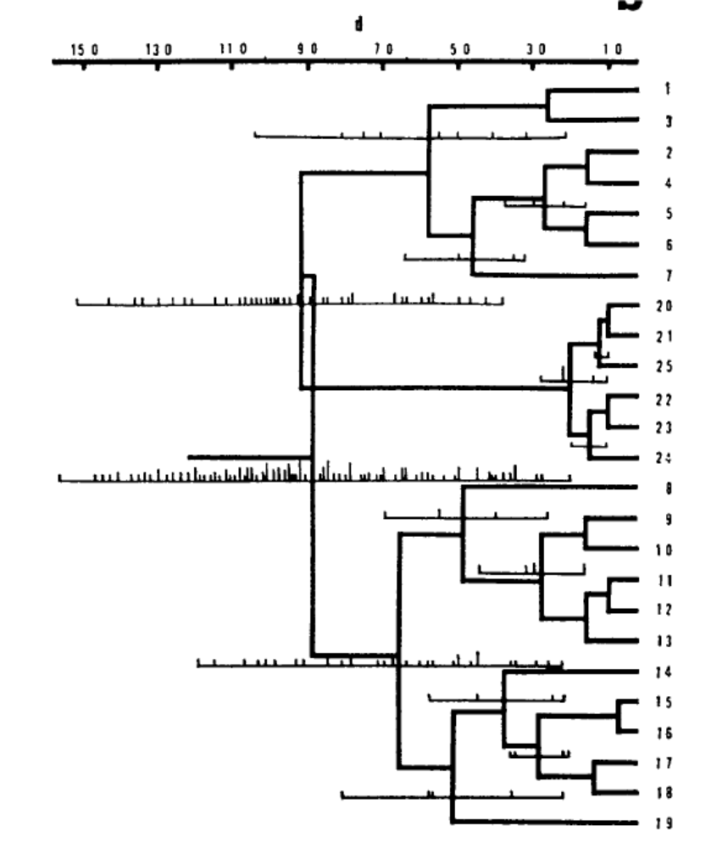
Visualization: Enhanced Dendograms
Dendograms
summarize grouping.
do NOT enable a verification of this grouping
Early concepts were developed to enhance dendograms, e.g. with histograms per cluster (Rohlf, 1970)
Bernhard Preim

Slide 34
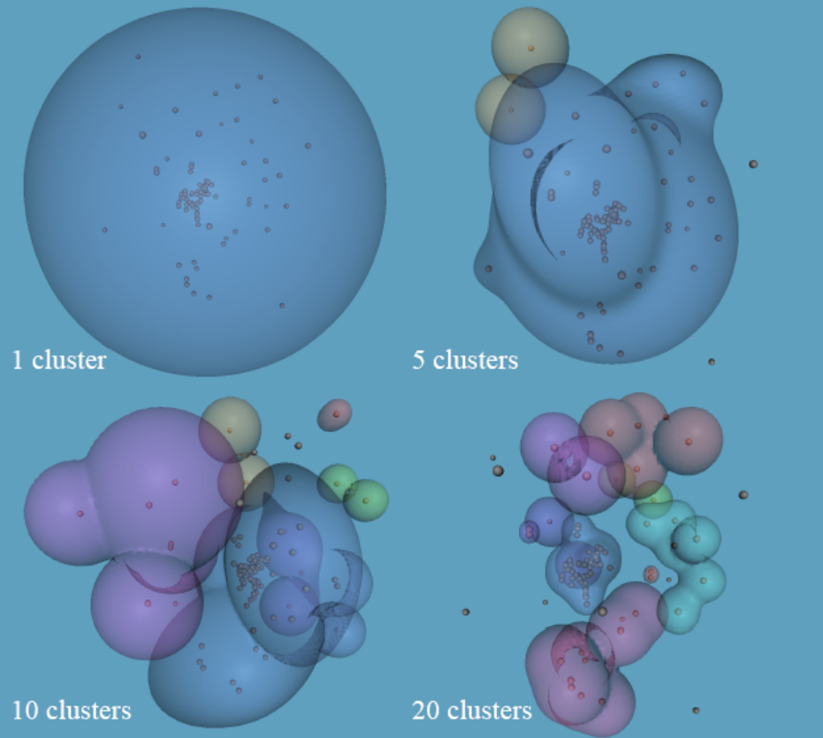
Visualization: 3D Hierarchy Visualizations
Hierarchy displayed with semi-transparent objects (nested surfaces). HD data projected to 3D with MDS
Human perception of 3D shapes employed
(in contrast to 3D point clouds where users are
not experienced)
(From: Sprenger, 2000)
Bernhard Preim

Slide 35
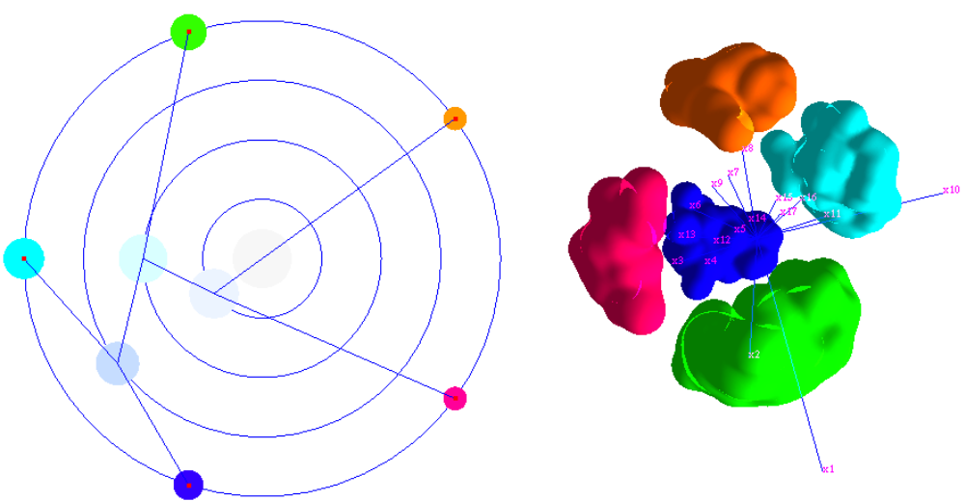
Visualization: 3D Hierarchy Visualizations
3D Hierarchy Visualization based on Star coordinates (From: van Long, 2009)
Bernhard Preim

Slide 36
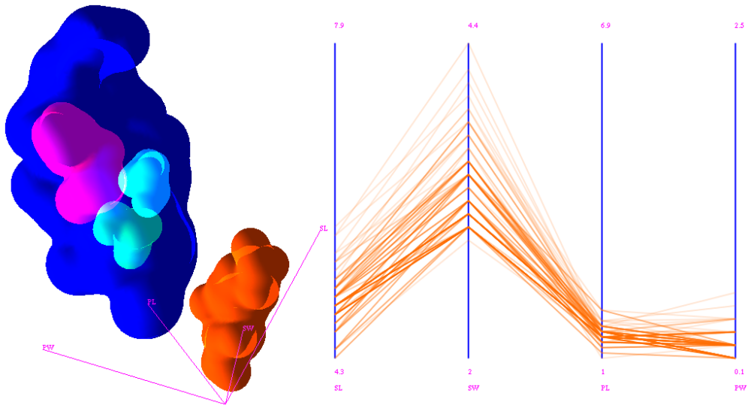

Visualization: 3D Hierarchy Visualizations
3D Hierarchy Visualization based on Star coordinates combined with parallel coordinates. 4D Iris dataset. Correspondence between PC plot and 3D view not shown (From: van Long, 2009)
Bernhard Preim

Slide 37
Visualization of Clustering Results
Integrating Cluster Analysis with Feature-Based Analysis:
1D Features: skew, degree of fit to uniform/Normal/ Poisson … distribution, largest gap size
2D Features: linear, quadratic, logistic … regression, statistical power (F value), number of outliers, …
Rank by Feature Framework: rank dimensions or pairs of dimensions according to selected 1D or 2D features (Seo, 2004; Seo, 2006)
Bernhard Preim

Slide 38
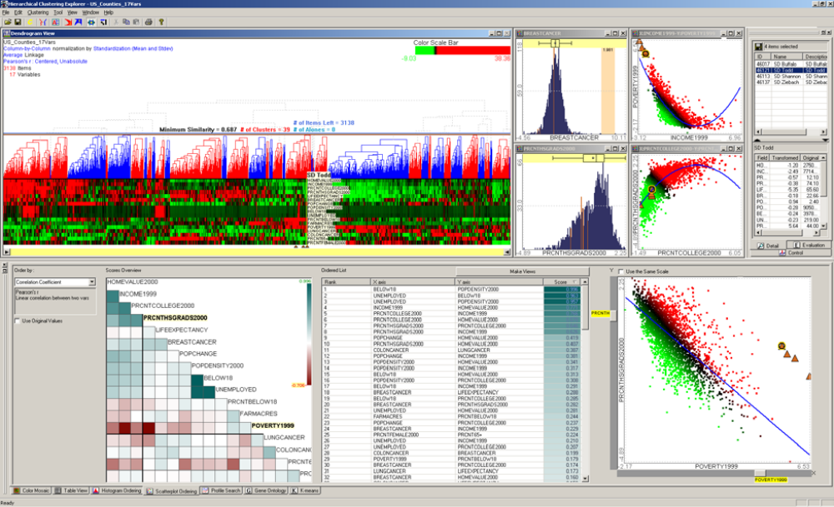
Visualization of Clustering Results
(From: Seo, 2004)
Bernhard Preim

Slide 39
Outlier Detection
Subfield of data mining that detects anomalies
  Essential Applications:
  detection of misuse of credit cards (abnormal transactions), other security measures (abnormal network traffic, DOS attack),
  abnormal values in medicine may indicate pathologies,
  abnormal values of medical parameters in sportsman may identify outstanding sportsman (or use of doping)
Challenge: „abnormality“ is highly context-dependent:
  expected values for blood composition depend on age, gender and body mass index
  energy consumption depends on seasonal, weekly and daily patterns
Outliers may be particularly interesting or unwanted, e.g. since they influence clustering or regression analysis.
Bernhard Preim

Slide 40
Outlier Detection
Outliers may result from sampling errors, e.g. a car database with many heavy cars (a lot of PS, cylinders, high oil consumption) and just one small car.
Detection of outliers may trigger the collection of more data.
Preprocessing:
  Valid outlier detection requires a high data quality
  Particular problem: duplicate entries
Bernhard Preim
Notes:
If a dataset in a database exists twice, e.g. a person with the name before and after marriage, this duplicated entry probably cannot be an outlier, because there is a dataset with identical values.
Vorlesung 7: Visualisierung von Multiparameter Daten

Slide 41
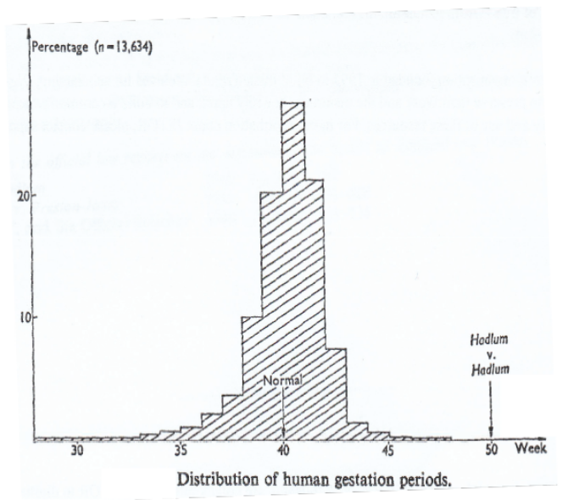
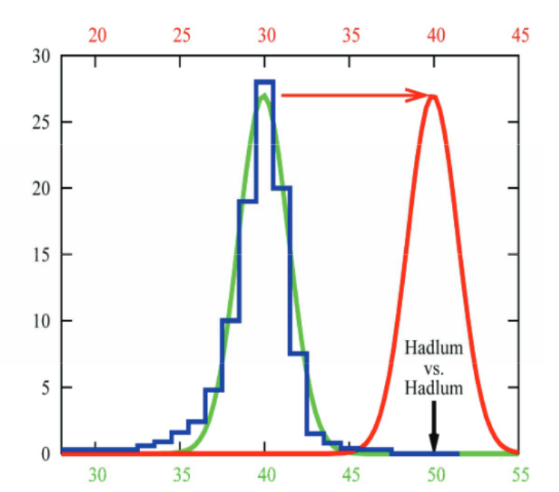
Outlier Detection: Entertaining Example
Histogram of gestation periods (Schwangerschaftsdauer): 349 days (more than 11 months) is an outlier.
The birth of a child to Mrs. Hadlum occured 349 days after Mr. Hadlum went to military service abroad.
(consider also uncertainty)
To assess outliers, a normal distribution is fitted to the data and also a normal distribution centered on the 349 days.
(Source: Kriegel, 2010)
Bernhard Preim
Notes:
Vorlesung 7: Visualisierung von Multiparameter Daten

Slide 42
Outlier Detection
An outlier does not fit to the expectations and deviates strongly from all neighbors
  Definition using the interquartile range:
  Mild outliers: outside an interval that is 1.5 x IQ range.
  Extreme outliers: outside an interval that is 3 x IQ range.
  Assumes a normal distribution; not meaningful for skewed distribution.
Outlier detection: typical visual analytics task - benefits from a combination of automatic analysis and visual exploration
Box plots explicitly label outliers.
Outliers are extrema (rare observations) – every distribution has them
Bernhard Preim

Slide 43
Outlier Detection
Outliers in multidimensional or high-dimensional space hard to identify
In statistics, often certain distributions assumed (and checked), e.g. normal distribution
  If an attribute value is extremely unlikely for the given distribution, it is not based on the assumed generative process → considered as an outlier
Implementations in data mining differ from statistical outlier measures for performance reasons
Bernhard Preim

Slide 44
Outlier Detection
Outlier detection and clustering
A variety of clustering algorithms identifies outliers.
However, „clustering algorithms are optimized to find clusters rather than outliers” (Kriegel, 2009)
Bernhard Preim

Slide 45
Outlier Detection
Outlier Detection: Methods
Depth-based
  Assumption: Outliers at the boundary of a distribution and „normal“ points in the center
  Depth 1: points are part of the convex hull of the data → likely outliers
  Depth 2: points are part of the convex hull after Depth 1 points are removed → less likely outliers
Distance-based
  Outlier has abnormal distance to its nearest neighbor
  Not appropriate if the distribution of data varies strongly in local density
Density-based
  Outlier has an abnormally low density in the surrounding
Bernhard Preim

Slide 46
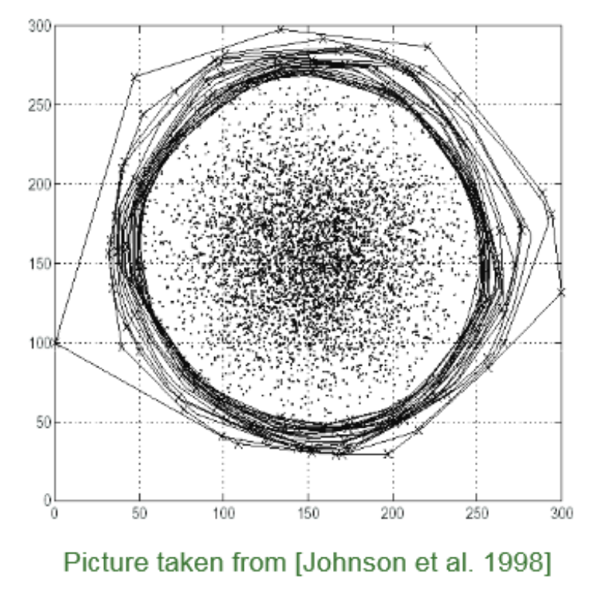
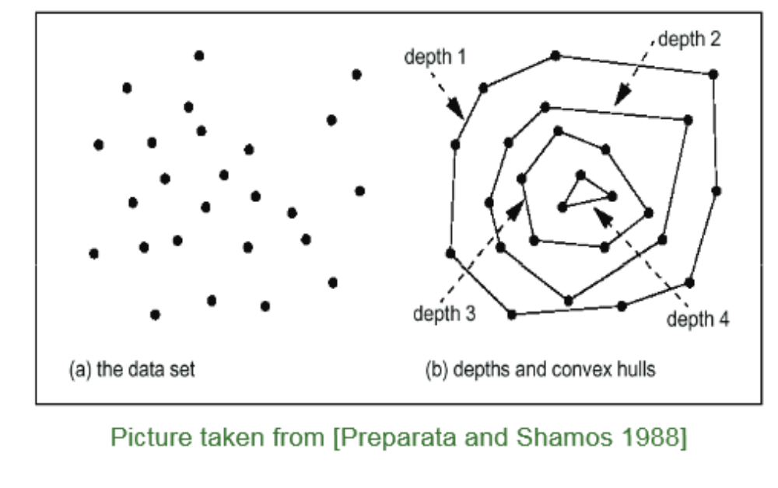
Outlier Detection: Methods
Depth-based outlier detection relies on convex hulls. Efficient for 2D and 3D data. Delivers binary output or scoring (depth values as scores)
Methods can be combined, e.g. points on the convex hull may be considered outlier candidates to be checked with other methods.
Bernhard Preim

Slide 47
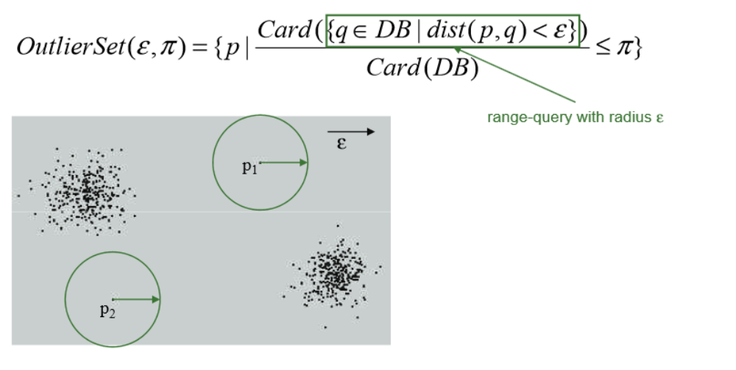
Outlier Detection: Methods
  Distance-based outlier
  Given a radius ε and a percentage π
A point p is an outlier if at most π percent of all other points have a distance to p less than ε
p₁ and p₂ not considered outliers with a depth-based method (From: Kriegel, 2009)
Bernhard Preim

Slide 48
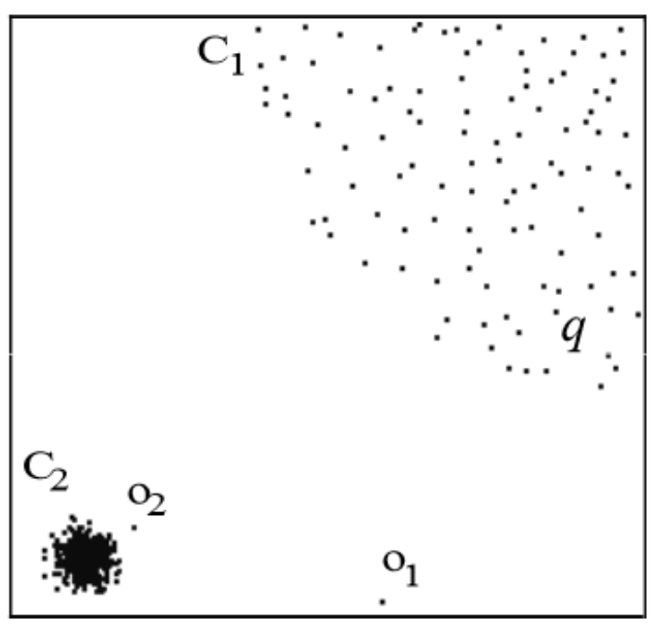
Outlier Detection: Methods
Density-based methods detect outliers if they have a locally abnormal distance to the nearest neighbor. In contrast to depth- and distance-based methods, o₂ is an outlier according to the Local Outlier Factor (LOF) (Breuning, 2000)
Clusters with different density. o₂ has abnormal distances to the C₂ members (From: Kriegel, 2009)
Bernhard Preim

Slide 49
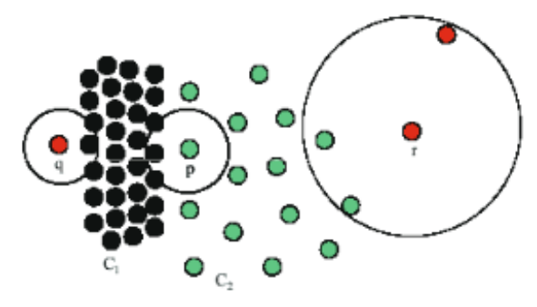
Outlier Detection: Methods
Discussion: Density-based methods
Simple techniques do not detect outliers reliably if clusters with different density are not clearly separated.
Advanced density-based methods are computa-tionally demanding (exponential w.r.t. number of dimensions)
Look at p, q and r: What is an outlier? (From: Kriegel, 2009)
Bernhard Preim

Slide 50
Outlier Detection: Results
Algorithms generate
continuous output, a measure for outlierness, or
discrete output, e.g. an integer value in depth-based methods
binary output, where some elements are labeled as outliers
Users often interested in the top n outliers.
An outlier measure may be used to define a cutoff value where the distance to the next element is large. (Top 5 outliers are not very reliable if the 5th, 6th and 7th ranked elements are very similar).
Bernhard Preim

Slide 51
Outlier Detection: Validation
Ground truth data:
Medicine: Often healthy participants and patients in a database. Healthy persons considered inliers; patients outliers.
If one class is over-represented, e.g. patients, it is downsampled (strongly) (Campos, 2016)
Bernhard Preim

Slide 52
Outlier Detection: Discussion
Selection of methods should consider the context, problem and derived model assumptions.
To provide a small set of methods, is better than a single method.
Parameters: Good initial suggestions and flexibility to adjust them should be provided.
Bernhard Preim

Slide 53
Outlier Detection in HD Data
In HD data, some dimensions may contain noise, non-discriminative and irrelevant data.
Outlier detection, in particular with distance-based methods, suffers from irrelevant dimensions
Often, data is preprocessed (feature selection, dimension reduction) to restrict the dimensions
Outlier detection applied to the corresponding subspaces.
Open source software: ELKI@github provides implementations of all major outlier detection methods and supports the generation of new algorithms https://elki-project.github.io/tutorial/
Bernhard Preim

Slide 54
Summary
Clustering evaluated with quality measures, visualization and expert feedback.
Cluster visualization: multidimensional visualization (PC plot, …) and projection techniques.
Overview and detail visualizations provide information on cluster members, distributions, …
Outliers may be deliberately searched for or are a side-effect of clustering
Outlier detection based on an outlier model.
Bernhard Preim

Slide 55
Outlook
Current research focuses on
Temporal clustering (how to show the emergence, development of clusters over time)
Online clustering (without storing all incoming data, cluster current data)
Incremental clustering (update clustering results when new data arrive)
Clustering of complex data, e.g. blood flow, other flow data, fiber tracts
Rare subgroup detection (outliers that are similar, e.g. learners in online courses)
Bernhard Preim

Slide 56
References
Bae, E., & Bailey, J. 2006. COALA: A Novel Approach for the Extraction of an Alternate Clustering of High Quality and High Dissimilarity.In: Proc. of IEEE Int.nat. Conference on Data Mining (ICDM), pp. 53-62.
James C. Bezdek (1981). Pattern Recognition with Fuzzy Objective Function Algorithms.
Breunig MM, Kriegel HP, Ng R, Sander J (2000). „LOF: identifying density-based local outliers“. Proc. of ACM conference on management of data (SIGMOD), pp 93–104
Nan Cao, David Gotz, Jimeng Sun, Huamin Qu, "DICON: Interactive Visual Analysis of Multidimensional Clusters," IEEE Trans. Vis. Comput. Graph. Vol. 17(12):2581-2590, 2011
G. O. Campos, A. Zimek, J. Sander, R. J. Campello, B. Micenková, E. Schubert, I. Assent et al.: On the evaluation of unsupervised outlier detection: measures, datasets, and an empirical study. Data Min. Knowl. Discov. 30(4): 891-927 (2016)
Matthias Dehmer (2007). Strukturelle Analyse Web-basierter Dokumente, DUV Verlag
M. Ester, H.-P. Kriegel, J. Sander, and X. Xu, “A density-based algorithm for discovering clusters in large spatial databases with noise,” Proc. of Knowledge Discovery and Data Mining, KDD, pp. 226–231, 1996.
Y. Fua, M. Ward, and E. Rundensteiner. Hierarchical parallel coordinates for exploration of large datasets. Proc. of IEEE Visualization, 1999.
S. Glaßer, K. Lawonn, B. Preim. Visualization of 3D Cluster Results for Medical Tomographic Image Data. In Proc. of Conference on Computer Graphics Theory and Applications (VISIGRAPP), pp. 169-176, 2014
S. Glaßer, S. Roscher, B. Preim. Adapted Spectral Clustering for Evaluation and Classification of DCE-MRI Breast Tumors, Bildverarbeitung für die Medizin (BVM), pp. 198-203, 2014
D. Graves and W. Pedrycz, „Fuzzy C-Means, Gustafson-Kessel FCM, and Kernel-Based FCM: A Comparative Study", In: "Analysis and Design of Intelligent Systems using Soft Computing Techniques", Springer, 2007", pp. 140-149,
Bernhard Preim

Slide 57
References (II)
RJ Hathaway, JC Bezdek. “Visual cluster validity for prototype generator clustering models“, Pattern Recognition Letters 24 (9), 1563-1569
Huang Z. Extensions to the k-Means Algorithm for Clustering Large Data Sets with Categorical Values. Data Mining and Knowledge Discovery. 1998;2(3):283-304
Johnson, T., Kwok, I., and Ng, R.T. 1998. Fast computation of 2-dimensional depth contours. In Proc. Int. Conf. on Knowledge Discovery and Data Mining (KDD)
Kriegel H.-P., Kröger P., Zimek A.: Outlier Detection Techniques. Tutorial. In: 13th Pacific-Asia Conference on Knowledge Discovery and Data Mining (PAKDD 2009).
R. L. Ling. 1973. A computer generated aid for cluster analysis. Commun. ACM 16(6) (1973), 355-361.
S. Salvador and P. Chan, “Determining the number of clusters/segments in hierarchical clustering/segmentation algorithms,” IEEE Tools with Artificial Intelligence, pp. 576–584, 2004.
T. C. Sprenger, R. Brunella, and Markus H. Gross. H-blob: a hierarchical visual clustering method using implicit surfaces. Proc. of IEEE Visualization, pp. 61–68, 2000
Bart Moberts, Anna Vilanova, Jarke J. van Wijk: Evaluation of Fiber Clustering Methods for Diffusion Tensor Imaging. Proc. of IEEE Visualization 2005: 9-16
J. B. MacQueen: Some Methods for classification and Analysis of Multivariate Observations. In: Proc. of Berkeley Symposium on Mathematical Statistics and Probability. 1, University of California Press, 1967, pp. 281–297
Bernhard Preim

Slide 58
References (III)
E. Müller, S. Günnemann, I. Färber, and T. Seidl. "Discovering Multiple Clustering Solutions: Grouping Objects in Different Views of the Data", Tutorial at the International Conference on Machine Learning, Atlanta, USA (2013)
S. Oeltze, D. J. Lehmann, A. Kuhn, G. Janiga, H. Theisel, B. Preim: Blood Flow Clustering and Applications in Virtual Stenting of Intracranial Aneurysms. IEEE Trans. Vis. Comput. Graph. 20(5): 686-701 (2014)
Oliynyk, Andriy; Bonifazzi, Claudio; Montani, Fernando; Fadiga, Luciano, "Automatic online spike sorting with singular value decomposition and fuzzy C-mean clustering", BMC Neuroscience", 2012", Vol. 13(1): 1--19
Preparata, F. and Shamos, M. 1988. Computational Geometry: an Introduction. Springer
F. J. Rohlf. “Adaptive hierarchical clustering schemes”, Systematic Zoology, 19:58-82, 1970
E. M. Reingold and J. S. Tilford. Tidier drawings of trees. IEEE Transactions on Software Engineering, 7(2):223–238, 1981
Michael Sedlmair, A. Tatu, Tamara Munzner, Melanie Tory: A Taxonomy of Visual Cluster Separation Factors. Comput. Graph. Forum 31(3): 1335-1344 (2012)
J. Seo, B. Shneiderman: Interactively Exploring Hierarchical Clustering Results. IEEE Computer 35(7): 80-86 (2002)
T Van Long (2009). Visualizing high-density clusters in multidimensional data, PhD thesis, School of Engineering and Science, Jacobs University, Bremen
H. Zhou, X. Yuan, H. Qu, W. Cui, and B. Chen. Visual clustering in parallel coordinates. Computer Graphics Forum, Vol. 27(3):1047–1054, 2008
Bernhard Preim

