Slide 1
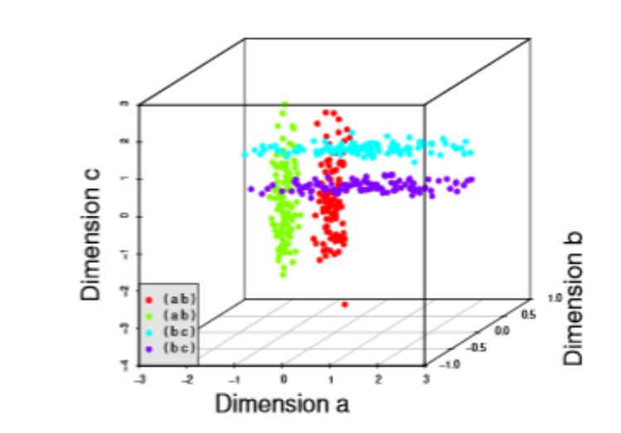
Cluster Analysis and Visualization of Clustering Results:
Subspace Clustering

Slide 2
Outline
Strategies for subspace search and clustering
Methods for subspace search and clustering
  Preprocessing (missing data, normalization, transformation)
Visualization of Clustering Results
  Scatterplots
  Parallel coordinates
  Graphs showing relations between subspaces
  Multiple linked views
Applications
Evaluation
Bernhard Preim

Slide 3
Introduction
Most problems where clustering may detect structures are subclustering problems:
Demographic datasets: many attributes per person are registered
  Person A and B may be similar w.r.t. health, but may differ w.r.t. political attitudes, mobility and wealth-related attributes.
Recommender systems: people are grouped w.r.t. similar interests
  Person A and B may have similar interests in science, but A has completely different interests in music.
Gene expression profiles from DNA microarray chips: grouping according to similar expression profiles and related functions (pioneering application, Cheng, 2000).
  Gene A and B may be similar under certain environmental conditions (in some tissues or before a treatment), but under different conditions Gene B and C are similar (that were not similar originally)
Bernhard Preim

Slide 4
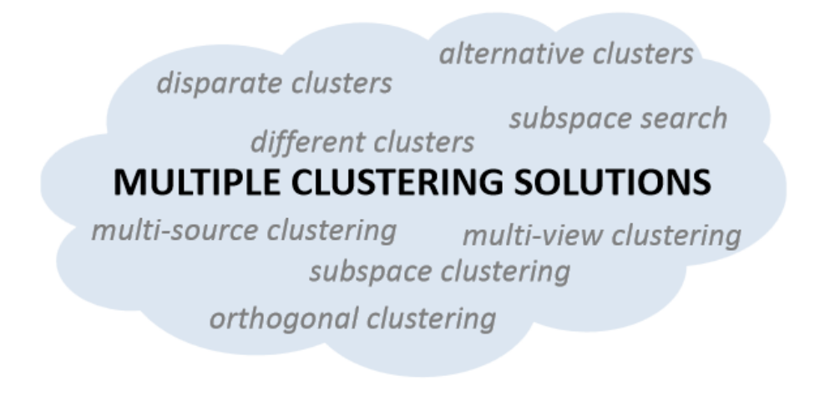
Introduction
Subspace search and subspace clustering: essential instances of multiple clustering solutions (From: Müller, 2013)
Bernhard Preim

Slide 5
Subspace Clustering
Curse of dimensionality: While data in low-dimensional spaces is rather tight and can be clustered, in high-dimensional (HD, (D > 10 .. 15)) spaces distances are very large (sparse data).
Noise, irrelevant and highly correlated dimensions reduce the quality of global clustering (Hund, 2016)
Subspace search: finding low-dimensional representa-tions of a HD dataset useful for grouping (clusterable subspaces).
Subspace search requires heuristics to prune the search: For n dimensions: 2^{n}-1 possible axis-aligned subspaces.
Bernhard Preim

Slide 6
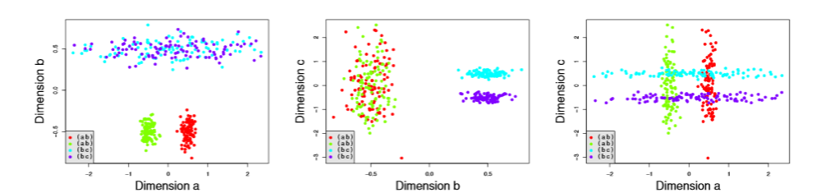
Subspace Clustering
A 3D dataset with no 3D cluster but 4 clusters in different 2D subspaces. In 2D space all clusters are recognizeable but overlap (a-c). (From: Parsons, 2004)
Bernhard Preim

Slide 7
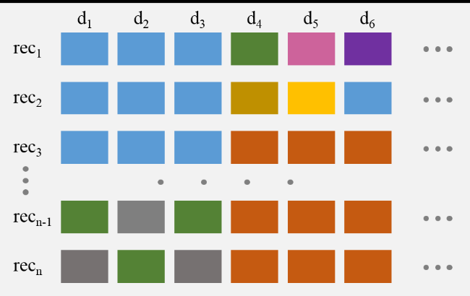
Subspace Clustering
Clusters in subspaces: e.g. the first three records similar in dimensions d₁, d₂, d₃ (From: Hund, 2015). No records similar in all dimensions.
Bernhard Preim

Slide 8
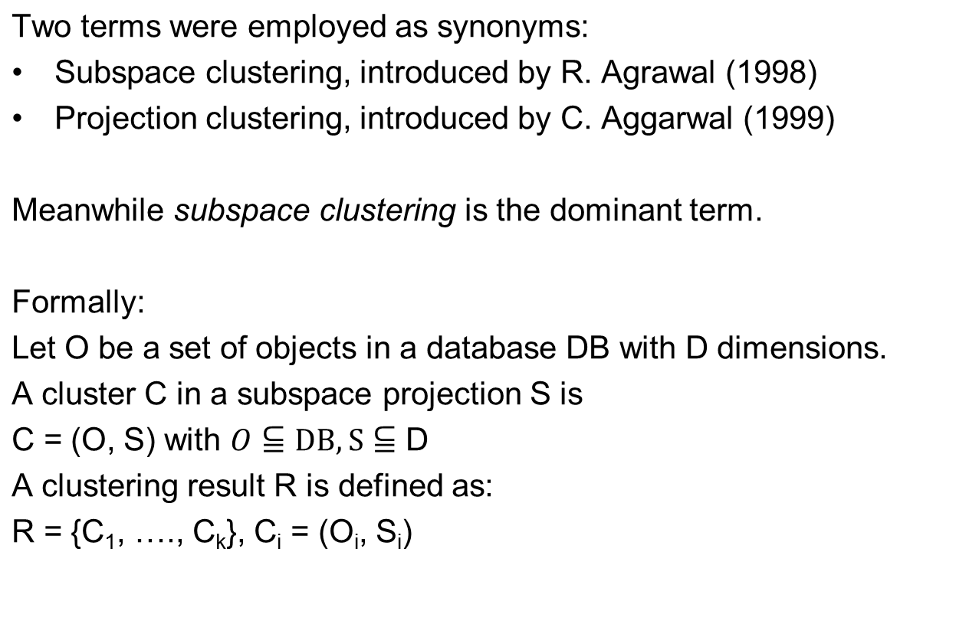
Introduction
Bernhard Preim

Slide 9
Subspace Clustering
Two tasks:
Search relevant subspaces and provide a measure of „interestingness“ for ranking
  Since this may take long → preprocess
Cluster data in these subspaces
Related tasks in visual subspace analysis (Tatu, 2009):
Display the subspaces (involved dimensions)
Display similarity between subspaces (e.g. involved dimensions)
Display the clustering results in these subspaces
Show relations between subspace clusters
Bernhard Preim

Slide 10
Subspace Clustering
Feature selection is NOT part of subspace search.
    Feature selection: based on entropy or information gain; statistical measures related to the dimension.
  These GLOBAL techniques do not find local clusters
Bernhard Preim

Slide 11
Subspace Clustering
Different strategies:
Subspace search algorithms only return subspaces (where clustering may be applied)
Subspace clustering techniques combine subspace search and clustering
Discussion (see Tatu, 2012):
Decoupling subspace search from the actual clustering is
more flexible,
less biased (clustering often relies on assumptions), and
more effective, since „uninteresting“ subspaces are filtered
Bernhard Preim

Slide 12
Subspace Clustering
Assumptions and Heuristics
Number of possible arbitrarily oriented sub-spaces is infinite → use assumptions and heuristics
Most algorithms search only for axis-aligned subspaces
Some algorithms (again) expect a certain number of clusters and optimize subspace search accordingly
Some algorithms biased towards low dimensional clusters
Bernhard Preim

Slide 13
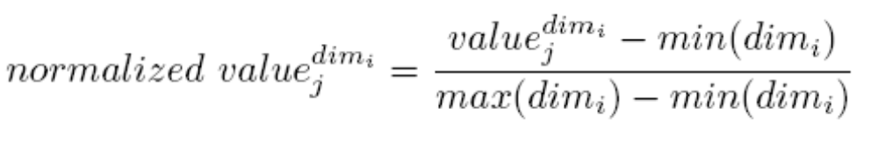
Subspace Clustering
Preprocessing:
Treatment of incomplete datasets
  May be removed (Hund, 2015)
  Missing data may be „interpolated“ (or imputed)
  Advanced: consider incomplete data but do not use interpolated values
Categorical transformed to numbers
  Binary variables: mapped to 0 and 1
  Variables with e.g. 6 values mapped to 0, 0.2, …, 1.0
Normalization
  For numerical variables in the range [min, max] they are transformed to the range [0,1]
Bernhard Preim

Slide 14
Subspace Search: RIS
Subspace search without clustering
„Ranking Interesting Subspaces“ (RIS) (Kailing, 2003)
Observations (derived from density-based clustering):
Interesting subspaces comprise core objects:
o is a core object if │N ε(o) ≥ minPoints │
Dense regions: set of objects connected to core objects; the more objects dense regions comprise, the more interesting is the subspace.
count(S): number of objects in dense regions
„Interestingness“ = count(S)/Volume (S)
Relevance: a subspace is deleted if embedded in another subspace (more dimensions) with higher interestingness.
Bernhard Preim

Slide 15
Subspace Search: RIS
How to choose ε and minPoints? (Kailing, 2003)
Suggestion: minPoints = ln (n) where n is the overall number of objects
Q: ln(1000)?, ln (10000)?
Choice of ε more difficult. Upper bound lim for ε determined considering that for a completely uniform distribution not all points are considered core objects.
Suggestion: ε = lim/4
Bernhard Preim
Notes:
ln (1.000) ~ 370 x e ~ 130 ~ e² ~16 e^4 ~ 2e^6 ~7
Ln (10.000) ~9

Slide 16
Subspace Search: Surfing
SURFING (Subspaces Relevant For ClusterING, [Baumgartner, 2004])
Searches for subspaces without clustering
Analyze the histogram of the k nearest neighbor (NN) distances in all subspaces → Subspaces with non-uniform distributions more interesting.
Scaleability: NN computation restricted to e.g. 5% of the elements
Bottom-up search: An interesting subspace is expanded with further dimensions as long as „interestingness“ increases.
Properties:
  Does not assume a specific clustering structure
  Applicable for a wide range of numbers of dimensions
  Stability for k between 5-20
  Resulting high-ranked subspaces tend to be similar/redundant
Bernhard Preim

Slide 17
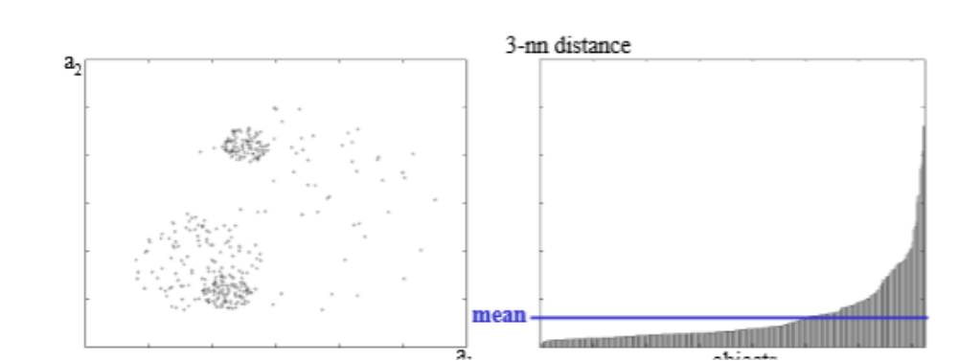
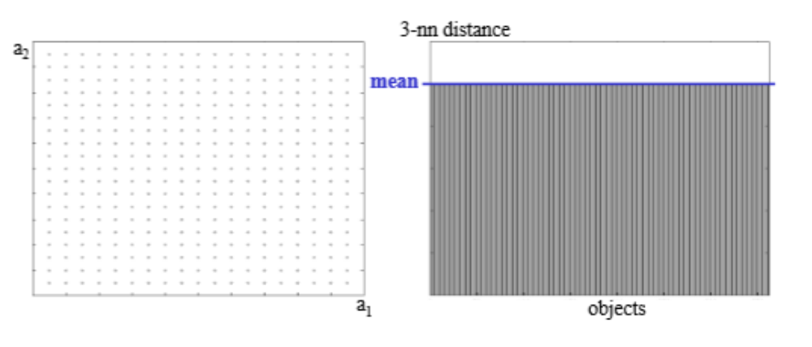
Subspace Search: Surfing
Clusterable subspace → histogramm of the 3-nn distances highly non-uniform
Uniformly distributed data → histogram with equal values → Subspace not „interesting“
(From: Baumgartner, 2004)
Bernhard Preim

Slide 18
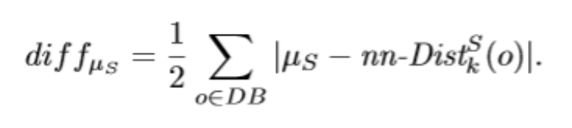

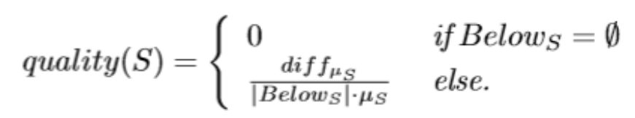
Subspace Search: Surfing
„Interestingness“
Compute the differences of the k nn-distance to the mean
Count points with a k nn-distance below the mean value (points in dense regions)
Determine quality as normalized differences
Bernhard Preim

Slide 19
Subspace Search: Surfing
SURFING
returns relevant subspaces ranked by „interestingness“ e.g. by variance and entropy
no clustering
Combination with (global) clustering: Authors suggest density-based clustering and favor OPTICS (Ankerst, 1999)
Q: Why not k-Means?
Bernhard Preim

Slide 20
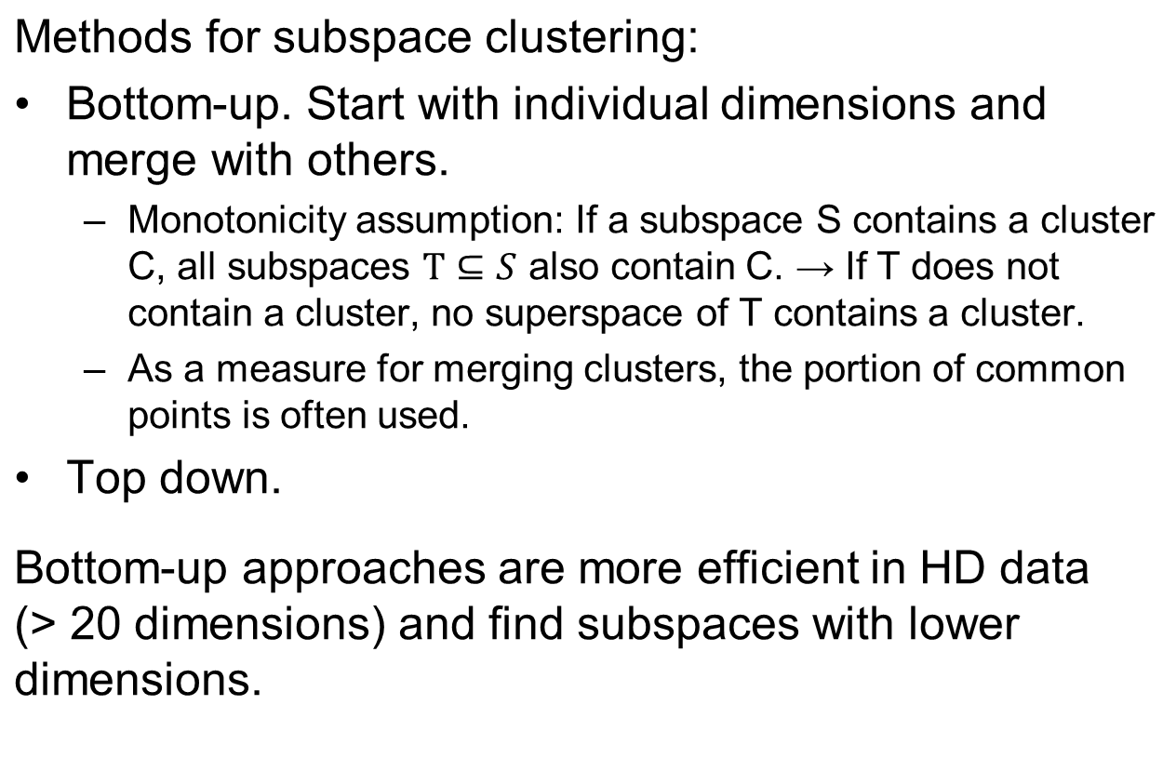
Subspace Clustering
Bernhard Preim

Slide 21
Subspace Clustering
Heuristics to prune the search (Tatu, 2012):
Prefer subspaces with a high variance
For generating a set of subspaces, avoid high redundancy
  Instead of exploring similar spaces, they should be grouped and one representative should be explored.
  In addition, further – not similar – subspaces should be displayed.
Redundancy w.r.t. involved dimensions: Tanimoto Similarity (fraction of dimensions contained in both subspaces)
Bernhard Preim

Slide 22
Subspace Clustering
Different paradigms and algorithms (Müller, 2009):
Cell-based algorithms search for grid cells where number of objects is above a threshold.
Density-based algorithms search for subspaces where the local density is higher than in the surrounding. Resulting subspace clusters may differ in density (depending on the surrounding)
Clustering-based algorithms steered by global parameters related to the expected result, e.g. the number of clusters or the average number of dimensions of these clusters.
Bernhard Preim

Slide 23
Subspace Clustering: Clique
CLIQUE (CLustering In QUEst, Agrawal, 1998):
Pioneering cell-based method
Generates clusters of arbitrary shapes
Bottom-up method that seeks dense rectangular cells in all subspaces with a high density
  A grid with constant size overlaid on the data.
  Results heavily depend on the grid resolution ε and the minimum number of points per cell minPoints.
Clusters represent connected components in a graph where the nodes represent dense units
Refinements
Free positioning of cells (hyper-cubes) with fixed grid size
Adaptive grid size (depending on the number of dimensions, SCHISM)
Bernhard Preim

Slide 24
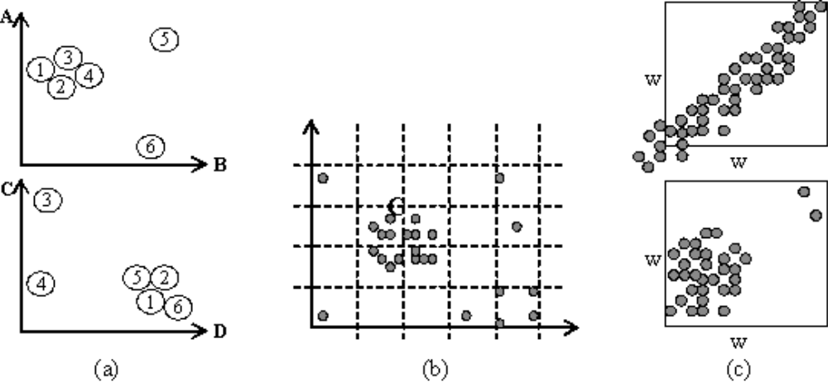
Subspace Clustering: Clique
(From: Kailing, 2003)
Left: minPoints=5 → no cluster
minPoints=4 → two clusters
The correct result, one cluster, cannot be achieved with this gridsize. Think about post-processing the result!
Right: Other algorithms with hypercubes of fixed sizes have similar problems. Reported clusters do not contain all objects and contain also wrong objects.
Bernhard Preim

Slide 25
Subspace Clustering: SubClue
SUBCLUE (Kailing, 2004) density-based method that employs a global density threshold t.
Generates clusters of arbitrary size and shape
Slightly better quality than the grid-based approach but also dependent on t.
Slower than CLIQUE (performance slows down with > 15 dimensions, [Müller:2009:HSM])
With a global threshold t not all relevant subclusters are found.
Bias towards low dimensionality
Bernhard Preim
Notes:
SUBCLUE from Michael Kailing is another widely used method.

Slide 26
Subspace Clustering: Proclus
Proclus (PROjected CLUStering [Charu, 1999])
Clustering-based approach with two parameters: number of clusters (C) and average dimensionality (D)
Random initialization of C medoids (similar to k-means)
In the refinement stage, for the medoids well-fitting subspaces are searched.
Medoids are translated until the subspaces do not get better anymore.
Properties: prefers large clusters, efficient, simple, robust agaist noise
Bernhard Preim
Notes:
Medoids are representative objects of a data set or a cluster with a data set whose average dissimilarity to all the objects in the cluster is minimal.^{[1]} Medoids are similar in concept to means or centroids, but medoids are always restricted to be members of the data set.

Slide 27
Subspace Clustering: Parameters
Average or maximum number of dimensions,
Expected number of clusters
Cluster dominance factor (how much the density in a cluster should exceed the average density?) (Kailing, 2004)
  Typical values: [1.5, …, 2.0]
  Usually applied for grid-based approaches
Bernhard Preim

Slide 28
Subspace Clustering: Categorical Data
Term „subspace clustering“ unusual for categorical data
Instead, search for objects that share an attribute value (over several dimensions) – frequent item mining (e.g. to analyze products bought by several customers)
Few methods deal with hybrid data (continuous numerical and categorical data).
HSM method (Müller, 2009) considers the expected density in subspaces with continuous data and the expected frequency in categorical subspaces
Special normalization for categorical, continuous and hybrid data
Frequency counting is faster than density estimation → performance increases with more categorical attributes.
Bernhard Preim

Slide 29
Subspace Clustering: Visualization
Challenge:
A multitude of information needs to be conveyed:
the overlapping dimensions of subspaces,
the overlapping subspaces,
the membership of objects to subspaces.
Bernhard Preim

Slide 30
Subspace Clustering: Visualization
Tasks to be supported (Tatu, 2012, TST):
Properties of individual clusters
  How many objects? Which dimensions? Which dimensions are removed (and why?) Distributions in each dimension?
Cluster comparison
  Difference between clusters w.r.t. involved objects and dimensions
  Overlap between clusters
Quality
  How good is the quality?
  How sensitive is the clustering result w.r.t. parameters?
→ Navigation through a parameter space needs to be supported.
Bernhard Preim

Slide 31
Subspace Clustering: Visualization
Importance of visualization:
While for global clustering, established automatic quality assessments are available (e.g. the silhouette coefficient), for partially overlaping subspace clusters these measures are not directly applicable.
→ Visualization as primary quality assessment
Even more data and more perspectives need to be conveyed compared to global clustering.
Bernhard Preim

Slide 32
Subspace Clustering: Visualization
How to assess visualizations of subspace clustering? (derived from Hund, 2016)
Non-redundancy:
Are there not too many overlapping dimensions?
Not too many overlapping instances?
Coverage:
Are most instances part of any cluster?
Are most dimensions part of any cluster?
Cluster characteristics:
What number of dimensions the clusters have? (1D or 2D often not interesting)
Cluster compactness/separability
Bernhard Preim

Slide 33
Subspace Clustering: Visualization
Major techniques:
Parallel coordinates
Scatterplot visualizations
Heatmaps
Linked views (overview and detailed visualizations)
Bernhard Preim

Slide 34
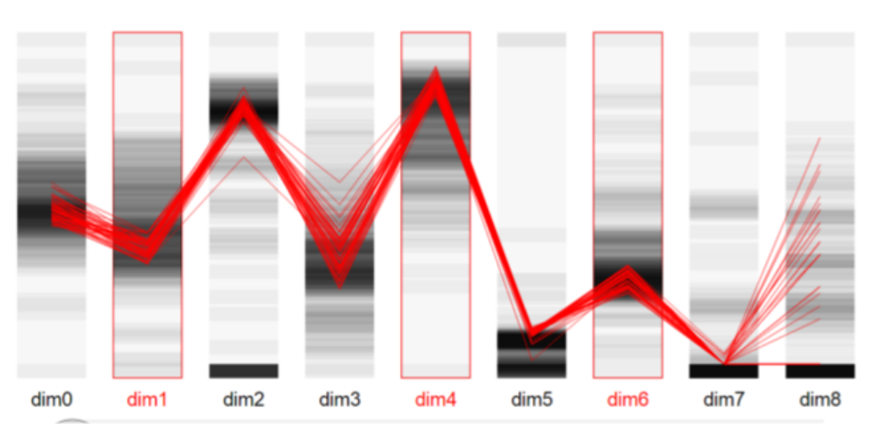
Subspace Clustering: Visualization
Parallel coordinates reveal members of a selected subspace cluster. Red dimensions belong to the subspace. As expected, members are more similar in contributing dimensions (From: Hund, 2016).
Bernhard Preim

Slide 35
Subspace Clustering: Visualization
Scatterplot-based representations:
Since most clusters involve >2 dimensions, results need to be projected to 2D
Projection should preserve proximity, but involves loss of information
MDS often used (Assent, 2007; Tatu, 2012; Alemzadeh, 2017)
Comparison with other dimension reduction techniques is essential (→ later two lectures on DR).
Bernhard Preim

Slide 36
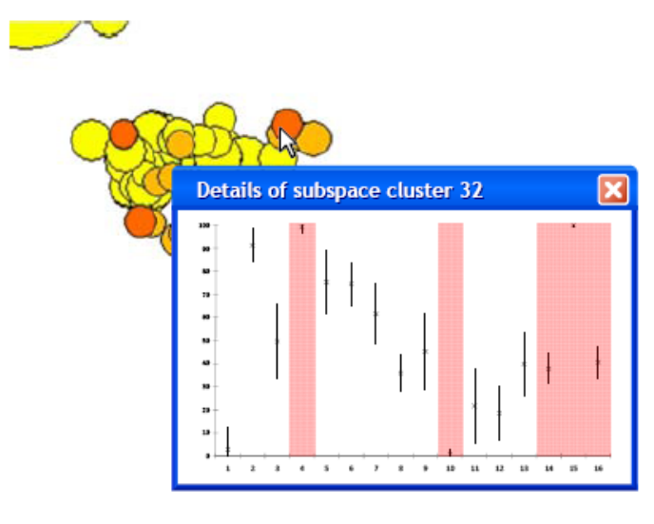
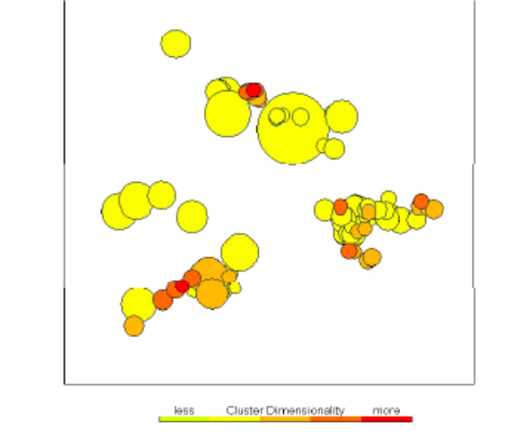
Subspace Clustering: Visualization
VISA: Visual Subspace Cluster Analysis (Assent, 2007)
Overview: Clusters (determined with a density-based method DUSC) projected with MDS and displayed with circles.
Size represents the number of objects and color represents the dimensionality. (Q: How exactly size should be mapped to a circle?)
Spatial proximity reflects similarity between clusters (measured w.r.t. overlapping dimensions and overlapping objects) (From: Assent, 2007)
On demand, details displayed for the selected cluster: µ and σ and dimensions involved
Bernhard Preim
Notes:
Drawing circles: Draw circles sorted by size and start with the largest. Smaller circles drawn later on top to increase the chance that they are visible.
Interaction: When the user clicks, the mouse may be inside several circles. Consider only visible circles and prefer the smallest circle as selected.

Slide 37
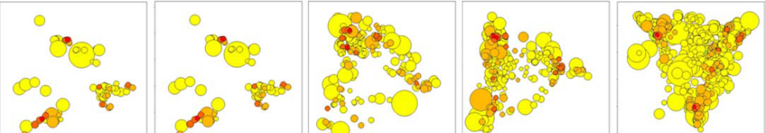
Subspace Clustering: Visualization
Redundancy between subspaces used to adjust the redundancy level (From: Assent, 2007).
„Bracketing“ to support the parameter selection – a technique known from photography presenting a number of possible choices in a range
Discussion:
Distance between clusters can be obscured by a cluster with large size.
Many clusters lead to a high degree of overlap and clutter.
Bernhard Preim

Slide 38
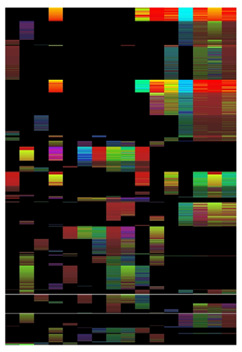
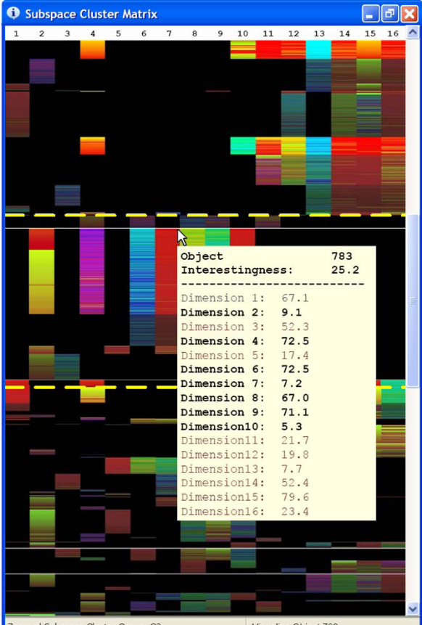
Subspace Clustering: Visualization
VISA: Visual Subspace Cluster Analysis (Assent, 2007)
Matrix visualization for detailed analysis: columns represent dimensions and rows represent clusters and elements. On demand: detailed information
Bernhard Preim

Slide 39
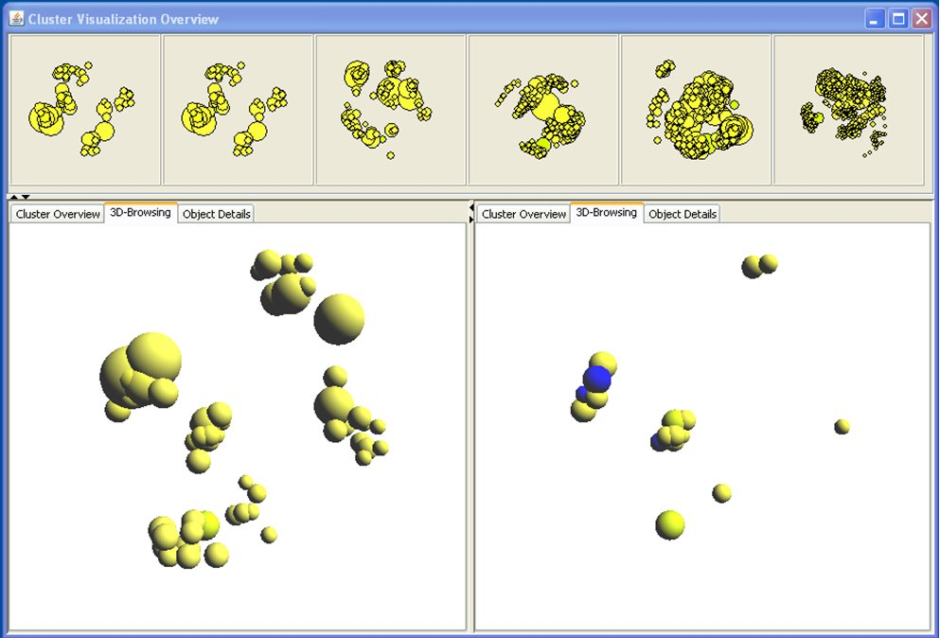
Subspace Clustering: Visualization
3D overview visualization with rotation/zooming for exploration (From: OpenSubspace).
Integrated in the Weka Machine Learning toolkit
Bernhard Preim
Notes:
OpenSubspace is integrated in the Weka Machine Learning toolkit.

Slide 40
Announcement
There will be no lecture on the 09.05.2022 and the 23.05.2022. During this time, please watch the videos “Scatterplot-Based Visual Representations Part 1 | Part 2 | Part 3”.
Bernhard Preim

Slide 41
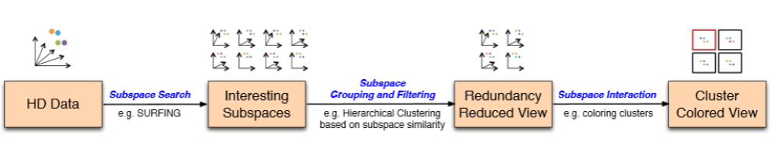
Subspace Clustering
Workflow for subspace search, clustering and exploration (From: Tatu, 2012).
Preprocessing: outlier removal and imputation of missing values. SURFING, e.g., very sensitive to missing values, but robust to outliers.
Bernhard Preim

Slide 42
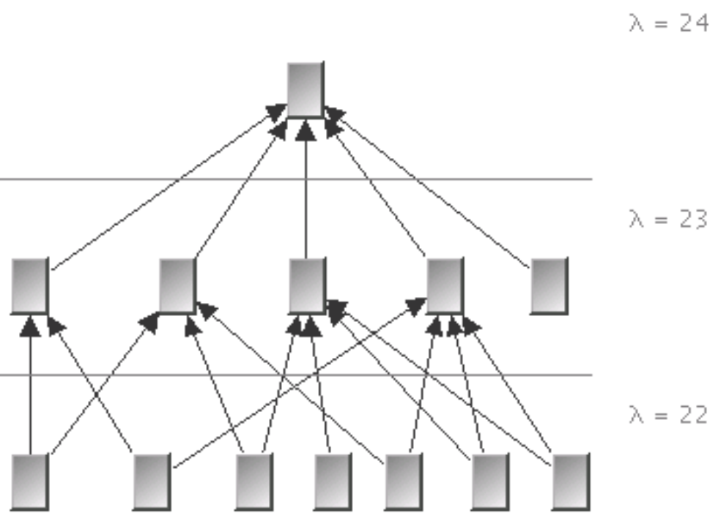
Subspace Clustering: Visualization
Relation between subspaces (overview).
Arrows represent subset relations w.r.t. dimensions involved.
The overview serves to select interesting subspaces.
Note that this is a directed acyclic graph, not a tree (multiple „inheritance“) (From: Achtert, 2007)
Bernhard Preim

Slide 43
Subspace Clustering: Visualization
Relation between different subspaces by means of graphs and trees does not scale well.
For larger datasets: „we found that this rarely provides interesting insights and makes the visualization too cluttered“ (Tatu, 2012)
Bernhard Preim

Slide 44
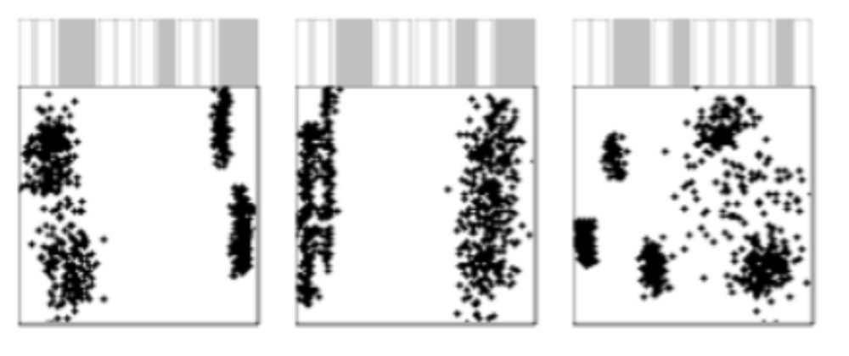
Subspace Clustering: Visualization
Clusters in three subspaces of a 12D space.
„Dimension glyph“ indicates the involved dimensions.
Left and middle view 5D clusters. Right: cluster in 4D:
Data projected to a 2D scatterplot with multi-dimensional scaling (From: Tatu, 2012)
Interaction: Based on domain knowledge, the user may add/remove dimensions.
Bernhard Preim

Slide 45
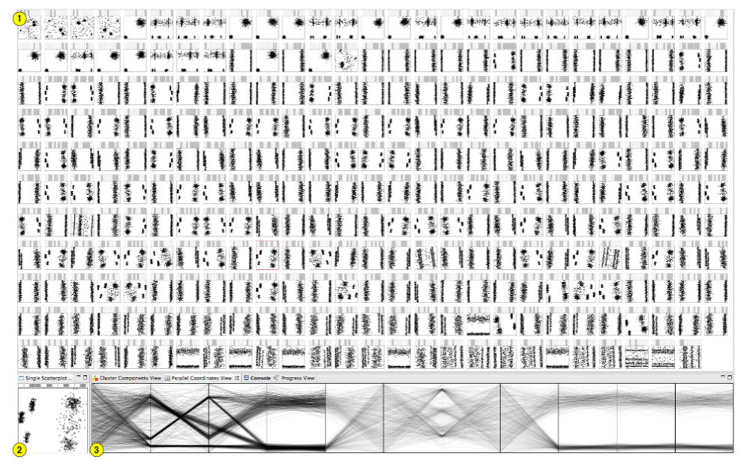
Subspace Clustering: Visualization
295 subspaces identified in12D space (with SURFING).
Subspaces shown in scatterplots. One scatter-plot selected and enlarged (2) and the data of that subspace shown in parallel coordinates (3) (with subspace dimensions and clusters emphasized) (From: Tatu, 2012).
Bernhard Preim

Slide 46
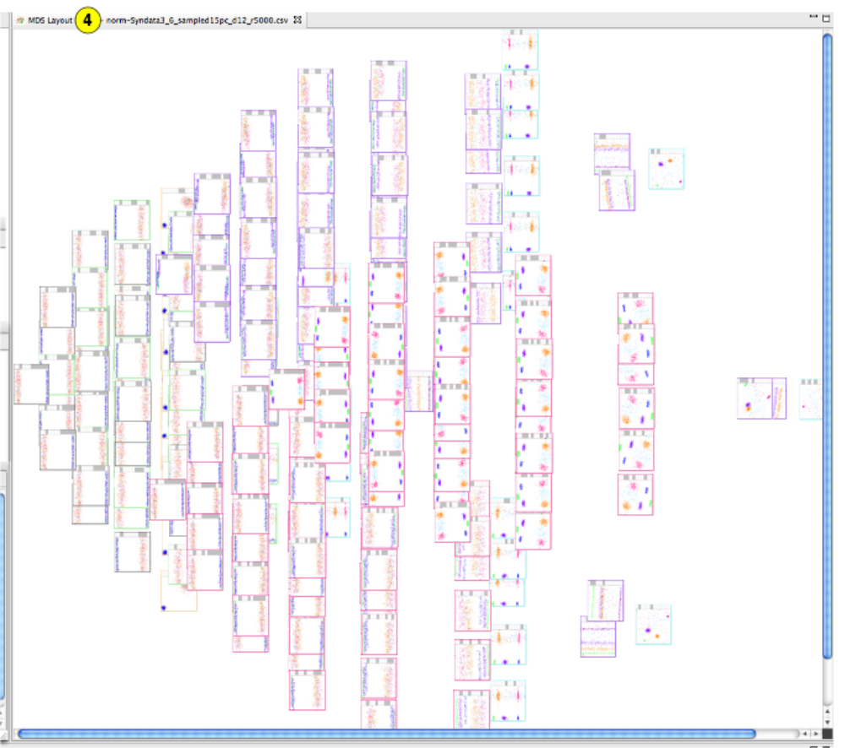
Subspace Clustering: Visualization
Similarity view related to the involved dimensions (spatial proximity indicates high similarity) (From: Tatu, 2012).
For a real application, users should see visited sub-spaces and should be able to record results/findings.
Bernhard Preim

Slide 47
Subspace Clustering: Visualization
Interaction with subspace visualizations
Lasso interaction to select interesting portions
Brushing to other (similar) subspaces
Detail information for the involved dimensions after selection, e.g. histogramm, mean, std. dev.
Relevant results should be stored (bookmark function)
Analysis of clusters:
Similarity (overlap) of clusters analyzed with measures for set comparison, e.g. Dice coefficient and Jaccard Index.
Bernhard Preim

Slide 48
Application
USDA Food Composition Dataset (Link)
After preprocessing 722 records (food) with 18 dimensions (indicating which minerals, vitamins, … are part of typical food)
SURFING produced 216 interesting subspaces (from potentially ~ 262.000)
Distributions in the high-ranked subspaces often highly skewed
High redundancy among the subspaces
(From: Tatu, 2012)
Bernhard Preim

Slide 49
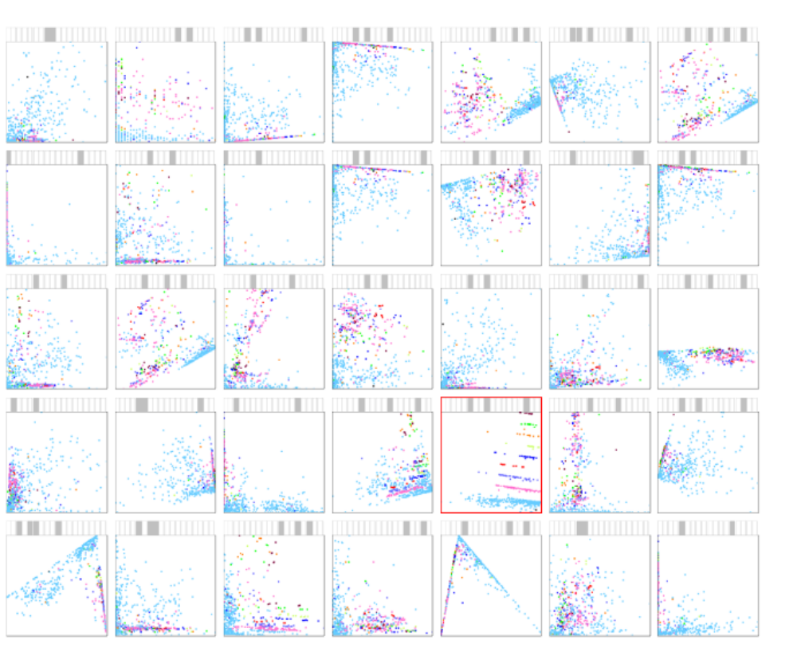
Application
High-ranked subspaces in a food dataset. Selected subspace with interesting structure (From: Tatu, 2012)
Bernhard Preim

Slide 50
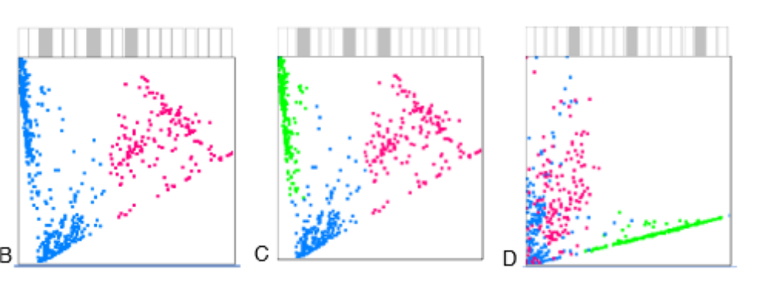
Application
Three subspace clusters from the food dataset:
Food with carbohydrate, lipid, protein (left)
Additional cluster marked in the same space (middle)
Fiber (Ballaststoffe), protein, Vitamin D
Visualizations: 2D projections from 4D and 6D
(From: Tatu, 2012)
Bernhard Preim

Slide 51
Subspace Clustering: SubVis
Hund, 2015
35 male and 58 female persons (aged [50 and 89] years).
61 dimensions: clinical parameters such as sex, age, anthropometric measures, hematological, and biochemical tests and dimensions containing diagnosis results of common chronic diseases
Analysis goal: outcome of vaccination
Bernhard Preim

Slide 52
Subspace Clustering: SubVis
(C)
(B)
(D)
(E)
(A)
Comprehensive visualization of clustering results: 2D-Overview of sub-space clusters bottom left (MDS projection)(A). Small multiples represent results with different distance functions (B). On top: Distribution properties of subspaces (C). Aggregation tables with aggregated members (D) and table lens for details (E). (From: Hund, 2015)
Bernhard Preim

Slide 53
Subspace Clustering: SubVis
MDS overview. One cluster selected. Color-scale application-specific. Patients with positive or negative outcome of vaccination for flu (Grippe-Impfung). Coloring may reflect number of cluster members, dimensions (From: Hund, 2015)
Bernhard Preim

Slide 54
Subspace Clustering: SubVis
(From: Hund, 2015).
Data for 93 patients, only 71 complete records → others removed.
Result of Proclus: 64 subspace clusters with 1 to 5 dimensions.
Information related to allergies (encircled) involved in most clusters.
Bernhard Preim
Notes:
Top image: Number of elements shown as percentage from overall dataset size, e.g. the largest cluster (1) has 7% members; others less than 1%. Most clusters have 3 dimensions, followed from 2 and 4 dimensions.
Bottom image: Many dimensions did not contribute to a single cluster; could be irrelevant

Slide 55
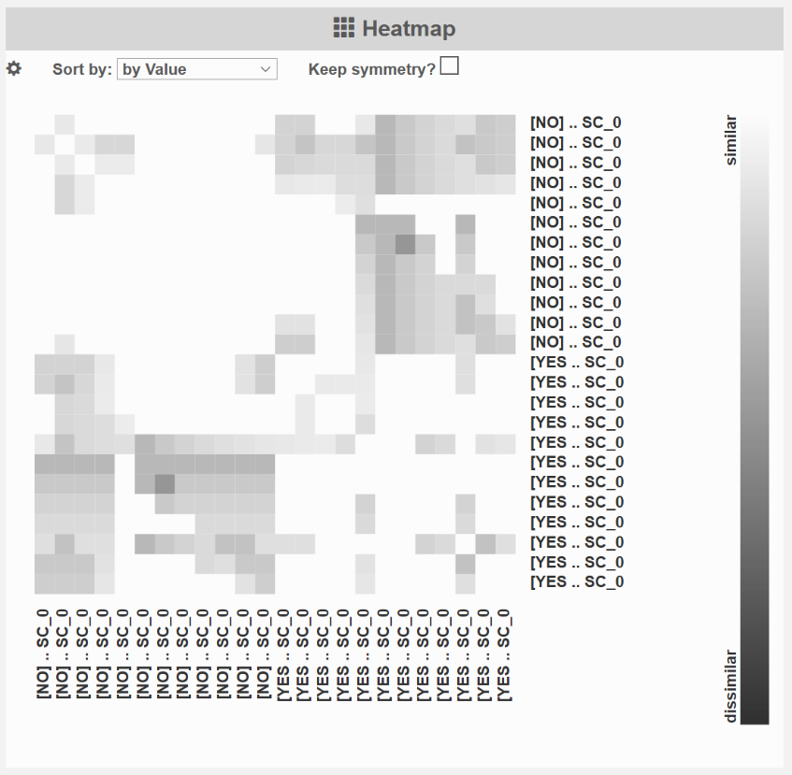
Subspace Clustering: SubVis
Heatmap represents similarity of the detected subspaces (w.r.t. overlapping dimensions). Only a few are dissimilar from others (From: Hund, 2015).
Bernhard Preim

Slide 56
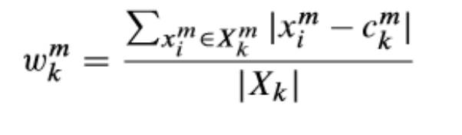
Subspace Clustering: ClustNails
Tatu, 2012, Tsinghua Science and Technology Journal
For a subspace cluster, each dimension that contributes has a weight
Where c^{m}_{k} is the center of points in dimension m and
x^{m} _{i} is the value in dimension m and |X_{k}| is the
number of points in this cluster.
→ dimensions with high variance have a high weight since they contribute strongly to the separation.
Bernhard Preim

Slide 57
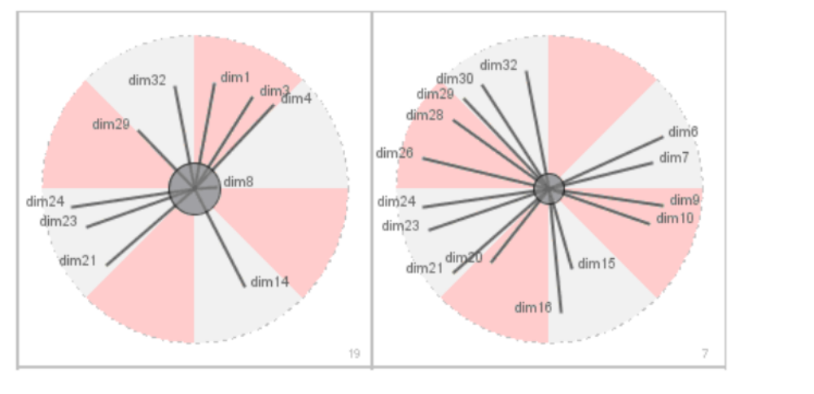
Subspace Clustering: ClustNails
Subspace clusters visualized along with the weights of their dimensions.
Radial visualization designed such that clusters are comparable w.r.t. involved dimensions.
Length of the spikes („nails“) represents the weights per dimension. Only contributing dimensions labeled. Background colors for comparability.
(From: Tatu, 2012)
Bernhard Preim

Slide 58
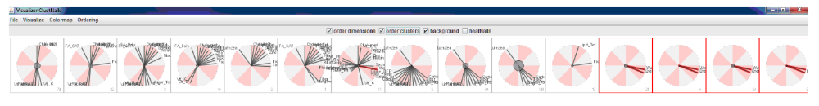
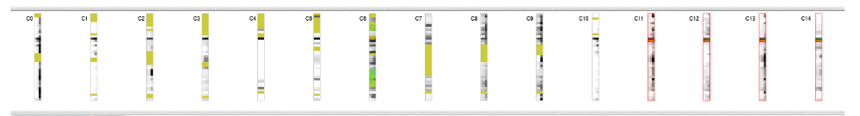
Subspace Clustering: ClustNails
Overview of the subspace clusters (inspired by Star coordinates).
Combined with detailed views for selected clusters.
At the 2nd level, a histogram view represents the distributions in the relevant dimensions. (From: Tatu, 2012)
Bernhard Preim

Slide 59
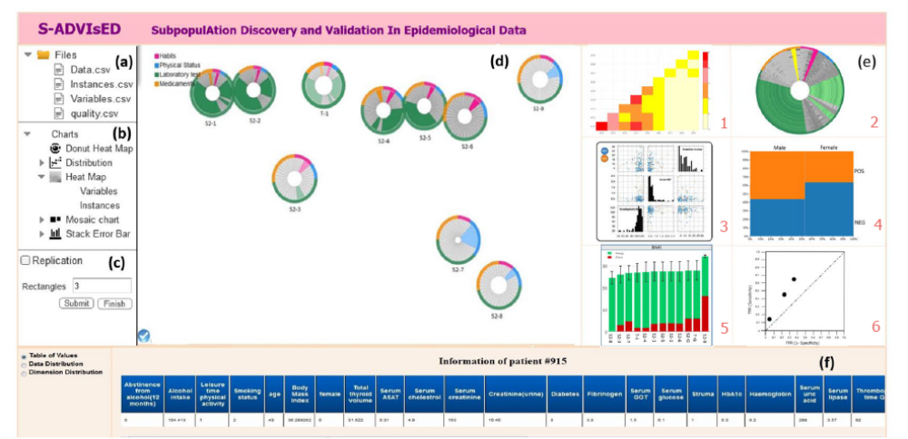
Subspace Clustering: Epidemiological Data
(d) Overview visualization of subspace clusters with Donut charts. Large clusters have a smaller hole. Each sector is a dimension. Dimensions colored according to type (drugs used, physical status, laboratory experiments). Grey dimensions do not contribute. Layout computed with MDS (From: Alemzadeh, 2017).
(e) Detailed exploration of a selected cluster (heatmap, boxplots, …)
Bernhard Preim

Slide 60
Subspace Clustering: Epidemiological Data
Details for one 3D cluster and an overview of the 10 SCs (red: participants with; green without fatty liver) (From: Alemzadeh, 2017).
Bernhard Preim

Slide 61
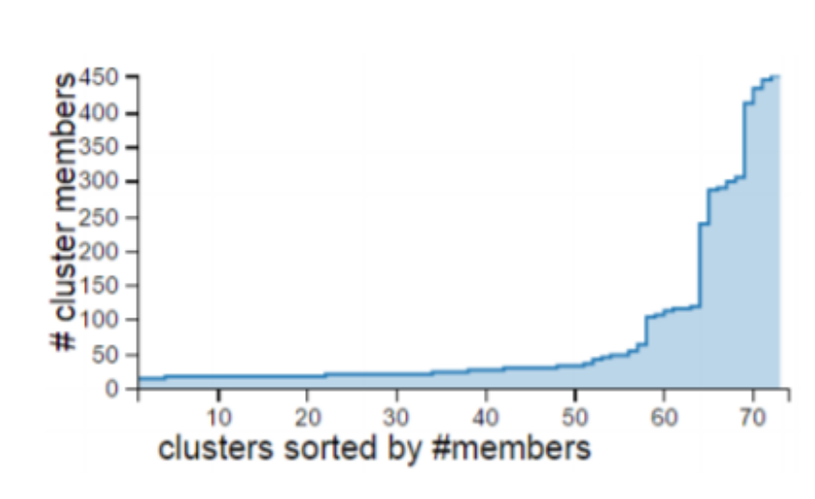
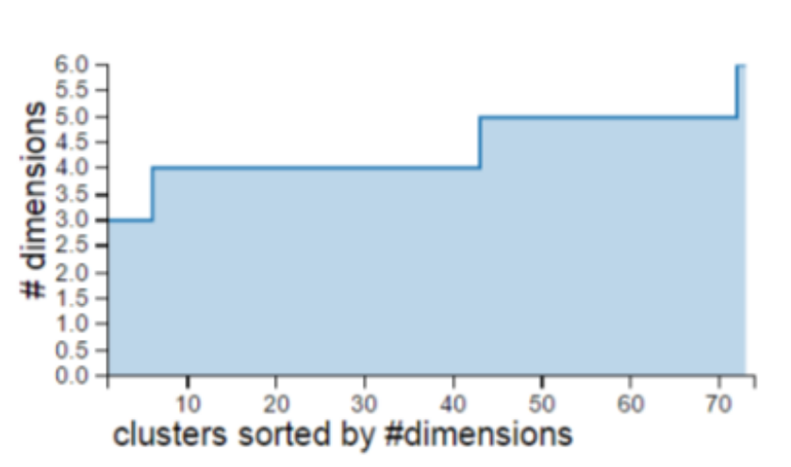
Subspace Clustering: Visual Quality
Overview: distribution of cluster members and dimensions per cluster (From: Hund, 2016).
Histogram views can be combined with interaction: filter for clusters with a minimum number of objects or a certain range of dimensions.
Bernhard Preim

Slide 62
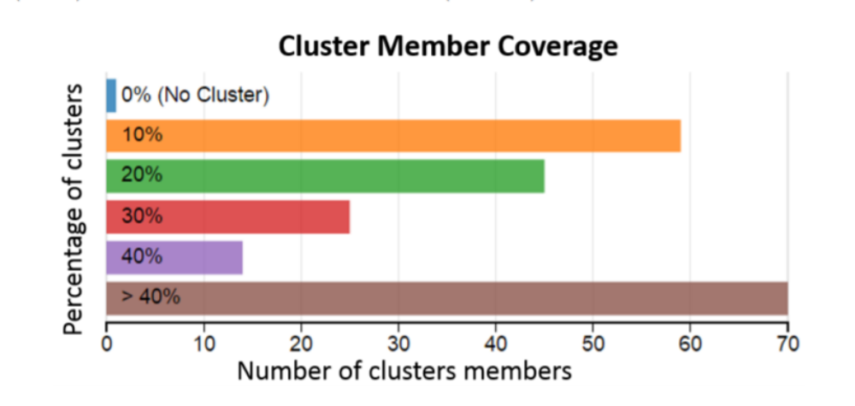
Subspace Clustering: Visual Quality
All objects part of ≥ 1 cluster (C). Most objects part of < 10% of |N(C)| or > 40% |N(C)| (From: Hund, 2016).
Bernhard Preim

Slide 63
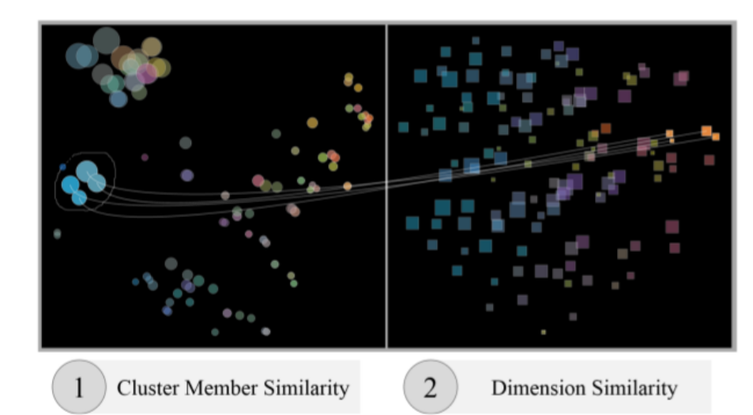
Subspace Clustering: Visual Quality
To assess redundancy, dimension similarity and cluster member similarity is essential.
Display both features and support links between them (Hund, 2016).
Overview of 132 subspace clusters. Two linked MDS projections. Colors indicate similarity in the opposite view. For the selected clusters (left) also the dimensions highly overlap – these clusters are truly redundant (From: Hund, 2016).
Bernhard Preim

Slide 64
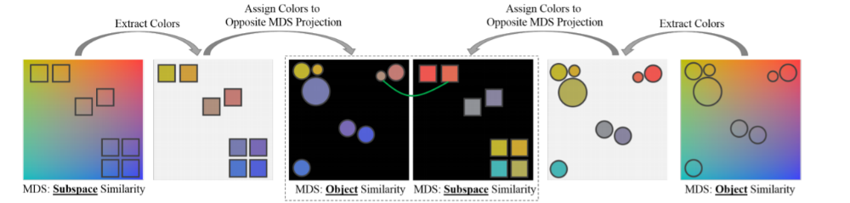
Subspace Clustering: Visual Quality
A perceptually motivated 2D color space is employed to encode object and dimension similarity. The primary criterion is proximity and the secondary criterion similarity of colors (From: Hund, 2016).
Bernhard Preim
Notes:
This is based on Gestalt laws known in design. Certaint attributes contribute to the perception of similarity/belonging together: alignment, color, basic shape, proximity. Proximity is the most salient criterion: if something is shown close to each other, it is considered as belonging together. The same color has a little lower priority. Think of web forms: yellow for mandatory input; white/grey for optional.

Slide 65
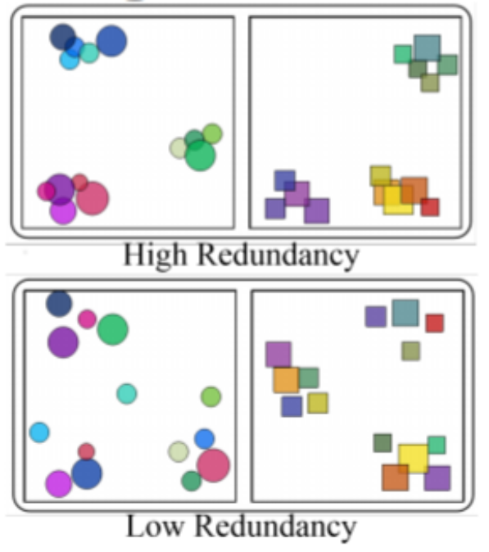
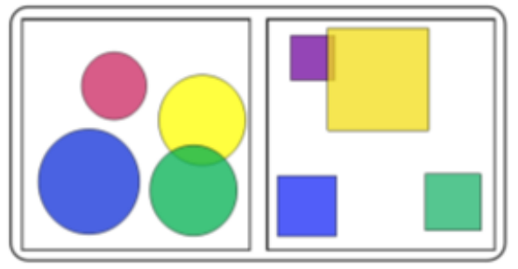
Subspace Clustering: Visual Quality
Subspace clusters with high and low redundancy (w.r.t. dimensions and instances).
Big (not compact) clusters
(From: Hund, 2016)
Bernhard Preim

Slide 66
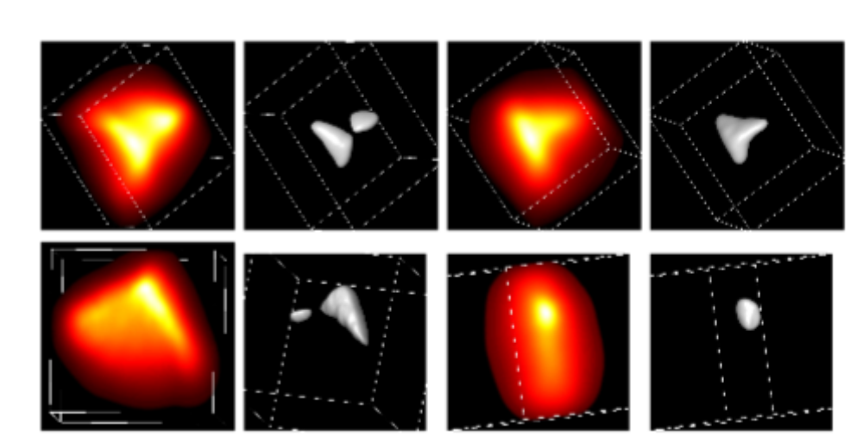
Subspace Clustering: 3D Visualization
Only one publication employs 3D (volume) rendering to reveal results of subspace clustering.
Astronomy data (galaxy datasets)
Top-ranked subspaces: Top row renderings of 3D subspaces. Bottom row: A 5D subspace transformed in 3D via PCA and rendered. Attributes relate to color components and log of the mass of galaxies (From: Ferdosi, 2010)
Bernhard Preim

Slide 67
Subspace Clustering: Visualization
What is missing?
Clustering was assessed with projections of all data and color-coded clusters.
For really HD data, such projections suffer from the curse of dimensionality.
Projections only meaningful for subspaces.
→ Show for each selected subspace cluster, the projection of the points in that subspace and emphasize the cluster.
Bernhard Preim

Slide 68
Subspace Clustering: Evaluation
Datasets:
Artificial data, e.g. generated data with some high-density areas and random noise (Tatu, 2012, used a 12D dataset with two 6D Gaussian clusters).
→ Check whether algorithms return known clusters
Real-World data, e.g. from the machine learning repository, as benchmark data
Real world data from your customer/research partner to understand the influence on insight generation.
Combination most interesting.
Bernhard Preim

Slide 69
Subspace Clustering: Evaluation
Subspace clustering: based on various parameters. Evaluation serves to understand the influence of parameter combinations
Clustering evaluation criteria, e.g. Purity, are relevant for subspace clusters as well.
Visualization of such measures improves evaluation.
Subspace clustering may return some excellent, some moderate and some bad clusters.
Probably not all clusters are very good with one parameter combination.
Bernhard Preim

Slide 70
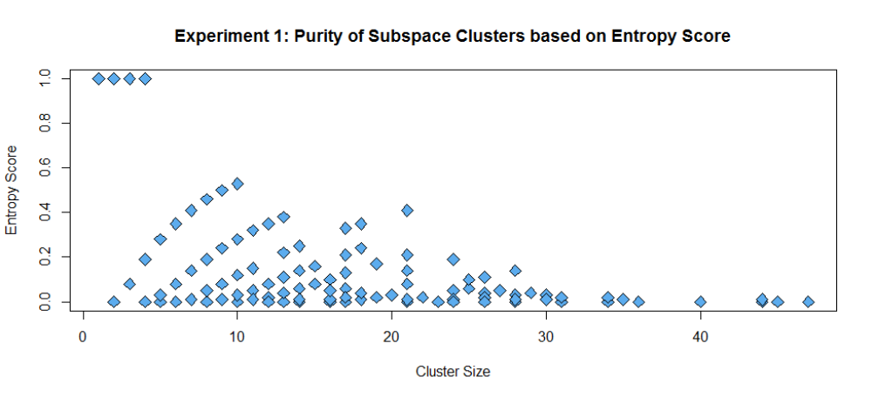
Subspace Clustering: Evaluation
Some clusters not too small and have a good entropy score (From: Hund, 2015). Application to patient data where vaccination was sometimes successful, sometimes not.
Bernhard Preim

Slide 71
Subspace Clustering: Evaluation
Datasets.
No reliable ground truth for real world data.
Often, a combination of synthetic data (hidden clusters and various levels of noise) and real-world data (primarily publicly available data).
For a specific application, representative datasets of this domain required, e.g. customer profile data.
Clustering results need to be discussed with domain experts w.r.t. cluster quality and relevance for their decisions.
„Representative“ relates to the typical distribution, to the number of objects and dimensions (no „toy“ data).
Bernhard Preim

Slide 72
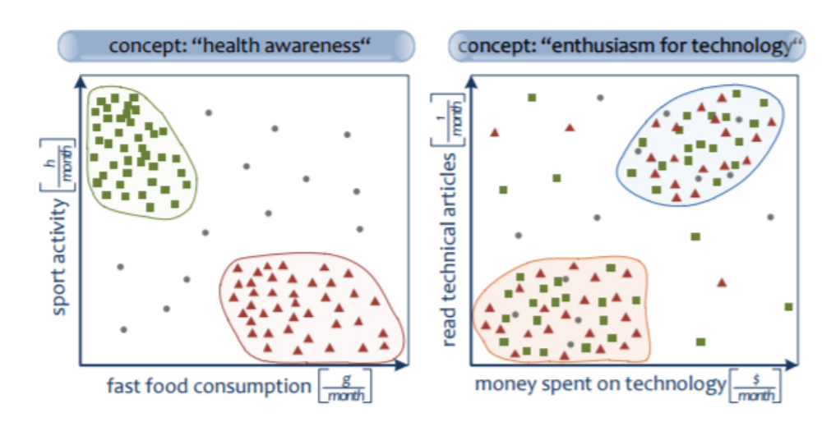
From Subspace Clusters to Concepts
Subspace clusters are determined automatically.
Relevant concepts - represented by these clusters - need interpretation from an expert.
Concept based on a subset of subclusters, it has significant dimensions and a label (From: Günnemann, 2010).
Bernhard Preim

Slide 73
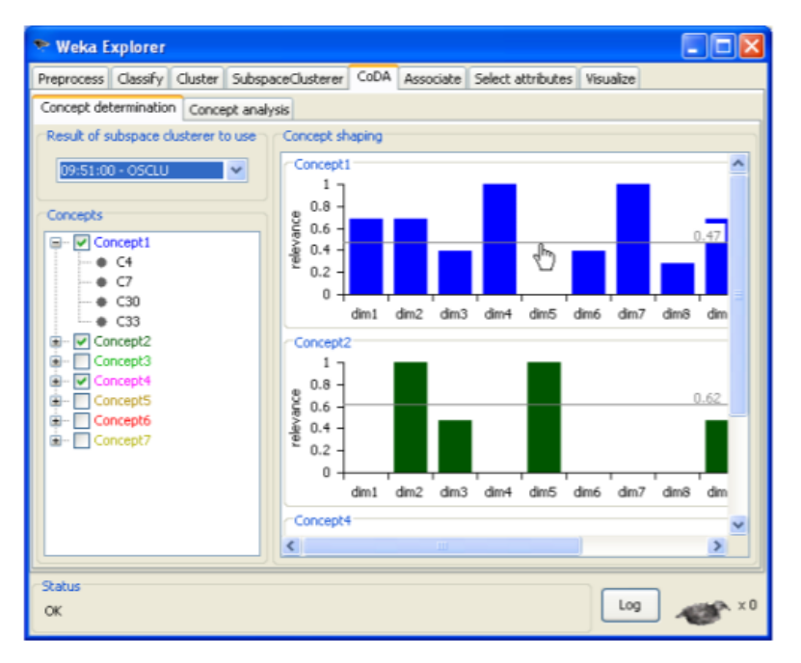
From Subspace Clusters to Concepts
Concept discovery and interpretation may be supported by (see Günnemann, 2010).
Grouping (concept represented by clusters with equal or very similar dimensions) → clustering on the clusters
Ordering dimensions w.r.t. significance
Concept candidates – each comprising a few clusters. Significance of the dimensions shown to support the user in setting a threshold (From: Günnemann, 2010).
Bernhard Preim

Slide 74
Summary
Subspace clustering enables explorative analysis of HD data from multiple perspectives.
Most applications are related to a few dozen dimensions
Subspace clustering involves
  the search for clusterable subspaces,
  the clustering itself and
  the presentation of subspace clusters involving the related dimensions.
Bernhard Preim

Slide 75
Summary
According to an interestingness measure, the most interesting subspaces are often similar → clustering on these subspaces to choose a representative.
Subspace clustering involves complex workflow. → Comprehensive systems with a good trade-off between flexibility and guidance essential.
Visualization techniques not very advanced. How to use transparency, line styles etc. to reveal cluster properties is not clear.
Clustering identifies (only) one interesting aspect of data: dense areas. Other interesting aspects: correlated dimensions, outliers, ...
Bernhard Preim

Slide 76
Limitations
Subspace clustering enables the exploration of more dimensions compared to global clustering.
For truly high-dimensional data, e.g. > 100 dimensions of client/ patient data, unsupervised subspace clustering produces an enormous amount of information that can not hardly explored.
Clustering does not employ background knowledge w.r.t. domain and dataset.
Constrained-based clustering more scaleable (see e.g. Hielscher, 2014). Experts specify that
  some objects should belong to the same cluster (must-link)
  others must not belong to the same cluster (must-not)
Bernhard Preim

Slide 77
Limitations
Constraint-based clusters often employ few constraints (e.g. for 1% of the instances) and improve accuracy of grouping all constraints.
Must-link constraints are transitive: If d_{i} must link to d_{j} and d_{j} must link to d_{k} → d_{i} must link to d_{k} (Wagstaff, 2001)
Examples:
  Finance data: analysts label instances of true credit card frauds.
  Medicine: analysts label pathologic situations (back pain).
Constraints may be considered hard – enforcing that all constraints are met or soft, more as hints (recall fuzzy clustering).
Bernhard Preim

Slide 78
References
Elke Achtert, Christian Böhm, Hans-Peter Kriegel, et al.: „Detection and Visualization of Subspace Cluster Hierarchies“. Proc. of DASFAA 2007: 152-163
C. C. Aggarwal, J. L. Wolf, P. S. Yu, C. Procopiuc, J. S. Park. 1999. „Fast algorithms for projected clustering“, Proc. of ACM SIGMOD Conf. on Management of Data, pp. 61-72
R. Agrawal, Gehrke J., Gunopulos D., Raghavan P.: „Automatic Subspace Clustering of High Dimensional Data for Data Mining Applications”, Proc. ACM SIGMOD Conf. on Management of Data, 1998, pp. 94-105
S. Alemzadeh , T. Hielscher, U. Niemann, L. Cibulski,T. Ittermann, H. Völzke, M. Spiliopoulou, B. Preim. „Subpopulation Discovery and Validation in Epidemiological Data”, Proc. of EuroVis Workshop on Visual Analytics, 2017
I. Assent, R. Krieger, E. Müller, T. Seidl: VISA: visual subspace clustering analysis. SIGKDD Explorations 9(2): 5-12 (2007)
C. Baumgartner, C. Plant, K. Kailing, H.-P. Kriegel, and P. Kröger. Subspace selection for clustering high-dimensional data. Proc. of IEEE Conference on Data Mining, pp. 11–18, 2004
Y. Cheng and G. M. Church. “Biclustering of expression data”. In International Conference on Intelligent Systems for Molecular Biology, pp. 93-103, 2000
Ferdosi B, Buddelmeijer H, Trager S, et al. Finding and visualizing relevant subspaces for clustering high-dimensional astronomical data using connected morphological operators. In: Proc. of IEEE Visual Analytics Science and Technology (VAST), 2010: 35-42
S. Günnemann, I. Färber, H. Kremer, T. Seidl. „CoDA: Interactive Cluster Based Concept Discovery”, Proc. of VLDB Endowment (PVLDB) 3(2): 1633-1636 (2010)
T. Hielscher, M. Spiliopoulou, H. Völzke, J.-P. Kühn: Using Participant Similarity for the Classification of Epidemiological Data on Hepatic Steatosis. Proc. of CBMS 2014: 1-7
Bernhard Preim

Slide 79
References (II)
M. Hund, W. Sturm, T. Schreck, T. Ullrich, D. A. Keim, L. Majnaric, A. Holzinger (2015). „Analysis of Patient Groups and Immunization Results Based on Subspace Clustering“. Brain Informatics, pp. 358-368
M Hund, I Färber, M Behrisch, A Tatu, T Schreck, DA Keim, T Seidl (2016). „Visual Quality Assessment of Subspace Clusterings”, Proc. of KDD Workshop on Interactive Data Exploration and Analytics (IDEA’16)
Kailing, K. Kriegel, H.P., Kröger, P. “Density-Connected subspace clustering for high-dimensional data”, In Proc. of SIAM International Conference on Data Mining (SDM), 2004
H.-P. Kriegel, P. Kröger, A. Zimek. „Clustering high-dimensional data: A survey on subspace clustering, pattern-based clustering, and correlation clustering“, ACM Trans. Knowl. Discov. Data 3, 1, Article 1 (2009), 58 pages
E. Müller, S. Günnemann, I. Assent, and T. Seidl. Evaluating clustering in subspace projections of high dimensional data. Proc. VLDB Endow. 2, 1 (2009), 1270-1281
E. Müller, I. Assent, and T. Seidl. HSM: Heterogeneous Subspace Mining in High Dimensional Data. Proc. of Scientific and Statistical Database Management, (2009), 497-516
E. Müller, S. Günnemann, I. Färber, T. Seidl. "Discovering Multiple Clustering Solutions: Grouping Objects in Different Views of the Data", Tutorial at the International Conference on Machine Learning, 2013
L. Parsons, E. Haque, H. Liu: Subspace clustering for high dimensional data: a review. SIGKDD Explorations 6(1): 90-105 (2004)
Bernhard Preim

Slide 80
References (III)
M. Sips, B. Neubert, J. P. Lewis, P. Hanrahan: Selecting good views of high-dimensional data using class consistency. Comput. Graph. Forum 28(3): 831-838 (2009)
A. Tatu, F. Maass, I. Färber, E. Bertini, T. Schreck, T. Seidl, D. A. Keim: Subspace search and visualization to make sense of alternative clusterings in high-dimensional data. IEEE VAST 2012: 63-72
A. Tatu, G. Albuquerque, M. Eisemann, J. Schneidewind, H. Theisel, M. A. Magnor, D. A. Keim: Combining automated analysis and visualization techniques for effective exploration of high-dimen-sional data. IEEE VAST 2009: 59-66
Tatu, L. Zhang, E. Bertini, T. Schreck, D. Keim, S. Bremm, T. von Landesberger, "ClustNails: Visual analysis of subspace clusters," in Tsinghua Science and Technology, vol. 17(4): 419-428, 2012.
S. Vadapalli, K. Karlapalem. 2009. Heidi matrix: nearest neighbor driven high dimensional data visualization. In Proc. of ACM SIGKDD Workshop on Visual Analytics and Knowledge Discovery (VAKD '09), 83-92.
K. Wagstaff, C. Cardie, S. Rogers and S. Schroedl (2001). “Constrained K-means Clustering with Background Knowledge”, Proc. of Machine Learning, 2001, p. 577–584
Bernhard Preim

