Slide 1
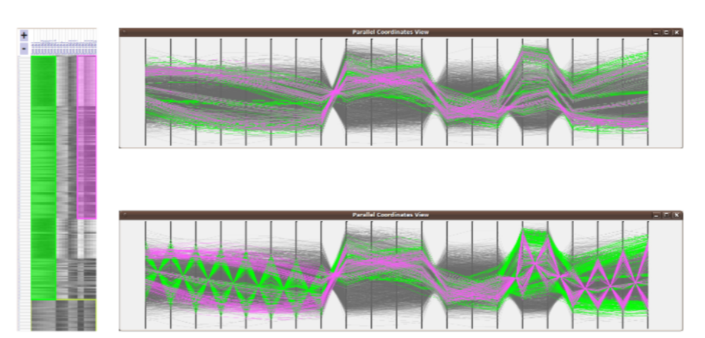
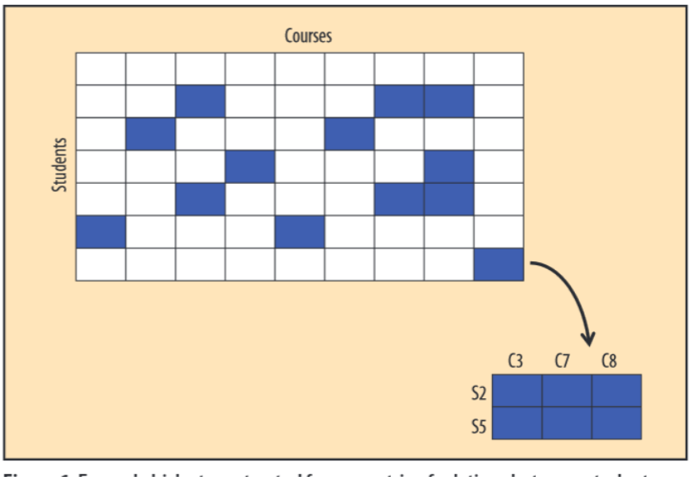
Visual Analysis of Biclusters
Notes:
Vorlesung 7: Visualisierung von Multiparameter Daten

Slide 2
Outline
Bi-Clustering: Definition and Algorithms
Visualization of Biclusters
Chaining Biclusters
Summary & Outlook
Bernhard Preim

Slide 3
Introduction
Bi-partite graphs represent relations between two types of nodes, e.g. associations of people to organizations (parties, sport clubs, …) or researchers and publications
Bi-partite graphs typically visualized as node-link diagramms or as bi-adjanceny matrix.
1 | 0 | 0 | 0 | 1
1 | 1 | 1 | 0 | 1
0 | 0 | 0 | 1 | 0
0 | 0 | 0 | 1 | 0
Bernhard Preim

Slide 4
Introduction
Biclustering¹: data mining technique that searches for subsets in bi-partite graphs.
Examples:
A set of students that take the same courses
A set of students coming from the same city
→ Biclusters reveal relations.
Most applications: data categorical, i.e., values compared for being (exactly) equal.
¹also called co-clustering or block clustering
Bernhard Preim

Slide 5
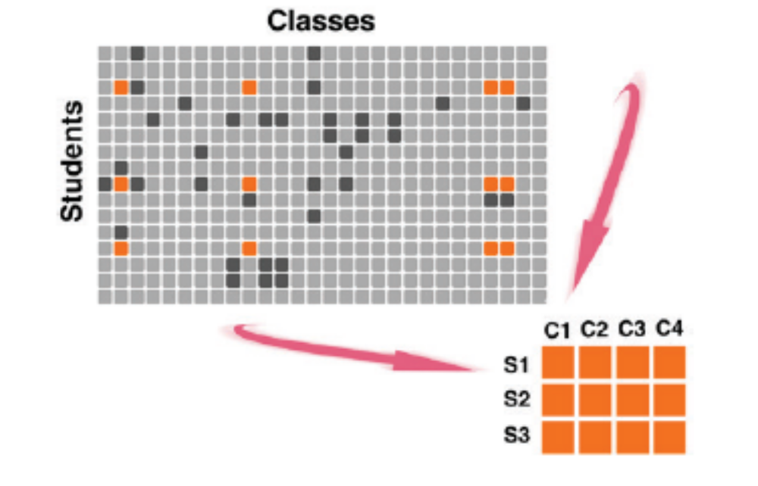
Introduction
Raw visualization: Difficult to recognize which elements in specific rows are related to elements in specific columns.
This n:m relationship R between a subset of rows and columns is detected by biclustering (From: Sun, 2014)
Bernhard Preim

Slide 6
Introduction
Biclustering introduced in statistics (Hartigan, 1972)
Name biclustering introduced later (Mirkin, 1996)
Biclustering generalized to objects with similar (numerical) values for use in gene expression data: matrix represents genes and environm. conditions (Cheng, 2000) → Bicluster analysis revealed metabolic pathways
Comparison
Clusters represent a partioning of the database (all objects belong to one cluster; clusters do not overlap).
Biclusters (often heavily) overlap and many objects do not belong to biclusters (without being outliers).
Bernhard Preim

Slide 7
Introduction
Biclustering algorithms – like subspace clustering – reveals usually many (thousands) of biclusters
Biclusters – again like subclusters – often similar/redundant.
Biclusters of maximum size (closed biclusters), e.g., property of being a bicluster violated if any row or column is added.
Biclusters represent relations between two dimensions and serve as orientation for more in-depth analysis.
Bernhard Preim
Notes:
Redundancy is a general problem in data mining and information retrieval. Search results, association rules, subspace clusters, decision trees, … ranked by some interestingness measure tend to be strongly redundant/similar. Deliberate action is necessary to provide a representative set of results and thus to increase diversity.
Vorlesung 7: Visualisierung von Multiparameter Daten

Slide 8
Definition and Algorithms
Definition: A bicluster (E‘, F‘) on a relation R(E,F) is a set E‘ ⊆E and a set F‘⊆F such that E‘xF‘⊆R.
→ There is a relation between every element of {E} and {F}.
Graph theory: a bicluster corresponds to a complete bipartite graph¹ – a graph where the set of vertices N may be split in two sets N₁ and N₂ where each edge connects a node from N₁ and a node from N₂.
→ no edge connects vertices from N₁ and no edge connects vertices from N_{2.}
¹also called Biclique (see Wikipedia)
Bernhard Preim

Slide 9
Definition and Algorithms
Algorithms often parameterized w.r.t. minimum number of rows and/or columns
Bimax algorithm (Prelic, 2006) delivers a complete set of biclusters.
Other frequently used algorithms:
  LMAX (Uno, 2004) and
  Charm (Zaki, 2005)
Bicluster algorithms available as R plugins, e.g. (Kaiser, 2013)
Bernhard Preim

Slide 10
Definition and Algorithm
Exhaustive search for biclusters NP complete.
Heuristic algorithms often define biclusters bottom-up (Cheng, 2007)
In every row possible clusters are determined
Next step: row clusters merged to form big biclusters when the number of rows does not „decrease too much“.
If applied to numerical data, two types of comparison:
  Absolute difference between two items (additive-related)
  The relation between two items (multiplicative-related)
Analytics tools should provide both
Bernhard Preim
Notes:
Additive: v1-v2 < eps
Multiplicative: v1/v2-1 < eps
The choice of eps is difficult and may depend on the range of the data (as a kind of normalization)
Vorlesung 7: Visualisierung von Multiparameter Daten

Slide 11
Algorithms
Application to numerical data:
When applied to measured data, consider noise
Biclustering algorithms
  estimate the noise level and consider a subset of the rows and columns as biclusters if the values differ less than the estimated noise level.
  differ in assumptions and heuristics
  may be stochastic or deterministic (see [Tanay, 2004] and Wikipedia for surveys)
Bernhard Preim

Slide 12
Algorithms
Large variety of algorithms (different heuristics, different complexity) (survey Pontes, 2015)
Most algorithms return hard clustering results (binary membership).
For numerical data, fuzzy clustering better represents the membership of objects to a bicluster.
FABIA (FABIA: factor analysis for bicluster acquisition, Hochreiter, 2010)
  fuzzy biclustering technique, e.g. for clustering gene expression data, drug discovery and recommender systems.
  assumes a sparse matrix where only few rows and few columns belong to a bicluster.
Bernhard Preim
Notes:
Last point: If you know something about the data, you can design an algorithm that is particularly effective when the assumption is actually fulfilled.
Vorlesung 7: Visualisierung von Multiparameter Daten

Slide 13
Preprocessing
Depending on the nature of the data, different preprocessing steps are performed, primarily for numerical data:
Outlier removal
Noise reduction
Numerical data often discretized (binned). Binning resolution should be adjustable.
Transformation of values (in gene expression data often a log transform of expression levels)
Normalization of data in case of different scales
Bernhard Preim
Notes:
Draw a log transform (1, 10, 100, 1000, 10000)
Vorlesung 7: Visualisierung von Multiparameter Daten

Slide 14
Postprocessing
After biclustering: (compare vanDromme, 2016):
Removal of biclusters with too few rows or columns
Filter for biclusters with the highest quality (low variance in numerical data)
Rank biclusters according to size
Bernhard Preim

Slide 15
Visualization of Biclusters: Tasks
Visualization tasks:
Gain an overview of biclusters
  Size, involved rows/columns (~datasets/dimensions)
Show individual biclusters
  Members, additional metadata per member
Display a set of biclusters simultaenously
  Enable comparison w.r.t. size and distribution of values
  Indicate overlaps
Explore properties of individual and sets of biclusters
For fuzzy biclusters (Streit, 2014):
Display membership values and support transformation to hard clusters
Bernhard Preim
Notes:
Very similar to Subspace Clustering.
Vorlesung 7: Visualisierung von Multiparameter Daten

Slide 16
Visualization of Biclusters
Requirements:
In addition to the vis. tasks, scalability requirements need to be considered:
Techniques should be scalable, w.r.t.
Number of rows and columns,
Number of biclusters,
Number of rows and columns associated with several biclusters (overlap)
Bernhard Preim

Slide 17
Visualization of Biclusters: Parameters
Parameters for Initial Generation or Filtering:
Minimum number of rows/columns (minimum support parameter)
  Users often use high values and decrease as long as the number of biclusters is manageable
Percentage minimum number of rows/columns
Percentage maxiumum filter obvious relations, e.g. biclusters that indicate that many persons are married
Noise threshold for numerical data (for the comparison)
Overlap between biclusters (to control redundancy)
Bernhard Preim

Slide 18
Visualization of Biclusters
Graph visualizations
  Edge bundling for reducing clutter
Table visualizations
  Emphasis of Biclusters within tables
Parallel coordinates
Node-link diagrams for displaying chained biclusters
Set-based visualizations
Bernhard Preim

Slide 19
Visualization of Biclusters: Bixplorer
Bixplorer (Sun, 2014; Fiaux, 2013): Visual analytics prototype based on biclustering.
Bixplorer supports the following tasks:
Detect biclusters and chains of biclusters as starting point for further analysis,
Reveal connections,
Labeling and „organizing“ information
Bixplorer supports search in documents (representing co-occurrence of words in documents).
Bernhard Preim

Slide 20
Visualization of Biclusters
2D matrix of courses and students: one bicluster (with at least two rows/columns) identified (From: Fiaux, 2013).
Bicluster labeled with the related items.
By reordering the matrix, the bicluster is emphasized.
Bernhard Preim

Slide 21
Visualization of Biclusters
Within one 2D subspace, several (overlapping) biclusters may occur.
Re-ordering of cells in a table and explicit visualization of the overlap represents this information.
Without duplication of rows/columns → technique restricted to displaying two biclusters
Bernhard Preim

Slide 22
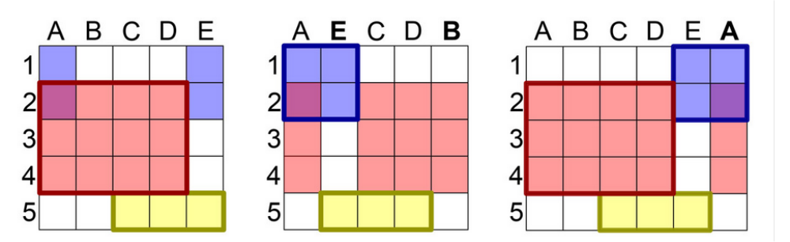
Visualization of Biclusters
(From: Streit, 2014).
To display >2 biclusters in contiguous rows/columns requires to duplicate rows/columns.
Each bicluster should be mapped to a unique color.
Bernhard Preim

Slide 23
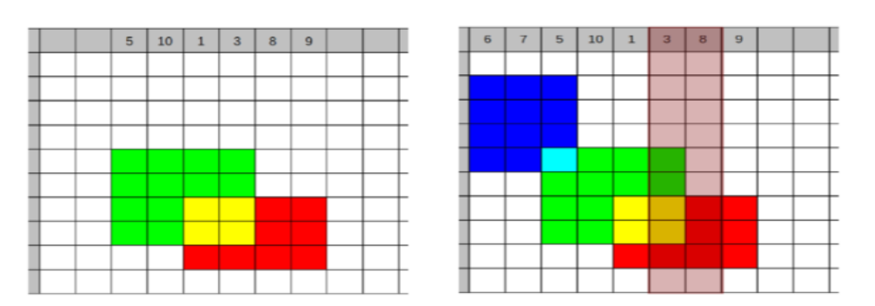
Visualization of Biclusters
Duplicated entries (columns 3 and 8, right) should be tagged, e.g. with a transparent background (From: Heinrich, 2011).
Duplication does not scale well: For HD data, many rows and columns need to be inserted.
Each bicluster should be displayed with a unique color → limited to a few dozens of biclusters
Bernhard Preim

Slide 24
Visualization of Biclusters: Interaction
Several algorithms compute a layout for overlapping biclusters with minimal duplication, e.g. (Grothaus, 2006).
Interactive adjustment (Heinrich, 2011):
  Users select one bicluster as focus
  Biclusters are added sorted by descending overlap to the focus bicluster
Further interaction
  Select biclusters for temporary or permanent hightlighting
  Sort biclusters, e.g. by size
  Label biclusters with a descriptive term
  Zoom in and out to see names of items
  Show biclusters without duplicating rows and columns → use colors to reveal which separated regions form the same bicluster.
Bernhard Preim

Slide 25
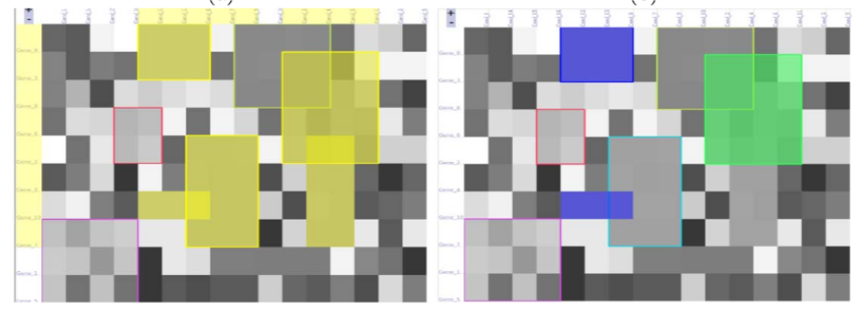
Visualization of Biclusters: Interaction
Bicluster viewer: Some biclusters selected and empha-sized. Involved dimensions shown (From: Heinrich, 2011).
Rectangles do not carry immediate meaning. Labels, e.g. genes, provided as tooltips or in detailed views.
Overlap may be used to emphasize e.g. larger biclusters by drawing them on top (2 ½ D)
Bernhard Preim

Slide 26
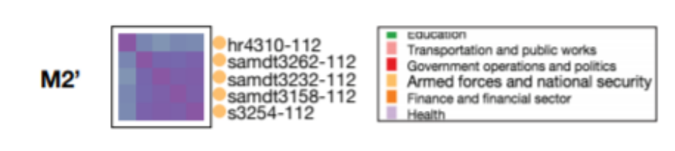
Visual Exploration of Biclusters
Case study: Voting behavior of 100 US senators, 2012, (govtrack.us) 22 bills and 117 amendments
Further attributes
Senators (party, state, age, gender)
Brightness indicates similarity between members of a bicluster
Color (hue) to discriminate bills related to finance, health, national security, …
Interactive exploration to refine biclusters based on the node similarity (Xu, 2016)
Cluster of 6 senators and 5 bills related to national security (From: Xu, 2016)
Bernhard Preim

Slide 27
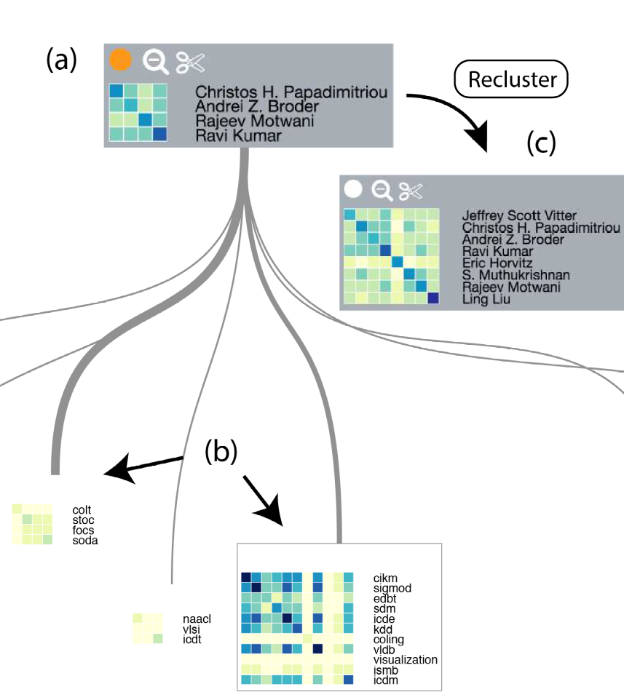
Visual Exploration of Biclusters
Remove button
Case Study II
Data: Researchers on massive data processing and conferences where they publish (theoretical comp. science and data mining).
Different biclusters identified and linked (line width encodes size of biclusters).
Colors encode similarity between researchers in terms of other conferences.
Interactively a new cluster is formed.
(From: Xu,2016).
Bernhard Preim
Notes:
Vorlesung 7: Visualisierung von Multiparameter Daten

Slide 28
Visualization: Parallel Coordinates
While heatmaps show an aggregated similarity, PC plots reveal individual values
Items with all attributes represented as lines (Cheng, 2007)
Lines color-coded to represent membership to a bicluster
  Problem: Items that belong to several biclusters
PC display linked to a table-based heatmap to enable brushing and linking
Same colors used in both displays.
Bernhard Preim

Slide 29
Visualization: Parallel Coordinates
Single rows/columns (representing genes) may be selected and compared with the biclusters
BiVisu (Cheng, 2007, Link). Example: 2900 genes in 17 conditions analyzed resulting in 113 biclusters with the additive and 93 biclusters with the multiplicative model (overlap < 80%, minimum 6 columns).
Bernhard Preim

Slide 30
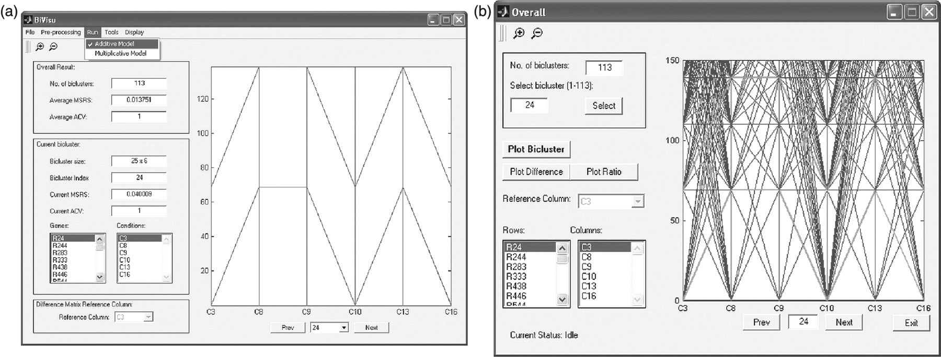
Visualization: Parallel Coordinates
One bicluster selected and values for different attributes shown in naive PC visualization
(Screenshot from BiVisu, Cheng, 2007).
Bernhard Preim

Slide 31
Visualization: Parallel Coordinates
Bicluster viewer: Bicluster visualization with heatmaps (left) and parallel coordinates showing other variables (env. conditions).
Bottom row: centroids emphasized (From: Heinrich, 2011)
Bernhard Preim

Slide 32
Visualization of Biclusters
Scheme for a visual analytics approach
Layout includes basic techniques: node-link diagrammes and matrices. Users can interactively modify the layout and restart the analysis (From: Xu, 2016).
Bernhard Preim

Slide 33
Visualization of Biclusters
Bixplorer: users interested in the frequency of items when selecting biclusters (Fiaux, 2013).
They did not chose the most frequent items, because if an item occurs everywhere (e.g. each student choses math), it is not interesting.
Biclusters as „lead“ information to guide the selection of individual documents.
Layouts (prev. slide) considered as analytical results.
Users employed a subset of the available biclusters (less than 10% from 1001 biclusters)
Bernhard Preim
Notes:
Second point: Remember our discussion of a maximum support
Vorlesung 7: Visualisierung von Multiparameter Daten

Slide 34
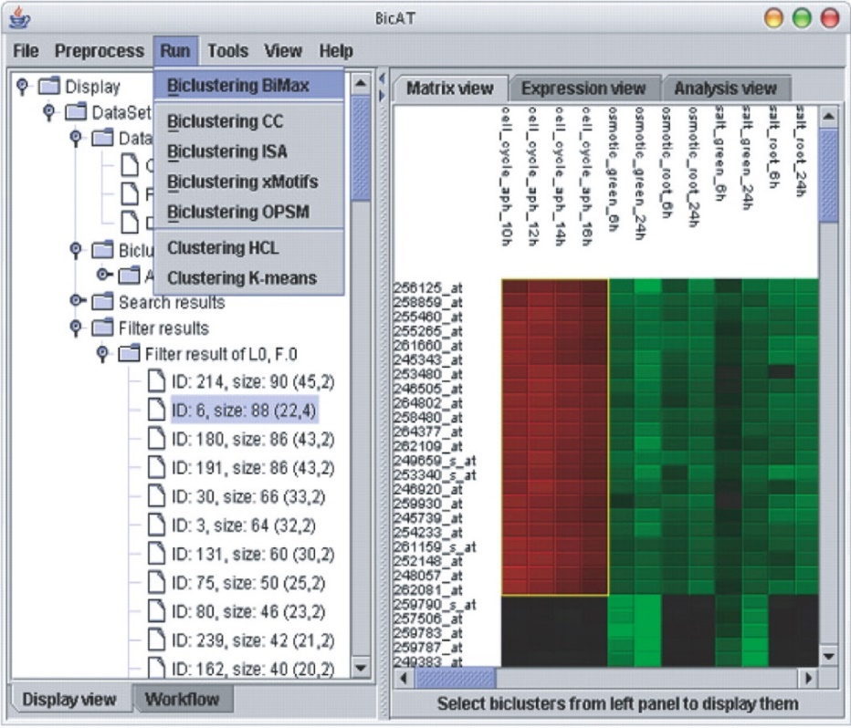
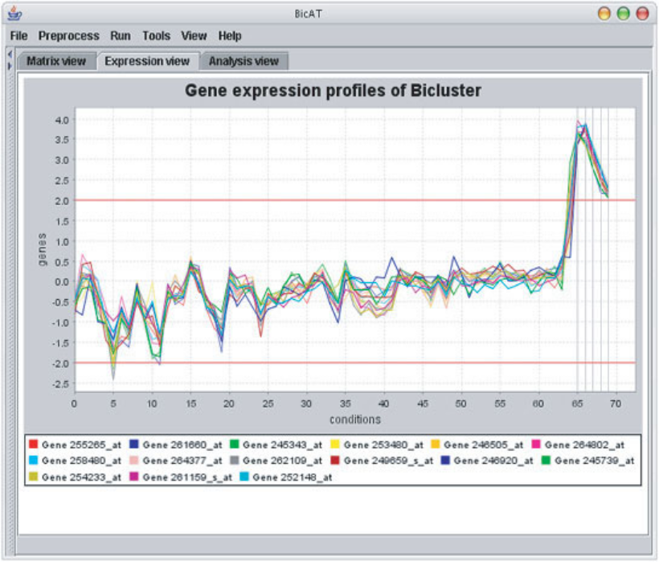
Visualization of Biclusters
7 algorithms provided
Advanced filtering. Heatmap as overview. For the selected bicluster, the gene profile view (PC plot on the right) shows their expression levels in the involved conditions (From: Barkov, 2006).
Bernhard Preim
Notes:
The genes have different colors. This helps slightly to understand the individual genes‘ behavior. To understand the coherence of the cluster, one color for all genes would be sufficient.
Vorlesung 7: Visualisierung von Multiparameter Daten

Slide 35
Visualization of Biclusters: Graph Display
Chained biclusters:
If several documents or high-dimensional data are analyzed, m:n: .. : z relations represent connections between a set of documents/dimensions.
These chained biclusters may be represented as node-link diagramms with biclusters represented by nodes.
Example: Patients share a symptom, a diagnostic procedure (e.g. a biopsy) and a treatment, e.g. a drug.
Bernhard Preim

Slide 36
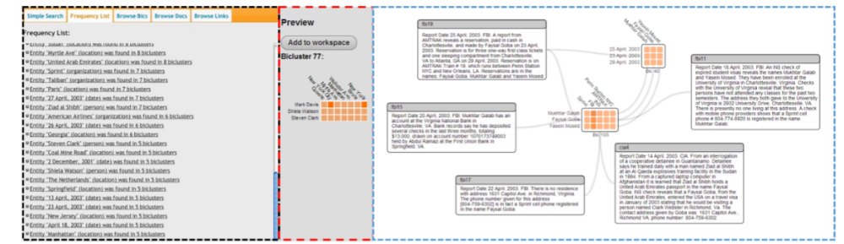
Visualization of Biclusters: Graph Display
Bixplorer: From a set of entities that occur frequently (left) users select a pair and identify biclusters that may be dragged to the workspace and labeled (From: Sun, 2014).
Darkness decodes similarity (according to the additive/multiplicative model).
Chains of biclusters detected efficiently (Wu, 2014)
Bernhard Preim
Notes:
Frequency list: results of searches for a keyword in a document collection order by size (8 to 5 biclusters).
A bicluster is a set of documents and persons mentioned in that document. Thus, some persons are mentioned together in several documents.
Vorlesung 7: Visualisierung von Multiparameter Daten

Slide 37
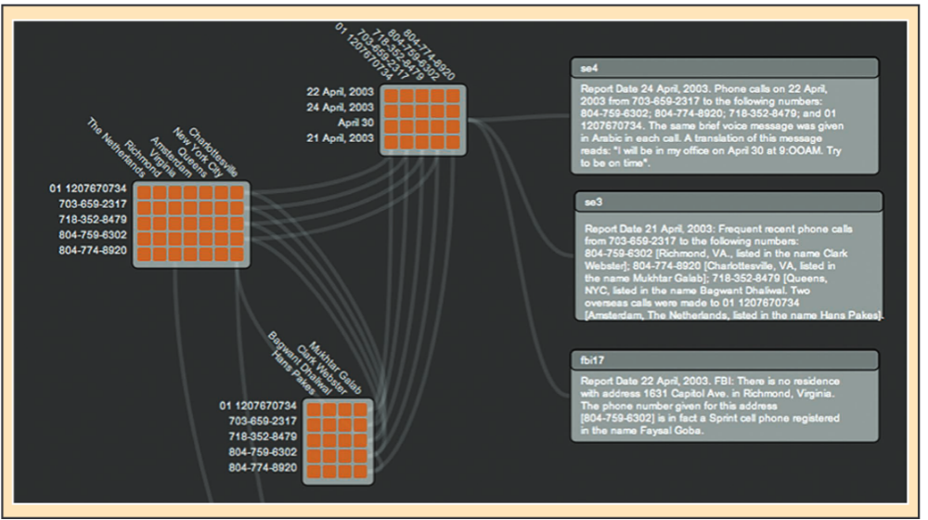
Visualization of Biclusters: Graph Display
Persons
Dates
Places
Phone numbers
Bixplorer: biclusters connected via joined attributes. Items linked to (police) (From: Fiaux: 2013).
Chains used for overlapping biclusters. Edges represent which (subset of) nodes of one bicluster are also part of another.
Bernhard Preim

Slide 38
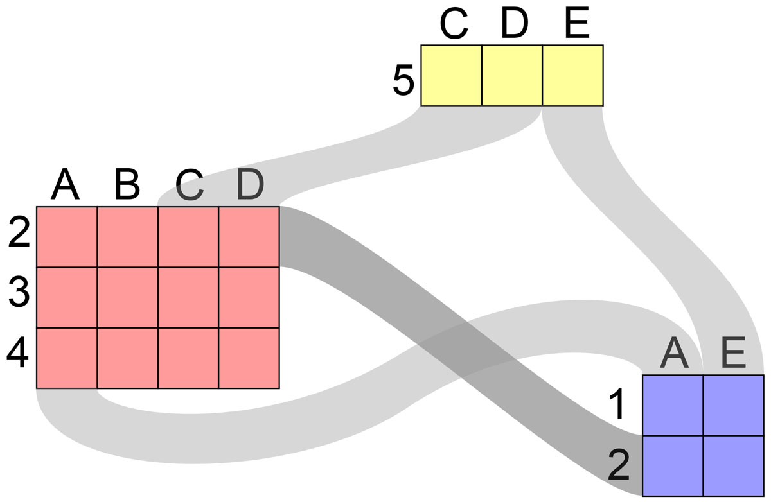
Visualization of Biclusters: Graph Display
(From: Streit, 2014).
Edges between (overlapping) biclusters bundled for an overview. Width encodes frequency of objects in the associated biclusters.
Technique scales well for data of a realistic complexity.
Bernhard Preim

Slide 39
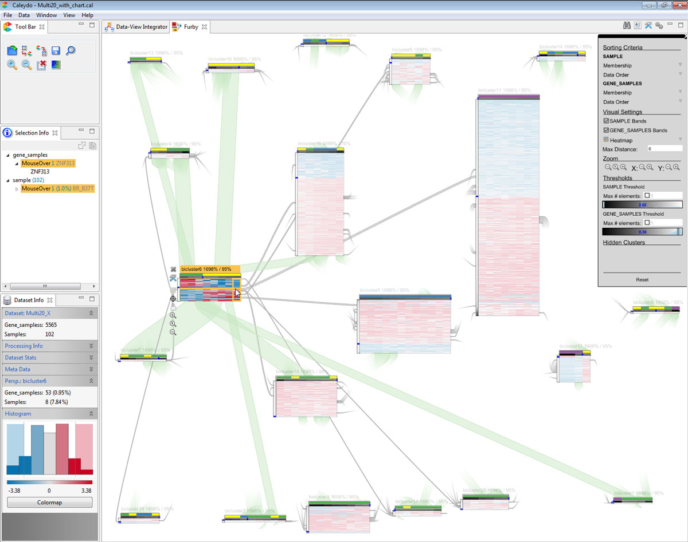
Visualization of Biclusters: Graph Display
Visualization of
gene sample data. Layout (20 biclusters) computed with a force-directed graph layout (overlapping biclusters attract each other).
(From: Streit, 2014).
Bernhard Preim
Notes:
Graph drawing: computation of aesthetically pleasing graphs, numerically efficient graph drawing is a special area. Ulrik Brandes as a key researcher. Force-directed layouts where nodes
Excert repulsive forces and a force equilibrum is computed is an essential family of such algorithms.
Vorlesung 7: Visualisierung von Multiparameter Daten

Slide 40
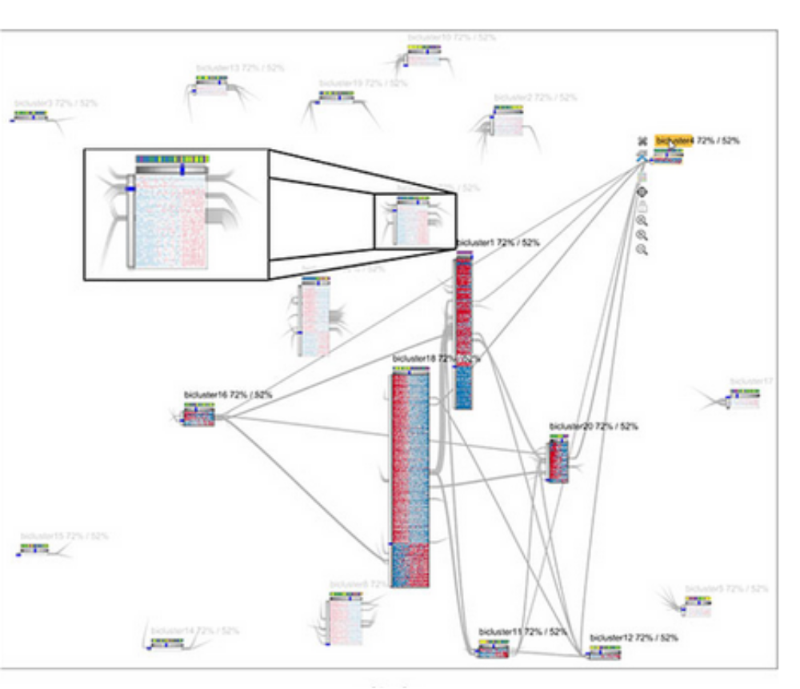
Visualization of Biclusters: Graph Display
Detail visualization for a selected bicluster. To accommodate the additional information, some biclusters faded out. Edges represented with stubs (From: Streit, 2014, Video, up to 2:00).
Bernhard Preim

Slide 41
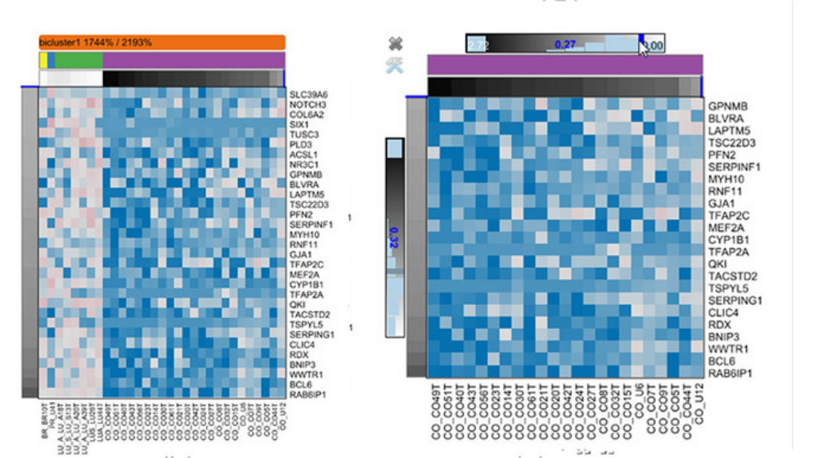
Visualization of Biclusters: Graph Display
Fuzzy biclustering: membership thresholds adapted → biclusters appear/disappear, grow or shrink.
Detail visualization of a bicluster changed after manipulating the threshold.
(From: Streit, 2014).
Bernhard Preim

Slide 42
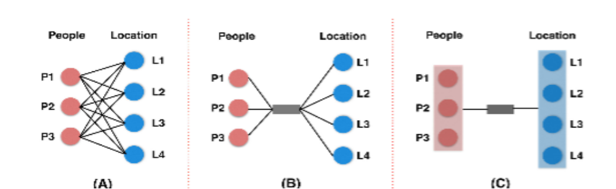
Visualization of Biclusters: Set-based
Bi-Set: From left to right: naive graph representation with edges between elements of both sets. Compact representations reducing clutter by using the complete connectivity between both sets (From: Sun, 2016).
Individual connections may be abstracted in connections between sets.
Bernhard Preim
Notes:
Note how crossing lines are avoided with the set-based techniques (middle, right)
Vorlesung 7: Visualisierung von Multiparameter Daten

Slide 43
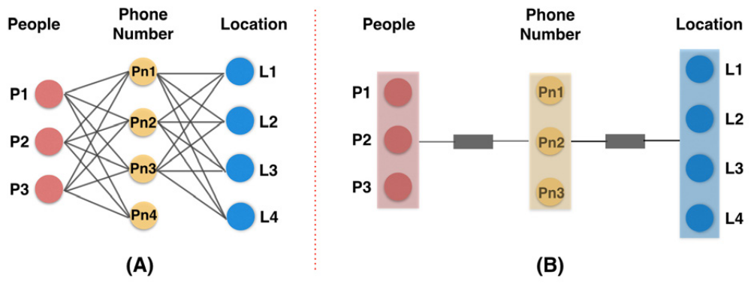
Visualization of Biclusters: Set-based
(From: Sun, 2016).
Bi-Set
Visual abstraction and semantic edge bundling as major concepts for a set-based visualization of biclusters.
Extension to bicluster chains possible.
Nodes represent entities and edges represent relations between sets of entities.
Bernhard Preim
Notes:
Konkretes Beispiel: Die Personen P1, …, P3 haben in ihrer Kontaktliste alle die Phone Numbers Pn1, …, Pn4 und alle waren an den Orten L1, …, L4.
Vorlesung 7: Visualisierung von Multiparameter Daten

Slide 44
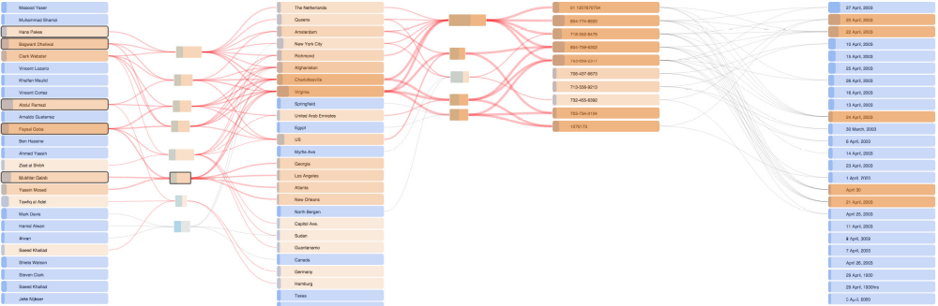
Visualization of Biclusters: Set-based
With entities drawn as lists connected by edge bundles, an „in-between“ layer is added to display properties of the relation, e.g. how many items are involved.
Bi-Set: Chained biclusters. Two color hues distinguish items part of a bicluster or not. Shades of orange represent number of biclusters an item belongs to. Some items (and associated edges) highlighted (From: Sun, 2016)
Bernhard Preim

Slide 45
Visualization of Biclusters: Set-based
Further encodings:
Length of the rectangle represents size of the bicluster.
Small rectangles in the item list view represents frequency in the dataset (e.g. in text documents, where words/names may occur multiple times)
Interaction:
Items may be ordered (based on lexicographic order, frequency, …)
Items may be interactively placed
Bernhard Preim

Slide 46
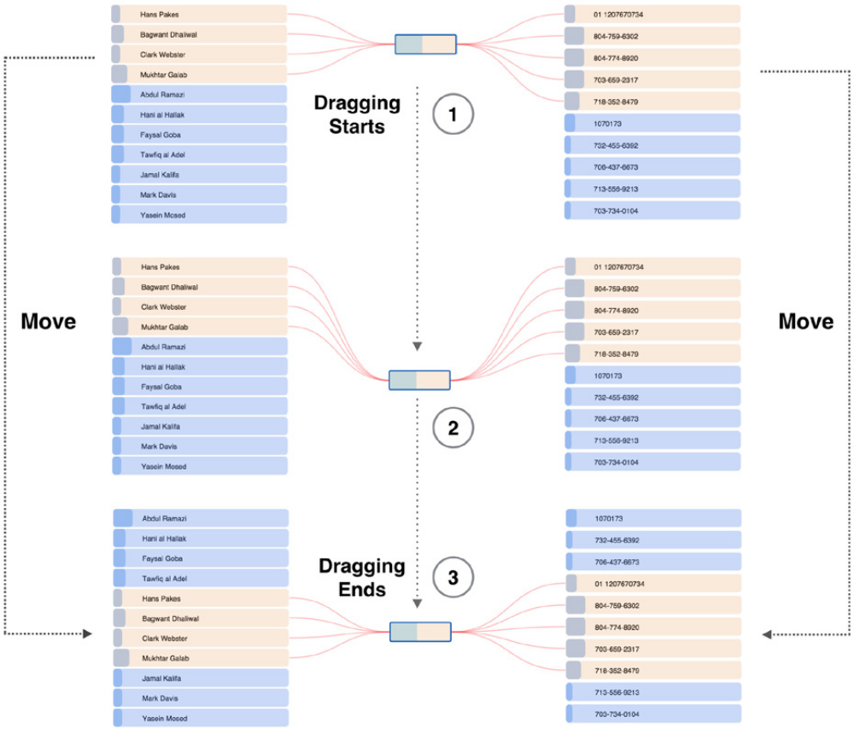
Visualization of Biclusters: Set-based
Interactive adjustment of items. Movement also affects the associated edge bundles (From: Sun, 2016). Edge bundling has a semantic basis; not spatial proximity. Thus it is stable after changes.
Bernhard Preim

Slide 47
Visualization of Biclusters: BicOverlapper
Node-link diagrams for chained biclusters do not scale well.
Multitude of links (edges) leads to clutter that may be reduced with curved lines and edge bundling.
Some techniques avoid edges, e.g. the BicOverlapper.
Biclusters wrapped in hulls that are drawn transparently to reveal overlaps.
Bernhard Preim

Slide 48
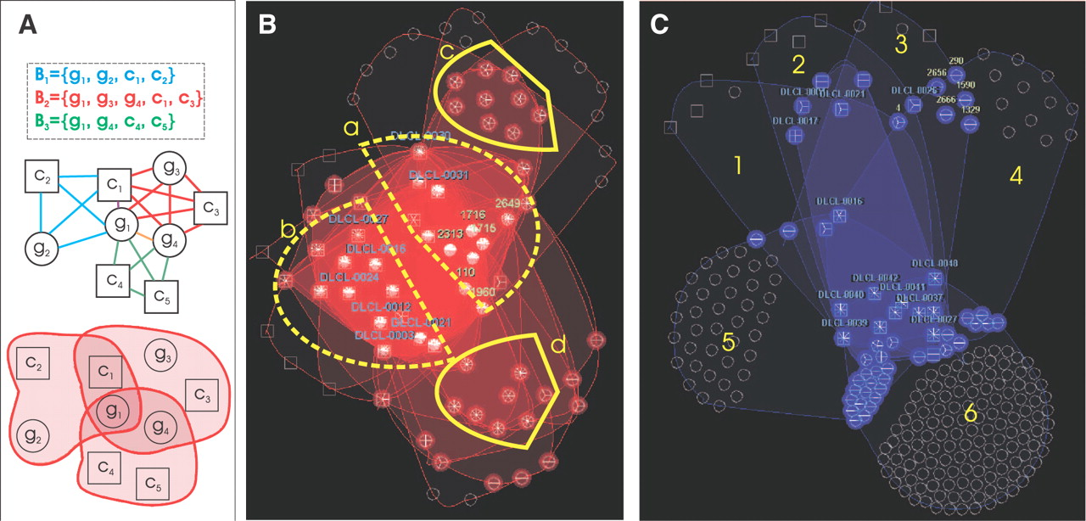
Visualization of Biclusters: BicOverlapper
BicOverlapper: Biclusters representing sets of genes (g) and conditions (c), as bipartite graphs and as Euler diagrams revealing their overlap.
Nodes representing genes and conditions have different shape.
In „real“ data (B and C) more biclusters occur. Within a node link diagramm sets of genes that are part of many biclusters are recognizeable (From: Santamaría, 2008)
Bernhard Preim
Notes:
Euler diagrams can show the overlap between 3 sets. For more than 3 sets, this cannot be guaranteed.
Vorlesung 7: Visualisierung von Multiparameter Daten

Slide 49
Visualization of Biclusters: BicOverlapper
Interactive exploration:
Search for specific nodes (e.g. genes, conditions),
Highlight connections to selected nodes,
Adapt parameters of the force-directed layout algorithm,
Fix node positions,
Navigation through the graph
Bernhard Preim

Slide 50
Applications of Biclusters
Many publications focused on gene expression
Biclusters to identify genes that express similar proteins along different conditions, e.g. when being in different types of tissues (normal, cancer, different subtypes) or after treatment. → Similarity likely reflects the same metabolic pathways.
Other publications (Sun, 2014; Sun, 2016) aim at intelligence analysis based on text occurence in documents and social network analysis
Bernhard Preim

Slide 51
Systems and Techniques
System | Techniques
BicOverlapper (Santamaría, 2008) | Multiple coordinated view framework with Euler diagrams, transparent overlays, Parallel coordinates, comprehensive interaction techniques
Bixplorer (Sun, 2014; Fiaux, 2013) | Node link diagramms, annotations. Only system NOT intended for microarray analysis.
Bicluster viewer (Heinrich, 2011) | Comprehensive interaction techniques and highlighting
BiVisu (Cheng, 2007) | Different cluster models, simple parallel coordinates plot
BicAT: a biclustering analysis toolbox (Barkow, 2006) | First comprehensive tool providing 5 bicluster and 2 cluster algorithms. Gene Profile Plots (parallel coordinates) and matrix visualizations (heat map), extensive preprocessing (normalization schemes)
BiSet (Sun, 2016) | List views for items (rows, columns) and an in-between layer that represents relations
Furby (Streit, 2014) | Visualization aiming for scalability (many biclusters), representation and manipulation of fuzzy memberships
Bernhard Preim

Slide 52
Some Useful Links
Software
FABIA Biclustering Software for gene expression data
Videos
Fuzzy Force-Directed Bicluster Visualization
Biclustering multivariate data for correlated subspace mining
Bernhard Preim

Slide 53
Summary
Biclusters as essential structure in 2D data
In some applications, e.g. gene analysis, more expressive than conventional (subspace) clusters
Biclustering employs algorithms also used for association rule mining
Visualization include
  Node-and-link diagrams for chains of biclusters,
  Reordered adjacency matrices (with duplicate entries)
  Table-based heatmaps and parallel coordinates.
Similar to (subspace) clustering, individual clusters and sets of clusters need to be explored and compared.
„Overview first, ..., details on demand strategy“
Bernhard Preim

Slide 54
Summary
Outlook (see Sun, 2014 and Streit, 2014):
Overview visualizations for large amounts of bi-clusters. Layout computation (also computationally) challenging.
More research needed how individual views should be combined and how this affects sense-making.
How much guidance to support the explo-ration related to large sets of biclusters?
Biclustering should be enhanced with other data mining and statistics tools, e.g. w.r.t. variance and skewness of raw data.
Bernhard Preim

Slide 55
References
Barkow S, Bleuler S, Prelic A, Zimmermann P, Zitzler E. “BicAT: a biclustering analysis toolbox”, Bioinformatics. 2006, 15;22(10):1282-3.
Cheng, Y., Church, G.: Biclustering of expression data. In: Proc. of International Conference on Intellegent Systems for Molecular Biology. (2000) 93-103
Cheng, K., Law, N., Siu, W., Lau, T.: BiVisu: Software tool for bicluster detection and visualization. BMC Bioinformatics 23 (2007) 2342-44
Patrick Fiaux, Maoyuan Sun, Lauren Bradel, C. North, N. Ramakrishnan, A. Endert. 2013. Bixplorer: Visual Analytics with Biclusters. Computer 46, 8 (2013), 90-94.
Grothaus, G., Mufti, A., Murali, T.: Automatic layout and visualization of biclusters. Algorithms for Molecular Biology 1 (2006)
J. A. Hartigan. Direct Clustering of a Data Matrix. Journal of the American Statistical Association, 67(337):123–29, Mar. 1972
Julian Heinrich, Robert Seifert, Michael Burch, Daniel Weiskopf: BiCluster Viewer: A Visualization Tool for Analyzing Gene Expression Data. ISVC (1) 2011: 641-52
Hochreiter S, Bodenhofer U, Heusel M, et al. (2010). "FABIA: factor analysis for bicluster acquisition". Bioinformatics 26 (12): 1520–27
Kaiser, S., Santamaria, R., and Others (2013). biclust: BiCluster Algorithms. R package version 1.0.2.
Mirkin, Boris (1996). Mathematical Classification and Clustering. Kluwer Academic Publishers
B Pontes, R Giráldez, JS Aguilar-Ruiz. „Biclustering on expression data: A review“, Journal of biomedical informatics 57, 163-80
Bernhard Preim

Slide 56
References (II)
Prelic, A. et al. (2006) A systematic comparison and evaluation of biclustering methods for gene expression data. Bioinformatics, 22: 1122–29
Santamaría R, Therón R, Quintales L. BicOverlapper: a tool for bicluster visualization. Bioinformatics. 2008 1;24(9):1212-3.
Santamaría, R.; Therón, R. and Quintales, L. BicOverlapper 2.0: Visual Analysis for Gene Expression. Bioinformatics 30(9), 1785-86, 2014
Maoyuan Sun, Lauren Bradel, Chris L. North, and Naren Ramakrishnan. 2014. “The role of interactive biclusters in sensemaking”, In Proc. of the ACM SIGCHI Conference (CHI '14).
Maoyuan Sun, Peng Mi, Chris North, Naren Ramakrishnan: BiSet: Semantic Edge Bundling with Biclusters for Sensemaking. IEEE Trans. Vis. Comput. Graph. 22(1): 310-319 (2016)
Marc Streit, Samuel Gratzl, Michael Gillhofer, Andreas Mayr, A. Mitterecker, S. Hochreiter: Furby: fuzzy force-directed bicluster visualization. BMC Bioinformatics 15(S-6): S4 (2014)
Tanay. R. Sharan, and R. Shamir, "Biclustering Algorithms: A Survey", In Handbook of Computational Molecular Biology, Edited by Srinivas Aluru, Chapman (2004)
T. Uno et al., An efficient algorithm for enumerating closed patterns in transaction databases, Int. Conf. Discovery Science, 2004, pp. 16-31
H. Wu, J. Vreeken, N. Tatti, and N. Ramakrishnan. Uncovering the plot: detecting surprising coalitions of entities in multi-relational schemas. Data Mining and Knowledge Discovery, 28(5-6):1398–1428, 2014.
Panpan Xu, Nan Cao, Huamin Qu, John T. Stasko: Interactive visual co-cluster analysis of bipartite graphs. IEEE PacificVis, 2016: 32-39
Maxence Vandromme, Julie Jacques, Julien Taillard, Laetitia Jourdan, Clarisse Dhaenens: A Scalable Biclustering Method for Heterogeneous Medical Data. MOD 2016: 70-81
Zaki, M., Hsiao, C. Charm: An efficient algorithm for closed itemset mining. SDM, vol. 2 (2002), 457–73
Bernhard Preim

