Slide 1
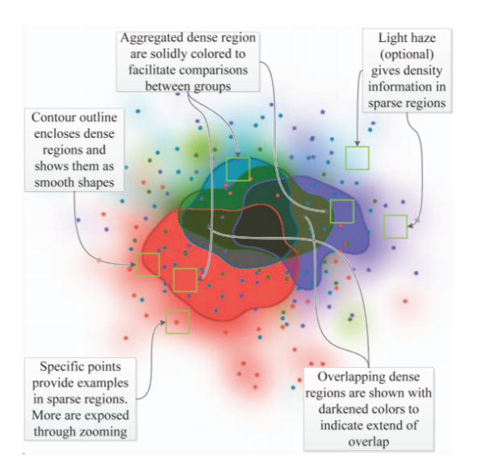
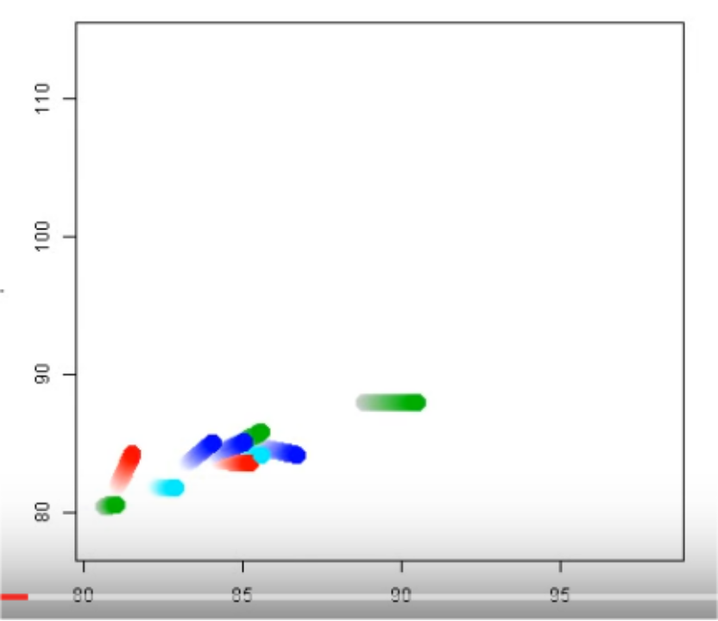
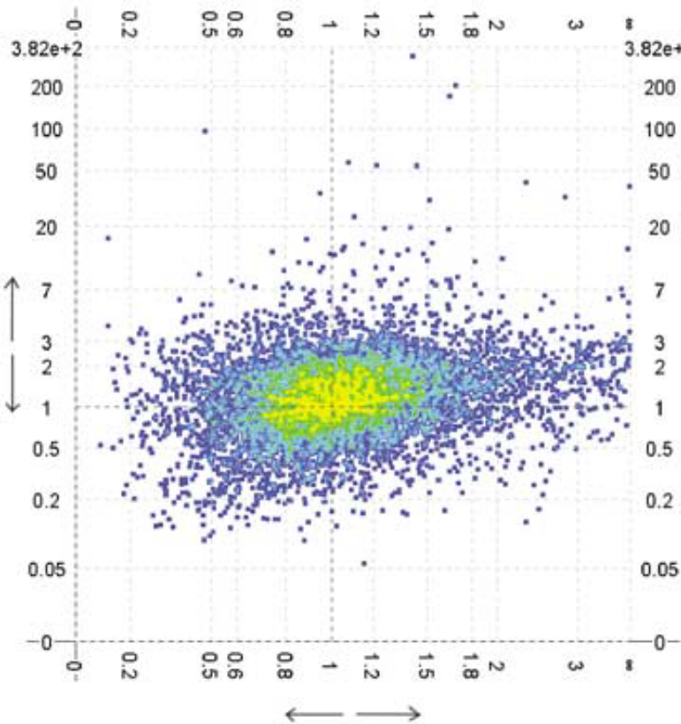
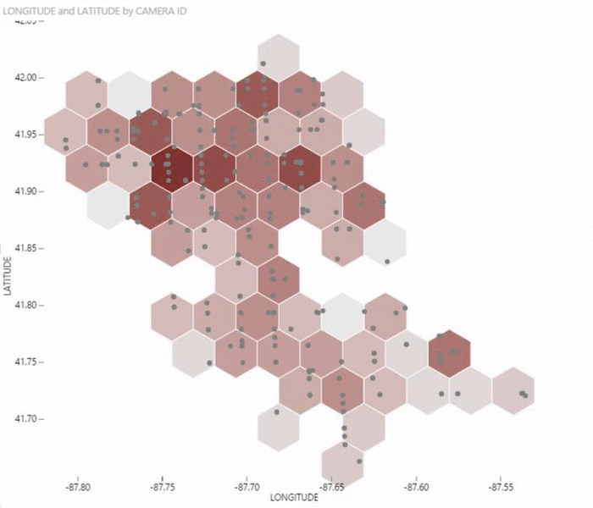
Scatterplot-Based Visual Representations
Notes:
Vorlesung 7: Visualisierung von Multiparameter Daten

Slide 2
Outline
Introduction
2D and 3D Scatterplots
Transformation and Distortion
Multiclass Scatterplots
Scatterplot Matrices and GPLOMs
Advanced Scatterplot-Based Representations
  Binning and Density Plots
  A scaleable technique: Splatter Plots
  Scagnostics-Based Exploration
  Animated Scatterplots
  Scatterplots on Small Screens
Bernhard Preim

Slide 3
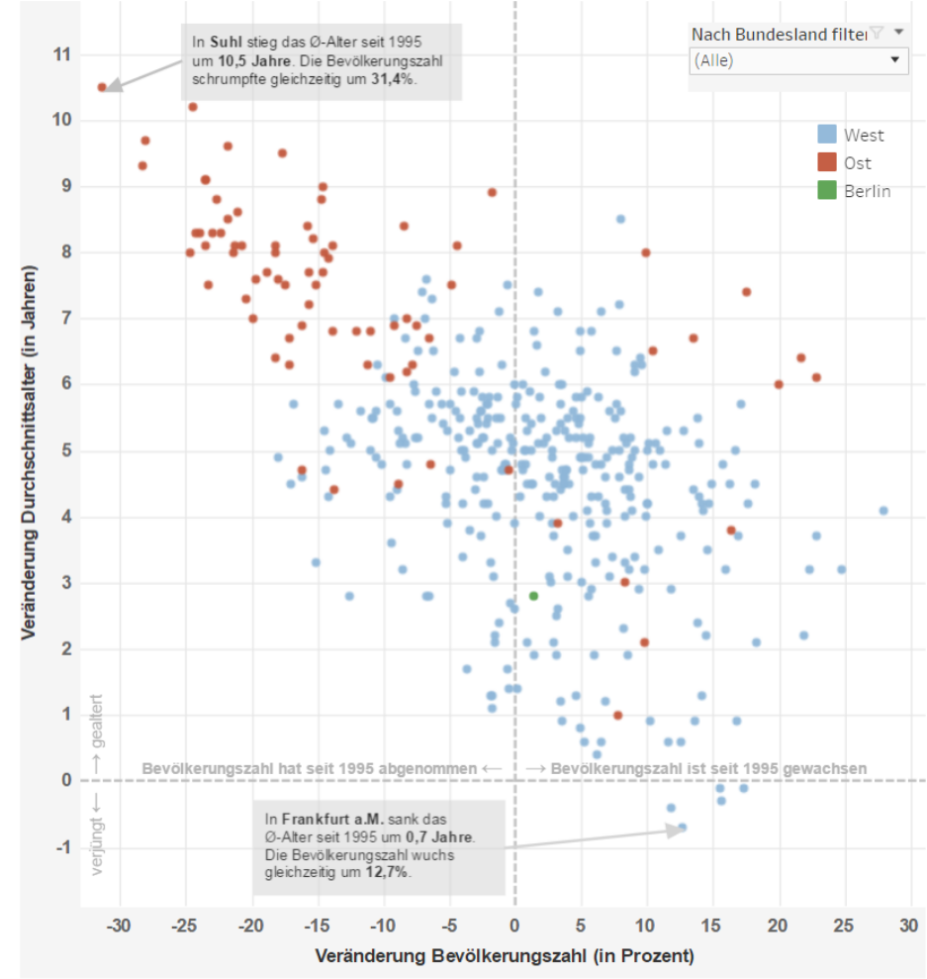
Introduction
Germany gets older. Only in 5 of 432 districts average age decreased.
Often, the population decreased and got older.
Interaction:
Tooltips with precise numbers
Filtering (Bundesland)
(Screenshot from zeit.de, created with Tableau)
Bernhard Preim
Notes:
Narrative visualization
Vorlesung 7: Visualisierung von Multiparameter Daten

Slide 4
Introduction
Scatterplots
represent distributions of 2 continuous variables x and y based on a sample (x_{i}, y_{i})
serve to study how y is influenced by x (type and amount of association)
based on small glyphs (circles, rectangles) representing the value of objects in 2D
  Design decisions: glyph shape, size, fill color, border color, transformation, labeling of axes
represent sparse regions and high-density areas
assessed based on Gestalt laws (perceptual grouping)
familiar since the 19th century (Tufte, 1983)
Bernhard Preim

Slide 5
Introduction
Scatterplots serve a number of purposes (Tufte, 1983):
Analysis of clusters
Analysis of correlations
Identification of outliers
Comparison of different datasets plotted on the same axes (changes over time, comparison of numbers in different countries, differences man/woman, …)
Bernhard Preim

Slide 6
Introduction
Scaleability:
Traditional scatterplots: limited to 2D and to a few thousand elements
Beyond the limit: visual clutter and overplotting hamper the perception of groups, correlations, …
Modern techniques aim at reducing/avoiding the overplotting problem.
Bernhard Preim

Slide 7
Introduction
Human perception of regression in scatterplots (and line charts): for a wide range of angles, linear trends are perceived quite correctly.
Also quadratic and exponential trends are correctly perceived
Influence of outliers underestimated.
Display of regression lines may be restricted to cases with outliers (Correll, 2017, video).
Bernhard Preim

Slide 8
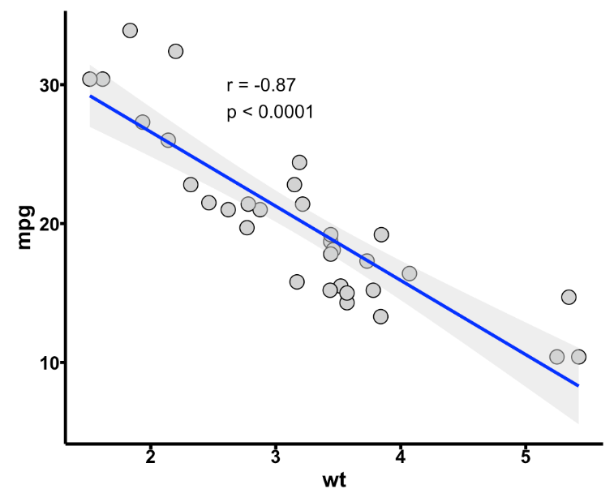
Introduction
Human perception of correlation not perfect (Rensink, 2010).
Correlations (r) between 0.2 and 0.6 underestimated.
With r < 0.2 no correlation perceived.
Display of regression line and correlation coefficient support quantitative analysis.
To convey uncertainty: add confidence interval around the regression line
Variables (miles per galon and weight of cars) correlate negati-vely with a strong coefficient (From: Link)
Bernhard Preim

Slide 9
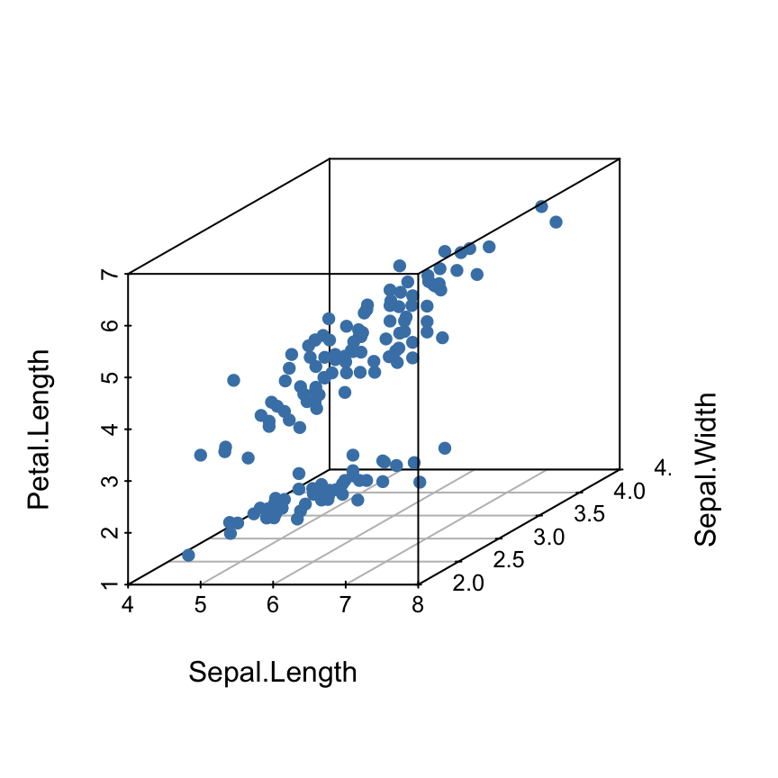
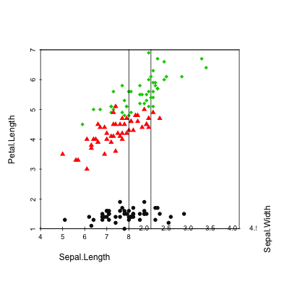
2D and 3D Scatterplots
Distributions of 3 variables depicted with 3D scatterplots
3D scatterplot requires a view angle and facilities to change the viewpoint
Screenshot of the R System (From: Link)
Bernhard Preim

Slide 10
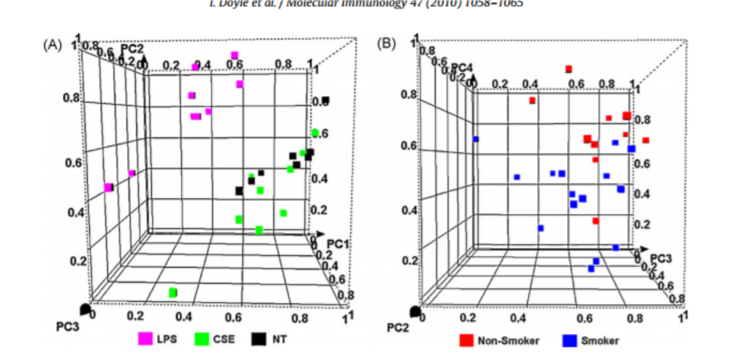
2D and 3D Scatterplots
3D Scatterplots from gene analysis paper (From: Dolye, 2010)
„Switching to 3D rarely helps and often hurts, it has higher time costs and prvides less class separability“
„the time of interaction is high because the user must spend significant time rotating the view to see the structure from different angles“ (Sedlmaier, 2013)
Bernhard Preim

Slide 11
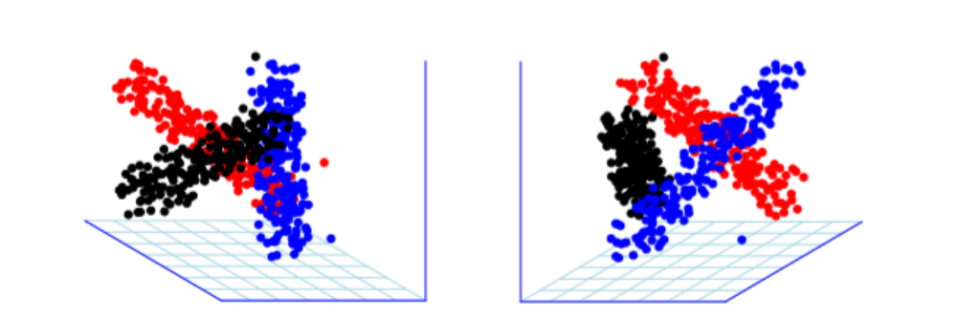
2D and 3D Scatterplots
Three classes shown in 3D scatterplots. Only by considering a number of view-points the full picture becomes obvious (From: Sedlmaier, 2013).
Real-world data more complex and classes not easy to separate.
Bernhard Preim

Slide 12
2D and 3D Scatterplots
3D Scatterplots
aim to exploit the human capabilities of understanding spatial relations
suffer from occlusion problems and require mentally demanding interaction
Studies indicate: 3D scatterplots not favorable. Human experience relates to 3D shapes, not to 3D point clouds.
Depth cues, such as shadow and shading, do not make sense for point clouds.
Bernhard Preim

Slide 13
2D and 3D Scatterplots
In case of three dimensions (x,y,z), a layout with a scatterplot matrix (x,y), (y,z), (x,z) and a 3D scatterplot may be favorable.
Only advantage of a 3D scatterplot: more integrated view of three dimensions (Sedlmaier, 2013).
Bernhard Preim

Slide 14
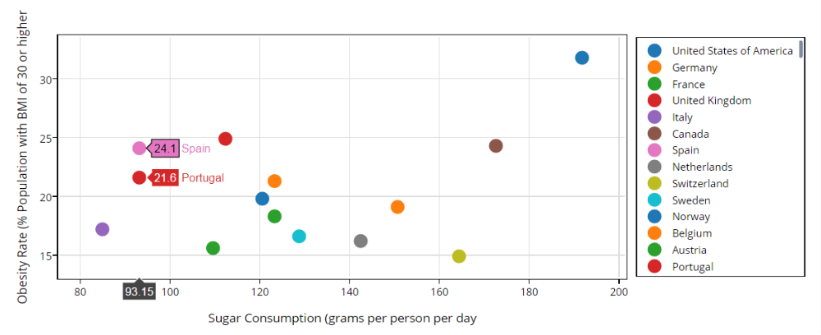
2D Scatterplots
Interaction:
Zoom In/Zoom Out
Autoscale
Select (rectangle/lasso) for a detail view
Hover
  Show closest data
  Compare two closest data
On hover closest data are labeled for comparison (Screenshot from Plotly, Link)
Bernhard Preim
Notes:
Also aspects of narrative visualization
Vorlesung 7: Visualisierung von Multiparameter Daten

Slide 15
2D Scatterplots: Fight Overplotting
Major goal of advanced techniques: scaleabilty w.r.t. element number and/or dimensions and classes.
Metrics of visual clutter as benchmarks:
  Screen-space statistics (number of used pixels, number of free pixels, „collisions“ where 2 elements are mapped to the same pixel, collision ratio) (Bertini, 2006)
  Ideally, SP-based representation has the same complexity metrics over a wide range of data.
Clutter reduction in information visualization - general issue, related to parallel coordinates, tables, … (see Ellis and Dix, 2007 for a taxonomy)
Bernhard Preim

Slide 16
2D Scatterplots: Fight Overplotting
Clutter reduction (Ellis and Dix, 2007):
Appearance: Change colors, transparency, …
Geometric: Filter, adjust sampling, distortion
Re-ordering: relevant for tables, parallel coordinates; not for scatterplots
For scatterplots, ideally a technique:
Avoids overlap, or
Indicates the amount of overlap
Is scaleable, and
Is adjustable (control clutter interactively)
Bernhard Preim

Slide 17
2D Scatterplots: Fight Overplotting
Overplotting distorts the perception of correlations and groupings.
Solutions for the Overplotting Problem (Few, 2008):
Appearance: Adjust transparency to the number of elements
Appearance: Adjust darkness to the number of elements
Geometric: Reduce the glyph size
Geometric: Change glyph shape, e.g. from circle to + shape
Geometric: Jittering (slightly displace points by adding noise,
often considered the best method)
  Requires automatic solution
  Often justified by rounded data (70 kg; actually [69.5, 70.5]
Widely available in vis. analytics products
Bernhard Preim

Slide 18
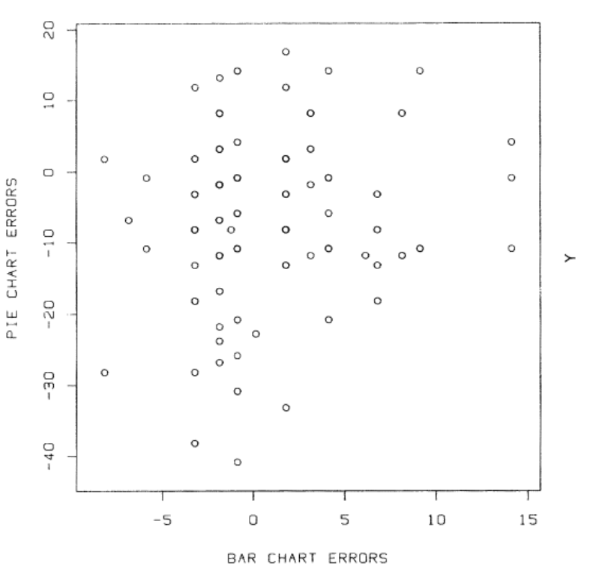
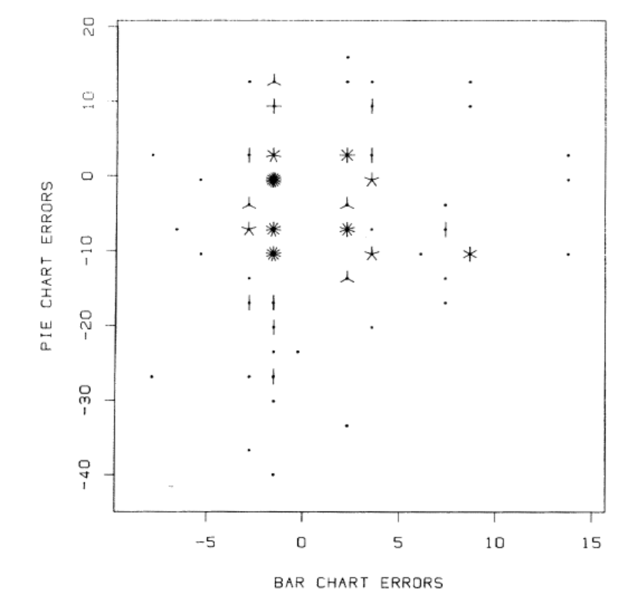
2D Scatterplots: Fight Overplotting
Classic example: A conventional SP and a SP with „sunflower glyphs“ to indicate overplotting.
Each bar represents one instance indicating up to 15 overlaps (From: Cleveland, 1984).
+ The cluster around (0,0) becomes obvious.
- Each glyph consumes at least 49 pixels.
Bernhard Preim

Slide 19
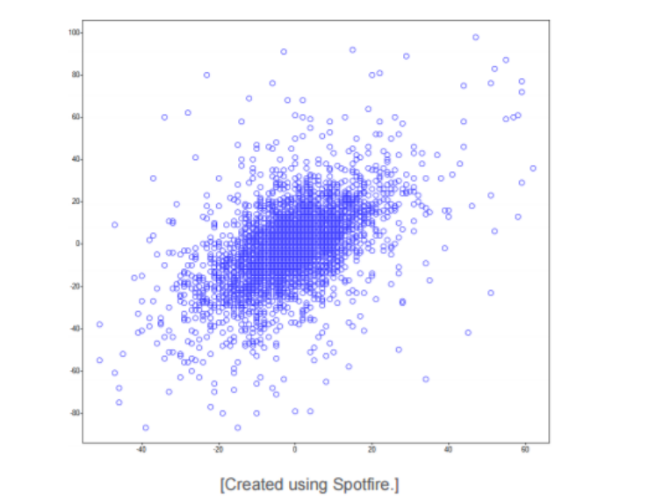
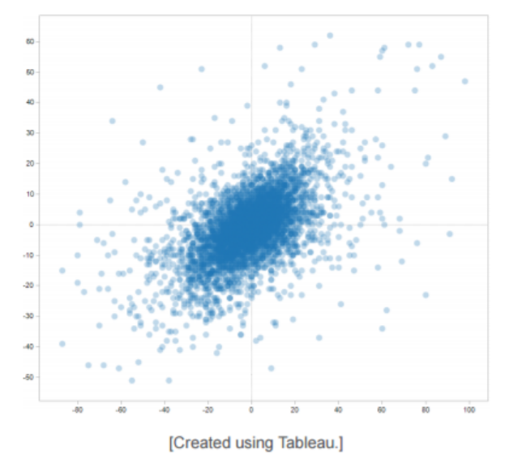
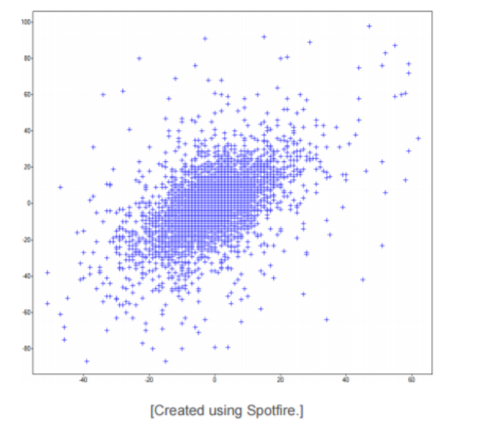
2D Scatterplots: Fight Overplotting
Typical solutions to overplotting
Left: no adjustment, middle:Transparency adapted to point number; right: glyph shape adjusted (From: Few, 2008)
Could be further enhanced with lens-based interaction: Show more details in a lens region controlled by the user.
Bernhard Preim

Slide 20
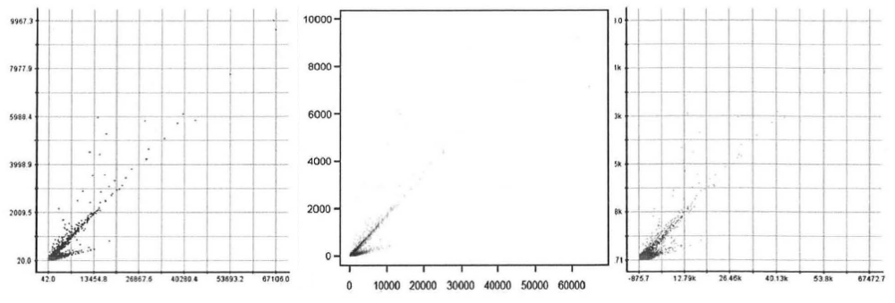
2D Scatterplots: Fight Overplotting
Left: Classic scatterplot.
Middle: Opacity modulation indicates: few points outside the diagonal lines.
Right: Jittering cannot fully solve the overlap problem (From: Keim, 2010).
Bernhard Preim

Slide 21
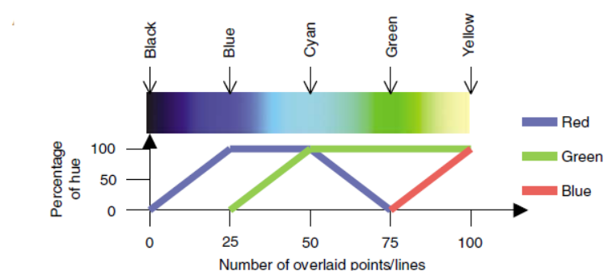
2D Scatterplots: Fight Overplotting
Color indicates the amount of overplotting and thus the central cluster (From: Craig, 2005).
Specific color scale matters: when mapped to a blue-yellow scale, higher numbers better perceived compared to a „red-green“ or gray value scale (Bertini, 2006).
Bernhard Preim

Slide 22
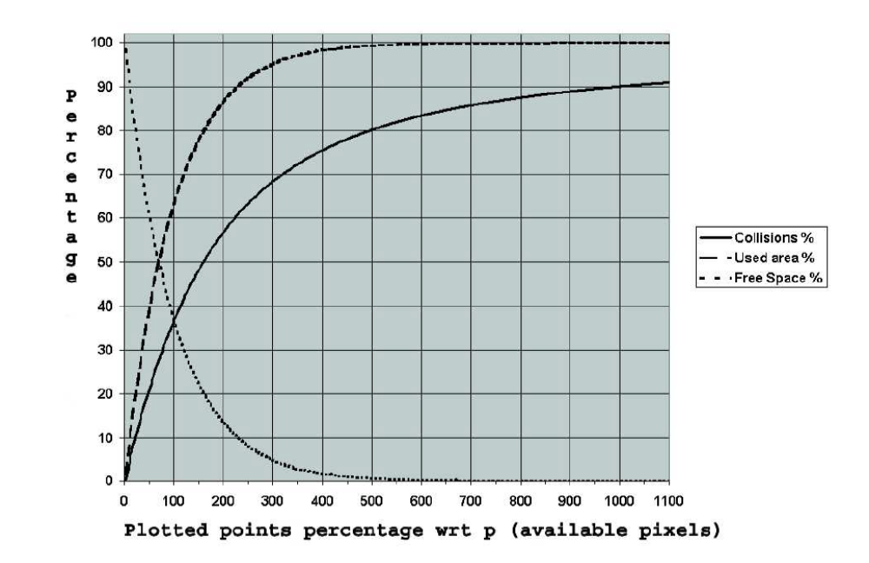
2D Scatterplots: Fight Overplotting
Perceptual maximum trade-off for a conventional SP
Maximum trade-off for a SP with transparency/color modulation
For data that follows a normal distribution, the %screen space and the #collisions increase and the %free space decreases with more data (From: Bertini, 2006).
Bernhard Preim

Slide 23
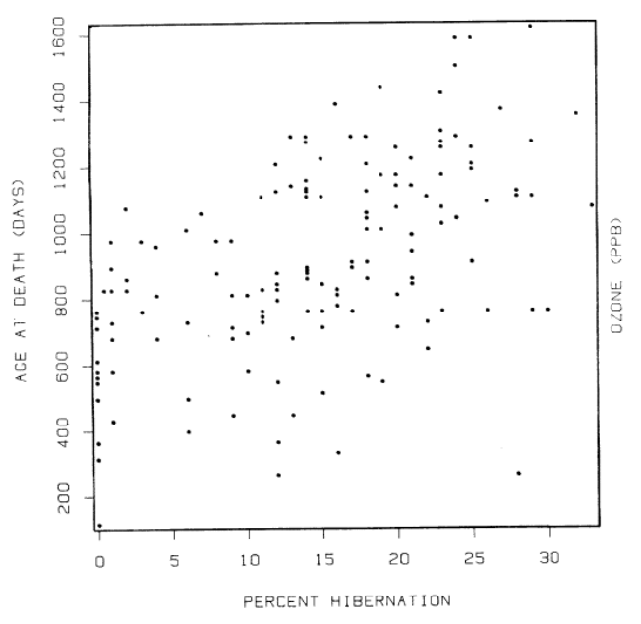
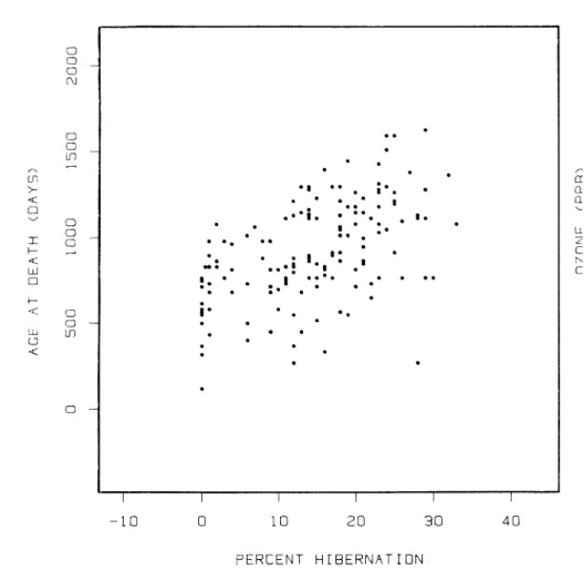
Transformation and Distortion
Scale matters: Left: SP scaled to exactly the extent of the data (x_{min}, y_{min}) (x_{max}, y_{max}). Right: SP scaled twice that range (From Cleveland, 1984).
Perceived amount of correlation increased by 40% on average from left to right.
Bernhard Preim

Slide 24
Transformation and Distortion
What is the right scale?
The frame should not be
too close to the data,
too far away from the data
Frame with coordinates (0,0) (1,1) → minimum value (x_{min}, y_{min}) should be mapped to a point between in [0.05, 0.10] and maximum value to [0.90-0.95] (in x and y) (Cleveland, 1984).
Bernhard Preim

Slide 25
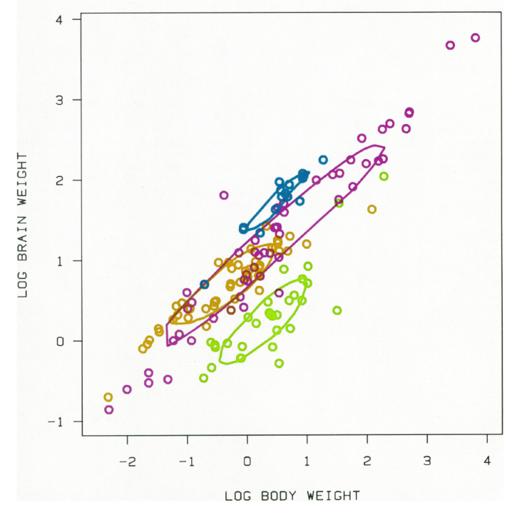
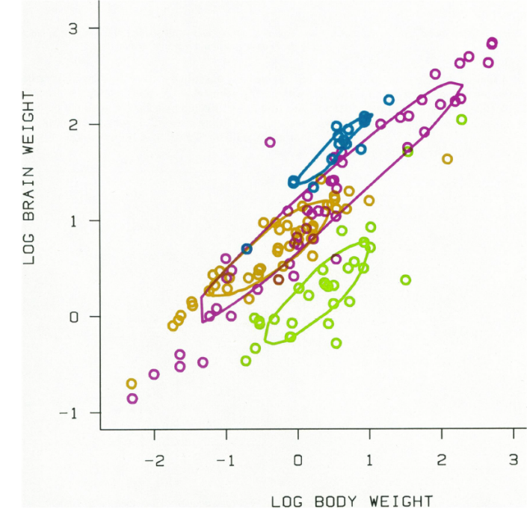
Transformation and Distortion
Outliers matter:
Cause reductions in point cloud size since the majority of the points is compressed in a small region.
Provide SPs with and without outliers (Cleveland, 1984).
(From: Cleveland, 1984)
Bernhard Preim

Slide 26
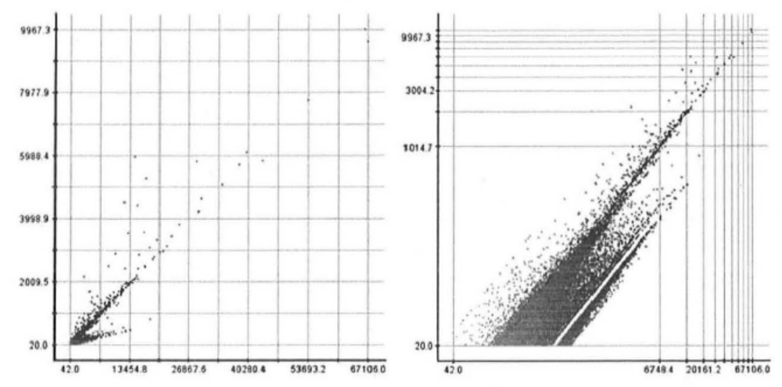
Transformation and Distortion
Often, a linear scale leads to large sparse regions. Logarithmic or square-root scaling for one or both axes may improve the display.
Linear and logarithmic scale. Grid indicates the stretched and compressed regions (From: Keim, 2010).
„Log-scales offer a new and often effective representation of data“
Bernhard Preim

Slide 27
Transformation and Distortion
Distortion-based techniques
Increase space for high-density areas and
Compress space for low-density (sparse) regions
→ reduce overlaps and overplotting at the expense of a more difficult-to-interpret visualization
Users should be
  Aware of the distortion, e.g. by showing grid lines
  Able to control the amount of distortion, e.g. with a slider or just with mouse movement
Bernhard Preim

Slide 28
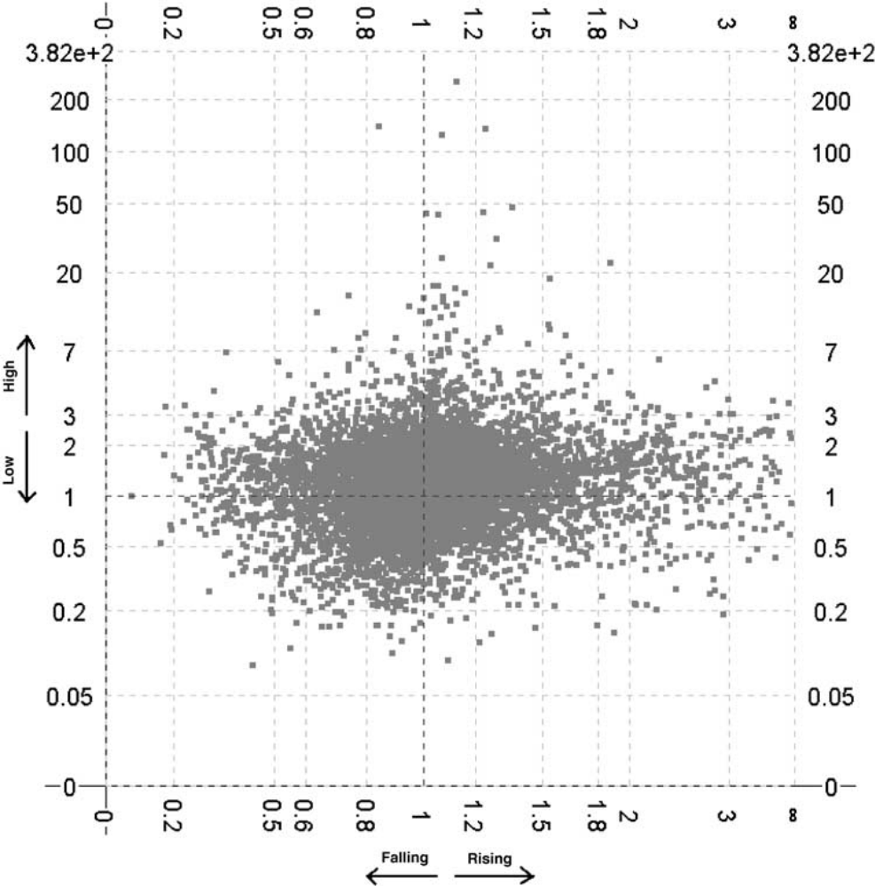
Transformation and Distortion
Gene expression data.
Changes of gene expression relevant → relative values indicate falling/rising values.
Logarithmic scale.
Jittered displacement (discussed later) reduces overlaps (From: Craig, 2005)
Bernhard Preim

Slide 29
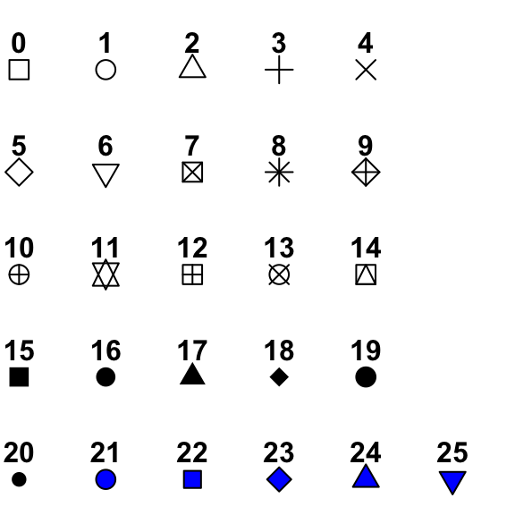
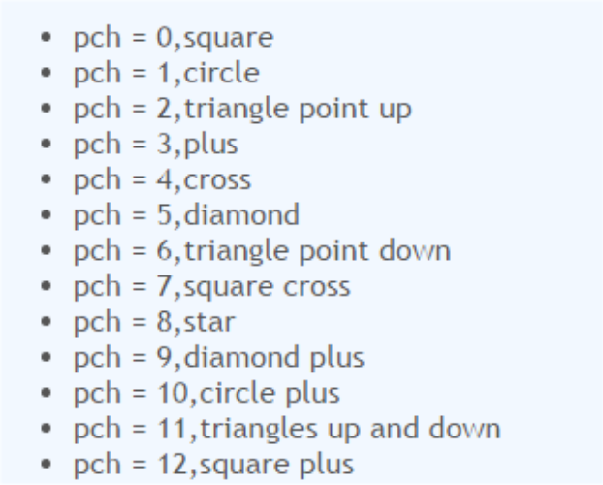
Multiclass Scatterplots
Often, entries in a scatterplot represent different classes, e.g. the relation between two variables is assessed to understand differences between healthy and ill persons, woman and men, …
Different classes represented by
  Colors, using the hue component for discrimination, or
  Glyph shapes
Glyph types of the R System (From: Link)
Bernhard Preim

Slide 30
Multiclass Scatterplots
Color supports visual discrimination (for healthy persons) better than shape.
Saturated colors with maximum differences perceived as unesthetic (Las Vegas method of color coding, Cleveland, 1984).
Essential goal: users perceive the distribution of each class separetely (as if other classes are not there) and in relation to the overall distribution. How does a subpopulation differs from the global mean?
Bernhard Preim

Slide 31
Scatterplot Matrices and GPLOMs
To visualize higher dimensional data, create a matrix where each non-diagonal element is a scatterplot showing the relation between a pair of variables.
Number of scatterplots grows quadratically.
→ SPLOMS appropriate for low-dimensional data (following examples, n=4, n=5)
Bernhard Preim

Slide 32
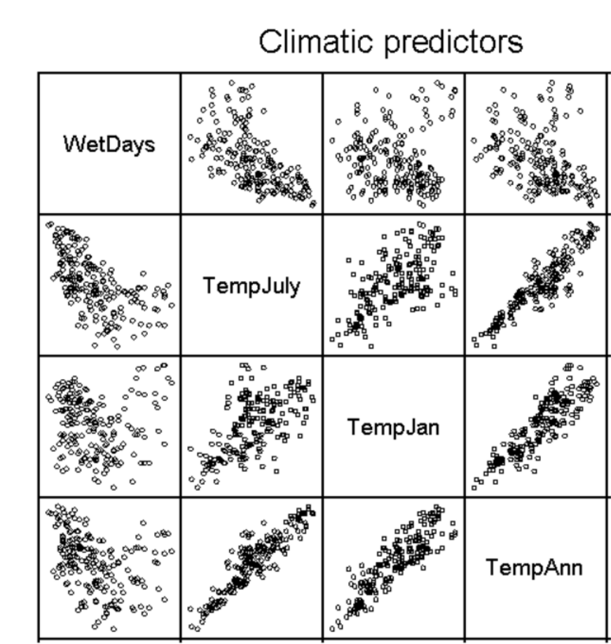
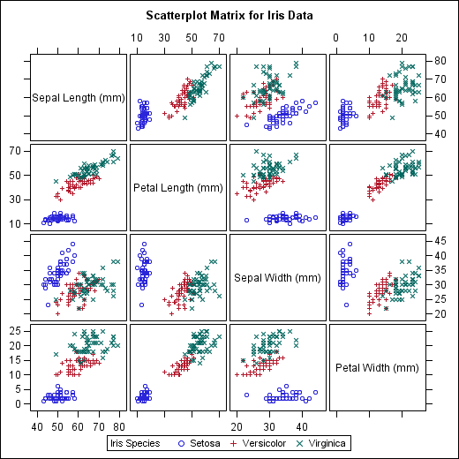
Scatterplot Matrices and GPLOMs
Single class and multiclass scatterplots matrices (also called Trellis display). High redundancy. Diagonal elements only used for a label (From: Link1 and Link2)
Bernhard Preim

Slide 33
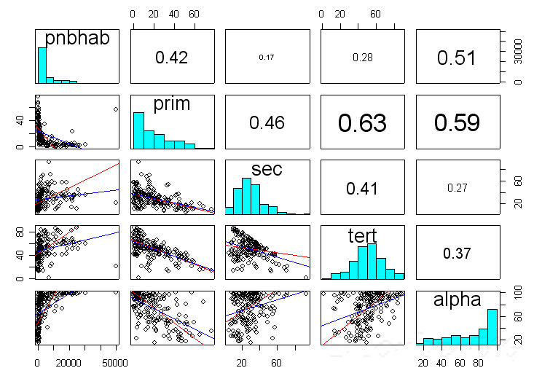
Scatterplot Matrices and GPLOMs
Better use of the space (but not optimal). Diagonal elements contains a histogramm and elements above the diagonal correlation coefficients (From: Link)
Bernhard Preim

Slide 34
Scatterplot Matrices and GPLOMs
Scaling is crucial. If possible, all elements of a SPLOM should have the same scale. Disadvantage: In some scatterplots, elements may be concentrated in a small area.
Completely different scales and transformations within one SPLOM, e.g. linear, log-linear, log-log, … very hard to interpret
Bernhard Preim

Slide 35
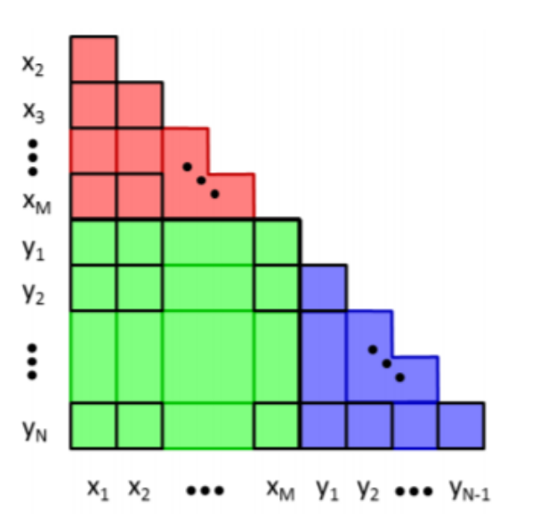
Scatterplot Matrices and GPLOMs
Generalized Pair Plot Matrix (GPLOMS) for the display of categorical variables. Pairs may represent
Two scalar values,
Scalar and a categorical value and
Two categorical values (Im, 2013).
Categorical variables x₁, x_{m} and scalar variables y₁, y_{m} (From: Im, 2013).
Blue area → scatter plots are used.
Green area → bar charts (each bar represents one value of the categorical variable).
Red area → heatmaps for categorical/categorical data
Bernhard Preim

Slide 36
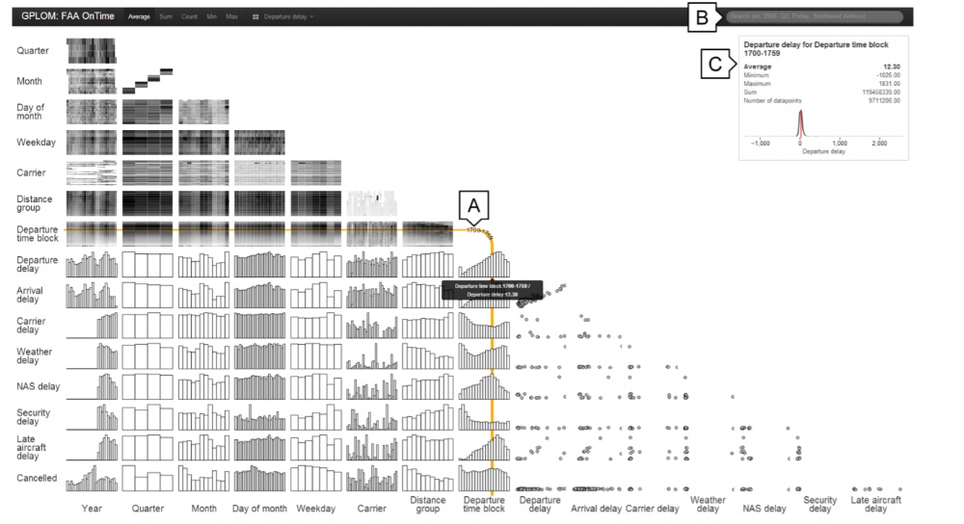
Scatterplot Matrices and GPLOMs
Generalized pair plot matrix supporting comparisons of scalar, categorical and mixed scalar/categorical distributions (From: Im, 2013).
Bernhard Preim

Slide 37
Scatterplots and Regression
SPs serve to assess the influence of x on y → compute regression lines (linear global correlation).
Correlations often only locally linear, strongly affected by outliers or non-linear.
→ compute local regression
Robust local regression restricts influence of outliers.
If no strong linear correlation exists, a quadratic correlation may be analyzed.
Bernhard Preim

Slide 38
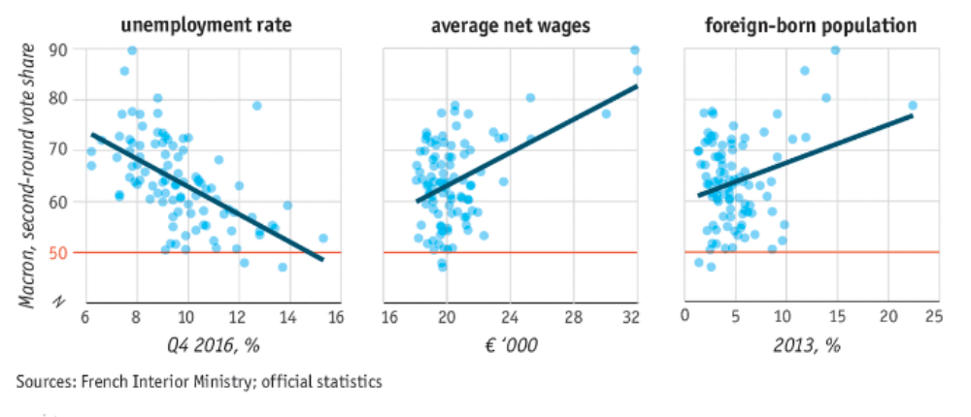
Scatterplots and Regression
Voters of Emanuel Marcon dominate in regions with low unemployment, middle to high salaries. Portion of immigrants has little influence
(From: The Economist).
Bernhard Preim

Slide 39
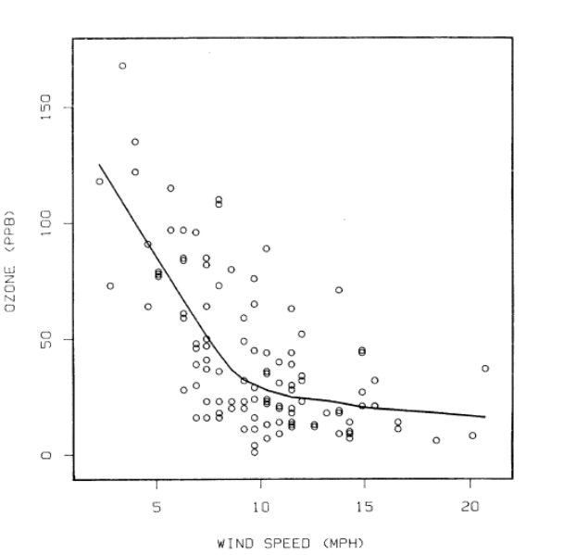
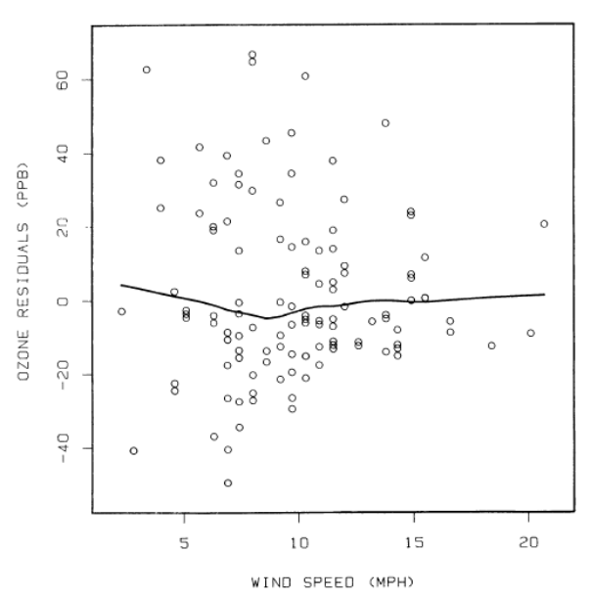
Scatterplots and Regression
(From: Cleveland, 1984).
Robust local regression lines („smoothings“).
Right: To indicate the deviation → display adapted (deviations to the line are shown).
Local regression: for each x-value, compute a weighted average of n points with the most similar x-values (least square fitting)
(From: Cleveland, 1984).
Bernhard Preim

Slide 40
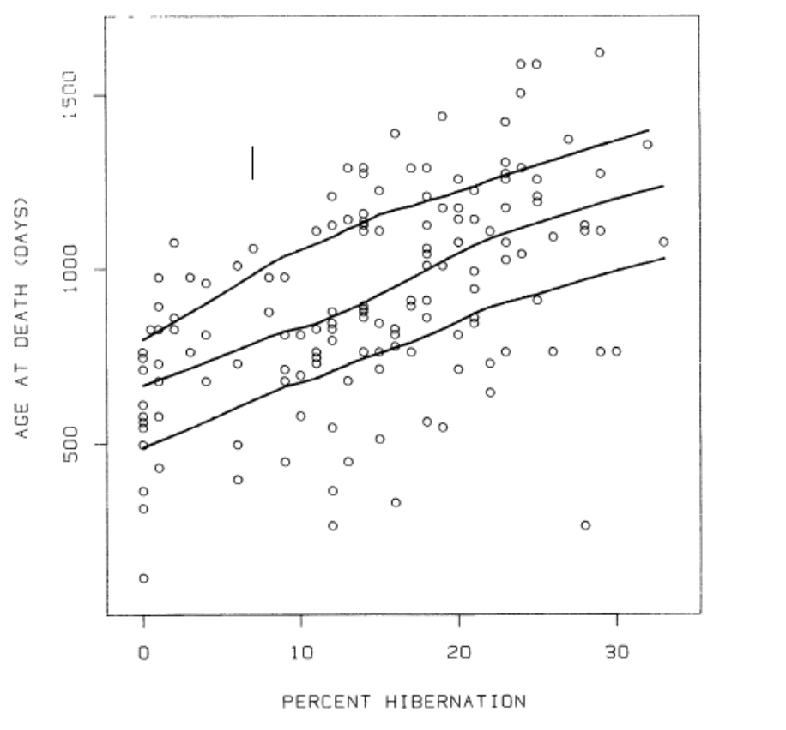
Scatterplots and Regression
(From: Cleveland, 1984).
Low, middle and high “smoothings” determined. For each x-value, the same values considered and split into 1/3 with the highest, middle and lowest y-values → linear correlation in all regions
Bernhard Preim

Slide 41
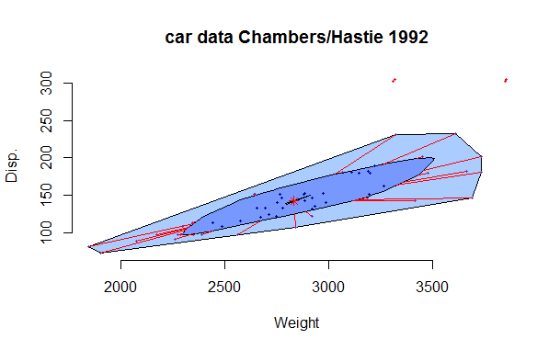
Bag Plots
Generalization of Box Plots to 2D (Rousseeuw, 1999):
Bag: A convex polygon surrounding the „depth median“ containing n/2 points
Depth Median: generalization of the median in n dimensions.
In 2D: a point such that any line that goes through that point divides the set of points in two roughly equal subsets.
Fence: Outer convex polygon that inflates the bag with a factor (usually 3). Convex hull of the related points.
Remaining points considered as outliers.
(From: Wikipedia)
Bernhard Preim

Slide 42
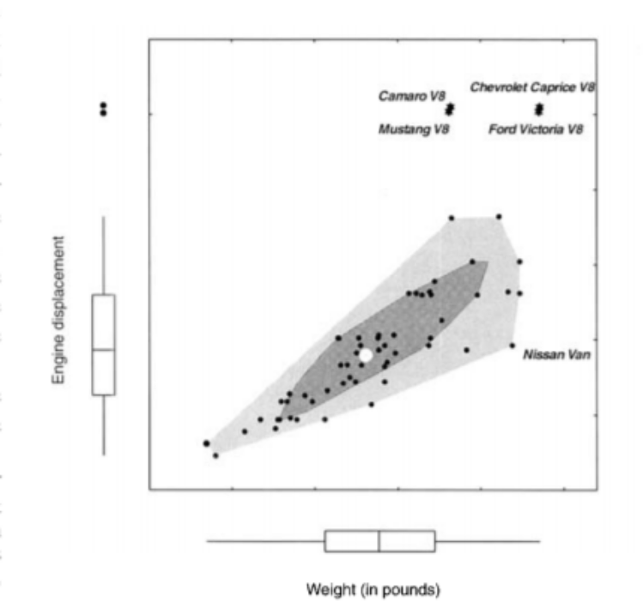
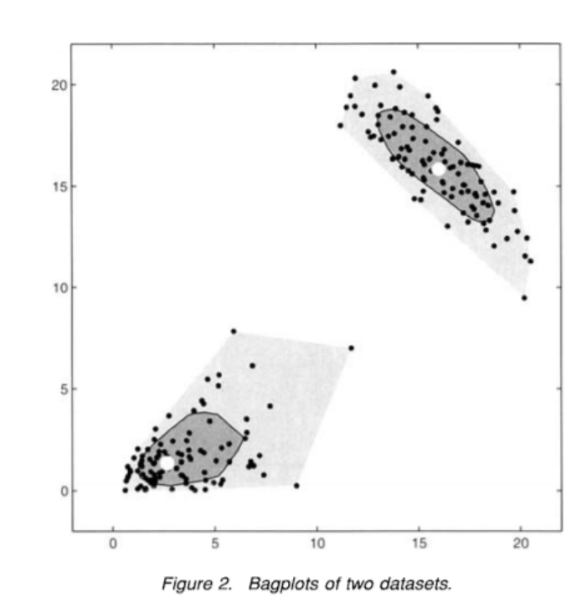
Bag Plots
Balanced distribu-tion (elliptical shape), negatively correlated
Skewed distribution (note the center position), positively correlated
Fence: In x and y, an interval is constructed [Q2 – 3 (Q2-Q1), Q2 + 3 (Q3-Q2)]
Comparison of two distributions with BagPlots (From: Rousseeuw, 1999).
Bernhard Preim

Slide 43
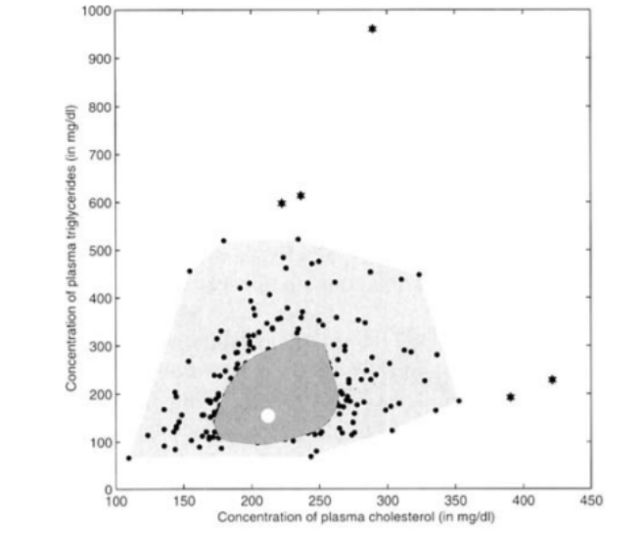
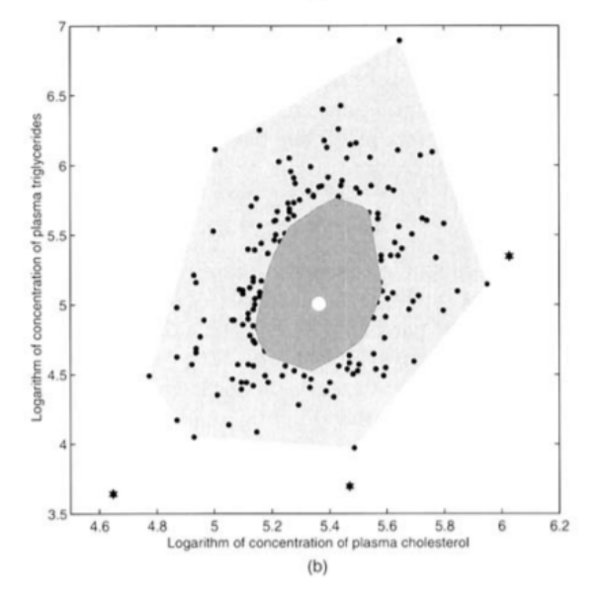
Bag Plots
Design choices: The inner part of the bag may be left filled (without points).
Transparency and color for comparison (potentially overlapping shapes)
BagPlots with a filled bag. Left: normal scale, right logarithmic scale (From: Rousseeuw, 1999).
Bernhard Preim

Slide 44
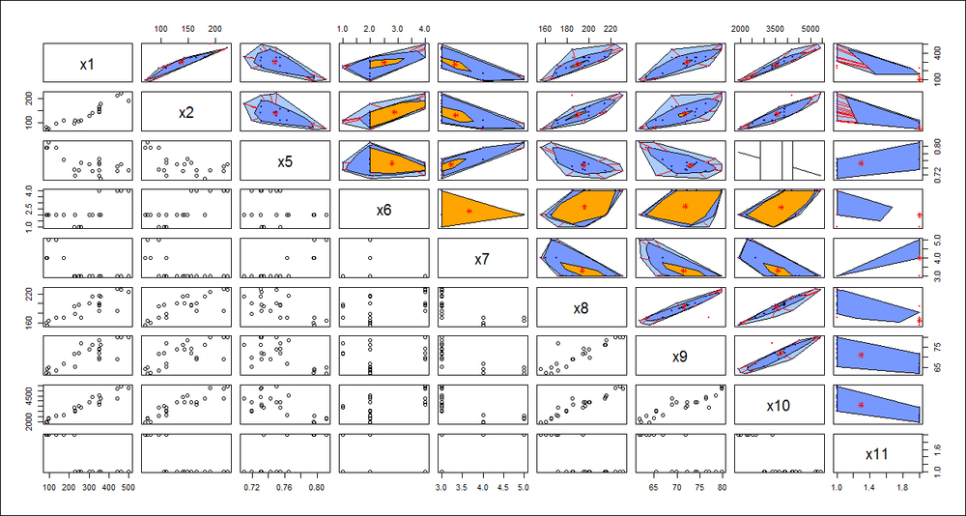
Bag Plots
Enhanced Scatterplot Matrices with BagPlots.
From: Link
Bernhard Preim

Slide 45
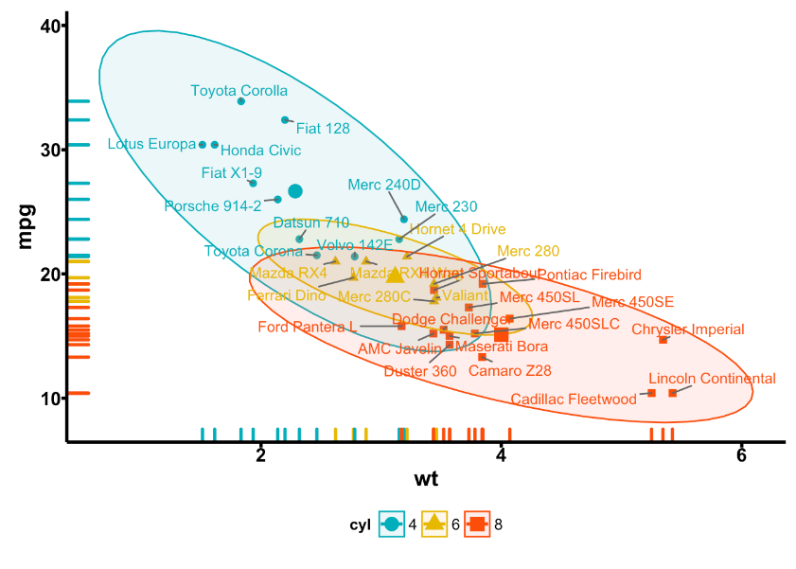
Advanced 2D Scatterplots
Concentration ellipses: Abstract depiction of (multiclass) distributions.
Filled (transparent) ellipse with solid outline surrounding data points (of a class).
Midpoint may be explitly shown.
Outliers (mild or severe) may be excluded. Often ellipses surround 95% of the data.
Scatter plot with concentration ellipses and midpoint. Classes represent cars with 4, 6 and 8 cylinders. Low element number. (Source: Link)
Bernhard Preim

Slide 46
Advanced 2D Scatterplots
Discussion: Concentration ellipses:
Good perceptual motivation: Contours easily perceived if they are „locally linear and globally circular or elliptical“ (Kuai, 2006).
Smooth contours with solid fill beneficial.
Abstracted visualization. For larger number of datasets, individual elements are not visible.
Interaction required to explore data locally.
Bernhard Preim

Slide 47
Advanced 2D Scatterplots
Binning
Data aggregation for grouping a dataset (abstraction from individual elements)
Used, e.g. in histogram generation
Density plots:
Binning based on a grid (quadrilateral, hexagonal, …) and indicates frequency/density.
Bin size as major parameter.
Density plots
  + Avoid clutter and overplotting in dense regions
  - Do not convey distribution in sparsely populated regions well.
Bernhard Preim

Slide 48
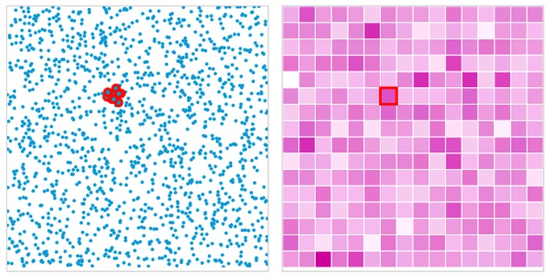
Advanced 2D Scatterplots: Binning
A scatterplot and its binned approximation (discrete density plot). Highlighted points (left) correspond to the selected cell right. Darkness indicates frequency (From: Link).
Bernhard Preim

Slide 49
Advanced 2D Scatterplots: Binning
Hexbin scatterplot:
map points onto a uniform grid of hexagons.
uses variation in bin color similar to a heat map.
higher saturation or darker color indicates higher density
HexBin Scatterplot (From: Link, see
Also the video, up to 1:15 min.)
Bernhard Preim

Slide 50
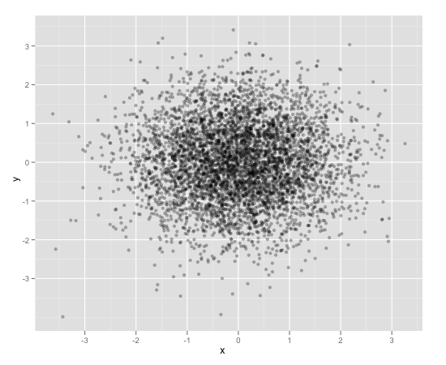
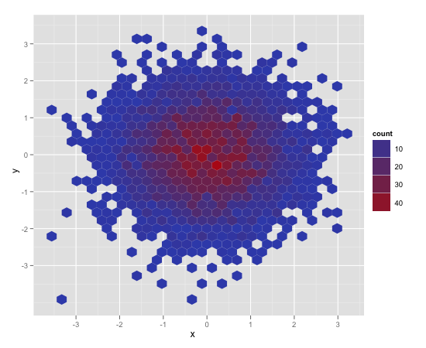
Advanced 2D Scatterplots: Binning
Comparison of a transparency-adjusted scatterplot and a hexbin plot. Hexbin plots enable faster interpretation but do not indicate all details (From: Link)
Bernhard Preim

Slide 51
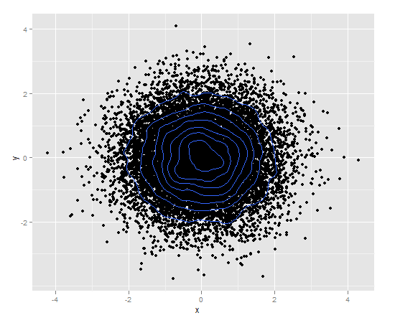
Advanced 2D Scatterplots: Binning
Density contour plot: Each contour encloses a certain percentage of the data, e.g. 10% (From: Link)
Bernhard Preim

Slide 52
Advanced 2D Scatterplots: Binning
Variable Binned Scatterplots (Hao, 2010):
Data binned in adaptive ranges
Density in these bins color-coded
Interaction: zoom in and out to adjust level of detail
Extension: binned scatterplot matrices
Bernhard Preim

Slide 53
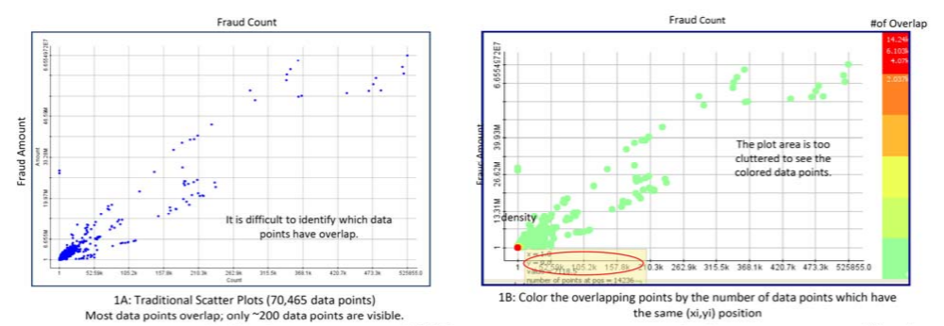
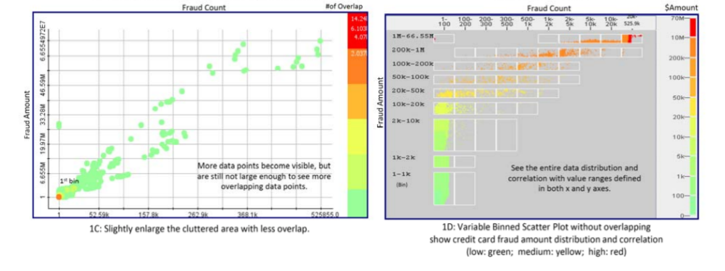
Advanced 2D Scatterplots: Binning
Construction of variable binned scatterplots from classic scatterplots (From: Hao, 2010).
Bernhard Preim

Slide 54
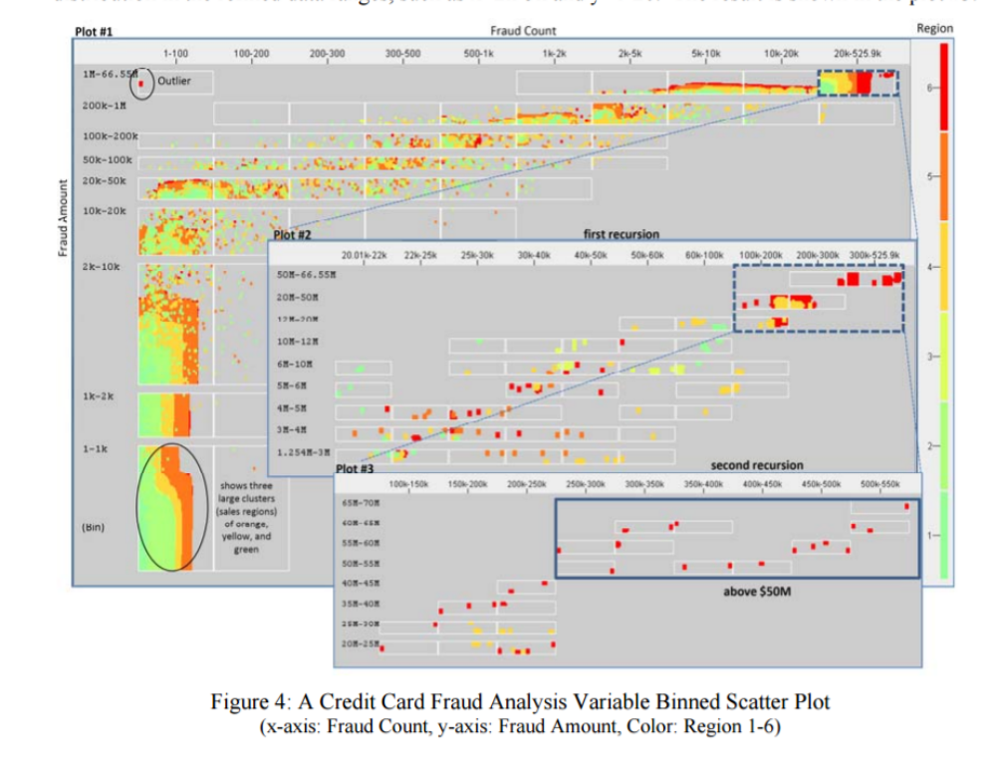
Advanced 2D Scatterplots: Binning
Variable Binned Scatterplot. Fraud count and fraud amount in six regions (mapped to color). (From: Hao, 2010).
Bernhard Preim

Slide 55

Advanced 2D Scatterplots: Splatter Plots
Splatter plot: Improving class separability with smoothly overlapping shapes (Mayorga, 2013)
Creation of splatter plots involves:
Kernel density estimation (KDE)
Color blending
Left: poor class separability (conventional SP).
Right: based on KDE and a density threshold θ overlapping shapes are generated (From: Mayorga, 2013).
Bernhard Preim

Slide 56
Advanced 2D Scatterplots: Splatter Plots
Visualization of densely populated regions:
General concept (Fekete, 2002): Connect densely packed points to shapes
Density p: computed as a smooth function over the whole domain
No grid involved.
Regions where p>θ shown as transparently colored polygons with contours (continuous density)
Polygons may be smoothed to enhance perception of clustered dense regions.
Color modulation in overlapping regions
Bernhard Preim

Slide 57
Advanced 2D Scatterplots: Splatter Plots
Visualization of Sparse regions:
Individual points shown on top of strongly transparent background
Points selected based on a filtering and sampling strategy to avoid too many distracting outliers
Selection of points guided by the goals to show representative points and to consider perceptual issues (avoid overload and clutter)
Bernhard Preim

Slide 58


Advanced 2D Scatterplots: Splatter Plots
Kernel density estimation at point q considering n nearest neighbors
K – kernel function, B - bandwidth parameter, r_{i} – distance to q
Typical choice for K: Gaussian, for B: variance of the Gaussian
Bernhard Preim

Slide 59


Advanced 2D Scatterplots: Splatter Plots
Major parameters of splatterplots:
Density Threshold, bandwidth, point filtering in sparse regions, contour width, smoothing
Influence of different splatter plot para-meters for an artificial dataset (From: Mayorga, 2013).
Bernhard Preim

Slide 60

Advanced 2D Scatterplots: Splatter Plots
Splatterplots: Smoothing
Smoothing supports interpretation of (overlapping) shapes (recall perceptual discussion of concentration ellipses) (From: Mayorga, 2013).
Bernhard Preim

Slide 61

Advanced 2D Scatterplots: Splatter Plots
Colors:
Colors for each class chosen in LAB space to be as different as possible
Colors for overlapping regions weighted interpolations in LAB space
Overlapping colors modified to indicate the amount of overlapping (increased lightness and decreased saturation)
Color scheme useful for any set-based vis.
Automatic selection of five colors and up to three overlaping shapes (From: Mayorga, 2013).
Bernhard Preim

Slide 62
Advanced 2D Scatterplots
Generalized scatterplots (Keim, 2010):
Provides an adjustable trade-off between an overlap-free but distorted view and an undistorted view with considerable overlap.
Users indicate amount of acceptable overlap (slider).
Interaction essential to understand the data.
Bernhard Preim

Slide 63

Advanced 2D Scatterplots
Displacement Algorithmic:
For any point in the output view check how often it is used so far.
If this counter is below the adjusted limit→ the point is (over)drawn.
Otherwise → search in the surrounding for a point with a counter below the limit.
Update visual representation.
From left to right: Overlapping reduced; distortion increased (From: Keim, 2010).
Bernhard Preim

Slide 64
Scagnostics-Based Exploration
Scagnostics – scatterplot and diagnostics (Wilkinson, 2005)
Derives 9 attributes from a scatterplot
Scagnostic features may be used for (Dang, 2014)
exploration of large sets of scatterplots
filtering, e.g. with monotonicity >0.5 and outlierness <0.5
similarity-based search, e.g. show clusters of scatterplots with similar features
Bernhard Preim

Slide 65


Scagnostics-Based Exploration
Scatterplots with high values for monotonicity, stringyness and striated distribution (From: Dang, 2014).
Nine measures with examples for low, moderate and high values (From: Dang, 2014).
Bernhard Preim

Slide 66

Scagnostics-Based Exploration
Scagnostics features based on a geometrical analysis of the point distribution including Minimum Spanning Tree (From: Dang, 2014).
Bernhard Preim

Slide 67

Scagnostics-Based Exploration
Filtering for high outlierness and high monotonicity. Life expecantancy of woman and men in ~150 countries are highly correlated. Due to war, in 3 countries, the male life expectancy is strongly lower (From: Dang, 2014).
Bernhard Preim

Slide 68
Advanced 2D Scatterplots: Small Screens
Small Screens (Bühring, 2006):
Relevant for mobile experts, e.g. sales persons and real-estate experts (Immobilienmakler)
Scatterplots with details-on demand presented in a separate window are not feasible for small screens → overview and detail need to be integrated in one screen → smooth transition between visualization with and without detail, use of fisheye zoom combining geometric distortions and semantic zoom (change
representations)
Bernhard Preim

Slide 69
Advanced 2D Scatterplots: Small Screens
Highlighting (Bühring, 2006):
Zooming always targets at an item → Avoid that the user gets lost between items (desert fog)
Continous zoom starts after a delay, e.g. 150 ms
Bernhard Preim

Slide 70

Advanced 2D Scatterplots: Small Screens
Small screen with scatter-plot.
Zooming - representation changes towards rectangles, labeled rectangles and more detailed representations. Elements of a book database (From: Bühring, 2006).
Bernhard Preim

Slide 71
Animated Scatterplots
Humans familiar with analyzing animated movements and observe changes.
Human motion perception restricted by the amount of moving objects and the complexity of movements.
Fast movements perceived as urgent; slow movements in the periphery may be overlooked (change blindness)
Few items, moving linearly or on smooth trajectories, following similar directions are easy to interpret.
Bernhard Preim

Slide 72
Animated Scatterplots
Animation may be incorporated to support
interaction with a static dataset (animate the transition to a new adjustment, e.g. w.r.t. filtering, sampling, distortion)
exploration of dynamic datasets, e.g. changes of sugar consumption and BMI over time
Although the latter is more natural, both are useful.
For dynamic data: Users need „tight control over animation speed“ to inspect relevant intervals in detail and skip over others (Craig, 2005)
Bernhard Preim

Slide 73

Animated Scatterplots
Left: User may select a timepoint or use the „play“ button to start an animation (From: Link)
Trails support perception of movement. Technique for few datasets (From: Youtube (12s), see also Youtube)
Bernhard Preim

Slide 74

Evaluation
Comparison of Scatterplot-Based Displays
Selection of a representative set of test data (with different types and strength of correlations, clusters, outliers)
Criteria (Sedlmaier, 2013):
  Visual Separability of Clusters
  Correct assessment of correlations
  Trust (certainty) of interpretation
Evaluation w.r.t. separability based on three datasets
(From: Sedlmaier, 2013)
Bernhard Preim

Slide 75
Summary
Scatterplots: frequently used infovis. technique
Scatterplots often enhanced with cluster analysis and regression analysis (visual analytics)
Overplotting: essential scaleability problem increased by a large number of datasets and/or a large number of dimensions (SPLOMs)
Density plots, jittered placement, variable binning: scaleable variants based on aggregation of values or distortion
Interaction for advanced variants, e.g. to control the trade-off between distortion and overlap
Outlook: Add narrative components (labels, captions, emphasis, sequence of scatterplots)
Bernhard Preim

Slide 76
References
E. Bertini, G. Santucci: „Quality Metrics for 2D Scatterplot Graphics: Automatically Reducing Visual Clutter“. Proc. of Smart Graphics 2004: 77-89
E. Bertini, G. Santucci: „Improving 2D Scatterplots Effectiveness through Sampling, Displacement, and User Perception“, Proc. of Information Visualization 2005: 826-834
E. Bertini: “Quality Metrics in High-Dimensional Data Visualization: An Overview and Systematization”, IEEE Trans. Vis. Comput. Graph. 17(12): 2203-2212 (2011)
T. Büring, J. Gerken, H. Reiterer: User Interaction with Scatterplots on Small Screens - A Comparative Evaluation of Geometric-Semantic Zoom and Fisheye Distortion. IEEE Trans. Vis. Comput. Graph. 12(5): 829-836 (2006)
W. S.CLEVELAND and R. McGILL (1984). “The Many Faces of a Scatterplot”, Journal of the American Statistical Association, Vol. 79(388)
Michael Correll and Jeffrey Heer. 2017. Regression by Eye: Estimating Trends in Bivariate Visualizations. In Proc. of the ACM CHI Conference on Human Factors in Computing Systems, pp. 1387-1396
Craig, P., J. Kennedy, A. Cumming. "Animated interval scatter-plot views for the exploratory analysis of large-scale microarray time-course data." Information Visualization 4.3 (2005): 149-163.
Dang Tuan Nhon, L. Wilkinson (2014). “ScagExplorer: Exploring Scatterplots by Their Scagnostics”, Proc. of IEEE PacificVis 2014: 73-80
Doyle I, Ratcliffe M, Walding A, Vanden Bon E, Dymond et al. „Differential gene expression analysis in human monocyte-derived macrophages: impact of cigarette smoke on host defence“, Mol Immunol. 2010 Feb;47(5):1058-1065.
JD Fekete, C Plaisant (2002). „Interactive information visualization of a million items“, Proc. of IEEE Symposium on Information Visualization, pp. 117-124
Bernhard Preim

Slide 77
References (II)
S. Few (2008). Solutions to the Problem of Over-Plotting in Graphs, Link
M. Gleicher, M. Correll, C. Nothelfer, S. Franconeri: „Perception of Average Value in Multiclass Scatterplots“, IEEE Trans. Vis. Comput. Graph. 19(12): 2316-2325 (2013)
M. C. Hao, U. Dayal, R. K. Sharma, D. A. Keim, H. Janetzko: „Variable binned scatter plots“, Information Visualization 9(3): 194-203 (2010)
S. Haroz, R. Kosara, S. L. Franconeri: The Connected Scatterplot for Presenting Paired Time Series. IEEE Trans. Vis. Comput. Graph. 22(9): 2174-2186 (2016)
J.-F. Im, M. J. McGuffin, R. Leung: GPLOM: The Generalized Plot Matrix for Visualizing Multidimensional Multivariate Data. IEEE Trans. Vis. Comput. Graph. 19(12): 2606-2614 (2013)
D. A. Keim, M. C. Hao, U. Dayal, H. Janetzko, P. Bak: „Generalized scatter plots“, Information Visualization 9(4): 301-311 (2010)
S. Kuai, C. Yu (2006). „Constant contour integration in peripheral vision for stimuli with good gestalt properties“, Journal of Vision, Vol. 9(2)
J. Li, J.-B. Martens, J. J Van Wijk (2010). „Judging correlation from scatterplots and parallel coordinate plots“. Information Visualization 9, 1 (2010),13–30
A. Mayorga, M. Gleicher (2013). „Splatterplots: Overcoming Overdraw in Scatter Plots“, IEEE Trans. Vis. Comput. Graph. 19(9): 1526-1538
A. V. Pandey, J. Krause, C. Felix, J. Boy, E. Bertini: „Towards Understanding Human Similarity Perception in the Analysis of Large Sets of Scatter Plots“, Proc. of the ACM SIGCHI Conference on Human Factors in Computing Systems, 2016, pp. 3659-3669
R. A. Rensink, G. Baldridge (2010). “The perception of correlation in scatterplots”, Computer Graphics Forum, Vol. 29, pp. 1203–1210
Bernhard Preim

Slide 78
References (III)
R. Rosenholtz, Y. Li, L. Nakano (2007). “Measuring visual clutter”, Journal of Vision, Vol. 7(17)
Rousseeuw, P. J.; Ruts I.; Tukey J.W. (1999). "The Bagplot: A Bivariate Boxplot“, The American Statistician. Vol. 53 (4): 382–387
M. Sedlmair, T. Munzner, M. Tory (2013). „Empirical Guidance on Scatterplot and Dimension Reduction Technique Choices“, IEEE Trans. Vis. Comput. Graph., Vol. 19, (12): 2634-2643.
A. Tatu, P. Bak, E. Bertini, D. A. Keim, J. Schneidewind (2010). „Visual quality metrics and human perception: an initial study on 2D projections of large multidimensional data“. Proc. of Advanced Visual Interfaces (AVI), pp. 49-56 (2010)
E. Tufte (1983). The Visual Display of Quantitative Information, Graphics Press
Leland Wilkinson, Anushka Anand, Robert L. Grossman (2005). “Graph-Theoretic Scagnostics“, Proc. of INFOVIS 2005, pp. 21-28
Bernhard Preim

