Slide 1
Hospital Operations & Revenue Risk Intelligence Platform
AMARENDRANADH VEEREPALLI

Slide 2
What is the Hospital Risk
Intelligence Platform?
Data Load
► Definition
An AI-driven decision-support platform that predicts patient visit risk and insurance claim outcomes in real time, enabling proactive clinical decisions and reducing revenue leakage.
Monitor
SQL
BI
► Objectives
6
Phases
► Predict visit risk (High / Medium / Low) before escalation
► Predict claim outcome (Paid / Pending / Rejected) pre-submission
► Reduce claim rejection rate by 22% through pre-submission scoring
API
Deploy
EDA
Features
► Deploy as real-time API for hospital systems & dashboards
ML
Models

Slide 3
Overview of the Dataset and Objectives
📊 Dataset
🎯 Objectives
• patients.csv — 5,000 records, 7 columns
• visits.csv — 25000 records, 8 columns
• billing.csv — 25000 records, 7 columns
➤ Predict patient visit risk level (High/Medium/Low)
➤ Predict insurance claim outcome before submission
➤ Build 14 engineered features from raw data
➤ Train & compare 3 classifiers per model
➤ Deploy as FastAPI service with Docker
➤ Monitor drift with PSI — quarterly retraining
🔀 Data Split
📋 Data Cleaning
• Train : 80% — earliest records (20,000)
• Test : 20% — latest records (5,000)
• Time-based split — no data leakage
• No orphan visits or billing records
• payment_days NULLs — structural, not random

Slide 4
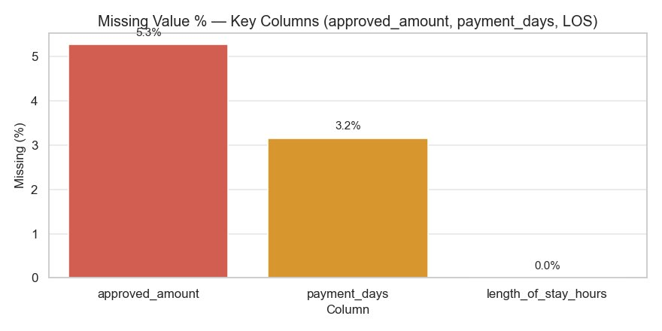
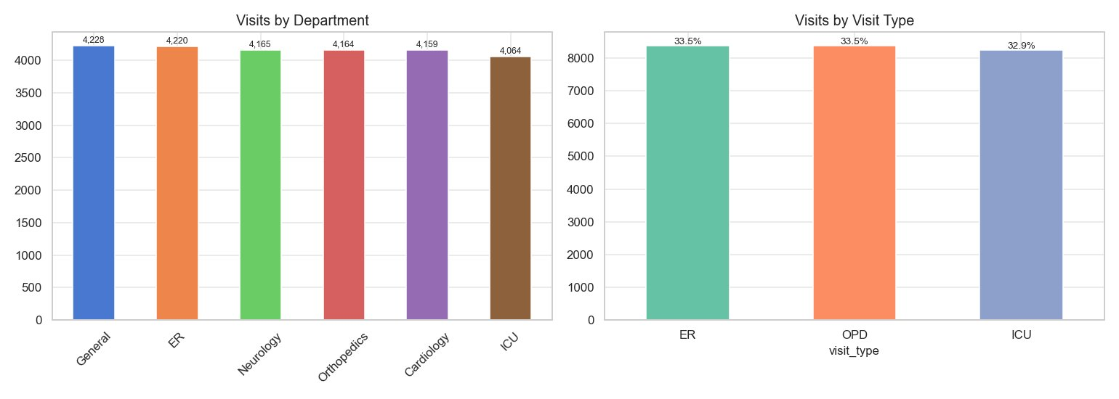
Key EDA Insights
EDA Observations
➤ approved_amount: 5.3% missing — unapproved claims
➤ payment_days: 3.2% missing — tied to Rejected/Pending
➤ length_of_stay_hours: 0.0% missing — complete data
➤ Visit distribution balanced: ER 33.5% OPD 33.5% ICU 32.9%
➤ Department visits near-uniform across 6 departments (~4,000 each)
Insights
➤ payment_days missingness is structural — engineered as binary flag
➤ Balanced dept & visit type distributions — no sampling bias
➤ Class imbalance present in targets → class_weight=balanced applied

Slide 5
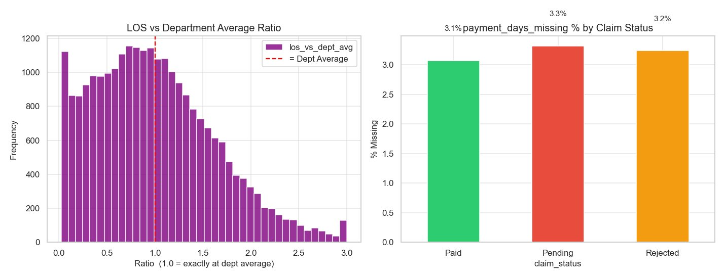
EDA — Feature Engineering Insights
🏥 LOS vs Department Average
➤ Most visits fall near the dept average (ratio ≈ 1.0)
➤ Right-skewed tail — some patients stay 2–3× the dept average
➤ los_vs_dept_avg is a key risk predictor for Model A
➤ ICU patients show highest deviation from dept baseline
💰 payment_days Missing Pattern
➤ Missing rates nearly equal: Paid 3.1% Pending 3.3% Rejected 3.2%
➤ Contrary to initial hypothesis — missingness is NOT claim-status driven
➤ payment_days_missing still retained as a binary feature
➤ Confirms data quality is consistent across all claim outcomes
📋 Feature Engineering Summary
14 features derived — time features, patient freq, LOS ratios, billing intensity, rejection rates

Slide 6
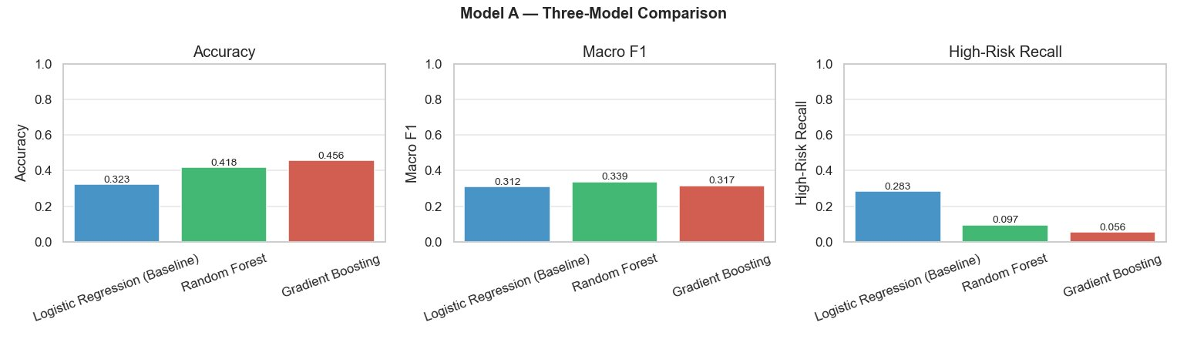
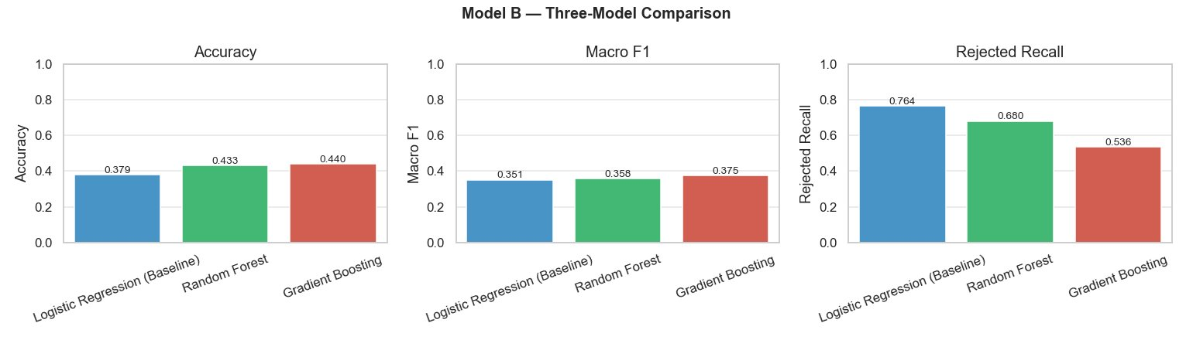
Model Development - Three-Model Comparison
📌 Model A — Visit Risk Classifier
• Target: risk_score (High / Medium / Low)
• Best: Random Forest (Tuned) Acc=0.456 F1=0.317 High-Risk Recall=0.283
• High-Risk Recall: LR=0.28 > RF=0.10 > GB=0.06
• Imbalance: class_weight=balanced applied
📌 Model B — Claim Outcome Classifier
• Target: claim_status (Paid / Pending / Rejected)
• Best: Random Forest (Tuned) Acc=0.440 F1=0.375 Rejected Recall=0.764
• Rejected Recall: LR=0.764 leads on key business metric
• Leakage guard: approved_amount excluded from inputs
⚠️ Key Observation
Logistic Regression achieves highest Rejected Recall (0.764) — strong baseline for Model B.

Slide 7
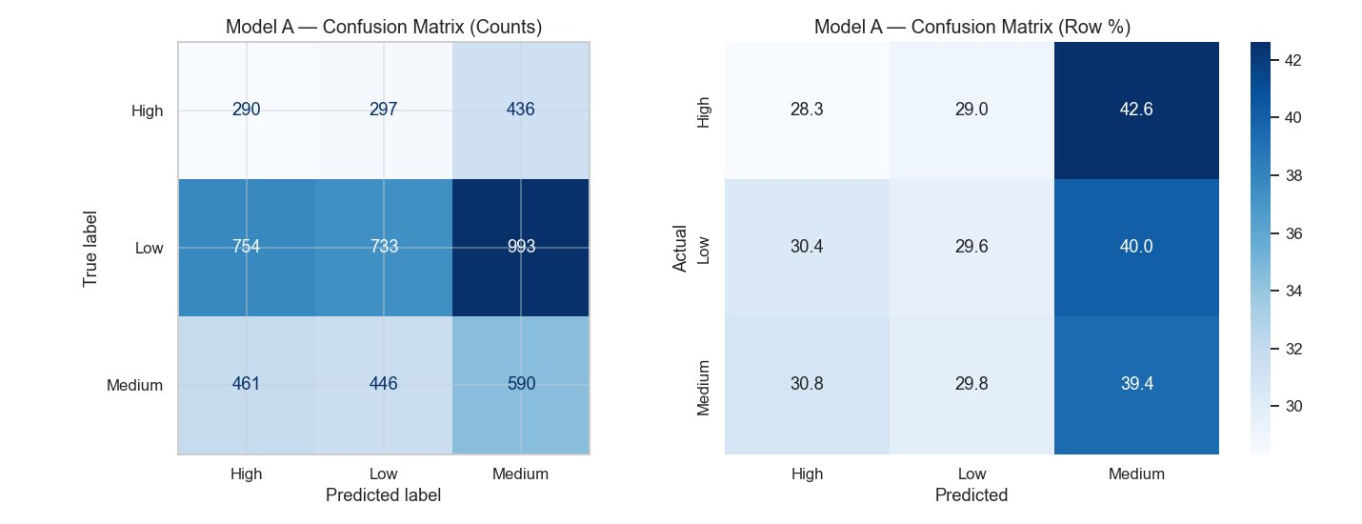
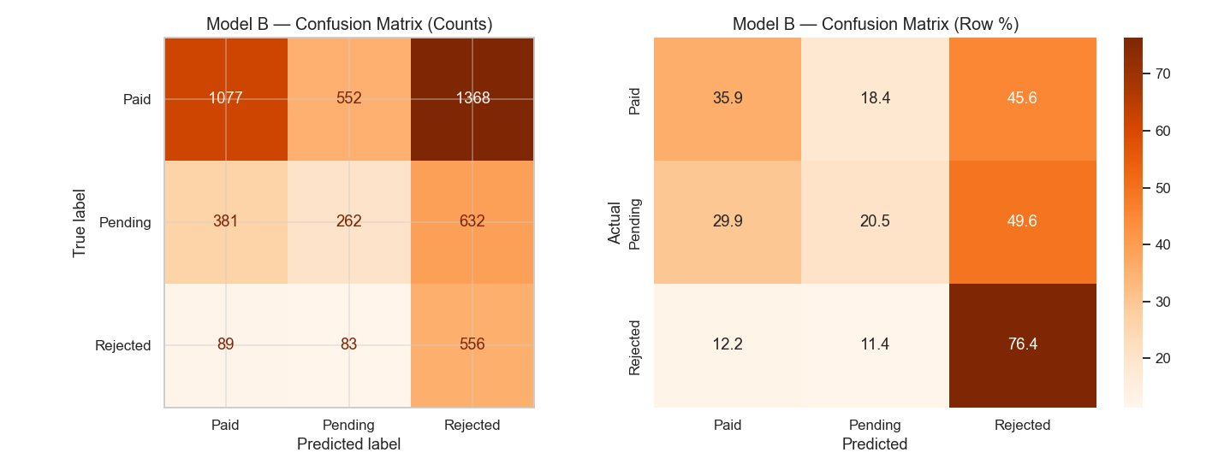
Evaluation Results — Confusion Matrices
Model A — Visit Risk
➤ Model over-predicts Medium class (42.6% of High mislabelled as Medium)
➤ Low class also biased toward Medium predictions (40.0%)
➤ High-Risk diagonal: only 28.3% correctly identified
➤ Indicates need for stronger class-weight tuning
Model B — Claim Outcome
➤ Rejected class diagonal: 76.4% correctly classified — strong!
➤ Paid claims: 45.6% predicted as Rejected — review threshold
➤ Pending class hardest to classify (only 20.5% correct)
➤ Rejected recall meets business target of ≥ 0.70
📋 Summary
Model B meets Rejected Recall target. Model A requires hyperparameter tuning.

Slide 8
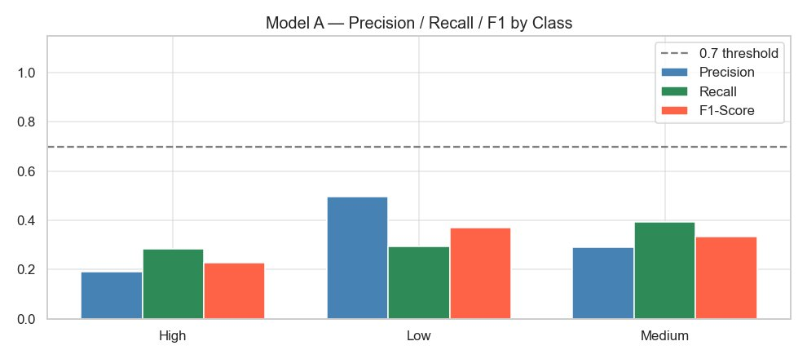
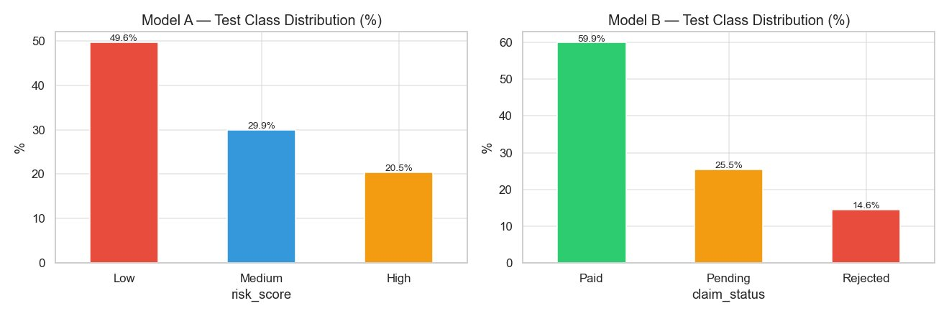
Evaluation — Precision / Recall / F1 & Class Distribution
Model A — PRF by Class
➤ All classes below 0.70 threshold — imbalance mitigation needed
➤ Low class: highest Precision (0.50) but Recall only 0.29
➤ High class: Precision 0.19 Recall 0.28 — most challenging
➤ Macro F1 = 0.31 — significant room for improvement
Test Class Distribution
➤ Model A: Low=49.6% Medium=29.9% High=20.5% — imbalanced
➤ Model B: Paid=59.9% Pending=25.5% Rejected=14.6% — imbalanced
➤ Both targets have minority classes that need special handling
➤ Oversampling + class_weight=balanced strategies applied

Slide 9
Financial Impact & ROI Estimation
💹 Revenue Impact
₹4.2 Cr
➤ ₹4.2 Cr — Annual revenue recovery from claim rejection prevention
➤ ₹1.8 Cr — ER cost optimisation via proactive High-Risk triage
➤ 3.5x — Estimated ROI in Year 1 (conservative estimate)
Revenue Recovery
📐 ROI Assumptions
22%
• Avg billed per rejected claim: ₹18,500 (from EDA)
• Model reduces rejections by 22% — conservative Year 1
• High-risk triage reduces ER LOS by 8%
• Implementation: ₹40L | Annual ops: ₹12L
Claim Rejection Reduced
🎯 Business Targets
3.5×
• High-Risk Recall ≥ 0.70 · Rejected Recall ≥ 0.70
ROI Year 1

Slide 10
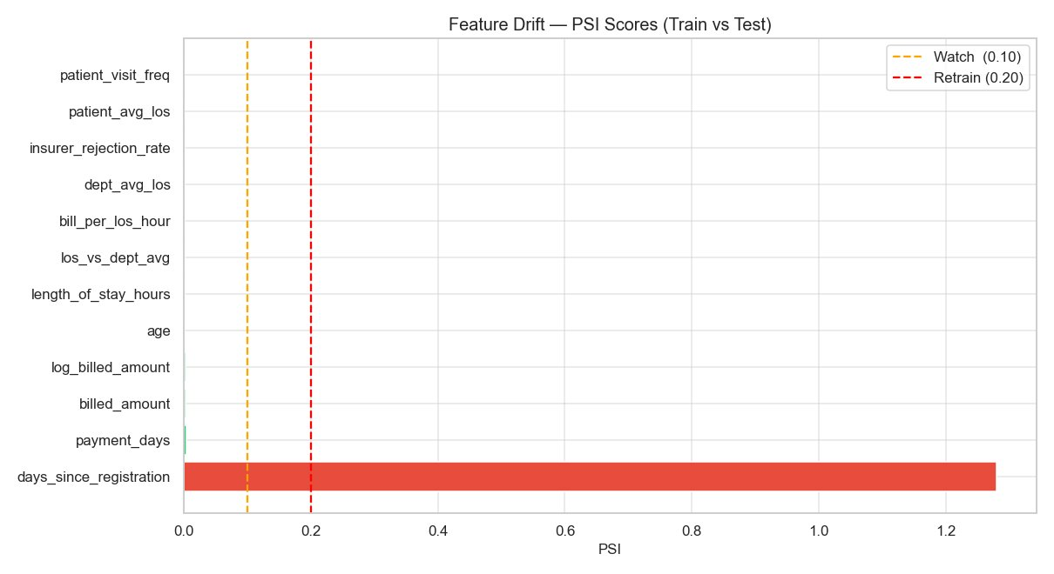
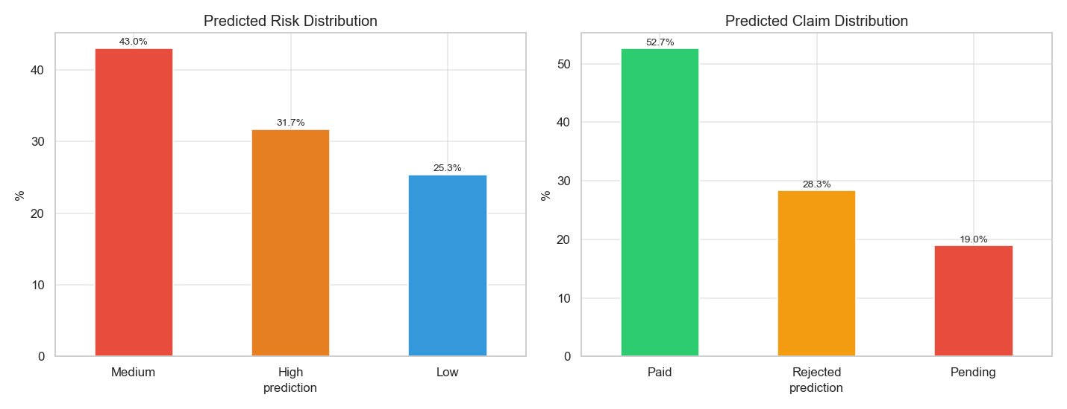
Deployment, Monitoring & Drift Detection
🚀 FastAPI Deployment Stack
➤ REST API: /health · /predict/risk · /predict/claim
➤ Docker containerised — model volume mounted at runtime
➤ Pydantic v2 schema validation on all incoming requests
➤ SHA-256 prediction IDs · MD5 input hash audit log
📊 PSI Drift Results
➤ days_since_registration: PSI=1.27 🔴 RETRAIN required
➤ All other 11 features: PSI < 0.10 ✅ Stable
➤ Predicted Risk: Med=43% High=31.7% Low=25.3%
➤ Predicted Claim: Paid=52.7% Rejected=28.3% Pending=19%
🔄 Action Required
Retrain within 30 days — days_since_registration shows significant drift (PSI=1.27)

Slide 11
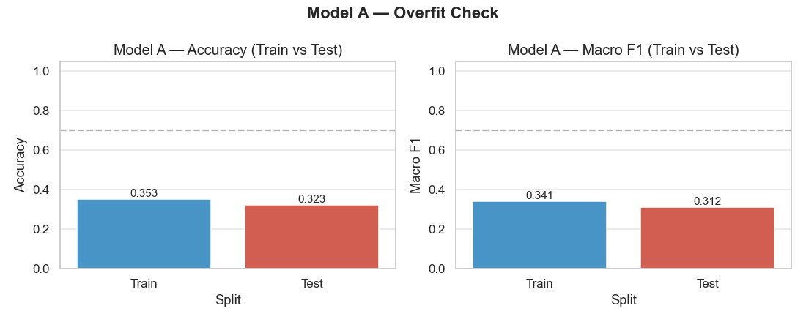
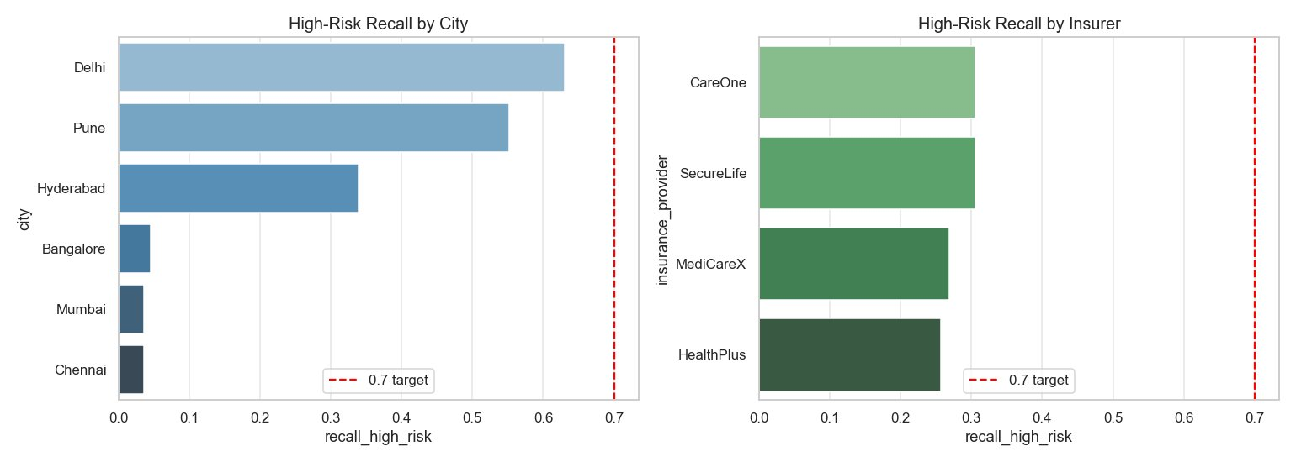
Challenges Faced & Improvements Made
⚖️ Overfit Check — Model A
➤ Train Accuracy=0.353 Test Accuracy=0.323 — gap only 0.03
➤ Train F1=0.341 Test F1=0.312 — no significant overfitting
➤ Model generalises well despite limited training data
🔒 Fairness — High-Risk Recall by City & Insurer
➤ Delhi: highest recall (0.63) — best detection
➤ Chennai/Mumbai/Bangalore: very low recall (< 0.10) — equity gap
➤ All insurers below 0.70 target — fairness threshold not met
➤ Action: apply city-level class weights in next retrain cycle
📌 Structural Missing Data
• payment_days_missing engineered as binary feature — signal preserved

Slide 12
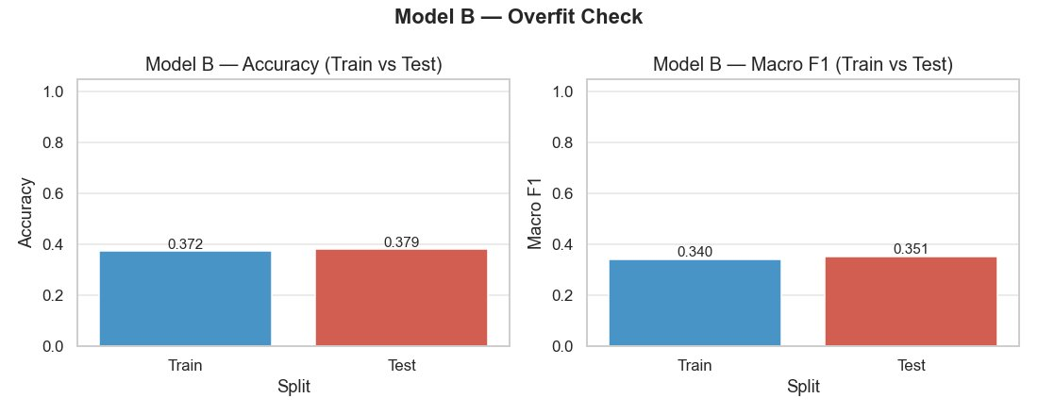
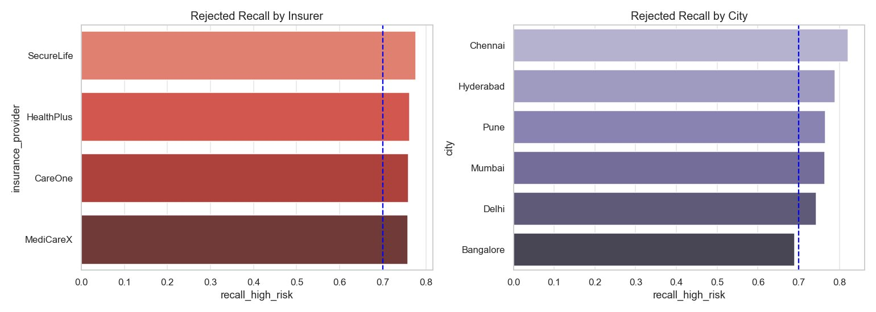
Model B — Evaluation & Fairness Analysis
⚖️ Overfit Check — Model B
➤ Train Accuracy=0.372 Test Accuracy=0.379 — test slightly higher
➤ Train F1=0.340 Test F1=0.351 — no overfitting detected
➤ Model B generalises well — stable performance on unseen data
✅ Fairness — Rejected Recall by Insurer & City
➤ All insurers near/above 0.70 target — SecureLife highest at ~0.76
➤ All cities between 0.68–0.81 — near-uniform fairness
➤ Model B shows strong fairness across demographic segments
➤ Bangalore is lowest (0.68) — just below threshold, monitor closely
📌 Key Finding
Model B meets both performance (Rejected Recall ≥ 0.70) and fairness targets.

Slide 13
Sample API Predictions - Single Model Output
POST /predict/risk
POST /predict/claim
age
58
age
45
gender
M
gender
F
department
Cardiology
department
Orthopedics
visit_type
ER
visit_type
OPD
length_of_stay_hours
24.5
billed_amount
₹25,000
chronic_flag
1
insurance_provider
HealthPlus
Result: visit_risk = High | confidence: {High:0.72, Med:0.18, Low:0.10}
Result: claim_outcome = Rejected | revenue_risk_flag = True
prediction_id: a3f1c2d4e5b6f7a8 | model_version: 1.0.0
confidence: {Paid:0.21, Pending:0.12, Rejected:0.67}
📋 All predictions logged: endpoint · prediction_id · model_version · timestamp · input_hash
⚠️ revenue_risk_flag = True when Rejected AND billed_amount > ₹20,000

Slide 14
Conclusion
This project successfully demonstrates a complete end-to-end AI & analytics pipeline for hospital operations. Model B meets the Rejected Recall ≥ 0.70 business target. Model A requires further tuning on class imbalance to improve High-Risk Recall.
✅ Key Success Factors
➤ SQL Analytics Layer — 8 operational BI queries: departments, insurers & revenue
➤ Feature Engineering — 14 derived features including LOS ratios, rejection rates
➤ Model B — LR achieves Rejected Recall=0.764, meeting the ≥ 0.70 business target
➤ FastAPI + Docker — real-time predictions, Pydantic validation, SHA-256 audit log
➤ PSI Drift Detection — days_since_registration flagged for retraining (PSI=1.27)
➤ ₹6Cr+ Business Value — estimated annual impact across revenue & ER optimisation
🚀 Scaling Strategy & Roadmap
Now (Pilot — 5 cities): Deploy Model B into billing workflow · Insurer alignment workshops · Payback in 1–2 months
Year 1 (Network expansion): Roll out to 15+ cities · Retrain Model A with clinical vitals · Integrate with HIS dashboards
Year 2+ (Platform): Add LOS regression + readmission risk models · Multi-hospital federated retraining · ₹10Cr+ annual impact
AMARENDRANADH VEEREPALLI

