Slide 1
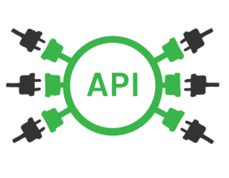
SOAP2Rest
Automation of API conversion
Nirali Patel, Chandan Singh, Amarjeet Kumar

Slide 2
Create a tool that will help convert SOAP to Rest API protocol which will support single commit, security, exception management, idempotency …
Problem Statement

Slide 3
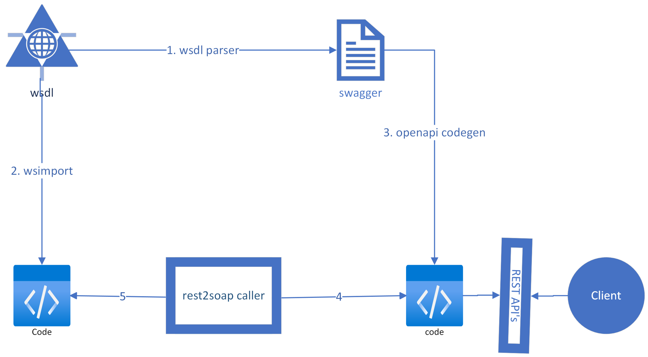
Solution diagram:

Slide 4
Steps :
WSDLParser to generate swagger from WSDL
OpenAPI codegen plugin generates codes from swagger
Wsimport plugin generates code from from WSDL
Few more library added to convert into Spring Boot application
Link code generated from swagger and WSDL

Slide 5
Thankyou
?

