Slide 1
A VISUAL LECTURE
Autoencoders
From PCA to the variational autoencoder
the models then astrophysics & particle physics
One geometric idea — data lives on a low-dimensional manifold — built up, then put to work.
Notes:
Two halves: build the model ladder carefully (PCA → nonlinear → the three regularized variants → the VAE), then spend real time on a few scientific deep dives. The through-line is always the manifold.

Slide 2
ROADMAP
Two halves: the models, then the science
THE MODELS
IN THE SCIENCES — FEW EXAMPLES, GONE DEEP
1
Motivation data on a low-D manifold
Astrophysics
① compressing galaxy spectra ② anomaly & discovery in surveys ③ deblending overlapping galaxies
2
Linear AE = PCA the exactly-solved case
3
Swiss roll → the hourglass why we go nonlinear
Particle physics
4
Sparse · Denoising · Contractive three knobs, one geometric goal
④ model-agnostic new-physics search in the LHC trigger
5
Variational autoencoder a smooth, sample-able latent
“Off-manifold = interesting” shows up in both sciences — the same idea, two different skies.
Notes:
Set expectations: the applications half is deliberately only four examples, each treated properly, rather than a tour.

Slide 3
PART I
The models
From the exactly-solved linear case to the variational autoencoder.
Notes:
Build carefully. Every model is the previous one plus one new idea to fix a specific failure.

Slide 4
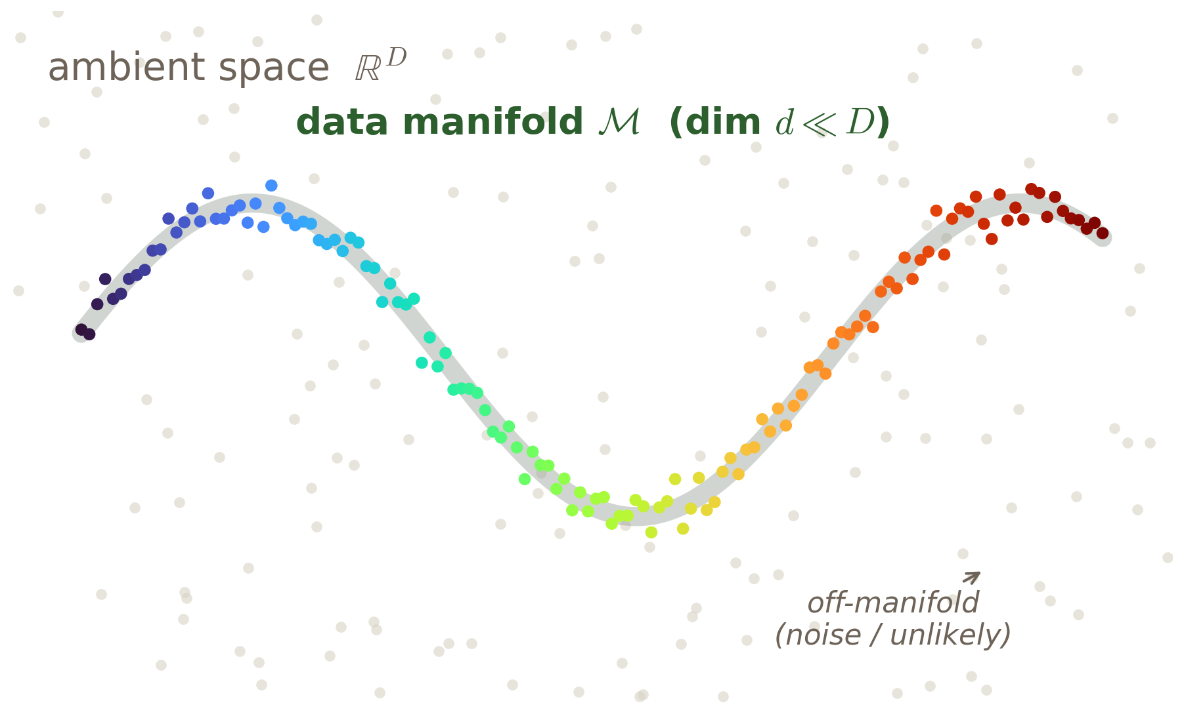
THE MODELS · MOTIVATION
01
Why compress at all? The manifold hypothesis
A 256×256 colour image is a point in ℝ^196,608 — yet a uniform random draw is pure static, never a face or a galaxy.
The data we care about occupies a thin, highly curved sliver of that ambient space.
Reason: only a few generative factors vary — a galaxy spectrum is set by age, metallicity, star-formation, redshift, dust; a few numbers, not 4000.
Same story for images, gene counts, turbulent fields: nominally enormous, intrinsically low-dimensional.
KEY IDEA
Data concentrates near a manifold M ⊂ ℝ^D of intrinsic dimension d ≪ D. We want a code z = f(x) that is faithful where data lives and indifferent elsewhere — and a decoder that maps back. Compression, representation, and generation in one device.
Data clusters on M; almost all of ℝ^D is empty.
Notes:
Open with the dimensionality gap, not a definition. The three goals — compress, represent, generate — are the whole motivation.

Slide 5
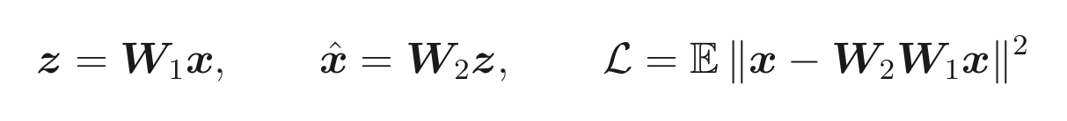
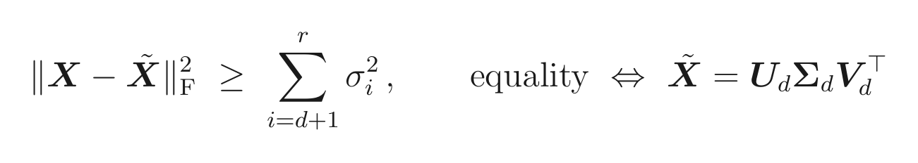
THE MODELS · LINEAR THEORY
02
Strip it to the bone: the linear AE is PCA
Linear encoder, linear decoder, squared-error loss:
The optimum is the PCA subspace: span of the top-d eigenvectors of the covariance.
Every local minimum is global (Baldi–Hornik 1989) — despite a non-convex loss.
Proof in one move: rotate to the basis where the problem is diagonal; keep the largest singular values.
Eckart–Young (1936): the best rank-d fit is the truncated SVD — i.e. PCA.
GOTCHA
Non-identifiability: the loss is invariant under W₁→A⁻¹W₁, W₂→W₂A. The d-dimensional subspace is pinned down, but the axes inside it are not — the root reason “disentanglement” is hard. “Latent unit 7 = age” is usually an accident of the seed.
Notes:
Two surprises worth dwelling on: the optimum is exactly PCA, and the landscape has no bad local minima. That globality is special to the linear case — everything nonlinear is about the leftover symmetry.

Slide 6
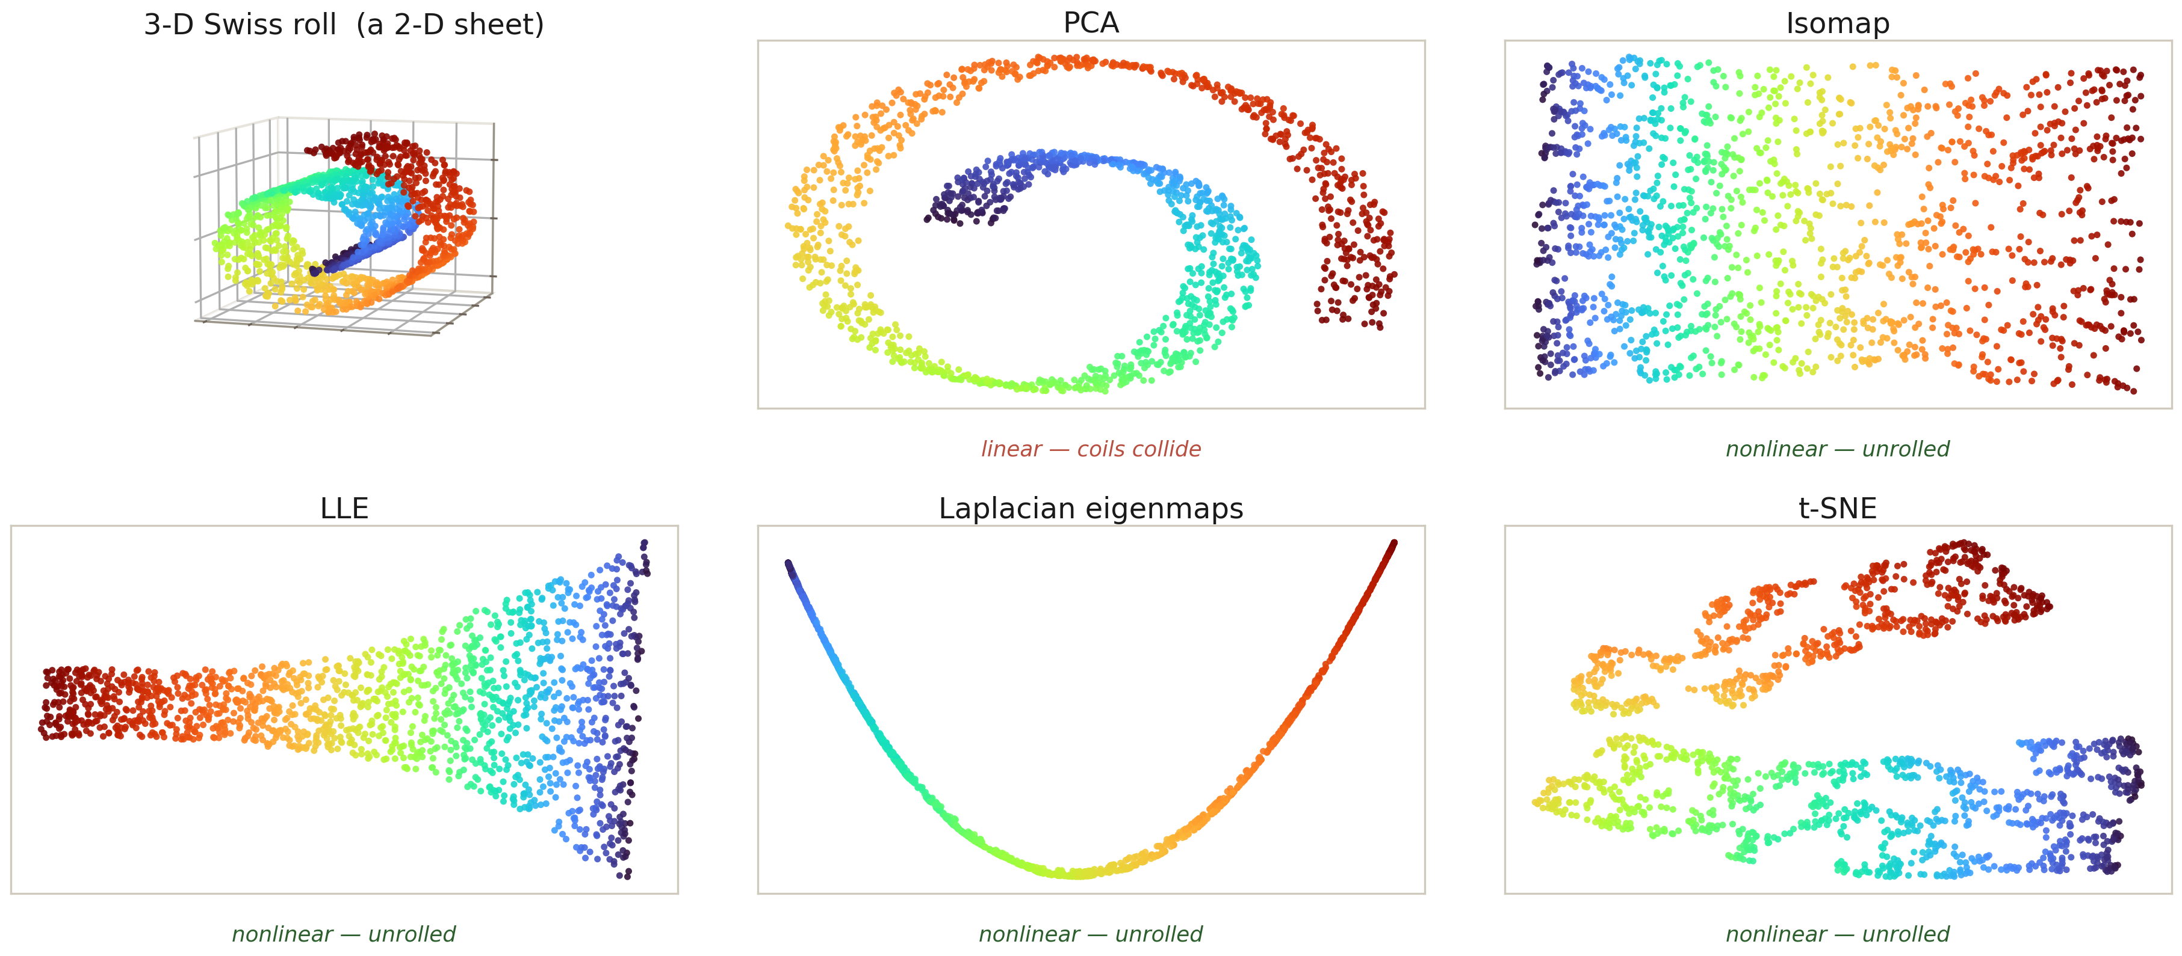
THE MODELS · WHERE LINEAR BREAKS
03
The Swiss roll: where linear methods collide
KEY IDEA
Same 2-D sheet, six views. PCA's plane collides the coils (reconstruction MSE ≈ 7); the nonlinear maps — Isomap, LLE, Laplacian eigenmaps, t-SNE — unroll it (MSE < 0.05). Nonlinearity buys fitting power, but the symmetry grows from rotations to all diffeomorphisms, so “what does a latent axis mean?” becomes a coordinate choice.
Notes:
Lead with the picture: the eye sees PCA fail and the manifold methods succeed. Then name the cost — a far bigger symmetry group, hence worse identifiability.

Slide 7
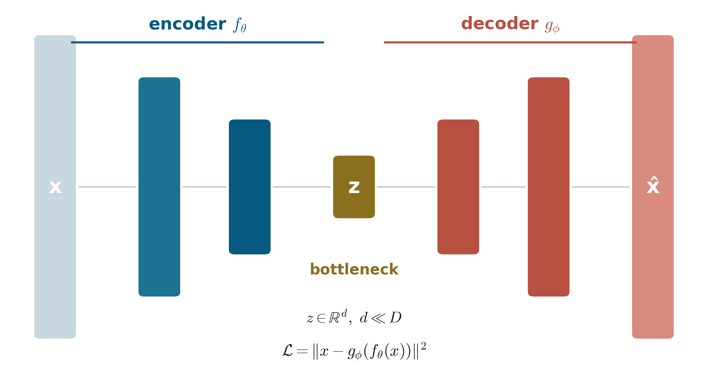
THE MODELS · NONLINEAR AUTOENCODER
04
The hourglass — and a hidden modelling choice
Replace the matrices with networks: encoder f_θ : ℝ^D→ℝ^d, decoder g_φ : ℝ^d→ℝ^D.
Undercomplete (d < D): the bottleneck forces compression — the useful regime.
Overcomplete (d ≥ D): the identity map is trivially optimal — nothing is learned unless you regularize.
The loss L = −log p_φ(x|z) is a likelihood: MSE = Gaussian, cross-entropy = Bernoulli, NB-NLL = counts. “MSE” is a choice, not a default.
KEY IDEA
Wide → narrow → wide. The bottleneck keeps only what rebuilds x.
Two levers decide what an AE learns: the bottleneck width, and the regularizer. Overcomplete + a smart penalty is the gateway to the next three models.
Notes:
This slide forks the lecture: either narrow the bottleneck, or keep it wide and constrain what the code is sensitive to. The next three models take the second road. Also plant the likelihood point for the science half.

Slide 8
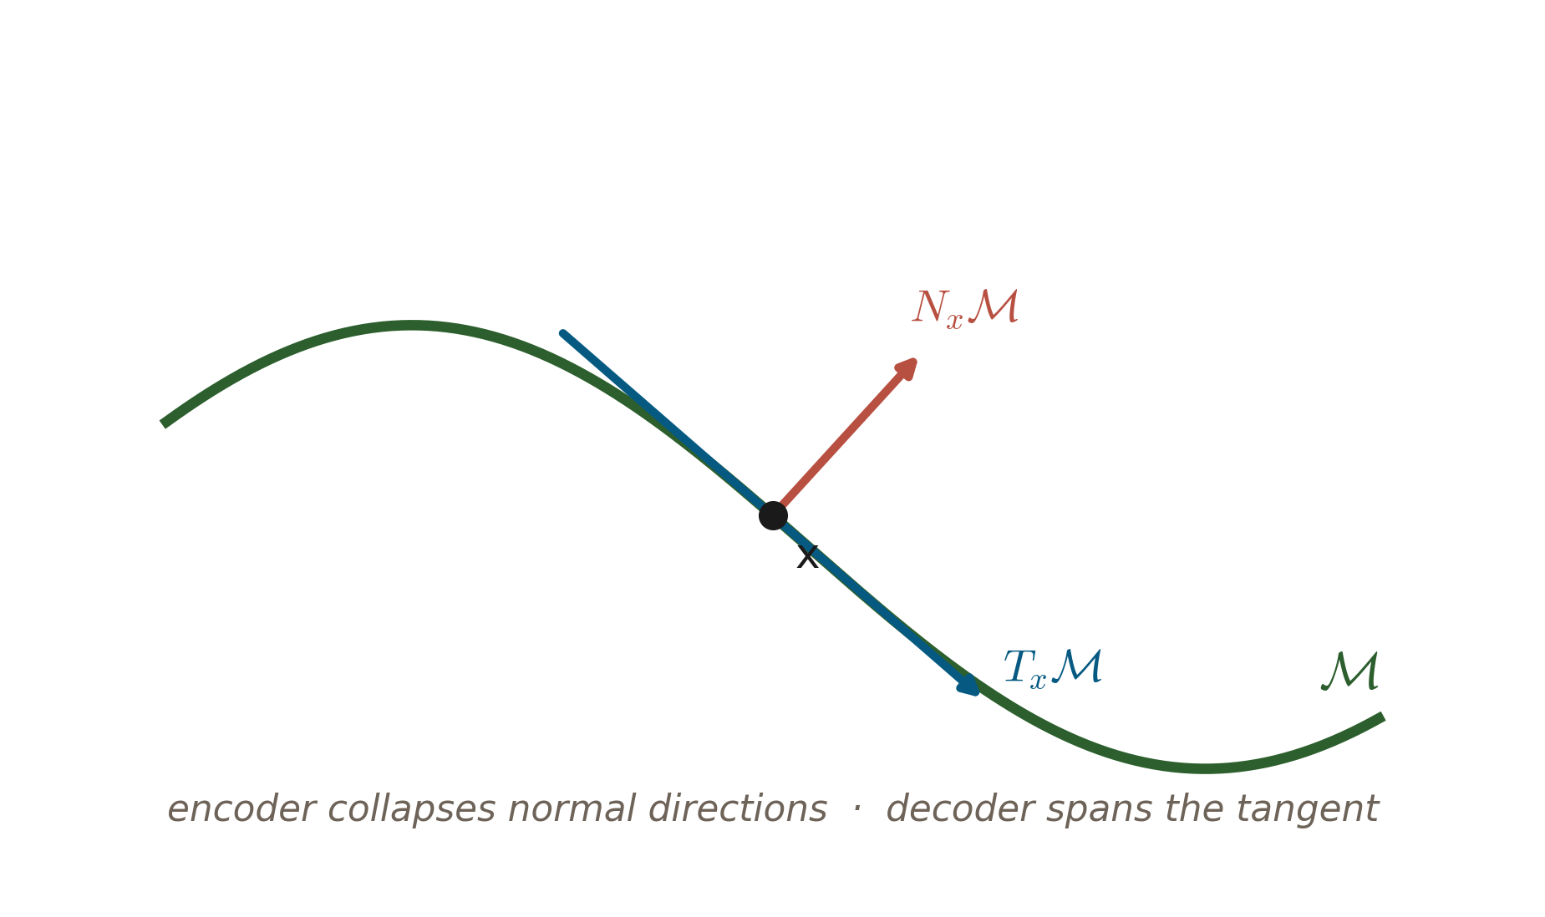
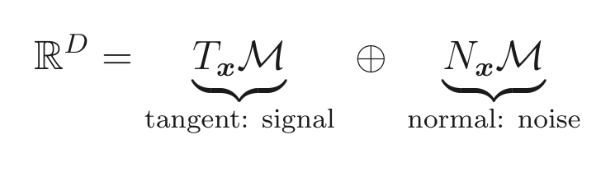
THE MODELS · REGULARIZED AUTOENCODERS
05
One geometric goal, three ways to enforce it
At each x, ℝ^D splits: directions ALONG M change the object (signal); directions OFF M are just noise.
A high-capacity AE could memorize. The fix is to control what it is sensitive to, not just its width.
Diagnostic reused everywhere: the encoder-Jacobian singular spectrum shows a gap at d — d large values (tangent), the rest ≈ 0 (normal).
KEY IDEA
Sparse, denoising, and contractive AEs are three routes to the same target — ignore the normal directions. Penalize activations (sparse) · resist corruption (denoising) · penalize the Jacobian (contractive). The next three slides take each in turn.
Be sensitive along M (signal); be blind across it (noise).
Notes:
The connective slide. Hold the tangent/normal picture up; the three variants are just different ways to say “don't be sensitive off the manifold.”

Slide 9
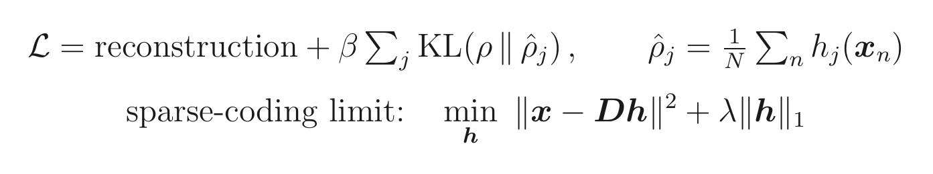
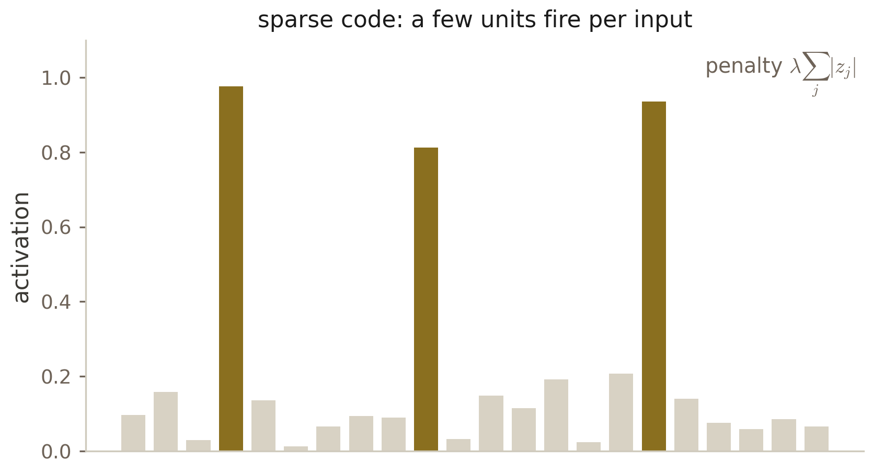
THE MODELS · SPARSE AUTOENCODER
06
Sparse autoencoders: a few parts per input
Keep the layer wide (often overcomplete), but force most hidden units OFF for any given input — each x is built from a few “parts.”
Penalty: pull each unit's average activation ρ̂_j to a small target ρ (a KL term), or put an L¹ penalty straight on the activations.
Lineage: sparse coding (Olshausen & Field 1996) — an overcomplete dictionary with an L¹ code. On natural-image patches it learns Gabor-like edge filters, strikingly close to V1 receptive fields.
Payoff: interpretable, parts-based features; a strong unsupervised pretraining signal.
GOTCHA
The penalty weight β trades reconstruction against sparsity. Too weak → a dense, uninterpretable code; too strong → dead units that never fire. Tune ρ and β together.
Notes:
Emphasize the sparse-coding heritage and the V1 result — that's the “aha” that makes sparse AEs feel principled rather than a hack.

Slide 10
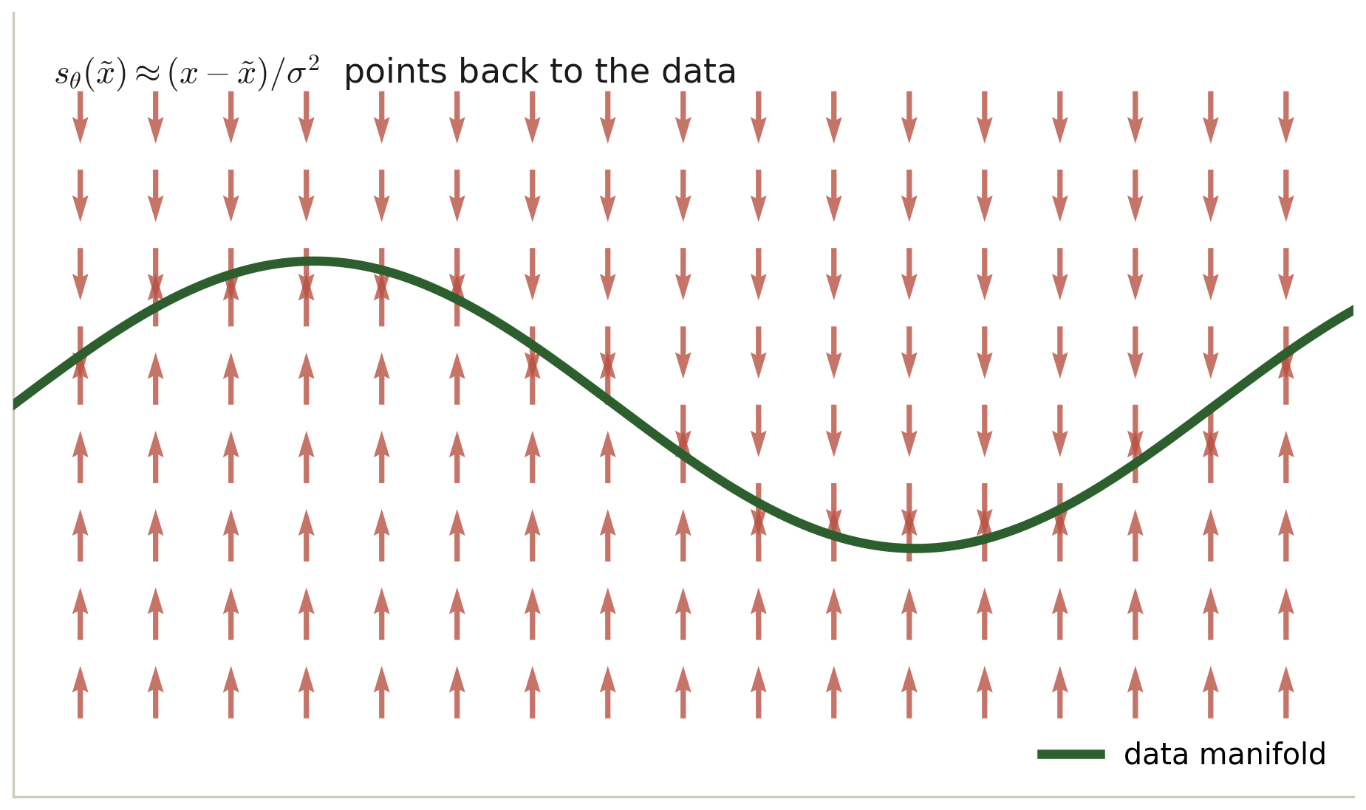
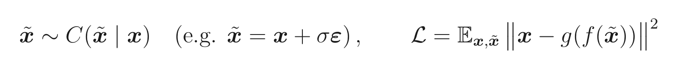
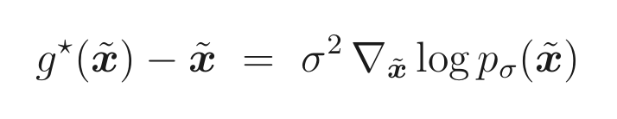
THE MODELS · DENOISING AUTOENCODER
07
Denoising autoencoders = learning the score
Corrupt the input — x̃ = x + σε, or randomly mask it — and train the net to recover the clean x.
To undo corruption the network must learn the manifold: it projects x̃ back onto M.
Vincent (2011): the optimal denoiser's residual equals σ²·∇log p_σ — a DAE learns the score of the noise-smoothed data density.
So no bottleneck is needed — corruption itself is the regularizer (be insensitive to the noise directions).
HISTORY
Train one denoiser across many noise levels and anneal σ large→small — that is a diffusion model. Published 2011; became state-of-the-art generation only in 2019–20 (Song–Ermon; Ho et al.).
The residual points toward M — the score of the smoothed density.
Notes:
The most beautiful identity in the subject and the seed of diffusion. Stress: the corruption replaces the bottleneck as the thing that enforces manifold-awareness.

Slide 11
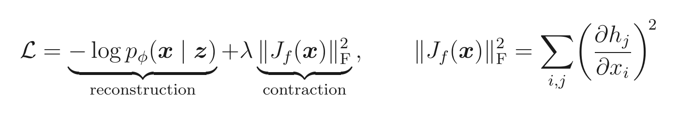
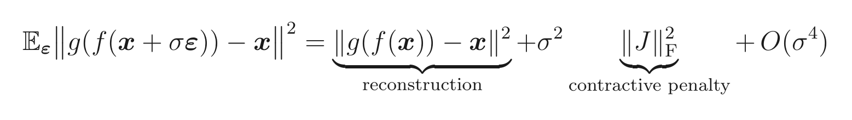
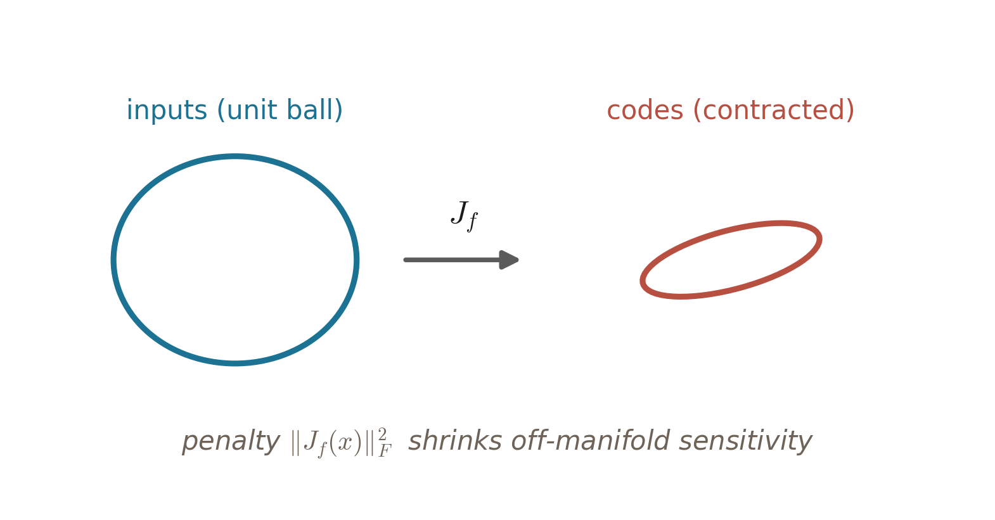
THE MODELS · CONTRACTIVE AUTOENCODER
08
Contractive autoencoders: penalize sensitivity directly
Add λ‖J_f(x)‖_F² — make the encoder's Jacobian small, so the code barely moves when x is nudged.
It can't shrink the tangent directions (those are needed to reconstruct) — so it contracts only the normal ones, flattening the map off M.
The deep link: in the small-σ limit, the denoising objective equals reconstruction + σ²‖J‖_F². So a denoising AE is an implicit contractive AE (Alain & Bengio 2014).
CAE = explicit, analyzable contraction; DAE = implicit, sampling-based. Two roads, one geometry.
KEY IDEA
Sparse, denoising, and contractive are three knobs on ONE objective: be insensitive to the normal directions. That is the unifying statement for all of regularized autoencoding.
Notes:
The payoff slide of the trio: write the small-noise expansion and let the DAE≈CAE equivalence land. Then state the unifying sentence.

Slide 12
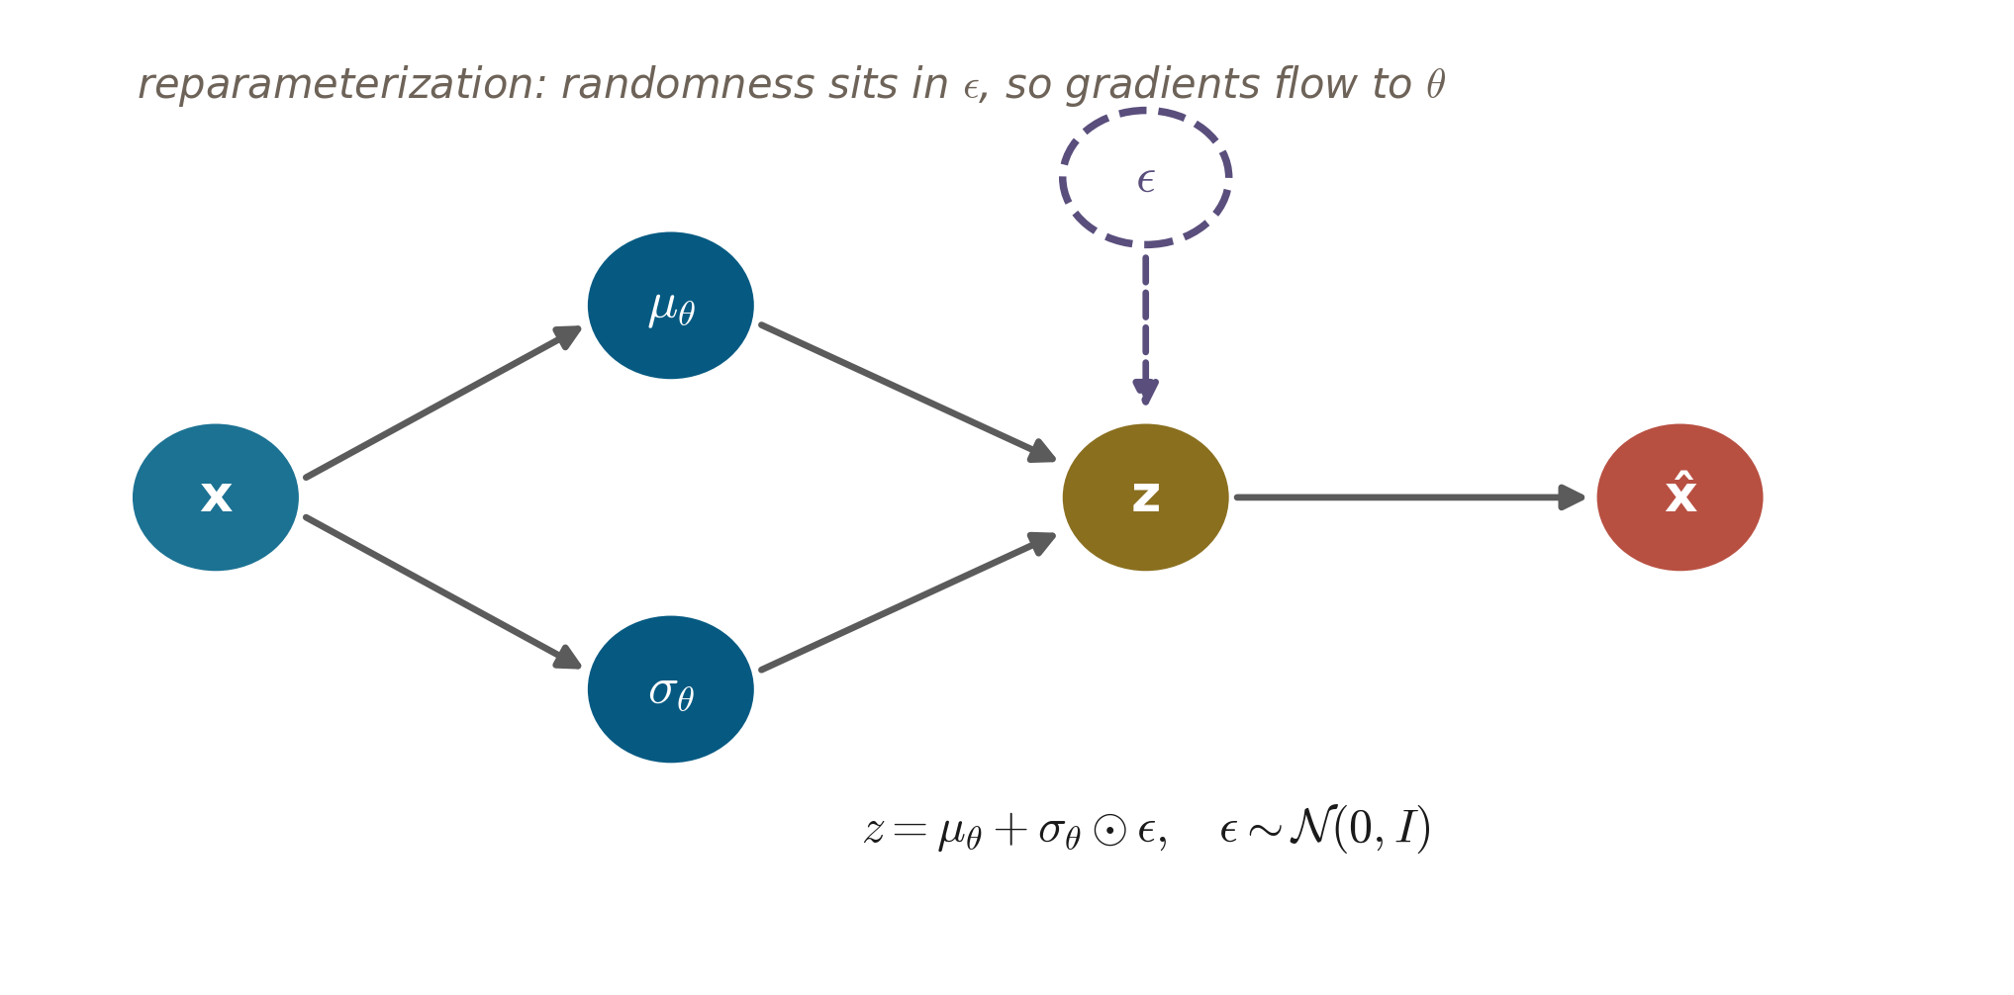
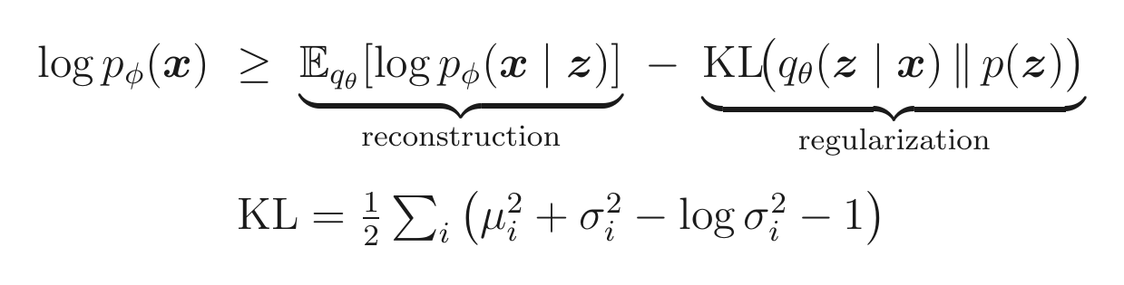
THE MODELS · VARIATIONAL AUTOENCODER (1/3)
09
The VAE: a generative model with a tractable bound
Plain AEs leave a holey latent, no likelihood, and meaningless interpolation. The VAE fixes all three by going probabilistic.
Prior z ∼ N(0,I); decoder p_φ(x|z); the intractable true posterior is approximated by an amortized encoder q_θ(z|x).
Maximize the ELBO: log p(x) ≥ E_q[log p(x|z)] − KL(q‖prior). The slack equals KL(q ‖ true posterior) ≥ 0.
Reparameterize: z = μ + σ⊙ε, ε∼N(0,I) — randomness sits in ε, so gradients flow to θ.
Maximize the ELBO; reparameterize so the sampler is differentiable.
Notes:
Three problems with the plain AE, all fixed by going probabilistic. The ELBO is a bound and the gap is a KL — say that, it demystifies why we maximize it.

Slide 13
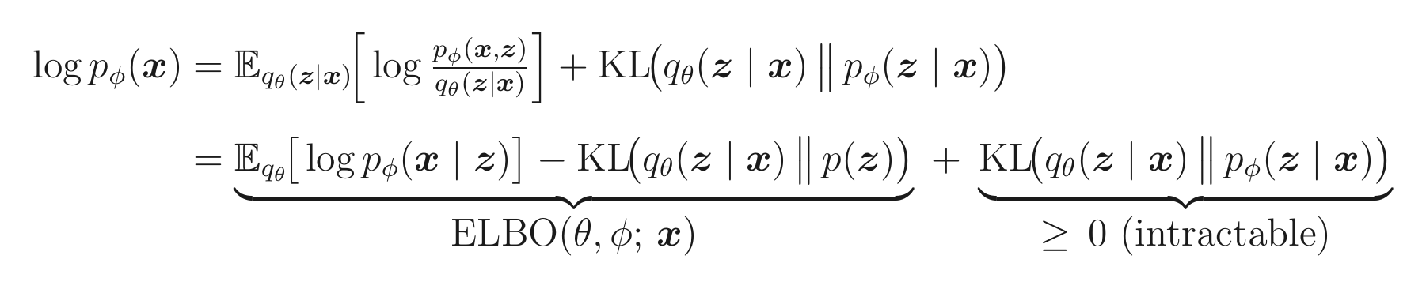
THE MODELS · VARIATIONAL AUTOENCODER (2/3)
10
Deriving the ELBO — a bound that is also a posterior fit
Start from the intractable marginal likelihood and insert the encoder q. The log splits exactly:
Insert q and regroup: log p(x) = ELBO(θ,φ) + KL(q(z|x) ‖ true posterior) — an exact identity, no approximation yet.
That trailing KL is ≥ 0 and intractable. Drop it and you are left with a computable lower bound: the ELBO.
Maximizing the ELBO does double duty: it raises log p(x) AND shrinks KL(q ‖ posterior) — the encoder is trained to approximate the true posterior.
Usable form: ELBO = E_q[log p(x|z)] − KL(q ‖ prior) = reconstruction minus a pull to the prior. Tight iff q is the posterior.
KEY IDEA
The ELBO is not an arbitrary loss: it is the unique decomposition whose slack equals the encoder's posterior error — so “tighten the bound” and “do better inference” are the same instruction.
Notes:
Walk the two lines slowly: the first is an exact identity; the second names the ELBO and the non-negative gap. The punchline — maximizing the bound trains the encoder toward the true posterior — is what makes variational inference work.

Slide 14
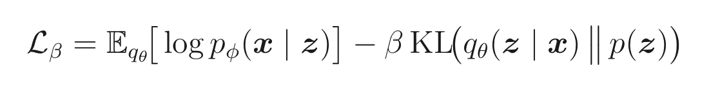
THE MODELS · VARIATIONAL AUTOENCODER (3/3)
11
The tug-of-war, posterior collapse, and the β knob
Two terms pull apart: reconstruction wants q spiked on the exact z that rebuilds x; the KL pulls q toward the prior.
Equilibrium → a smooth, densely-packed latent you can sample and interpolate. Gaussian KL = ½∑(μ²+σ²−logσ²−1).
β-VAE: scale the KL by β. β>1 ⇒ more disentangled but blurrier; β<1 ⇒ sharper but holey. β is the compression / rate knob.
GOTCHA
Posterior collapse: if the decoder is powerful enough, the cheapest way to pay the KL is q(z|x) ≈ prior for every x — the latent is ignored entirely and the model degenerates to an unconditional decoder. Fixes: KL warm-up (anneal its weight) or “free bits” (a per-dimension KL floor).
KEY IDEA
What you get: a continuous latent that is dense (sample anywhere) and smooth (interpolate meaningfully). That single property is what every generative use in the sciences — simulating spectra, deblending galaxies — is built on.
β
small β — sharp, holey
large β — smooth, disentangled, blurry
Notes:
Frame the VAE as a controlled tug-of-war. Flag posterior collapse as the failure every practitioner hits, and end on the sample-able latent — the bridge to the applications.

Slide 15
PART II
In the sciences
Three deep dives in astrophysics, one in particle physics — “off-manifold = interesting.”
Notes:
Deliberately few examples, each done properly. Watch the manifold idea do real scientific work.

Slide 16
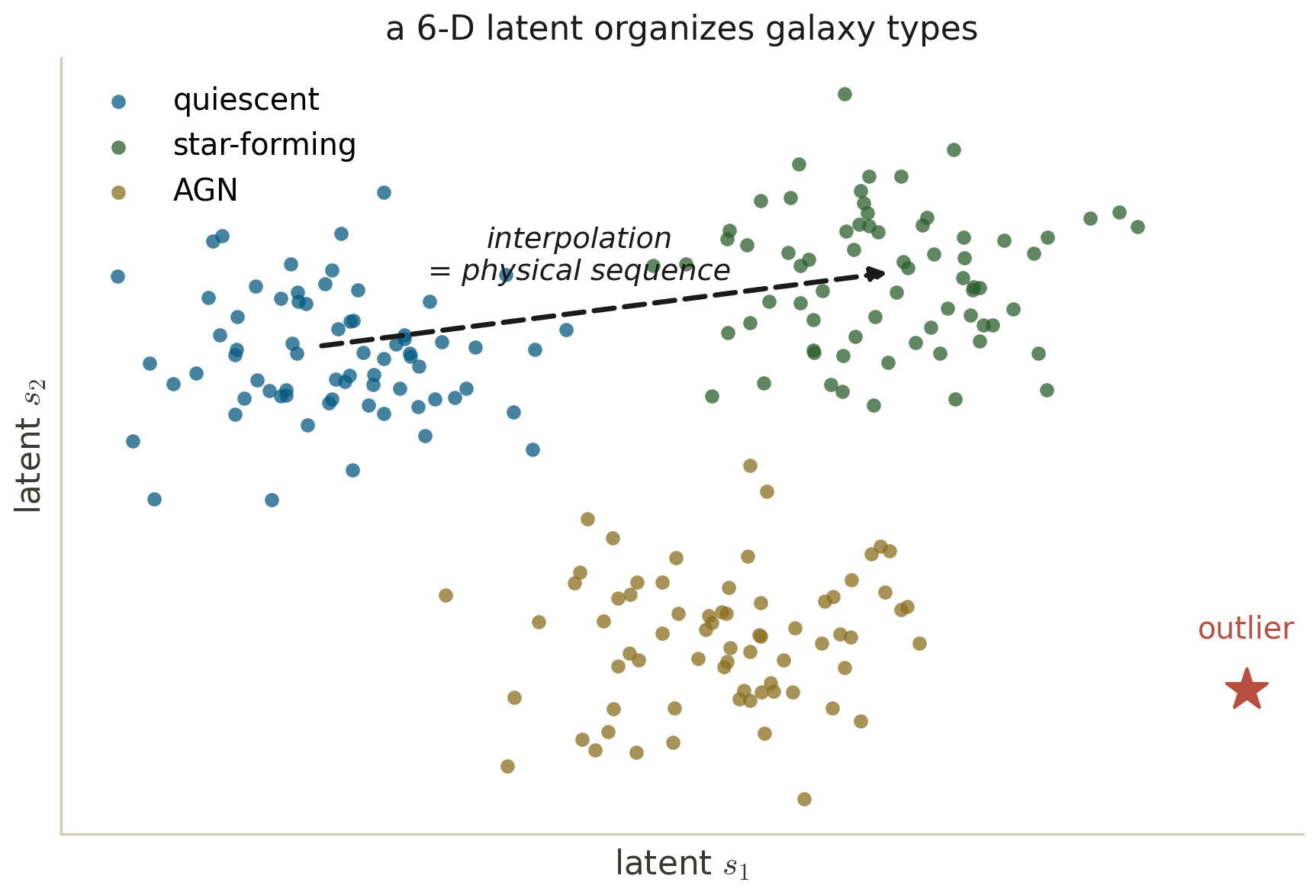
ASTROPHYSICS · DEEP DIVE ①
12
Compressing galaxy spectra
A galaxy spectrum is ~4000 flux values, but the physics has only a handful of degrees of freedom.
spender (Melchior et al. 2023) autoencodes SDSS spectra; the encoder decodes in the rest frame and shifts to the observed redshift, so z̄ is not wasted on redshift. Six latents beat PCA at the same count (cf. Portillo 2020).
The latent self-organizes with no labels: star-forming ↔ quiescent ↔ AGN separate; smooth paths are physical morphs; artifacts land in empty regions.
SCIENCE
One trained network behaves as four instruments at once: unsupervised structure · meaningful interpolation · outlier detection · a generative spectrum simulator. That bundling is why autoencoders spread through observational astronomy.
A 6-D latent: classes self-organize; paths interpolate; outliers fall in voids.
Notes:
This is PCA-vs-nonlinear plus the sample-able latent, paying rent on real data. The redshift trick is the clever, domain-specific part worth dwelling on.

Slide 17
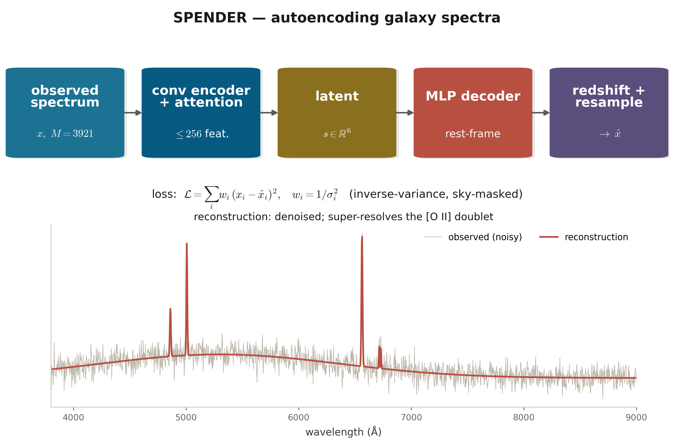
ASTROPHYSICS · PAPER IN DETAIL
13
spender — autoencoding galaxy spectra (I)
Melchior, Liang, Hahn & Goulding · The Astronomical Journal 166:74 (2023) · arXiv:2211.07890
What the paper shows
Accurate reconstructions with substantially reduced noise — the AE acts as a denoiser.
Deconvolution + oversampling give a super-resolution model that resolves the [O II] doublet.
Attention weights double as a map of which spectral features matter.
Six latents capture the main physical degrees of freedom — beating PCA at the same count (Portillo 2020).
S = 6
latents rebuild a full spectrum
Why it matters: The key design move: the redshift transformation lives in the decoder, not the latent — so the code encodes galaxy type at any redshift, letting one model swallow a whole survey.
Notes:
Dwell on the redshift-in-the-decoder trick — that is the architectural insight that makes spender more than a generic AE on spectra.

Slide 18
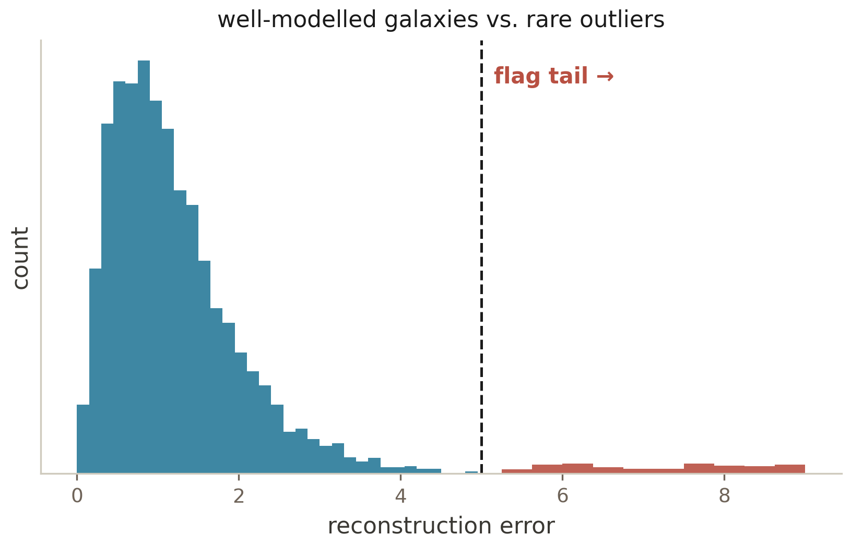
ASTROPHYSICS · DEEP DIVE ②
14
Discovery by reconstruction error
Surveys (SDSS, DESI, Rubin/LSST) yield 10⁷–10⁹ objects; the interesting ones are rare and of unknown type — there are no labels for “unknown unknowns.”
Train an AE on the typical population; reconstruction error is a novelty score. Off-manifold means “unlike anything common.”
Remove the dominant nuisance first: redshift-invariant latents (Liang et al. 2023, on spender) make the residual surface genuinely new physics, not just a different redshift.
What surfaces at the top: rare quasars, blends, instrument artifacts, unclassified oddballs — a model-agnostic discovery engine.
Train on the bulk; rank by reconstruction error; inspect the tail.
GOTCHA
Use reconstruction error, not model likelihood: deep generative models can assign higher likelihood to out-of-distribution inputs than to real data (Nalisnick et al. 2019). The same caution returns, verbatim, in the particle-physics search.
Notes:
Frame as the discovery problem: you cannot train a classifier for things you have not seen. This is the astrophysics twin of the LHC anomaly search two slides later.

Slide 19
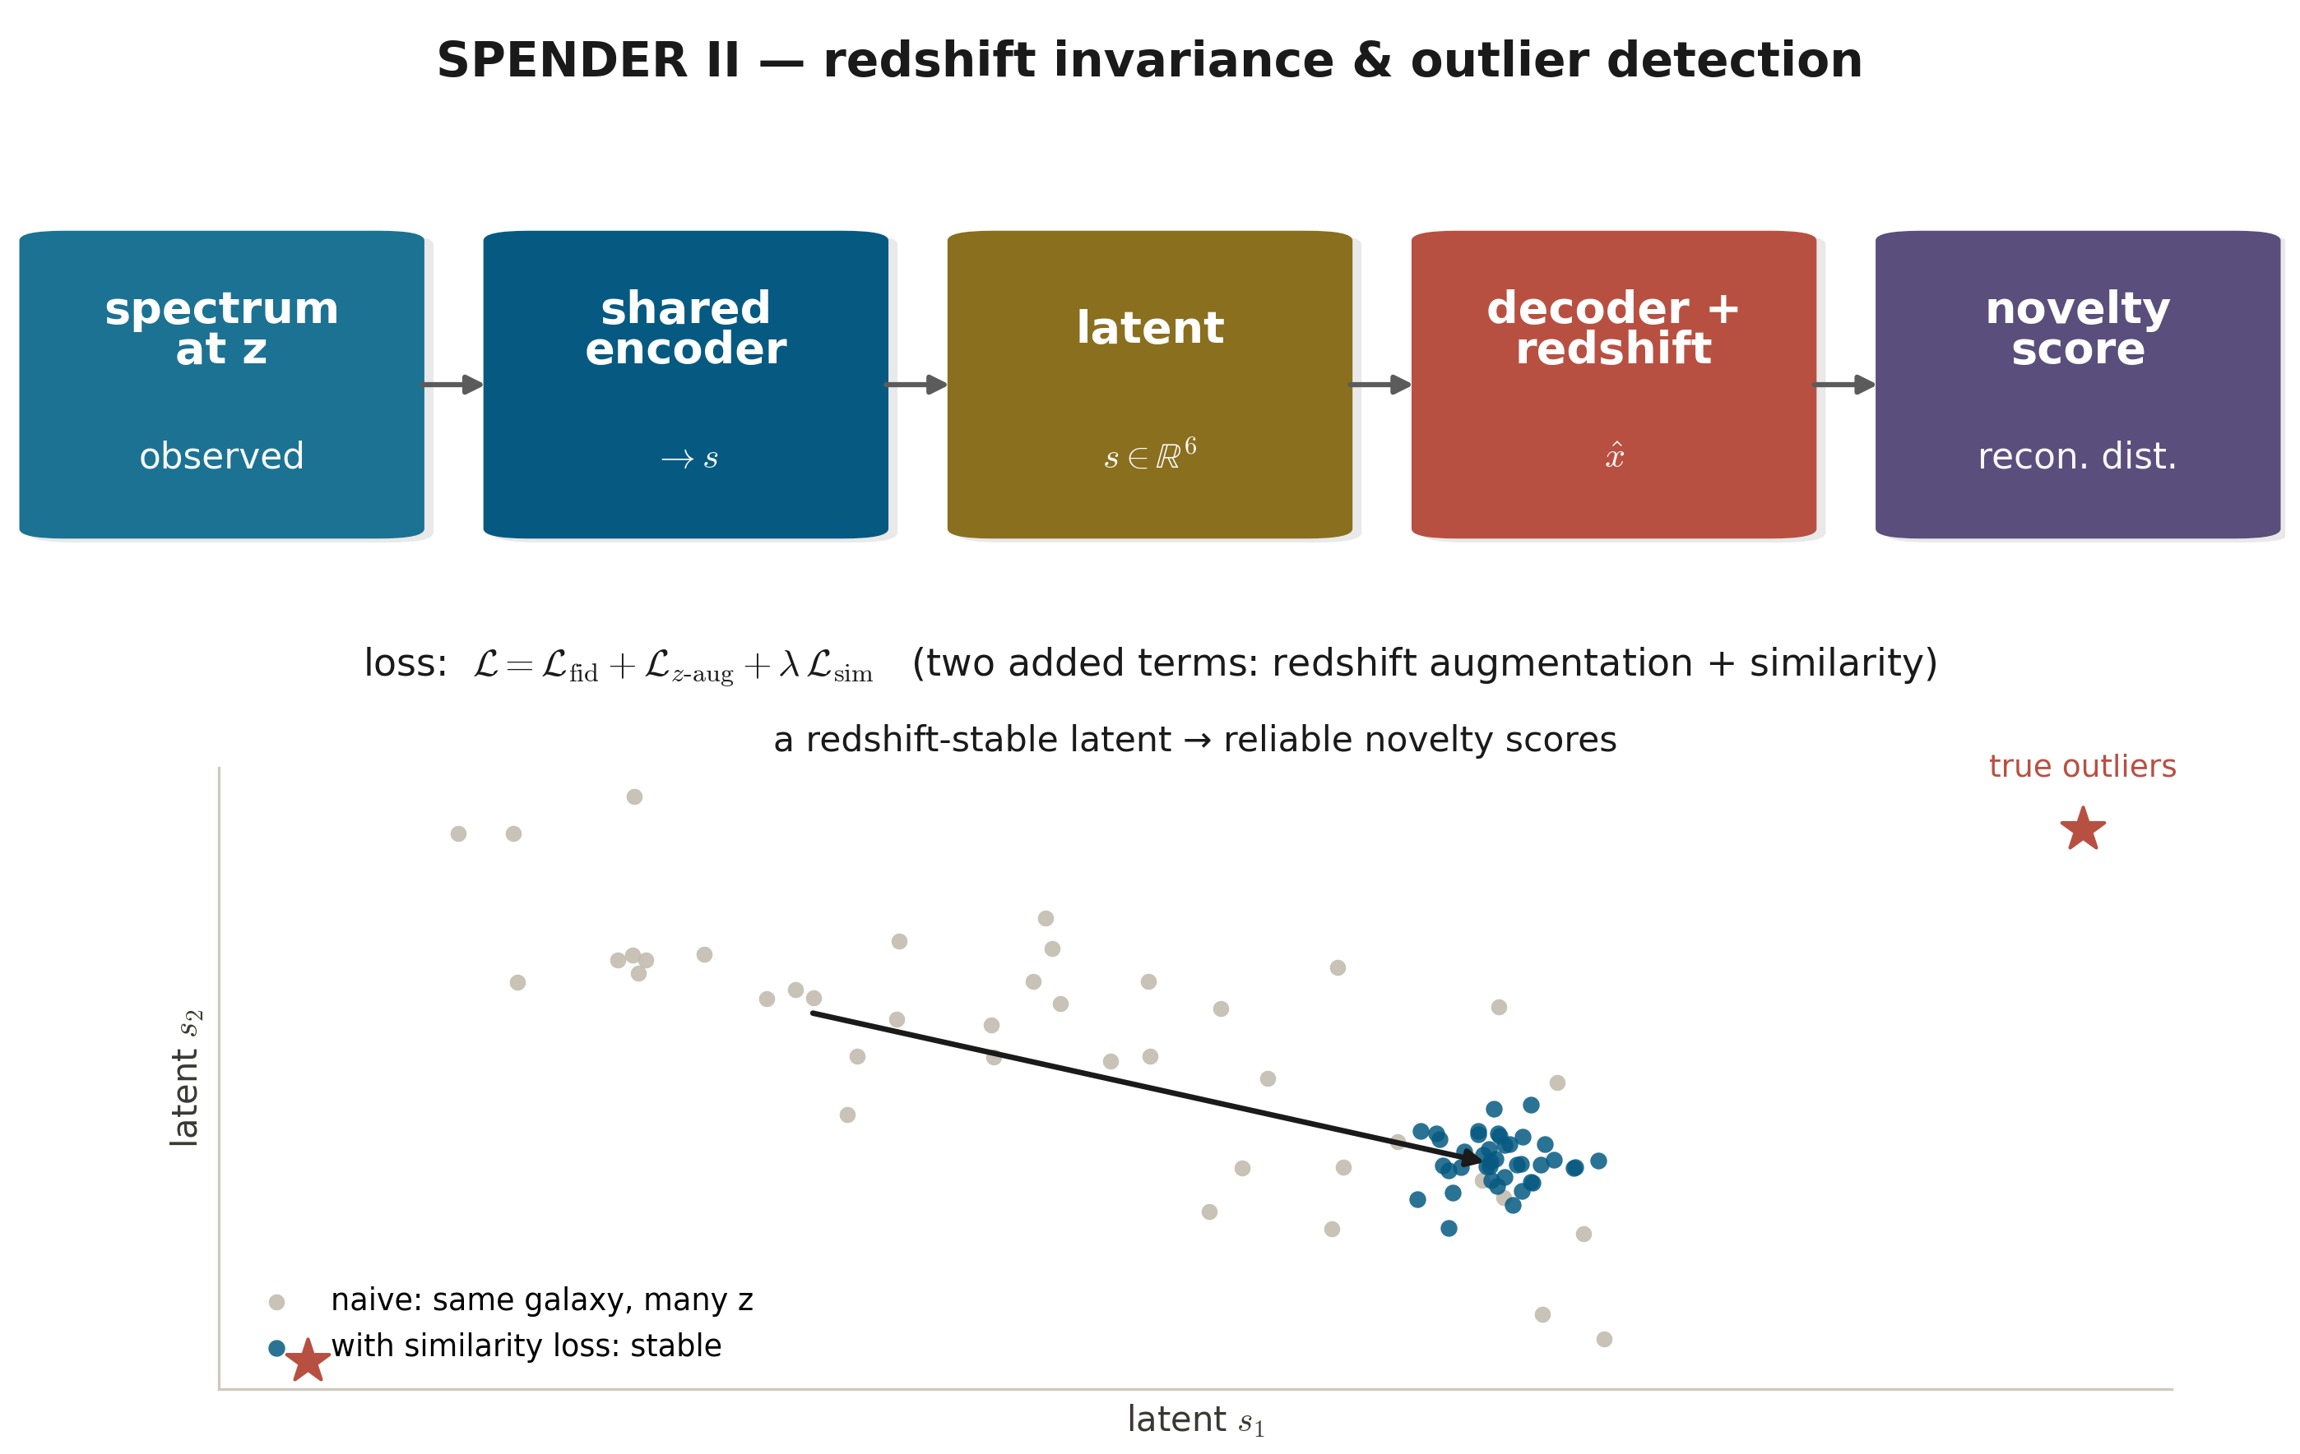
ASTROPHYSICS · PAPER IN DETAIL
15
spender (II) — redshift invariance & outlier detection
Liang, Melchior, Lu, Goulding & Ward · The Astronomical Journal (2023) · arXiv:2302.02496
What the paper shows
A redshift-stable latent → reliable, reproducible novelty scores.
Surfaces genuine oddities: artifacts, blends, and stars misclassified as galaxies.
Released the retrained model and a latent-space probability for the entire SDSS-I galaxy sample.
SDSS-I
full sample scored & released
Why it matters: A cautionary tale worth keeping: an architecture that should be invariant need not be. Invariance often has to be trained in, not assumed — true of equivariant networks generally.
Notes:
The pedagogical gold here is the failure: symmetry by construction is not symmetry in practice. Connects to the broader equivariance literature.

Slide 20
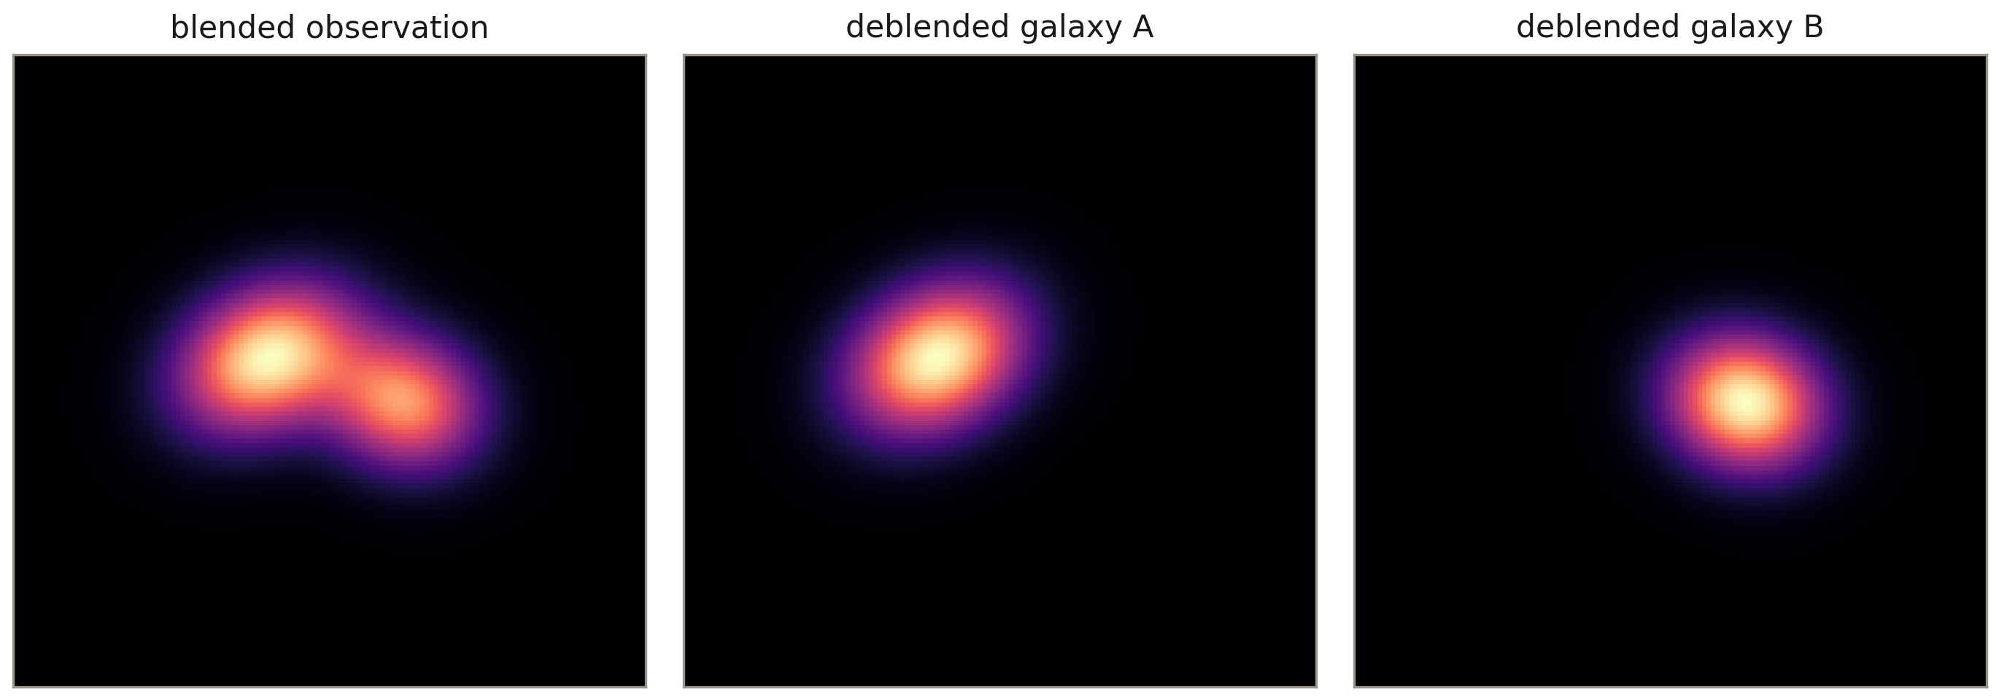
ASTROPHYSICS · DEEP DIVE ③
16
Deblending overlapping galaxies
In deep Rubin/Euclid images the sky is crowded: galaxies overlap (“blends”), biasing every shape and flux measurement — and thus weak-lensing cosmology.
Train a VAE as a prior over isolated galaxy images. Deblending becomes inference in that latent space (Arcelin et al. 2021): find codes whose decoded galaxies sum to the observed pixels.
The generative prior regularizes an ill-posed inverse problem — far more robust than parametric (Sérsic) fits on irregular, real galaxies.
Explain blended pixels as a sum of galaxies decoded from a learned prior.
SCIENCE
Here the autoencoder is not analyzing data but generating constraints: a smooth, sample-able latent turns “separate the sources” into optimization under a learned prior. The VAE's defining property is doing the scientific work.
Notes:
The third astro angle: AEs as generative priors for inverse problems, not just compressors. Tie it back to why we built a sample-able latent in Part I.

Slide 21
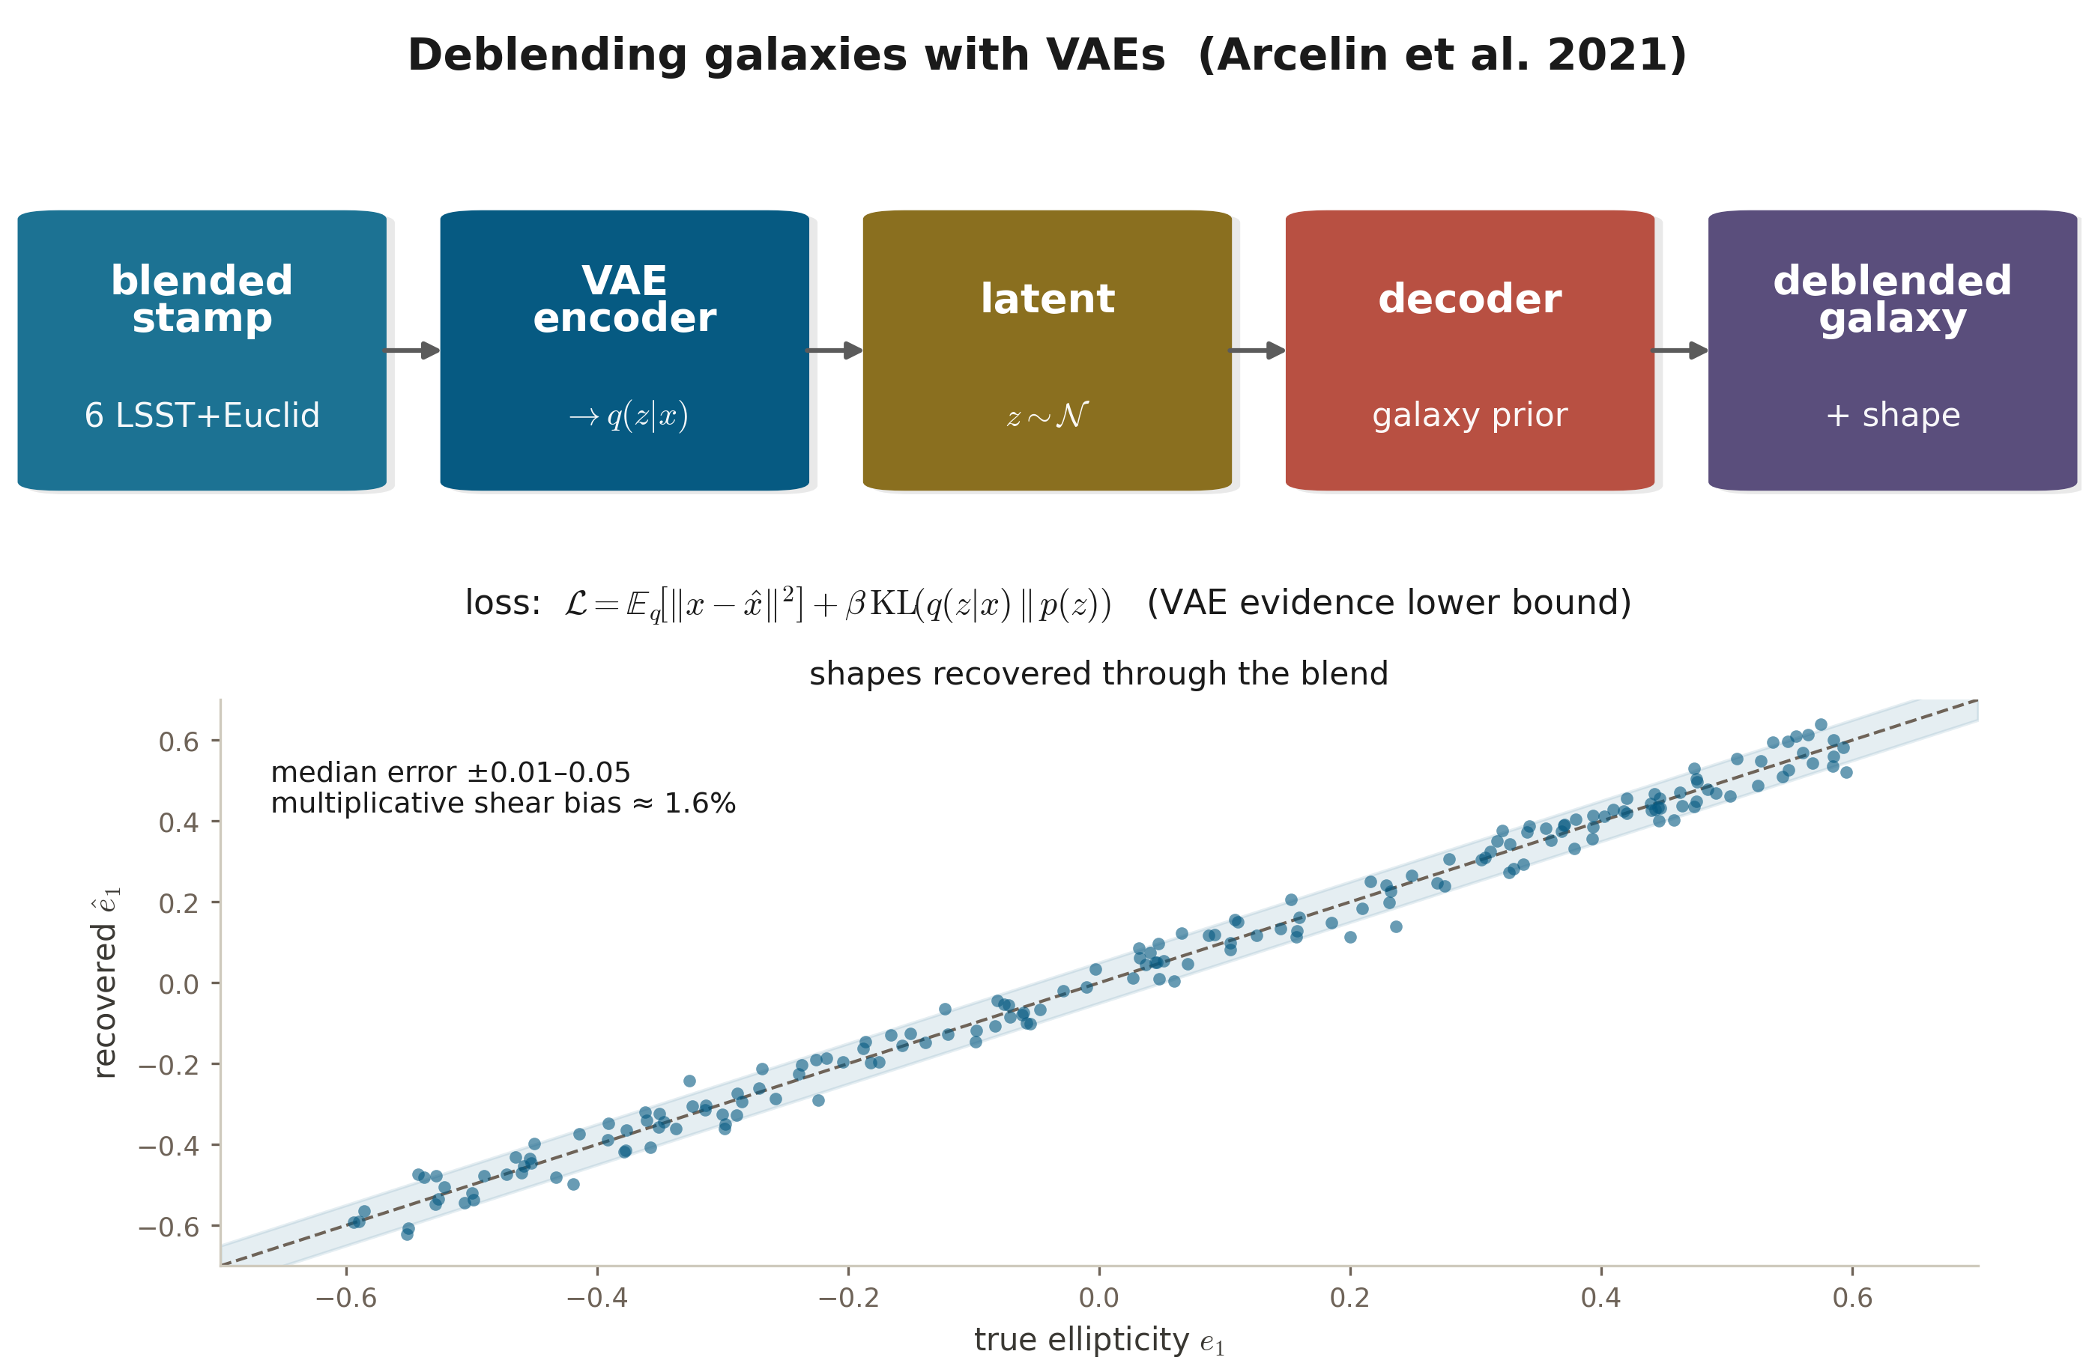
ASTROPHYSICS · PAPER IN DETAIL
17
Deblending galaxies with VAEs — Arcelin et al. 2021
Arcelin, Doux, Aubourg & Roucelle (LSST DESC) · MNRAS 500:531 (2021) · arXiv:2005.12039
What the paper shows
Median errors of ±0.01–0.05 on ellipticity and r-band magnitude in most configurations.
Ellipticity multiplicative (shear) bias ≈ 1.6% for blended objects in the best setup; robust to decentring.
Transfer learning toward real data gives encouraging early results.
1.6%
shear bias on blended objects
Why it matters: The generative prior regularizes an ill-posed inverse problem — flexible enough for irregular real galaxies where parametric fits break, and it carries straight to multi-band, multi-instrument data.
Notes:
Tie back to Part I: this is the sample-able latent doing inference. The shear-bias number is what cosmologists actually care about.

Slide 22
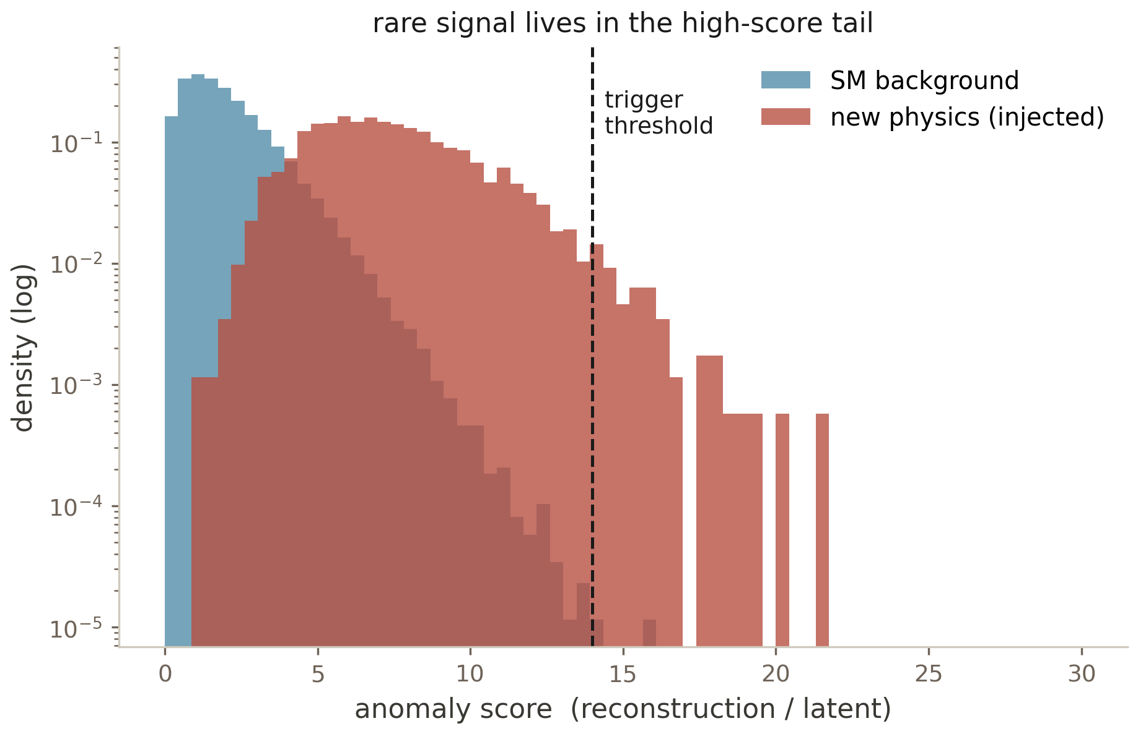
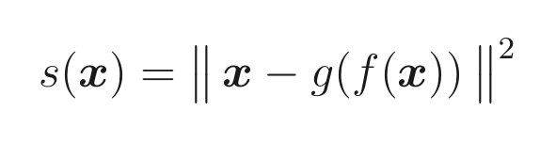
PARTICLE PHYSICS · DEEP DIVE ④
18
Hunting new physics in the LHC trigger
The LHC collides bunches at 40 MHz; ~99.999% is known Standard-Model background, and new physics is rare and shape-unknown — you cannot train a supervised classifier for it.
Model-agnostic move: train a (V)AE on background only; the reconstruction error is the anomaly score (Cerri et al. 2019). New physics is off the SM manifold.
The hard constraint is latency: the Level-1 trigger decides in O(100 ns). Govorkova et al. (2022) compiled an autoencoder onto an FPGA, running anomaly detection in hardware at the full collision rate.
GOTCHA
Train on Standard-Model background only; new physics piles up off-manifold.
Same caveat as the astro search: VAE likelihoods are unreliable OOD (Nalisnick 2019). Reconstruction error + background-only training + mass-decorrelation are what make the trigger robust.
Notes:
Close the loop with the astro anomaly slide: identical idea — off-manifold = interesting — under a brutal latency budget. The decoder's failure is the physics signal.

Slide 23
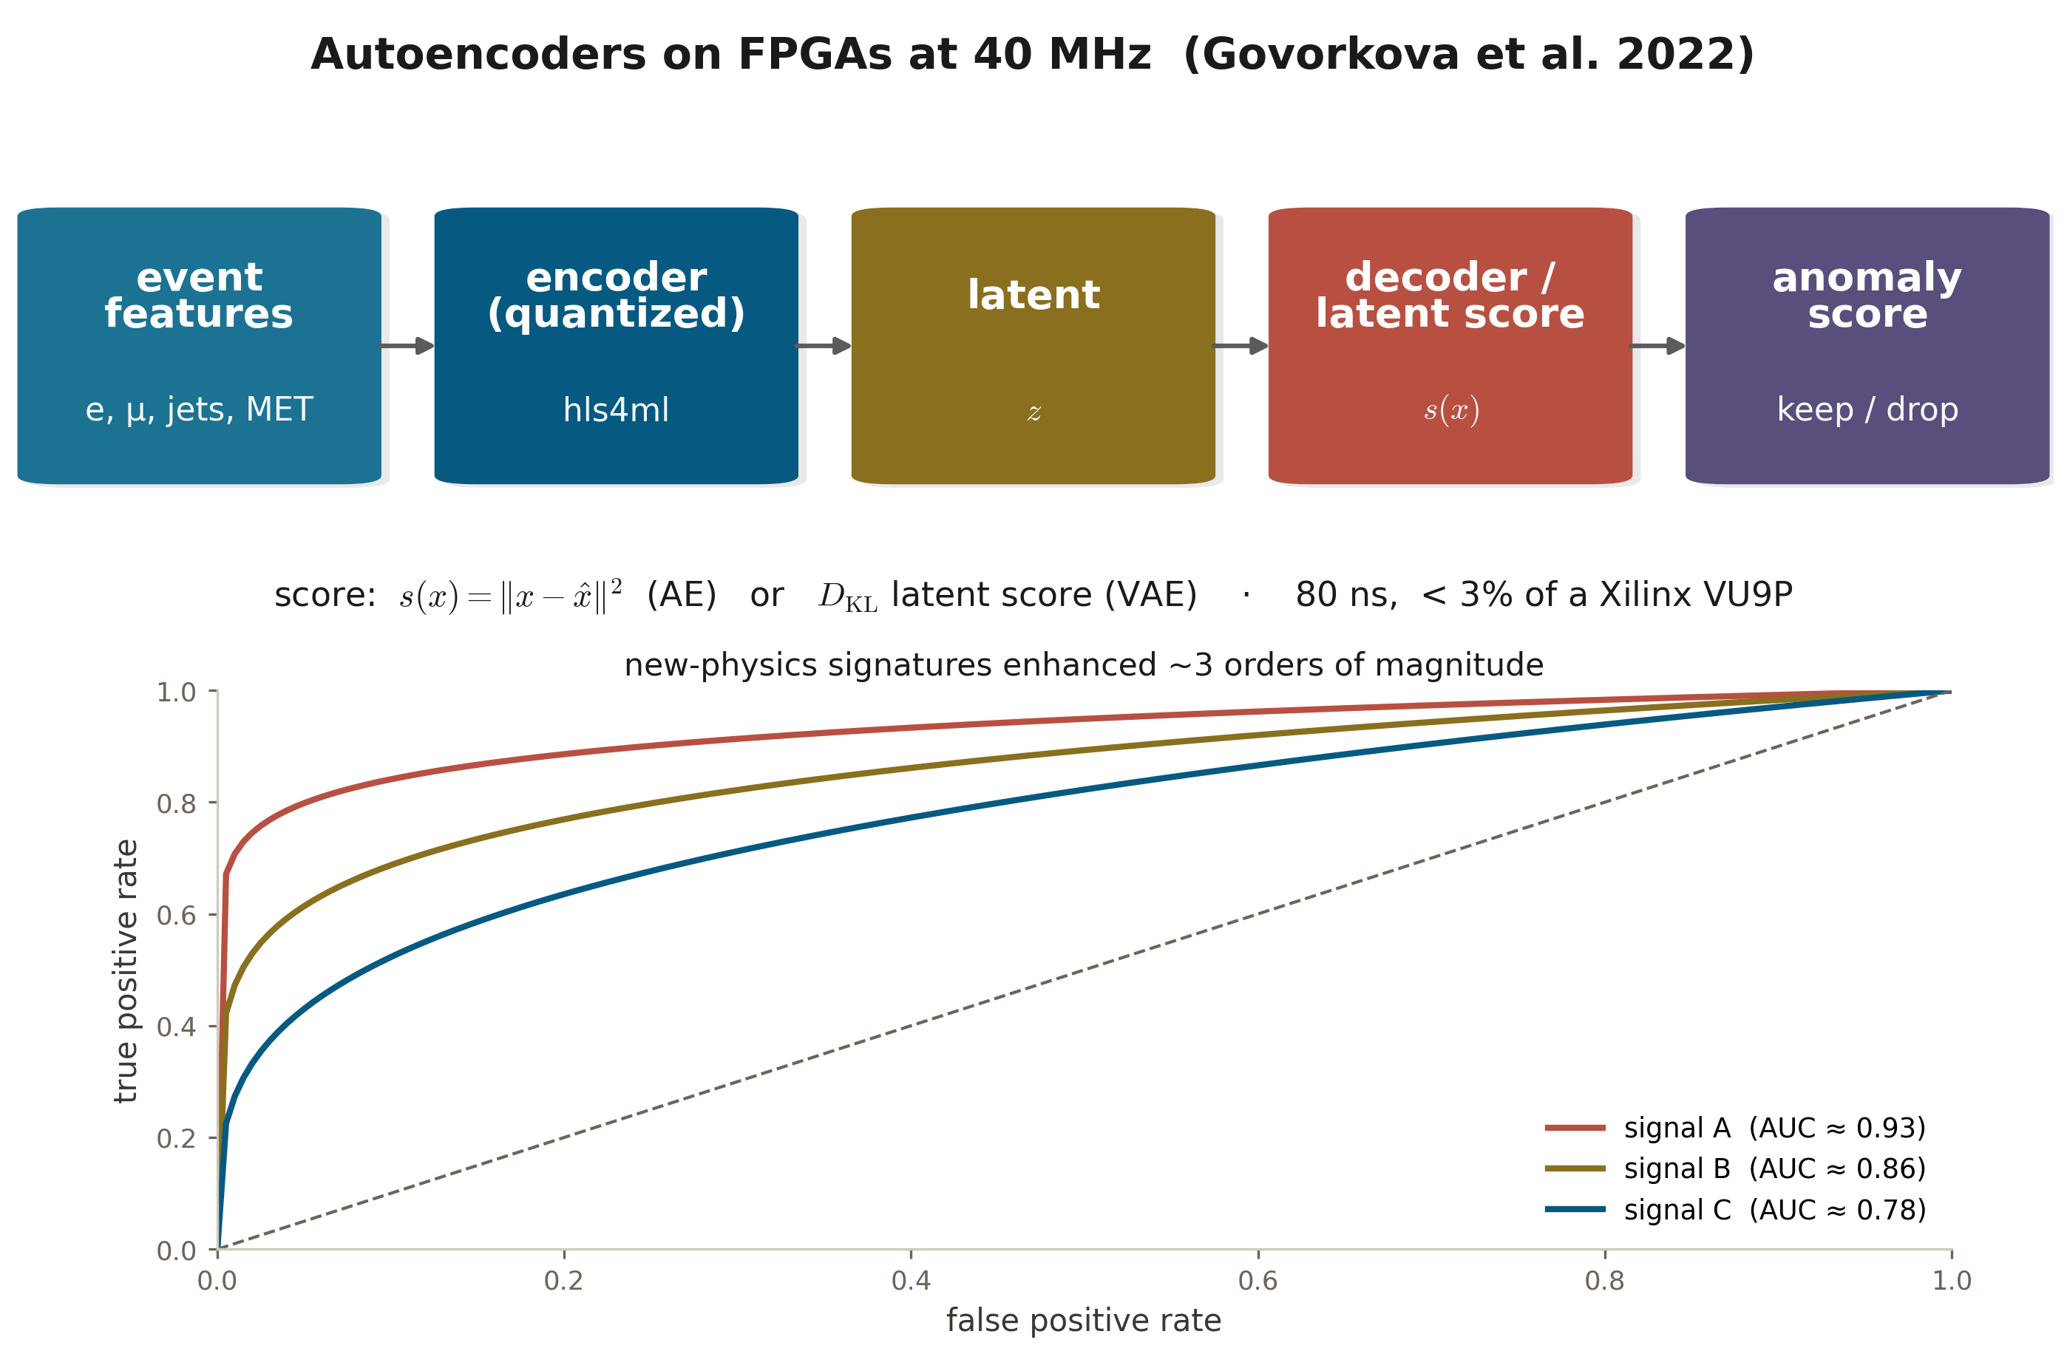
PARTICLE PHYSICS · PAPER IN DETAIL
19
Autoencoders on FPGAs at 40 MHz — Govorkova et al. 2022
Govorkova, Puljak, Aarrestad, Pierini, Ngadiuba, Nguyen et al. · Nature Machine Intelligence 4:154 (2022) · arXiv:2108.03986
What the paper shows
Inference in as little as 80 ns using under 3% of the logic on a Xilinx Virtex VU9P.
New-physics signatures enhanced by ~three orders of magnitude — within the trigger's strict latency and resource budget.
Opens the way to collecting new-physics-enriched datasets during live LHC running.
80 ns
L1-trigger inference, < 3% FPGA logic
Why it matters: The manifold idea under a hardware stopwatch: reconstruction / latent error as the anomaly score, computed in real time, lets the LHC keep potential new-physics events it would otherwise throw away.
Notes:
Headline the 80 ns and ~1000× together — that pairing (real-time AND a big signal boost) is the whole point. Mirror it against the astrophysics anomaly slide.

Slide 24
THE THROUGH-LINE
What to keep
1
Data lives on a low-D manifold. The autoencoder is the device that finds it — compress, represent, generate.
5
Denoising = the score; ≈ contractive. DAEs learn ∇log p (→ diffusion); small-σ denoising equals a Jacobian penalty.
2
Linear = PCA. Truncated-SVD subspace; every local min global; the axes are not identified.
6
The VAE adds a prior + amortized posterior. A smooth, sample-able latent; β tunes the rate–distortion trade.
3
Nonlinearity unrolls curved manifolds. The Swiss roll — at the cost of a much larger symmetry, so harder identifiability.
7
In science, the AE is an instrument. Compress spectra, discover anomalies, deblend galaxies, hunt new physics — off-manifold = interesting.
4
Three regularizers, one goal. Sparse · denoising · contractive all say: be blind to the normal directions.
Notes:
Recap the ladder and the single sentence that unifies the science half. The four ideas from Part I are exactly what Parts II spends.

Slide 25
REFERENCES
Further reading
Foundations
Sparse · sparse coding
Eckart & Young, Psychometrika (1936) · Baldi & Hornik, Neural Networks (1989) · Hinton & Salakhutdinov, Science (2006).
Olshausen & Field, Nature (1996) · Ng, sparse-autoencoder notes (2011) · Makhzani & Frey, k-sparse AE (2014).
Denoising · contractive · score
Variational autoencoders
Vincent et al. (2008); Vincent, Neural Comp. (2011) · Rifai et al., ICML (2011) · Alain & Bengio, JMLR (2014) · Song & Ermon (2019); Ho et al. (2020).
Kingma & Welling (2014) · Rezende et al. (2014) · Higgins et al., β-VAE (2017).
Astrophysics
Particle physics
Portillo et al., AJ (2020) · Melchior et al. (2023), spender · Liang et al., AJ (2023), redshift-invariant outliers · Arcelin et al., MNRAS (2021), VAE deblending.
Cerri et al., JHEP (2019) · Govorkova et al., Nat. Mach. Intell. (2022) · Nalisnick et al., ICLR (2019), OOD likelihoods.
Full derivations and figures are in the companion lecture notes.

