Slide 1
Integrated Flood and Landslide Risk Assessment and Response System for Sri Lanka
J26-IT-334

Slide 2
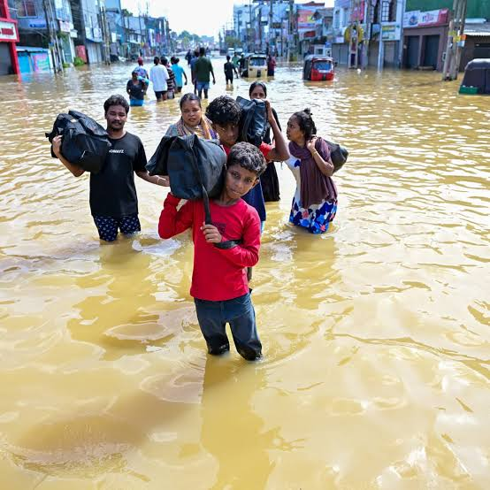
Overall Project Description
Research Problem
Sri Lanka faces recurring, high-casualty flood and landslide disasters that current response systems address in a fragmented, reactive manner rather than through predictive, coordinated action.
Flooding alone has affected more than 10 million people in Sri Lanka over the past 30 years, with average annual disaster losses of approximately $313 million and roughly 750,000 people affected by natural disasters every year between 2011 and 2020 [9].
Cyclone Ditwah (November–December 2025) demonstrated the scale of compounded flood-and-landslide risk: it affected all 25 districts, caused 639+ deaths, displaced or affected up to 2.2 million people, and caused an estimated $4.1–7 billion in damage - with the worst casualties concentrated in Kandy, Nuwara Eliya, and Badulla, where flooding and landslides struck the same communities simultaneously [7], [10].
Existing early-warning and response mechanisms operate as separate, uncoordinated systems: hazard-specific susceptibility mapping exists for floods and landslides independently, impact and vulnerability assessment is done ad hoc, and resource dispatch relies on manual coordination — with no integrated pipeline connecting predictive hazard output to prioritized, evidence-based emergency action.

Slide 3
Existing Solutions and Limitations
Existing Solutions
Aspect | Details
Operator | National Building Research Organisation (NBRO) now referred to in some sources as NBRI
Type 1: Regional Landslide Early Warning (RLEW) | Running since 2007; issues warnings based on rainfall thresholds set at three levels — watch, alert, and evacuation — triggered at roughly 75 mm/day, 100 mm/day, and 150 mm/day, or 75 mm in one hour
Data collection | An automated network of 325 rain gauges installed across landslide-prone areas feeds real-time rainfall data into the system
Type 2 | Site-Specific Landslide Early Warning, which relies on dedicated ground-monitoring instruments at individual high-risk sites
Warning dissemination | Alerts reach the public through NBRO's website as well as radio, television, phone, and on-site sirens run by local agencies
Ongoing R&D | Since 2020, NBRO and the International Consortium on Landslides (ICL) have run project RRLL, a 5-year SATREPS-backed effort focused on rain-induced rapid, long-travelling landslides
Related mechanism | Slope Failure Hazard Zonation and Yellow Zone/Red Zone methodology used for debris-flow risk mapping (e.g. Aranayake, Kegalle)

Slide 4
Existing Solutions and Limitations
Limitations
Limitation | Explanation
Rainfall-only trigger logic | The current approach relies almost entirely on rainfall volume, even though rainfall is only one of the two known triggering factors more accurate predictive parameters exist but aren't systematically used
Can't predict rapid/long-travel slides | The technology to identify and stabilize already-reactivated, slow-creeping landslides has advanced, but rapid, long-travelling landslides can't be located or predicted in advance once they begin moving, they can't be stopped, as shown by the 2016 Aranayake disaster which killed 125 people
Regional, not hyperlocal | RLEW issues broad regional/DS-division-level alerts rather than village- or household-level, precision guidance — this is a gap your IDMERS localized Web-GIS approach targets
No soil/geotechnical modeling at scale | Doesn't integrate soil saturation, slope geometry, or human factors (road cuts, building loads) into a unified probability model the way your multi-factor ML approach proposes
No explainability | The system issues a warning level but doesn't break down why no XAI-style breakdown of environmental vs. human contribution, which your project adds
Language/accessibility gaps | Alerts often assume the public checks NBRO's website, radio, or TV limited built-in support for elderly users or full Sinhala/Tamil village-level localization
Static thresholds | Uses fixed nationwide rainfall thresholds rather than a model that adapts to terrain, soil type, and historical local landslide data
Fragmented data sources | Landslide, weather, and geotechnical data are spread across agencies (NBRO, DMC, Dept. of Meteorology) rather than integrated into one decision-support system the gap your broader IDMERS project (multi-hazard + emergency response + flood) is designed to close

Slide 5
Proposed Solution
Component 1: Probabilistic Assessment and Forecasting of Occurrences of Landslides
Component 2: Flood Severity Assessment & Mapping
predicting landslides in three hill-country areas of Nuwara Eliya Ambagamuwa, Kothmale, and Walapane Using machine learning. I'm training a model on factors like rainfall, soil type, historical landslide records, and slope angle (how steep the terrain is, since steeper slopes are physically more prone to failing) to predict where a landslide is likely to occur before it happens, rather than reacting after. On top of the basic prediction
My component focuses on flood severity assessment and mapping. It uses rainfall, river water levels, DEM, historical flood records, land use, population, and satellite data to understand how severe a flood could be and which areas may be affected. The system estimates flood extent and potential impacts, then produces clear flood severity maps to support authorities in planning evacuations and disaster response.
Component 3: Human Impact And Decision Support
Component 4: Emergency Response and Resource Coordination
Human Impact Prediction – Combines flood and landslide severity with population, demographic vulnerability, and infrastructure data to predict the potential human impact at GN-division level. Risk Prioritization and Explainable Alerts – Classifies affected areas into graded risk levels and uses SHAP to explain the main factors contributing to each prediction. Decision Support and Action Recommendations – Generates colour-coded, prioritized alerts with recommended actions and provides the results through an API to support emergency resource allocation and response.
The Emergency Response and Resource Coordination component focuses on transforming high-priority disaster alerts into automated, real-time dispatch and evacuation actions for Sri Lanka's disaster management authorities. It features an intelligent allocation framework that assesses live resource availability and prioritizes urgent districts during shortages, while generating safe, hazard-aware navigation routes that avoid active floods or landslides.

Slide 6
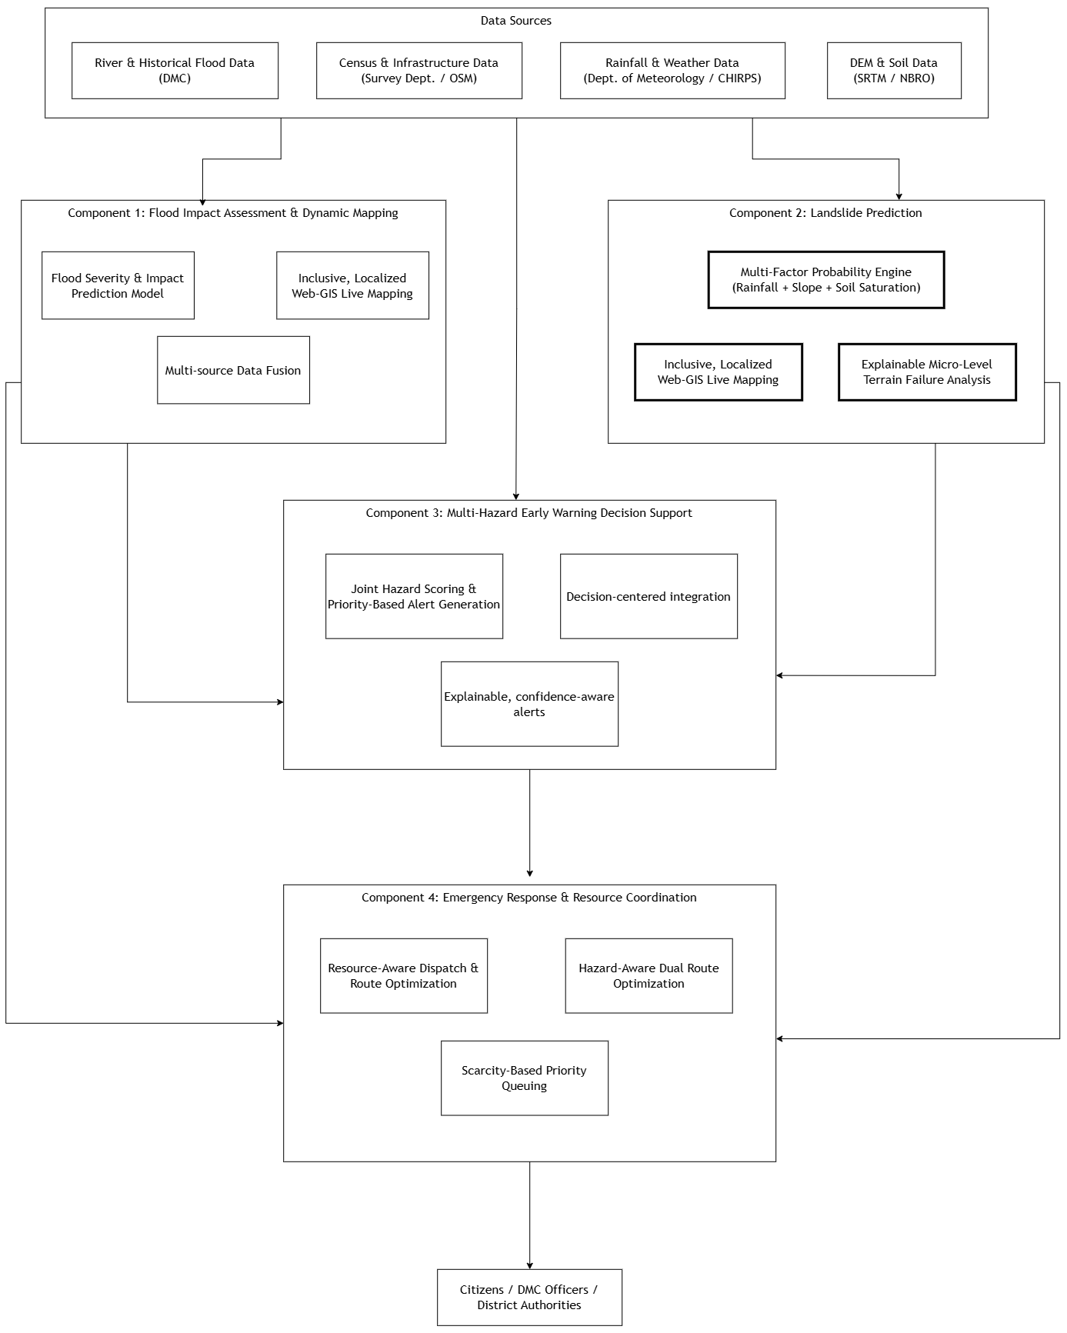
System Overview Diagram
J26-IT-334

Slide 7

Component 01
Flood Impact Assessment and Dynamic Mapping
I am Amasha, and I specialize in flood severity assessment and spatial impact mapping by developing an AI-driven flood assessment system focused on identifying and classifying flood-affected areas, assessing their severity, and estimating potential damage using satellite imagery, GIS, environmental factors, and historical flood data.
Presented By : IT23280892
Sinhalagoda S.A.U.R.A.V
IT23280892 | Sinhalagoda S.A.U.R.A.V |J26-IT-334

Slide 8
Research Question
Research Problem
Can an integrated GIS, satellite imagery, and machine learning approach assess flood severity and estimate flood-related damage more accurately than conventional flood assessment methods in selected high-risk areas of Sri Lanka?
Component Wise Objective
Component Wise Sub Objective
1. Collect and prepare flood-related data * Historical flood records * River water levels * Rainfall data * DEM/elevation * Land use/land cover * Satellite images * Population/building information
2. Identify flooded areas * Use satellite images to detect the areas covered by floodwater.
3. Assess flood severity * Combine factors such as water level, flood extent, elevation, land use and population exposure. * Classify areas into Low, Moderate, High and Severe flood-risk/impact levels.
4. Estimate damage/impact using AI * Use AI/ML to estimate possible damage to buildings and other exposed areas.
5. Create an interactive flood severity map * Display flooded areas and severity levels using GIS/web mapping.
main objective is to assess how severe a flood is and show the affected areas on a map.

Slide 9
Features And Gaps
Existing Gap (from Literature / Systems) | Feature (How Component Closes It)
Fragmented and multi-source flood data: Flood data is scattered across multiple agencies (river levels, meteorology, population data) without unified ingestion. | Multi-Source Data Fusion Engine: Automatically ingests and spatially aligns historical flood records, river gauge levels, rainfall data, elevation (DEM), land use, and census records into a single integrated pipeline.
Lack of spatial clarity on flood extents: Traditional monitoring relies on point-based water levels, making it difficult to visualize the true spatial extent of flooded terrain. | Remote Sensing-Based Flood Extent Mapping: Detects and delineates active floodwater boundaries using satellite imagery processing to generate dynamic flood extent layers.
Coarse and non-standardized severity outputs: Existing flood maps often show inundated areas without categorizing the intensity or severity of the hazard. | Multi-Factor Flood Severity Classifier: Combines water level, flood extent, elevation, land use, and population exposure to classify areas into Low, Moderate, High, and Severe impact tiers.
Limited integration of satellite imagery with spatial databases: Remote sensing outputs are often isolated from operational GIS environments used for decision support. | Integrated Remote Sensing & GIS Pipeline: Merges satellite-detected flood masks directly with PostGIS/OSM spatial layers for real-time spatial analysis.
Static, non-interactive warning presentations: Bulletins and reports are published as static text or raw maps, making them difficult for non-technical stakeholders to interpret. | Interactive Web-GIS Visualization Platform: Presents dynamic severity levels and flood extents through an accessible, high-contrast, interactive mapping UI.
IT23280892 |Sinhalagoda S.A.U.R.A.V|J26-IT-334

Slide 10
Methdology
tage | Key Actions | Technical Approach & Inputs | Key Output
Step 1 – Data Collection | Gather multi-source environmental, geospatial, and demographic datasets. | Ingest data from government agencies (DMC, Met Dept) and open repositories (OSM, satellite feeds). | Raw heterogeneous multi-source dataset.
Step 2 – Data Preprocessing | Clean, format, and align spatial data layers. | Standardize spatial coordinate reference systems, process DEM tiles, and prepare satellite rasters. | Unified, GIS-compatible spatial feature layers.
Step 3 – Flood Extent Mapping | Delineate active floodwater boundaries. | Perform multi-temporal analysis comparing pre-event and post-event satellite imagery. | Satellite-derived flood extent vector masks.
Step 4 – Flood Severity Assessment | Calculate localized hazard intensity scores. | Combine flood extent, river water levels, DEM elevation, land use, population density, and historical records. | Classified flood severity scores (Low, Moderate, High, Severe).
Step 5 – AI Damage Estimation | Predict structural and localized impact. | Apply machine learning models to analyze exposed building footprints and infrastructure assets. | Quantitative damage and impact estimates.
Step 6 – Mapping & Visualization | Render spatial outputs for decision-makers. | Integrate spatial database layers (PostGIS/QGIS) into an interactive Web-GIS dashboard. | Dynamic live flood map showing extents, severity, and damage.
Research Design
This methodology combines multi-source environmental and satellite data through automated preprocessing and multi-temporal remote sensing to delineate flood extents, calculate localized severity scores, predict infrastructure damage using machine learning, and deliver dynamic spatial risk visualizations via an interactive Web-GIS platform
IT23280892 |Sinhalagoda S.A.U.R.A.V|J26-IT-334

Slide 11
Functional and Non-Functional Requirements
Functional Requirements
Non -Functional Requirements
Data Ingestion & Multi-Source Fusion: The system shall ingest rainfall records, river water-level measurements, elevation profiles (DEM), land use/cover datasets, and census population data across target river basins.
Satellite Image Processing & Extent Detection: The system shall process multi-temporal satellite imagery (pre- and post-event) to identify and delineate active floodwater boundaries.
Multi-Factor Flood Severity Assessment: The system shall combine water levels, flood extents, terrain elevation, land use, and population exposure data to calculate composite flood severity scores.
Flood Severity Risk Classification: The system shall classify evaluated regions into four discrete risk categories: Low, Moderate, High, and Very High (Severe).
AI-Driven Infrastructure & Asset Damage Estimation: The system shall apply machine learning models to exposed building footprints and infrastructure layers to predict structural and asset damage.
GIS-Based Interactive Visualization: The system shall display dynamic flood extents, severity classifications, and damage estimates on an interactive Web-GIS mapping interface.
Structured Output Transmission: The system shall generate and expose a structured JSON API output containing geotagged flood extent maps, severity classifications, and damage data for downstream components.
Performance & Processing Latency: The system shall complete spatial data fusion, severity assessment, and map generation for a queried basin within 5 seconds under standard operational conditions.
Accuracy & Model Evaluation: The AI damage estimation model shall report per-class precision, recall, and F1-scores alongside overall accuracy to prevent misclassification of high-severity zones.
Spatial Reliability & Precision: The satellite-derived flood extent mapping shall achieve a spatial resolution sufficient to accurately delineate village and Grama Niladhari division boundaries.
Scalability: The system architecture shall support concurrent data processing and alert requests across all target river basins without exceeding response time thresholds.
Accessibility & Usability: The Web-GIS mapping dashboard shall feature localized Sinhala and Tamil support with a high-contrast UI accessible to non-technical users.
Security & Interoperability: All data transmission between source databases, processing pipelines, and API endpoints shall use encrypted HTTPS/TLS connections with versioned RESTful contracts.
IT23280892 |Sinhalagoda S.A.U.R.A.V|J26-IT-334

Slide 12
Validation Strategy
Validation means checking whether my system’s results are actually correct.
Historical flood events* Test the system using previous floods.* Compare your detected flood areas with officially recorded flood areas.
Satellite image validation* Compare your flood map with actual satellite imagery from known flood events.
Ground/official data* Compare predicted/assessed severity with: * Irrigation Department water-level records * DMC flood records * Field/ground information where available.
AI model validation* Split the data into training and testing data.* Use metrics such as Accuracy, Precision, Recall, and F1-score for classification.
GIS accuracy* Check whether the mapped flood boundaries match the actual affected areas.
IT23280892 |Sinhalagoda S.A.U.R.A.V|J26-IT-334

Slide 13
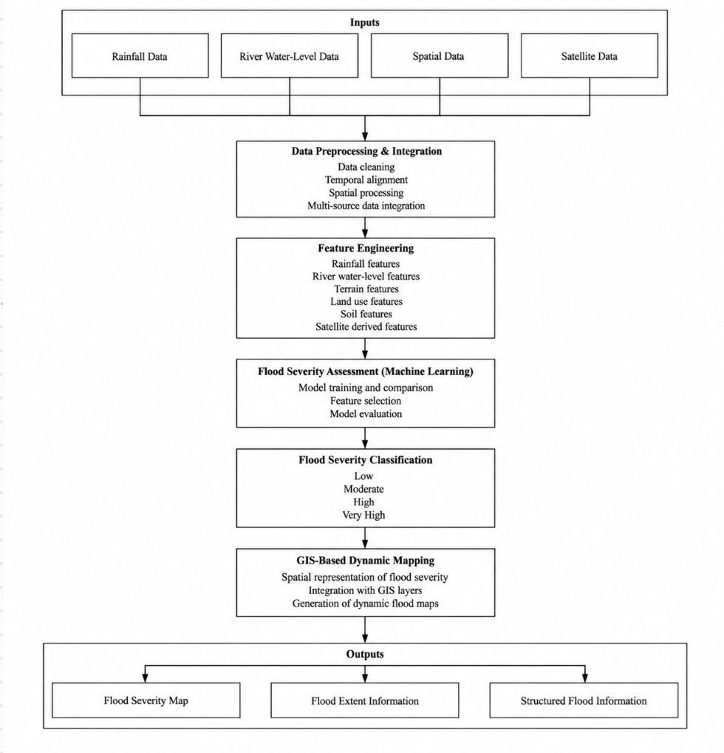
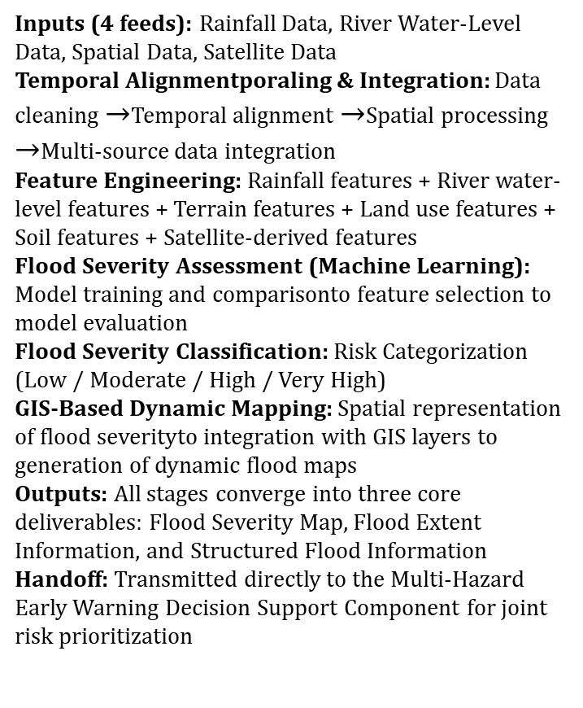
System Architecture – IT23280892
Inputs (4 feeds): Rainfall Data, River Water-Level Data, Spatial Data, Satellite Data
Temporal Alignmentporaling & Integration: Data cleaning $→$Temporal alignment $→$Spatial processing $→$Multi-source data integration
Feature Engineering: Rainfall features + River water-level features + Terrain features + Land use features + Soil features + Satellite-derived features
Flood Severity Assessment (Machine Learning): Model training and comparisonto feature selection to model evaluation
Flood Severity Classification: Risk Categorization (Low / Moderate / High / Very High)
GIS-Based Dynamic Mapping: Spatial representation of flood severityto integration with GIS layers to generation of dynamic flood maps
Outputs: All stages converge into three core deliverables: Flood Severity Map, Flood Extent Information, and Structured Flood Information
Handoff: Transmitted directly to the Multi-Hazard Early Warning Decision Support Component for joint risk prioritization
IT23280892 |Sinhalagoda S.A.U.R.A.V|J26-IT-334

Slide 14

Component 02
Probabilistic Assessment and Forecasting of Occurrences of Landslides
I am Sadumina Rathnayaka, and I specialize in the probabilistic assessment and forecasting of landslides by developing a machine learning-driven forecasting engine focused on high-risk regions in the Nuwara Eliya District, including Walapane, Ambagamuwa, and Kotmale.
Presented By : IT23394124
Bagya R M S

Slide 15
Research Question
Research Problem
Can a machine-learning model predict landslide occurrence probability more accurately than existing heuristic methods for Nuwara Eliya District?
Component Wise Objective
Component Wise Sub Objective
Acquire and compile core landslide dataset for Nuwara Eliya District
Construct multi-factor geospatial feature set (slope, soil, rainfall thresholds)
Integrate human-factor risk parameters (road cuts, deforestation, drainage obstruction)
Train and comparatively evaluate ML models (XGBoost, LightGBM, logistic regression)
Develop a WebGL-powered, dual-language (Sinhala/Tamil/English) live mapping interface
Implement an explainable-AI layer (SHAP/LIME)
To create an intelligent, integrated disaster management system that identifies flood and landslide risks, estimates impacts, and provides timely decision support and emergency response recommendations for Sri Lanka
IT23394124|Bagya R M S |J26-IT-334

Slide 16
Features And Gaps
 | Gap (from literature/existing systems) | Feature (how your component closes it)
1 | No comparative, locally-calibrated probabilistic forecasting. International ML studies (Gaidzik 2021, Brenning 2005) are validated in Mexico/Ecuador not Sri Lankan terrain, soil, or monsoon rainfall. Local studies (Kegalle AHP, Walapane zonation) use subjective expert-weighted factors rather than models trained on actual outcome data, with no comparative ML evaluation. | Multi-Factor Probability Engine — trains and comparatively evaluates XGBoost, LightGBM, and logistic regression specifically on Nuwara Eliya's historical inventory, rainfall, slope, and soil data — replacing subjective AHP weights with data-learned factor importance
2 | No continuously updated, accessible severity output at the community level. NBRO/DMC bulletins stop at district/DS-division scale; AHP studies produce static, seasonal maps. Even response-side tools like ResQConnect are reactive (post-incident) rather than proactive, and nothing delivers accessible, localized output to elderly or non-technical rural residents. | Inclusive, Localized Web-GIS Live Mapping — village-level granularity, continuously updated (not seasonal), high-contrast/elderly-friendly UI, Sinhala/Tamil localization
3 | No factor-level explanation of individual predictions. Existing models (heuristic or statistical) output only fixed weights or a single aggregate probability — none decompose why a specific site is at risk in terms of environmental vs. human-driven causes. | Explainable Micro-Level Terrain Failure Analysis — SHAP/LIME layer breaking down each prediction into % contribution from environmental factors (rainfall, slope, soil) vs. human factors (road cuts, deforestation, drainage obstruction)
IT23394124|Bagya R M S |J26-IT-334

Slide 17
Methdology
Phase | Activities | Key Output
1. Literature & Research Design | Literature review (landslide models, hazard mapping); problem formulation & objective refinement; methodology & tech stack finalization | Research gap, research question, finalized methodology
2. Data Preparation | DMC/NBRO data request & acquisition; data cleaning & preprocessing; GIS feature stacking (slope, soil, DEM) | Clean, geospatially-aligned dataset with equal positive/negative samples
3. Experiments | Baseline model experiments (XGBoost/LightGBM); feature importance & hyperparameter tuning; explainability (SHAP) experimentation | Best-performing model configuration
4. Development | Probability engine implementation; explainability layer integration; Web-GIS mapping UI development; localization (Sinhala/Tamil) | Working landslide prediction system
5. Prototype & Testing | End-to-end component prototype; unit & model validation testing; accessibility & usability testing | Validated, functioning prototype
6. Integration | API contract finalization; integration with Decision Support component | Component connected to full IDMERS system
7. Evaluation & Analysis | Model accuracy evaluation (extra-domain/spatial validation); system performance evaluation; results analysis & discussion | Final accuracy, recall, and explainability results vs. benchmarks
8. Final Presentation | Draft report writing; review & revisions; final report & viva preparation | Completed dissertation + defense
Research Design
Quantitative, experimental (comparative) research design
Core question is comparative and quantifiable, with measurable ground truth (documented landslide occurrence vs. non-occurrence) not exploratory or interpretive
Structured as a supervised ML modelling pipeline: data acquisition → feature engineering → comparative model training → statistical evaluation → validation against external benchmarks
IT23394124|Bagya R M S |J26-IT-334

Slide 18
Validation Strategy
Following the spatial cross-validation approach used by Brenning [2] who showed that naive random train/test splits over-inflate accuracy on spatial data due to autocorrelation between nearby points this component will use 5-fold cross-validation with spatial buffering, ensuring test points are not spatially adjacent to training points from the same landslide event. Statistical significance between competing models will be assessed using a paired Wilcoxon signed-rank test across cross-validation folds, consistent with the comparative methodology already piloted in this project's earlier synthetic-data feature-set comparison. Where multiple comparisons are made (e.g., across all three models), a Bonferroni correction will be applied to control the family-wise error rate, following the precedent set in [2]. Finally, the model will undergo external validation against a held-out set of real, documented incidents specifically, post-Cyclone-Dithawa high-risk inspection points not used during training to test whether the model's predicted probabilities align with an actual, independently verified disaster event rather than only cross-validated historical data [12]
IT23394124|Bagya R M S |J26-IT-334

Slide 19
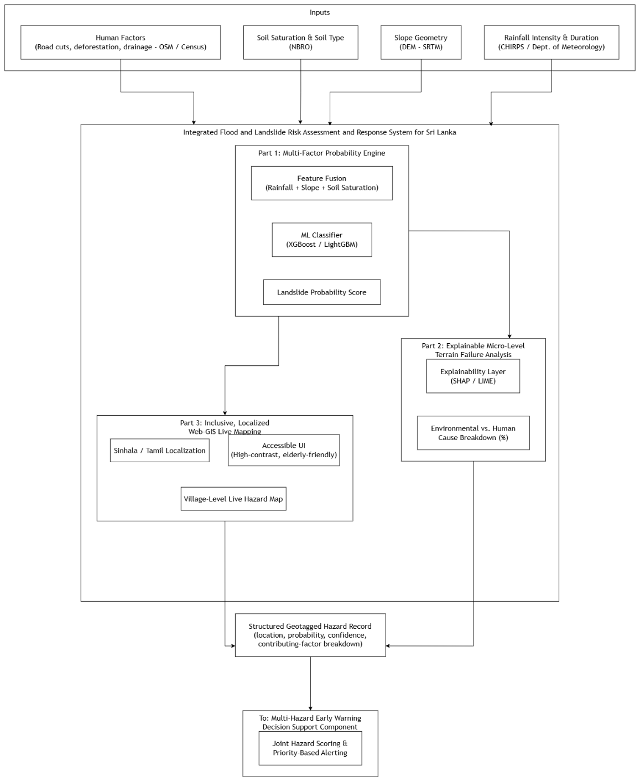
System Architecture –IT23394124
Inputs (4 factors): Human Factors (road cuts, deforestation, drainage OSM/Census), Soil Saturation & Type (NBRO), Slope Geometry (DEM–SRTM), Rainfall Intensity & Duration (CHIRPS/Dept. of Meteorology)
Part 1 - Multi-Factor Probability Engine: Feature Fusion (rainfall + slope + soil saturation) → ML Classifier (XGBoost/LightGBM) → Landslide Probability Score
Part 2 - Explainable Micro-Level Terrain Failure Analysis: Explainability Layer (SHAP/LIME) → Environmental vs. Human Cause Breakdown (%)
Part 3 - Inclusive, Localized Web-GIS Live Mapping: Sinhala/Tamil Localization + Accessible UI (high-contrast, elderly-friendly) + Village-Level Live Hazard Map
Output: All three parts converge into a Structured Geotagged Hazard Record (location, probability, confidence, contributing-factor breakdown)
Handoff: This record is sent to the Multi-Hazard Early Warning Decision Support Component for joint hazard scoring & priority-based alerting
IT23394124|Bagya R M S |J26-IT-334

Slide 20
Functional and Non-Functional Requirements
Functional Requirements
Non -Functional Requirements
 | Requirement
1 | The system shall ingest historical landslide records, rainfall data, slope/soil data, and land-use data from NBRO, the Department of Meteorology, and open geospatial sources (SRTM, OSM)
2 | The system shall compute a landslide probability score for a given location using a multi-factor model combining rainfall intensity/duration, slope geometry, and soil saturation
3 | The system shall classify predicted landslide risk into discrete categories (Very Low, Low, Moderate, High, Very High), consistent with established susceptibility-mapping conventions
4 | The system shall generate an explainable breakdown of each prediction, showing the relative contribution of environmental factors (rainfall, slope, soil) versus human factors (road cutting, deforestation, drainage obstruction)
5 | The system shall display predictions on a Web-GIS live map at village/DS-division granularity for the pilot area (Ambagamuwa, Kotmale, Walapane)
6 | The system shall support map interface localization in Sinhala and Tamil
7 | The system shall output a structured, geotagged hazard record (location, probability, confidence, contributing-factor breakdown) consumable by the Decision Support component via a defined API contract
8 | The system shall allow authorized users (e.g., NBRO/DMC officers) to view historical prediction accuracy against confirmed landslide events for a given area
 | Category | Requirement
1 | Response time | The system shall return a landslide-probability prediction for a queried location within 5 seconds under normal network conditions
2 | Reliability | The prediction model shall achieve a minimum out-of-sample (spatially independent) accuracy of 80%, evaluated using held-out test regions rather than training-area accuracy alone
3 | Usability | At least 90% of test users unfamiliar with GIS tools shall be able to identify their village's current risk level on the map interface within 2 minutes, without prior training
4 | Accessibility | The map interface shall meet WCAG 2.1 AA color-contrast requirements and support high-contrast display modes for users with low vision, including elderly residents
5 | Scalability | The system shall support prediction requests across all DS divisions in the pilot district (Nuwara Eliya) without degradation in response time beyond the 5-second threshold
6 | Security | All data exchanged with the Decision Support component via the API shall use authenticated, encrypted (HTTPS/TLS) connections
IT23394124|Bagya R M S |J26-IT-334

Slide 21

Component 03
Human Impact And Decision Support
I am Ohasee Lanka, and I specialize in human impact prediction and decision support by developing an explainable machine learning component that estimates demographic risk and generates color-coded, actionable alerts at the Grama Niladhari division level.
Presented By : IT23317512
Prathibhani Y.L.O.L

Slide 22
Research Question
Research Problem
Can a machine learning-driven decision support component accurately estimate human impact such as deaths, displacement, and affected population, and generate explainable, prioritized emergency decisions more effectively than existing hazard monitoring dashboards for high-risk regions in Sri Lanka?
Component Wise Objective
Component-wise Sub-Objective
To create an intelligent, integrated disaster management system that identifies flood and landslide risks, estimates impacts, and provides timely decision support and emergency response recommendations for Sri Lanka
1. To design and populate a spatially joined dataset that fuses historical hazard event records from DesInventar,.
2. To formulate and empirically validate a composite human impact scoring formula, structured as Hazard × Exposure × Sensitivity ÷ Capacity, with feature weights informed by published Sri Lankan flood and landslide risk literature, and to test each candidate feature for genuine predictive contribution rather than including it by assumption. To design, train, and comparatively evaluate at least three classification approaches, namely a logistic regression baseline, a Random Forest classifier, and an XGBoost classifier, selecting the model that achieves the strongest validated performance on the four-class human impact risk classification (Low, Moderate, High, Critical).
4. To integrate SHAP-based explainability into the prediction pipeline such that every generated alert is accompanied by a traceable, feature-level rationale for its classification.

Slide 23
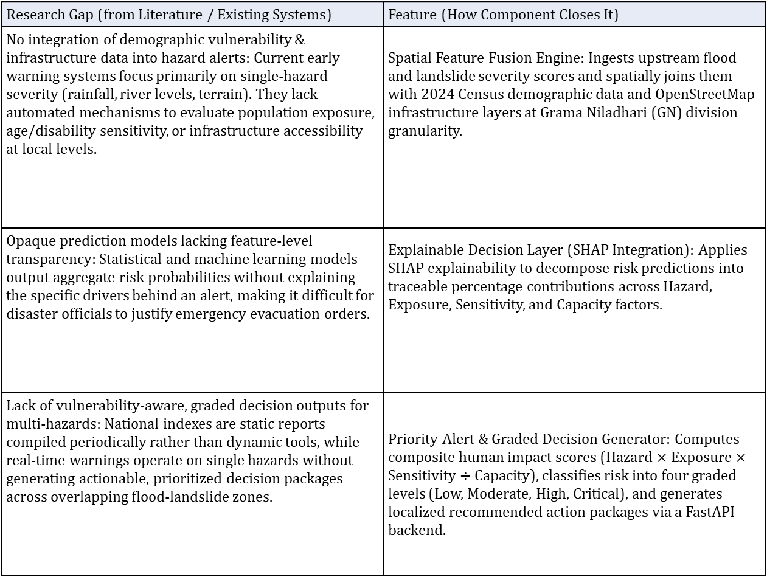
Features And Gaps
Research Gap (from Literature / Existing Systems) | Feature (How Component Closes It)
No integration of demographic vulnerability & infrastructure data into hazard alerts: Current early warning systems focus primarily on single-hazard severity (rainfall, river levels, terrain). They lack automated mechanisms to evaluate population exposure, age/disability sensitivity, or infrastructure accessibility at local levels. | Spatial Feature Fusion Engine: Ingests upstream flood and landslide severity scores and spatially joins them with 2024 Census demographic data and OpenStreetMap infrastructure layers at Grama Niladhari (GN) division granularity.
Opaque prediction models lacking feature-level transparency: Statistical and machine learning models output aggregate risk probabilities without explaining the specific drivers behind an alert, making it difficult for disaster officials to justify emergency evacuation orders. | Explainable Decision Layer (SHAP Integration): Applies SHAP explainability to decompose risk predictions into traceable percentage contributions across Hazard, Exposure, Sensitivity, and Capacity factors.
Lack of vulnerability-aware, graded decision outputs for multi-hazards: National indexes are static reports compiled periodically rather than dynamic tools, while real-time warnings operate on single hazards without generating actionable, prioritized decision packages across overlapping flood-landslide zones. | Priority Alert & Graded Decision Generator: Computes composite human impact scores ($\text{Hazard}×\text{Exposure}×\text{Sensitivity}÷\text{Capacity}$), classifies risk into four graded levels (Low, Moderate, High, Critical), and generates localized recommended action packages via a FastAPI backend.
IT23317512 |Prathibhani Y.L.O.L |J26-IT-334

Slide 24
Methdology
Phase | Activities | Key Output
1. Literature & Research Design | Literature review (landslide models, hazard mapping); problem formulation & objective refinement; methodology & tech stack finalization | Research gap, research question, finalized methodology
2. Data Preparation | DMC/NBRO data request & acquisition; data cleaning & preprocessing; GIS feature stacking (slope, soil, DEM) | Clean, geospatially-aligned dataset with equal positive/negative samples
3. Experiments | Baseline model experiments (XGBoost/LightGBM); feature importance & hyperparameter tuning; explainability (SHAP) experimentation | Best-performing model configuration
4. Development | Probability engine implementation; explainability layer integration; Web-GIS mapping UI development; localization (Sinhala/Tamil) | Working landslide prediction system
5. Prototype & Testing | End-to-end component prototype; unit & model validation testing; accessibility & usability testing | Validated, functioning prototype
6. Integration | API contract finalization; integration with Decision Support component | Component connected to full IDMERS system
7. Evaluation & Analysis | Model accuracy evaluation (extra-domain/spatial validation); system performance evaluation; results analysis & discussion | Final accuracy, recall, and explainability results vs. benchmarks
8. Final Presentation | Draft report writing; review & revisions; final report & viva preparation | Completed dissertation + defense
Research Design
Quantitative, experimental (comparative) research design
Core question is comparative and quantifiable, with measurable ground truth (documented landslide occurrence vs. non-occurrence) not exploratory or interpretive
Structured as a supervised ML modelling pipeline: data acquisition → feature engineering → comparative model training → statistical evaluation → validation against external benchmarks
IT23317512 |Prathibhani Y.L.O.L |J26-IT-334

Slide 25
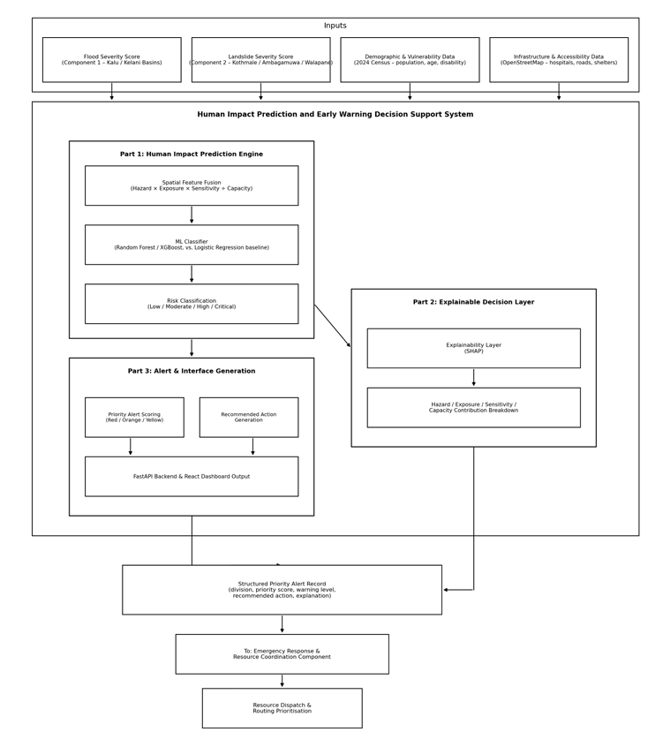
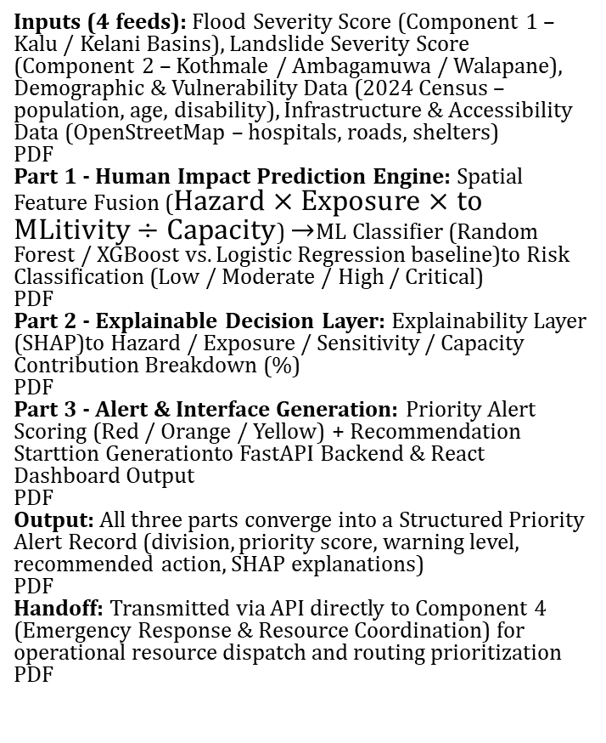
System Architecture – IT23317512
Inputs (4 feeds): Flood Severity Score (Component 1 – Kalu / Kelani Basins), Landslide Severity Score (Component 2 – Kothmale / Ambagamuwa / Walapane), Demographic & Vulnerability Data (2024 Census – population, age, disability), Infrastructure & Accessibility Data (OpenStreetMap – hospitals, roads, shelters)
PDF
Part 1 - Human Impact Prediction Engine: Spatial Feature Fusion ($\text{Hazard}×\text{Exposure}×\text{to ML}\text{itivity}÷\text{Capacity}$) $→$ML Classifier (Random Forest / XGBoost vs. Logistic Regression baseline)to Risk Classification (Low / Moderate / High / Critical)
PDF
Part 2 - Explainable Decision Layer: Explainability Layer (SHAP)to Hazard / Exposure / Sensitivity / Capacity Contribution Breakdown (%)
PDF
Part 3 - Alert & Interface Generation: Priority Alert Scoring (Red / Orange / Yellow) + Recommendation Starttion Generationto FastAPI Backend & React Dashboard Output
PDF
Output: All three parts converge into a Structured Priority Alert Record (division, priority score, warning level, recommended action, SHAP explanations)
PDF
Handoff: Transmitted via API directly to Component 4 (Emergency Response & Resource Coordination) for operational resource dispatch and routing prioritization
PDF
IT23317512 |Prathibhani Y.L.O.L |J26-IT-334

Slide 26
Functional and Non-Functional Requirements
Functional Requirements
Non -Functional Requirements
 | Requirement
1 | The system shall ingest historical landslide records, rainfall data, slope/soil data, and land-use data from NBRO, the Department of Meteorology, and open geospatial sources (SRTM, OSM)
2 | The system shall compute a landslide probability score for a given location using a multi-factor model combining rainfall intensity/duration, slope geometry, and soil saturation
3 | The system shall classify predicted landslide risk into discrete categories (Very Low, Low, Moderate, High, Very High), consistent with established susceptibility-mapping conventions
4 | The system shall generate an explainable breakdown of each prediction, showing the relative contribution of environmental factors (rainfall, slope, soil) versus human factors (road cutting, deforestation, drainage obstruction)
5 | The system shall display predictions on a Web-GIS live map at village/DS-division granularity for the pilot area (Ambagamuwa, Kotmale, Walapane)
6 | The system shall support map interface localization in Sinhala and Tamil
7 | The system shall output a structured, geotagged hazard record (location, probability, confidence, contributing-factor breakdown) consumable by the Decision Support component via a defined API contract
8 | The system shall allow authorized users (e.g., NBRO/DMC officers) to view historical prediction accuracy against confirmed landslide events for a given area
 | Category | Requirement
1 | Response time | The system shall return a landslide-probability prediction for a queried location within 5 seconds under normal network conditions
2 | Reliability | The prediction model shall achieve a minimum out-of-sample (spatially independent) accuracy of 80%, evaluated using held-out test regions rather than training-area accuracy alone
3 | Usability | At least 90% of test users unfamiliar with GIS tools shall be able to identify their village's current risk level on the map interface within 2 minutes, without prior training
4 | Accessibility | The map interface shall meet WCAG 2.1 AA color-contrast requirements and support high-contrast display modes for users with low vision, including elderly residents
5 | Scalability | The system shall support prediction requests across all DS divisions in the pilot district (Nuwara Eliya) without degradation in response time beyond the 5-second threshold
6 | Security | All data exchanged with the Decision Support component via the API shall use authenticated, encrypted (HTTPS/TLS) connections
IT23317512 |Prathibhani Y.L.O.L |J26-IT-334

Slide 27

Component 04
Emergency Response and Resource Coordination
I am Manul Palihena, and I specialize in emergency response and resource coordination by developing an automated optimization and routing engine for Sri Lanka's disaster management framework. My work focuses on real-time resource availability verification, scarcity-based priority queuing, constraint-based allocation using Google OR-Tools, and dynamic, hazard-aware routing for safe evacuation and dispatch.
Presented By : IT23411562
Palihena M B

Slide 28
Research Question
Research Problem
Can an automated, constraint-based optimization engine reduce mean first-response times and eliminate duplicate resource assignments during disaster dispatches in Sri Lanka more effectively than existing manual coordination methods?
Component-wise Objective
Component Wise Sub Objective
To ingest prioritized district-level alerts and verify real-time resource availability (ambulances, boats, shelters, relief stock) via a standardized API before any dispatch decision is committed
To design a scarcity-based priority queuing model that sequences resource allocation across multiple simultaneously affected districts.
To develop a constraint-based resource allocation engine, using operations-research optimization, that assigns available resources to affected districts under capacity and resource type-matching constraints. To construct a hazard-aware dual route optimization module that dynamically excludes flood- and landslide-blocked road segments for both citizen evacuation and rescue-team dispatch.
To implement a multi-channel dispatch mechanism that delivers localized alerts and resource/route information to DMC coordinators and citizens.
To build a closed-loop feedback model that logs actual response outcomes and improves future allocation efficiency using historical and simulated Sri Lankan disaster data.
To create an intelligent, integrated disaster management system that identifies flood and landslide risks, estimates impacts, and provides timely decision support and emergency response recommendations for Sri Lanka
IT23411562|Palihena M B | J26-IT-334

Slide 29
Features And Gaps
Research Gap (from Literature / Existing Systems) | Feature (How Component Closes It)
No real-time, resource-verified dispatch for Sri Lanka's DDMC network: Existing systems proceed directly to routing without verifying if resources are actually available beforehand. Manual coordination without a shared registry leads to high rates of duplicate resource assignments. | Real-Time Resource-Aware Dispatch Engine: Integrates a live, query-based resource availability check (ambulances, boats, shelters, relief stock) as a mandatory precondition before any allocation decision is committed.
No dynamic, road-segment-level hazard-aware routing for both evacuation and rescue dispatch: Standard routing APIs cannot process dynamic road closures, and existing platforms treat road accessibility as a broad district-level score rather than dynamically excluding specific blocked roads. | Hazard-Aware Dual Route Optimization: Dynamically updates street network graphs by intersecting live flood and landslide extent data to exclude blocked road segments, simultaneously generating safe evacuation paths for citizens and rapid dispatch routes for rescue teams.
No closed-loop allocation model calibrated to Sri Lankan disaster outcomes: Current coordination methods do not log response metrics to improve system performance over time. Existing optimization models act as one-time simulations rather than learning from actual operational outcomes. | Closed-Loop Response Feedback Model: Logs post-dispatch metrics (arrival times, shelter occupancy, resource utilization) and uses machine learning to retrain on historical and event outcomes, continuously improving future allocation efficiency.
IT23411562|Palihena M B | J26-IT-334

Slide 30
Methdology
Phase | Activities | Key Output
1. Literature & Research Design | Literature review (landslide models, hazard mapping and Hazard Mapping); problem formulation & objective refinement; methodology & tech stack finalization | Research gap, research question, finalized methodology
2. Data Preparation | DMC/NBRO data request & acquisition; data cleaning & preprocessing; GIS feature stacking (slope, soil, DEM) | Clean, geospatially-aligned dataset with equal positive/negative samples
3. Experiments | Baseline model experiments (XGBoost/LightGBM); feature importance & hyperparameter tuning; explainability (SHAP) experimentation | Best-performing model configuration
4. Development | Probability engine implementation; explainability layer integration; Web-GIS mapping UI development; localization (Sinhala/Tamil) | Working landslide prediction system
5. Prototype & Testing | End-to-end component prototype; unit & model validation testing; accessibility & usability testing | Validated, functioning prototype
6. Integration | API contract finalization; integration with Decision Support component | Component connected to full IDMERS system
7. Evaluation & Analysis | Model accuracy evaluation (extra-domain/spatial validation); system performance evaluation; results analysis & discussion | Final accuracy, recall, and explainability results vs. benchmarks
8. Final Presentation | Draft report writing; review & revisions; final report & viva preparation | Completed dissertation + defense
Research Design
Quantitative, experimental (comparative) research design
Core question is comparative and quantifiable, with measurable ground truth (documented landslide occurrence vs. non-occurrence), not exploratory or interpretive
Structured as a supervised ML modelling pipeline: data acquisition → feature engineering → comparative model training → statistical evaluation → validation against external benchmarks
IT23411562|Palihena M B | J26-IT-334

Slide 31
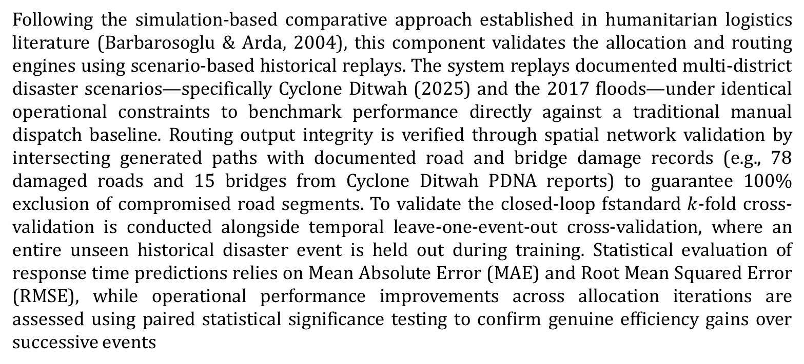
Validation Strategy
Following the simulation-based comparative approach established in humanitarian logistics literature (Barbarosoglu & Arda, 2004), this component validates the allocation and routing engines using scenario-based historical replays. The system replays documented multi-district disaster scenarios—specifically Cyclone Ditwah (2025) and the 2017 floods—under identical operational constraints to benchmark performance directly against a traditional manual dispatch baseline. Routing output integrity is verified through spatial network validation by intersecting generated paths with documented road and bridge damage records (e.g., 78 damaged roads and 15 bridges from Cyclone Ditwah PDNA reports) to guarantee 100% exclusion of compromised road segments. To validate the closed-loop fstandard $k$-fold cross-validation is conducted alongside temporal leave-one-event-out cross-validation, where an entire unseen historical disaster event is held out during training. Statistical evaluation of response time predictions relies on Mean Absolute Error (MAE) and Root Mean Squared Error (RMSE), while operational performance improvements across allocation iterations are assessed using paired statistical significance testing to confirm genuine efficiency gains over successive events
IT23411562|Palihena M B | J26-IT-334

Slide 32
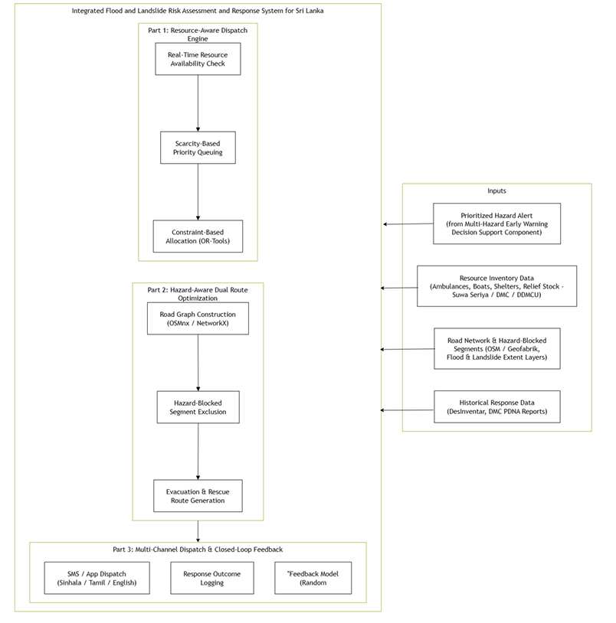
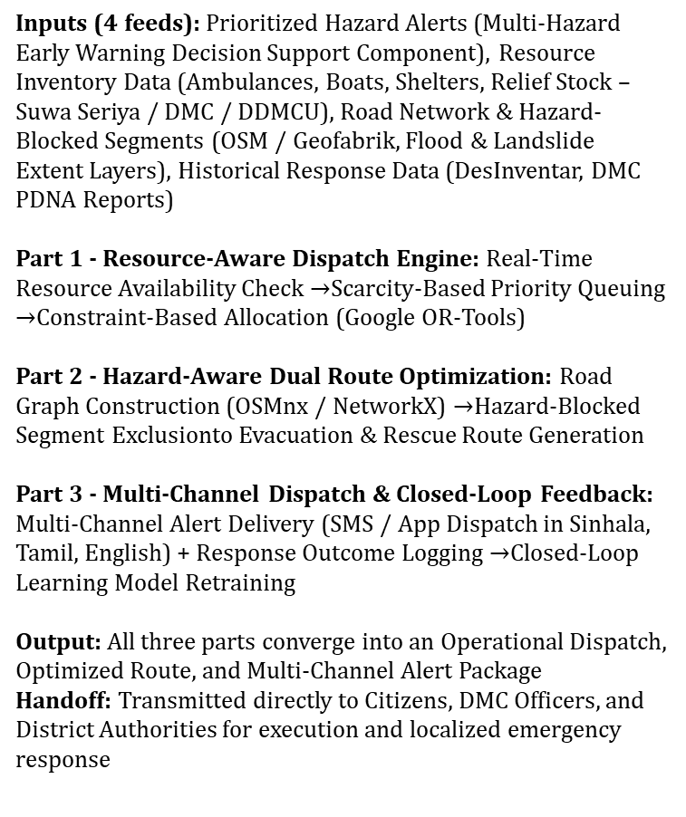
System Architecture Diagram
Inputs (4 feeds): Prioritized Hazard Alerts (Multi-Hazard Early Warning Decision Support Component), Resource Inventory Data (Ambulances, Boats, Shelters, Relief Stock – Suwa Seriya / DMC / DDMCU), Road Network & Hazard-Blocked Segments (OSM / Geofabrik, Flood & Landslide Extent Layers), Historical Response Data (DesInventar, DMC PDNA Reports)
Part 1 - Resource-Aware Dispatch Engine: Real-Time Resource Availability Check $→$Scarcity-Based Priority Queuing $→$Constraint-Based Allocation (Google OR-Tools)
Part 2 - Hazard-Aware Dual Route Optimization: Road Graph Construction (OSMnx / NetworkX) $→$Hazard-Blocked Segment Exclusionto Evacuation & Rescue Route Generation
Part 3 - Multi-Channel Dispatch & Closed-Loop Feedback: Multi-Channel Alert Delivery (SMS / App Dispatch in Sinhala, Tamil, English) + Response Outcome Logging $→$Closed-Loop Learning Model Retraining
Output: All three parts converge into an Operational Dispatch, Optimized Route, and Multi-Channel Alert Package
Handoff: Transmitted directly to Citizens, DMC Officers, and District Authorities for execution and localized emergency response
IT23411562|Palihena M B | J26-IT-334

Slide 33
Functional and Non-Functional Requirements
Functional Requirements
Non -Functional Requirements
 | Requirement
1 | The system shall ingest historical landslide records, rainfall data, slope/soil data, and land-use data from NBRO, the Department of Meteorology, and open geospatial sources (SRTM, OSM)
2 | The system shall compute a landslide probability score for a given location using a multi-factor model combining rainfall intensity/duration, slope geometry, and soil saturation
3 | The system shall classify predicted landslide risk into discrete categories (Very Low, Low, Moderate, High, Very High), consistent with established susceptibility-mapping conventions
4 | The system shall generate an explainable breakdown of each prediction, showing the relative contribution of environmental factors (rainfall, slope, soil) versus human factors (road cutting, deforestation, drainage obstruction)
5 | The system shall display predictions on a Web-GIS live map at village/DS-division granularity for the pilot area (Ambagamuwa, Kotmale, Walapane)
6 | The system shall support map interface localization in Sinhala and Tamil
7 | The system shall output a structured, geotagged hazard record (location, probability, confidence, contributing-factor breakdown) consumable by the Decision Support component via a defined API contract
8 | The system shall allow authorized users (e.g., NBRO/DMC officers) to view historical prediction accuracy against confirmed landslide events for a given area
 | Category | Requirement
1 | Response time | The system shall return a landslide-probability prediction for a queried location within 5 seconds under normal network conditions
2 | Reliability | The prediction model shall achieve a minimum out-of-sample (spatially independent) accuracy of 80%, evaluated using held-out test regions rather than training-area accuracy alone
3 | Usability | At least 90% of test users unfamiliar with GIS tools shall be able to identify their village's current risk level on the map interface within 2 minutes, without prior training
4 | Accessibility | The map interface shall meet WCAG 2.1 AA color-contrast requirements and support high-contrast display modes for users with low vision, including elderly residents
5 | Scalability | The system shall support prediction requests across all DS divisions in the pilot district (Nuwara Eliya) without degradation in response time beyond the 5-second threshold
6 | Security | All data exchanged with the Decision Support component via the API shall use authenticated, encrypted (HTTPS/TLS) connections
IT23411562|Palihena M B | J26-IT-334

Slide 34
Commercialization Plan
Target Market & Customer Persona
Primary market (paying customer): Government disaster-management bodies DMC, NBRO, District/Divisional Secretariats in landslide-prone districts (Nuwara Eliya, Kegalle, Badulla, Ratnapura)
Persona "The District DMC Officer": Mid-level official responsible for issuing early warnings and coordinating evacuation. Currently relies on manual rainfall bulletins and static NBRO maps; needs real-time, village-level risk visibility and defensible, explainable justification for evacuation orders
Secondary market (non-paying, indirect beneficiary): Citizens in high-risk rural villages (Ambagamuwa, Kotmale, Walapane), especially elderly and non-technical residents
Tertiary market (future/adjacent): NGOs and international disaster-response agencies (UNDRR, Red Cross) licensing aggregated hazard analytics for planning
J26-IT-334

Slide 35
Commercialization Plan
Cost type | Note
Development | Team time (largely sunk/academic at this stage)
Infrastructure | Cloud hosting (API + PostGIS + inference), scales per district
Data acquisition | Largely free — NBRO/DMC/SRTM/CHIRPS under MOU or open-access
Maintenance | Ongoing model retraining, localization updates, support staff
Value Proposition
For government agencies: a single, explainable, village-level landslide risk system that replaces scattered manual processes across NBRO/DMC/Meteorology, reduces time from rainfall event to actionable warning, and gives an auditable explanation of why an area is flagged high-risk
For citizens: a free, localized, accessible way to check their own area's risk without interpreting technical hazard maps
Revenue Model
B2G licensing/SaaS subscription - annual/multi-year fee paid by DMC/NBRO via government IT procurement
Grant/donor-funded deployment - World Bank, UNDP, ADB disaster-resilience grants, or Sri Lanka's own disaster-risk-reduction budget
Free citizen tier - public Web-GIS map and alerts stay free; this is the public-good delivery mechanism, not a revenue line
Optional data/API licensing - aggregated hazard analytics licensed to NGOs/research institutions as a secondary stream
J26-IT-334

Slide 36
Work Breakdown Description
Phase | Sub-tasks
1. Project Initiation and Requirements | Initial discussion & scope → Topic assessment → Requirement analysis → Feasibility & tool selection
2. Research and System Design | Literature review → System architecture design → Component-level design → Dataset & data source identification → Project proposal
3. Component Implementation | Split into 4 parallel components: 3.1 Flood Prediction · 3.2 Landslide Prediction System (my component) · 3.3 Human Impact & Decision Support · 3.4 Emergency Response & Resource Coordination
3.2 Landslide Prediction System (my component, detailed) | Historical landslide data → Geospatial feature processing → Rainfall trigger analysis → Machine learning landslide prediction → Explainable AI and Web-GIS
4. Integration and System Testing | Component integration → API & database integration → End-to-end pipeline testing → Bug fixing & refinement
5. Evaluation and Result Analysis | Per-component performance evaluation → Accuracy & reliability analysis → Risk & response evaluation → User study & explainability evaluation → Results compilation
6. Documentation and Final Submission | Research paper writing → Final report & documentation → Presentation preparation → Final submission
J26-IT-334

Slide 37
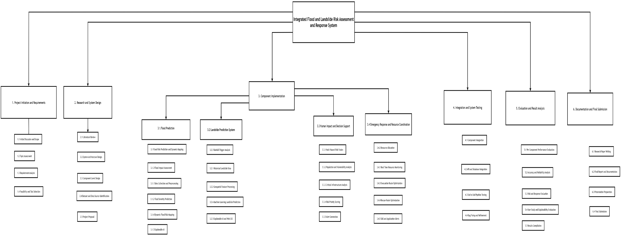
Work Breakdown chart
J26-IT-334

Slide 38
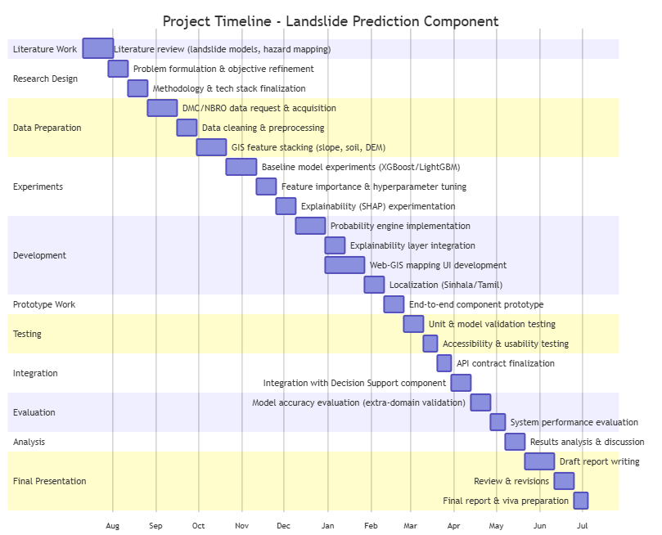
Gantt chart
J26-IT-334

Slide 39
References
[1] K. Gaidzik and M. T. Ramírez-Herrera, "The importance of input data on landslide susceptibility mapping," Sci. Rep., vol. 11, art. no. 19334, 2021, doi: 10.1038/s41598-021 98830-y.
[2] A. Brenning, "Spatial prediction models for landslide hazards: review, comparison and evaluation," Nat. Hazards Earth Syst. Sci., vol. 5, pp. 853–862, 2005.
[3] L. Gunasinghe, L. Gunawardhana, and L. Rajapakse, "Predictive analysis of landslide susceptibility under hydrological aspects of climate change in Kegalle District, Sri Lanka," in Proc. 2023 Moratuwa Eng. Res. Conf. (MERCon), Colombo, Sri Lanka, 2023, pp. 119–124, doi: 10.1109/MERCon60487.2023.10355394
[4] National Building Research Organisation, "Landslide early warning issued," NBRO, Colombo, Sri Lanka. [Online]. Available: https://www.nbro.gov.lk
[6] UN Office for the Coordination of Humanitarian Affairs (OCHA) and UN Resident Coordinator's Office (RCO), "Cyclone Ditwah – situation report (23 January 2026)," United Nations Sri Lanka, Colombo, Sri Lanka, Jan. 2026. [Online]. Available: https://srilanka.un.org/en/308868-cyclone-ditwah-situation-report-23-january-2026
[7] Disaster Management Centre, Sri Lanka, "Landslide warning / situation reports," DMC, Colombo, Sri Lanka. [Online]. Available: https://www.dmc.gov.lk (accessed Sep. 12, 2026).
[8] S. Rathnayaka, "Landslide Susceptibility Component," GitHub Pages, 2026. [Online]. Available: https://sadumina.github.io/Landlside-Suceptability-Component/ [9] "Landslide hazards assessment in Nuwara Eliya District in Sri Lanka," 2018. [Online]. Available: https://www.researchgate.net/publication/322652881
[10] A. Sinhalagoda, "J26-IT-334: Datasets for Integrated Flood and Landslide Risk Assessment and Response System," GitHub repository, 2026. [Online]. Available: https://github.com/amasha sinhalagoda/J26-IT-334
J26-IT-334

