Slide 1
ORAL PROJECT REPORT
T 64.2 H 44.0 S 73.8
Real-Time Anomaly Detection
in an IoT Setting
T 66.1 H 48.1 S 75.0
T 63.5 H 41.7 S 69.2
T 87.0 H 63.6 S 101.5
ALERT
Spotlight: stream processing — from a Python model to a monitored, production-style prediction service
T 65.8 H 46.9 S 71.4
Course
DLBDSMTP01 – Project: From Model to Production
T 62.9 H 43.2 S 68.8
Task 1
Anomaly detection in an IoT setting
T 85.6 H 71.2 S 96.3
ALERT
Presented by
Amash Mohamed
Date
[DD Month YYYY]
T 67.3 H 47.5 S 72.6
DLBDSMTP01 · Project: From Model to Production
1

Slide 2
Outline
The problem
Approach & project phases
01
02
Factory scenario, stakeholders, what the system must do
How I planned and worked through the project
System architecture
Data & model
03
04
Conceptual design: ingestion → service → decision support
Simulated sensor stream, Isolation Forest, evaluation
The model as a service
Reflection & conclusion
05
06
Flask REST API, live stream, monitoring — demonstrated
Challenges, constraints, results, what I would improve
DLBDSMTP01 · Project: From Model to Production
2

Slide 3
01 · PROJECT / TASK DEFINITION
The problem: a BI dashboard is not a warning system
A factory produces machine components for wind turbines; numerous sensors track every production cycle.
Managers already see the numbers in a BI dashboard — but a dashboard only shows values; it does not tell anyone that something has gone wrong.
Shop-floor employees (domain experts) confirmed that temperature, humidity and sound volume are reliable indicators of a faulty item.
Required: a decision-support system that scores every produced item in real time and raises an alert when the pattern looks abnormal.
Stakeholders
Factory managers
Want fewer faulty items and earlier warnings
Shop-floor employees
Domain knowledge; receive and act on the alerts
IT / operations
Must run, monitor and maintain the service
The gap to close: the factory can already see its data. What it cannot do is notice, item by item and in real time, when the pattern stops looking normal. That decision — not the dashboard — is what this project automates.
Data scientist (me)
Designs, builds and hands over the system
DLBDSMTP01 · Project: From Model to Production
3

Slide 4
01 · PROJECT / TASK DEFINITION
Project goal and the four non-negotiable requirements
Goal: build a simple ML model that scores each produced item for anomalies, and — the actual focus of the task — put it into production so it can be fed by a continuous sensor stream over a standardised API.
M
T
S
A
Monitorable
Maintainable
Scalable
Adaptable
Every prediction logged; a /health endpoint for uptime checks
Small, separated scripts: data · training · serving · streaming
A stateless API — replicate it behind a load balancer to add capacity
Retrain offline, swap model.pkl, restart — the API contract never changes
Deliberate scope decision: the task asks for a simple model, so the effort went into the production path — the API, the stream and the monitoring — not into squeezing out model accuracy.
DLBDSMTP01 · Project: From Model to Production
4

Slide 5
02 · PROCESS
How I proceeded: five phases, architecture first
1
2
3
4
5
Design
Data
Model
Serve
Stream
Draft the conceptual architecture before writing any code — it defined every later step
›
Generate reproducible synthetic sensor data (seeded) with planted ground-truth anomalies
›
Train an Isolation Forest pipeline offline; check basic statistical measures
›
Wrap the frozen model in a Flask REST API — the most work-intensive step
›
Feed the API continuously, raise alerts, log every prediction for monitoring
Why this order? Designing the architecture first meant each script had one clear job and a fixed interface to the next, so the phases could be built and tested independently — and a change in one (for example retraining the model) never forced a change in another. Roughly two thirds of the effort sat in phase 4, exactly where the brief predicted it would.
DLBDSMTP01 · Project: From Model to Production
5

Slide 6
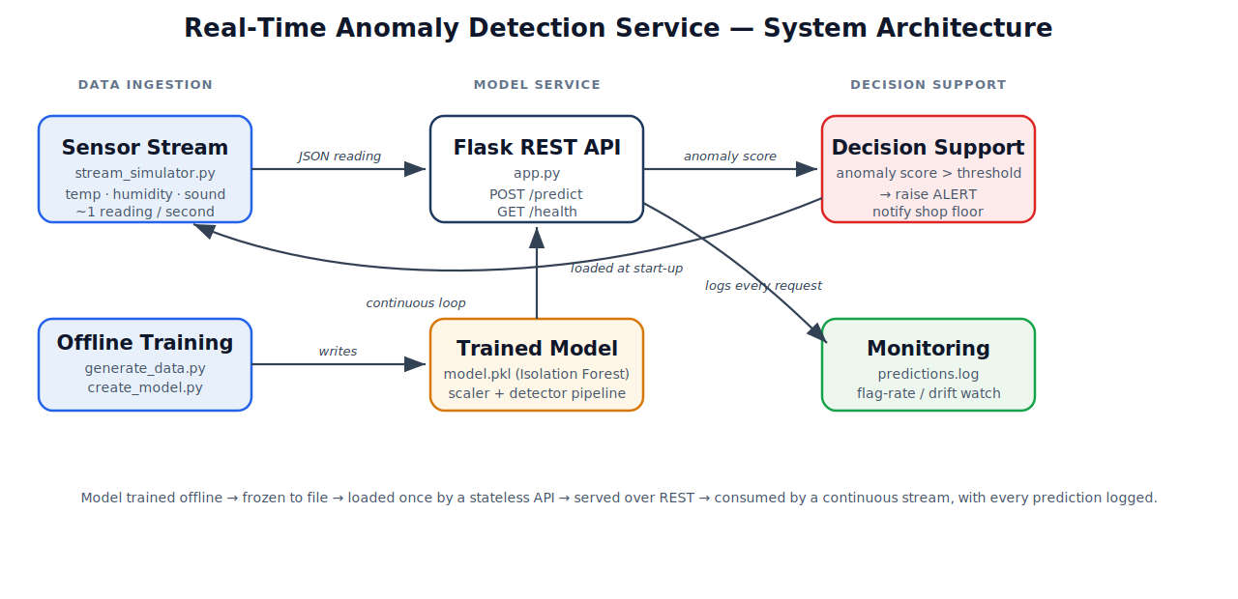
03 · SYSTEM DESIGN
Conceptual system architecture
Figure 1: Conceptual architecture of the anomaly-detection service (own illustration).
DLBDSMTP01 · Project: From Model to Production
6

Slide 7
03 · SYSTEM DESIGN
Three design decisions that make it production-ready
1
2
3
Train offline, serve frozen
One pipeline object, not two artefacts
A stateless REST contract
The model is trained once and pickled. The API never trains — it only loads model.pkl at start-up, so a prediction costs milliseconds and start-up cost is paid once, not per request.
StandardScaler + IsolationForest are bundled in a single sklearn Pipeline. Training and serving therefore apply identical preprocessing — training/serving skew, a well-documented source of hidden technical debt in ML systems (Sculley et al., 2015), is removed by construction.
Each request is independent JSON in, JSON out. Nothing is held between calls, so the service can be replicated horizontally, restarted, or replaced with a new model version without breaking any caller.
Together these three decisions are what turn a trained model into a service the factory's IT team could actually run, monitor and replace — the difference the module is really about.
DLBDSMTP01 · Project: From Model to Production
7

Slide 8
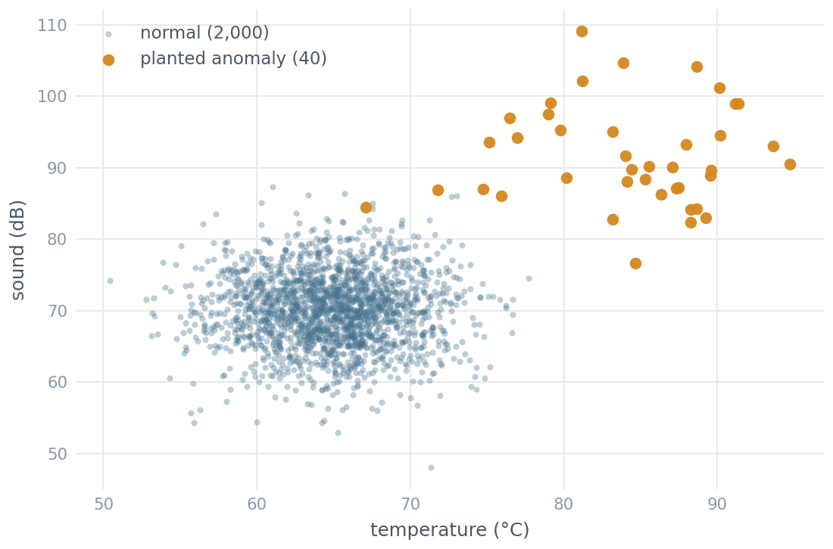
04 · DATA & MODEL
Data: a reproducible, simulated sensor stream
The task allows fictional sample data — I chose it deliberately over a Kaggle set: I control the ground truth, so I can verify the model actually catches the faults I planted.
generate_data.py draws normal items around typical operating values and faulty items with shifted temperature, humidity and sound.
A fixed random seed makes the dataset and the trained model fully reproducible — anyone running the repo gets the identical training figures shown here.
Storage requirement: readings arrive as small JSON messages and are appended, timestamped, to an immutable log — retained both for audit and as the corpus for the next retraining.
The stream is simulated locally (task option 1): stream_simulator.py emits one reading per second, ~10% of them faulty, to keep the live demo lively.
2,040
3
40
2.0%
readings
features
anomalies
contamination
Trade-off I accepted: synthetic data buys reproducibility and a known ground truth, but it cannot reproduce the messiness of real sensors.
Figure 2: Planted anomalies against normal operation (own illustration).
DLBDSMTP01 · Project: From Model to Production
8

Slide 9
04 · DATA & MODEL
Why Isolation Forest — and why unsupervised
The reasoning
The pipeline that gets pickled
In a real factory, labelled faults are rare and expensive to collect — a supervised classifier would need them for every new fault type.
Isolation Forest is unsupervised: it learns what normal looks like and flags what is easy to isolate. It is fitted on the features alone, without labels.
It is fast to train, fast to score, and has one intuitive knob — contamination, set to the ~2% fault rate the domain experts expect (Liu, Ting & Zhou, 2008).
It returns a continuous score, not just a yes/no — so the alert threshold can be tuned later without retraining.
Input
temperature · humidity · sound
▼
StandardScaler
puts the three sensors on a comparable scale
▼
IsolationForest
100 trees · contamination = 0.02 · seed 42
▼
Output
anomaly score + boolean flag
DLBDSMTP01 · Project: From Model to Production
9

Slide 10
04 · DATA & MODEL
Does it work? Basic statistical measures
0.93
0.95
0.94
Precision
Recall
F1-score
of the items flagged,
93% really were faulty
38 of the 40 planted
anomalies were caught
balanced performance
on the anomaly class
SCREENSHOT PLACEHOLDER
Console output of create_model.py
Capture the terminal showing the confusion matrix,
the classification report and the anomaly score range
(min 0.372 · max 0.766 · mean 0.439).
Confusion matrix — 2,040 items
pred. normal
pred. anomaly
actual normal
1,997
3
actual anomaly
2
38
Figure 3: Console output of create_model.py (own screenshot).
DLBDSMTP01 · Project: From Model to Production
10

Slide 11
05 · THE MODEL AS A SERVICE
Packaging the model as a RESTful service
Two endpoints, one contract
POST
/predict
Accepts a single reading or a batch (a JSON list) and returns an anomaly score plus a boolean flag.
SCREENSHOT PLACEHOLDER
GET
/health
The API answering a request
Returns status and a timestamp — what an uptime monitor or a load balancer polls.
Capture app.py running in one terminal, plus a
curl or Postman call to /predict showing the JSON
response — and a /health check alongside it.
POST /predict
{"temperature": 88, "humidity": 73, "sound": 95}
→ {"input": {...}, "anomaly_score": 0.7445,
"is_anomaly": true}
Figure 4: Flask REST API responding to a /predict request (own screenshot).
DLBDSMTP01 · Project: From Model to Production
11

Slide 12
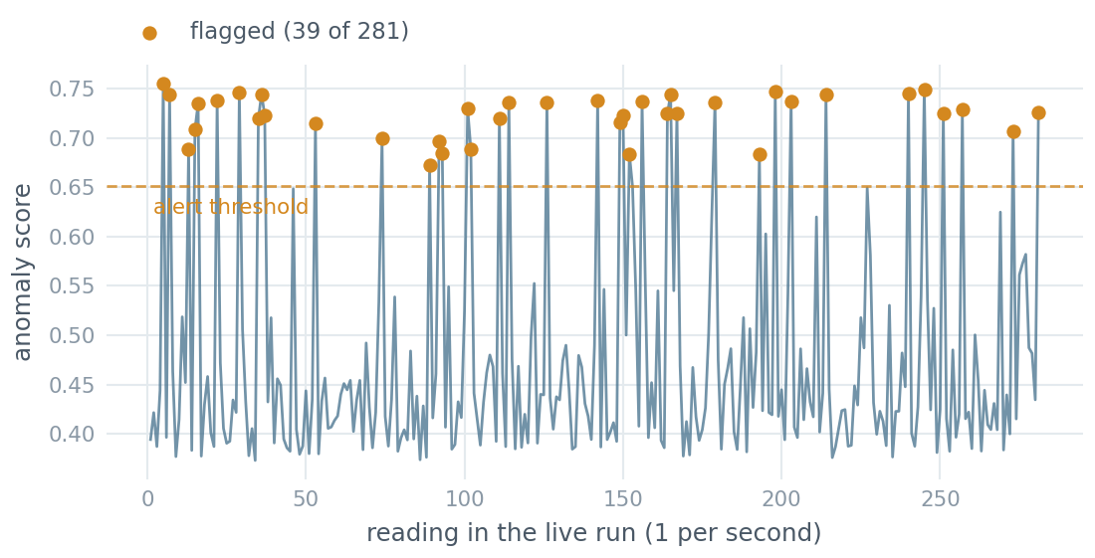
05 · THE MODEL AS A SERVICE
Stream processing in action
One reading per second is POSTed to the API; the response is scored against the alert threshold and a flagged item immediately raises an ALERT on the shop floor.
SCREENSHOT PLACEHOLDER
Live output of stream_simulator.py
Capture the scrolling stream: normal readings
with low scores and at least two flagged lines
showing “← ALERT: anomaly detected!”
Figure 6: Anomaly score for every reading of one recorded run (own illustration).
281
39
10%
Figure 5: Live output of stream_simulator.py with alerts (own screenshot).
readings scored
flagged = 13.9%
faults injected
One recorded run; the stream is not seeded, so these figures vary.
The model errs cautious — the safer direction for a warning system.
DLBDSMTP01 · Project: From Model to Production
12

Slide 13
05 · THE MODEL AS A SERVICE
Monitoring: what keeps it reliable in production
Liveness
1
/health returns status + timestamp, so an uptime monitor can detect a dead service in seconds.
Traceability
SCREENSHOT PLACEHOLDER
2
Every single request is appended to predictions.log with its inputs, score and verdict — so any alert can be explained after the fact.
predictions.log
Capture a section of the log file showing timestamped
entries with inputs, scores and anomaly=True/False —
the evidence that every prediction is recorded.
Drift watch
3
The share of items flagged over time is the early-warning signal: a sudden jump means the sensors or the process changed and the model needs retraining.
Figure 7: Extract from predictions.log (own screenshot).
DLBDSMTP01 · Project: From Model to Production
13

Slide 14
06 · CRITICAL REFLECTION
Integration challenges and their constraints
What was hard
What the service must accept
Keeping preprocessing identical in training and serving — solved by pickling scaler and detector as one pipeline.
Loading the model once at start-up rather than per request; the first version reloaded the pickle on every call and was far slower.
Input validation is the gap I did not close: a missing field still raises inside the handler and returns a bare 500 instead of a clean 400.
Turning a raw score into a decision — the model outputs a number, the shop floor needs a yes/no.
It must be stateless: every request independent, nothing remembered between calls.
A fixed input/output contract — change the JSON schema and every caller breaks.
It must answer fast enough to keep up with the stream; a slow model is a broken model here.
It must be versioned, so a retrained model can replace the old one without downtime for callers.
In short: the model was the easy part. Everything hard about this project lived at the boundary between the model and the system around it.
DLBDSMTP01 · Project: From Model to Production
14

Slide 15
06 · CRITICAL REFLECTION
Critical reflection: what I would do differently
Data
Threshold
Synthetic data with cleanly separated faults makes the model look better than it would on real sensor readings, where faults are subtle and overlap with normal operation. The honest reading of 0.94 F1 is “the plumbing works”, not “the model is excellent”.
The alert threshold is currently the model's own default. In practice it should be chosen with the shop floor, trading false alarms against missed faults — an ignored alarm is worse than no alarm.
Storage
Automation
A log file is enough to demonstrate monitorability, but it does not scale. The next step is a message queue (e.g. Kafka) in front of the API and a time-series database behind it.
Retraining is manual today — the glue code and manual steps Sculley et al. (2015) warn about. A scheduled job triggered by the drift signal would close the loop. Containerising the API and deploying it to a cloud host is the natural extension I did not attempt.
DLBDSMTP01 · Project: From Model to Production
15

Slide 16
Conclusion: goal versus result
Process a continuous data stream
One reading per second, scored end-to-end in real time
✓
Serve predictions over a standardised API
Flask REST service: POST /predict, GET /health
✓
Be monitorable
Health endpoint, full prediction log, drift signal
✓
Be maintainable & adaptable
Four small scripts; retrain and swap model.pkl, contract unchanged
✓
Be scalable
Stateless design — replicate the API to add capacity
✓
The requirement the task called the most work-intensive — putting the model into production — is the part that is fully delivered. The model itself is deliberately simple, exactly as the brief asked.
DLBDSMTP01 · Project: From Model to Production
16

Slide 17
List of figures
Figure 1
Conceptual architecture of the anomaly-detection service
Own illustration
Slide 6
Figure 2
Planted anomalies against normal operation (temperature vs. sound)
Own illustration
Slide 8
Figure 3
Console output of create_model.py (confusion matrix, classification report)
Own screenshot
Slide 10
Figure 4
Flask REST API responding to a /predict request
Own screenshot
Slide 11
Figure 5
Live output of stream_simulator.py with anomaly alerts
Own screenshot
Slide 12
Figure 6
Anomaly score for every reading of one recorded stream run
Own illustration
Slide 12
Figure 7
Extract from predictions.log
Own screenshot
Slide 13
All figures in this presentation are own work; no third-party images were used.
DLBDSMTP01 · Project: From Model to Production
17

Slide 18
Reference list
Liu, F. T., Ting, K. M., & Zhou, Z.-H. (2008). Isolation forest. In 2008 Eighth IEEE International Conference on Data Mining (pp. 413–422). IEEE. https://doi.org/10.1109/ICDM.2008.17
Pedregosa, F., Varoquaux, G., Gramfort, A., Michel, V., Thirion, B., Grisel, O., Blondel, M., Prettenhofer, P., Weiss, R., Dubourg, V., Vanderplas, J., Passos, A., Cournapeau, D., Brucher, M., Perrot, M., & Duchesnay, É. (2011). Scikit-learn: Machine learning in Python. Journal of Machine Learning Research, 12, 2825–2830.
Pallets. (2024). Flask documentation (Version 3.0). https://flask.palletsprojects.com/
Scikit-learn developers. (2024). sklearn.ensemble.IsolationForest — API reference. https://scikit-learn.org/stable/modules/generated/sklearn.ensemble.IsolationForest.html
Sculley, D., Holt, G., Golovin, D., Davydov, E., Phillips, T., Ebner, D., Chaudhary, V., Young, M., Crespo, J.-F., & Dennison, D. (2015). Hidden technical debt in machine learning systems. Advances in Neural Information Processing Systems, 28, 2503–2511.
IU International University of Applied Sciences. (2024). Course DLBDSMTP01: Project — From model to production [Course material].
Citation style: APA 7th edition, in line with the IU General Citation Guidelines.
DLBDSMTP01 · Project: From Model to Production
18

Slide 19
Follow and reproduce the code
Repository
What is in the repository
[ PASTE YOUR GITHUB REPOSITORY URL HERE ]
generate_data.py
creates the synthetic sensor dataset
create_model.py
trains and evaluates, writes model.pkl
Reproducible from a clean checkout: the data generator is seeded, so the dataset, the trained model and the evaluation metrics come out identical. The stream simulator is not seeded — its figures describe one recorded run.
app.py
the Flask REST API
pip install -r requirements.txt
python generate_data.py
python create_model.py
python app.py # terminal 1
python stream_simulator.py # terminal 2
stream_simulator.py
the continuous sensor stream
predictions.log
monitoring evidence from a live run
README.md
architecture, how to run, reflection
DLBDSMTP01 · Project: From Model to Production
19

Slide 20
Thank you
Questions are welcome.
[ PASTE YOUR GITHUB REPOSITORY URL HERE ]
Amash Mohamed · DLBDSMTP01 · Project: From Model to Production
DLBDSMTP01 · Project: From Model to Production
20

