Slide 1

Will you get accepted into a graduate school?
Subtitle
Notes:
NOTE:
To change the image on this slide, select the picture and delete it. Then click the Pictures icon in the placeholder to insert your own image.

Slide 2
Will you get into a graduate school?
Problem Statement
Inspecting the data
First Impression
Model development

Slide 3
Problem Statement & Objectives
Problem Statement
College admission is a process that seems to sow fear in the hearts of high school students
Specially, hard for graduate schools due to several factors being considered
Understanding the process and what factors that really weight in will help students be well prepared
Objective
Predict the chance of being admitted based on different factors described in the data dictionary. In other word, what weight the most in the admission process.

Slide 4
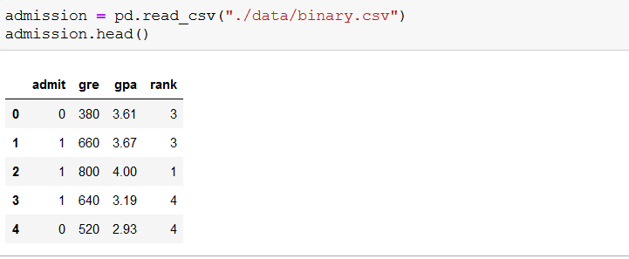


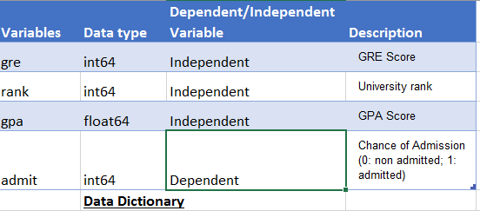
Inspecting the data
Getting the data

Slide 5
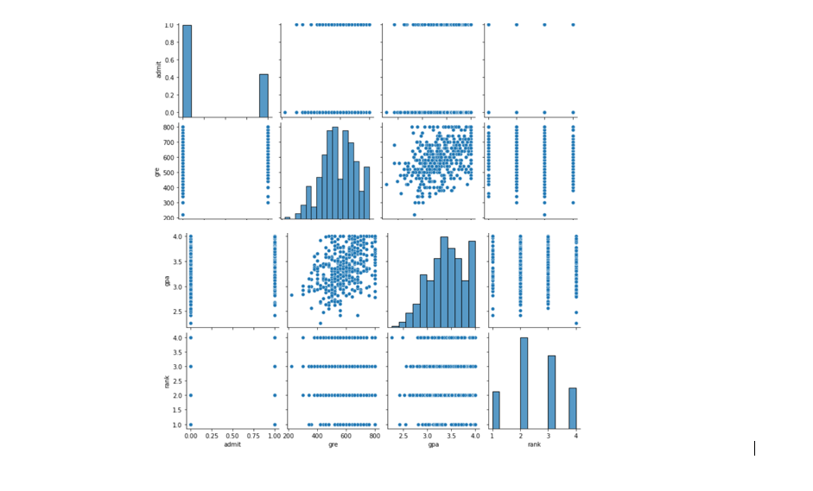
First Impressions
Distribution of the variables
Distribution of variables and relationships between them

Slide 6
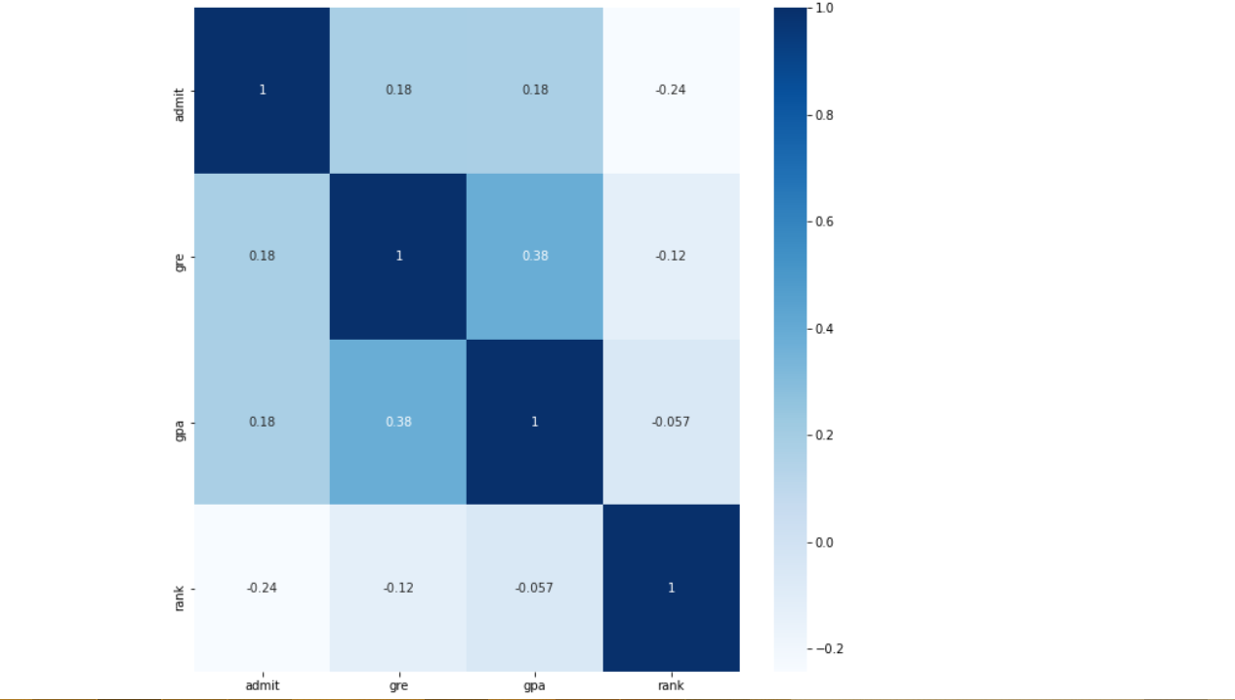
First Impressions - Race to Admit prediction
Heatmap graph

Slide 7
Model Development
Given the data type of the dependent variable (contains either 0 or 1) , a classification analysis seems to be the best fit. 3 Classification models were analyzed in this project:
Logistic Regression
Random Frorest Classifier
Decision Tree Classifier

Slide 8
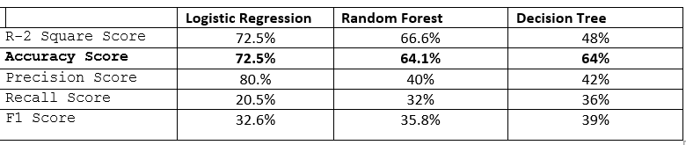
Model Development
Model Comparison

Slide 9
Summary
Rank Score seems to be the most important feature in the admission process
Logistic Regression seems to have the highest accuracy
In the future,
Tuning the models with GridSearchCV may lead to better results and also may be looking at other evaluation metrics
Building an app seems also to be an interesting journey to consider

Slide 10

The End

