Slide 1
Cyclistic USAGE
Differences between members and casual users
A. Mastromarino
Report prepared Dec 21, 2021

Slide 2

Background
We looked at the past 12 months of Cyclistic usage data, which contained about 5.5 million trips made between Dec 2020 and Nov 2021.
We examined how annual members and casual riders use the service differently.

Slide 3
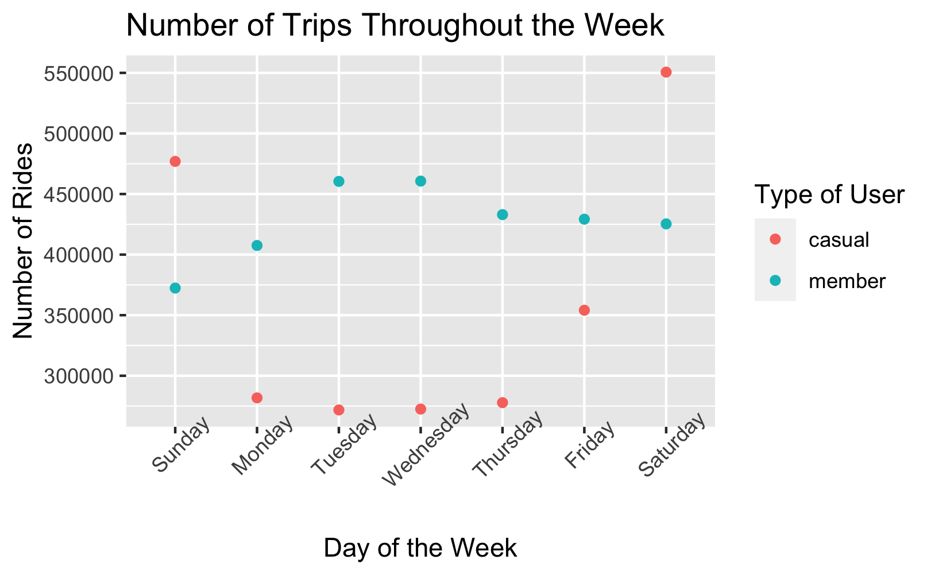
Insights
Casual riders
Tend to travel on the weekends
Barely travel during the week
Member riders
Travel throughout the week
Travel more during weekdays
Take more trips

Slide 4
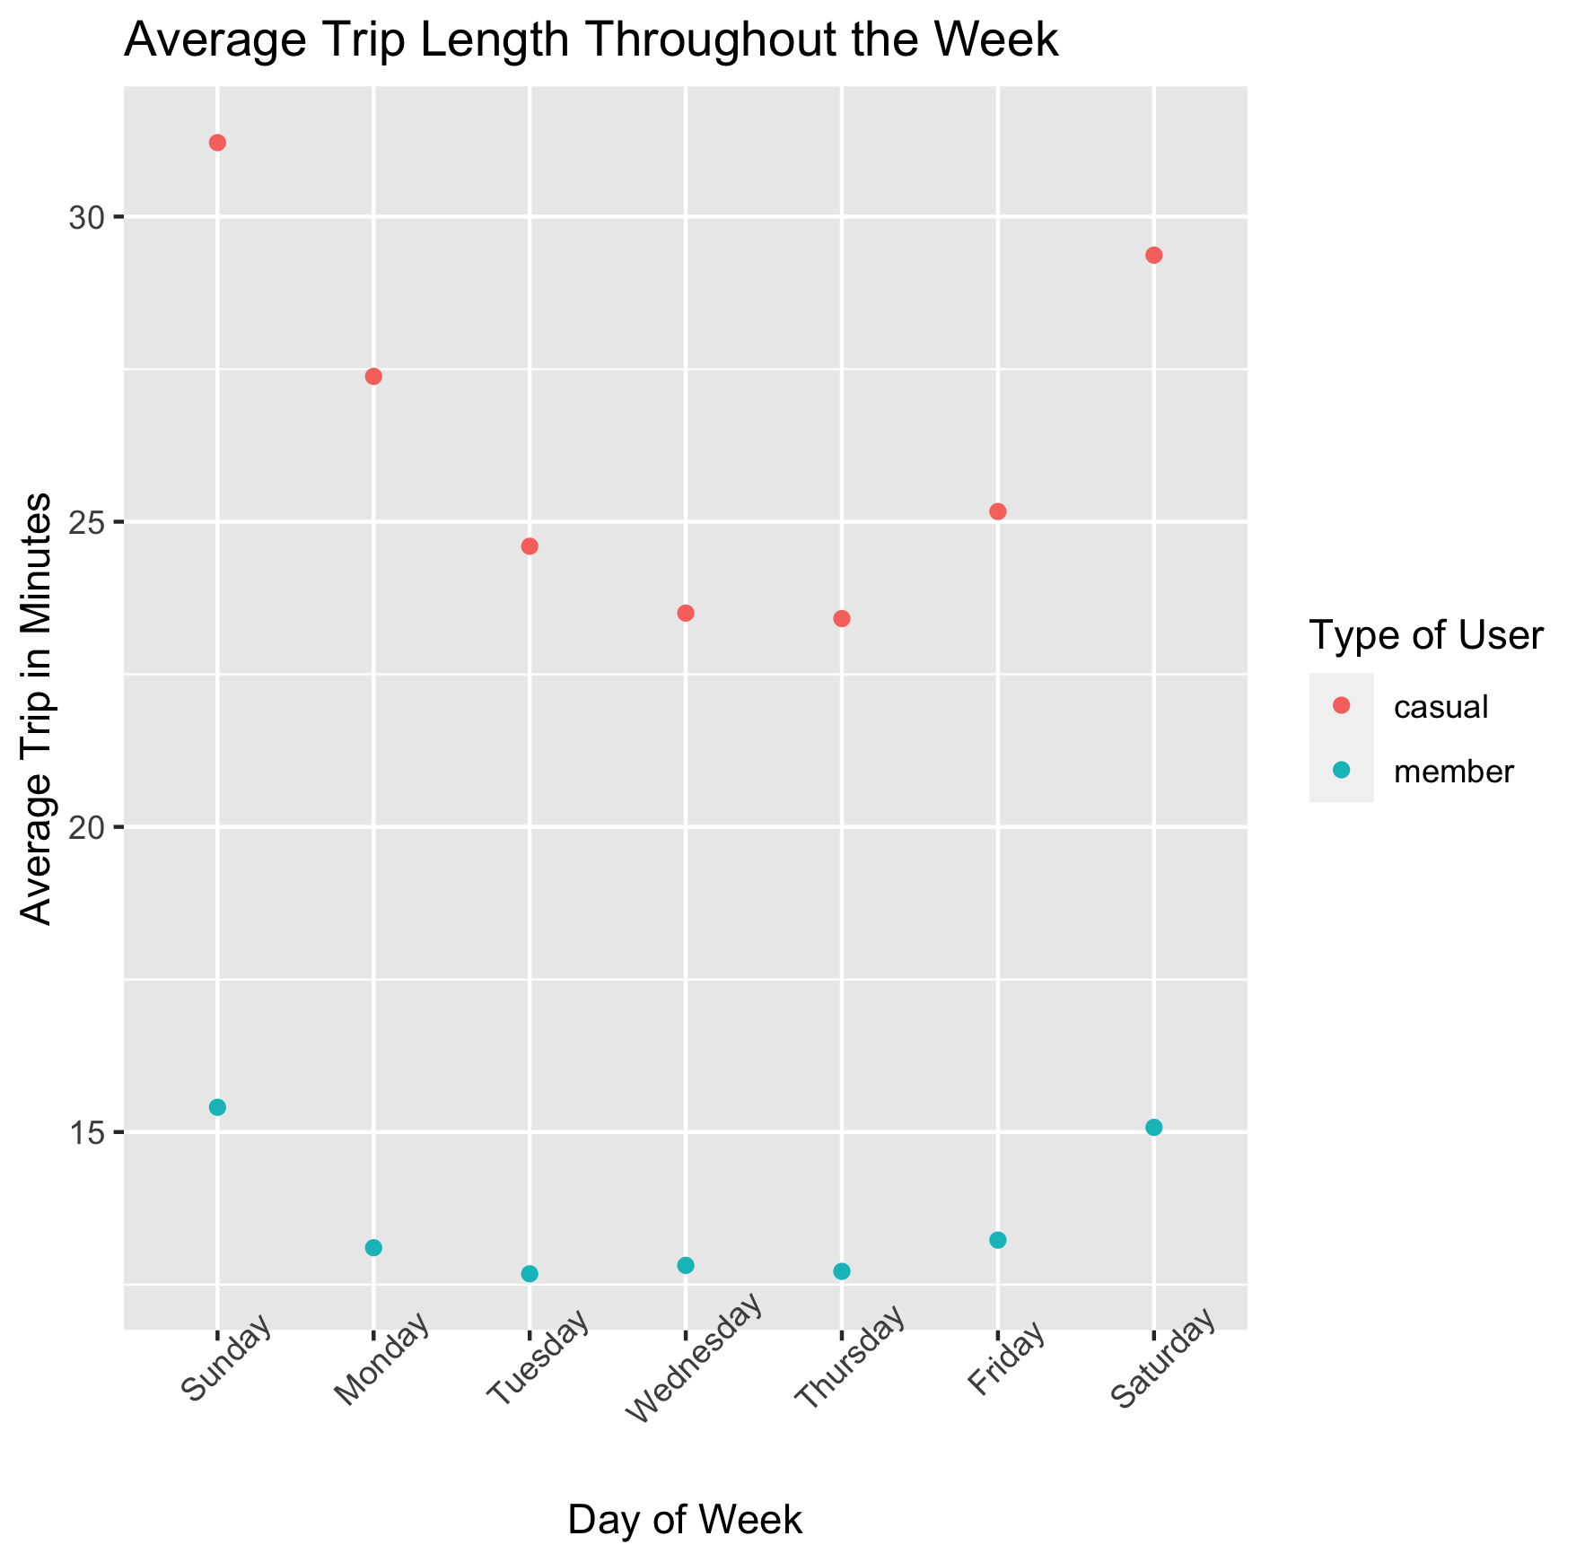
Insights
Casual riders
Tend to have much longer trips
Travel the longest during the weekends
Have greater variation of average trip length throughout the week

Slide 5
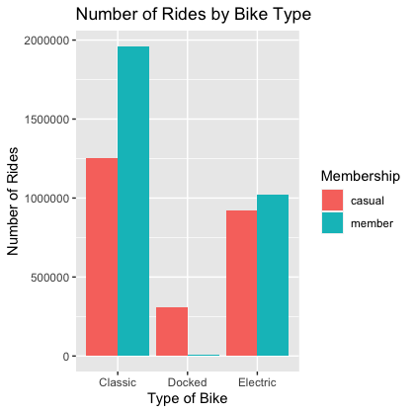
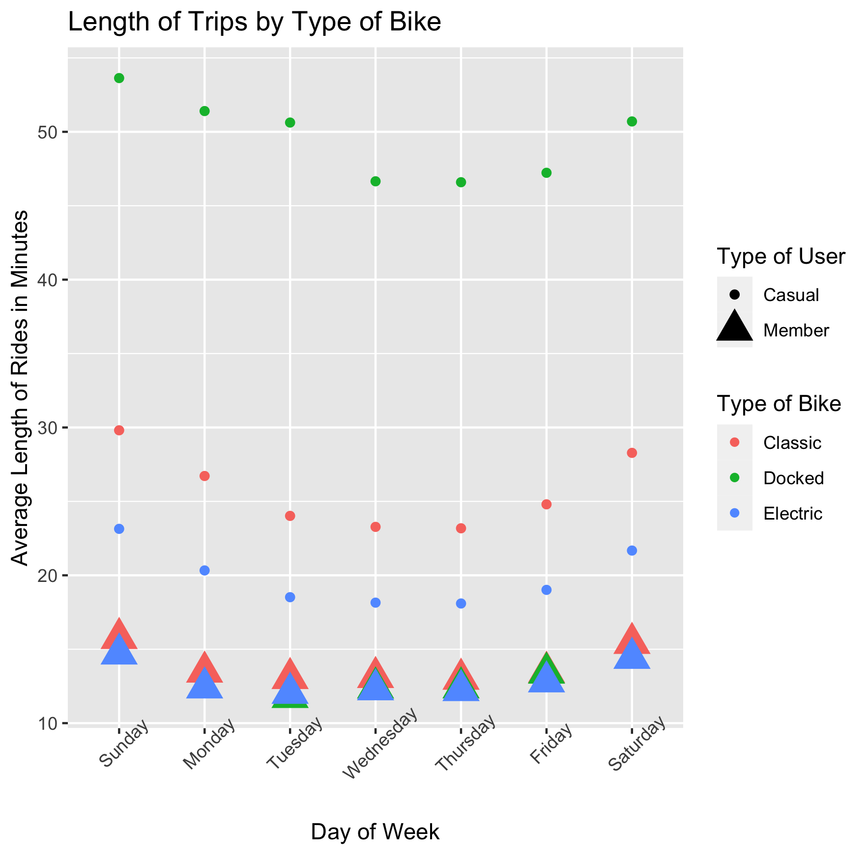
Insights
Casual riders
Are more likely to use Electric bikes than Classic
Use Docked bikes more than members
Take their longest trips using the Docked bikes

Slide 6
Recommendations
Create a marketing strategy that focuses on
Weekend users
Those who take longer trips
Those who use docked bikes

Slide 7
Appendix
Data removed from working dataset included trips with a length less than or equal to 0 seconds or greater than a day
The analysis can be reviewed in the R Markdown Notebook here
The data came from https://divvy-tripdata.s3.amazonaws.com/index.html, provided by Google for this case study as a Capstone project
The bike clip art came from http://clipart-library.com/clipart/42689.htm and is free for personal use

