Slide 1

Comprehensive Analysis of Sales and Profit Metrics in BikeStore

Slide 2

INTRODUCTION Uncovering Trends, Customer Insights, and Seasonal Patterns

Slide 3
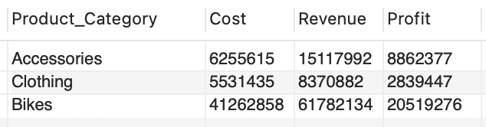
Product Category Financial Overview: Cost, Revenue, and Profit Analysis

Slide 4

Understand customer demographics for targeted insights.

Slide 5
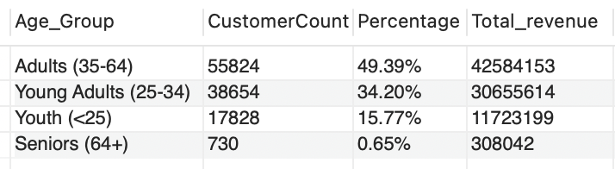
Analyzing Customer by Age Group

Slide 6
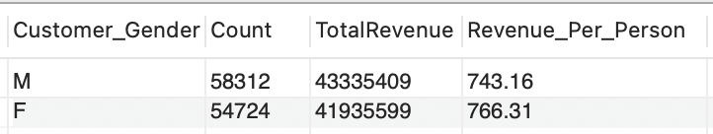
Analyzing Customer by Gender

Slide 7
The sales performance across different countries and states

Slide 8
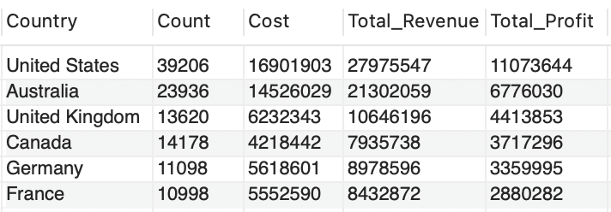
Sales Analysis by Country
and State

Slide 9
Identify the most and least profitable product categories and sub-categories.

Slide 10
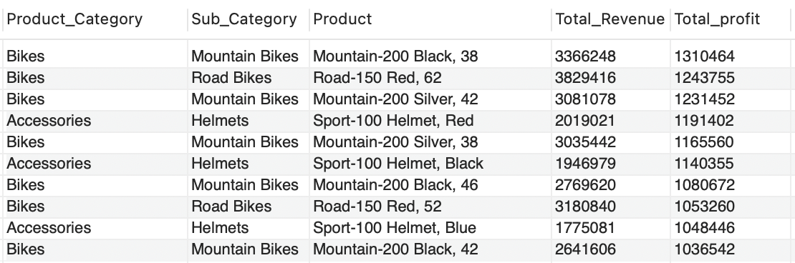
Revenue and Profit Analysis by Product Category and Sub-Category

Slide 11
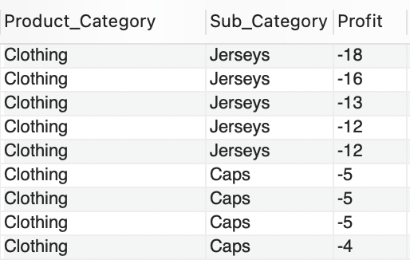
Loss-Making Products

Slide 12
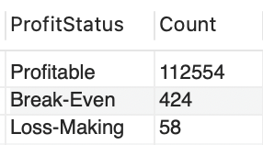
Profitability Status Overview

Slide 13
Analyzed yearly and monthly sales patterns , identified seasonality

Slide 14
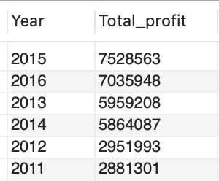
Explore monthly and yearly trends

Slide 15
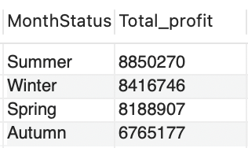
Explore monthly and yearly trends

Slide 16

Conclusion:
Adults between the ages of 35 and 64 make the most Revenue while the least are Seniors.
Males generate more revenue , however Females have a higher Revenue per person.
USA achieves the most revenue while France achieves the lowest.
Bikes generate the highest revenue & profit , while Clothing makes loss.
Summer is the season with the highest profits, followed by Winter.
The Store’s Profits increase annually , with a slight decrease in 2016.

Slide 17


