Slide 1
TRANSPORT IN TRANSITION
The Electric Shift
How electric cars went from niche to mainstream in five years.
Example deck · morphdeck

Slide 2
Where we're going
01
The surge →
02
What made it happen →

Slide 3
← Where we're going
01
The surge
Sales took off after 2020.

Slide 4
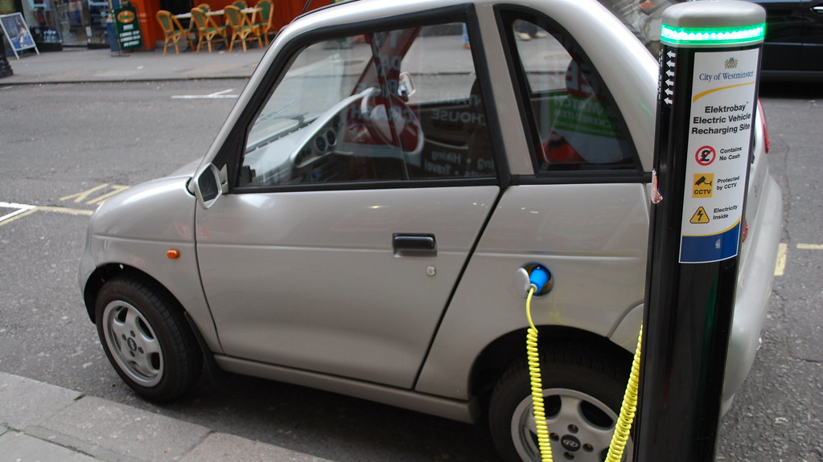
ON THE ROAD
Plugged in
Charging points are spreading through cities, highways and homes.
Notes:
Image credit: “Electric car charging” by Alan Trotter (CC BY 2.0) — https://www.flickr.com/photos/87065732@N00/2492684025

Slide 5
Global EV sales, millions
6x in four years
Battery-electric plus plug-in hybrid cars.
Source: IEA Global EV Outlook 2024

Slide 6
Where 2023's EVs were sold
China leads
Share of global electric car sales.
Source: IEA Global EV Outlook 2024

Slide 7
← Where we're going
02
What made it happen
Cheaper batteries, stronger policy, better cars.

Slide 8
The adoption flywheel
1
01 Cheaper batteries
Battery pack prices fell sharply over the decade.
Flywheel
02 More models
Carmakers launch EVs in every segment.
4
2
03 More buyers
Sales volume grows and scale cuts costs.
04 More chargers
Demand pulls in charging investment.
3

Slide 9
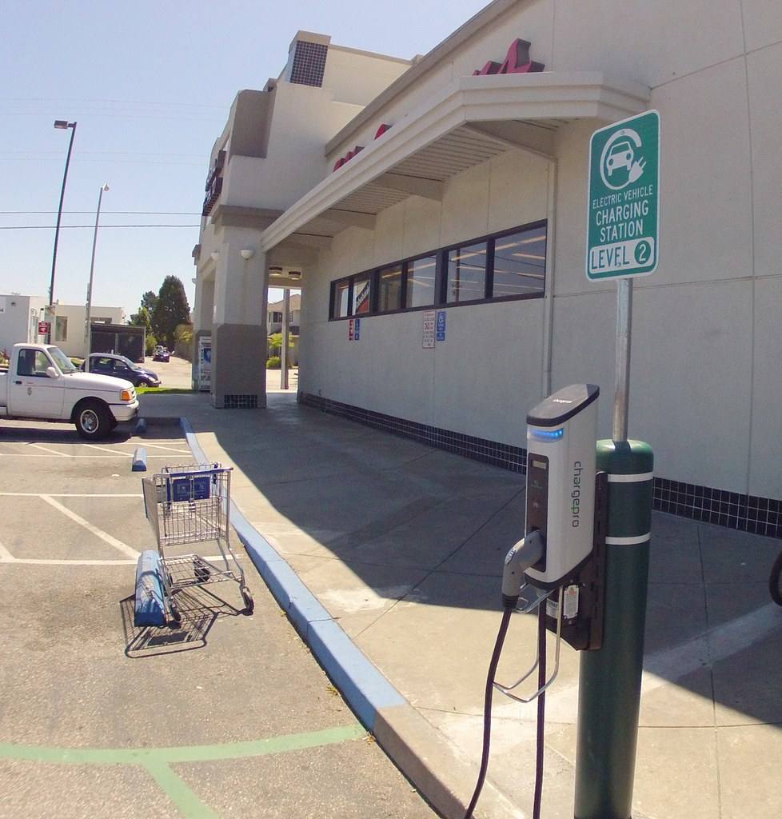
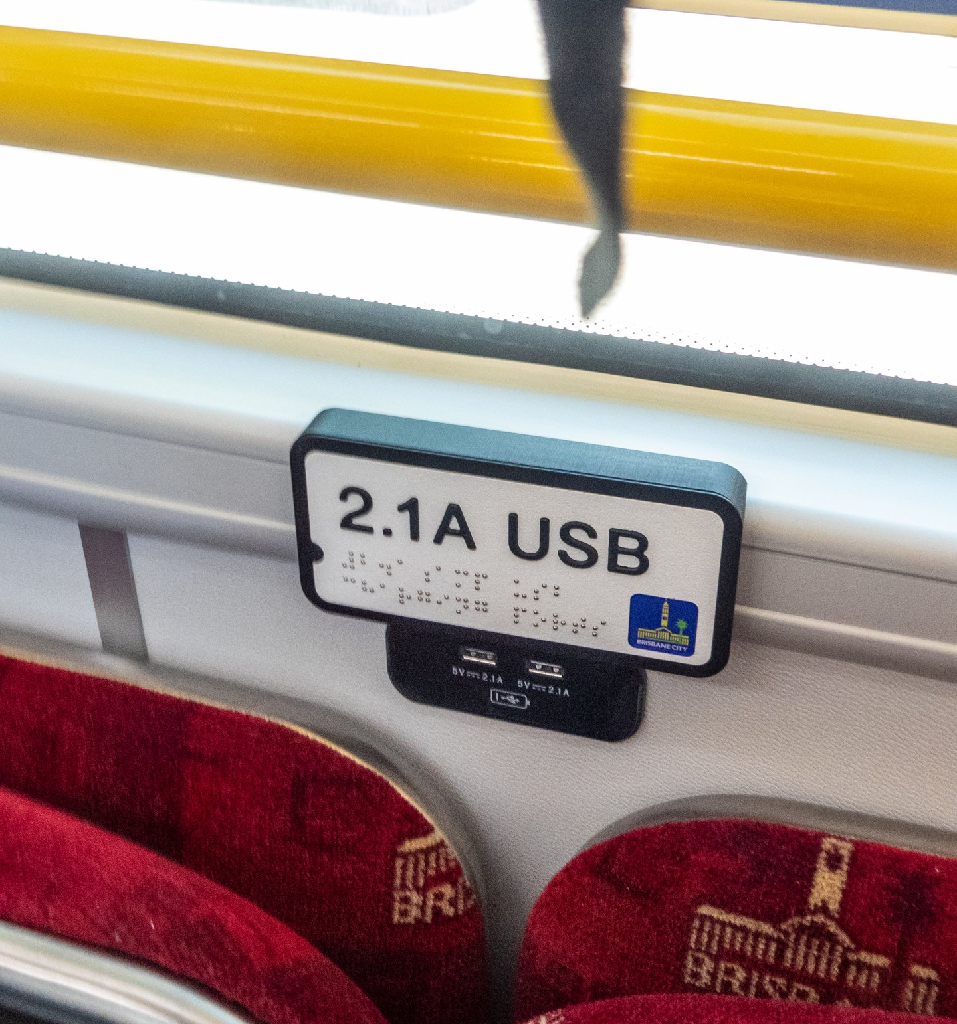

The new streetscape
Fast chargers
Electric buses
Clean power
Notes:
Image credit: “Electric Vehicle Charging Station” by Richard Masoner / Cyclelicious (CC BY-SA 2.0) — https://www.flickr.com/photos/99247795@N00/7236827580
Image credit: “Braille and tactile signs in Yutong E12 electric bus City Loop route Brisbane P1090946” by John Robert McPherson (CC BY-SA 4.0) — https://commons.wikimedia.org/w/index.php?curid=110428471
Image credit: “Wind Turbine” by SustainableDevelopment (CC BY 2.0) — https://www.flickr.com/photos/22626091@N04/2204304728

Slide 10
BIG QUESTION
Can the grid keep up?
Millions of cars plugging in at once is a new kind of demand.

Slide 11
The road ahead is electric
Thank you. Questions?

