Slide 1
INTRODUCING
morphdeck
Type a topic. Get a PowerPoint that moves like a film.
A Claude Code skill · github.com/amateurcoder015/morphdeck-skill
Notes:
Everything you are about to see was generated by morphdeck itself, from one JSON spec.

Slide 2
Most slide decks just sit there. This one moves like a single camera shot.
— The idea in one line

Slide 3
The tour
01
The idea →
02
What it can do →
03
Make it yours →
04
Get started →
Notes:
These items are clickable in slideshow mode. Each one jumps to its section.

Slide 4
← The tour
01
The idea
Why build another slide tool?

Slide 5
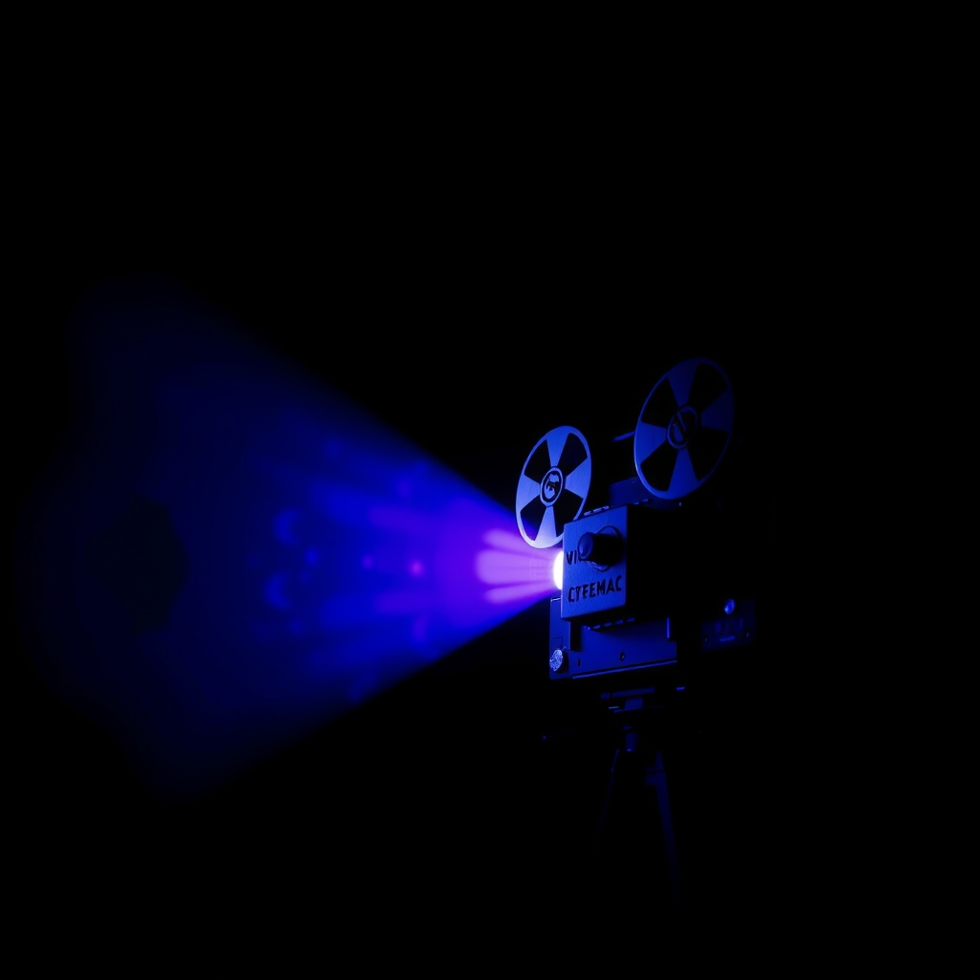
“
I want a proper fluid PPT that looks like a movie of sorts.
The original brief
The request that started it all
Notes:
Image credit: AI-generated image (Cloudflare Workers AI, FLUX.1 schnell). Prompt: vintage film projector casting a violet and cyan light beam in a dark cinema, deep navy palette, cinematic photo, centered subject

Slide 6
Basic deck vs morphdeck
BASIC DECK
— Static shapes and bullet walls
— Click, appear, click, appear
— Same template for every topic
MORPHDECK
— Shapes glide between slides with Morph
— Content builds itself, no extra clicks
— Theme and motion matched to the topic

Slide 7
How it works
1
01 Brief
You give a topic, a short brief and any options.
5
One prompt
2
02 Story
Claude writes the storyline and speaker notes.
03 Design
It picks a theme, layouts and images.
04 Build
A script writes a native .pptx with Morph and animations.
4
3
05 Check
PowerPoint renders previews; Claude fixes what overflows.

Slide 8
← The tour
02
What it can do
Motion, data and images, all native PowerPoint.

Slide 9
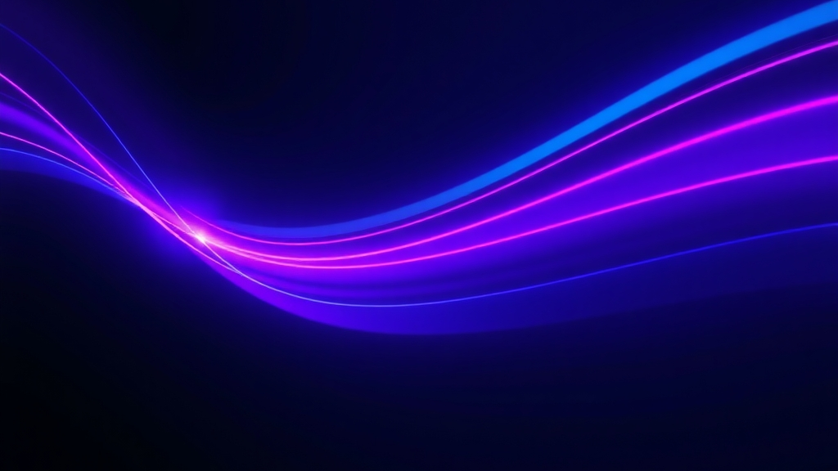
MOTION
One continuous shot
A shared stage of glows, rings and panels morphs from slide to slide.
Notes:
Image credit: AI-generated image (Cloudflare Workers AI, FLUX.1 schnell). Prompt: abstract glowing violet and cyan light trails sweeping through a dark space, long exposure, deep navy and violet palette with cyan accents, cinematic lighting, bright trails on the right, empty dark space on the left

Slide 10
Anatomy of one slide
Morph
Title
Content
Loop
The stage glides into its new pose.
The headline builds letter by letter.
Points, cards and charts rise in turn.
A disc floats and the ring sways.

Slide 11
Three layers of motion
01
Morph
Named stage shapes glide, resize and rotate between every slide.
02
Entrances
Rise, zoom, wipe, wheel and letter-by-letter builds, staggered automatically.
03
Ambient
Floating, swaying and slow Ken Burns zooms keep each slide alive.

Slide 12
Layouts available
19 layouts
Native, editable PowerPoint charts like this one.
Source: morphdeck release history

Slide 13
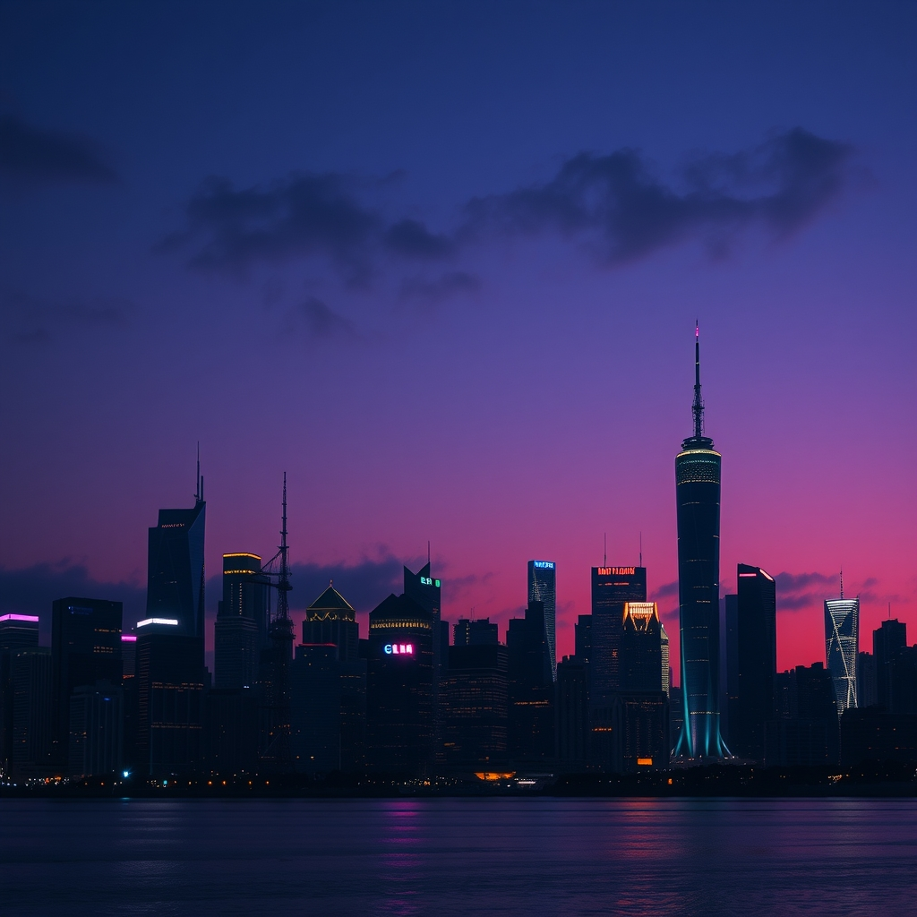
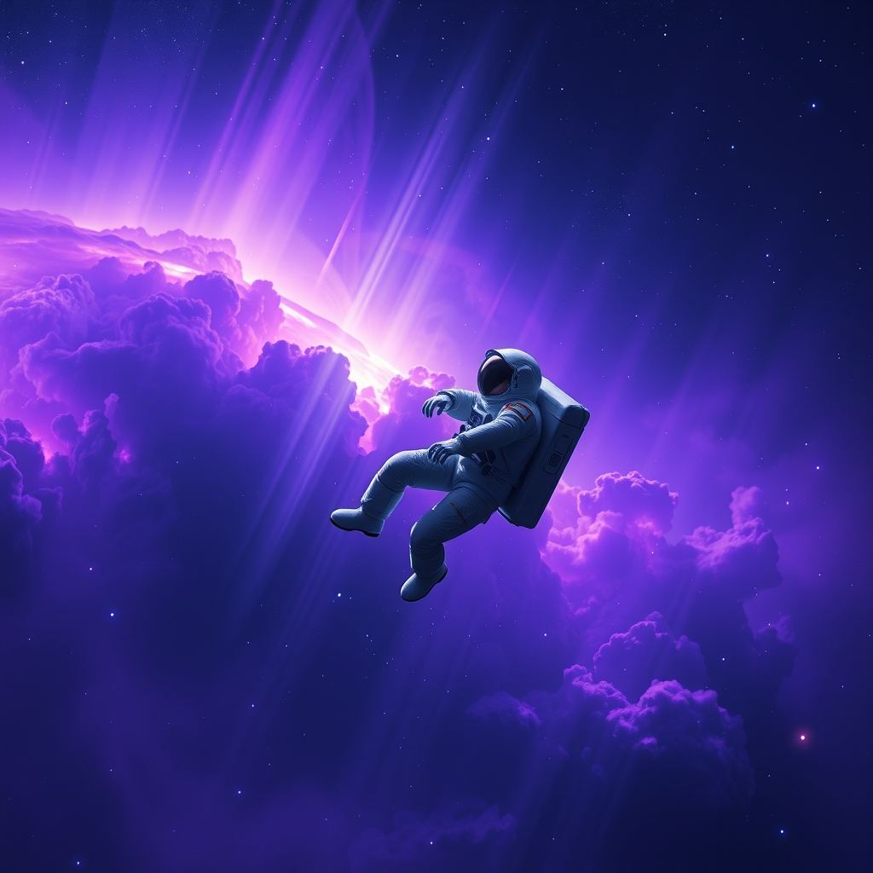
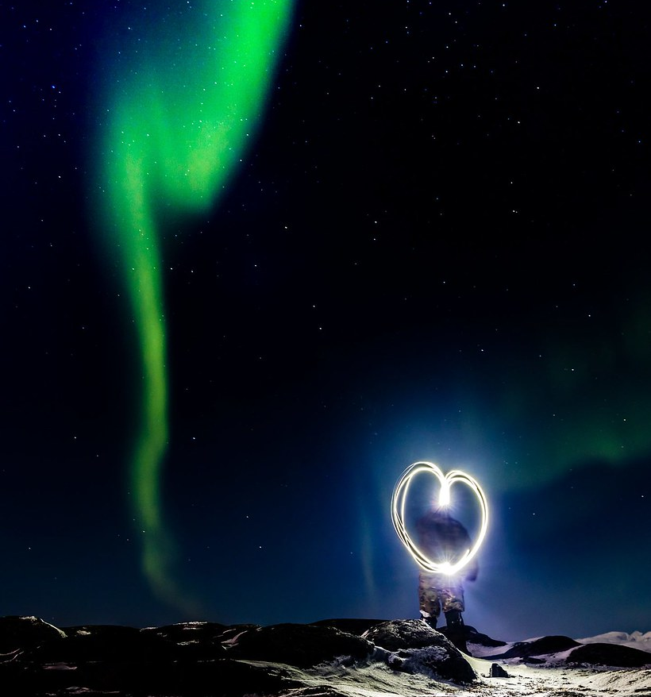
Images on demand
AI · Cloudflare FLUX
AI · Cloudflare FLUX
Stock · Openverse
Notes:
Image credit: AI-generated image (Cloudflare Workers AI, FLUX.1 schnell). Prompt: futuristic city skyline at dusk with glowing towers, deep navy and violet palette with cyan accents, cinematic lighting, photo
Image credit: AI-generated image (Cloudflare Workers AI, FLUX.1 schnell). Prompt: astronaut floating above a violet nebula, deep navy and violet palette with cyan accents, cinematic lighting, photo
Image credit: “Valentines Day” by Defence Images (CC BY-SA 2.0) — https://www.flickr.com/photos/48399297@N04/32902076795

Slide 14
Layouts used in this deck
19 of 19
All 19 layouts appear in these 23 slides.
Source: this deck

Slide 15
~170/day
No credit card needed
Free AI images
Cloudflare Workers AI gives 10,000 free neurons a day; one FLUX.1 schnell image costs about 58.

Slide 16
← The tour
03
Make it yours
Every deck is shaped by a few simple options.

Slide 17
Options you can set
Say them in plain words or as key=value pairs after the topic.
slides: exact slide count
aspect: 16:9, 16:10 or 4:3
motion: calm, normal or dramatic
tone: exec, academic, kids, persuasive
density: text-heavy, balanced or image-heavy
images: stock, AI, mixed or none
theme: six looks matched to the topic
agenda: clickable, with links back

Slide 18
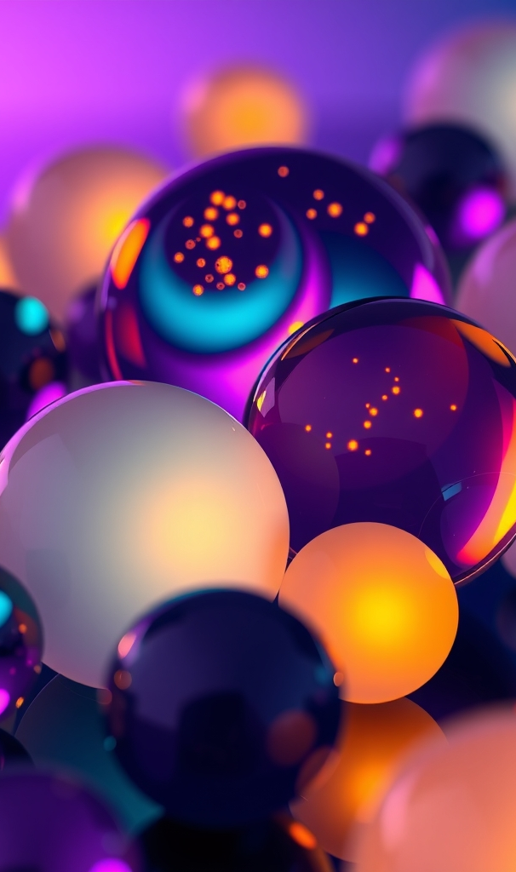
Six themes, one per mood
Midnight: tech, AI and space
Emerald: finance and nature
Ember: history, sport and culture
Aurum: luxury and leadership
Paper and Lagoon: business, science, health
Notes:
Image credit: AI-generated image (Cloudflare Workers AI, FLUX.1 schnell). Prompt: elegant abstract composition of glowing glass spheres in violet, cyan, emerald, amber and gold, deep navy and violet palette with cyan accents, cinematic lighting, vertical composition

Slide 19
Who it's for
S
T
F
T
Students
Class talks
Topic in, finished deck out.
Teachers
Lessons
Clear, calm decks for any subject.
Founders
Pitches
Dramatic motion for big moments.
Teams
Reports
Charts and data, on brand.

Slide 20
← The tour
04
Get started
One minute to install.

Slide 21
INSTALL
Clone, copy, ask
Then just ask Claude
Clone the repo, copy the morphdeck folder into ~/.claude/skills, install the free Unbounded font, then ask Claude for a deck.

Slide 22
YOUR TURN
What will you present next?
Give morphdeck a topic and watch it move.

Slide 23
Type a topic. Get a film.
github.com/amateurcoder015/morphdeck-skill

