Slide 1

K-means
Sequential and parallel implementations
Matteo Amatori
7024736
Firenze, 6 Febbraio 2020

Slide 2

K-means
Firenze, 6 Febbraio 2020
Presentation outline
Theorical analysis of the algorithm
Technologies used
Sequential algorithm implementation
Parallel algorithm implementation
Performance analysis
2

Slide 3
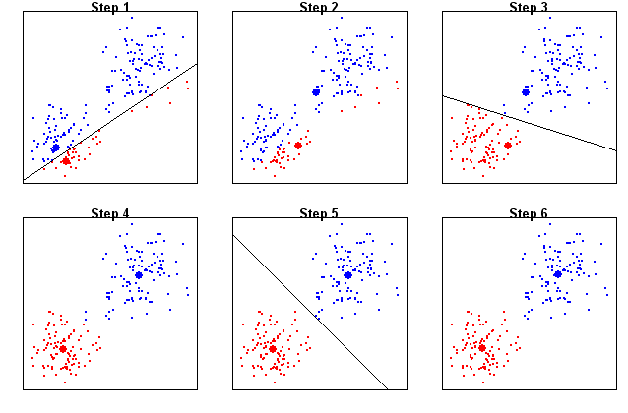
K-means
Firenze, 6 Febbraio 2020
Theorical analysis of the algorithm
K-means algorithm: how it works
Metric used for the performance evaluation
3

Slide 4



K-means
Firenze, 6 Febbraio 2020
Technologies used
Language adopted
Parallel Computing API: OpenMP
CPU
4

Slide 5
K-means
Firenze, 6 Febbraio 2020
Sequential algorithm implementation
Dataset and clusters creation
Assign dataset points to closest cluster
Recompute clusters centroids
Output and cleanup
5

Slide 6
K-means
Firenze, 6 Febbraio 2020
Parallel algorithm implementation
Each thread assigns points to the closest cluster (local)
Dataset and clusters creation
Create n threads, each one has a local copy of the clusters
One thread at a time updates the shared resource inside the critical section
Output and cleanup
Recompute clusters centroids
6

Slide 7
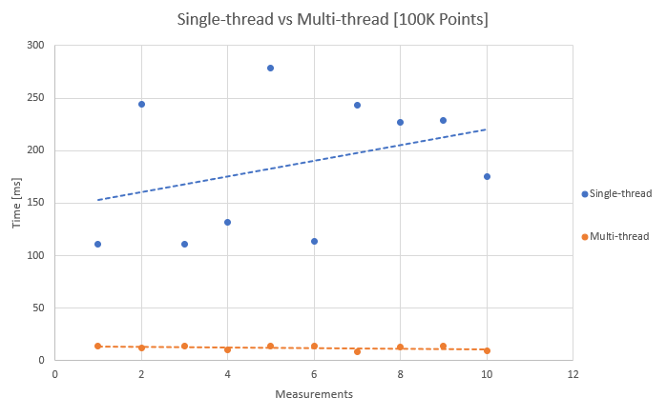
K-means
Firenze, 6 Febbraio 2020
Performance analysis
7

Slide 8
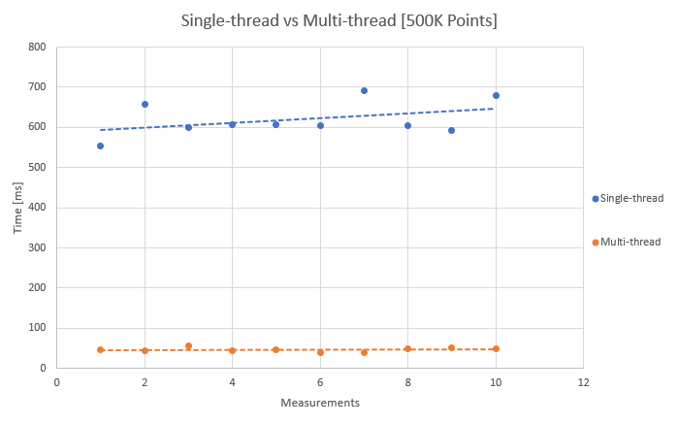
K-means
Firenze, 6 Febbraio 2020
Performance analysis
8

Slide 9
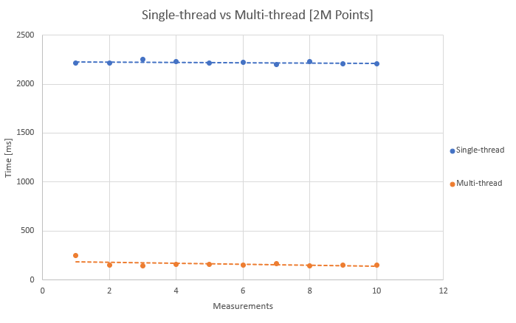
K-means
Firenze, 6 Febbraio 2020
Performance analysis
9

Slide 10
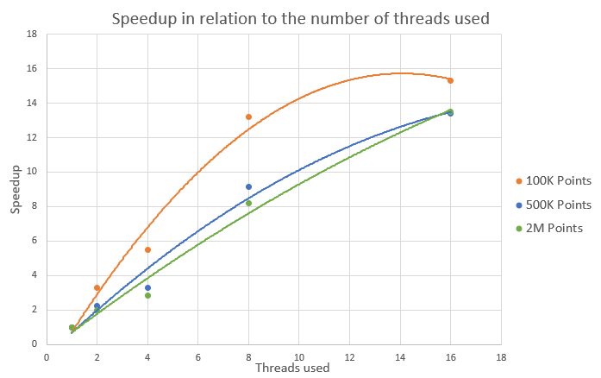
K-means
Firenze, 6 Febbraio 2020
Performance analysis
10

