Slide 1

Kernel Image Processing
Sequential and parallel implementations
Matteo Amatori
7024736
Firenze, 6 Febbraio 2020

Slide 2

Kernel Image Processing
Firenze, 6 Febbraio 2020
Presentation outline
Theorical analysis of the algorithm
Technologies used
Sequential algorithm implementation
Parallel algorithm implementation
Results
Performance analysis
2

Slide 3
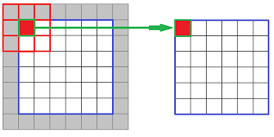
Kernel Image Processing
Firenze, 6 Febbraio 2020
Theorical analysis of the algorithm
Kernel Image Processing
Metric used for the performance evaluation
3

Slide 4



Kernel Image Processing
Firenze, 6 Febbraio 2020
Technologies used
Language adopted
Parallel Computing: CUDA
CPU
4

Slide 5
Kernel Image Processing
Firenze, 6 Febbraio 2020
Sequential algorithm implementation
Image reading
Padding addition
Process every pixel
Re-assemble the image and output
Process every pixel
Process every pixel for each band
5

Slide 6
Kernel Image Processing
Firenze, 6 Febbraio 2020
Parallel algorithm implementation
Image reading
Copying the image on the device
Each thread processes an individual pixel
Copying the output array back to the host
Re-assemble the image and output
Code running on host
Code running on device
6

Slide 7
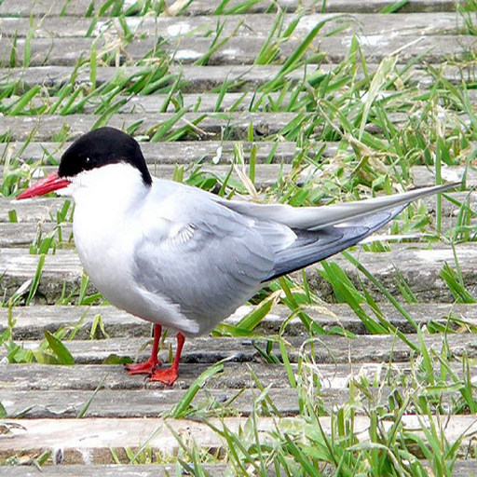

Kernel Image Processing
Firenze, 6 Febbraio 2020
Results – Sequential version
7

Slide 8
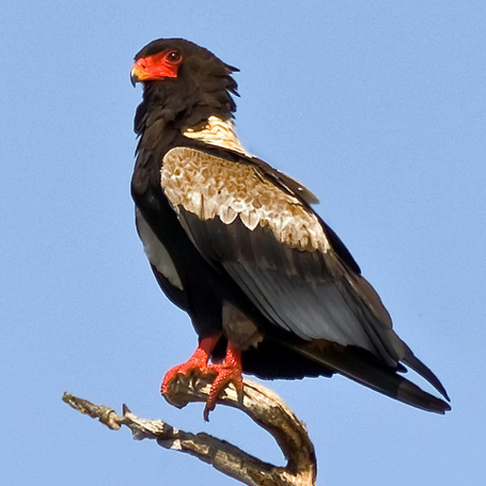

Kernel Image Processing
Firenze, 6 Febbraio 2020
Results – Parallel version
8

Slide 9
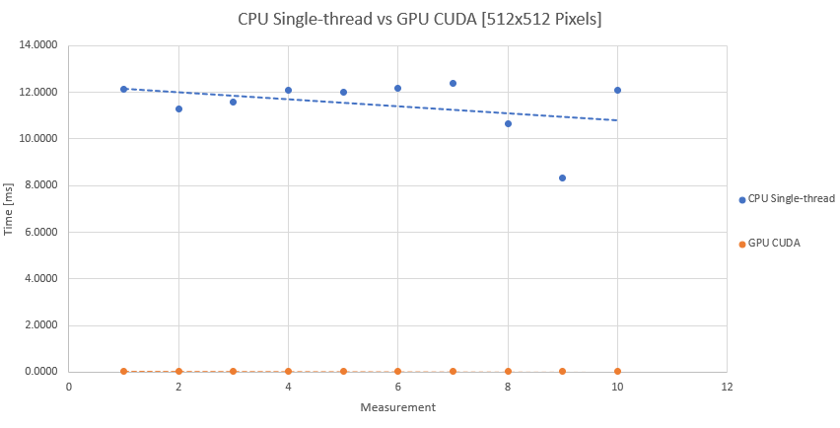
Kernel Image Processing
Firenze, 6 Febbraio 2020
Performance analysis
9

Slide 10
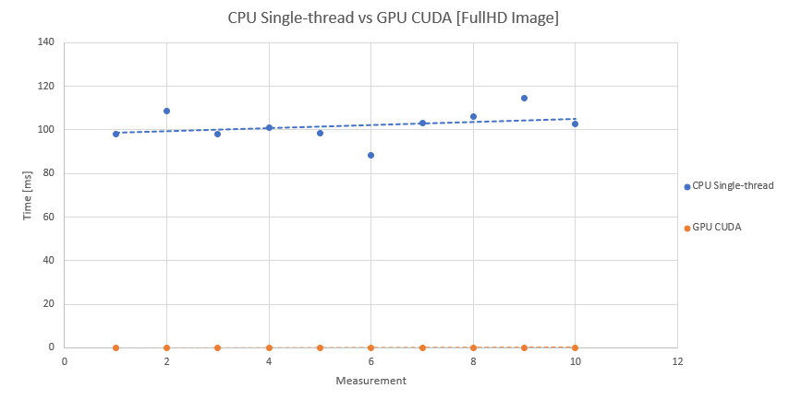
Kernel Image Processing
Firenze, 6 Febbraio 2020
Performance analysis
10

Slide 11
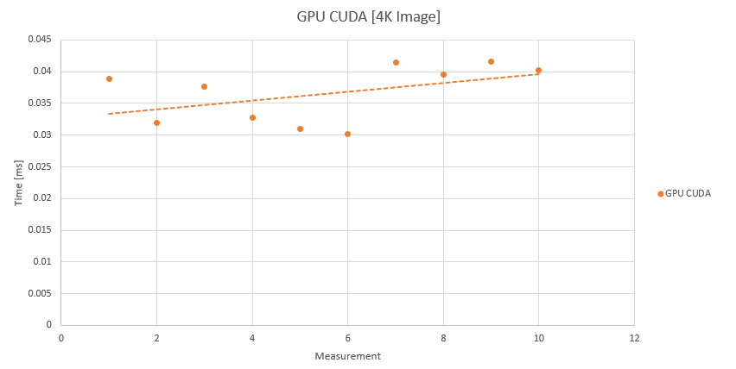
Kernel Image Processing
Firenze, 6 Febbraio 2020
Performance analysis
11

