Slide 1
PHASE 2 · SHORT VERSION
Reproducing EfficientNet-B0 for malaria detection
From the paper's own code to all 10 folds: results, findings and what we test next
AJ
J Amathziah
230139 · Kaggle runs, repository
MM
C Murali Madhav
230115 · Code: notebook, scripts
RY
Ravi Yadav
230131 · Slides
PJ
Pugazhendhi J
230066 · Report
Department of Computer Science · Rishihood University, Sonipat, India · github.com/amathziah/malaria-detection
Notes:
This is the short version of Phase 2: everything we did after the literature review, in thirteen slides.

Slide 2



What we did after Phase 1, and what we found
IN ONE SLIDE
Phase 1 · reviewed 11 studies
Accuracy on the NIH cells is reported at 96–99.9 %, but most studies split images at random, so one patient's cells sit in both training and testing.
Phase 2 · reproduced the base paper
Marques et al. (2022): EfficientNet-B0 + a 10-fold ensemble. We rebuilt it from the authors' own code and trained all 10 folds.
Next · test it fairly
H1: does accuracy drop once slide-level leakage is removed? H2: does YUV stain normalisation win it back?
97.55 %
97.62 %
99.73 %
≈ 11 min
mean fold accuracy
10-model ensemble
ensemble ROC-AUC
per fold on an RTX 4090
paper 97.56 % · Δ −0.01 pp
paper 98.29 % · Δ −0.67 pp
paper 99.76 % · Δ −0.03 pp
paper ≈ 4 h 46 min per fold
All 10 folds within 1 percentage point of the paper. Every metric is computed from the saved predictions in results/A0_10fold_paper/.
Notes:
The whole story in one slide. We picked Marques et al. as our base paper, rebuilt it from the authors' own code, and trained all ten folds in parallel. Mean fold accuracy 97.55 against 97.56, ensemble 97.62 against 98.29, ROC-AUC 99.73 against 99.76, about eleven minutes per fold. Next, we test it under a fair, slide-level split.

Slide 3




Why EfficientNet-B0 with a 10-fold ensemble
BASE PAPER · MARQUES ET AL. [8], 2022
Open, executable code
The authors published their executed Jupyter notebook as a supplementary file, so a faithful rebuild is possible.
Strict validation
Stratified 10-fold cross-validation plus a separate hold-out set that no model trains on.
Light backbone
4.2 M parameters in total: the smallest EfficientNet, close to our deployability goal.
Strong, not at the ceiling
98.29 % leaves room to see whether a change helps or hurts.
THE PAPER'S TARGETS (from its own printed results)
97.56 %
mean fold accuracy (Table 5)
97.69 %
single model on hold-out (Table 6)
98.29 %
ensemble accuracy
99.76 %
ensemble ROC-AUC
Notes:
Why this paper: published, executable code, the strictest validation in our review, a light backbone, and results strong enough to matter but with room to measure change. These are the numbers we had to match.

Slide 4

The authors' notebook differs from the paper's text
WHAT THE PAPER'S OWN CODE REVEALED
Setting | Paper's code (used now) | Our first reproduction (from the text)
Pretrained weights | noisy-student · efficientnet 1.1.1 (qubvel) | ImageNet · tf.keras.applications
Classifier head | GAP → 128 → 64 → 32 → 2 softmax, dropout 0.3 | GAP → dropout 0.2 → 1 sigmoid
Loss | categorical cross-entropy, label smoothing 0.1 | binary cross-entropy
Schedule | 33 epochs, LR × 0.5 on plateau, keep best val_loss | ≤ 15 epochs, LR × 0.1, early stopping
Batch size | 16 (1,240 steps per epoch) | 128 (64 per GPU, 2 GPUs)
Augmentation | full albumentations pipeline (noise, blur, distortions, CLAHE…) | flips + 90° rotations
Source: Springer supplementary file MOESM1, the authors' executed notebook (30 Jan 2021). Our notebook now follows it line by line; 32 automated tests check the recipe.
Two quirks in the paper itself: its code evaluates on augmented images, and its text swaps precision and recall (true recall 97.74 %, precision 98.82 %).
Notes:
Our first attempt followed the paper's text and got within a point, but several settings were guesses. The authors' executed notebook differs from the text in eight places; these are the most important ones. It also revealed two quirks: evaluation on augmented images, and precision and recall swapped in the text.

Slide 5
One split, ten fold models, one ensemble
THE PAPER-EXACT PROTOCOL
27,558
NIH cell images, 13,779 per class
80 / 20 split
random, seeded so all 10 GPUs agree
22,046
learning set for 10-fold CV
10 stratified folds
each: train 19,841, test 2,205
10 models
one per fold, best val_loss weights
5,512
hold-out set, never used in training
Ensemble = average of the 10 softmax outputs
scored on the hold-out set → 97.62 % accuracy, 99.73 % ROC-AUC (paper 98.29 %, 99.76 %)
Every fold model is also scored on its own CV test part (the paper's Table 5) and on the hold-out set (Table 6). Each fold stores a fingerprint of the split (a0cc112e…): all 10 folds match.
Notes:
The protocol exactly as the code runs it: an 80/20 split, ten stratified folds on the 22,046 learning images, ten models, and an ensemble that averages their outputs on the 5,512 hold-out images. The split is seeded so every GPU used the same one.

Slide 6

EfficientNet-B0 with the paper's dense head
THE MODEL
Input
224 × 224 × 3 · uint8
÷ 255
pixels to 0–1
EfficientNet-B0 backbone
noisy-student weights · 4,049,564 parameters
Part | Parameters
EfficientNet-B0 backbone | 4,049,564
Dense head | 174,370
Total | 4,223,934
Trainable | 4,181,918
Non-trainable (BatchNorm) | 42,016
stem
32
16
×1
24
×2
40
×2
80
×3
112
×3
192
×4
320
×1
1×1
1280
Inside the backbone: a stem convolution, 16 MBConv blocks in 7 stages (output channels, repeats), and a 1×1 convolution → 7 × 7 × 1280 features.
Global avg pool
→ 1,280
Dense 128
ReLU, dropout 0.3
Dense 64
ReLU, dropout 0.3
Dense 32
ReLU, dropout 0.3
Dense 2
softmax
Identical to the paper's Table 2, digit for digit, checked by an automated test.
Output: P(parasitized), P(uninfected). Loss: categorical cross-entropy with label smoothing 0.1.
Noisy-student weights: EfficientNet-B0 pre-trained on ImageNet plus self-training on unlabelled images (Xie et al., 2020). The paper loads them from the efficientnet package; so do we.
Notes:
The model: EfficientNet-B0 with noisy-student weights and the paper's dense head of 128, 64 and 32 units with a two-unit softmax. 4,223,934 parameters, exactly the paper's Table 2.

Slide 7
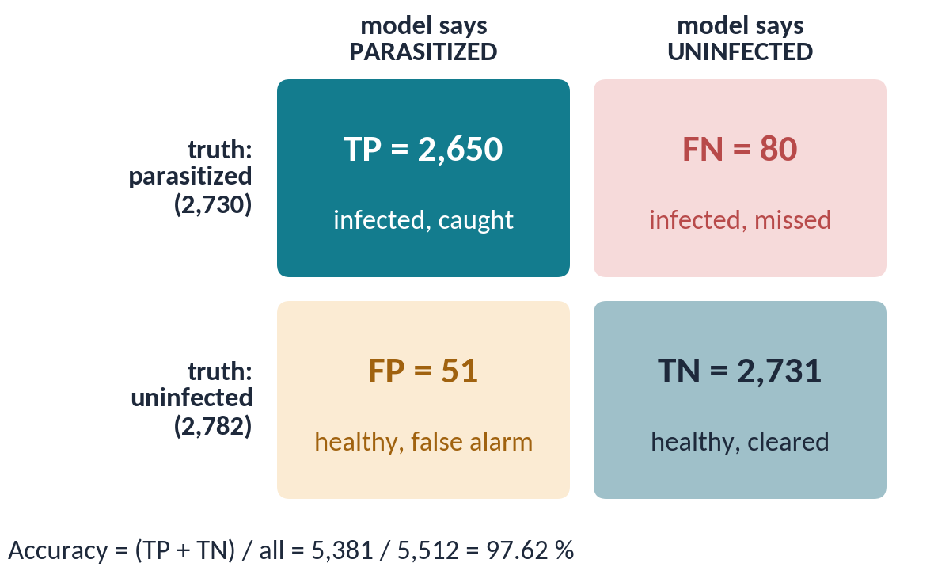
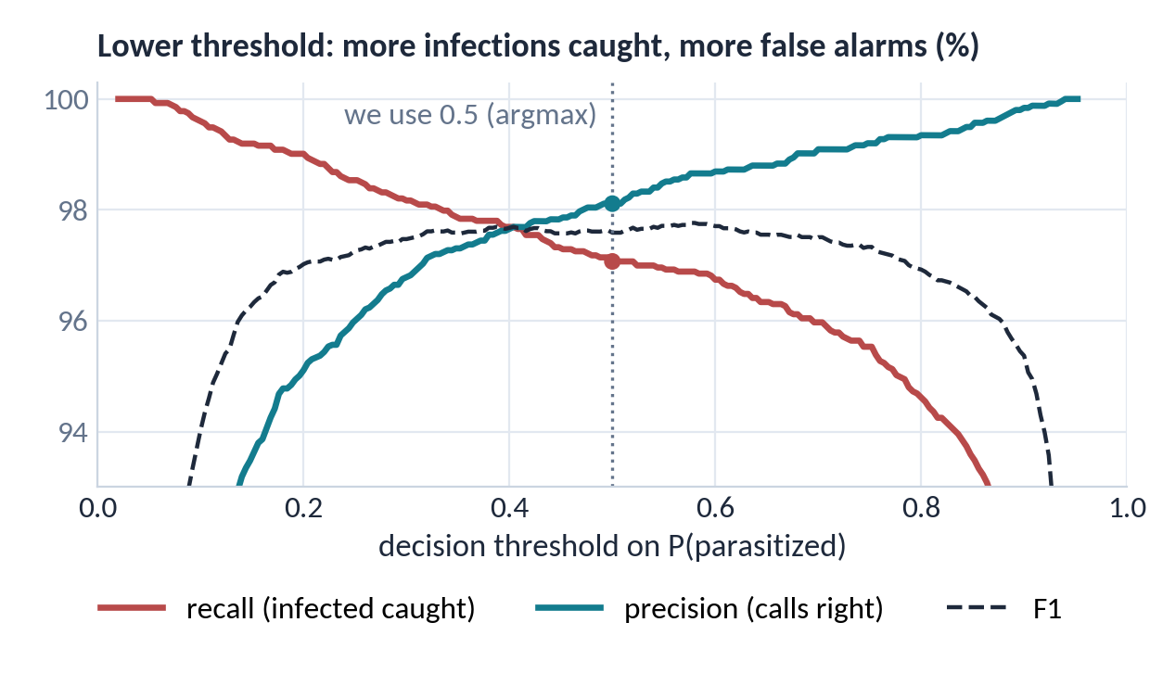
How to read the metrics
BEFORE THE RESULTS
Recall (sensitivity) = TP / (TP + FN): infected cells caught · 97.07 %
Precision = TP / (TP + FP): 'parasitized' calls that are right · 98.11 %
F1 = harmonic mean of precision and recall · 97.59 %
ROC-AUC: chance that an infected cell outscores a healthy one · 99.73 %
pp (percentage point) = plain difference of two percentages: 97.62 − 98.29 = −0.67 pp
Notes:
How to read the numbers. Left: the ensemble's four outcomes on the 5,512 hold-out cells; 2,650 infected cells caught and 80 missed. Recall is the share of infected cells we catch, precision the share of our 'infected' calls that are right, and F1 balances the two. Right: a lower threshold catches more infections but raises more false alarms; we use 0.5. A pp is the plain difference between two percentages.

Slide 8
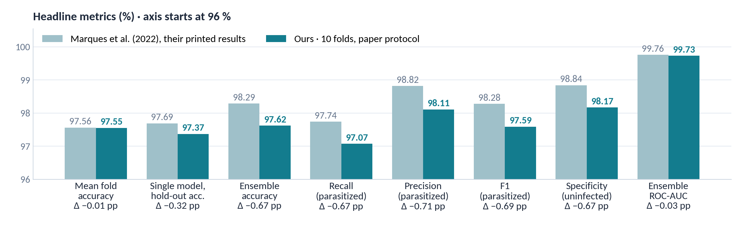
Paper vs. ours on the 5,512-image hold-out set
RESULTS
All within our 1 pp success criterion; mean fold accuracy matches to 0.01 pp. On clean (un-augmented) images the ensemble scores 97.64 %, so the paper's augmented evaluation changes little.
Notes:
Our results next to the paper's printed numbers, with the axis starting at 96 percent. Mean fold accuracy matches to a hundredth of a point; the ensemble metrics are about 0.7 points lower, all inside our one-point criterion. Scoring on clean images changes little.

Slide 9
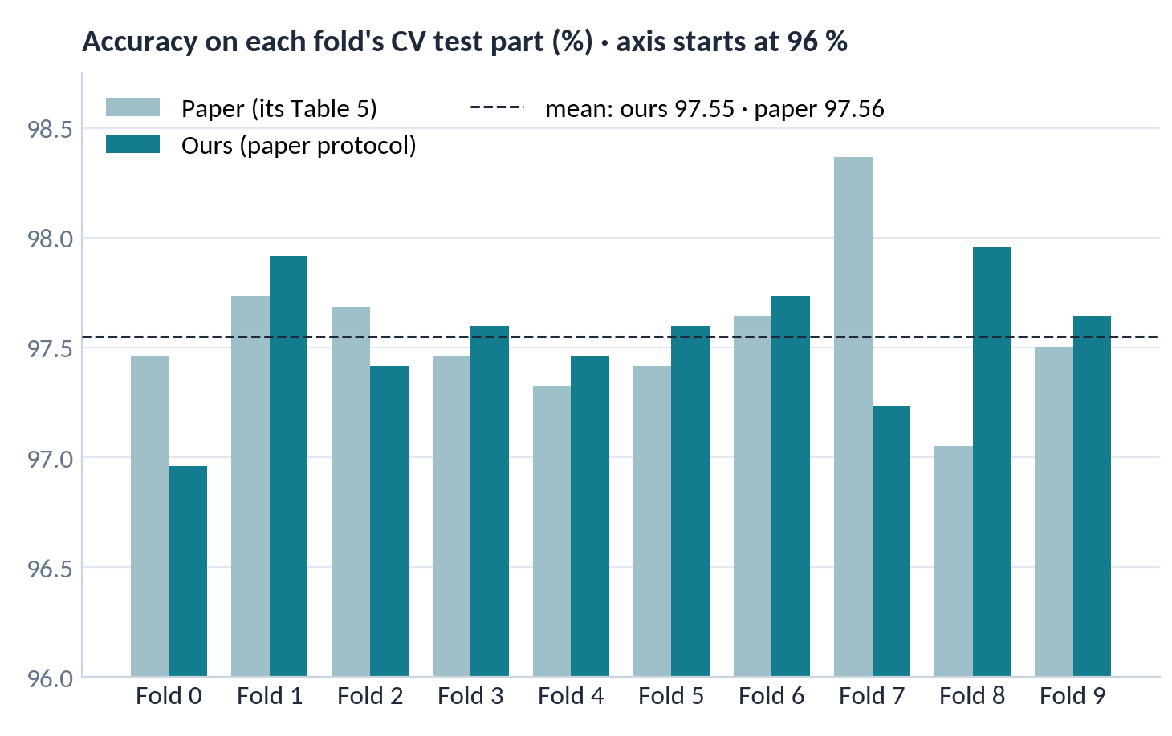
Ten consistent folds, and where the ensemble errs
RESULTS · TEN FOLDS
Ensemble on 5,512 hold-out cells
Pred. parasitized
Pred. uninfected
Parasitized
2,650
80
Uninfected
51
2,731
Paper: 62 missed, 32 flagged. Recall (catching infected cells) is our priority metric.
Notes:
Fold by fold we track the paper closely: the dashed line shows both means, 97.55 for us and 97.56 for the paper. On the right are the ensemble's mistakes on the hold-out cells: 80 missed infections and 51 false alarms, against 62 and 32 in the paper. Recall is our priority metric, because a missed infection is the worse mistake.

Slide 10
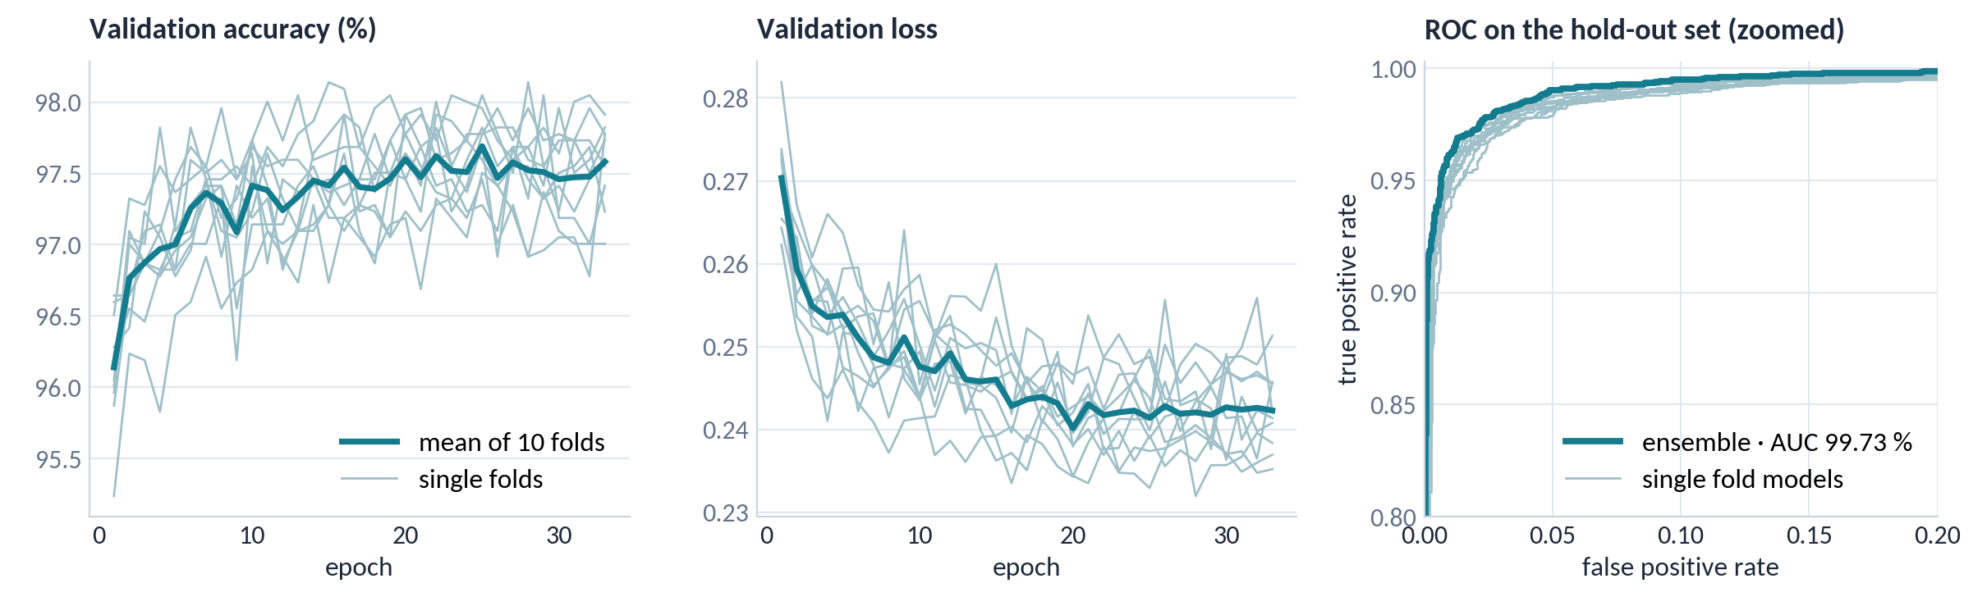

Stable training, near-perfect ranking
RESULTS · TRAINING AND ROC
Validation accuracy settles near 97.5 % after about 10 epochs; the learning rate halves on plateaus and the lowest-val_loss weights are kept. The ensemble's ROC hugs the top-left corner: AUC 99.73 % (paper 99.76 %).
Notes:
Left and middle: validation accuracy and loss for all ten folds, thin lines, and their mean, the thick line. Accuracy settles near 97.5 percent after about ten epochs, and the loss keeps drifting down as the learning rate halves. Right: the ensemble's ROC curve hugs the top-left corner with an AUC of 99.73 percent, so it ranks infected cells above healthy ones almost perfectly.

Slide 11
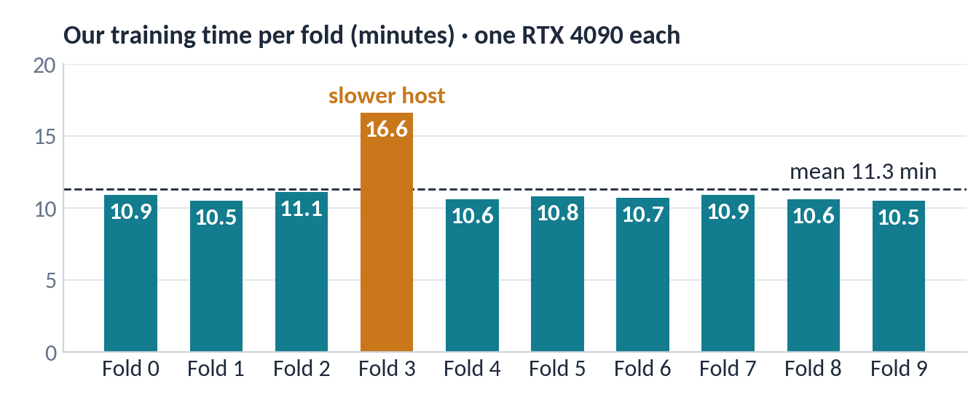
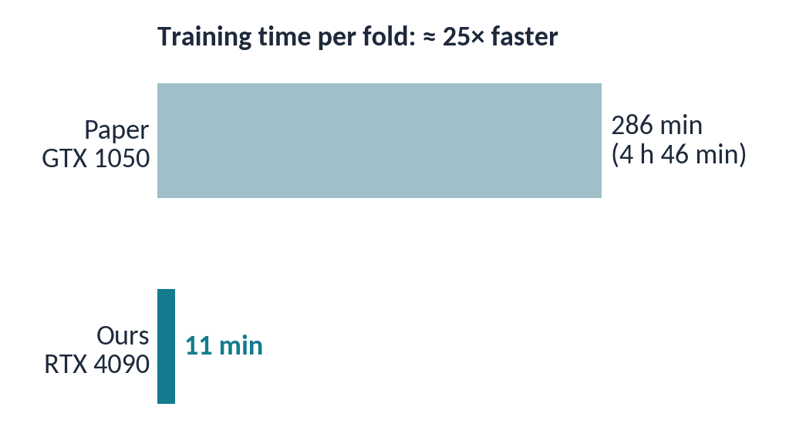

Ten GPUs in parallel: about 11 minutes per fold
ENGINEERING
10 RunPod pods (Secure Cloud, RTX 4090, 16 vCPU each), one fold per pod, all training at the same time. Fold 3 landed on a slower host (16.6 min).
≈ 25×
faster per fold
≈ $4.8
total cloud cost
1 d 23 h
the paper's full run
The 10 trained models are published as a GitHub release, so nobody has to retrain to use or evaluate them.
Notes:
Left: our ten folds, one RTX 4090 each, all at once: about 11 minutes per fold, fold 3 on a slower host. Right: the paper needed 286 minutes per fold, so we are about 25 times faster, for about 4.8 dollars in total. The key speed-ups were a decoded image cache, parallel seeded augmentation, uint8 transfers and XLA, all without changing the maths, and the trained models are published.

Slide 12


Two proposed changes, one variable at a time
NEXT · OUR HYPOTHESIS
H1 · VALIDATION
Leakage-free, slide-grouped split
H2 · PREPROCESSING
YUV stain normalisation (Umer [4])
CHANGE
Split by slide/patient (StratifiedGroupKFold) instead of random images. Model unchanged.
WE EXPECT
Accuracy and MCC fall below the image-split baseline, and fold-to-fold spread widens.
CHANGE
RGB → YUV → histogram-equalise Y → RGB before EfficientNet-B0. Grouped split kept fixed.
WE EXPECT
Higher recall and MCC than the H1 model on unseen slides; little change on the random split.
ID | Split | Preprocessing | Answers | Status
A0 | image (paper) | none | baseline: does it match the paper? | done ✓ (10 folds)
A1 | slide-grouped | none | H1: leakage gap (A0 − A1) | next
A2 | slide-grouped | YUV + hist-eq | H2: gain on unseen slides (A2 − A1) | next
A3 | image (paper) | YUV + hist-eq | control: is the gain slide-specific? | next
Notes:
Next: H1 tests whether accuracy drops once cells from the same slide can no longer appear in both training and testing. H2 tests whether YUV stain normalisation wins it back. A0 is done; A1 to A3 are one switch each in our code.

Slide 13


CONCLUSION
Where we stand
Reproduced
The paper's recipe, rebuilt from its own code, lands within 1 pp on every metric (mean fold 97.55 vs 97.56 %).
Corrected
The paper evaluates on augmented images and swaps precision and recall in its text; we report both views.
Fast and shareable
10 folds in parallel, ≈ 11 min each instead of ≈ 4 h 46 min; the trained models are published.
Next
A1–A3 test whether 97–98 % holds on unseen slides (H1) and whether stain normalisation helps (H2).
Thank you · questions welcome
github.com/amathziah/malaria-detection
Notes:
To wrap up: reproduced within one point, two quirks of the paper documented, training about 25 times faster per fold with published models, and a clear plan for testing on unseen slides. Thank you.

