Slide 1
PHASE 2 · DEEP LEARNING FOR COMPUTER-AIDED DIAGNOSIS
Automated Malaria Cell Detection
Reproducing an EfficientNet-B0 ensemble on the NIH cell images exactly as the paper's code ran it, across all 10 folds, and planning a fairer test
AJ
J Amathziah
230139 · Kaggle runs, repository
MM
C Murali Madhav
230115 · Code: notebook, scripts
RY
Ravi Yadav
230131 · Slides
PJ
Pugazhendhi J
230066 · Report
Department of Computer Science · Rishihood University, Sonipat, India · github.com/amathziah/malaria-detection
Notes:
Hello everyone. We are building a system that looks at a single red blood cell and decides whether it is infected with malaria. In Phase 1 we reviewed eleven studies. In Phase 2 we took the strongest documented one, reproduced it exactly as its authors' code ran, across all ten folds, and planned how to test it more fairly. These are the four of us and our roles.

Slide 2



What we did after Phase 1, and what we found
IN ONE SLIDE
Phase 1 · reviewed 11 studies
Accuracy on the NIH cells is reported at 96–99.9 %, but most studies split images at random, so one patient's cells sit in both training and testing.
Phase 2 · reproduced the base paper
Marques et al. (2022): EfficientNet-B0 + a 10-fold ensemble. We rebuilt it from the authors' own code and trained all 10 folds.
Next · test it fairly
H1: does accuracy drop once slide-level leakage is removed? H2: does YUV stain normalisation win it back?
97.55 %
97.62 %
99.73 %
≈ 11 min
mean fold accuracy
10-model ensemble
ensemble ROC-AUC
per fold on an RTX 4090
paper 97.56 % · Δ −0.01 pp
paper 98.29 % · Δ −0.67 pp
paper 99.76 % · Δ −0.03 pp
paper ≈ 4 h 46 min per fold
All 10 folds within 1 percentage point of the paper. Every metric is computed from the saved predictions in results/A0_10fold_paper/.
Notes:
Here is the whole talk in one slide. Phase 1: eleven studies report 96 to 99.9 percent accuracy, but most split images at random, so the same patient's cells can be in training and testing. Phase 2: we rebuilt the base paper from its own code and trained all ten folds. Our mean fold accuracy is 97.55 percent against the paper's 97.56, the ensemble is 97.62 against 98.29, and each fold took about eleven minutes instead of almost five hours. Next we test whether those numbers survive a fair, slide-level split.

Slide 3
What the literature says
PHASE 1
Eleven studies on automated malaria detection with the NIH cell images, 2016–2024
Notes:
First, a short recap of Phase 1, our literature review, because it explains every choice we made in Phase 2.

Slide 4



Why malaria diagnosis needs automation
MOTIVATION
The gold standard is manual microscopy of Giemsa-stained blood smears: a technician checks every cell for parasites. It works, but it doesn't scale.
WHAT WE SET OUT TO BUILD
An automated deep-learning system that classifies single red-blood-cell images as parasitized or uninfected: accurate, consistent, fast, and light enough for point-of-care use.
Slow and laborious
Each slide holds hundreds of cells, counted one by one.
Expert-dependent
Needs a trained microscopist: scarce where malaria is common.
Task binary classification of single-cell crops
Subjective
Results vary between observers and labs for the same smear.
Method deep CNNs, no hand-crafted features
Goal clinically reliable, deployable
Notes:
Why automate? Today malaria is confirmed by a technician looking at stained blood under a microscope. That is slow, it needs an expert who is often not available where malaria is common, and two people can read the same slide differently. Our goal is a deep-learning system that classifies single cells as parasitized or uninfected, accurately and consistently, and light enough to run at the point of care.

Slide 5
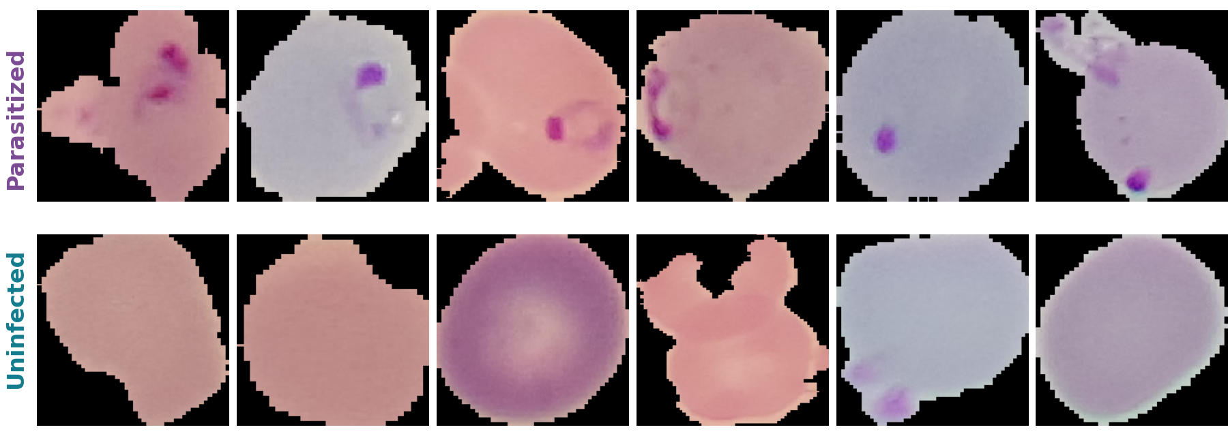

NIH Malaria Cell Images: the field's common benchmark
THE DATASET
27,558
single-cell images
50 / 50
13,779 parasitized · 13,779 uninfected
200
patients · 150 infected, 50 healthy
Infected cells show dark violet specks (the Giemsa stain). Crops of 70–230 px are resized to 224 × 224.
Giemsa-stained thin blood smears from Chittagong Medical College Hospital, Bangladesh, segmented into single cells by the NIH.
Known issue, noisy labels: Fuhad et al. [5] found stain artifacts labelled as parasites and cleaned the set to 26,161 images. We use the standard 27,558 so our numbers compare with the paper.
Notes:
The dataset everyone uses: the NIH malaria cell images. 27,558 single-cell crops, exactly half infected, from 200 patients in Bangladesh. You can see the difference in the samples: infected cells carry dark violet specks from the Giemsa stain. One caveat from the literature: some labels are noisy, and Fuhad et al. cleaned the set to 26,161 images. We keep the standard version so we can compare with our base paper.

Slide 6

How malaria CNNs evolved, 2016 → 2024
THE STORY OF THE FIELD
2016
2018
2019–22
2020
2020–24
Custom CNN beats transfer
Liang [1]
97.37 %
Pre-trained features
Rajaraman [2]
best layers mapped
Ensembles
Rajaraman [3] · Marques [8]
98.29 %
Lightweight, on-device
Fuhad · Masud · Zhao
99.23 % at 4,600 FLOPs
Inputs, capsules, benchmarks
Umer · Madhu · Hemachandran · Mujahid
99.35 % capsules
The arc: "can a CNN do this?" → squeeze accuracy from big models → shrink them for a phone → keep cell structure and benchmark fairly.
Notes:
The field in one line. 2016: a custom CNN beat generic AlexNet features. 2018: researchers mapped which pre-trained layers transfer best. 2019 to 2022: ensembles, including our base paper at 98.29 percent. 2020: lightweight models that run on a phone. 2020 to 2024: better inputs like stain normalisation, capsule networks, and fairer benchmarks.

Slide 7




Five ideas that shaped the field
KEY IDEAS
Domain features win
Ensembles steady answers
Small enough for a phone
Liang [1]: a 16-layer CNN 97.37 % vs. AlexNet features 91.99 %. Rajaraman [2] mapped which pre-trained layers transfer best.
Rajaraman [3]: VGG-19 + SqueezeNet. Marques [8]: 10-fold EfficientNet-B0 ensemble, 98.29 %, AUC 99.76 %.
Fuhad [5]: 99.23 % at 4,600 FLOPs, < 1 s on a phone. Masud [7]: 409 K parameters. Zhao [6]: 2 species.
Better inputs and structure
Fair benchmarks
Takeaway
Accuracy on clean, randomly split data is largely solved. The open problems are trust (leakage, labels) and deployment.
Umer [4]: YUV stain normalisation, ~99.9 %. Madhu [9]: capsule network keeps the parasite's pose, 99.35 %.
Hemachandran [10]: MobileNetV2 97.06 % ≈ ResNet-50. Mujahid [11]: tuned 12-layer CNN 97.57 % beats 11 backbones.
Notes:
Five ideas from the eleven papers. Purpose-built features beat generic ones. Ensembles reduce variance. Models got small enough for a phone. Better inputs like stain normalisation, and capsule networks, pushed accuracy up. And recent work benchmarks fairly and finds light models match heavy ones. The takeaway: on clean, randomly split data the problem looks solved; the real questions are trust and deployment.

Slide 8
All 11 studies on one page
AT A GLANCE
# | Study (year) | Approach | Headline result
1 | Liang (2016) | Custom 16-layer CNN from scratch | 97.37 %, beats AlexNet features (91.99 %)
2 | Rajaraman (2018) | Pre-trained CNNs as feature extractors | Mapped the best transfer layers
3 | Rajaraman (2019) | VGG-19 + SqueezeNet ensemble | Lower variance, better generalisation
4 | Umer (2020) | Stacked CNN + YUV stain normalisation | ~99.9 % accuracy, 100 % precision (5-fold)
5 | Fuhad (2020) | Autoencoder + knowledge distillation | 99.23 % · 4,600 FLOPs · < 1 s · cleaned labels
6 | Zhao (2020) | VGG16 + FSRCNN super-resolution + SSD300 | 96.5 % · cross-species (P. vivax)
7 | Masud (2020) | Lightweight CNN + cyclical learning rate | 97.30 % · 409 K parameters · ~97 min
8 | Marques (2022) · base paper | EfficientNet-B0 · 10-fold ensemble | 98.29 % · AUC 99.76 % · open code
9 | Madhu (2023) | Inception-V3 + capsule network | 99.35 % · preserves spatial pose
10 | Hemachandran (2023) | CNN vs. MobileNetV2 vs. ResNet-50 | MobileNetV2 97.06 % · light ≈ heavy
11 | Mujahid (2024) | Custom 12-layer CNN vs. 11 backbones | 97.57 % · lowest test loss (0.0995)
Direct ranking is misleading: protocols, splits and label cleaning differ between papers.
Notes:
All eleven studies on one page. No need to read every row: the methods vary a lot, and reported accuracies cluster between 96 and almost 100 percent. Row 8, highlighted, is Marques et al., our base paper. The caveat at the bottom leads to the next slide: these numbers are not directly comparable.

Slide 9


Reported accuracy is high, but not comparable
COMPARATIVE ANALYSIS
Different splits
5-fold, 10-fold and 80:20 protocols are not comparable.
Different data
Some use the noisy set, some cleaned labels.
Possible leakage
Random image splits can put one patient's cells in both training and test.
Notes:
Reported accuracy across the studies, with the axis starting at 94 percent so the differences are visible. Everyone lands between 96.5 and almost 100 percent. But read it with care: the papers use different splits, different versions of the labels, and many split images at random, which can leak one patient's cells into both training and testing.

Slide 10


What none of the papers has solved
RESEARCH GAPS
GAP 1
Patient-level data leakage
GAP 2
Single-species focus
Random image-level splits put cells from the same patient in training and test, inflating accuracy. Only [1] and [2] split by patient.
Almost all models see only P. falciparum; vivax, ovale, malariae and knowlesi are largely untested. Only Zhao [6] tried.
GAP 3
Noisy ground-truth labels
GAP 4
Clinical-workflow gap
Except Fuhad [5], everyone trains and reports on the mislabelled public set.
Work centres on clean, pre-segmented single cells; real labs need raw, unsegmented smears.
Notes:
Four gaps that none of the eleven papers fully solves. One: patient-level leakage, which is the gap our hypothesis targets. Two: almost everything is trained on a single malaria species. Three: noisy labels. Four: real labs work with raw smears, not clean single-cell crops.

Slide 11

How the review shapes our project
FROM GAPS TO A PLAN
YUV stain normalisation
from Umer [4]
Patient-level validation
from Rajaraman [2]
Verified labels
from Fuhad [5]
Lightweight model
from Masud [7] / Fuhad [5]
Make the model robust to staining differences between labs. → H2
Group cells by slide before splitting: honest, leakage-free scores. → H1
Learn real features, not artifacts (future work).
Keep inference light enough for low-resource settings.
First step: reproduce a strong, open baseline, then change one thing at a time. That is Phase 2.
Notes:
Each gap turns into a design decision. Stain normalisation from Umer becomes our hypothesis H2. Patient-level validation from Rajaraman becomes H1. Verified labels and a lightweight model stay on the roadmap. But before changing anything, we need a baseline we trust, and that is Phase 2.

Slide 12
Reproducing the base paper
PHASE 2
Marques et al. (2022), rebuilt from its own code and trained on all 10 folds
Notes:
Phase 2. We reproduce the base paper, first from its text, then exactly from its own code.

Slide 13




Why EfficientNet-B0 with a 10-fold ensemble
BASE PAPER · MARQUES ET AL. [8], 2022
Open, executable code
The authors published their executed Jupyter notebook as a supplementary file, so a faithful rebuild is possible.
Strict validation
Stratified 10-fold cross-validation plus a separate hold-out set that no model trains on.
Light backbone
4.2 M parameters in total: the smallest EfficientNet, close to our deployability goal.
Strong, not at the ceiling
98.29 % leaves room to see whether a change helps or hurts.
THE PAPER'S TARGETS (from its own printed results)
97.56 %
mean fold accuracy (Table 5)
97.69 %
single model on hold-out (Table 6)
98.29 %
ensemble accuracy
99.76 %
ensemble ROC-AUC
Notes:
Why Marques et al. as our base paper. Four reasons: the authors published their executed code, they use the strictest validation in our review, the backbone is light, and 98.29 percent leaves room to measure whether a change helps. The bottom row shows the numbers we have to match, taken from the paper's own printed results.

Slide 14
First attempt: the recipe from the paper's text
MILESTONE 2 · FIRST REPRODUCTION
Setting | First run (A0)
Hardware | Kaggle, 2× Tesla T4
Folds trained | 3 of 10 (free GPU budget)
Weights | ImageNet EfficientNet-B0
Training | ≤ 15 epochs, early stopping, batch 128
Augmentation | flips + 90° rotations
Hold-out set | 10 % = 2,756 images
97.38 %
mean fold accuracy
± 0.74 over 3 folds
97.57 %
3-model ensemble
on 2,756 hold-out cells
99.76 %
ensemble ROC-AUC
Within 1 pp on accuracy, but several settings were guesses because the text leaves them out. So we went to the authors' own code.
Notes:
Our first reproduction, called A0, followed the paper's text. We trained three of the ten folds on Kaggle's free GPUs and got 97.38 percent mean fold accuracy and 97.57 percent for the small ensemble, within one point of the paper. But the text leaves out the augmentation, the epochs and the batch size, so we had guessed. That made us look for the authors' actual code.

Slide 15
The authors' notebook differs from the paper's text in 8 places
WHAT THE PAPER'S OWN CODE REVEALED
Setting | Paper's code (used now) | Our first reproduction (from the text)
Pretrained weights | noisy-student · efficientnet 1.1.1 (qubvel) | ImageNet · tf.keras.applications
Classifier head | GAP → 128 → 64 → 32 → 2 softmax, dropout 0.3 | GAP → dropout 0.2 → 1 sigmoid
Loss | categorical cross-entropy, label smoothing 0.1 | binary cross-entropy
Schedule | 33 epochs, LR × 0.5 on plateau, keep best val_loss | ≤ 15 epochs, LR × 0.1, early stopping
Batch size | 16 (1,240 steps per epoch) | 128 (64 per GPU, 2 GPUs)
Hold-out set | 20 % = 5,512 images | 10 % = 2,756 images
Augmentation | full albumentations pipeline (noise, blur, distortions, CLAHE…) | flips + 90° rotations
Input | nearest-neighbour resize, pixels ÷ 255 | bilinear resize, ImageNet normalisation
Source: Springer supplementary file MOESM1, the authors' executed notebook (30 Jan 2021). Our notebook now follows it line by line; 32 automated tests check the recipe.
Notes:
The authors published their executed notebook as a supplementary file, and it differs from what the text suggests in eight places. Different pretrained weights, a three-layer dense head with a two-unit softmax, label smoothing, batch size 16 for 33 epochs, a 20 percent hold-out set, and a much heavier augmentation pipeline. Our new notebook follows this code line by line, and 32 automated tests check that it does.

Slide 16


Two things the paper's numbers hide
READING THE PAPER CLOSELY
Evaluation images were augmented too
Precision and recall are swapped in the text
One ImageDataAugmentor object fed the training, test and validation generators, so every prediction the paper reports was made on a randomly distorted image.
We keep this for the headline numbers ("paper protocol") and also score the same models on clean images.
The paper's own printed ensemble report:
 | Pred. parasitized | Pred. uninfected
Parasitized (2,744) | 2,682 | 62 missed
Uninfected (2,768) | 32 flagged | 2,736
Recall = 2,682 / 2,744 = 97.74 % (text says 98.82 %)
Precision = 2,682 / 2,714 = 98.82 % (text says 97.74 %)
So our first run's "recall 2 pp lower" compared against the wrong number. Against the true 97.74 %, the paper-exact run is 0.67 pp lower.
Notes:
Reading the code also revealed two quirks. First, the same augmenting data generator fed training, test and validation, so every reported prediction was made on a randomly distorted image. We keep that for the headline numbers and also report clean-image results. Second, the text swaps precision and recall. From the paper's own printout, recall is 97.74 and precision 98.82. So when our first run said 'recall is 2 points lower', it was comparing against the wrong number.

Slide 17
One split, ten fold models, one ensemble
THE PAPER-EXACT PROTOCOL
27,558
NIH cell images, 13,779 per class
80 / 20 split
random, seeded so all 10 GPUs agree
22,046
learning set for 10-fold CV
10 stratified folds
each: train 19,841, test 2,205
10 models
one per fold, best val_loss weights
5,512
hold-out set, never used in training
Ensemble = average of the 10 softmax outputs
scored on the hold-out set → 97.62 % accuracy, 99.73 % ROC-AUC (paper 98.29 %, 99.76 %)
Every fold model is also scored on its own CV test part (the paper's Table 5) and on the hold-out set (Table 6). Each fold stores a fingerprint of the split (a0cc112e…): all 10 folds match.
Notes:
This is the protocol exactly as the paper's code runs it. 27,558 images are split 80 to 20. The 22,046 learning images go through stratified ten-fold cross-validation, giving ten models. The 5,512 hold-out images are never used for training: each of the ten models predicts them, and the ensemble averages the ten softmax outputs. We seeded the split so all ten GPUs used exactly the same one, and each fold saved a fingerprint to prove it.

Slide 18

EfficientNet-B0 with the paper's dense head
THE MODEL
Input
224 × 224 × 3 · uint8
÷ 255
pixels to 0–1
EfficientNet-B0 backbone
noisy-student weights · 4,049,564 parameters
Part | Parameters
EfficientNet-B0 backbone | 4,049,564
Dense head | 174,370
Total | 4,223,934
Trainable | 4,181,918
Non-trainable (BatchNorm) | 42,016
stem
32
16
×1
24
×2
40
×2
80
×3
112
×3
192
×4
320
×1
1×1
1280
Inside the backbone: a stem convolution, 16 MBConv blocks in 7 stages (output channels, repeats), and a 1×1 convolution → 7 × 7 × 1280 features.
Global avg pool
→ 1,280
Dense 128
ReLU, dropout 0.3
Dense 64
ReLU, dropout 0.3
Dense 32
ReLU, dropout 0.3
Dense 2
softmax
Identical to the paper's Table 2, digit for digit, checked by an automated test.
Output: P(parasitized), P(uninfected). Loss: categorical cross-entropy with label smoothing 0.1.
Noisy-student weights: EfficientNet-B0 pre-trained on ImageNet plus self-training on unlabelled images (Xie et al., 2020). The paper loads them from the efficientnet package; so do we.
Notes:
The model. An EfficientNet-B0 backbone with noisy-student pretrained weights: a stem convolution, sixteen MBConv blocks in seven stages, and a one-by-one convolution to 1,280 features. On top, the paper's head: global average pooling, then dense layers of 128, 64 and 32 units with dropout, and a two-unit softmax. 4,223,934 parameters in total, which matches the paper's Table 2 exactly.

Slide 19
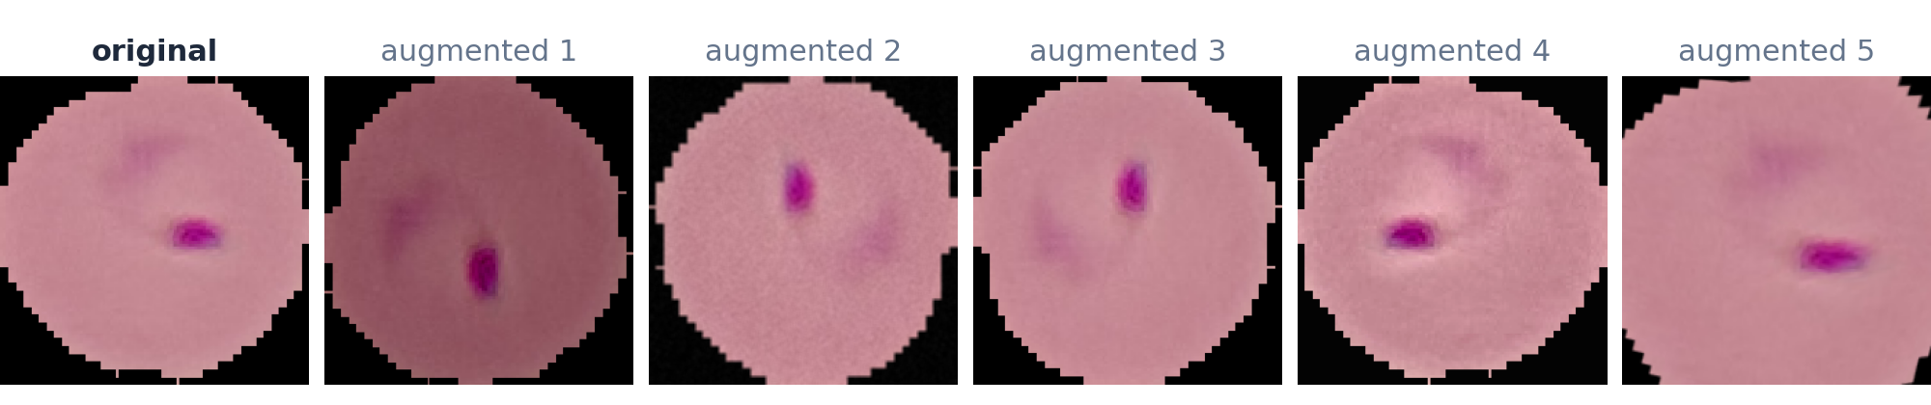
Trained exactly as the authors did
TRAINING RECIPE
Setting | Value
Optimiser | Adam, learning rate 1e-4
Schedule | halve the LR after 6 epochs without val_loss gain, floor 1e-6
Length | 33 epochs × 1,240 steps × 16 images, no early stopping
Checkpoint | keep the weights with the lowest val_loss
Precision | float32 as in the paper (no mixed precision)
AUGMENTATION · a new random version of every image, every epoch
Always: random 90° rotation, flip, transpose
Sometimes: Gaussian noise · motion/median blur · shift-scale-rotate · optical / grid / piecewise-affine distortion · CLAHE, sharpen, emboss, contrast, brightness
Notes:
Training exactly as the authors did: Adam at 1e-4, the learning rate halves after six epochs without improvement, 33 epochs of 1,240 steps with batches of 16, and we keep the weights with the lowest validation loss. Augmentation creates a new random version of every image every epoch; the strip at the bottom shows one infected cell and five augmented versions.

Slide 20
A faithful reproduction: within 1 pp of the paper on every metric
RESULTS
97.55 %
97.37 %
97.62 %
99.73 %
mean fold accuracy
single model, hold-out
10-model ensemble
ensemble ROC-AUC
paper 97.56 % · Δ −0.01 pp
paper 97.69 % · Δ −0.32 pp
paper 98.29 % · Δ −0.67 pp
paper 99.76 % · Δ −0.03 pp
src/check_results.py on results/A0_10fold_paper: "within 1 pp of the paper". Mean fold accuracy matches to 0.01 pp; the ensemble gains a little less from averaging than the paper's did (+0.25 vs +0.60 pp).
Paper protocol = predictions on augmented images, exactly as the paper's code made them. Clean = the same models on original images: ensemble 97.64 %, mean fold 97.78 %, so the augmented evaluation is not what drives the paper's numbers.
Notes:
The headline. Mean fold accuracy 97.55 against the paper's 97.56. Single models on the hold-out set 97.37 against 97.69. The ten-model ensemble 97.62 against 98.29, and ROC-AUC 99.73 against 99.76. Every metric is within our one-point success criterion. Scoring the same models on clean images changes almost nothing, so the paper's augmented evaluation is not what drives its numbers.

Slide 21
Paper vs. ours on the 5,512-image hold-out set
RESULTS · METRIC BY METRIC
Metric (%) | Paper | Ours · paper protocol | Ours · clean images | Δ (pp)
Mean CV-fold accuracy (Table 5) | 97.56 | 97.55 | 97.78 | -0.01
Mean single-model hold-out accuracy (Table 6) | 97.69 | 97.37 | 97.48 | -0.32
Mean single-model hold-out ROC-AUC (Table 6) | 99.65 | 99.52 | 99.52 | -0.13
Ensemble accuracy | 98.29 | 97.62 | 97.64 | -0.67
Ensemble recall, parasitized | 97.74 | 97.07 | 97.18 | -0.67
Ensemble precision, parasitized | 98.82 | 98.11 | 98.04 | -0.71
Ensemble F1, parasitized | 98.28 | 97.59 | 97.61 | -0.69
Ensemble specificity (uninfected recall) | 98.84 | 98.17 | 98.09 | -0.67
Ensemble ROC-AUC | 99.76 | 99.73 | 99.68 | -0.03
How to read it
Green Δ = within our 1 pp success criterion: all nine metrics.
The ensemble gap (−0.67 pp) is about 3 standard errors of a 5,512-image test set, so not all of it is noise: the paper's unseeded split and TensorFlow 2.3 vs 2.15 remain different.
Clean vs. augmented evaluation changes little.
Notes:
Metric by metric. Green differences are inside our one-point criterion, which is all nine. The largest gap is the ensemble at minus 0.67 points. On a test set of 5,512 images that is about three standard errors, so it is not all noise: the paper's split was not seeded and cannot be recreated, and it used an older TensorFlow version.

Slide 22
Ten folds, one consistent model
RESULTS · TEN FOLDS
± 0.30 pp
spread across folds (SD)
first 3-fold run: ± 0.74 pp
16 – 33
best epoch per fold
checkpoint = lowest val_loss
33 × 1,240
epochs × steps, every fold
batch 16, as in the paper
Notes:
Fold by fold: light bars are the paper's Table 5, dark bars are ours. Every fold lands between 96.96 and 97.96 percent. The spread across folds is 0.30 points, much tighter than our first three-fold run. The best epoch varies from 16 to 33, which is why keeping the lowest-validation-loss checkpoint matters.

Slide 23
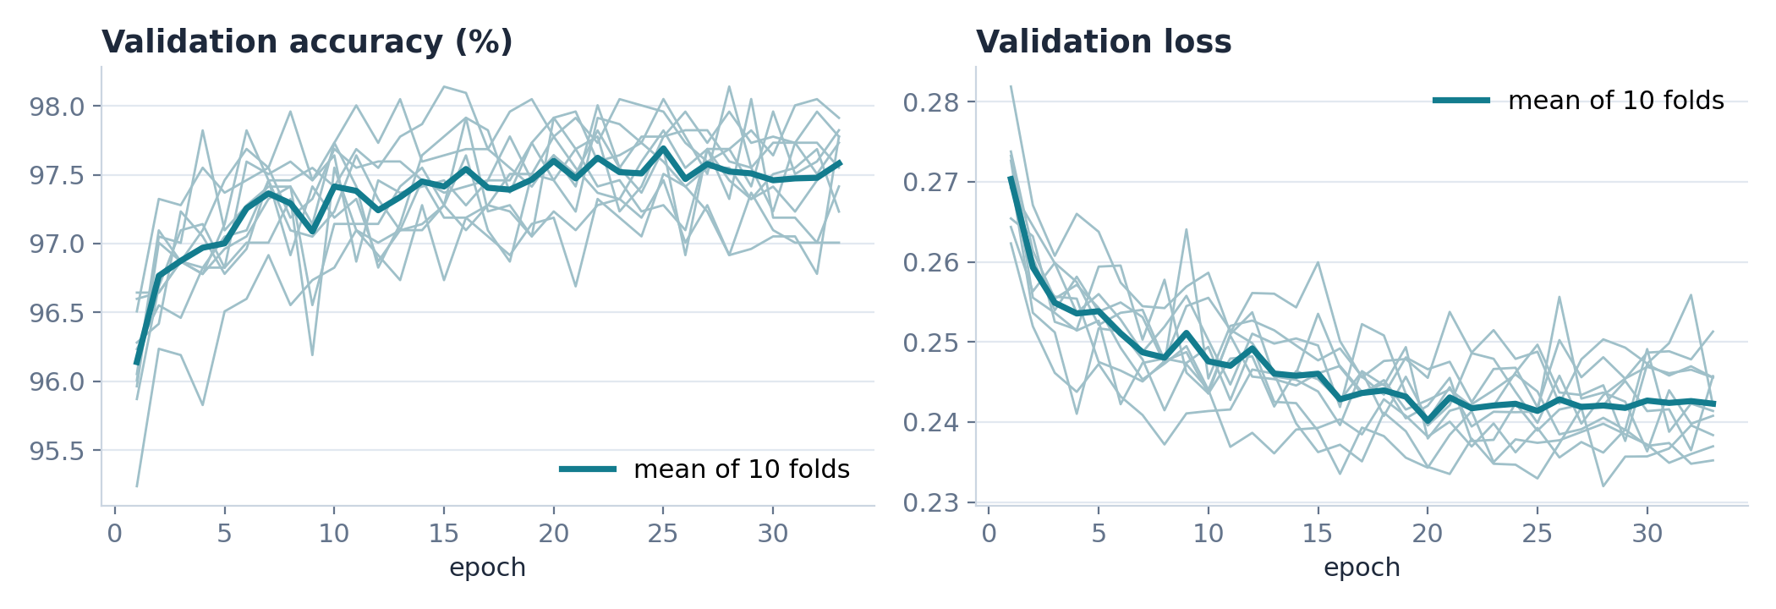
Training behaved like the paper's
RESULTS · TRAINING
Validation = each fold's own CV test part (2,204–2,205 augmented cells). The learning rate halves when val_loss stalls for 6 epochs, and the weights with the lowest val_loss are kept, exactly as in the paper.
Notes:
Training curves for all ten folds, thin lines, and their mean, thick line. Validation accuracy climbs fast in the first ten epochs and then settles around 97.5 percent. Validation loss keeps drifting down while the learning rate halves, and we keep the epoch with the lowest validation loss.

Slide 24
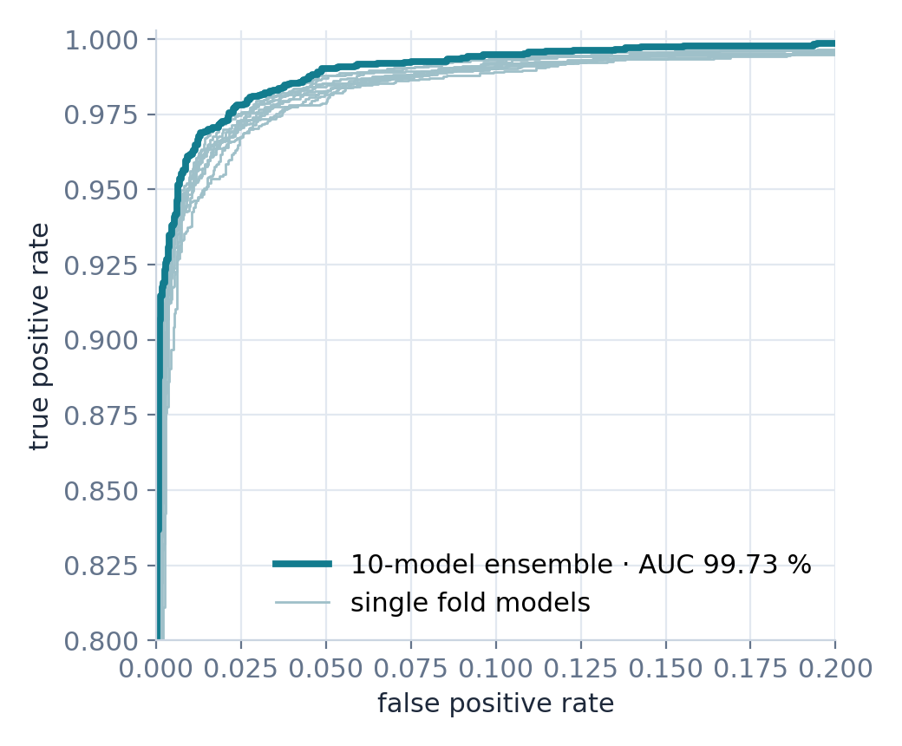
Where the 10-model ensemble still errs
RESULTS · THE ENSEMBLE
Ours (paper protocol)
Paper (its printed report)
Pred. parasitized
Pred. uninfected
Pred. parasitized
Pred. uninfected
Parasitized
2,650
80
Parasitized
2,682
62
Uninfected
51
2,731
Uninfected
32
2,736
Out of 5,512 hold-out cells: 80 infected cells missed and 51 healthy cells flagged (paper: 62 and 32). For diagnosis a miss costs more than a false alarm, so recall comes first.
ROC zoomed to the top-left corner: ensemble AUC 99.73 % (paper 99.76 %).
Notes:
Where the ensemble still makes mistakes. On 5,512 hold-out cells we miss 80 infected cells and wrongly flag 51 healthy ones; the paper reports 62 and 32. The ROC curve hugs the top-left corner with an AUC of 99.73 percent, so the model ranks cells almost perfectly. For diagnosis, a missed infection is the worse mistake, so recall is the metric we watch most.

Slide 25
Ten GPUs in parallel: about 11 minutes per fold
ENGINEERING
Fold 0
RTX 4090
10.9 min
Fold 1
RTX 4090
10.5 min
Fold 2
RTX 4090
11.1 min
Fold 3
RTX 4090
16.6 min
Fold 4
RTX 4090
10.6 min
Fold 5
RTX 4090
10.8 min
Fold 6
RTX 4090
10.7 min
Fold 7
RTX 4090
10.9 min
Fold 8
RTX 4090
10.6 min
Fold 9
RTX 4090
10.5 min
10 RunPod pods (Secure Cloud, RTX 4090, 16 vCPU each), one fold per pod, all training at the same time. Fold 3 landed on a slower host (16.6 min).
≈ 25×
faster per fold
≈ $4.8
total cloud cost
1 d 23 h
the paper's full run
The 10 trained models are published as a GitHub release, so nobody has to retrain to use or evaluate them.
Notes:
How we trained so fast. Ten cloud GPUs, RTX 4090s on RunPod, one fold each, all at the same time. A fold took about eleven minutes; the paper needed almost five hours per fold and close to two days in total. The whole run cost about 4.8 dollars, and the ten trained models are published so nobody has to retrain.

Slide 26





Five speed-ups, same maths
ENGINEERING · SPEED WITHOUT CHANGING THE MATHS
Decode once
Parallel, seeded augmentation
Bytes to the GPU
All 27,558 images are resized once into a 4.1 GB uint8 cache that every process shares. The paper re-read every PNG every epoch.
11 worker processes; each batch is seeded, so results are identical for any number of workers. One BLAS thread per worker: 957 → 2,884 images/s (3×).
Batches cross PCIe as uint8, 4× less data than float32, and are divided by 255 inside the model.
XLA on the training step
Same numerics, tested
Fused GPU kernels: 21.2 → 12.5 ms per step (1.7×). Evaluation stays uncompiled, so its smaller last batch never triggers a recompile.
float32 as in the paper (no mixed precision). 32 automated tests pin the recipe, e.g. the 4,223,934 parameters of Table 2.
Notes:
Five engineering changes made this fast without changing the maths. We decode each image once into a shared cache. Augmentation runs in eleven parallel worker processes with fixed seeds, and limiting each worker to one math thread tripled throughput. Images travel to the GPU as bytes. The training step is compiled with XLA, 1.7 times faster. And we kept float32 like the paper, with 32 tests guarding the recipe.

Slide 27
Two proposed changes, one variable at a time
NEXT · OUR HYPOTHESIS
H1 · VALIDATION
Leakage-free, slide-grouped split
H2 · PREPROCESSING
YUV stain normalisation (Umer [4])
CHANGE
Split by slide/patient (StratifiedGroupKFold) instead of random images. Model unchanged.
WE EXPECT
Accuracy and MCC fall below the image-split baseline, and fold-to-fold spread widens.
BECAUSE
Cells from one slide share stain, lighting and the patient's cell shape: a random split lets the model recognise the slide instead of the parasite.
CHANGE
RGB → YUV → histogram-equalise Y → RGB before EfficientNet-B0. Grouped split kept fixed.
WE EXPECT
Higher recall and MCC than the H1 model on unseen slides; little change on the random split.
BECAUSE
Equalising brightness strips slide-specific colour cues, so the network has to rely on parasite shape, the signal that carries across labs.
Falsifiable: if H2's gain over H1 is smaller than the fold-to-fold SD, we reject H2. If grouped and random splits score the same, H1 is rejected and leakage is not a real issue on this dataset.
Notes:
Our hypothesis for the next milestone, one change at a time. H1: split by slide or patient instead of random images. We expect accuracy to drop, because the model can no longer recognise a slide it saw in training. H2: keep that honest split and add YUV histogram equalisation from Umer et al. We expect recall and MCC to recover, because stain colour stops being a shortcut. We also state in advance what result would prove us wrong.

Slide 28


Ablation plan and success criteria
HOW WE WILL TEST IT
ID | Split | Preprocessing | What it answers | Status
A0 | image-level (paper) | none | Baseline: does our reproduction match the paper? | done ✓ · paper-exact, 10 folds
A1 | slide-grouped | none | H1: how big is the leakage gap (A0 − A1)? | next
A2 | slide-grouped | YUV + hist-eq | H2: does stain normalisation help on unseen slides (A2 − A1)? | next
A3 | image-level | YUV + hist-eq | Control: is H2's gain specific to new slides (A3 − A0 ≈ 0)? | next
Metrics
Accuracy, recall, MCC and ROC-AUC: mean ± SD over the 10 folds plus the hold-out ensemble.
Clinical priority
Recall first: a missed parasitized cell costs more than a false alarm.
Already built
Slide-grouped split and YUV are switches in the code; one 10-fold run takes ≈ 11 min per fold on RunPod.
Notes:
The ablation plan. A0 is done, now the paper-exact ten-fold version. A1 removes leakage to test H1. A2 adds stain normalisation on top to test H2. A3 is a control on the random split. We report accuracy, recall, MCC and ROC-AUC as mean and standard deviation over the ten folds, with recall first. Both switches already exist in our code, and one ten-fold run takes about eleven minutes per fold.

Slide 29
CONCLUSION
Where we stand
Reproduced
The paper's recipe, rebuilt from its own code, lands within 1 pp on every metric (mean fold 97.55 vs 97.56 %).
Corrected
The paper evaluates on augmented images and swaps precision and recall in its text; we report both views.
Fast and shareable
10 folds in parallel, ≈ 11 min each instead of ≈ 4 h 46 min; the trained models are published.
Next
A1–A3 test whether 97–98 % holds on unseen slides (H1) and whether stain normalisation helps (H2).
Thank you · questions welcome
github.com/amathziah/malaria-detection
Notes:
To wrap up. We reproduced the paper from its own code within one point on every metric. We found and documented two quirks in the paper. We made training about 25 times faster per fold and published the models. Next, A1 to A3 test whether 97 to 98 percent holds on unseen slides. Thank you; we are happy to take questions.

Slide 30
The eleven reviewed studies
REFERENCES
[1] Z. Liang et al., "CNN-Based Image Analysis for Malaria Diagnosis," IEEE BIBM, 2016.
[2] S. Rajaraman et al., "Pre-trained CNNs as feature extractors toward improved malaria parasite detection," PeerJ 6:e4568, 2018.
[3] S. Rajaraman et al., "Performance evaluation of deep neural ensembles toward malaria parasite detection," PeerJ 7:e6977, 2019.
[4] M. Umer et al., "A Novel Stacked CNN for Malarial Parasite Detection in Thin Blood Smear Images," IEEE Access 8, 2020.
[5] K. M. F. Fuhad et al., "Deep Learning Based Automatic Malaria Parasite Detection … Smartphone Application," Diagnostics 10(5):329, 2020.
[6] O. S. Zhao et al., "Convolutional neural networks to automate the screening of malaria in low-resource countries," PeerJ 8:e9674, 2020.
[7] M. Masud et al., "Leveraging Deep Learning Techniques for Malaria Parasite Detection Using Mobile Application," WCMC 2020:8895429.
[8] G. Marques et al., "An ensemble-based approach for automated medical diagnosis of malaria using EfficientNet," MTAP 81, 2022 (base paper; code: Springer supplementary file MOESM1).
[9] G. Madhu et al., "Intelligent diagnostic model … imperative inception-based capsule neural networks," Scientific Reports 13, 2023.
[10] K. Hemachandran et al., "Performance Analysis of Deep Learning Algorithms in Diagnosis of Malaria Disease," Diagnostics 13(3):534, 2023.
[11] M. Mujahid et al., "Efficient deep learning-based approach for malaria detection using red blood cell smears," Scientific Reports 14, 2024.
Notes:
The eleven studies we reviewed. Reference 8 is our base paper by Marques et al.; its code is the Springer supplementary file MOESM1.

