Slide 1
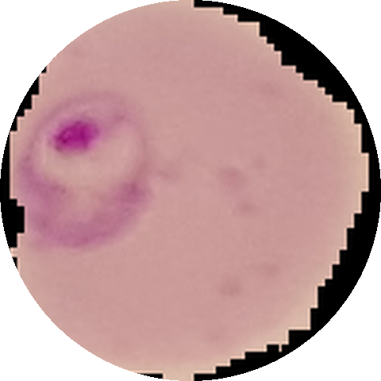
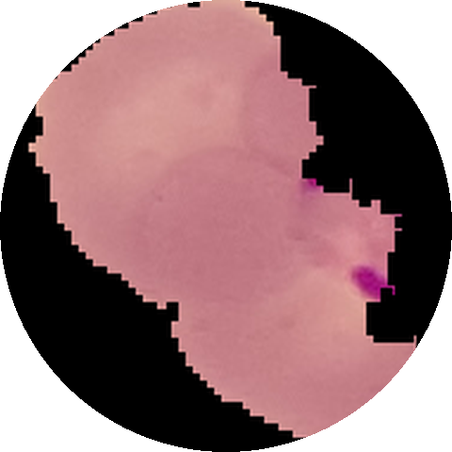
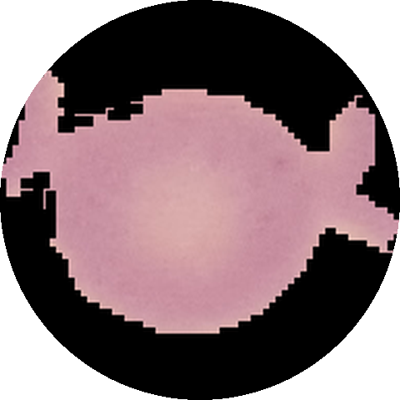
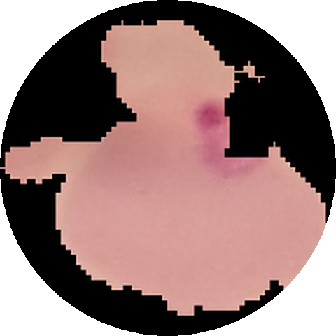
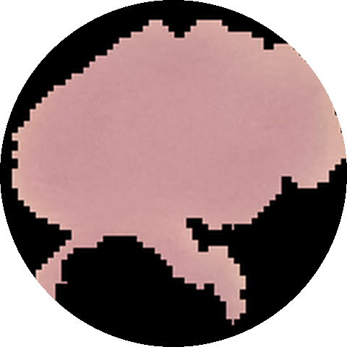
98 % Accuracy Holds on Unseen Patients
CV RESEARCH-REPRODUCTION PROJECT · FINAL DEFENCE
Code-exact reproduction and pre-registered patient-level validation of an EfficientNet-B0 malaria ensemble
J Amathziah
230139
C Murali Madhav
230115
Ravi Yadav
230131
Pugazhendhi J
230066
Department of Computer Science · Rishihood University, Sonipat · github.com/amathziah/malaria-detection
Notes:
Malaria is still diagnosed by a person counting blood cells under a microscope, and deep-learning papers report up to 99.9 per cent accuracy on the public NIH cell images. We took one of the strongest, an EfficientNet-B0 ensemble at 98 per cent, and asked two questions. Can it be rebuilt exactly from its authors' code? And does its accuracy hold on patients the model has never seen? The answer to both is yes, and the next slide shows the evidence.

Slide 2
What we achieved
AT A GLANCE
Within 1 pp
25× faster
98.45 %
of the paper on every metric, rebuilt from the authors' own code
11 minutes per fold instead of 4 h 46 min, with the same maths
accuracy on 40 unseen patients; recall 98.05 %, ROC-AUC 99.80 %
0.85 pp
±1 pp
26 of 28
patient leakage in MCC, measured on 17,591 identical cells: small
YUV stain normalisation is unnecessary: equivalent to no change
infected patients found and 12 of 12 healthy cleared (exploratory)
Pre-registered before training · patient-level statistics · all 40 models and the code are public
Notes:
Six results carry the talk. We rebuilt the paper's ensemble from its authors' code and matched it within one point on every metric, while training 25 times faster. On 40 patients the models never saw, it scores 98.45 per cent, with 98.05 per cent recall and 99.80 per cent ROC-AUC. Measured on identical cells, patient leakage is small, and the popular YUV stain normalisation turns out to be unnecessary. Combined per patient, the model finds 26 of 28 infected patients. Every analysis was fixed before training, and all 40 models are public.

Slide 3





Five parts, following the brief's six steps
ROADMAP
PART 1
PART 2
PART 3
PART 4
PART 5
The problem
Reproduction
Our change
Results
Failure analysis and conclusion
1
2
3
4
5
27,558 cells · 200 patients
within 1 pp · 25× faster
2 predictions, fixed before training
98.45 % on unseen patients
26 of 28 patients found
Brief step 1 · slides 4 to 6
Brief steps 2 and 3 · slides 7 to 9
Brief step 4 · slide 10
Brief step 5 · slides 11 to 14
Brief step 6 · slides 15 to 17
The tracker at the top right of every slide shows where we are.
Notes:
The talk follows the brief in five parts, and each part has a headline. Part one, the problem: 27,558 cells from 200 patients. Part two, the reproduction: within one point of the paper, 25 times faster. Part three, our change: two predictions, fixed before any training. Part four, the results: 98.45 per cent on patients the model has never seen. Part five, the failure analysis and conclusion: 26 of 28 infected patients found. The tracker at the top right of every slide shows where we are.

Slide 4



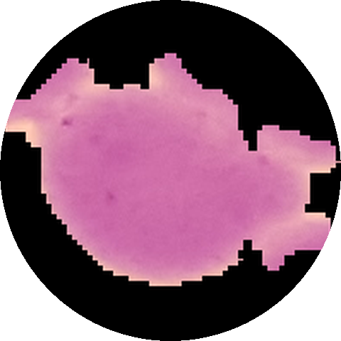
Automating malaria microscopy, one cell at a time
PART 1 · THE PROBLEM
1 · The problem
2 · Reproduction
3 · Our change
4 · Results
5 · Failure analysis, conclusion
27,558
Slow
Hundreds of cells per smear, checked by eye
single-cell images from the NIH dataset, half parasitized
Expert-dependent
Needs trained microscopists, scarce where malaria is common
parasitized
parasitized
parasitized
200
Variable
Calls differ between observers and laboratories
patients: 150 infected, 50 healthy
Our goal call each red blood cell parasitized or uninfected, accurately on new patients.
uninfected
uninfected
uninfected
C33P1thinF_IMG_…_cell_179.png
Every file name starts with the patient ID; we verified all 27,558 against NIH's mapping.
Notes:
Giemsa microscopy is the gold standard for malaria, but it is slow, it needs scarce experts, and calls vary between observers. Classifying single cells is a clean computer-vision task. The NIH dataset gives us 27,558 cell images, half parasitized, from 200 patients photographed at Chittagong Medical College Hospital. Crucially, every file name starts with the patient's ID, which we verified against NIH's own mapping. That is what lets us test the model on patients it has never seen.

Slide 5



11 studies report up to 99.9 %; 2 test unseen patients
PART 1 · THE PROBLEM
1 · The problem
2 · Reproduction
3 · Our change
4 · Results
5 · Failure analysis, conclusion
The open question
9 of 11 split cells at random, so the same patients sit in training and test.
Hard to compare
5-fold, 10-fold and 80/20 protocols; original or cleaned labels.
Our base paper
Marques et al. published executed code, so it can be rebuilt exactly.
Notes:
Step one of the brief is the literature survey. We reviewed eleven studies: they report between 96.5 and 99.9 per cent accuracy, on different protocols, so the numbers are hard to compare. Nine of the eleven split cells at random, which puts the same patients in training and test. Only Rajaraman and colleagues measured unseen patients. We chose Marques et al. as our base paper: a strong 98 per cent result, a standard architecture, and an executed notebook we could rebuild line by line.

Slide 6
Our question: does 98 % hold on new patients?
PART 1 · THE PROBLEM
1 · The problem
2 · Reproduction
3 · Our change
4 · Results
5 · Failure analysis, conclusion
Image split (the paper)
Patient split (ours)
cells shuffled at random: every patient on both sides
whole patients go to one side only
TRAINING
TEST
TRAINING
TEST
Each colour is one patient. A patient's cells share stain, lighting and blood, so we hold out whole patients: the model must recognise the parasite, not the patient.
Notes:
This is the question at the heart of the project. Under the paper's random image split, cells of the same patient sit in both training and test, so part of a high score could come from recognising the patient's stain and lighting. We split by patient instead: whole patients are held out, so the model has to recognise the parasite itself. If the 98 per cent survives this test, the result is real.

Slide 7
Base paper checklist: every gap closed
PART 2 · REPRODUCTION
1 · The problem
2 · Reproduction
3 · Our change
4 · Results
5 · Failure analysis, conclusion
Checklist item | Paper | What we did
Data public | Yes | Downloaded; patient IDs verified against NIH's mapping
Code public | Yes | Rebuilt from the authors' executed notebook
Model size | Yes | 4,223,934 parameters, matched exactly
Hyperparameters | Partly | Text and code differ in 8 places: we follow the code
Data split | No | Seeded and fingerprinted: identical on every machine
Evaluation protocol | No | Both reported: clean and augmented images
Patient-level test | No | Our hypothesis H1
Trained models | No | All 40 of ours public on GitHub
Marques et al. (2022)
8
places where the code differs from the paper's text; we follow the code
3
reporting errors we found and corrected
Precision and recall swapped · test images augmented · "accuracy" = (P + R) / 2
Notes:
Step two of the brief is the reproducibility checklist for our base paper, Marques et al. 2022. The essentials are there: public data, the authors' executed notebook, and the exact model size. Where the paper was incomplete, we closed the gap: we seeded and fingerprinted the split, report both evaluation protocols, and publish all 40 of our models. Reading the code closely, we found eight places where it differs from the text, and three reporting errors, which we corrected in our paper.

Slide 8
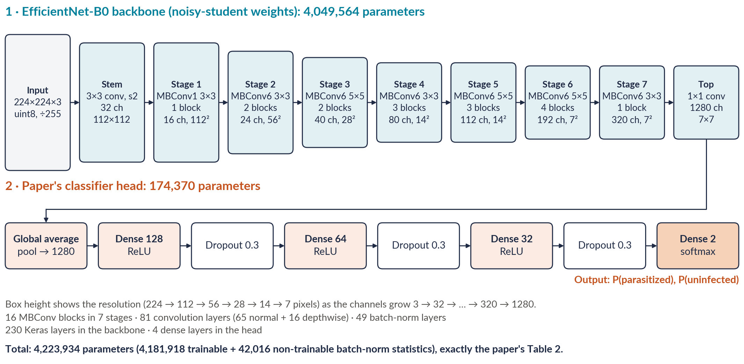
EfficientNet-B0 and the paper's head: 4.2 M parameters
PART 2 · REPRODUCTION
1 · The problem
2 · Reproduction
3 · Our change
4 · Results
5 · Failure analysis, conclusion
Ten fold models, each trained on a different nine tenths of the data, averaged into one ensemble.
Notes:
The model is the paper's exactly: a noisy-student EfficientNet-B0 backbone, sixteen MBConv blocks that turn a 224 by 224 cell into 1,280 features, and the paper's dense head of 128, 64 and 32 units with a two-way softmax. That is 4,223,934 parameters, matching the paper's Table 2 to the last digit, and an automated test checks it. Ten such models, one per cross-validation fold, are averaged into the ensemble.

Slide 9
Reproduced within 1 pp of the paper, 25× faster
PART 2 · REPRODUCTION
1 · The problem
2 · Reproduction
3 · Our change
4 · Results
5 · Failure analysis, conclusion
32
automated tests check the rebuild against the paper's outputs
97.55 %
mean fold accuracy, against the paper's 97.56 %
11 min
per fold on one RTX 4090, against 4 h 46 min
US$6.95
for 30 more models on ten cloud GPUs at once
Notes:
Step three is the reproduction. Across all ten folds our models match the paper to a hundredth of a point, 97.55 against 97.56 per cent, and every headline metric is within one point, including ROC-AUC at 99.73 against 99.76. Thirty-two automated tests check the rebuild against the paper's printed outputs. We also made it fast without changing the maths: images decoded once, parallel seeded augmentation and a compiled training step bring a fold from nearly five hours to eleven minutes, so all 30 new models cost under seven dollars.

Slide 10
Two predictions, fixed before training
PART 3 · OUR CHANGE
1 · The problem
2 · Reproduction
3 · Our change
4 · Results
5 · Failure analysis, conclusion
image split (paper)
patient split
H1 · PATIENT SPLIT
A0
A1
We predicted on unseen patients accuracy drops, and the fold-to-fold spread widens.
H1
original RGB
baseline
H1
control
H2
H2 · YUV STAIN NORMALISATION
A3
A2
We predicted equalising brightness raises recall and MCC on unseen patients.
YUV + hist-eq
control
H2
Committed to GitHub before training (0c086ee): patient bootstrap · paired tests · Holm correction · MCC as the primary metric
Notes:
Step four: our change and our predictions, fixed before any new model was trained. The design is a two by two grid. A1 changes only the split, to unseen patients, and tests H1: we predicted that accuracy would drop and the folds would spread. A2 adds YUV histogram equalisation on those unseen patients, testing H2: we predicted higher recall and MCC. A3 is the control. Everything else is identical, and the hypotheses, decision rules and statistics were committed to GitHub before training, so the results could not shape the questions.

Slide 11
Recall above 97 % and AUC above 99.6 % in every experiment
PART 4 · RESULTS
1 · The problem
2 · Reproduction
3 · Our change
4 · Results
5 · Failure analysis, conclusion
 | A0 · image split | A1 · patient split | A2 · patient + YUV | A3 · image + YUV
Hold-out set | 5,512 cells 200 patients | 5,550 cells 40 patients | 5,550 cells 40 patients | 5,512 cells 200 patients
Ensemble accuracy | 97.64 % | 98.45 % | 98.32 % | 97.64 %
Recall (sensitivity) | 97.18 % | 98.05 % | 98.22 % | 97.14 %
Specificity | 98.09 % | 98.87 % | 98.43 % | 98.13 %
MCC × 100 | 95.29 | 96.90 | 96.65 | 95.29
ROC-AUC | 99.68 % | 99.80 % | 99.76 % | 99.66 %
Fold MCC, mean ± SD | 95.57 ± 0.60 | 93.92 ± 1.51 | 93.32 ± 1.66 | 95.20 ± 0.37
Ten-model ensembles, clean evaluation. A1 and A2: 40 unseen patients; A0 and A3: the paper's split. 95 % intervals: paper, Table III.
Notes:
Here is every number for all four experiments, because the brief asks for recall and AUC, not just accuracy. Recall stays between 97.14 and 98.22 per cent, and ROC-AUC between 99.66 and 99.80 per cent, in every experiment. On the 40 unseen patients, A1 reaches 98.45 per cent accuracy, on par with the paper's 98.29. The last row is the cross-validation, which the next slides test properly.

Slide 12
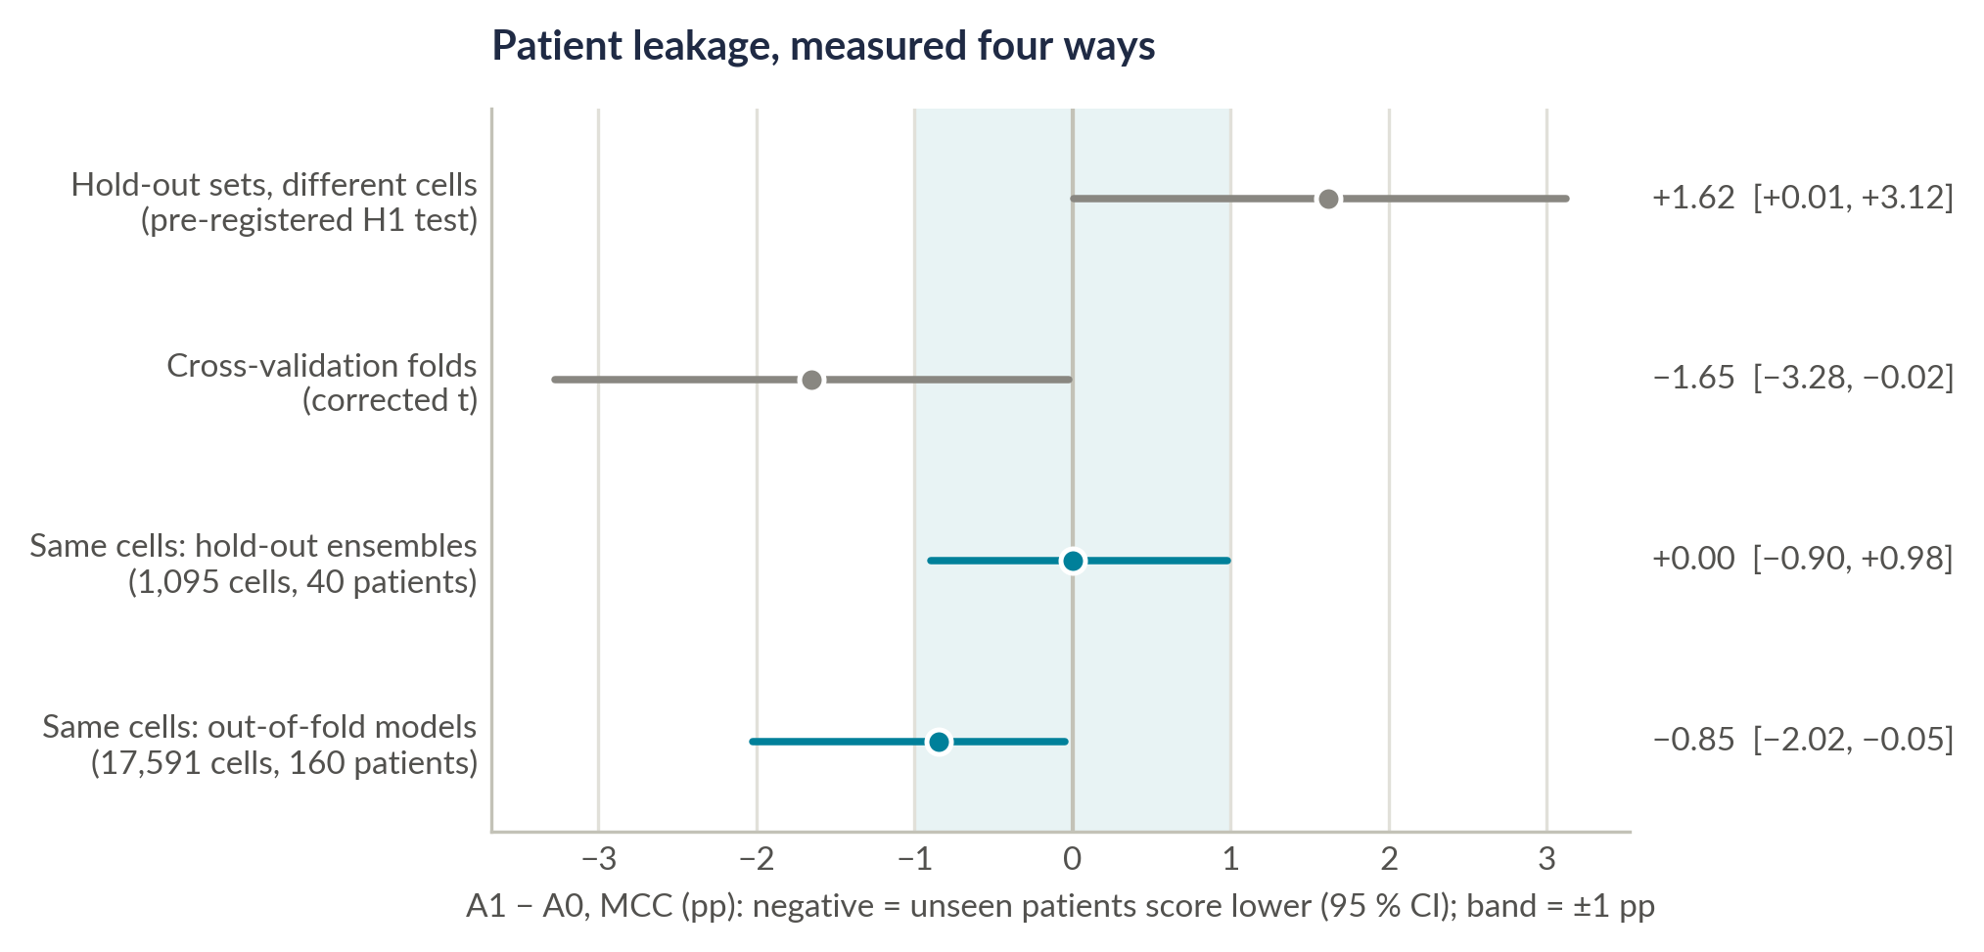
98 % accuracy holds on unseen patients
PART 4 · RESULTS
1 · The problem
2 · Reproduction
3 · Our change
4 · Results
5 · Failure analysis, conclusion
98.45 %
accuracy on 40 unseen patients (95 % CI 97.94 to 98.91)
98.05 %
recall, with ROC-AUC 99.80 %
0.85 pp
patient leakage in MCC on 17,591 identical cells: small
Teal rows: both models score the same cells.
Notes:
H1 predicted a clear drop on unseen patients. On the pre-registered test there is no drop: the ensemble scores 98.45 per cent on 40 patients it never saw, on par with the paper. The fairest test scores identical cells with both models: across 17,591 cells of 160 patients, leakage costs 0.85 points of MCC, under half a point of accuracy, and on the hold-out cells it is zero. The fold spread did widen 2.5 times, as we predicted. So the model generalises to new patients.

Slide 13
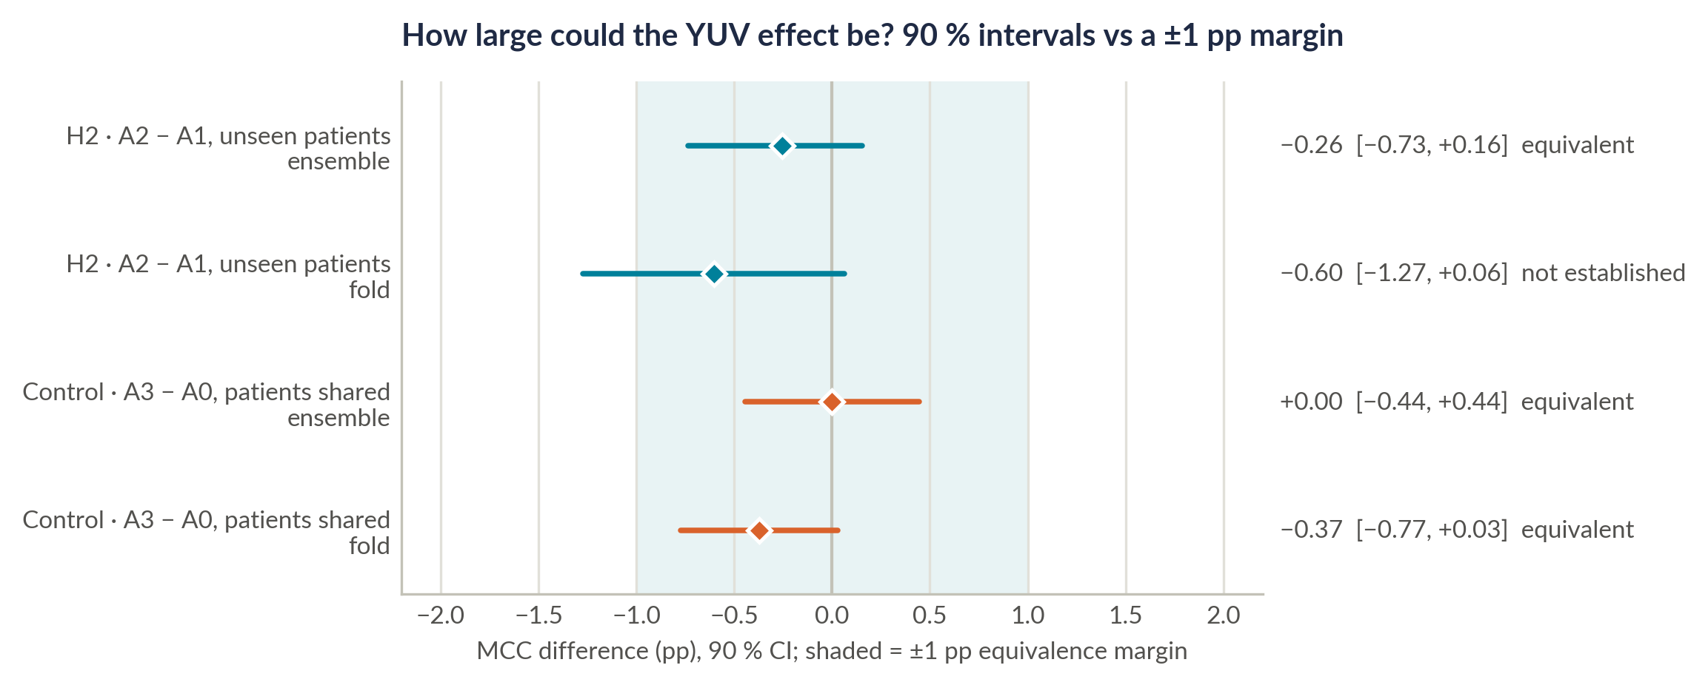
The model is already stain-robust
PART 4 · RESULTS
1 · The problem
2 · Reproduction
3 · Our change
4 · Results
5 · Failure analysis, conclusion
±1 pp
YUV's effect on MCC: 90 % CI −0.73 to +0.16
p = 0.008
equivalence test (TOST): the effect lies inside the margin
Simpler
pipeline, same accuracy: no stain normalisation step needed
How to read it: a bar wholly inside the shaded ±1 pp band means the effect is too small to matter. On the hold-out set, YUV's bar sits inside it.
Notes:
H2 predicted that YUV histogram equalisation would raise recall and MCC on unseen patients. It is equivalent to no change: on the same 40 patients the 90 per cent interval runs from −0.73 to +0.16 points of MCC, inside our pre-registered margin of one point, with an equivalence p of 0.008. Recall moves by +0.18 points. The control confirms it with patients shared. The baseline is already stain-robust, so the pipeline can stay simpler.

Slide 14
What our predictions taught us
PART 4 · RESULTS
1 · The problem
2 · Reproduction
3 · Our change
4 · Results
5 · Failure analysis, conclusion
H1 · PATIENT LEAKAGE
H2 · YUV STAIN NORMALISATION
Predicted a clear drop on unseen patients, with a wider fold spread.
Found the spread widened 2.5× as predicted; leakage is just 0.85 pp MCC.
Insight parasite chromatin looks alike in every patient, and the augmentation hides each patient's stain: the model generalises.
Predicted higher recall and MCC on unseen patients.
Found equivalent to no change, within ±1 pp.
Insight the augmentation already varies brightness and contrast, so the baseline is stain-robust; the large published gain came from a baseline that had not trained.
Next test: colour augmentation, on another laboratory's smears [16].
Notes:
The brief rewards the reasoning behind each prediction, so here is what ours taught us. For H1 we had the direction right: the unseen-patient folds vary 2.5 times more. The size is small, because the decisive cue, purple-stained parasite chromatin, looks the same in every patient, and the paper's heavy augmentation already hides each patient's stain. For H2, the YUV step equalises brightness, which the augmentation already varies, and the large published gains were measured against models that had not trained. That points to the next test: colour augmentation on another laboratory's smears.

Slide 15
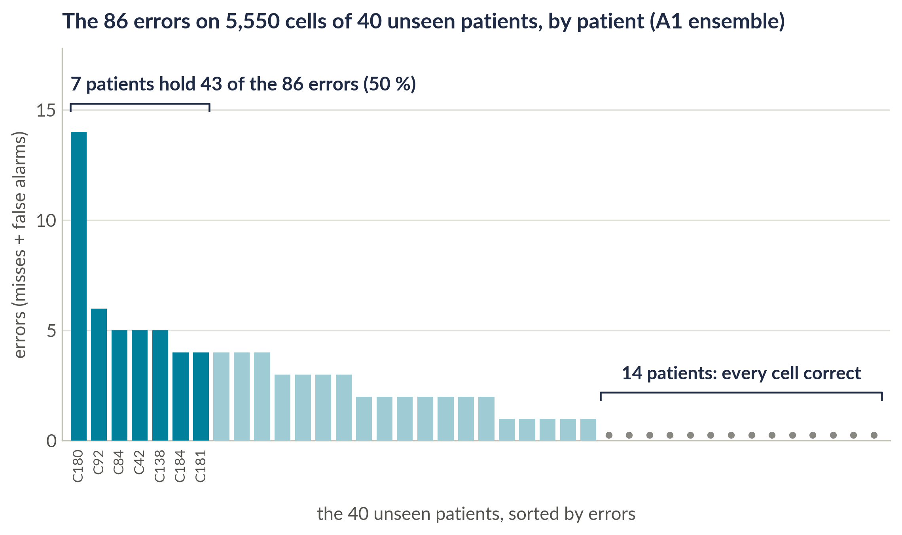
The remaining errors point to the labels
PART 5 · FAILURE ANALYSIS AND CONCLUSION
1 · The problem
2 · Reproduction
3 · Our change
4 · Results
5 · Failure analysis, conclusion
7 of 40
patients hold half of the 86 errors
14 of 40
patients: every cell classified correctly
30 of 31
false alarms on infected patients' smears (1.57 % vs 0.12 %)
8
cells flagged as likely label errors (confident learning)
Notes:
Step six is the failure analysis. A1 classifies 5,464 of 5,550 cells correctly, and its 86 errors are not random: seven patients hold half of them, fourteen patients have none, and a permutation test confirms the clustering. False alarms fall almost entirely on infected patients' smears, 1.57 against 0.12 per cent of uninfected cells, which fits parasites the labeller missed. Confident learning flags 8 likely label errors; removing them changes none of our conclusions. We have a blinded protocol ready for an expert to check them.

Slide 16
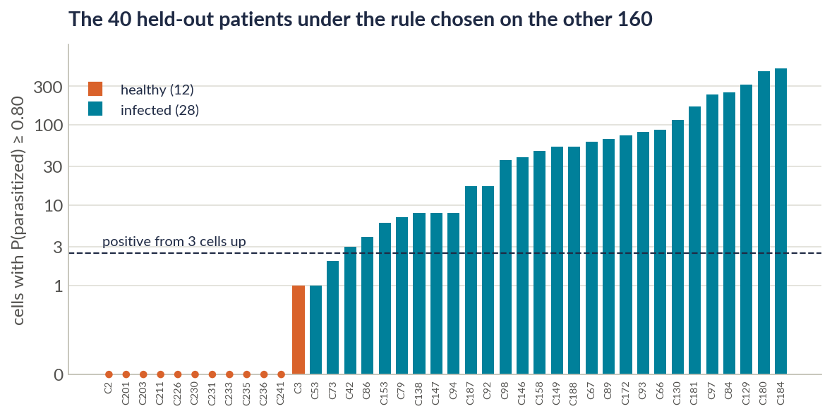
26 of 28 infected patients found, 12 of 12 cleared
PART 5 · FAILURE ANALYSIS AND CONCLUSION
1 · The problem
2 · Reproduction
3 · Our change
4 · Results
5 · Failure analysis, conclusion
26 / 28
infected patients found (92.9 %)
12 / 12
healthy patients cleared (100 %)
99.22 %
cell recall with a threshold chosen on the CV folds (from 98.05 %)
Rule fixed on the 160 training patients: at least 3 cells with P ≥ 0.80. Exploratory, on curated crops. Screening view, no clinical claim.
Notes:
A clinic diagnoses patients, not cells, so we combined the cell calls per patient. The rule was fixed on the 160 training patients: positive if at least 3 cells score 0.80 or more. Applied once to the 40 unseen patients, it finds 26 of 28 infected patients and clears all 12 healthy ones; the two it misses have just three parasitized crops in the dataset. For screening, a threshold chosen on the training folds lifts cell recall to 99.22 per cent. These are exploratory results on curated crops, not a clinical claim.

Slide 17
What we contribute
PART 5 · FAILURE ANALYSIS AND CONCLUSION
1 · The problem
2 · Reproduction
3 · Our change
4 · Results
5 · Failure analysis, conclusion
1
Code-exact reproduction
Scope
Within 1 pp of the paper, 25× faster, checked by 32 tests, 3 reporting errors corrected.
One hospital · curated cell crops · one expert's labels
2
Validated on unseen patients
Next
98.45 % accuracy and 99.80 % AUC on 40 new patients; leakage measured at 0.85 pp MCC.
Another lab's smears (MP-IDB)
Colour augmentation
Patient rule on whole smears
Distil into one light model
3
A simpler pipeline
YUV stain normalisation is unnecessary: equivalent within ±1 pp.
4
Open and pre-registered
Plan committed before training; code and all 40 models public.
Thank you · questions welcome · github.com/amathziah/malaria-detection
Notes:
Four contributions. A code-exact reproduction of a published ensemble, within one point and 25 times faster. A validation on patients the model has never seen, where 98 per cent holds and leakage is measured precisely. A simpler pipeline, because stain normalisation adds nothing. And an open, pre-registered study: every model and every number is public. Our scope is one hospital, curated cell crops and one expert's labels, which sets the next steps: another laboratory's smears, colour augmentation, patient rules on whole smears, and one light model for the field.

Slide 18
Sources
REFERENCES
[1] Z. Liang et al., “CNN-based image analysis for malaria diagnosis,” IEEE BIBM, 2016.
[2] S. Rajaraman et al., “Pre-trained CNNs as feature extractors toward improved malaria parasite detection,” PeerJ 6:e4568, 2018.
[3] S. Rajaraman, S. Jaeger, S. K. Antani, “Performance evaluation of deep neural ensembles toward malaria parasite detection,” PeerJ 7:e6977, 2019.
[4] M. Umer et al., “A novel stacked CNN for malarial parasite detection in thin blood smear images,” IEEE Access 8, 2020.
[5] K. M. F. Fuhad et al., “Deep learning based automatic malaria parasite detection from blood smear and its smartphone based application,” Diagnostics 10(5):329, 2020.
[6] O. S. Zhao et al., “Convolutional neural networks to automate the screening of malaria in low-resource countries,” PeerJ 8:e9674, 2020.
[7] M. Masud et al., “Leveraging deep learning techniques for malaria parasite detection using mobile application,” WCMC 2020:8895429.
[8] G. Marques, A. Ferreras, I. de la Torre-Díez, “An ensemble-based approach for automated medical diagnosis of malaria using EfficientNet,” MTAP 81, 2022 (base paper).
[9] G. Madhu et al., “Intelligent diagnostic model for malaria parasite detection … capsule neural networks,” Sci. Rep. 13, 2023.
[10] K. Hemachandran et al., “Performance analysis of deep learning algorithms in diagnosis of malaria disease,” Diagnostics 13(3):534, 2023.
[11] M. Mujahid et al., “Efficient deep learning-based approach for malaria detection using red blood cell smears,” Sci. Rep. 14, 2024.
[12] C. Nadeau, Y. Bengio, “Inference for the generalization error,” Machine Learning 52, 2003 · [13] S. Holm, “A simple sequentially rejective multiple test procedure,” Scand. J. Statist. 6, 1979.
[14] D. Lakens, “Equivalence tests: A practical primer for t tests, correlations, and meta-analyses,” Soc. Psychol. Personal. Sci. 8(4), 2017 · [15] C. G. Northcutt, L. Jiang, I. L. Chuang, “Confident learning: Estimating uncertainty in dataset labels,” JAIR 70, 2021.
[16] D. Tellez et al., “Quantifying the effects of data augmentation and stain color normalization in convolutional neural networks for computational pathology,” Med. Image Anal. 58, 2019.
Notes:
The eleven studies from our literature survey, the base paper, the statistical methods we rely on, and the stain-augmentation study behind our next experiment.

