Slide 1
Intelligence Integrated Environments: Using Swarm Intelligence and Graph Theory
Project Updates
Anthony Atkinson, CIS 598, Spring 2018

Slide 2
Goals
Provide a library for modeling agents interacting with an environment represented through a graph/network.
People in a town
Cells in the blood stream
Ants in a colony
Variables in a series of equations
Etc.
Provide demonstrations on how to use the base features of the library, as well as expand upon it to fit niche uses.

Slide 3
Features
Automatic graph generation with several different structure types:
Trees
Grids
Etc.
Node function definition
Graph population and depopulation
Versatile modeling engine
Comprehensive library

Slide 4



Tools & Platforms

Slide 5
Scalability
Delegation → Generalization
Integer, character, array, or even compound state
Random “dumb” vs. context-aware “smart” traffic flow
Simple vs complex mutation functions
Optimization
Small swarms to start
Significant growth with optimizations
Applications
Flow of data, illnesses, people, etc.
Use in conjunction with AI or other programs

Slide 6
Completed
User defined graph/agents via modularity
Set piece interface
Agent interface
Spawning/despawning & graph navigation
Observable state changes to graph during simulations
Mutable agents via leaf functions
Simple demo with expressions and coefficient changes

Slide 7
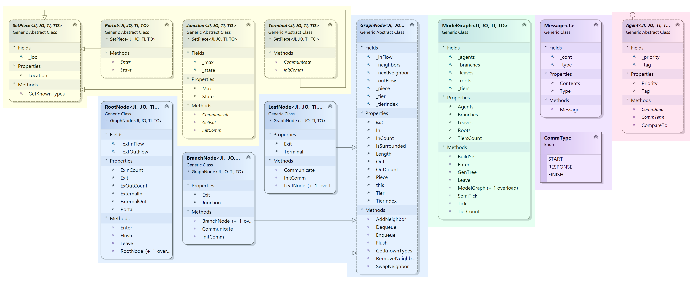

Slide 8
To do
External feedback via controlled user access
Graph visualization
More complex demos

Slide 9
Schedule
March
Basic implementation of: generation, conversion, simulation
Implementation of structure loading and saving
Increased user space through generalization
Simple programs for demonstration
April
Visualization
Interactivity
Bug testing
Optimization
Refinement of demonstations

Slide 10
Questions?

