Slide 1
Modeling Core: Using Swarm Intelligence on Networks
Project Overview and Requirements
Anthony Atkinson, CIS 598, Spring 2018

Slide 2
Goals
Provide a core for systems that model many agents working in parallel on networks:
People in a town
Cells in the blood stream
Ants in a colony
Variables in a series of equations
Etc.

Slide 3
Features
Dendritic structure generator
Structure to network synthesis
Versatile modeling engine
Comprehensive library

Slide 4
Requirements
Agents & Nodes:
Internal state
Distribution & interaction
Distinction of properties & purpose
Core Library:
Delegation of:
Aggregation
Network synthesis
Branch & leaf functions
Accept input
Interpret state changes
Provide output

Slide 5
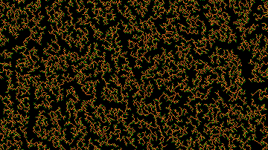
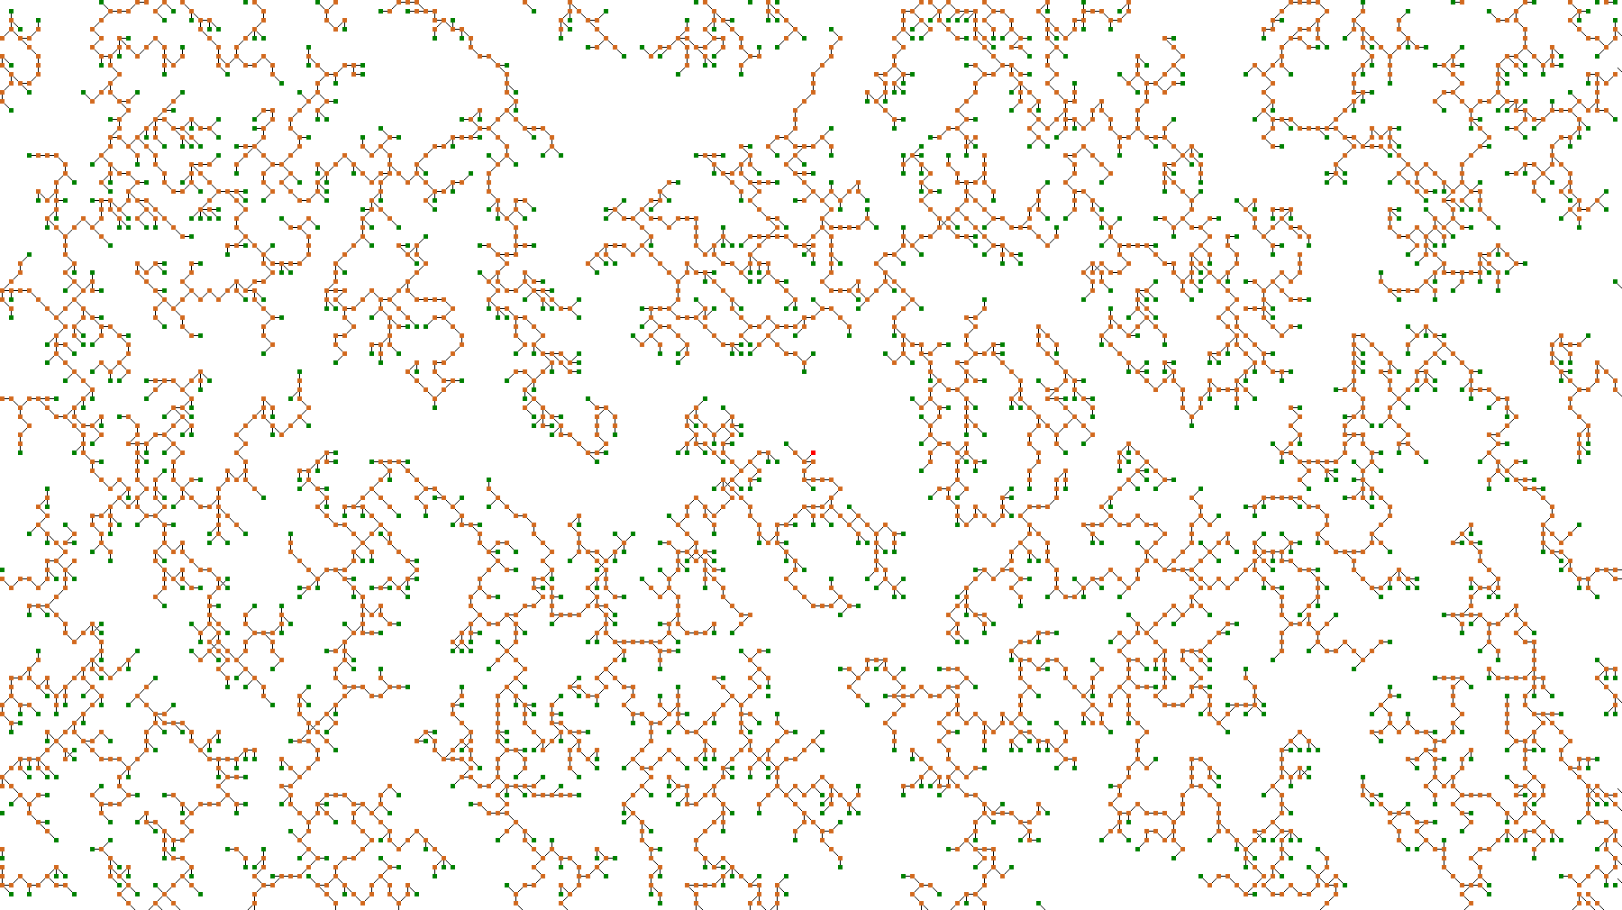
Basic Aggregation
Dense
Detailed

Slide 6






Basic Network Function
$$x_{0}$$
$$x_{1}$$
$$a$$
$$b$$
$$y_{1}$$
$$y_{0}$$

Slide 7



Tools & Platforms

Slide 8
Scalability
Delegation → Generalization
Integer, character, array, or even compound state
Random “dumb” vs. context-aware “smart” traffic flow
Simple vs complex mutation functions
Optimization
Small swarms to start
Significant growth with optimizations
Applications
Flow of data, illnesses, people, etc.
Use in conjunction with AI or other programs

Slide 9
Schedule
February
Basic implementation of: aggregation, conversion, and running the network
March
Implementation of structure loading and saving
Increased user space through generalization
Simple shell programs for demonstration
April
Bug testing
Optimization
Refinement of shells

Slide 10
Questions?

