Slide 1
NBA Shot Data Visualization
From scratch to an app in 60 minutes
Anna Matlin
amatlin@princeton.edu

Slide 2
Overview
The world of sports data is vast, and significant quantities of information are publicly available online. The ability to access, capture, analyze, and illustrate that data is extremely valuable.
In this workshop, we will:
scrape data from the web using Python
process it in R
guide participants (you) through the basics of making a Shiny app in R
By the end of the workshop, each participant will have made a visualization of player data as a web application.

Slide 3
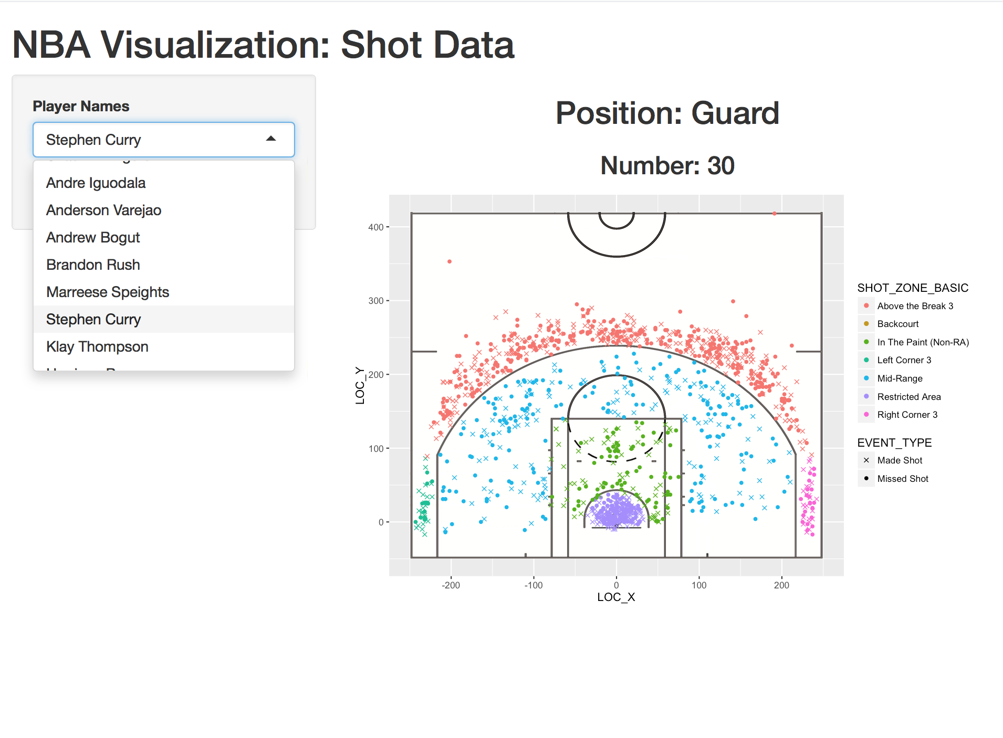
End goal

Slide 4
Resource dump
All code used in this workshop: https://github.com/amatlin/NBAvis
Stats data retrieved from http://www.nba.com/warriors/stats
Scraping:
https://www.crummy.com/software/BeautifulSoup/bs4/doc/
http://web.stanford.edu/~zlotnick/TextAsData/Web_Scraping_with_Beautiful_Soup.html (tutorial)
Shiny:
http://shiny.rstudio.com/
http://shiny.rstudio.com/articles/cheatsheet.html
Download python: https://www.python.org/downloads/
Download R and Rstudio:
http://lib.stat.cmu.edu/R/CRAN/
https://www.rstudio.com/products/rstudio/download/
ggplot2:
http://ggplot2.org/
https://www.rstudio.com/wp-content/uploads/2015/03/ggplot2-cheatsheet.pdf
Lots of code used from http://thedatagame.com.au/2015/09/27/how-to-create-nba-shot-charts-in-r/

Slide 5
Step 1: Have Python and R installed
Python needed for web scraping
R, RStudio needed for visualization + Shiny

Slide 6
Step 2: go to Github repository
https://github.com/amatlin/NBAvis
→ open README and follow instructions for installation of necessary packages

Slide 7
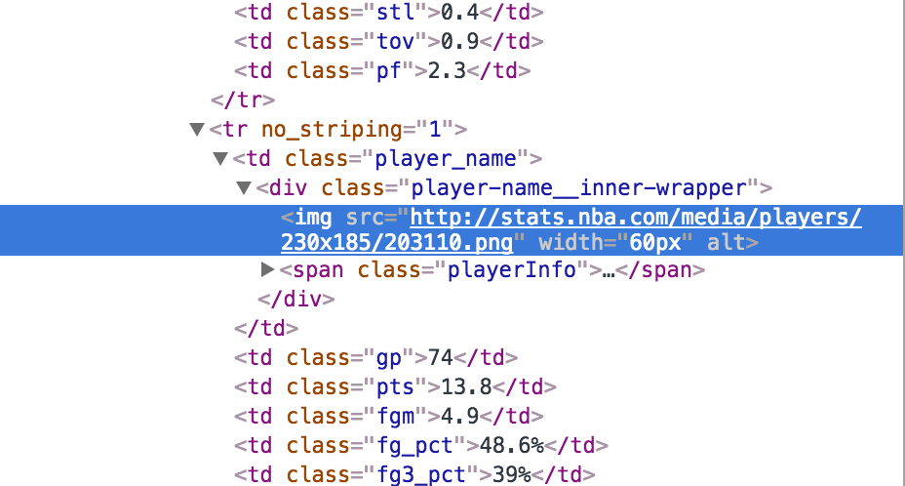
Step 3: Scraping
Go to http://www.nba.com/warriors/stats to get a look for what we will be scraping.
Player IDs come from image links in HTML.
Find image of player, right click and select “Inspect”
Frameworks/APIs we will be using to scrape:
→ Beautiful Soup

Slide 8
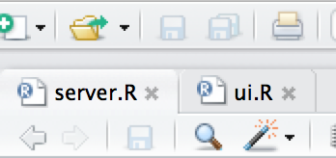
What is a Shiny app?
Check out http://shiny.rstudio.com/ for documentation + tutorials
→ “A web application framework for R; Turn your analyses into interactive web applications; No HTML, CSS, or JavaScript knowledge required”
→ each app is made containing two files
server.R: behind the scenes calculations
ui.R: what the user sees
→ designed for development in RStudio
→ Terms to keep in mind: render, reactive, input/output

Slide 9
Step 4: Start making our app

Slide 10
What does our data look like?
Column names:
GRID_TYPE GAME_ID GAME_EVENT_ID PLAYER_ID PLAYER_NAME TEAM_ID TEAM_NAME PERIOD MINUTES_REMAINING SECONDS_REMAINING EVENT_TYPE ACTION_TYPE SHOT_TYPE SHOT_ZONE_BASIC SHOT_ZONE_AREA SHOT_ZONE_RANGE SHOT_DISTANCE LOC_X LOC_Y SHOT_ATTEMPTED_FLAG SHOT_MADE_FLAG
First data point
1 Shot Chart Detail 0021400014 50 201939 Stephen Curry 1610612744 Golden State Warriors 1 7 29 Made Shot Running Jump Shot 2PT Field Goal Mid-Range Left Side(L) 8-16 ft. 10 -81 72 1 1
Total data points for Steph Curry: 1341

Slide 11
Step 5: ggplot2
For more info check out
http://ggplot2.org/
https://www.rstudio.com/wp-content/uploads/2015/03/ggplot2-cheatsheet.pdf
“ggplot2 is a plotting system for R, based on the grammar of graphics, which tries to take the good parts of base and lattice graphics and none of the bad parts. It takes care of many of the fiddly details that make plotting a hassle (like drawing legends) as well as providing a powerful model of graphics that makes it easy to produce complex multi-layered graphics.”

Slide 12
Launch and run app

Slide 13
Questions?

Slide 14
Thank you!
http://princeton-data-science.github.io/

