Slide 1
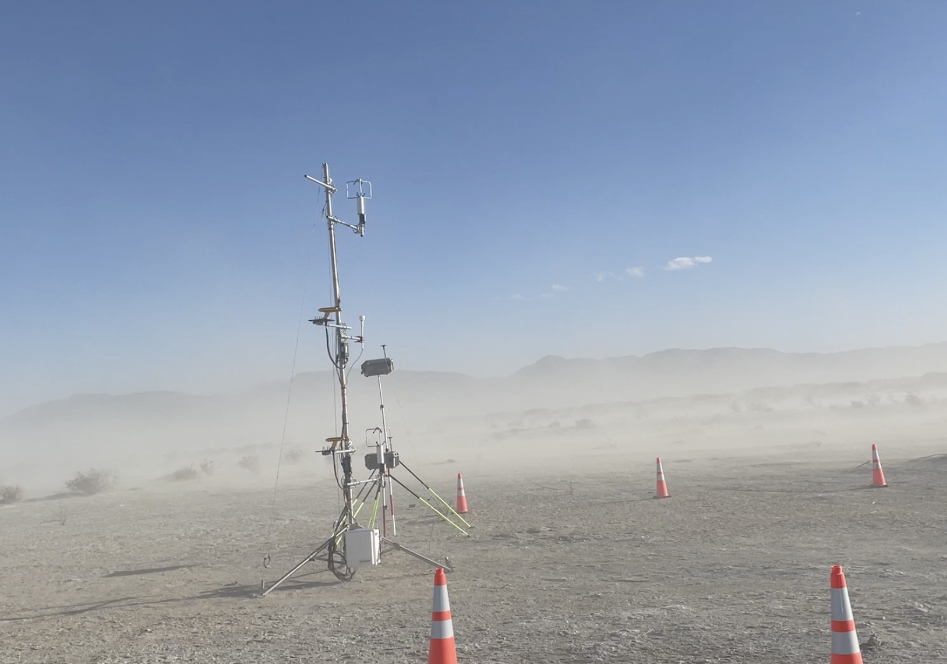

Slide 3
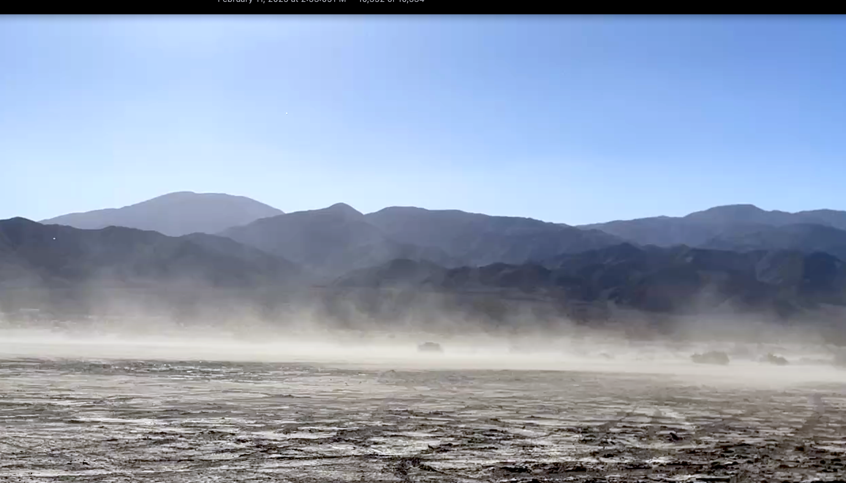



$$z=z_{int}$$
Constant Flux Layer
Surface Layer
$$z=z_{0}$$
Quasi-Laminar Layer
$$z=0$$

Slide 4

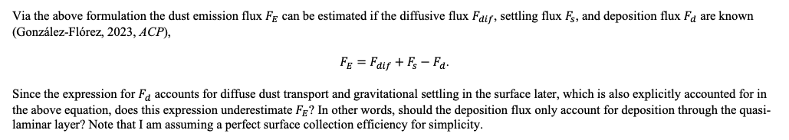

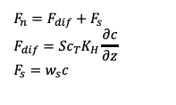






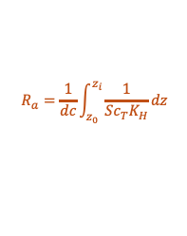
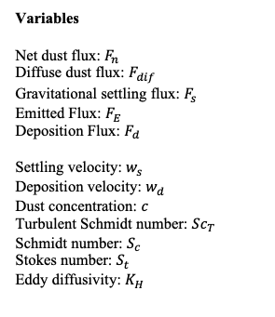
Dust Fluxes
$$z=z_{i}$$
Dust Deposition
$$F_{n}=F_{dif}+F_{s}$$
$$F_{dif}={Sc}_{T}K_{H}\frac{∂c}{∂z}$$
$$F_{s}=w_{s}c$$
Variables
Net dust flux: $F_{n}$
Diffuse dust flux: $F_{dif}$
Gravitational settling flux: $F_{s}$
Emitted Flux: $F_{E}$
Deposition Flux: $F_{d}$
Settling velocity: $w_{s}$
Deposition velocity: $w_{d}$
Dust concentration: $c$
Turbulent Schmidt number: ${Sc}_{T}$
Schmidt number: $S_{c}$
Stokes number: $S_{t}$
Eddy diffusivity: $K_{H}$
$$R_{a}=\frac{1}{dc}\int_{z_{0}}^{z_{i}}{\frac{1}{{Sc}_{T}K_{H}}dz}$$
$\frac{dF_{n}}{dz}=0$
Surface Layer
$$R_{s}=\frac{1}{w_{s}}$$
Quasi-laminar Layer
$$z=z_{0}$$
$$R_{b}={\left[u_{∗}\left(S_{c}^{−2/3}−{10}^{−3/S_{t}}\right)\right]}^{−1}$$
$$F_{n}=F_{E}+F_{d}$$
$$F_{d}=w_{d}c$$
$$z=0$$
$$w_{d}=\frac{1}{R_{a}+R_{b}+R_{a}R_{b}w_{s}}+\frac{1}{R_{s}}$$
Via the above formulation the dust emission flux $F_{E}$ can be estimated if the diffusive flux $F_{dif}$, settling flux $F_{s}$, and deposition flux $F_{d}$ are known (González-Flórez, 2023, ACP),
$F_{E}=F_{dif}+F_{s}−F_{d}$.
Since the expression for $F_{d}$ accounts for diffuse dust transport and gravitational settling in the surface later, which is also explicitly accounted for in the above equation, does this expression underestimate $F_{E}$? In other words, should the deposition flux only account for deposition through the quasi-laminar layer? Note that I am assuming a perfect surface collection efficiency for simplicity.

Slide 5

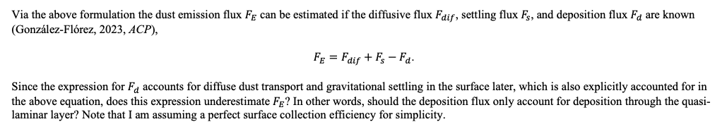

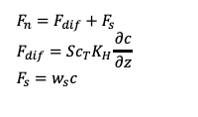







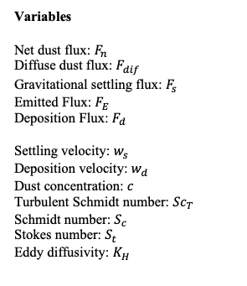
Dust Fluxes
$$z=z_{i}$$
Dust Deposition
$$F_{n}=F_{dif}+F_{s}$$
$$F_{dif}={Sc}_{T}K_{H}\frac{∂c}{∂z}$$
$$F_{s}=w_{s}c$$
Variables
Net dust flux: $F_{n}$
Diffuse dust flux: $F_{dif}$
Gravitational settling flux: $F_{s}$
Emitted Flux: $F_{E}$
Deposition Flux: $F_{d}$
Settling velocity: $w_{s}$
Deposition velocity: $w_{d}$
Dust concentration: $c$
Turbulent Schmidt number: ${Sc}_{T}$
Schmidt number: $S_{c}$
Stokes number: $S_{t}$
Eddy diffusivity: $K_{H}$
$$R_{a}=\frac{1}{dc}\int_{z_{0}}^{z_{i}}{\frac{1}{{Sc}_{T}K_{H}}dz}$$
$\frac{dF_{n}}{dz}=0$
Surface Layer
$$R_{s}=\frac{1}{w_{s}}$$
$$z=z_{i}$$
Quasi-laminar Layer
$$z=z_{0}$$
$$R_{b}={\left[u_{∗}\left(S_{c}^{−2/3}−{10}^{−3/S_{t}}\right)\right]}^{−1}$$
$$F_{n}=F_{E}+F_{d}$$
$$F_{d}=w_{d}c$$
$$z=0$$
$$w_{d}=\frac{1}{R_{a}+R_{b}+R_{a}R_{b}w_{s}}+\frac{1}{R_{s}}$$
Via the above formulation the dust emission flux $F_{E}$ can be estimated if the diffusive flux $F_{dif}$, settling flux $F_{s}$, and deposition flux $F_{d}$ are known (González-Flórez, 2023, ACP),
$F_{E}=F_{dif}+F_{s}−F_{d}$.
Since the expression for $F_{d}$ accounts for diffuse dust transport and gravitational settling in the surface later, which is also explicitly accounted for in the above equation, does this expression underestimate $F_{E}$? In other words, should the deposition flux only account for deposition through the quasi-laminar layer? Note that I am assuming a perfect surface collection efficiency for simplicity.

Slide 6
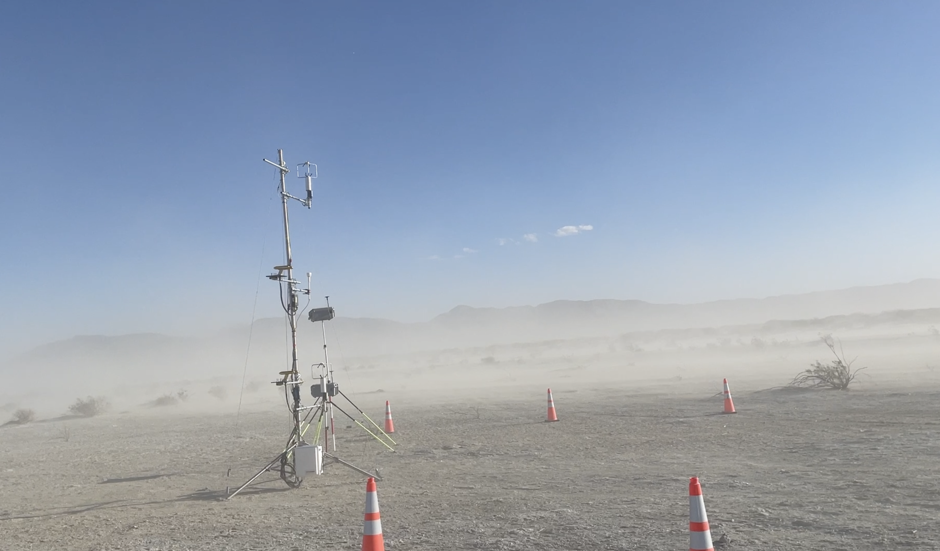

Slide 7
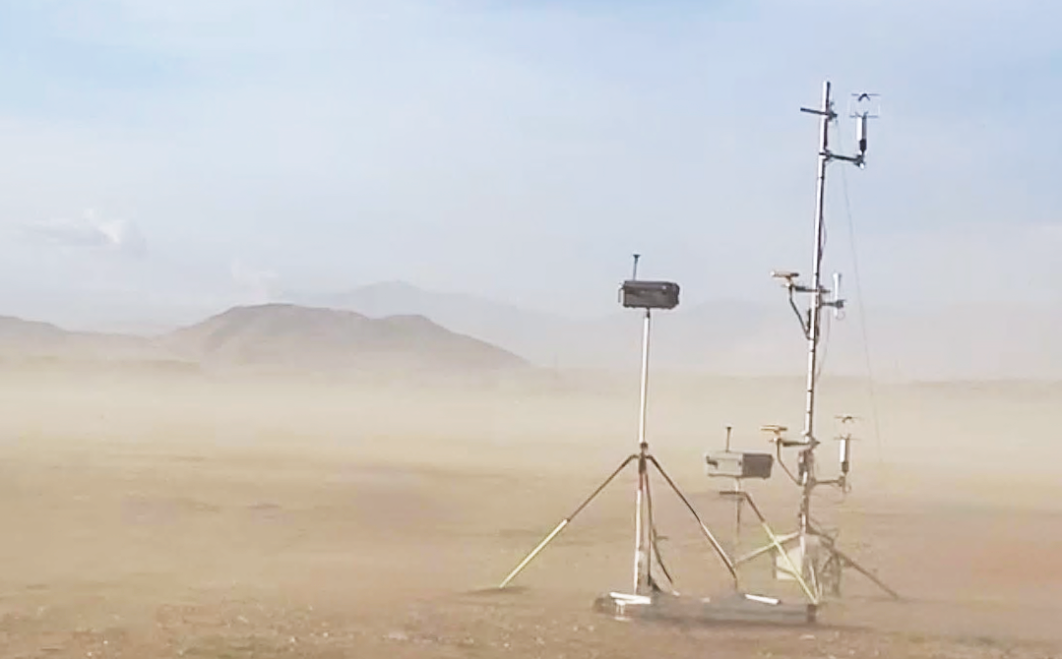








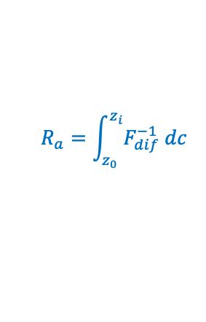





$$4.5 m$$
$$3 m$$
$$z=z_{i}$$
$$z_{i}=2.25 m$$
$$F_{0}=F_{dif}+F_{s}$$
$$dF_{0}/dz=0$$
$$1.5 m$$
$$R_{s}$$
$$R_{a}=\int_{z_{0}}^{z_{i}}{F_{dif}^{−1} dc}$$
$$z=z_{0}$$
$$R_{b}$$
$$F_{0}=F_{E}+F_{d}$$
$$z=0$$
$$z=0$$

Slide 8





$$4.5 m$$
$$z_{u}=3 m$$
$$z_{r}=2.25 m$$
$$z_{l}=1.5 m$$
$$z=0$$

Slide 9
$$4.5 m$$
$$z_{u}=3 m$$
$$z_{r}=2.25 m$$
$$z_{l}=1.5 m$$

Slide 10










$$F_{dif}$$
$$z=z_{i}$$
$$F_{s}$$
$$\frac{dF_{0}}{dz}=0$$
$$r_{a}$$
$$r_{s}$$
$$F_{E}$$
$$z=z_{0}$$
$$r_{b}$$
$$z=0$$
$$F_{D}$$

Slide 11








$$Fdiff$$
$$z=z_{i}$$
$$F_{s}$$
$$\frac{dF_{0}}{dz}=0$$
$$r_{a}$$
$$r_{s}$$
$$z=z_{0}$$
$$r_{b}$$
$$F_{E}$$
$$z=0$$
$$F_{d}$$

Slide 12


$$Fdiff$$
$${z=z}_{r}$$
$$F_{s}$$
$$\frac{dφ}{dz}=0$$
$$r_{a}$$
$$z=δ$$
$$r_{b}$$
$$F_{E}$$
$$z=0$$
$$F_{d}$$

Slide 13






$$Fdiff$$
$${z=z}_{r}$$
$$F_{s}$$
$$\frac{dφ}{dz}=0$$
$$r_{a}$$
$$z=δ_{m}$$
$$r_{b}$$
$$F_{E}$$
$$z=0$$
$$F_{d}$$

Slide 14
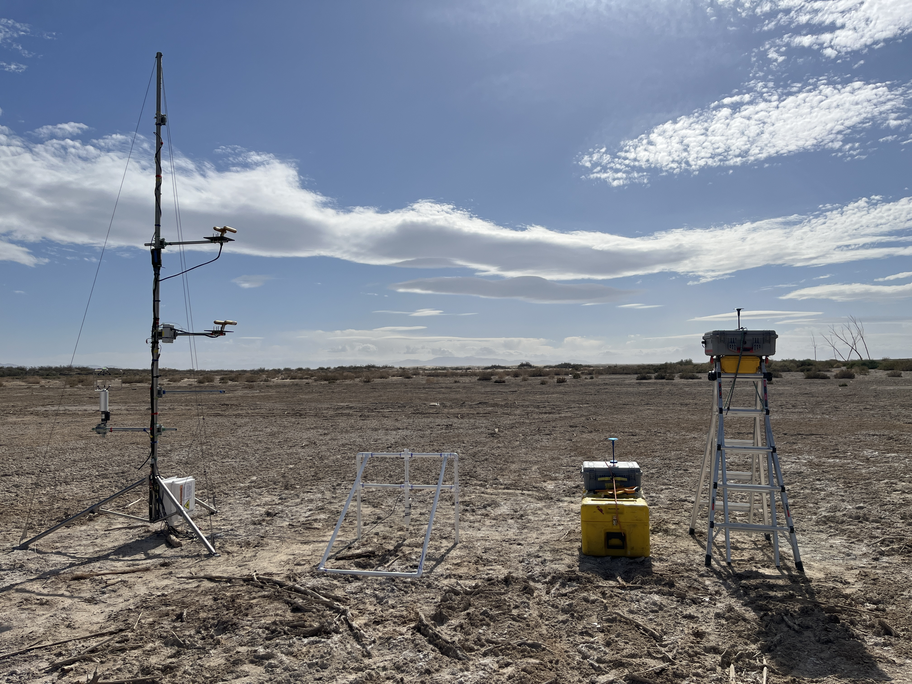
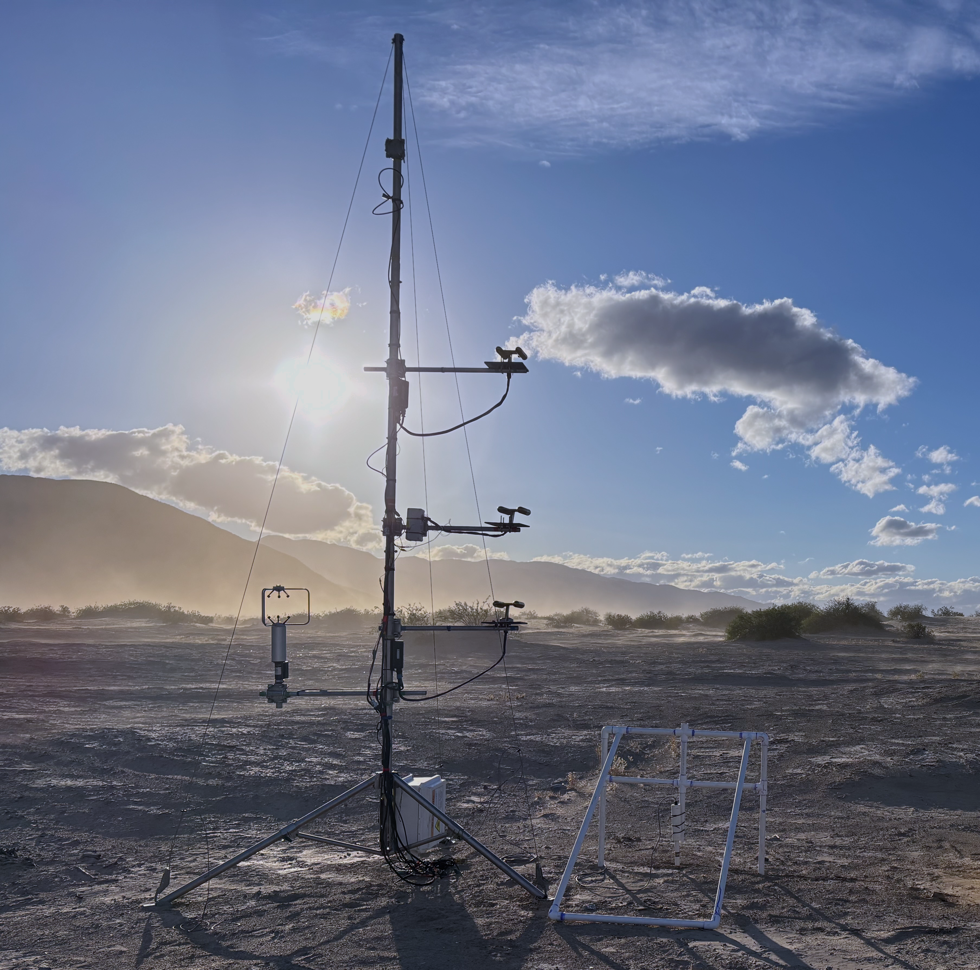



Cloud Droplet Probes
$${ z}_{u }$$
$$Fdiff$$
$${z=z}_{r}$$
$$φ=−w_{s}c\left(z_{r}\right)−K_{c}\frac{dc}{dz}$$
$$F_{s}$$
3-D sonic
anemometer
$${ z}_{l }$$
$$\frac{dφ}{dz}=0$$
$$r_{a}$$
Saltation
Sensor
$$z=δ_{m}$$
$$r_{b}$$
$$F_{E}$$
$$z=0$$
$$F_{d}$$

Slide 15
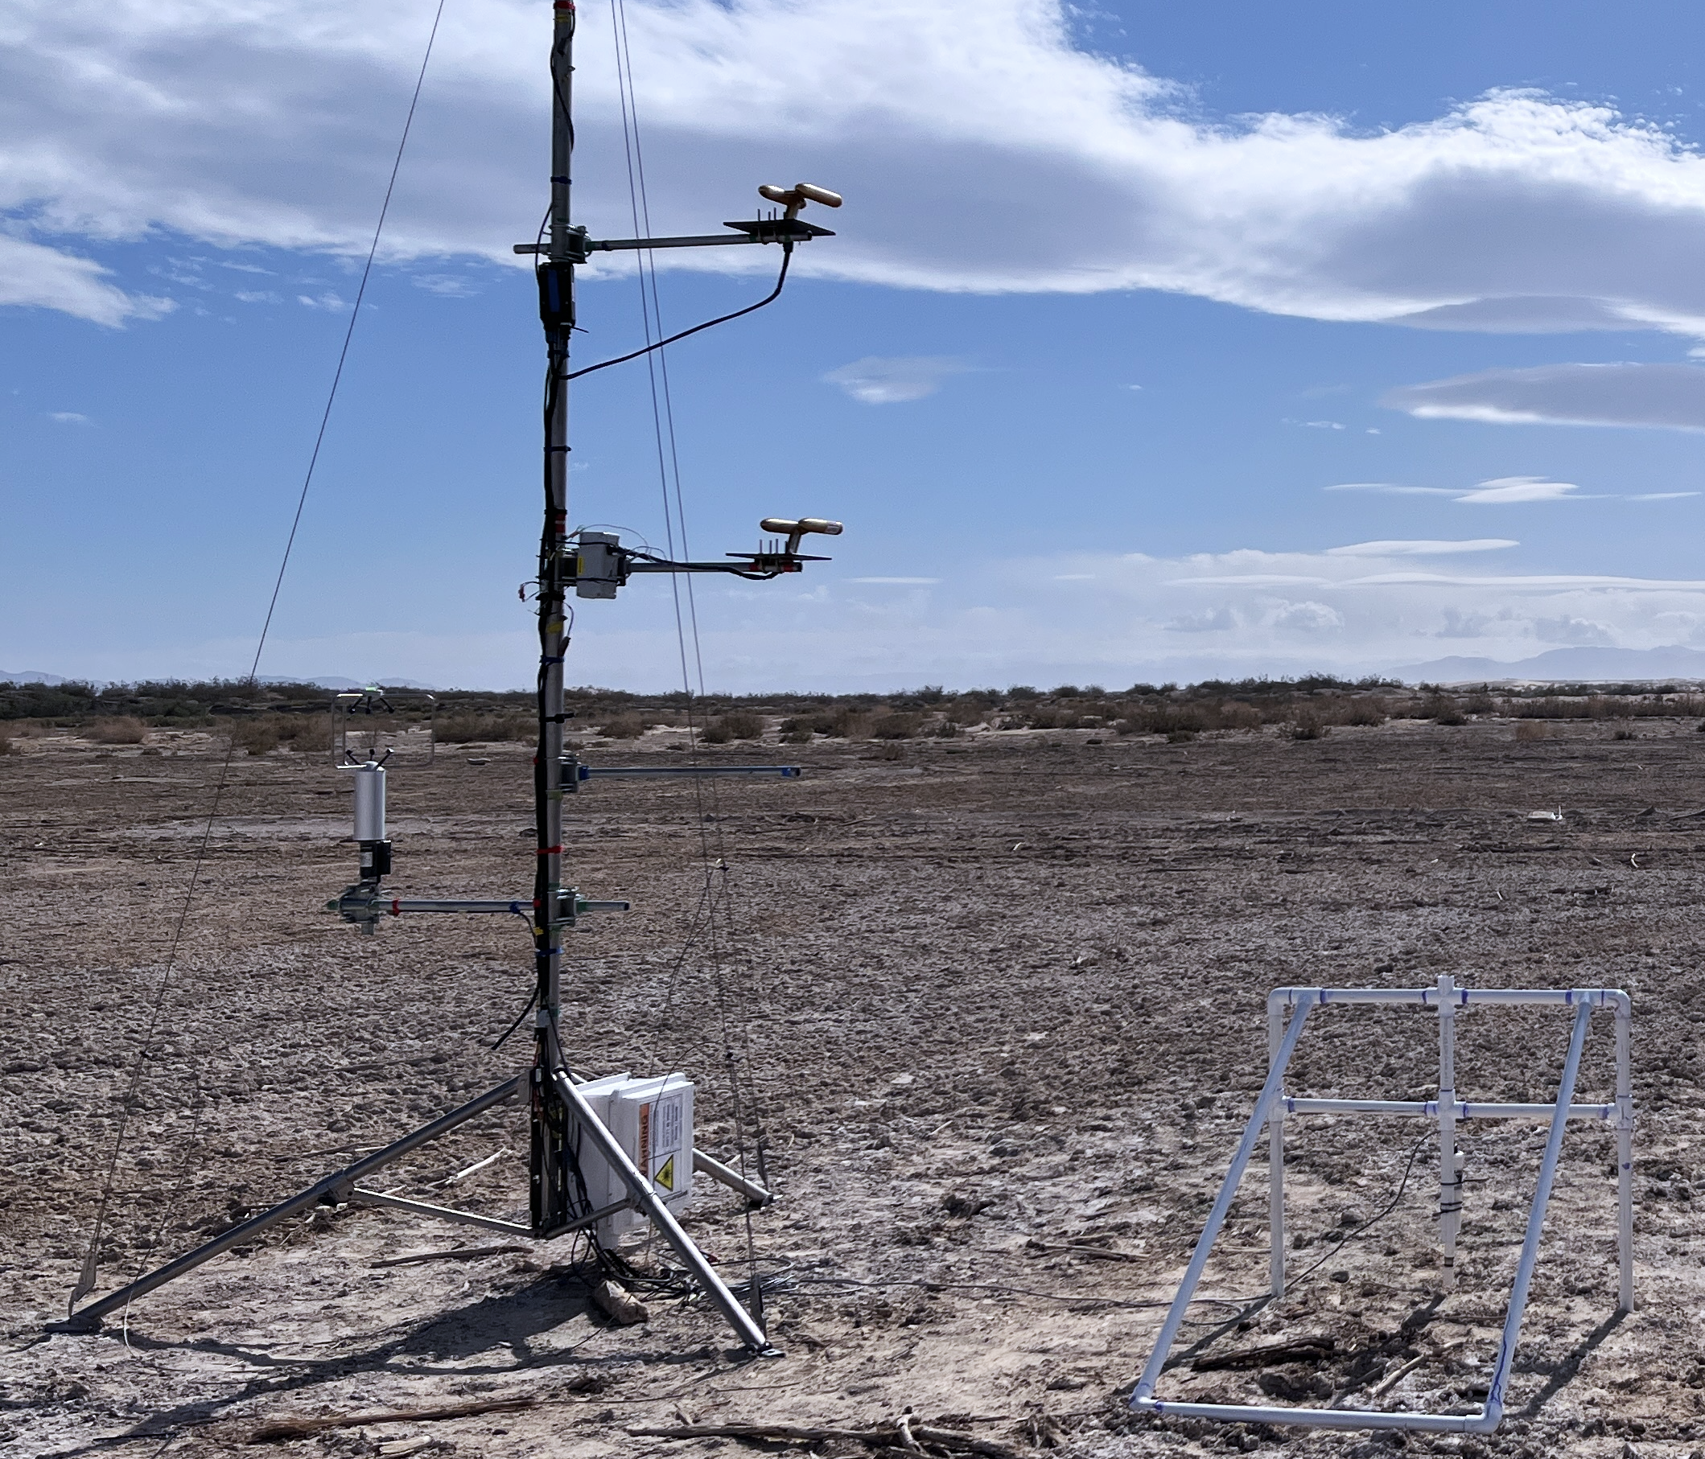

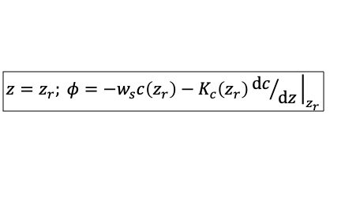


Cloud Droplet Probes
$${ z=z}_{u }$$
$$z=z_{r}; φ=−w_{s}c\left(z_{r}\right)−K_{c}\left(z_{r}\right){dc}/{dz}{\left.​\right|}_{z_{r}}$$
$${ z=z}_{l }$$
3-D sonic
anemometer
$$z=0; φ=−w_{d}(z_{r})c\left(z_{r}\right)$$
Saltation
Sensor

Slide 16
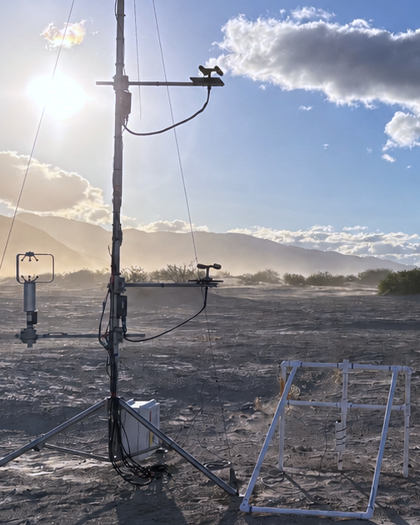







a.
b.
Cloud Droplet Probes
$${ z=z}_{u }$$
$$Fdiff$$
$${z=z}_{r}$$
$${ z_{r}=\sqrt{z_{l}z_{u}}}_{ }$$
$$F_{s}$$
$$\frac{dφ}{dz}=0$$
$${ z=z}_{l }$$
3-D sonic
anemometer
Saltation
Sensor
$$F_{d}$$
$$z=0$$

