Slide 1
How can quality break down despite school district could accurately predict enrollment?
Simulating long-term decision making and school openings and closings in a school district. C Laurin, ASU CAS 570 December 9, 2024

Slide 2
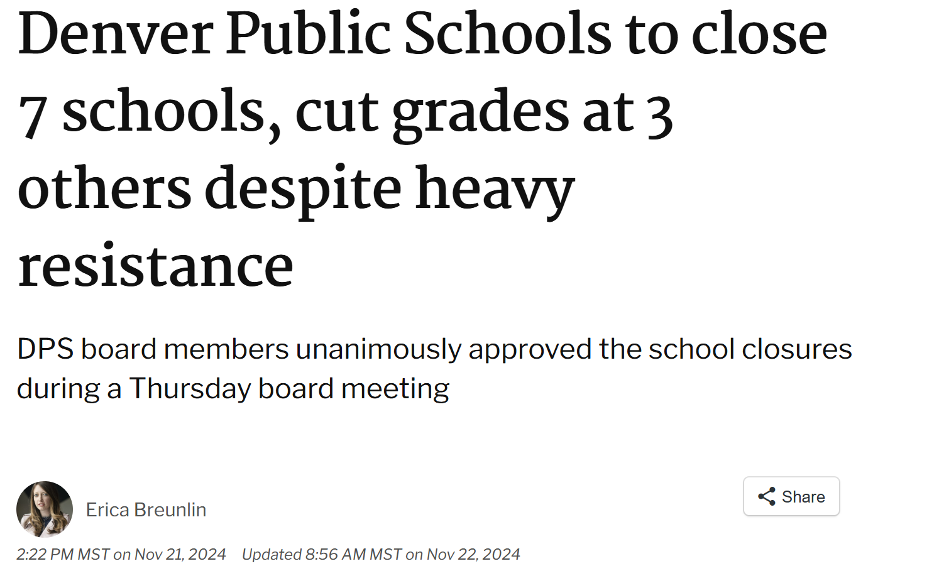
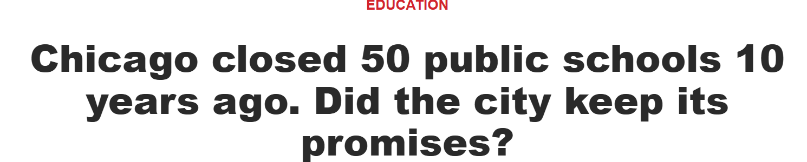
Demographic change is predictable—why do schools close suddenly?
Despite sufficient time to prepare, large school districts sometimes close several schools quickly, leading to sudden change in the quality of services available to their communities. (Denver 2024, Chicago Public 2013, Chicago Charters 2024)
Conflict with the community results; sometimes the district’s actions are found to violate students’ civil rights.
How can this be distinguished from a district genuinely trying—but failing—to accurately predict and respond to changing demographics?
Funding is a function of population—what role does budgeting play in these problems?

Slide 3
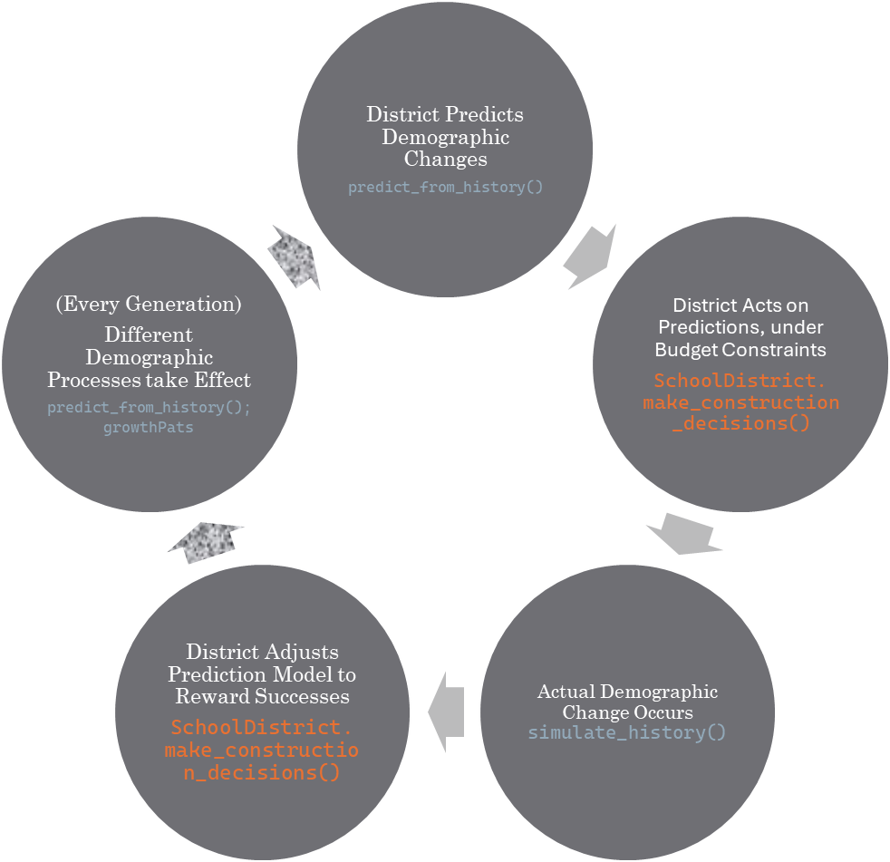
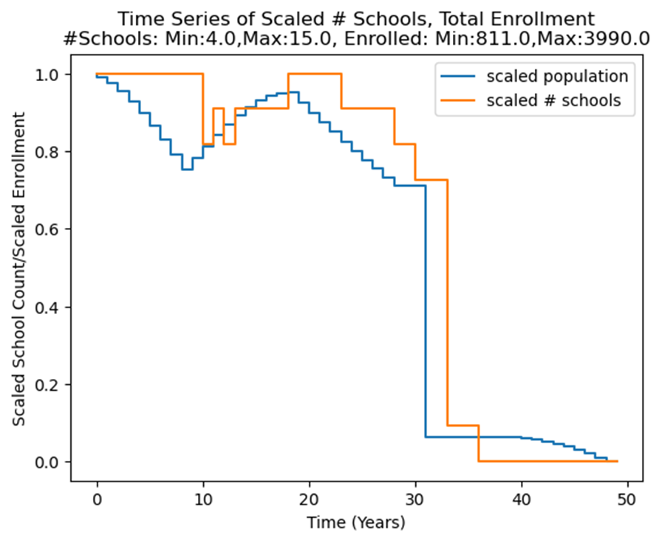
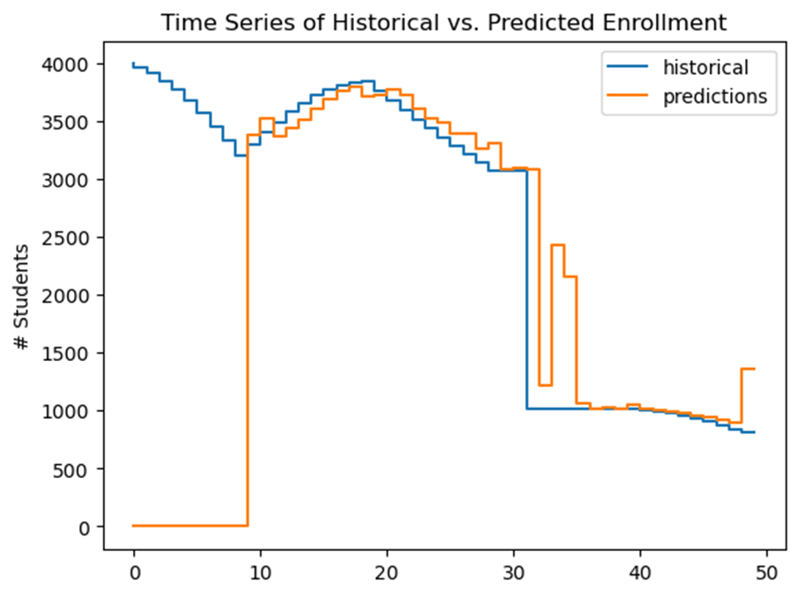
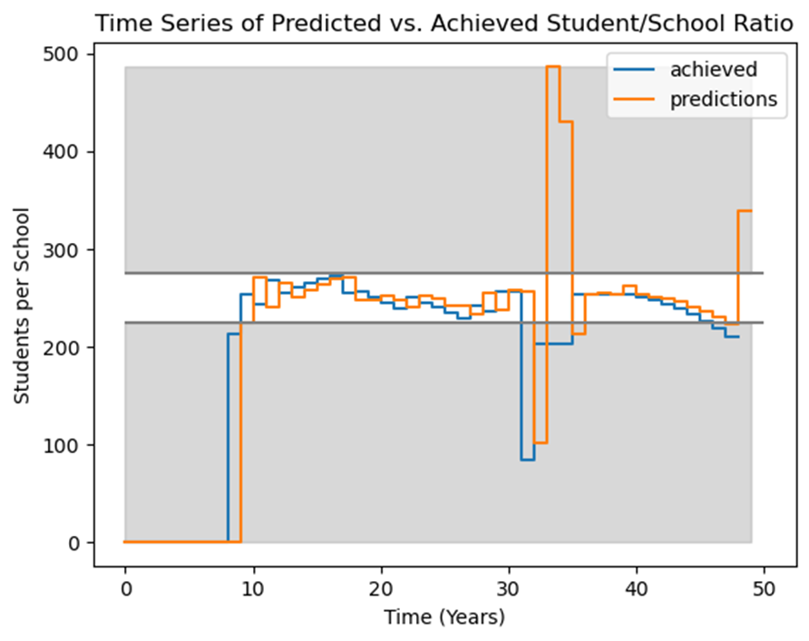
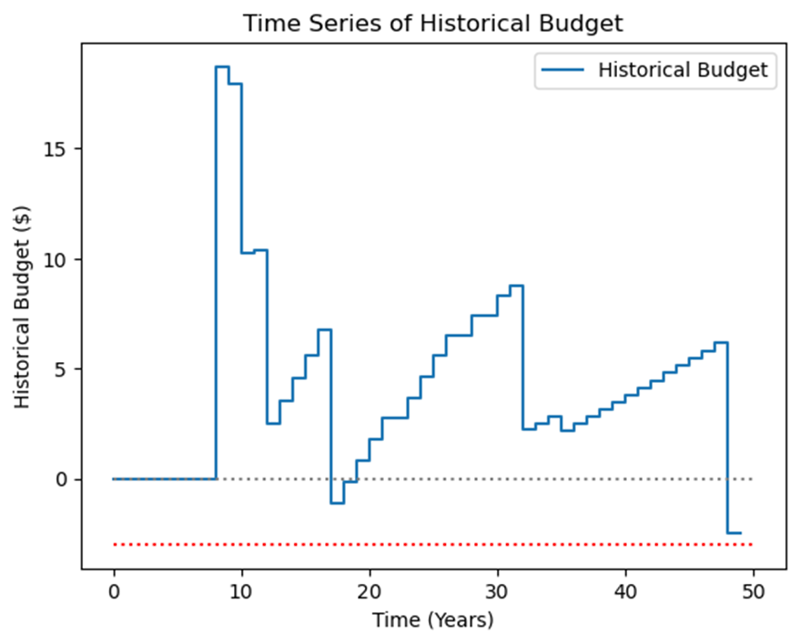
A budget-conscious, prediction-making district faces (random) growth
A two-agent model (decisionmakers, students), implemented as a Python Class

Slide 4
Budget & generational pattern: criticality?
A slight change in a growth pattern (but not # students!) led to vastly changed performance (85% to 67%)
A slight change in budget had an even larger impact (85% to 54%)

Slide 5
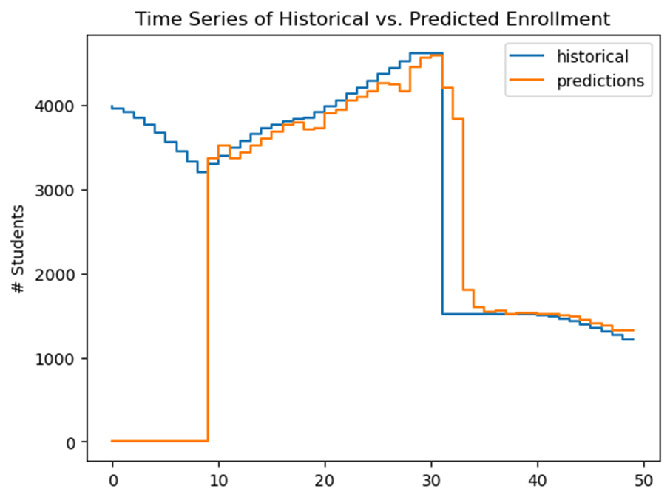
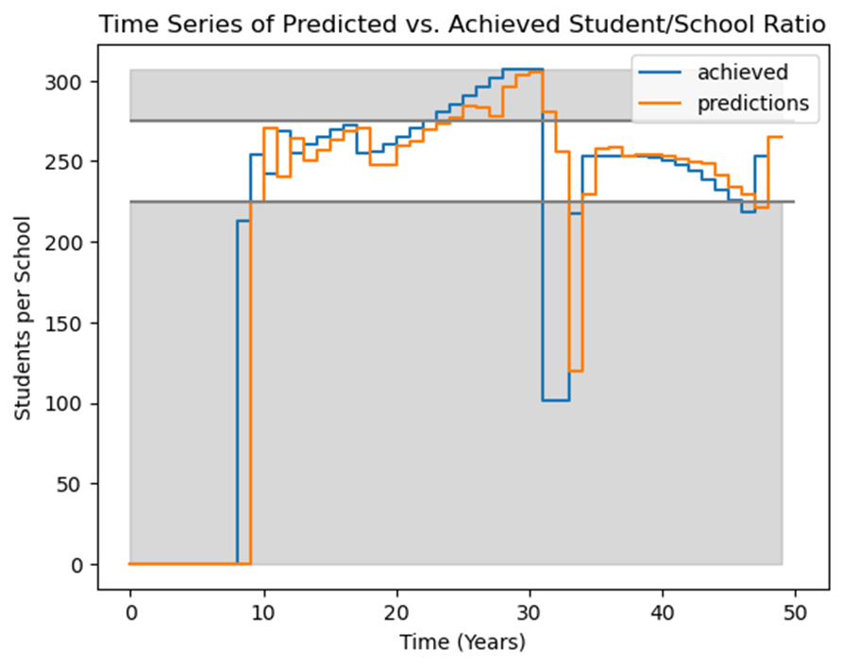
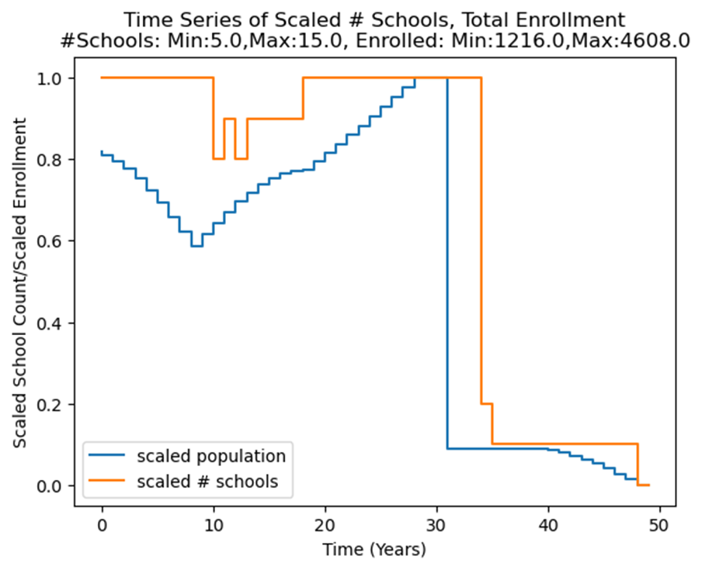
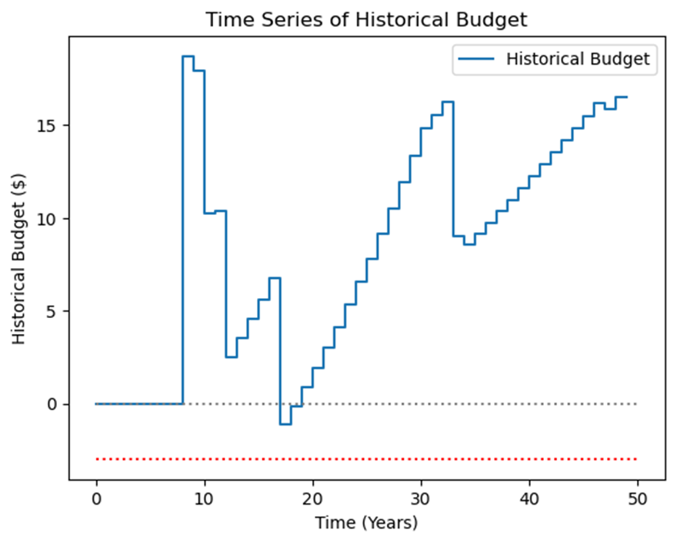
[6,5,4,2,6] -> perf 85%, r2:94%, rl: 3; budget -3.
[6,5,3,2,6]) -> perf 67%, r2 90%, rl:1; budget -3.

Slide 6
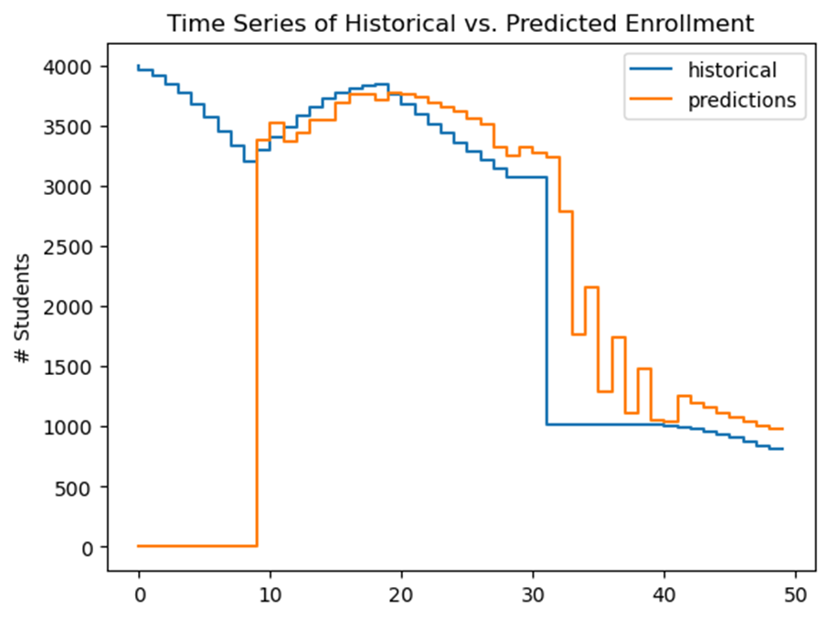
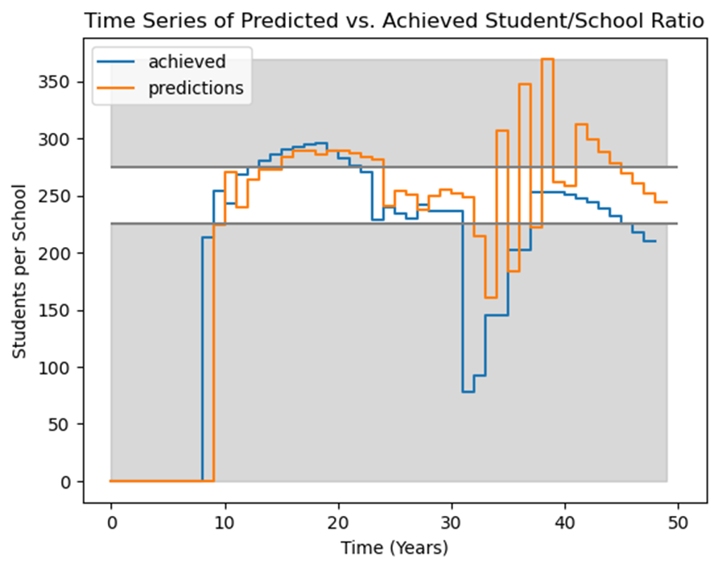
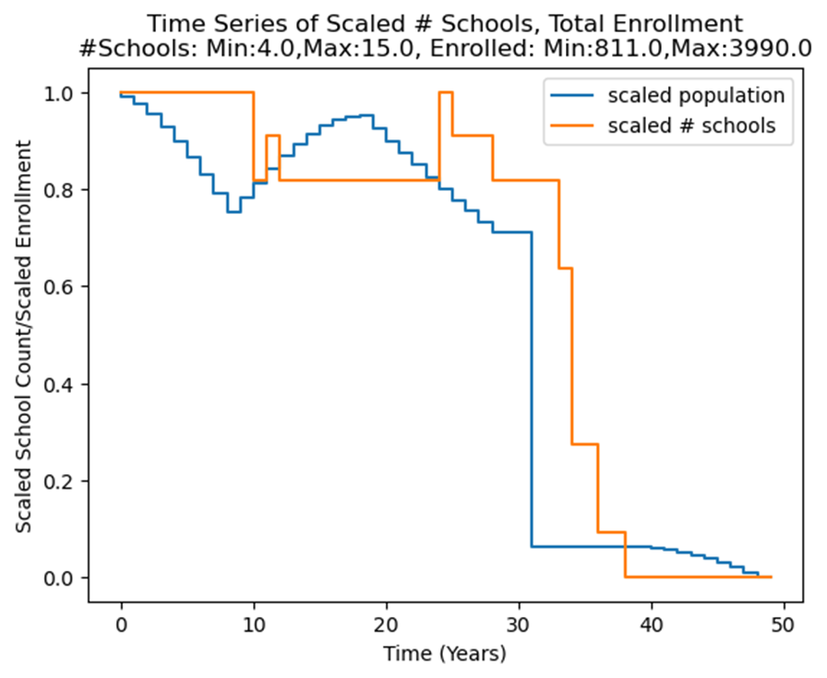
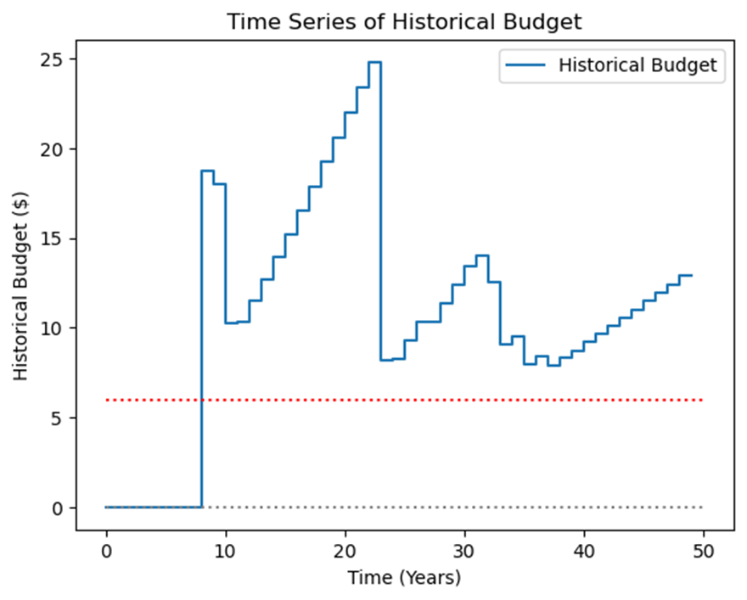
[6,5,4,2,6] -> perf 85%, r2:94%, rl: 3; budget -3.
[6,5,4,2,6]) -> perf 54%, r2 93%, rl:2; budget 6.

Slide 7
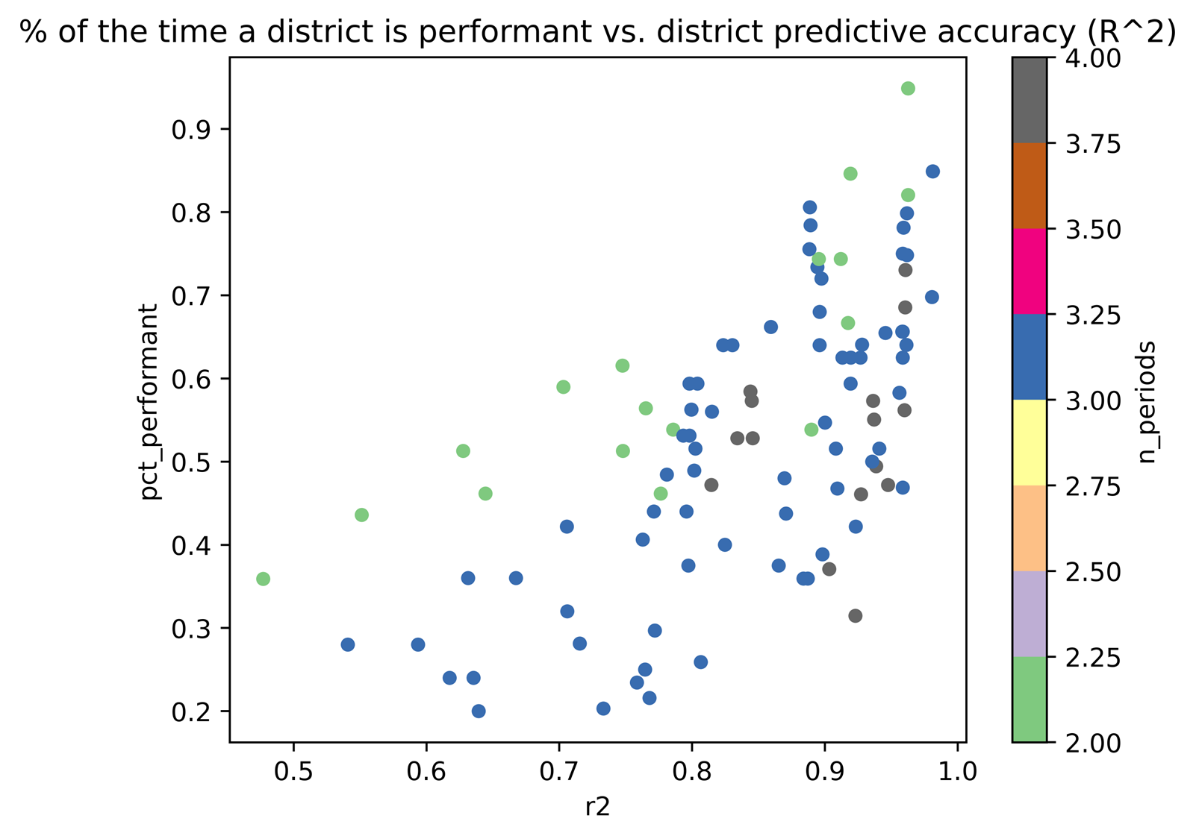
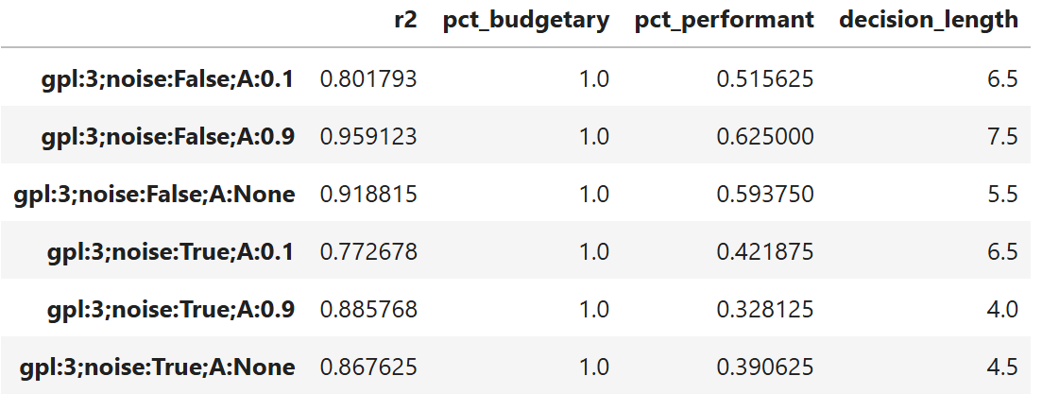
Better predictions → better results (in the short run or same pattern)
Implemented a class that varying all possible growth patterns and allowed for variability in length of total history, number of generations, presence or absence of noise.
Ran factorial experiments using percent of time student-to-school ratio was performant and time between school openings/closings (decision length)
Validated expected effects of data quality (things were better with more observations, worse when noise was added or budgets were strict)
Working on understanding the role of changing growth patterns between generations—about 60% of variance in performance, 30% in decision length was explained by main effect of patterns

Slide 8
Next question: when is it budget and which patterns are key?
A useful laboratory is under construction
The effects of noise, number of observations, and starting enrollments were as expected
There’s still a need to get into the system’s dynamics and understand scaling.
Next Steps
Empirical data analysis of decision-making trends
Process control modeling—what if students can choose to join a district based on its past community service?
Compare these simulated results, empirical data, and mathematically derived results from ruin theory.
Ruin theory comes from insurance, which deals with relatively rare but severe random changes; some modification
Continue to search for an appropriate level of coarse-graining to characterize the system

Slide 9

District Predicts Demographic Changes
predict_from_history()
(Every Generation)
Different Demographic Processes take Effect
predict_from_history(); growthPats
District Acts on Predictions, under Budget Constraints
SchoolDistrict. make_construction_decisions()
District Adjusts Prediction Model to Reward Successes
SchoolDistrict. make_construction_decisions()
Actual Demographic Change Occurs simulate_history()

