Slide 2
Our Ask
By age, gender, industry, and race, how has salary been impacted over the years.

Slide 3
Hypothesis
Roughly over the past 10 years we suspected that the Gender Gap will decrease.
Over the past 5 years, people in industries with a computer / engineering focus will have a higher income.

Slide 4
Data Retrieval Summary
Describe the data retrieval process (ie bureau of labor statistics, basketball world, data reference csv → read into dataframe → data munging → output to clean csv
API Wrapper
API Calls for data retrieval
Grab info from Read me

Slide 5
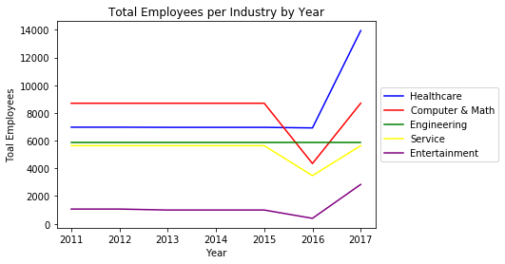

Slide 6
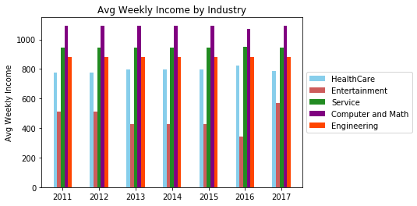

Slide 7
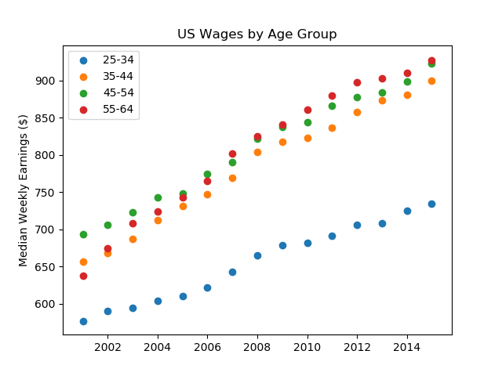

Slide 8
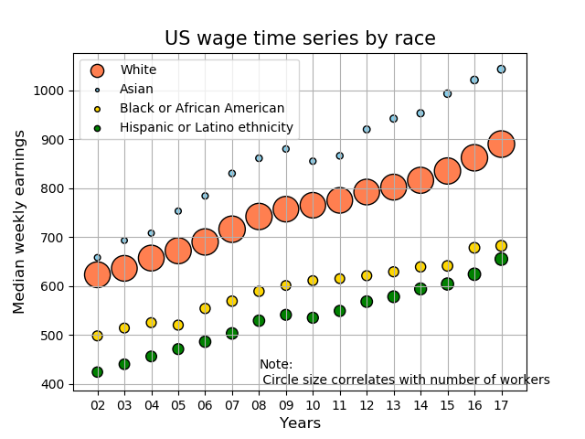

Slide 9
