Slide 2
Our Ask
By age, gender, industry, and race, how has salary been impacted over the years.

Slide 3
Hypothesis
Roughly over the past 10 years we suspected that the Gender Gap will decrease.
Over the past 5 years, people in industries with a computer / engineering focus will have a higher income.

Slide 4
Data Retrieval Summary
Describe the data retrieval process (ie bureau of labor statistics, basketball world, data reference csv → read into dataframe → data munging → output to clean csv
API Wrapper
API Calls for data retrieval
Grab info from Read me

Slide 5
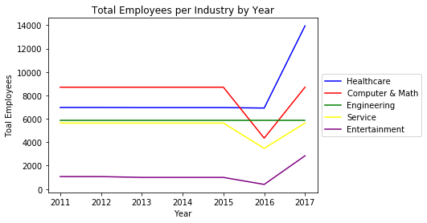

Slide 6
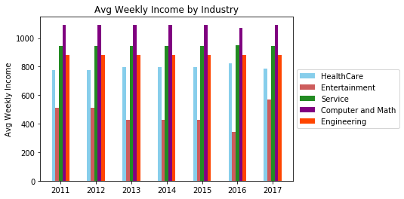

Slide 7
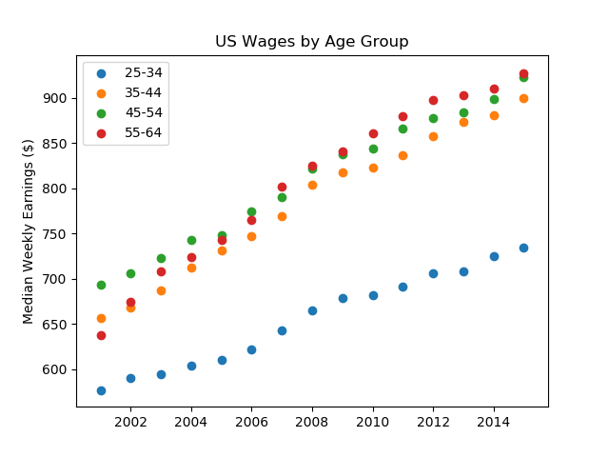

Slide 8
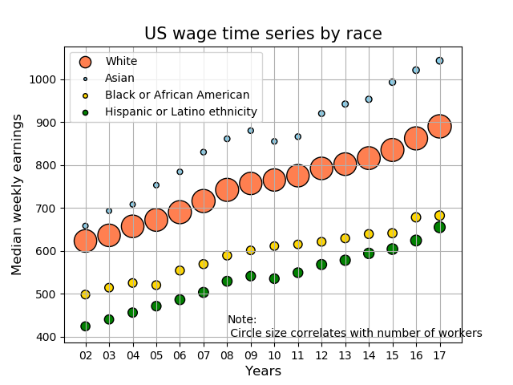
US wage by race
The general trend is increasing weekly earnings
During 2010, all races have a lower growth rate , the Asian and Hispanic or Latino groups even have a negative growth in US

Slide 9
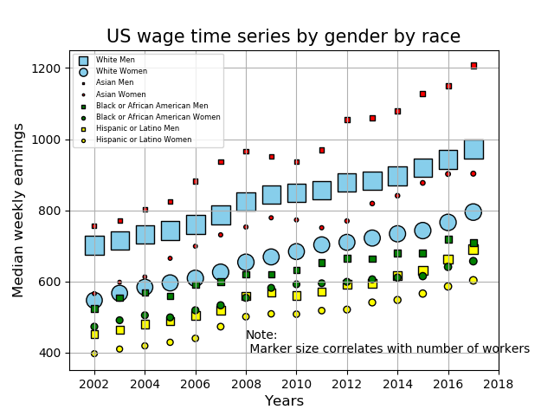
US wage by race of gender
Group of Asian men has the highest weekly earnings from 2002 to 2018 in US, it also has the maximum growth rate and lowest workers compared to other groups.
In each races, men has higher income than women in US.

