Slide 1
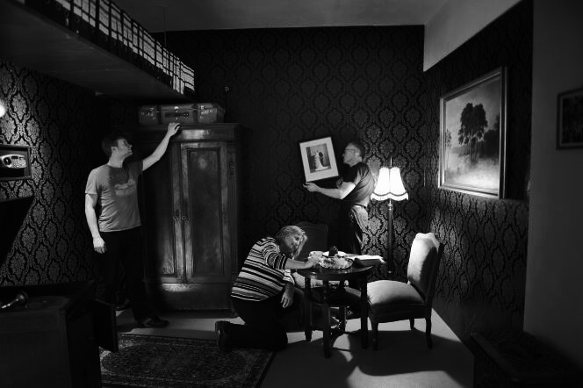
NIGHTMARE
LOCKDOWN
Escape Game
By:
Aisyah Amatul Ghina
Amir Abdul
Joel Ketu
Johana Rivas

Slide 2
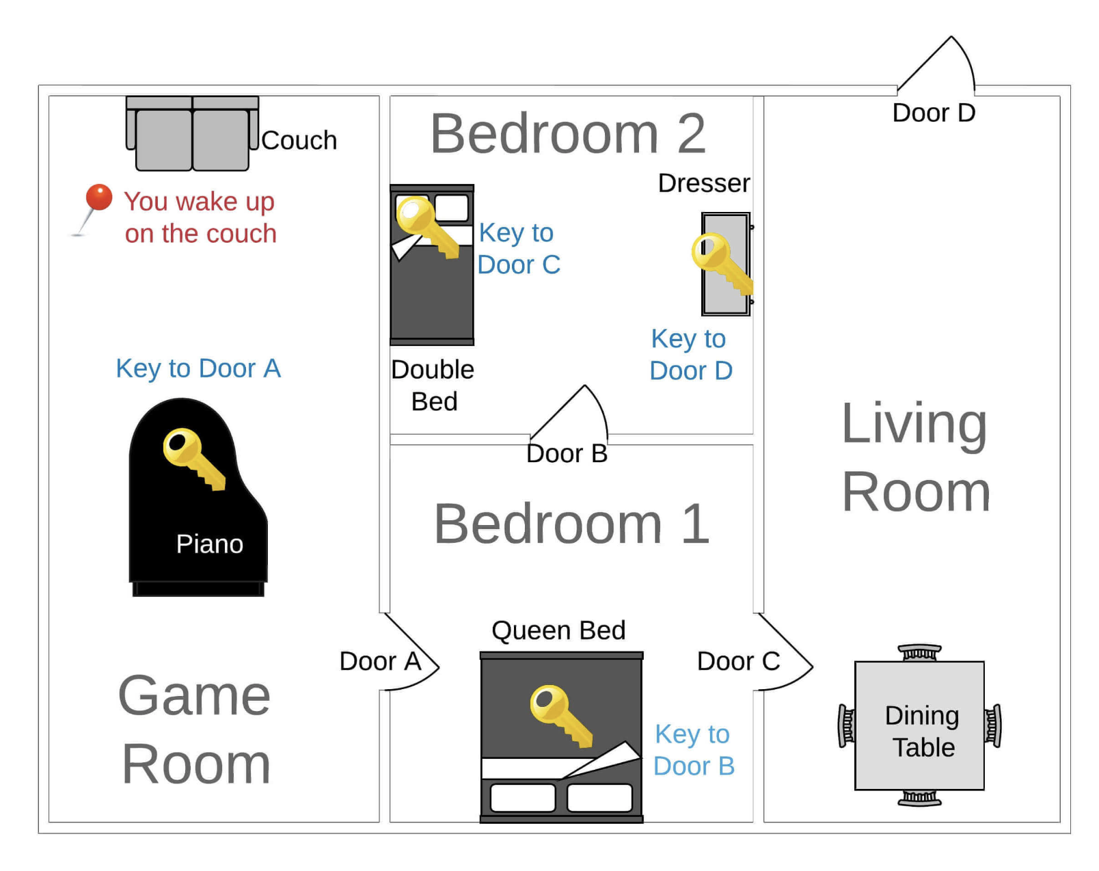
Project Overview
The Nightmare Lockdown game is designed to challenge the player's problem-solving and decision-making skills. It is set in a mysterious, windowless house, where the player must navigate through a series of interconnected rooms by finding keys and solving puzzles to escape the house.
The game flow is structured around a series of interconnected rooms (Game Room, Bedroom 1, Bedroom 2, Living Room).
Players navigate these rooms by exploring and examining different items, and using keys to unlock different doors.
Game state is maintained through dictionaries for current room status and keys collected.
Notes:
How is the game’s structure organized?
Which functions do you have and how are they imported?
Which features did you add to the game?

Slide 3
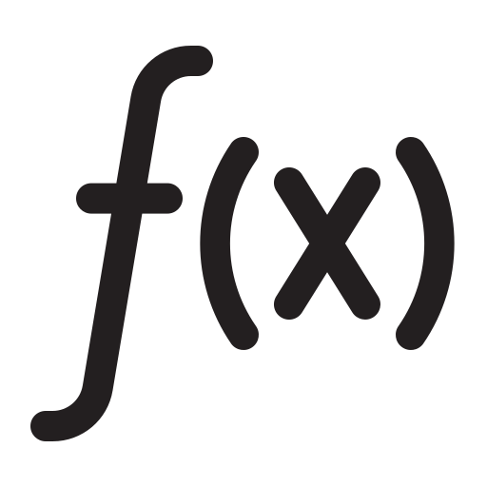

Project Overview
There are five main user-defined functions to run the game:
start_game()
  play_room(room)
    explore_room(room)
    examine_item(item_name)
      get_to_next_room_of_door(door, current_room)
Features added to the game are:
Extend dictionaries by defining more rooms and items
Extend dictionaries of object relations
Add string method .lower() on user input
Add narration of the game according to our project’s name
Notes:
start_game(): Initializes the game and introduces the player to the scenario.
play_room(room): Handles the main game loop, checking if the player has reached the final room.
explore_room(room): Lists the items available in the current room.
examine_item(item_name): Allows the player to interact with items, find keys, and unlock doors.
get_next_room_of_door(door, current_room): Determines which room a door leads to.

Slide 4


Technical challenge
Translating the game narrative from the quest brief into the game structure
Understanding how the function works on the sample_code.ipynb
Facing some errors when extending the dictionaries
Overcoming the challenge
Go through and execute each line of code within the functions to grasp the purpose of each line
Add room and item dictionaries gradually to minimize confusion and help identify any mistakes

Slide 5


Big mistake
“FAILING TO PLAN IS PLANNING TO FAIL”
Attempted to write the code without thoroughly planning the game structure, data structure, and the relationships between items and rooms.
Lessons learned
The importance of proper planning before jumping into coding. Mapping out the game’s structure, data structure, and item relationships beforehand is crucial to avoiding confusion and preventing errors.
The importance of iterative testing and refining the code gradually

Slide 6
DEMO

Slide 7
THANK YOU!
NIGHTMARE LOCKDOWN
Aisyah Amatul Ghina | Amir Abdul | Joel Ketu | Johana Rivas

