Slide 1
AutoGen-Based Multi-Agent Framework
for Crime Data Analysis and Prediction
AI-Based Intelligent System for Crime Pattern Detection
Presented by: Amatul Moula Shuva | Master's Program
AutoGen Framework
Multi-Agent System
5 ML Models
Chicago Crime Dataset
AI Project | AutoGen Crime Prediction

Slide 2
Table of Contents
01
Problem Statement
09
Model Comparison Results
02
Objectives
10
Cross-Validation
03
Dataset Details
11
Classification Report
04
Data Preprocessing
12
Feature Importance
05
System Architecture
13
Confusion Matrix
06
Agent Roles
14
Project Timeline
07
System Flowchart
15
Conclusion & Future Work
08
ML Models Used
16
References
AI Project | AutoGen Crime Prediction | 2 / 17

Slide 3
Problem Statement
Large & Complex Data
No Automation Pipeline
Chicago Crime Dataset contains 7M+ records spanning 2001–Present. Manual analysis is infeasible at this scale.
Traditional ML pipelines lack automated feedback loops. Steps (preprocess→train→evaluate) done manually without agent coordination.
Single Model Limitation
Low Prediction Efficiency
Using a single ML model gives suboptimal results. No automatic mechanism exists to compare and select the best performing model.
Without iterative improvement and cross-validation, models tend to overfit or underperform on unseen crime data.
AI Project | AutoGen Crime Prediction | 3 / 17

Slide 4
Objectives
1
Analyze Crime Patterns
Use Analysis Agent to analyze crime type distribution and temporal patterns (hour, month, day of week) from Chicago Crime Dataset.
2
Multi-Model Prediction
Predict crime type using 5 ML models: Decision Tree, Random Forest, Logistic Regression, Gradient Boosting, and XGBoost.
3
Automated Model Selection
Automatically compare all models and select the best-performing one based on test accuracy — without manual intervention.
4
Cross-Validation
Apply 5-Fold Stratified Cross Validation to confirm model stability and prevent overfitting on the crime dataset.
5
Automated Reporting
Generate comprehensive evaluation reports automatically using ReportAgent — including metrics, charts, and summaries.
AI Project | AutoGen Crime Prediction | 4 / 17

Slide 5
Dataset Details
50,000
14
2001–2024
3
Sampled Records
Feature Columns
Time Span
Target Classes
Dataset Info
Features Used
Source: Chicago Crime Dataset (2001–Present)
Latitude, Longitude
Sample Size: 50,000 records (random_state=42)
Hour, Month, DayOfWeek, Year
After cleaning (dropna): ~46,680 records
IsWeekend (engineered)
Target Variable: Crime Type (3 classes)
Arrest (boolean)
Top 3 Classes: THEFT, BATTERY, CRIMINAL DAMAGE
Location Code (label encoded)
Train/Test Split: 80% / 20% (stratified)
Beat, District, Ward, Community Area
AI Project | AutoGen Crime Prediction | 5 / 17

Slide 6
Data Preprocessing
Step 1
Load Data
Step 5
Feature Engineering
data_agent.load_data('Crimes_-_2001_to_Present.csv')
Hour, Month, DayOfWeek, Year extracted. IsWeekend = 1 if DayOfWeek ≥ 5
Step 2
Sample
Step 6
Filter Top 3 Crimes
df.sample(50000, random_state=42)
THEFT (9594), BATTERY, CRIMINAL DAMAGE selected
Step 3
Select Columns
Step 7
Label Encoding
11 key columns: Date, Primary Type, Lat, Lon, Arrest, Location Desc, Domestic, Beat, District, Ward, Community Area
Location Code = LabelEncoder(Location Description). Crime_Type = LabelEncoder(Primary Type)
Step 4
Drop Nulls
Step 8
Scaling
df.dropna() applied twice — before and after datetime conversion
StandardScaler applied to all 14 features before model training
AI Project | AutoGen Crime Prediction | 6 / 17

Slide 7
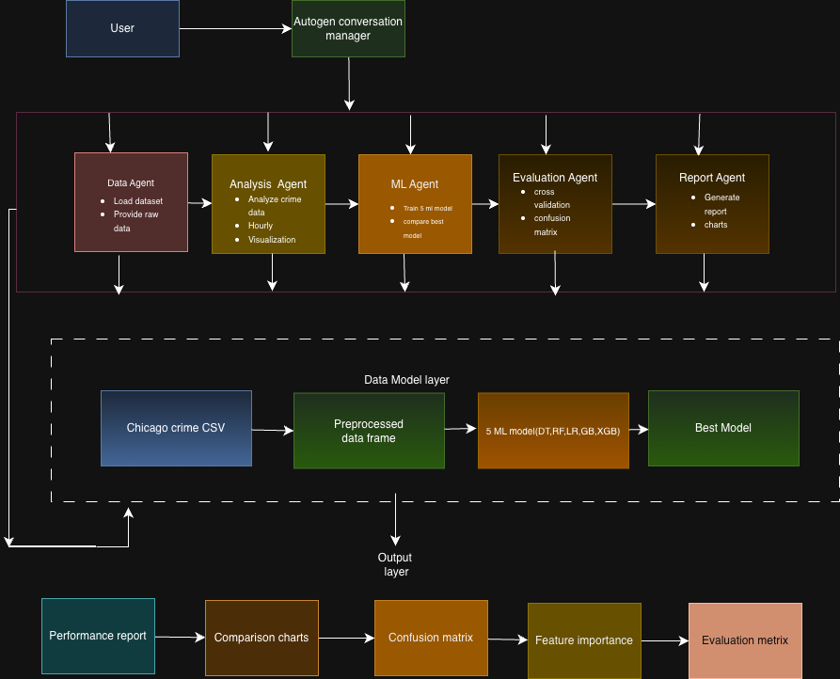
System Architecture

Slide 8
Agent Roles & Responsibilities
Data Agent
Loads Chicago Crime CSV via load_data(). Handles file I/O and returns the raw Data Frame to main pipeline.
data_agent.py
Analysis Agent
Runs analyze_crime_types(df) and analyze_by_hour(df) — generates crime distribution and hourly pattern charts.
analysis_agent.py
MLAgent
Trains all 5 models: Decision Tree, Random Forest, Logistic Regression, Gradient Boosting, XGBoost. Selects best automatically.
ml_agent.py
Evaluation Agent
Runs 5-Fold Stratified Cross Validation on best model. Computes accuracy_score, confusion matrix, classification report.
evaluation_agent.py
ReportAgent
Calls generate_report(df) — outputs final crime data report with top crime types, stats, and summary metrics.
report_agent.py
AI Project | AutoGen Crime Prediction | 8 / 17

Slide 9
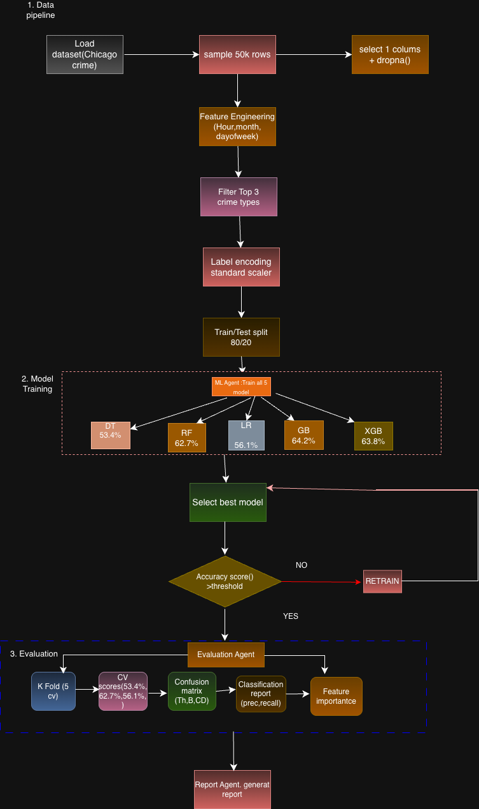
Project Workflow

Slide 10
ML Models Used
Decision Tree
DecisionTreeClassifier
Simple tree-based classifier. Splits data by best feature at each node. Fast but prone to overfitting.
Random Forest
RandomForestClassifier
Ensemble of 300 decision trees. Reduces overfitting via bagging and feature randomness.
Logistic Regression
LogisticRegression
Linear model for multi-class classification. Fast training, good baseline. Limited for non-linear patterns.
Gradient Boosting ★
GradientBoostingClassifier
Builds trees sequentially — each corrects errors of the previous. BEST accuracy: 64.2%.
XGBoost
XGBClassifier
Optimized gradient boosting with regularization. eval_metric=mlogloss. Close to Gradient Boosting.
AI Project | AutoGen Crime Prediction | 10 / 17

Slide 11
Model Comparison Results
Decision Tree
53.4%
Random Forest
62.7%
Logistic Regression
56.1%
Gradient Boosting ★ BEST
64.2%
XGBoost
63.8%
✓ Best Model: Gradient Boosting Classifier | Test Accuracy: 64.2% | All models trained on same 80/20 stratified split
AI Project | AutoGen Crime Prediction | 11 / 17

Slide 12
Cross-Validation Results
Avg: 64.25%
5-Fold Stratified Cross-Validation | Best Model: Gradient Boosting Classifier
67%
▲ BEST
66%
65.70%
65%
64.14%
64.12%
64%
▼ MIN
63.58%
63.70%
63%
Fold 1
Fold 2
Fold 3
Fold 4
Fold 5
64.25%
65.70%
63.58%
0.83%
Average CV Accuracy
Best Fold Score (F2)
Lowest Fold Score (F4)
Variance (Std Dev)
AI Project | AutoGen Crime Prediction | 12 / 17

Slide 13
Classification Report
Accuracy: 64%
Best Model: Gradient Boosting Classifier | Test Set: 4,668 samples | 3-class crime type classification
BATTERY
CRIMINAL DAMAGE
THEFT
Precision
0.75
Precision
0.48
Precision
0.62
Recall
0.69
Recall
0.32
Recall
0.78
F1-Score
0.72
F1-Score
0.38
F1-Score
0.69
Support: 1,693 | Correct: 1170
Support: 1,056 | Correct: 334
Support: 1,919 | Correct: 1493
Precision
Recall
F1-Score
Support
accuracy
0.64
4,668
macro avg
0.62
0.60
0.60
4,668
weighted avg
0.63
0.64
0.63
4,668
AI Project | AutoGen Crime Prediction | 13 / 17

Slide 14
Feature Importance & Confusion Matrix
Feature Importance (Gradient Boosting)
Confusion Matrix Values
Domestic
40.1%
Pred BAT
Pred CD
Pred THF
Location Code
26.9%
Longitude
6.3%
Act BAT
1170
142
381
Latitude
6.2%
Hour
5.7%
Arrest
3.4%
Act CD
190
334
532
Beat
2.4%
Year
2.3%
Act THF
201
225
1493
Ward
1.7%
Community Area
1.4%
Month
0.9%
Diagonal = correct predictions.
THEFT (1493) and BATTERY (1170) classified well.
CRIMINAL DAMAGE (334) shows most confusion.
DayOfWeek
0.5%
District
0.3%
IsWeekend
0.2%
Key Insight: 'Domestic' flag is the strongest predictor (40.1%) — domestic crimes have very distinct patterns. Location Code (26.9%) ranks 2nd.
AI Project | AutoGen Crime Prediction | 14 / 17

Slide 15
Project Timeline
Week 1–2
Week 5–6
Week 9–10
Problem
Definition
Preprocessing
Evaluation
Week 3–4
Week 7–8
Week 11–12
Dataset
Collection
Model
Development
Documentation
Identified problem, studied existing solutions, defined objectives
Found Chicago Crime Dataset, analyzed features & data structure
Removed nulls, extracted hour/day/month, encoded categories
Implemented DT, RF, LR, Gradient Boosting, XGBoost models
Cross Validation, Confusion Matrix, model comparison, feature importance
Project report, presentation, final review
AI Project | AutoGen Crime Prediction | 15 / 17

Slide 16
Conclusion & Future Work
Conclusion
Future Work
Built a 5-agent AutoGen framework: Data Agent, Analysis Agent, MLAgent, Evaluation Agent, ReportAgent
Integrate Deep Learning (LSTM, Transformer) for temporal crime sequence prediction
Compared 5 ML models — Gradient Boosting achieved best accuracy: 64.2% on test set
Real-time crime data streaming via Chicago Open Data API
5-Fold Stratified CV confirmed stable performance: avg 64.25% across all folds
Expand to multi-city datasets for generalized crime prediction models
'Domestic' flag (40.1%) and Location Code (26.9%) are top predictors of crime type
Interactive GIS dashboard for law enforcement visualization
Thank You

Slide 17
References
1
Chicago Data Portal
'Crimes – 2001 to Present.' City of Chicago Open Data. https://data.cityofchicago.org/
2
Wu, Q. et al. (2023)
'AutoGen: Enabling Next-Gen LLM Applications via Multi-Agent Conversation.' Microsoft Research. arXiv:2308.08155
3
Breiman, L. (2001)
'Random Forests.' Machine Learning, 45(1), 5-32. Springer.
4
Friedman, J.H. (2001)
'Greedy Function Approximation: A Gradient Boosting Machine.' Annals of Statistics, 29(5), 1189-1232.
5
Chen & Guestrin (2016)
'XGBoost: A Scalable Tree Boosting System.' KDD 2016. arXiv:1603.02754
6
Scikit-learn Developers
'Scikit-learn: Machine Learning in Python.' (2024). https://scikit-learn.org/
AI Project | AutoGen Crime Prediction | 17 / 17

