Slide 1

PRESENTATION ON INDUSTRIAL ATTACHMENT
TRIBHUWAN UNIVERSITY
INSTITUTE OF ENGINEERING
PULCHOWK CAMPUS
MEMBERS:
ADITYA AMATYA(072BME603)
NABIN NEUPANE(072BME623)
SANJEEB PAUDEL(072BME637)
UJWAL DHAKAL(072BME649)

Slide 2
OUTLINE OF THE PRESENTATION

Slide 3

Background:
Dairy Development Corporation(DDC)
Established in 2026 B.S.
One of the leading dairy product manufacturer of the country
Nationwide coverage
Annual 60 million liters of milk collection

Slide 4
Objectives of DDC:
To provide a guaranteed market for milk to the rural farmers with fair price.
To supply pasteurized milk and milk products to urban consumers.
To develop organized milk collection system to meet increasing demand for pasteurized milk and milk products.
To develop an organized marketing system for milk and milk products in urban areas.

Slide 5
Flow Network:
Farmers
Collection Centers
Chilling Centers
Processing Plants
Market

Slide 6


Objectives of Industrial Attachment:
To visit and work in different kinds of industries in the country

Slide 7

Objectives of Industrial Attachment:
To study the existing management system and technology of that industry

Slide 8
Organizational Structure:
Board of Directors
Internal Audit Section
General Manager
Projects
Internal Audit Examination
Planning
Quality Control
Marketing Management
Management
Finance
Production Management
Training
Technology Division
Marketing
Human Resource
Assets
Technical
Computer Section
Sales
Purchase
Budget
Management
Internal Management
Economic Analysis

Slide 9
Plant Layout:
S.N. | Description | S.N. | Description | S.N. | Description
1 | Main Gate | 11 | Deep Freeze | 21 | Butter Production Room
2 | Guard House | 12 | Bike Stand | 22 | Milk Cold Storage
3 | Clinic | 13 | Ghee Section | 23 | Butter Cold Storage
4 | Changing Room and Toilet | 14 | Boiler Room | 24 | Butter Packing
5 | Bike stand | 15 | Power Control Room | 25 | Milk Production
6 | Oil Storage Tank | 16 | Total Store Room | 26 | Administration
7 | Guard House | 17 | Compressor Room | 27 | Garden
8 | Canteen | 18 | Workshop | 28 | Auto Workshop
9 | Water Treatment Plant | 19 | Engineering and Maintenance | 29 | Fresh Milk Unit
10 | Evaporator | 20 | Butter Cold Storage Room | 30 | Generator Section
9

Slide 10
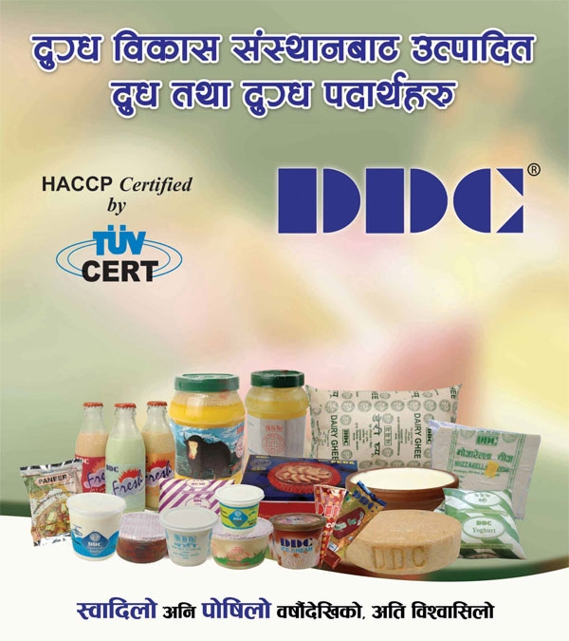
Products Manufactured From Kathmandu Milk Supply Scheme (KMSS):
Pasteurized Milk
Butter
Ghee
Flavored Milk
Curd

Slide 11

Pasteurized Milk:
Milk Reception from chilling centers
Immediate Holding
Filling
Cooling/ Refrigeration
Distribution
Filtration and Cooling
Preheating to 40⁰C
Cream Separation at 40-45⁰C
Standardization
Homogenizer
Pasteurization at 76⁰C/15sec
Cooling

Slide 12
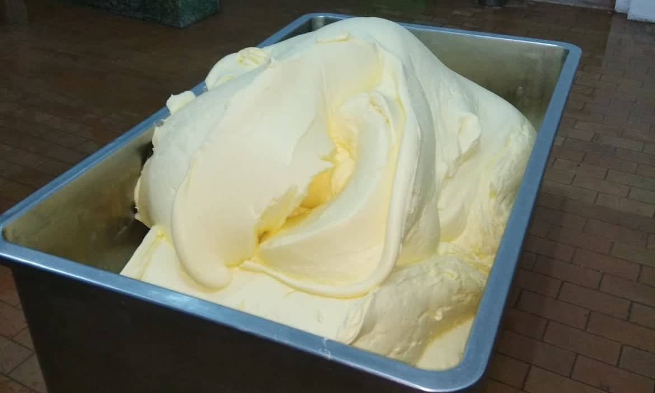
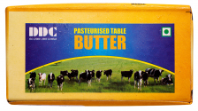
Butter:
Testing
Sampling
Milk Reception from chilling centers
Distribution
Cream Separation (Centrifugal)
Cream
(35-50% fat)
Pasteurization
(82-88⁰C, few sec)
Cooling (5-10⁰C)
Churning
(9-11⁰C, 45-75 min)
Check and Balance of Moisture Content
Packaging and Storage
(-10 to -20⁰C )

Slide 13
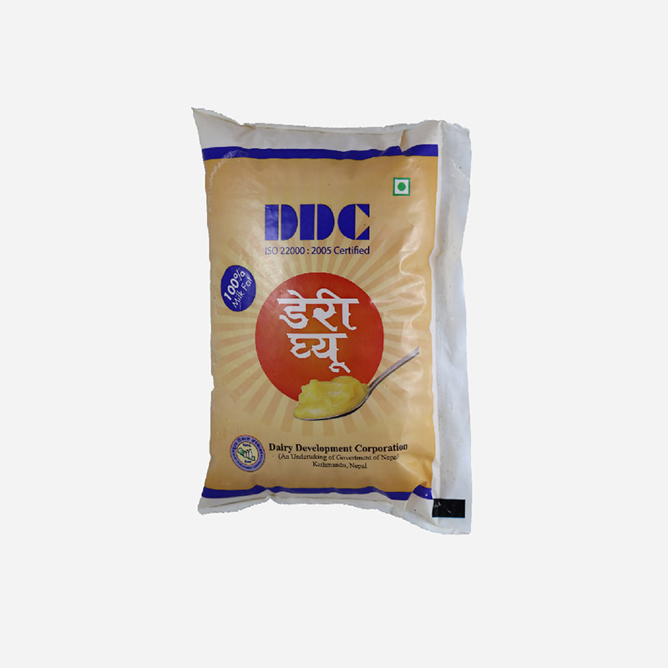
Ghee:
Purchase of Plastic
Quality Control
Receiving Butter
Clarification
Storage in Tank
Filling at 45⁰C
Ghee Melting VAT
Melting at 80⁰C
Ghee Stratification
Holding
Draining
Boiling at 110⁰C
Filtration
Storage

Slide 14

Flavored Milk:
Recollecting Bottles
Dipping in Chemical Solution
Brushing
Machine Cleaning
Store Facing Downwards
Inspection
Receiving Milk
Inspection
Sterilization at 121⁰C, 20 min
Storage
Distribution
Test (COB, Alcohol)
Cooling at 5⁰C
Addition of sugar, color and flavor
Mixing by agitation
Transfer in Reservoir
Filling in Bottles
Crowning
Cooling at room temperature
Labeling

Slide 15
Steam Production:
Boilers:
Fire Tube Boiler
Steam Distribution Center
Capacity: 2000 kg/hour
2-6.5 bar pressure
88% Efficient

Slide 16
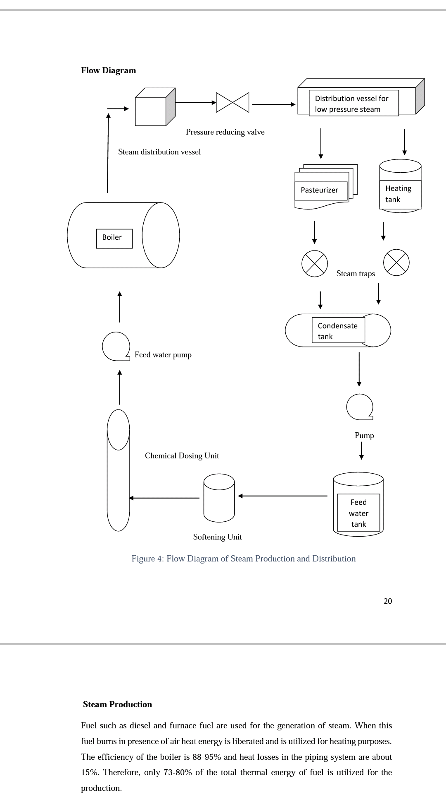
Steam Distribution Flow Diagram:

Slide 17
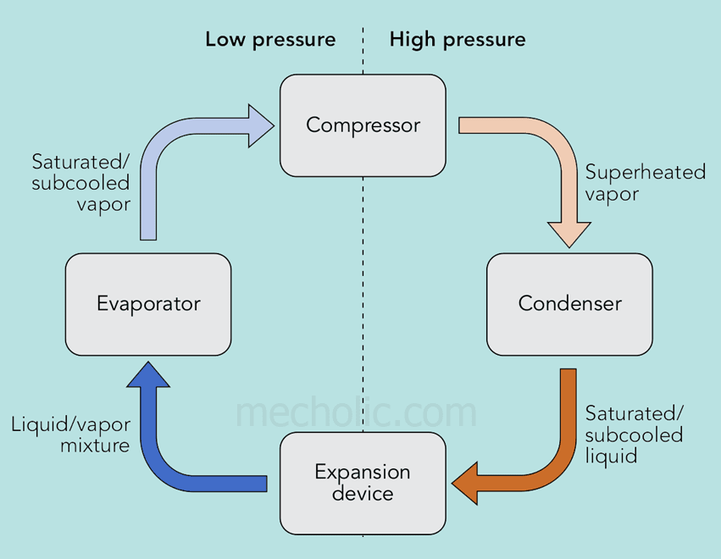
Refrigeration System:
Needs of Refrigeration System:
Cooling of Milk
Storage of Ghee and Butter
Pasteurization of milk and Cream
Refrigerant Used:
R22 (Chlorodifluoromethane)
Ozone Depletion Potential (ODP)
Global Warming Potetial (GWP)
Vapor Compression Refrigeration Cycle

Slide 18

Maintenance Crew:
Maintenance works are carried under production management section
Technical Engineers, foremen and workers are present for maintenance works

Slide 19
Frequent need of Maintenance works:
Bearings and washers of RMC Packaging Machine
Pipes joints leaks
Compressor oil leakage
Conveyor Stoppage

Slide 20
Breakdown Maintenance of Compressor:
Problem Statement:
Fast decrease in level of refrigerant in the system resulting in disrupted cooling of butter storage
Diagnosis:
Oil leakage due to misalignment of compressor shaft

Slide 21
Breakdown Maintenance of Compressor:
Solution Adopted:
Replacement of the Compressor unit with a new one

Slide 22
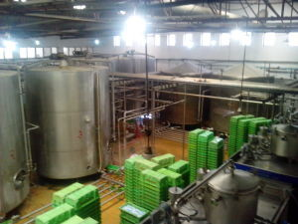
Task Assigned:
We were assigned to design a effective layout of the Conveyor system to carry packaged milk from packaging machines to the cold storage

Slide 23
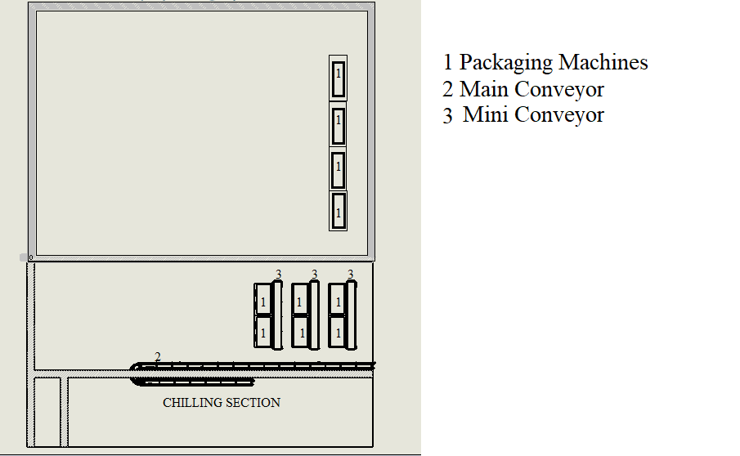
Necessity of the task:
There was no conveyor for moving the milk packaged by the RMC packaging machines to the cold storage
Man-pushed trolley of crates were being used

Slide 24
Proposed Layout:
3
3
3
1
1
2
Cold Storage

Slide 25
Solidworks Model:

Slide 26
Experienced actual industrial environment
Were familiarized with the existing management system of the industry
Were familiarized with the technology of the industry

Slide 27
Internship at one of the biggest dairy manufacturers of the nation was a matter of pride
Observation of real life working situations helped a lot in learning
Objectives of the industrial attachment were met

Slide 28
S.N | References
1. | Caldwell, G. (2003). The Small-Scale Diary.NR Press.
2. | Goff, G.H. (2009). The Diary Science and Technology Book. Canada: Guleph University Press.
3. | Chandan, R.C, & Kilara, A. (2011). Dairy Ingredients and Food Processing. Kerala: Scott Press.
4. | Mahajan, M. (2014). Industrial Engineering and Production Management.
5. | http://www.indianboilers.com/oil-and-gas-fired-fully-wetback-boiler.php
6. | http://www.dairydev.com.np/list/Kathmandu-Milk-Supply-Scheme-(KMSS)/32/103/0

