Slide 2
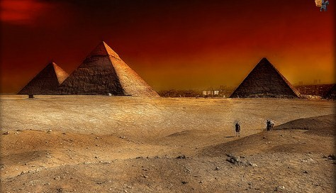

Slide 3
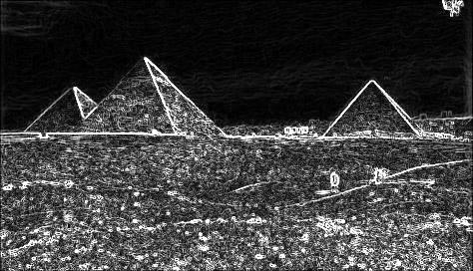

Slide 4

Sobel

Slide 5
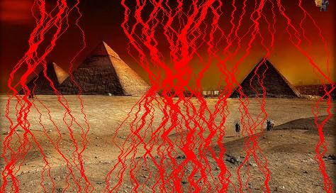
Sobel 5

Slide 6

Scharr

Slide 7

Kroon

Slide 8
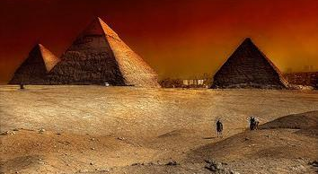

Slide 9


Slide 10


Slide 11


Slide 12


Slide 13


Slide 14


Slide 15


Slide 16


Slide 17


Slide 18


Dijkstra’s Algorithm
Dynamic Programming

