Slide 1
LE VOTE ELECTRONIQUE PRESIDENTIEL
Projet Blockchain – G1A2MSI
Vincent Angoulvant – Amaury Kamerer – Gauthier Pagezy
Notes:
Amaury

Slide 2



Présentation de l’équipe
PAGEZY Gauthier
KAMERER Amaury
ANGOULVANT Vincent
Notes:
Amaury

Slide 3

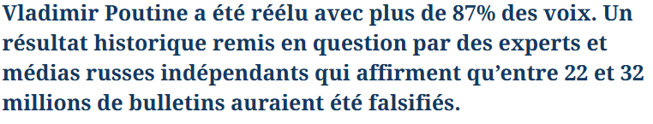
Cas d'utilisation : Gestion des élections
Notes:
Amaury
Contexte : La transparence et l'intégrité des élections sont essentielles pour garantir la confiance du public. Les méthodes actuelles sont vulnérables aux manipulations.
Problématique : Les élections traditionnelles sont souvent marquées par des fraudes, des erreurs de comptabilisation des votes, ou des problèmes de confidentialité.
Objectif du projet : Utiliser la Blockchain pour créer un système d’élection transparent, sécurisé et décentralisé, où chaque étape est auditable et immuable.

Slide 4




Architecture
Serveur frontend
Blockchain locale
Serveur frontend
Sepolia
Client Web
Client Web
Architecture de développement
Architecture de démonstration
Notes:
gauthier

Slide 5
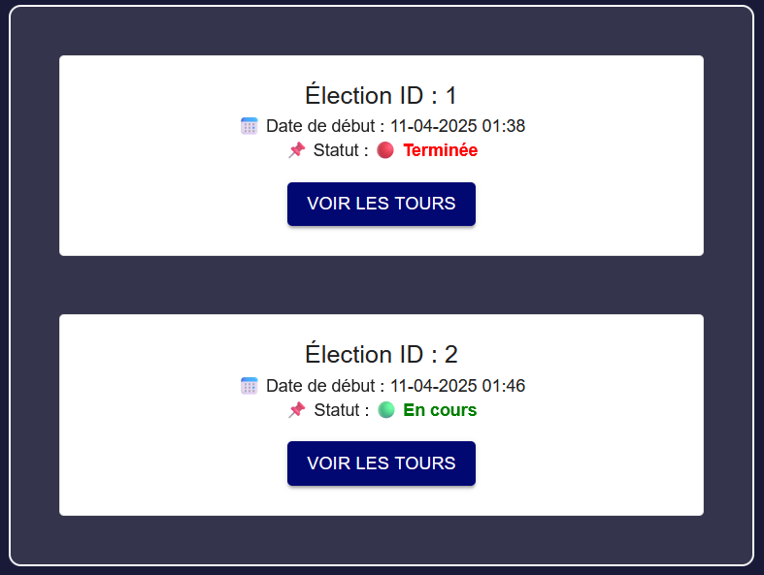
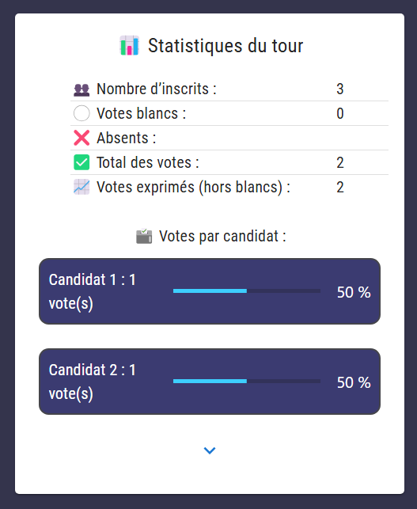
Fonctionnalités principales
Système de vote pour élections présidentielles :
Un contrat pour plusieurs éléctions
Une Liste électorale
Différents niveaux de privilèges dans l’administration du contrat
Génération de tours et déductions des résultats automatiques
Qu’est-ce que ça garanti ?
Intégrité des votes
Déduction automatique des résultats
Traçabilité des votes
Notes:
Vincent
Quelle est la fonction clé ?
Vote numérique sécurisé
Traçable
Création d’éléctions
Génération des tours
Génératon automatiques des résultats
Fiabilité de l’information
Qu’est ce que ça Garanti ?
Intégrité du vote, des résultats, traçabilité
Description : Le projet consiste à développer un smart contract permettant de créer et gérer des élections. Les votants peuvent s'inscrire, voter, et les résultats sont calculés automatiquement.
Utilisateurs : Administrateurs d’élections, votants, candidats.
Processus : Inscription des votants, création des candidats, lancement des élections, et comptabilisation des votes.

Slide 6
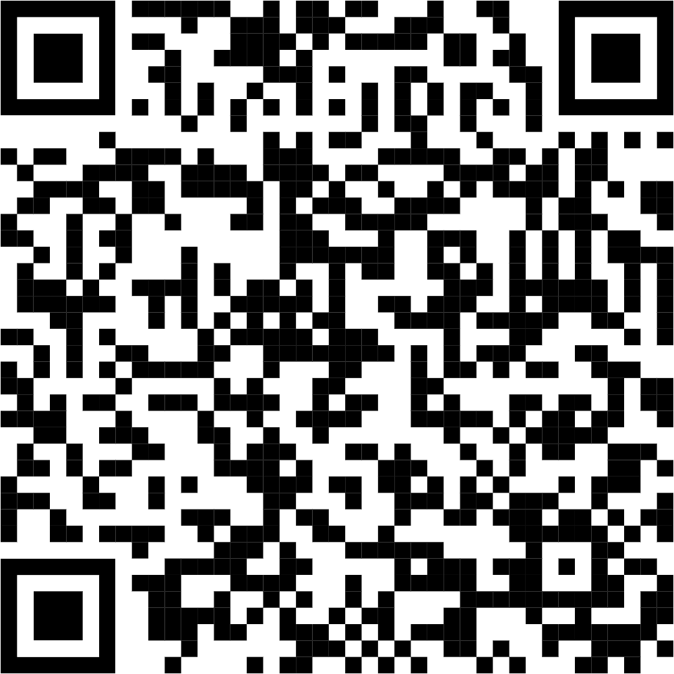
Fonctionnalités principales
PresidentialElection.sol
ElectionTypes.sol
VoterWhitelist.sol
Contrat principal
Format d’une élection
Liste des votants autorisés
Fichiers solidity
ElectionLogic.sol
CandidatesManager.sol
AdminManager.sol
Gestion des tours et résultats
Gestion des candidats
Gestion des administrateurs
https://github.com/amaurykam/Mini-projet_Blockchain
Notes:
Vincent

Slide 7
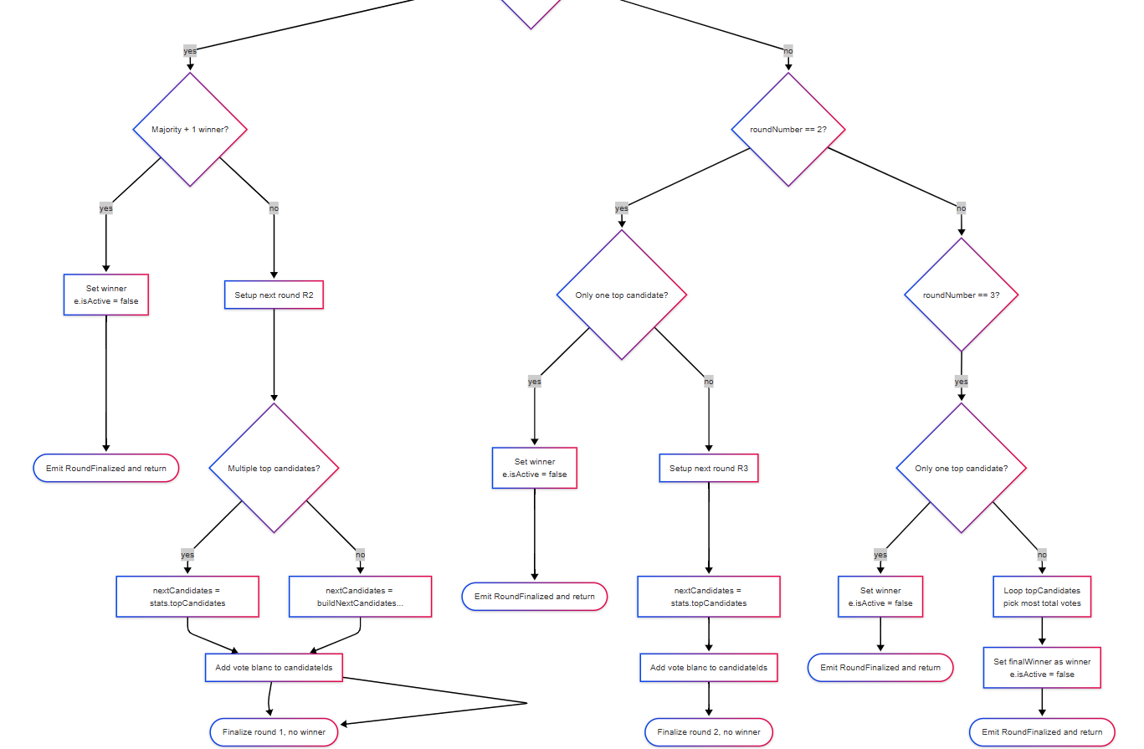
Diagramme d’activité Résultats d’un tour et generation du tour n+1
Notes:
gauthier

Slide 8
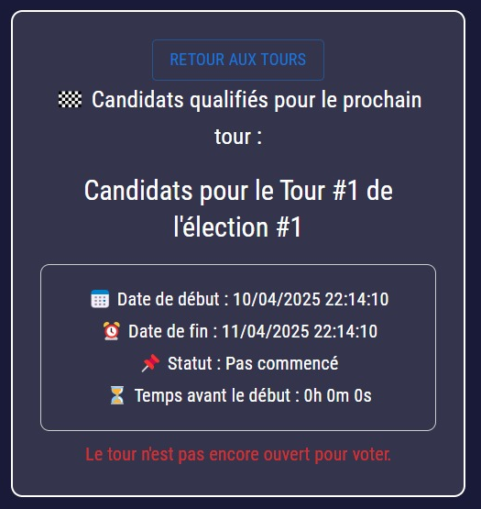
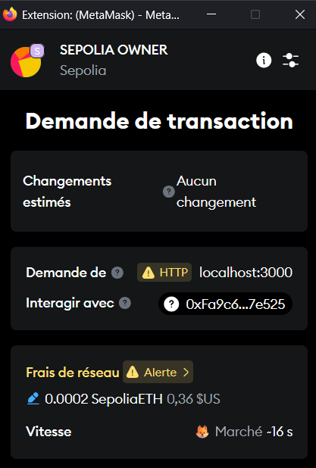

Avantages / invonvénients de l’usage de la blockchain
Problème de temps client – temps blockchain
Coût des transactions :
ajout candidat – ajout votant - voter
Notes:
Amaury
Avantages
Transparence complete
Impossibilité de falsifier les résultats si la liste d’inscrits est bien gérée
Traçabilité
Inconvénients
Problème de synchronization de temps entre le client et le temps blockchain -> on peut developer dessus
Un vote est payant dans la blockchain ETH
Processus de KYC pas géré par la blockchain

Slide 9
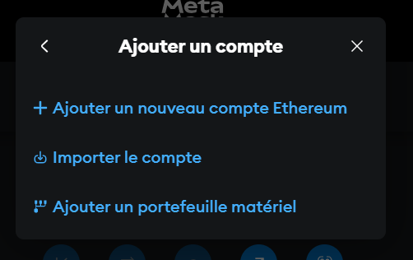
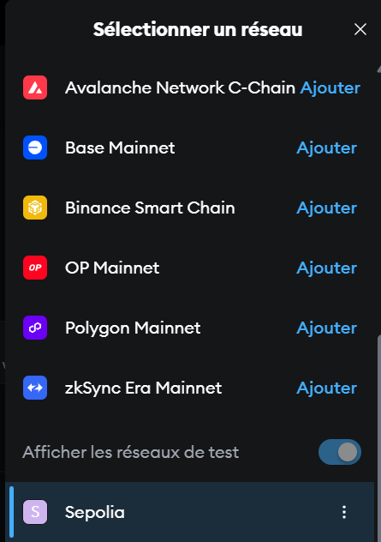
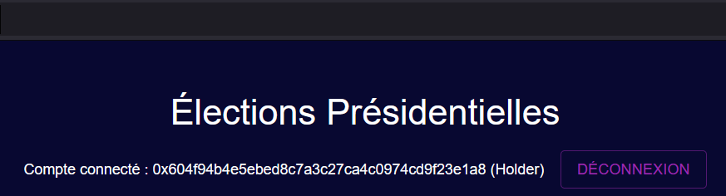
Démonstration
Importez la private key fournie en message Teams dans metamask
2. Connectez vous au réseau de test Sepolia dans Metamask
3. Lancez le site web http://10.4.252.210:3000/

Slide 10
Data migration process infographics
Jupiter
Neptune
Jupiter is a gas giant and the biggest planet in the Solar System
Neptune is the farthest planet from the Sun. It’s really cold there
Saturn
Mercury
Saturn is a gas giant with rings. It’s composed of hydrogen and helium
Mercury is the closest planet to the Sun and the smallest one

Slide 11
Data migration process infographics
Mars
Despite being red, Mars is a cold place. The planet is full of iron oxide dust
Saturn
Saturn is the ringed planet. It’s a gas giant, composed mostly of hydrogen
Neptune
Neptune is the farthest planet from the Sun. It’s really cold there
Mercury
Mercury is the closest planet to the Sun and the smallest one

Slide 12
Data migration process infographics
Neptune
Jupiter
Neptune is the farthest planet from the Sun
It’s the biggest planet in the Solar System
Venus
Saturn
It’s terribly hot, even hotter than Mercury
Saturn is the ringed planet and a gas giant
Mercury
Mars
Mercury is the closest planet to the Sun
Despite being red, Mars is a cold place

Slide 13
Data migration process infographics
Neptune
Jupiter
Mars
Neptune is the farthest planet from the Sun
Jupiter is the biggest planet in the Solar System
Despite being red, Mars is a cold place, not hot
Mercury

Slide 14
Data migration process infographics
Neptune
Venus
Mercury
It’s the farthest planet from the Sun
It’s terribly hot, even hotter than Mercury
Mercury is the closest planet to the Sun
Solar System
Jupiter
Saturn
Mars
It’s the biggest planet in the Solar System
Saturn is the ringed planet and a gas giant
Despite being red, Mars is a cold place

Slide 15
Data migration process infographics
Neptune
Jupiter
Neptune is the farthest planet from the Sun
It’s the biggest planet in the Solar System
Venus
Saturn
It’s terribly hot, even hotter than Mercury
Saturn is the ringed planet and a gas giant
Mercury
Mars
Mercury is the closest planet to the Sun
Despite being red, Mars is a cold place
The Sun
The Moon
It’s the star at the center of the Solar System
The Moon is Earth’s only natural satellite

Slide 16
Data migration process infographics
Jupiter
Neptune
Jupiter is a gas giant and the biggest planet in the Solar System
Neptune is the farthest planet from the Sun. It’s really cold there
Saturn
Mercury
Saturn is a gas giant with rings. It’s composed of hydrogen and helium
Mercury is the closest planet to the Sun and the smallest one

Slide 17
Data migration process infographics
Mercury
Mercury is the closest planet to the Sun
Neptune
Neptune is the farthest planet from the Sun
Venus
Jupiter
It’s terribly hot, even hotter than Mercury
It’s the biggest planet in the Solar System
Saturn
Saturn is the ringed planet and a gas giant

Slide 18
Data migration process infographics
01
03
Jupiter
Saturn
Jupiter is a gas giant and the biggest planet in the Solar System
Saturn has several rings. It’s composed of hydrogen and helium
02
04
Mars
Venus
Despite being red, Mars is actually a very cold place
Venus has a beautiful name and is the second planet from the Sun

Slide 19
Data migration process infographics
35%
30%
Neptune
Saturn
Neptune is the farthest planet from the Sun. It’s really cold there
Saturn is the ringed planet. It’s a gas giant, composed of hydrogen and helium
23%
12%
Jupiter
Venus
Jupiter is a gas giant and the biggest planet in the entire Solar System
Venus has a beautiful name and is the second planet from the Sun

Slide 20
Data migration process infographics
45%
Mercury
It’s the closest planet to the Sun and the smallest one in the Solar System—it’s only a bit larger than the Moon
55%
Venus
Venus has a beautiful name and is the second planet from the Sun. It’s terribly hot, even hotter than Mercury

Slide 21
Data migration process infographics
Neptune
Jupiter
Venus
Neptune is the farthest planet from the Sun
Is the biggest planet in the Solar System
Venus is terribly hot, even hotter than Mercury
Saturn
Earth
Mercury
Saturn is the ringed planet and a gas giant
Earth is the beautiful planet where we all live
Mercury is the closest planet to the Sun

Slide 22
Data migration process infographics
Jupiter
Neptune
Jupiter is a gas giant and the biggest planet in the Solar System
Neptune is the farthest planet from the Sun. It’s really cold there
Saturn
Mercury
Saturn is a gas giant. It’s composed of hydrogen and helium
Mercury is the closest planet to the Sun and the smallest one
Venus
Earth
Venus has a beautiful name and is the second planet from the Sun
Earth is the third planet from the Sun and where we all live

Slide 23
Data migration process infographics
Neptune
Jupiter
Neptune is the farthest planet from the Sun
It’s the biggest planet in the Solar System
Venus
Saturn
It’s terribly hot, even hotter than Mercury
Saturn is a gas giant with several rings
Mercury
Mars
Mercury is the closest planet to the Sun
Despite being red, Mars is a cold place

Slide 24
Data migration process infographics
1
7
8
8
Neptune
1
Jupiter
Neptune is the farthest planet from the Sun
It’s the biggest planet in the Solar System
2
6
7
3
5
Venus
4
Saturn
It’s terribly hot, even hotter than Mercury
Saturn is a gas giant with several rings
2
3
4
5
6
Mercury
Ceres
Mars
Earth
Mercury is the closest planet to the Sun
Ceres is located in the main asteroid belt
Despite being red, Mars is a cold place
Earth is the beautiful planet where we all live

Slide 25
Data migration process infographics
Venus
Jupiter
Mercury
Venus has a beautiful name and is the second planet from the Sun
Jupiter is a gas giant and the biggest planet in the Solar System
Mercury is the closest planet to the Sun and the smallest one

Slide 26
Data migration process infographics
Ceres is located in the main asteroid belt
Neptune is the farthest planet from the Sun
Venus is the second planet from the Sun
Mercury is the closest planet to the Sun
Planning
Data backup
Execution
Post-mig audit
Data profiling
Migration design
Testing
Jupiter is the biggest planet of them all
Despite being red, Mars is a cold place
Saturn is the ringed planet and a gas giant

Slide 27
Data migration process infographics
Introduction of an additional system
Shift to a centralized base
Ceres is located in the main asteroid belt
Despite being red, Mars is a cold place
Storage capacity expansion
Moving data to the cloud
Mercury is the closest planet to the Sun
Neptune is the farthest planet from the Sun
Legacy system modernization
Mergers and acquisitions
Venus is the second planet from the Sun
Saturn is the ringed planet and a gas giant
Historical data
Jupiter is the biggest planet of them all

Slide 28
Data migration process infographics
Storage migration: between physical media
Data center migration: between location/servers
Database migration: between DBMSs
Business process migration: Between infrastructures
Application migration: between platforms
Cloud migration: from on-prem/cloud to cloud

Slide 29
Data migration process infographics
Mars
Mercury
Despite being red, Mars is a cold place. The planet is full of iron oxide dust
It’s the closest planet to the Sun and the smallest one in the Solar System
Saturn
Venus
Saturn is a gas giant with rings. It’s composed of hydrogen and helium
Venus has a beautiful name and is the second planet from the Sun

Slide 30
Data migration process infographics
Neptune
Jupiter
Neptune is the farthest planet from the Sun
25%
40%
It’s the biggest planet in the Solar System
Venus
Saturn
It’s terribly hot, even hotter than Mercury
70%
85%
Saturn is the ringed planet and a gas giant

Slide 31
Data migration process infographics
Data
From
To
Data volume
Mars | Admin system 1 | Cloud service 1 | 1.8 GB
Mercury | Admin system 2 | Cloud service 2 | 25.4 GB
Jupiter | Admin system 3 | Cloud service 3 | 12.8 GB
Saturn | Admin system 4 | Cloud service 4 | 59,.1 GB
Venus | Admin system 5 | Cloud service 5 | 2.9 GB

Slide 32
Data migration process infographics
Jupiter
Neptune
Jupiter is a gas giant and the biggest planet in the Solar System
Neptune is the farthest planet from the Sun. It’s really cold there
Saturn
Mercury
Saturn is a gas giant with ring. It’s composed of hydrogen and helium
Mercury is the closest planet to the Sun and the smallest one

Slide 33
Data migration process infographics
Neptune
Saturn
Neptune is the farthest planet from the Sun. It’s really cold there
Saturn is the ringed planet. It’s a gas giant, composed of hydrogen and helium
01
02
03
04
Jupiter
Venus
Jupiter is a gas giant and the biggest planet in the entire Solar System
Venus has a beautiful name and is the second planet from the Sun

Slide 34
Data migration process infographics
Process
Description
Risk
Phase 1 | Despite being red, Mars is a cold place
Phase 2 | Mercury is the closest planet to the Sun
Phase 3 | Neptune is the farthest planet from the Sun
Phase 4 | Saturn is the ringed planet and a gas giant
Phase 5 | Venus is terribly hot, even hotter than Mercury

Slide 35
Data migration process infographics
35%
55%
80%
Neptune
Mercury
Jupiter
Neptune is the farthest planet from the Sun. It’s really cold there
Mercury is the closest planet to the Sun and the smallest one
Jupiter is a gas giant and the biggest planet in the Solar System

Slide 36
Data migration process infographics
Neptune
Neptune is the farthest planet from the Sun
Jupiter
Mars
Jupiter is the biggest planet in the Solar System
Despite being red, Mars is a cold place, not hot
Venus
Venus is terribly hot, even hotter than Mercury

Slide 37
Data migration process infographics
Neptune
Jupiter
Neptune is the farthest planet from the Sun
It’s the biggest planet in the Solar System
Venus
Saturn
It’s terribly hot, even hotter than Mercury
Saturn is the ringed planet and a gas giant
Mercury
Mars
Mercury is the closest planet to the Sun
Despite being red, Mars is a cold place

Slide 38
Data migration process infographics
Jupiter
Saturn
Mercury
Venus
60%
19%
12%
9%
Jupiter is a gas giant and the biggest planet in the Solar System
It’s the ringed planet. It’s a gas giant, composed mostly of hydrogen
It’s the closest planet to the Sun and the smallest one of them all
Venus has a beautiful name and is the second planet from the Sun

