Slide 1
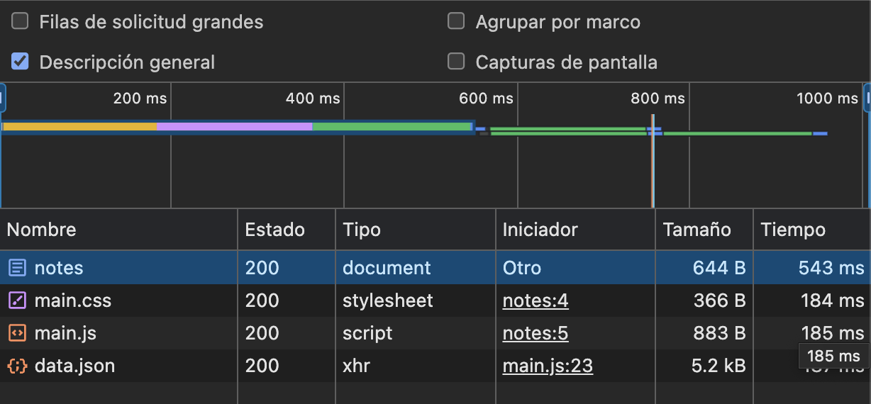
sequenceDiagram
participant browser
participant server
browser->>server: GET https://studies.cs.helsinki.fi/exampleapp/notes activate server server-->>browser: HTML document
deactivate server
browser->>server: GET https://studies.cs.helsinki.fi/exampleapp/main.css
activate server
server-->>browser: the css file
deactivate server
browser->>server: GET https://studies.cs.helsinki.fi/exampleapp/main.js
activate server
server-->>browser: the JavaScript file
deactivate server
Note right of browser: The browser starts executing the JavaScript code that fetches the JSON from the server
browser->>server: GET https://studies.cs.helsinki.fi/exampleapp/data.json
activate server
server-->>browser: [{ "content": "HTML is easy", "date": "2023-1-1" }, ... ] deactivate server
Note right of browser: The browser executes the callback function that renders the notes

Slide 2
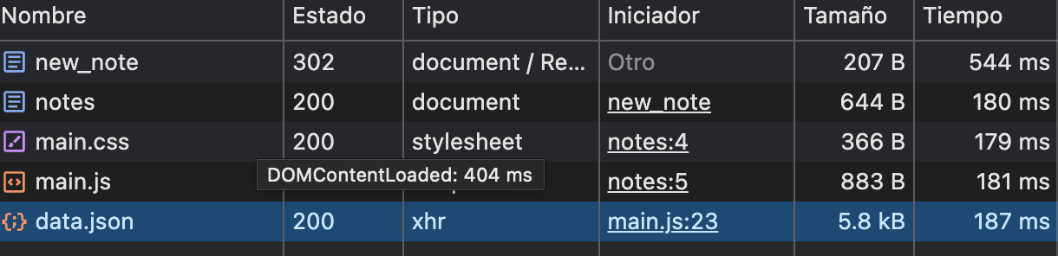
Sequence Diagram
participant browser
participant server
browser->>server: browser POST para enviar notahttps://studies.cs.helsinki.fi/exampleapp/
server->>browser: responde con 302 OK a browser y este redireccionada al browser a hacer un GET
browser->>server: browser hace solicitud GET https://studies.cs.helsinki.fi/exampleapp/
server->>browser: responde con 200 OK devuelve archivo html con lista de notas
browser->>server: browser hace solicitud GET de https://studies.cs.helsinki.fi/exampleapp/main.css
server->>browser: responde 200 OK con el archivo css para dar formato al html
browser->>server: browser hace solicitud GET de https://studies.cs.helsinki.fi/exampleapp/main.js server->>browser: responde 200 OK y envia el archivo main.js
Note right of browser: el browser empieza a ejecutar el archivo y hace solicitud de JSON al servidor
browser->>server: browser hace solicitud GEThttps://studies.cs.helsinki.fi/exampleapp/data.json
server->>browser: el servidor envia los json almacenados
Note right of server: envia los json en forma {"content": "free palestine","date": "2024-06-13T13:11:13.692Z"},.....

