Slide 1
Smart Factory Information Service Bus (SIBUS) for manufacturing application: requirement, architecture and implementation
Yoon, SooCheol, et al - Journal of Intelligent Manufacturing (2016): 1-20.
Seminário MO809 - 2º Semestre 2016

Slide 2
Sumário
PART I – Especificação do SIBUS
Introdução
Problemas
Requisitos
Arquitetura
Processo de Implementação
PART II – Caso de Estudo
Descrição
Implementação
Cenário de Uso
Comparação com outros middlewares
Referências

Slide 3
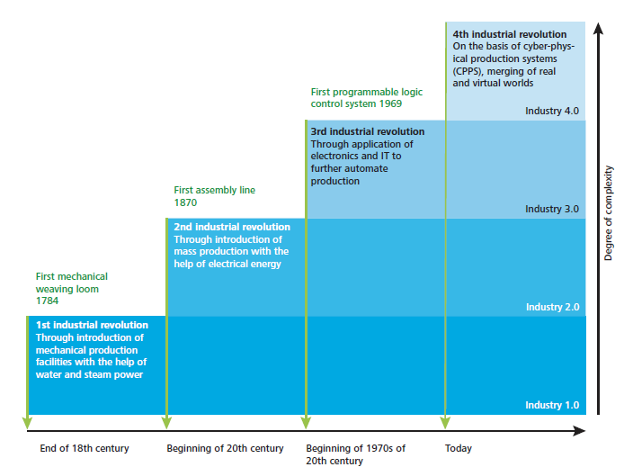
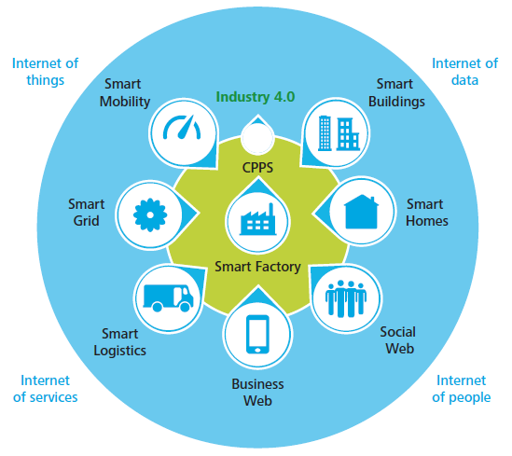
1. Introdução
Industry 4.0
Smart Factory refere-se a um ambiente baseado em IoT.
Fonte: [4] schaepfer15 – Industry 4.0 challenges and solutions for the digital transformation and use of exponential technologies

Slide 4
1. Introdução
Objetivo
Propor uma arquitetura de referência para um “barramento de informações” ou middleware a ser utilizado na aquisição de dados, análise e aplicações desde o nível das “máquinas” até o ERP.
Identificar problemas reais
Converter em requisitos
Definir a arquitetura
Estudo de caso de implementação

Slide 5
1. Introdução
Principais aspectos relativos à Smart Factory
Os componentes da Smart Factory estão conectados em rede e é possível coletar dados úteis dos mesmos;
O estado atual(corrente) dos componentes pode ser determinado e visualizado em tempo real;
Processos automáticos e autônomos podem ser executados baseados em planos de produção otimizados;
Serviços de produção avançados podem ser fornecidos no chão de fábrica e a sistemas externos.

Slide 6
1. Introdução
Objetivos do desenvolvimento do Smart Factory
Solução de Problemas como:
Curto ciclo de vida do produto (durabilidade)
Falta de experiência dos operadores
Regulamentação ambiental
Sistemas de manufatura isolados
Maior quantidade de requisitos dos clientes

Slide 7
1. Introdução
Objetivos do desenvolvimento do Smart Factory
Algumas soluções já foram aplicadas e solucionam alguns dos problemas:
Ubiquitous systems
Lean systems
Holonic systems
Porém os sistemas atuais necessitam de soluções mais abrangentes e com uso ativo de informações de todo processo produtivo:
Information and communication Technologies (ICT)
IoT
Big Data
Cloud computing

Slide 8
1. Introdução
Essência do Smart Factory
Como os dados são coletados,
Como os dados são analisados e
Como os dados são aplicados nos diversos sistemas dos diversos stakeholders.
Para se obter maior eficiência no fluxo de dados e informações é necessário um middleware especializado.
A proposta deste paper é definir um middleware que busca a melhoria do desempenho do processo de manufatura.

Slide 9
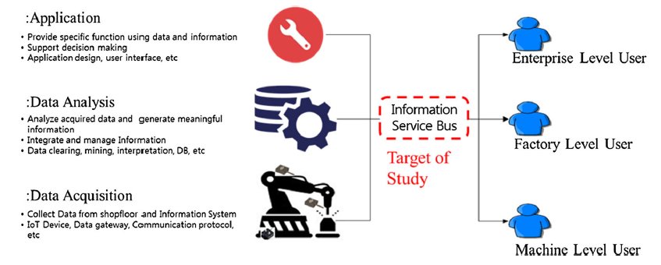
1. Introdução
Perspectiva de Informação no ambiente Smart Factory

Slide 10
1. Introdução
Algumas pesquisas prévias relativas a utilização de dados e tecnologia da informação abordaram:
Troca de informações de design, processo e recursos,
Processo de manufatura,
Monitoração,
Manutenção e
Reprocessamento e reciclagem.
Em um caso de uso de abrangência mais ampla, um sistema completo de Suporte aos Ciclo de Vida do Produto foi proposto (UPLS).

Slide 11
1. Introdução
Ubiquitous Produt Lifecycle Support (UPLS)
Middleware que suporta atividades relativas ao produto nas fases de:
Projeto,
Produção,
Uso e
Descarte
Utilizando informações em tempo-real relativas a cada fase.
Middleware orientado a produto!
Middleware não se mostra adequado no conceito de Smart Factory uma vez que o objetivo neste caso é uma melhoria de performance do ambiente como um todo, desde as máquinas, passando pela fábrica até a empresa.

Slide 12
1. Introdução
Ubiquitous Produt Lifecycle Support (UPLS)
Fonte: [2] lee09 – An architecture for ubiquitous product life cycle support system and its extension to machine tools with product data model.

Slide 13
1. Introdução
KPI(Key Performance Indicator) and TPI(Total Performance Indicator)
Estudos anteriores utilizaram, tipicamente, produtividade como KPI.
Considera-se que uma visão mais abrangente deve ser utilizada envolvendo questões ambientais e sustentabilidade as quais tem sido reforçadas nos ambientes de negócio e industrias. Assim várias KPIs devem ser consideradas.
ISO 22400 define KPIs para Gestão Operacional de Fabricação em diversas frentes como: tempo, logística e aspectos da qualidade como eficiência dos trabalhadores, taxa de transferência e taxa de qualidade.

Slide 14
1. Introdução
KPI(Key Performance Indicator) and TPI(Total Performance Indicator)
No estudo [3], foi proposto o conceito de TPI composto de indicadores de produtividade, ambientais e da sociedade que combinam efeitos relacionados ao produto, recursos, fabricação e humanos.
Neste paper, foi considerado da mesma forma o conceito de TPI com componentes derivados de impactos na produtividade, ambientais e na sociedade, não sendo utilizado foco em KPI específicas.
Fonte: [3] shin15 – Process-oriented Life Cycle Assessment framework for environmentally conscious manufacturing.

Slide 15
2. Problemas
Com o objetivo de se desenvolver um modelo realístico, é necessário que sejam considerados:
serviços disponíveis em sistemas reais de manufatura,
problemas reais a serem endereçados e
TPIs reais a serem avaliadas.
Os problemas foram levantados com base em projetos desenvolvidos na Korea e União Europeia entre 2010 e 2014.
Os problemas considerados são mais comuns em SMEs e podem não existir em grandes corporações.

Slide 16
2. Problemas

Slide 17
2. Problemas
[Problem (PR)#1] Collecting current-status data from the shop floor in real time is difficult. As a result, it takes time to identify problems.
[PR#2] Analysis of material consumption is conducted at factory level rather than machine level. This makes it difficult to know which machines or strategies are more efficient, and machine efficiency cannot be reflected in process planning and scheduling.
[PR#3] Performance evaluation is focused on only one or a few criteria (e.g., material removal rate and machining time). This can result in biased analysis from CTO defined policy.
[PR#4] Products and resources aremanually identified by workers. Manual identification can increase processing times with less reliability, and there remains the risk of errors due to human overload.

Slide 18
2. Problemas
[PR#5] Information systems work individually and are not networked to each other. There can be information gaps in processing operations with the potential for problems such as low quality, reworking, and overworking.
[PR#6] The production plan is scheduled without considering the current shopfloor environmental conditions. Temperature, humidity, or other environmental conditions can affect product quality. Without such considerations, quality cannot be guaranteed.
[PR#7]. It is difficult to predict the outcome of a manufacturing operation. There are gaps between the process plan and results in terms of product quality and production time, which eventually leads to lowermanufacturing efficiency.

Slide 19
2. Problemas
[PR#8] Shopfloor Information is mainly used for enterprise purposes rather than production purposes. There is no feedback to production planning and scheduling from such information, so manufacturing operations do not improve.
[PR#9] Manufacturing strategy is oriented more toward regular operations than exceptional cases. Machines or production lines cannot easily respond to varying conditions, delaying maintenance and operation times.
[PR#10] Decision making in shopfloor is dependent on worker’s knowledge. Knowledge differentials lead to unbalanced work assignment between workers, and novices have fewer opportunities to develop their skills.

Slide 20
3. Requisitos
Foram derivados 16 requisitos dos
problemas reais identificados:
5 for Data Aquisition
4 for Data Analysis
7 on Application Provide

Slide 21
3. Requisitos
16 requirements
10 problemas
5 data aquisition
4 data analysis
7 application provide

Slide 22
3. Requisitos
Requirements for data acquisition
[RAq#1] Current factory status monitoring: it is necessary to monitor the current status of factories including man, machine, material and method which are known as the 4Ms of the factory. This consideration is essential for proactive and preventive activities in operations, as well as for process planning and scheduling. For this, it is necessary to have data acquisition and monitoring for workers, machines, products, and process data. (To Solve PR#1, #4, #6, #9, #10)
[RAq#2] Machine level material management: it is necessary to manage the material consumption of each machine. This capability is critical in process planning for improving environmental KPIs. It is necessary to measure the consumption of each material (e.g., electrical energy and coolant), and it should be possible to distinguish between states of the machine (i.e., idle, turning-on, ready, processing, and turning-off). (To solve PR#2, #3)

Slide 23
3. Requisitos
Requirements for data acquisition
[RAq#3] Independent and identical elements: it is necessary to manage the 4Ms in a smart factory identically, and they should be independent from certain processes or systems. With this consideration, context based services can be provided. For this, 4M element identification in various shopfloor situations is required (To solve PR #1, #4, #10)
[RAq#4] System interoperability: it is necessary to communicate with internal information systems including ERP, MES, CAD/CAM, product lifecycle management (PLM) and databases, as well as with external systems. Factory operations can be speeded up through interoperability. For this, it is necessary to have a unified 4M data model, database network, and common communication protocol. (To solve PR #3, #5, #8, #10)

Slide 24
3. Requisitos
Requirements for data acquisition
[RAq#5] IoT in factory: it is necessary to network all 4M elements in the factory. They should communicate with each other and with information systems so that the shopfloor and its information are synchronized in real time. For this, it is necessary to have agent and sensor technologies. (To solve PR #1, #5)

Slide 25
3. Requisitos
Requirements on data analysis
[RAn#1] Intelligent consumption analysis: it is necessary to analyze material consumption according to the information usage context. It should be analyzed under various conditions for evaluating and managing environmental performance, especially for energy consumption. For example, it should be possible to analyze the energy consumption of a single work center in producing a product or to compare the consumption of different machines. (To solve PR #2, #3)
[RAn#2] Verified process plan: it is necessary to verify the feasibility of a process plan at machine, factory, and enterprise levels. A verified process plan reduces the probability of operational risks such as failure, malfunction, or poor quality. For this, it is necessary to derive requirements and constraints of materials, machines, production line, workers, and existing plans and schedules from the process plan, as well as to check their availabilities. (To solve PR #6, #9)

Slide 26
3. Requisitos
Requirements on data analysis
[RAn#3] Intelligent performance evaluation: it is necessary to evaluate manufacturing performance from the perspective of productivity, environment and social impact. It should also be possible to predict the performance from the process plan and schedule. The current factory level can be determined and further goals defined through this capability. (To solve PR #3, #6, #7, #10)
[RAn#4] Traceable factory elements: it is necessary to trace the 4M factory elements. Here, traceability covers holistic characteristics of each element, not only physical location. With traceability, it is possible to make on-site decisions quickly. For this, it is necessary to ascertain the current status of each element (e.g., location, mode, failure, history, and further schedule). (To solve PR #1, #4, #6, #10)

Slide 27
3. Requisitos
Requirements on application provide
[RAp#1] Autonomous control: it is necessary to control manufacturing operations autonomously by the system itself. Since the manufacturing plan does not usually describe how to react to events, it is necessary to determine this for each of the 4M elements for better efficiency. For this, it is necessary to have ontologies and context reasoning technologies. (To solve PR #6, #8, #9)
[RAp#2] Field-based process plan: it is necessary to generate process plans and schedules considering actual shopfloor conditions. Process plans that assume ideal conditions can cause a series of operational problems. In order to avoid this, it is necessary for process planning to reflect realistic information such as availability, capacity, or constraints of manufacturing resources. (To solve PR #6)

Slide 28
3. Requisitos
Requirements on application provide
[RAp#3] Holistic performance management: It is necessary to build, evaluate, and manage performance of manufacturing processes from a holistic viewpoint. Holistic performance management clearly describes which points have to be improved, and it is possible to detect changes in performance quickly. For this, a performance model must be built and it should be possible to instance the model for evaluation and prediction. (To solve PR #6, #7, #8, #10)
[RAq#4] Networked information system: it is necessary to exchange information between various information systems. Data and information generated on the shopfloor can be used beneficially in other systems in the company, and are also useful for external stakeholders. (To solve PR #5, #8)

Slide 29
3. Requisitos
Requirements on application provide
[RAp#5] Modeling and simulation: it is necessary to model and run simulations for process plans. Through simulation it is possible to discover process plan defects. The best alternatives for process parameters can then be chosen without compromising performance. (To solve PR #3, #6, #7, #10)
[RAp#6] Real-time information treatment: it is necessary to treat the generated information in real-time. Manufacturing performance improves with faster response to events occurring during operation. This consideration is critical in rapid smart factory applications. (To solve PR #5, #8)

Slide 30
3. Requisitos
Requirements on application provide
[RAp#7] Manufacturing assistance: it is necessary to support workers in various situations. Expert knowledge is required in many manufacturing areas. However, not all workers are not equally skilled, so proper support is needed. Manufacturing assistance improves quality and reduces working time. For this, it is necessary to have knowledge libraries, cognitive, ontologies, and various support protocols. (To solve PR #8, #10)

Slide 31
3. Requisitos
Os requisitos refletem o objetivo da Smart Factory que é a melhoria dos TPIs.
Resumidamente, uma Smart Factory deveria possibilitar:
Coleta de dados de fabricação,
Análise de dados produzindo informações uteis sobre o processo, e
Entrega e utilização destas informações pelas aplicações que serão monitoradas pelas TPIs.

Slide 32
4. Arquitetura
Smart factory service delivery elements

Slide 33
4. Arquitetura
Vision of SIBUS (Conceptual Model)
Para se desenvolver o modelo de referência é necessário saber o papel do sistema que esta sendo definido, de modo a conhecer suas entradas, suas saídas, sua função e elementos ao seu redor
Ambiente ao redor
Função
entradas
saídas

Slide 34
4. Arquitetura
Vision of SIBUS (Conceptual Model)

Slide 35
4. Arquitetura
Vision of SIBUS (Conceptual Model)
Modelo é dividido em 4 camadas dependendo do nível e conteúdo do serviço
Smart Enterprise Content Management System (SECM)
Prove serviços empresariais como histórico, gestão do conhecimento e gestão de performance.
Smart Manufacturing Execution System (SMES)
Prove os serviços de execução de processo: Controle Operacional, Avaliação de Performance e Suporte à Manutenção
Smart Manufacturing Optimizer (SMO)
Prove os serviços de preparação do processo: planejamento, agendamento, modelagem e simulação
Smart Machine Controller (SMC)
Prove os serviços de provisionamento, controle e monitoração

Slide 36
4. Arquitetura
Conceptual Aspects of SIBUS
Para se estruturar o modelo de referência é necessário:
Conectar-se aos serviços da fábrica,
Definir os serviços em uma maneira estruturada,
Descrever em detalhes cada serviço, e
Gerenciar os serviços e seu provisionamento.

Slide 37
4. Arquitetura
Conceptual Aspects of SIBUS

Slide 38
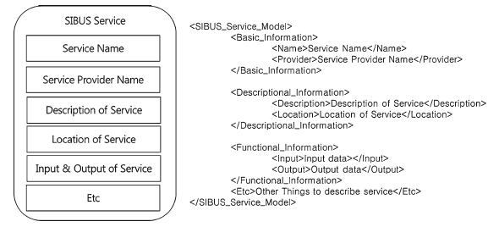
4. Arquitetura
SIBUS Service Description Language

Slide 39
4. Arquitetura
Service Request Process Application
Como vários sistemas e usuários irão se conectar ao SIBUS, existem várias questões a se considererar como:
Conveniência,
Reusabilidade,
Segurança,
Diferentes modelos de dados
Para isso, um módulo de aplicação de processos também deve ser criado para tratar as solicitações de serviços.

Slide 40
4. Arquitetura
Service Request Process Application
O módulo de aplicação de processos deve ter:
Modelo de Dados do Ciclo de Vida do Produto unificado,
Gestão de Execução de Processos,
Autenticação e autorização(data accessibility) de usuários,
Suporte a processos definidos pelos usuários,
Suporte à busca de serviços,
Gestão histórica de serviços.

Slide 41
4. Arquitetura
IDEF0 diagram for process application modules

Slide 42
4. Arquitetura
Reference architecture
of SIBUS

Slide 43
4. Arquitetura
Reference architecture of SIBUS – Process Application

Slide 44
4. Arquitetura
Reference architecture of SIBUS – SMC
Smart Machine Control
SMC is composed of services for controlling and managing manufacturing machines. Intelligent resource control and monitoring services are defined, and it is possible to evaluate manufacturing processes at the machine level. Advanced services are possible including closed loop manufacturing, tool and resource management, and automatic setup for better production efficiency (Reflects
RAqs#2, #3, #5; RAn#4; RAps#1, #8).

Slide 45
4. Arquitetura
Reference architecture of SIBUS – SMO
Smart Manufacturing Optimizer
SMO is composed of services for optimizing manufacturing processes. It provides machine-level process planning and services for sustainable TPI improvement. A performance model can be established and the expected performance can be achieved through manufacturing simulation. Manufacturing results can be adapted to existing models with corresponding updates. (RAns#2, #3; RAps#2, #3, #4, #6).

Slide 46
4. Arquitetura
Reference architecture of SIBUS – SMES
Smart Manufacturing Execution System
SMES is composed of services for manufacturing execution. It provides services for manufacturing-process planning and execution. Factory elements can be monitored, performance can be measured at production-line and factory levels, failure can be detected and analyzed, and proactive maintenance can be achieved through SEMS services. In order to provide SMES services, much of the real-time information from the shop floor is needed and three smart agents (product, resource, and human) are designed as a sub-module of SMES supporting real-time service provision (RAqs #1–6; RAns #1, #3–6; RAps #1, #8, #9).

Slide 47
4. Arquitetura
Reference architecture of SIBUS – Agents
Product/Resource/Human agent:
Each agent is designed for managing individual factory elements. The product agent provides services for supporting the manufacturing progress of a product. Through the product agent, the location, product lifecycle information, processing information, and quality information are managed in real time. The resource agent provides services for monitoring the condition of a resource. Through the resource agent, it is possible to provide sensor data (e.g., temperature, vibration, and humidity), to identify the machine, to manage tool usage history, to conduct real-data-based maintenance, and to react quickly to unforeseen events.
People are sources of data for some services and consumers of other services. Thus, the human agent contains two types of services: customer and provider. As a customer, the human agent provides support for smart-device usage (e.g., smart phone and tablet), augmented reality support, knowledge for manufacturing and maintenance operations, and other context-based information. As a data provider, it mainly reports the person’s current state (RAqs #1–6, #8; RAps #1, #8, #9).

Slide 48
4. Arquitetura
Reference architecture of SIBUS – SECM
Smart Enterprise Content Management
SECM provides services for managing the information of a manufacturing system. Through SECM services, it is possible to manage manufacturing process history, knowledge for operation and control, real-time manufacturing information, criteria for process evaluation, and maintenance information and knowledge. The delivery date can be controlled in conjunction with a process plan and performance can be evaluated on the entire manufacturing-system level. SECM generates reports for the operational results. (RAqs #7, #8; RAps #5, #8–10).

Slide 49
5. Processo de Implementação
Implementation Procedure
Não é necessário a implementação completa de todos os serviços
Assim, um objetivo menor deve ser definido a partir do qual os serviços essenciais para atende-los são implementados.

Slide 50
5. Processo de Implementação
Implementation Procedure

Slide 51
FIM – PARTE I

Slide 52
Revisão da Arquitetura SIBUS
Reference architecture
of SIBUS

Slide 53
Revisão da Arquitetura SIBUS
Implementation Procedure

Slide 54
6. Case Study - Descrição
European aircraft industry
Target Product of Study: Fishhead

Slide 55
6. Case Study - Descrição
Situação Existente
Existem 2 atores: 1 aircraft manufacter e 1 fishhead supplier
Processo:
Aircraft Manufacter envia ordem de produção do fishhead
Recebe o produto dentro de certo padrão de qualidade dependente das condições de prazo e produção
Problema:
Não é possível comparar a qualidade entre empresas e escolher a mais adequada para um fornecimento em condições adversas.
O status e condições de produção não são monitoradas.

Slide 56
6. Case Study - Descrição
Situação Desejada
Existem vários atores: 1 aircraft manufacter e vários fishhead suppliers
Processo:
Aircraft Manufacter envia ordem de produção do fishhead para um fishhead supplier escolhido dentre vários a partir avaliação da qualidade esperada do produto
Recebe o produto dentro do padrão de padrão de qualidade acordado.

Slide 57
6. Case Study - Descrição
Overall Operations of fishhead manufacturing

Slide 58
7. Case Study - Implementação
SIBUS Implementation Procedure

Slide 59
7. Case Study - Implementação
1: Goal and Scope Description
The goal of the study is to improve general productivity, environmental friendliness, and social impact for the supplier at machine, factory, and enterprise levels.
The scope: choosing the supplier, specifically operator, machines for fishhead manufacturing, the produced fishhead, activities for simulation and process planning, and scheduling, production, and monitoring.

Slide 60
7. Case Study - Implementação
TO-BE possui dois elementos adicionais: <Manufactoring Service System> and <Product>
2: AS-IS and TO-BE Factory Models
Os modelos possuem 2 níveis:
Modelo conceitual com os principais elementos envolvidos
Diagrama de Fluxo com as atividades com a sequência
AS-IS para o TO-BE mostra a evolução no fluxo em duas fases
AS-IS possui dois elementos: <Operator> and <Machine>

Slide 61
7. Case Study - Implementação
3, 4, 5 : AS-IS and TO-BE Information Flow and Factory Services
No AS-IS não existe fluxo de dados
No TO-BE são identificados:
15 information flows e
12 smart factory services
O fluxo d1 utiliza-se de d2, d3 e d4.

Slide 62
7. Case Study - Implementação
6: SIBUS Architecture for study case
A arquitetura é definida incluindo:
12 serviços identificados, módulos de comunicação(CM) e DB para cada subsistema e o subsistema de suporte Process Application

Slide 63
8. Case Study - Cenário de Uso
7: Verify TO-BE Model Information Flow - Operation Scenario
6. In “Monitor the process”, SMES Production Monitoring monitors the manufacturing performance continuously during the operations. Production monitoring requests other services needed for monitoring various performances. Product quality information is gathered by product quality of the product agent. Energy consumption is achieved by a combination of SMES Sustainability Evaluation and Sensor and Resource Signal Acquisition of the resource agent. The latter measures the energy consumption of a machine continuously, whereas the former evaluates the amount of energy used in fish-head manufacturing. After all fish-head operations have been executed, SECM Process History Management stores the production-monitoring result and manages the quality and energy consumption information for each part. The expected delivery time is calculated by SMES Production Execution and Control according to the current status of manufacturing. SECM Delivery-DateManagement manages the manufacturing progress, taking account of due dates.
Supplier escolhido recebe o pedido de produção
Supplier envia a performance esperada
Supplier recebe o pedido de simulação
Supplier envia o produto e relatório de produção
2. In the “Generate part program,” possible machines for fishhead production are identified and STEP-NC part programs are generated for each machine through SMO Optimal Process Program Generation.
3. In “Predict performance,” virtual manufacturing is operated through SMO Manufacturing Simulation using the “Generate part program.” The expected performances in terms of product quality, energy consumption, and delivery date under the defined condition are evaluated.
SMO Modeling of Sustainability provides a relevant sustainable model for the expected performance evaluation.
The supplier sends their machine availability and expected performance in terms of quality, delivery date, and energy consumption for the fish head to the
customer.
1. In “Receive call”, the requirements of the aircraft manufacturer are managed in a suitable way for the supplier’s system. Production requirements are translated into standard data models by an interoperability ontology model.
Quality specification, CAD data, and production due date are managed by the Unified Product Lifecycle Data
Model. After translation and management, the data are converted into a standard format for the SIBUS platform.
5. In “Run production”, manufacturing operations are executed according to the plan and schedule. The part program for each machine is executed by the SMES Production Execution and Control.
4. In “Build production plan and schedule,” an optimized process plan and schedule are built considering the current shop-floor status in terms of aspects such as machine schedules, expected operation time, and location of machines and logistics. SMES Production Planning and Scheduling determines the machines for operations and assigns new jobs for them. SMO Optimal Process Program generation sends a STEP-NC part program generated
in the simulation step to the assigned machines.
7. When the fishhead manufacturing operation is finished, the SECM Production Report generates a report on the product and its associated operations, including performance information. The supplier sends this with the product to the customer.

Slide 64
9. Comparação com outros middlewares
Comparation
of
SIBUS
The functions of these five middleware systems appear to be inadequate for the present case study. They seem to be technology-oriented systems, such as RFID, IoT, and cloud computing, with specific purposes. This characteristic also
limits their application domain to either within or outside the shop floor. The most novel aspect of SIBUS compared to other middleware is that SIBUS aims to improve TPI according to the purpose of the stakeholder. Based on this property, it can support activities that improve productivity, environment, and sociality at the machine,factory, and enterprise levels, respectively. These activities can be factory cooperation, factory utilization, work balance, and smart machine control, which are all adequate for the case study.
SIBUS é um middleware tailor made.
Assim, exclui-se da comparação (SIMENS WinCC OA, iTAC MES
Suite System, and Rockwell Automation FactoryTalk PharmaSuite)
In short, SIBUS contributes in two ways. First, it contains services from machine- to enterprise-level manufacturing activities, which is a wider coverage than that of existing middleware. Second, it helps to identify services and data that can be used to improve TPI according to the stakeholders’
requirements.

Slide 65
10. Referências
[1] yoon16 – Yoon, SooCheol, et al. "Smart Factory Information Service Bus (SIBUS) for manufacturing application: requirement, architecture and implementation." Journal of Intelligent Manufacturing (2016): 1-20
[2] lee09 – Lee, Byeong-Eon, and Suk-Hwan Suh. "An architecture for ubiquitous product life cycle support system and its extension to machine tools with product data model." The International Journal of Advanced Manufacturing Technology 42.5-6 (2009): 606-620.
[3] shin15 – Shin, Seung-Jun, et al. "Process-oriented Life Cycle Assessment framework for environmentally conscious manufacturing." Journal of Intelligent Manufacturing (2015): 1-19.
[4] schaepfer15 – Schlaepfer, R. C., and M. Koch. "Industry 4.0 challenges and solutions for the digital transformation and use of exponential technologies." Deloitte, AG, Zurich. http://​ www2.​ deloitte.​ com/​ content/​ dam/​ Deloitte/​ ch/​ Documents/​ manufacturing/​ ch-en-manufacturing-industry-4-0-24102014.​ pdf (20.12. 2015) (2015).

Slide 66
FIM
810043 – Amaury Mausbach Filho

