Slide 1
Pervasive health monitoring based on internet of things: Two case studies
Seminário MO809 - 2º Semestre 2016

Slide 2
Sumário
Introdução
Estudos Correlatos
Aspectos Gerais das Arquiteturas
Arquitetura baseada em ZigBee
Arquitetura baseada em WiFi
Comparações e Resultados
Referências

Slide 3
1. Introdução
No contexto atual, os custos de saúde tem crescido devido a novos tratamentos que exigem a necessidade de permanência do paciente em ambiente hospital devido a exigência de monitoração detalhada e permanente.
Aplicação de IoT na monitoração de saúde visa:
Redução de custos de monitoração
Melhora da qualidade dos dados e monitoração permitindo a prevenção ou identificação antecipada de situações de risco
Possibilidade de envio dos dados remotamente aos responsáveis pelo tratamento/diagnóstico
OBJETIVO: Avaliar o desempenho de duas arquiteturas IoT para monitoração de dados médicos: ZigBee e WiFi.

Slide 4
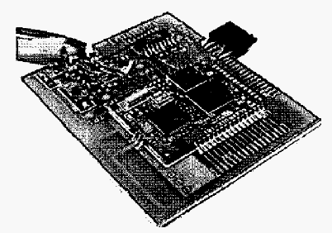
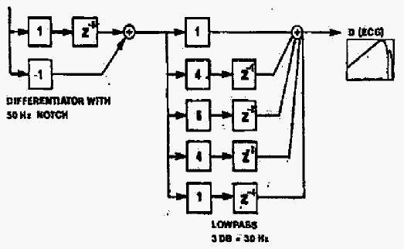
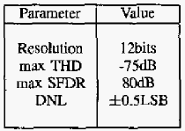
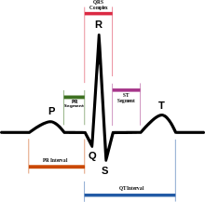
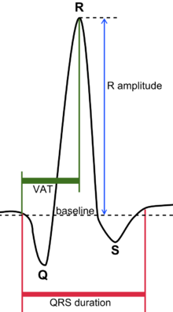
2. Estudos Correlatos
Coleta de dados ECG/EMG/EEG/EOG via Bluetooth
Test board
Digital filter to reduce noise and detect R peak
Filtered ECG
Fonte: [2] - Wireless DSP architecture for biosignals recording

Slide 5
2. Estudos Correlatos
Rede para informações médicas baseada em 3G e ZigBee (Casa e Hospital)
Monitora:
ECG/EMG/EEG/EOG
Heart rate
Breathing and blood pressure.
Características:
Priority scheduling
Data compression
Fonte: [3] - A network-based system architecture for remote medical applications

Slide 6
2. Estudos Correlatos
Context aware monitoring:
Medical: ECG, SPO2
Context: temperature, accelerometer, humidity
Plataforma de sensores wireless para monitoração médica (context aware)
(a) Wireless 3-lead ECG sensor, (b) ECG Strap, (c) SpO2 sensor, and the PDA base station
Fonte: [4] - Body sensor network–a wireless sensor platform for pervasive healthcare monitoring

Slide 7
2. Estudos Correlatos
The potential of Internet of m-health Things m-IoT for non-invasive glucose level sensing (1 de 3)
m-IoT concept:
Interconnects
IPV6 as 6LoWPAN (802.15.4)
with
next generation networks (4G)
to provide m-health services
Fonte: [5] - The potential of Internet of m-health Things “m-IoT” for non-invasive glucose level sensing

Slide 8
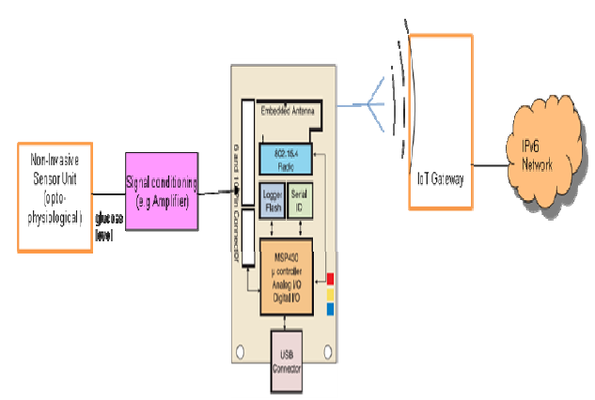
2. Estudos Correlatos
The potential of Internet of m-health Things m-IoT for non-invasive glucose level sensing (2 de 3)
Fonte: [5] - The potential of Internet of m-health Things “m-IoT” for non-invasive glucose level sensing

Slide 9
2. Estudos Correlatos
The potential of Internet of m-health Things m-IoT for non-invasive glucose level sensing (3 de 3)
Sample of m-IoT based temperature data
A typical Opto-physiological assessment sensor
Fonte: [5] - The potential of Internet of m-health Things “m-IoT” for non-invasive glucose level sensing

Slide 10
3. Aspectos Gerais das Arquiteturas
Problemas na transmissão e dados bio-médicos podem ter consequências de vida ou morte
Requisitos de taxa de transmissão e atraso são definidos pelo grupo IEEE 1073
Sensors:
Blood Pressure
Heart rate
Temperature
Respiration
Glucose
SPO2
ECG

Slide 11
3. Aspectos Gerais das Arquiteturas
The ISO 11073-xyyzz series of standards (status: s = published standard, d = draft, new = new project authorization request).
Three transports were defined:
Bluetooth Health Device Profile
USB Personal Healthcare Device Class
ZigBee Health Care Profile
Others may be defined in the future.
Fonte: https://en.wikipedia.org/wiki/ISO/IEEE_11073_Personal_Health_Data_(PHD)_Standards; [6] - Novel ISO/IEEE 11073 standards for personal telehealth systems interoperability

Slide 12
3. Aspectos Gerais das Arquiteturas
IEEE 11073 framework
Fonte: [7] - Building point of care health technologies on the IEEE 11073 health device standards

Slide 13
4. Arquitetura baseada em ZigBee
ZigBee Based Health Monitoring System

Slide 14
4. Arquitetura baseada em ZigBee
The system is implemented with ZigduinoR2 hardware platform, which is an Arduino compatible microcontroller platform (ATmega128RFA1).
Contiki operating system is used to implement WSN.
The ZigBee based architecture consists of several patient nodes and a sink node.
ZigBee based architecture can be divided into four sections: sensor interface, WSN implementation, database application and webserver application.

Slide 15
4. Arquitetura baseada em ZigBee
Sensor Interface:
The sensor interface is implemented using an Arduino-compatible E-health shield on top of the Zigduino hardware.
The E-health shield is basically a gateway between the medical sensors and Zigduino board.
Data measured from various sensors are collected by the Zigduino board via the E-health shield.
WSN implementation:
The Zigduino’s microcontroller contains an on-chip 2.4 GHz IEEE 802.15.4 radio.
The implemented WSN consists of several patient (client) nodes and a sink (server) node.
Patient nodes collect data from various sensors and send wirelessly over ZigBee to the sink (server) node.

Slide 16
4. Arquitetura baseada em ZigBee
Database application:
The sink (server) node is connected to a local PC (Personal computer) where a Python code executes to collect data from the serial terminal and save it into a remote database.
Webserver Application:
Web-server application written with PHP accesses the database and updates the web page in real time.
The data from the webpage can be accessed remotely by patient’s caregivers through their laptops or smart phones using any browser.

Slide 17
4. Arquitetura baseada em ZigBee

Slide 18
5. Arquitetura baseada em WiFi
Wi-Fi Based Health Monitoring System

Slide 19
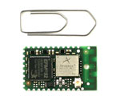
5. Arquitetura baseada em WiFi
The Wi-Fi based architecture consists of Wi-Fi enabled sensor nodes (Patient node) to access patient’s medical data and Wi-Fi access point (Wi-Fi router).
The sensor nodes (Patient node) are designed using an Analog Front-End (AFE, ADS1192 from Texas Instruments) and Wi-Fi module (RTX4140 Wi-Fi module).
The RTX module is provided with proprietary operating system (ROS). Processor used in the Wi-Fi module is EFM32GG230F1024.
The WiFi architecture can be divided into four sections: sensor interface, WSN implementation, database application and webserver application.

Slide 20
5. Arquitetura baseada em WiFi
Sensor interface:
The sensor interface is implemented using the AFE to read data from the medical sensors and perform analog to digital conversion.
The digital data from the output of AFE is read by RTX4140 through SPI (Serial Peripheral Interface).
WSN implementation:
A UDP (User Datagram Protocol) client application running on the RTX4140 sends the UDP data packet to a remote server through Wi-Fi, once the connection to the Wi-Fi access point is established.

Slide 21
5. Arquitetura baseada em WiFi
Database application:
A UDP server application (running on a remote system), written in python, continuously listens to the UDP port, collects the incoming data and updates a remote database.
Webserver application:
Webserver application is same as that of the ZigBee-based architecture.

Slide 22
6. Comparações e Resultados
Aspectos importantes a serem considerados:
Confiabilidade
Interferência
Coexistência
Escalabilidade
Consumo
Segurança

Slide 23
6. Comparações e Resultados
Ambiente Experimental:
20 pacientes
Sensores:
2-Lead ECG
SpO2
Blood Pressure
Heart Rate
Temperature
Respiration
Glucose Level

Slide 24
6. Comparações e Resultados
Resultados Obtidos:
Cada paciente gera 8,7Kbits/s de payload
ZigBee consume pouco para baixo payload, mas consumo cresce rapidamente com aumento de tráfego
Tráfego máximo obtido com ZigBee (contiki) foi 160Kbits/s o que limita um pouco a arquitetura mesh

Slide 25
7. Referências
[1] moosavi14 – Moosavi, Sanaz Rahimi, et al. "Pervasive health monitoring based on internet of things: Two case studies." Wireless Mobile Communication and Healthcare (Mobihealth), 2014 EAI 4th International Conference on. IEEE, 2014.
[2] piccini04 – Piccini, L., et al. "Wireless DSP architecture for biosignals recording." Signal Processing and Information Technology, 2004. Proceedings of the Fourth IEEE International Symposium on. IEEE, 2004.
[3] she07 – She, Huimin, et al. "A network-based system architecture for remote medical applications." Network Research Workshop. Vol. 27. 2007.
[4] lo05 – Lo, Benny PL, et al. Body sensor network–a wireless sensor platform for pervasive healthcare monitoring. na, 2005.
[5] istepanian11 – Istepanian, R. S. H., et al. "The potential of Internet of m-health Things “m-IoT” for non-invasive glucose level sensing." 2011 Annual International Conference of the IEEE Engineering in Medicine and Biology Society. IEEE, 2011.
[6] schmitt07 – Schmitt, L., et al. "Novel ISO/IEEE 11073 standards for personal telehealth systems interoperability." High Confidence Medical Devices, Software, and Systems and Medical Device Plug-and-Play Interoperability, 2007. HCMDSS-MDPnP. Joint Workshop on. IEEE, 2007.
[7] clarke13 – Clarke, Malcolm, et al. "Building point of care health technologies on the IEEE 11073 health device standards." 2013 IEEE Point-of-Care Healthcare Technologies (PHT). IEEE, 2013.

Slide 26
FIM
810043 – Amaury Mausbach Filho
Fonte:

