Slide 1
Time management tool
A time management tool using command line to record and track time usage

Slide 2
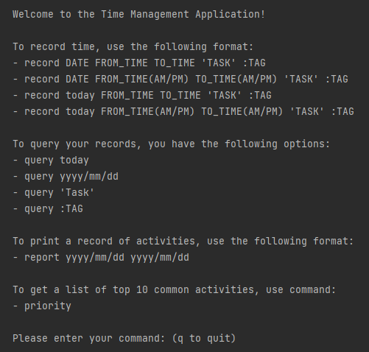
Getting started
Easy to use application
*Prompted instructions upon running program

Slide 3

concise recording
Record command
Record time using today’s date or key word “today” for fast recording time
Confirmation upon successful recording

Slide 4
Query Command
Query information based off date
Use key word “today” for faster results
Query Information

Slide 5


Query Command
Query time based on related tasks
Query time based on tag
Query Information

Slide 6
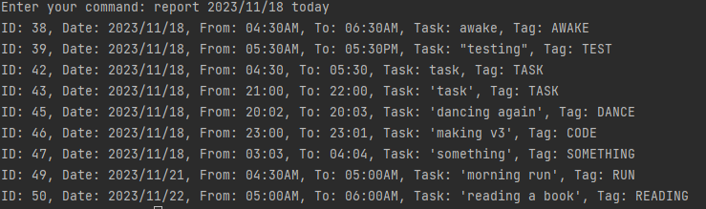
Generate Reports
Obtain insight on time usage by generating a report
Use key word “today” for faster results

Slide 7
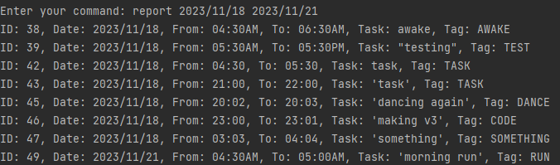
Generate Reports (cont.)

Slide 8
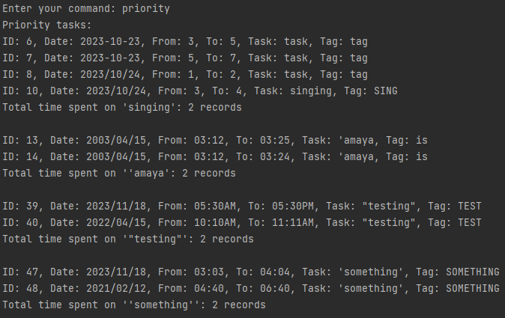
Priority Command
Receive a list of your top 10 frequently done tasks in order

