Slide 1


Command Line and Python for Data Science
How the Exam Will Work & Assignments
DTU, University of Chinese Academy of Sciences

Slide 2
How the Exam Will Work
In the following slides, you’ll see two programming assignments. Pick one, and do the following:
Plan out your project. What are the constraints, how do you handle corner cases or ambiguity?
Design some tests you can check your code with
Write your code and tests
Submit your project plan and code in WISEflow by Wednesday, 3rd Apr
Explain your code to me in your assigned oral exam slot on Monday, April 8th or Tuesday, April 9^{st.}
DTU, University of Chinese Academy of Sciences

Slide 3
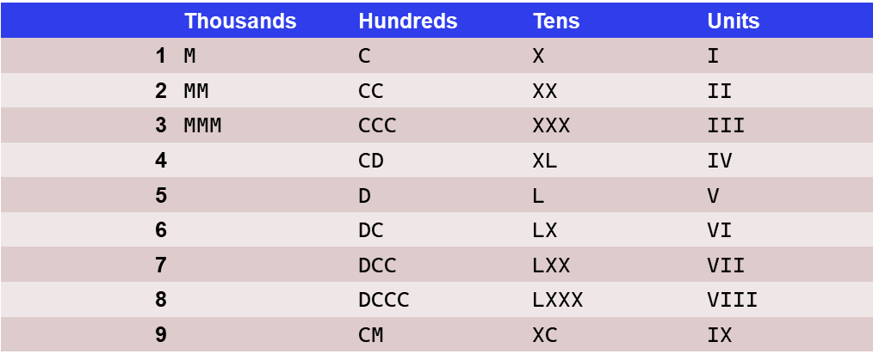
Project 1: Convert Roman Numerals
Ancient Romans used a numeric system different to the Arabic number system that is now used in western countries.
Numbers were represented by letters. Seven letters existed to denote 1(I), 5(V), 10(X), 50(L), 100(C), 500(D), and 1000(M). Some of these letters could be combined to form the numbers in-between, usually by addition. So e.g. II would be 2, CCC would be 300, and CCCLII would be 352. As a slight complication, the 4- and 9-numbers of the different magnitudes would be constructed by taking the next-higher 5- or 10-number and subtracting the 1-number of the same magnitude, so IV = 4, IX = 9, XC = 90, CD = 400, etc. See the table for a complete list. Note that 99 is written as XCIX, not as IC
For this project, create one function that can
convert Roman numerals into regular integer
Numbers and one that can convert integers to
Roman numerals.
Come up with a plan on how you want to handle
invalid inputs, and tests for the functions.
Please submit a Jupyter Notebook file with
your plan, code, and tests.
DTU, University of Chinese Academy of Sciences

Slide 4
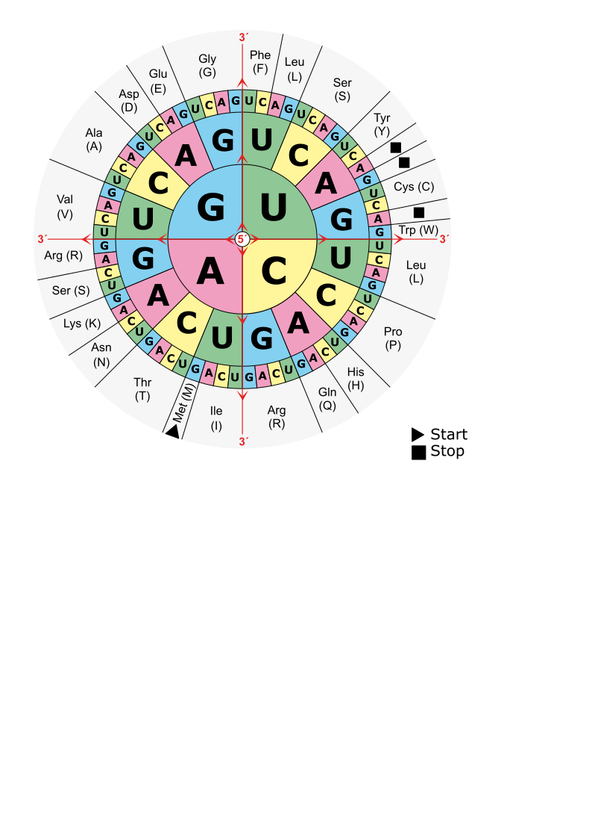
Project 2: Open Reading Frame Detection
A common challenge when working with microbial sequences is that genes have not been annotated yet. To detect genes, you first need to look at all possible open reading frames (ORFs).
There are three possible offsets to create the three nucleotide codons, and codons could be on the forward or the reverse strand. Genes run from a start codon to one of the three stop codon, but some approaches for ORF detection just pick up everything from after a previous stop codon until the next stop codon.
For this project, create a function that takes a sequence of DNA, and returns a list of all ORFs from all six possible reading frames.
Come up with a plan on how you want to handle start codons, and invalid inputs, and how to test your function.
Please submit a Jupyter Notebook file with your plan, code, and tests.
DTU, University of Chinese Academy of Sciences

Slide 5
Thank you
Good luck !
Marjan Mansourvar (marjma@dtu.dk),
YajingHao haoyajing@big.ac.cn,
蔡军 <juncai@big.ac.cn>

