Slide 2
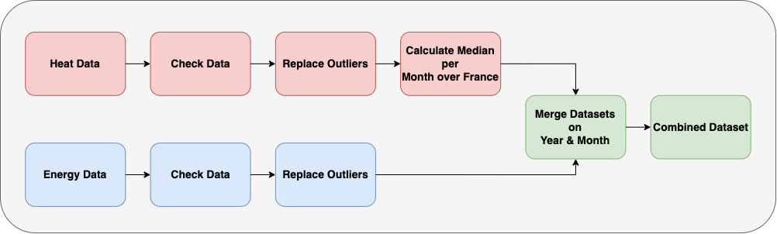
Mission Zero

Slide 3
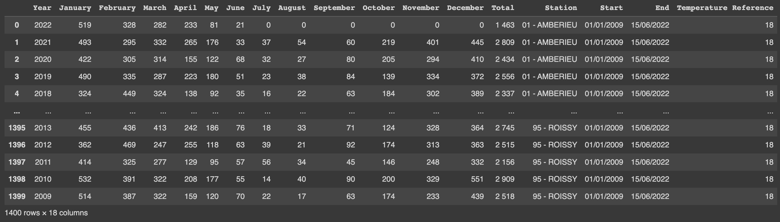
Heath Data
Notes:
Description:
This data was obtained from the French government.
The following data represents the amount of energy consumption required for heating in order the maintain the reference temperature for a given station.
Variables:
Year, indicates year.
Months, multiple columns comprising of energy data related to each month of the year.
Total, indicates total energy demands required for heating a given month.
Station, the location of the weather station (Prefecture & City).
Start, start date of data collection.
End, end date of data collection.
Temperature Reference, the temperature used to determine heating needs.

Slide 4
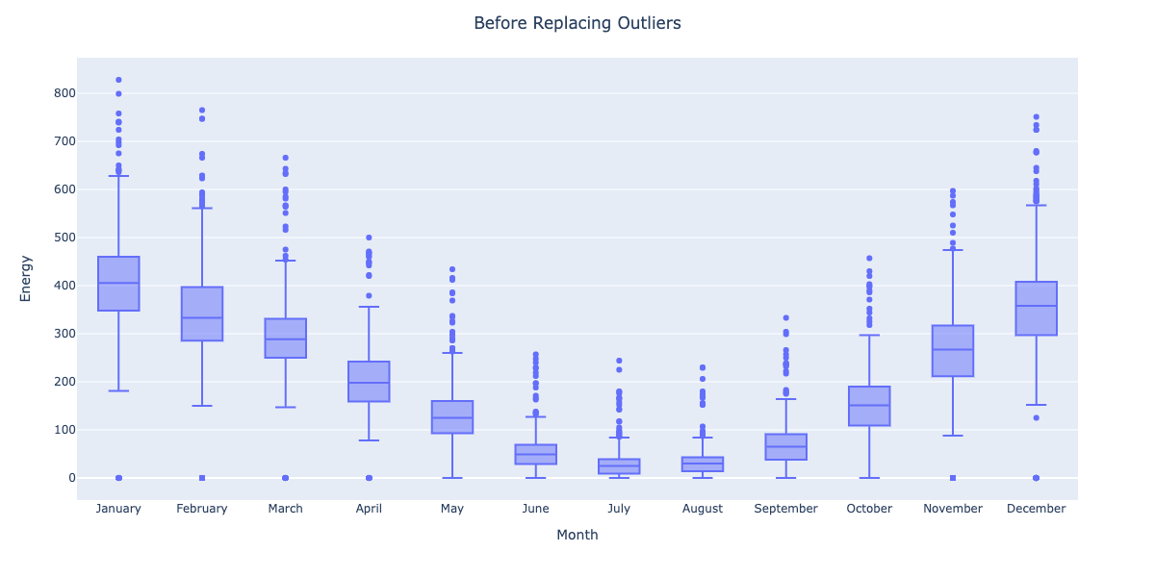
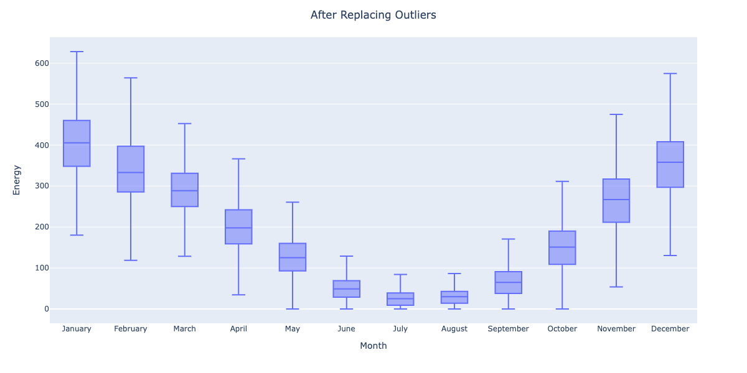
Heat Data

Slide 5
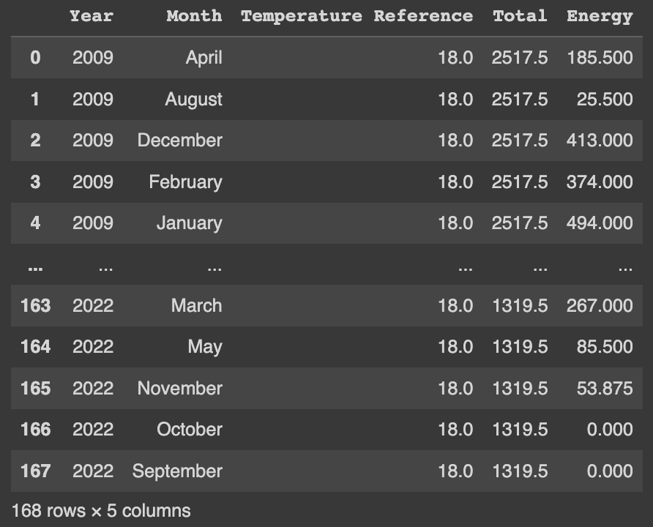
Heat Data

