Slide 1
EMBEDDED SYSTEMS ARCHITECTURE
IoT-Enabled Smart Health Monitoring and Emergency Alert System with AI-Based Anomaly Prediction for Smart City Integration
VITAL · Vitals Intelligence, Tracking & Anomaly Learning
Amay Krishna C R
[Member 2 name]
[Member 3 name]
[Member 4 name]
25BCE0023
[Reg. No.]
[Reg. No.]
[Reg. No.]
Faculty: [Faculty name] · Course: [Course code] · Vellore Institute of Technology
Notes:
SPEAKER: Member 1 (slides 1-7)
Good morning. Our project is an IoT-enabled smart health monitoring and emergency alert system, with AI-based anomaly prediction, designed for smart city integration. We call the software VITAL: Vitals Intelligence, Tracking and Anomaly Learning.
In one line: a small ESP32 device reads your heart rate, blood oxygen and temperature; a website shows them live; machine learning learns what is normal for you and predicts trouble; and if something goes wrong, VITAL alerts your emergency contact automatically.
Our team: [names].

Slide 2
INTRODUCTION
VITAL is a low-cost IoT health monitor built on an ESP32. It measures heart rate, blood oxygen (SpO₂) and body temperature, and shows them on the device and on a live web dashboard.
Machine learning learns each user's normal, flags unusual readings and predicts worrying trends before they turn critical. When something goes wrong, VITAL sends an emergency alert to a family member, and its design connects to a smart city's health network.
Notes:
SPEAKER: Member 1
VITAL brings together three things: an embedded device that measures vital signs, a web dashboard that shows them live, and an intelligence layer that learns, predicts and raises the alarm.
The device uses an ESP32 with a pulse oximeter sensor and an infrared thermometer. The dashboard works for ordinary users and for an administrator. The machine learning learns each person's own normal, and a trend model warns before readings become critical. Emergency alerts go out automatically, and the whole system is designed to feed a city's health network.

Slide 3
PROBLEMS
A
B
C
One-off checks
Same limits for all
Help arrives late
A thermometer or oximeter gives one number, then the moment is gone.
"Normal" is a textbook range. A big change for you can still look normal.
Readings stay on the device, so family or a doctor hear about an emergency only when someone calls.
VITAL watches continuously, learns each person's normal and raises the alarm automatically.
Notes:
SPEAKER: Member 1
Three problems drive this project.
A: checks are occasional. A thermometer or a pulse oximeter gives one number and then the moment is gone.
B: devices judge everyone against the same textbook limits. A resting pulse of 95 is "normal" on paper, but if your usual is 65, that's a big change for you.
C: help arrives late. Readings stay on the device, so in an emergency, family or doctors only find out when someone calls them.
VITAL solves all three: it watches continuously, learns each person's normal, and raises the alarm automatically.

Slide 4
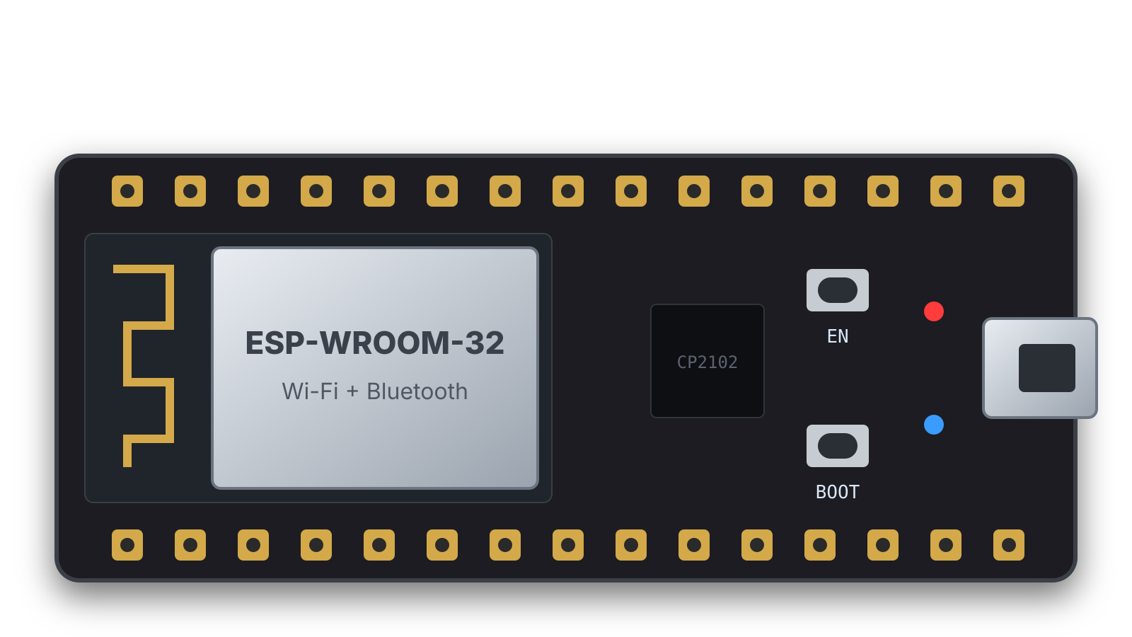
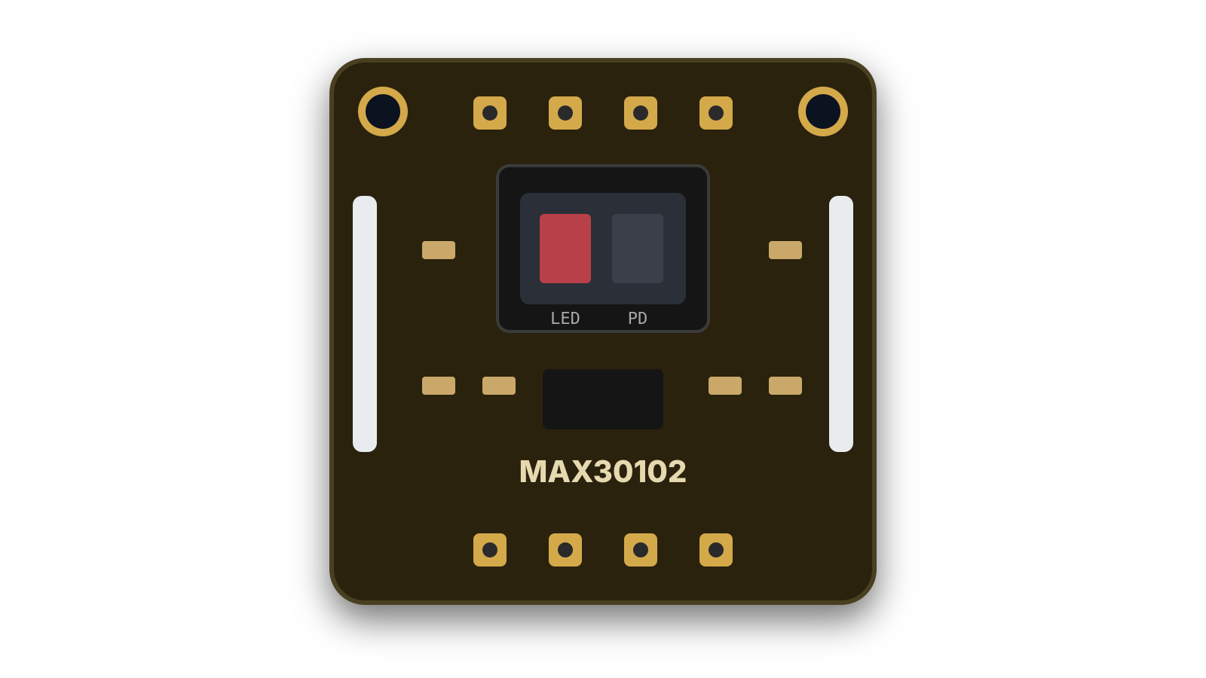
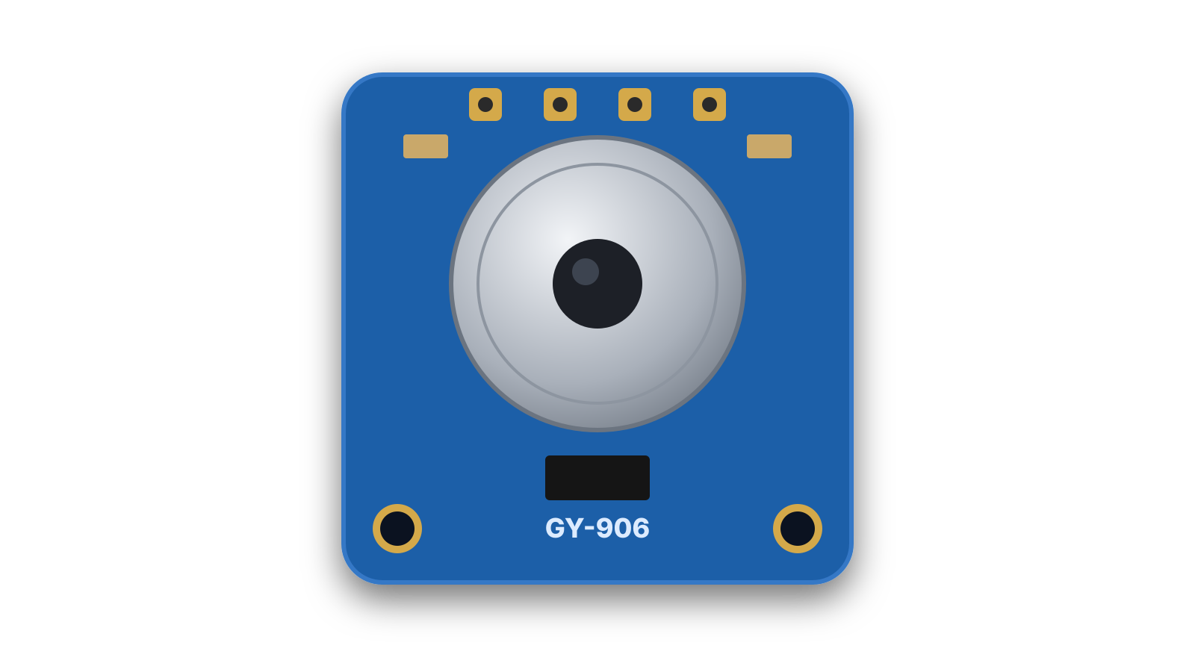
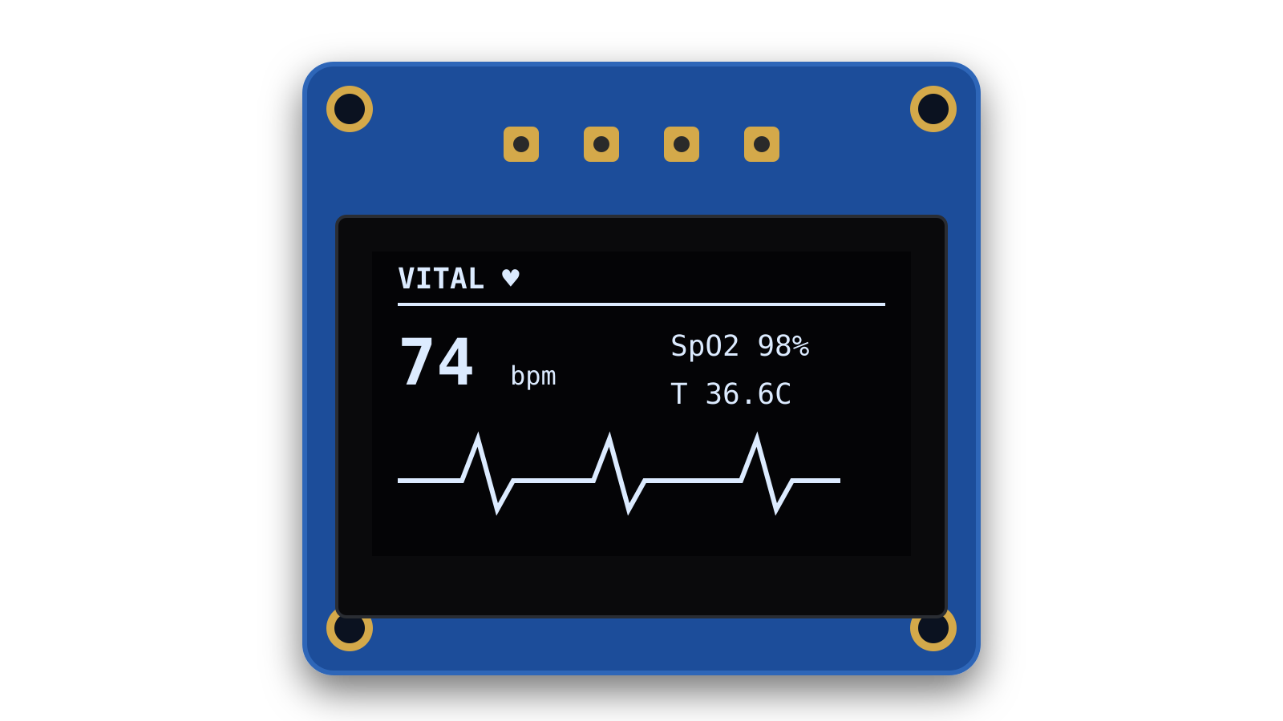
HARDWARE COMPONENTS
THE BRAIN
PULSE + OXYGEN
TEMPERATURE
DISPLAY
ESP32 DevKit V1
MAX30102
GY-906 MLX90614
NFP1315-157B OLED
Dual-core 240 MHz MCU with built-in Wi-Fi. Reads the sensors, sends data to the server.
Red + IR LEDs light the fingertip; a photodetector reads the light that returns.
Non-contact IR thermometer: skin (object) and room (ambient) temperature.
0.96" 128×64 screen (SSD1306 driver) showing live values on the device.
I²C master · Wi-Fi
I²C · 0x57
I²C · 0x5A
I²C · 0x3C
Also: breadboard and male/female jumper wires; USB power from a laptop (3.3 V regulated on board).
Notes:
SPEAKER: Member 1
Our hardware has four parts.
The ESP32 is the brain: a dual-core microcontroller with Wi-Fi built in, so it can read the sensors and send data to our server without any extra module.
The MAX30102 measures heart rate and blood oxygen using light. The GY-906 module carries the MLX90614 non-contact infrared thermometer. The 0.96-inch OLED shows the readings on the device itself.
The key design point is the label at the bottom of each card: all three peripherals speak I2C and each has its own address, so they share the same two data wires.

Slide 5
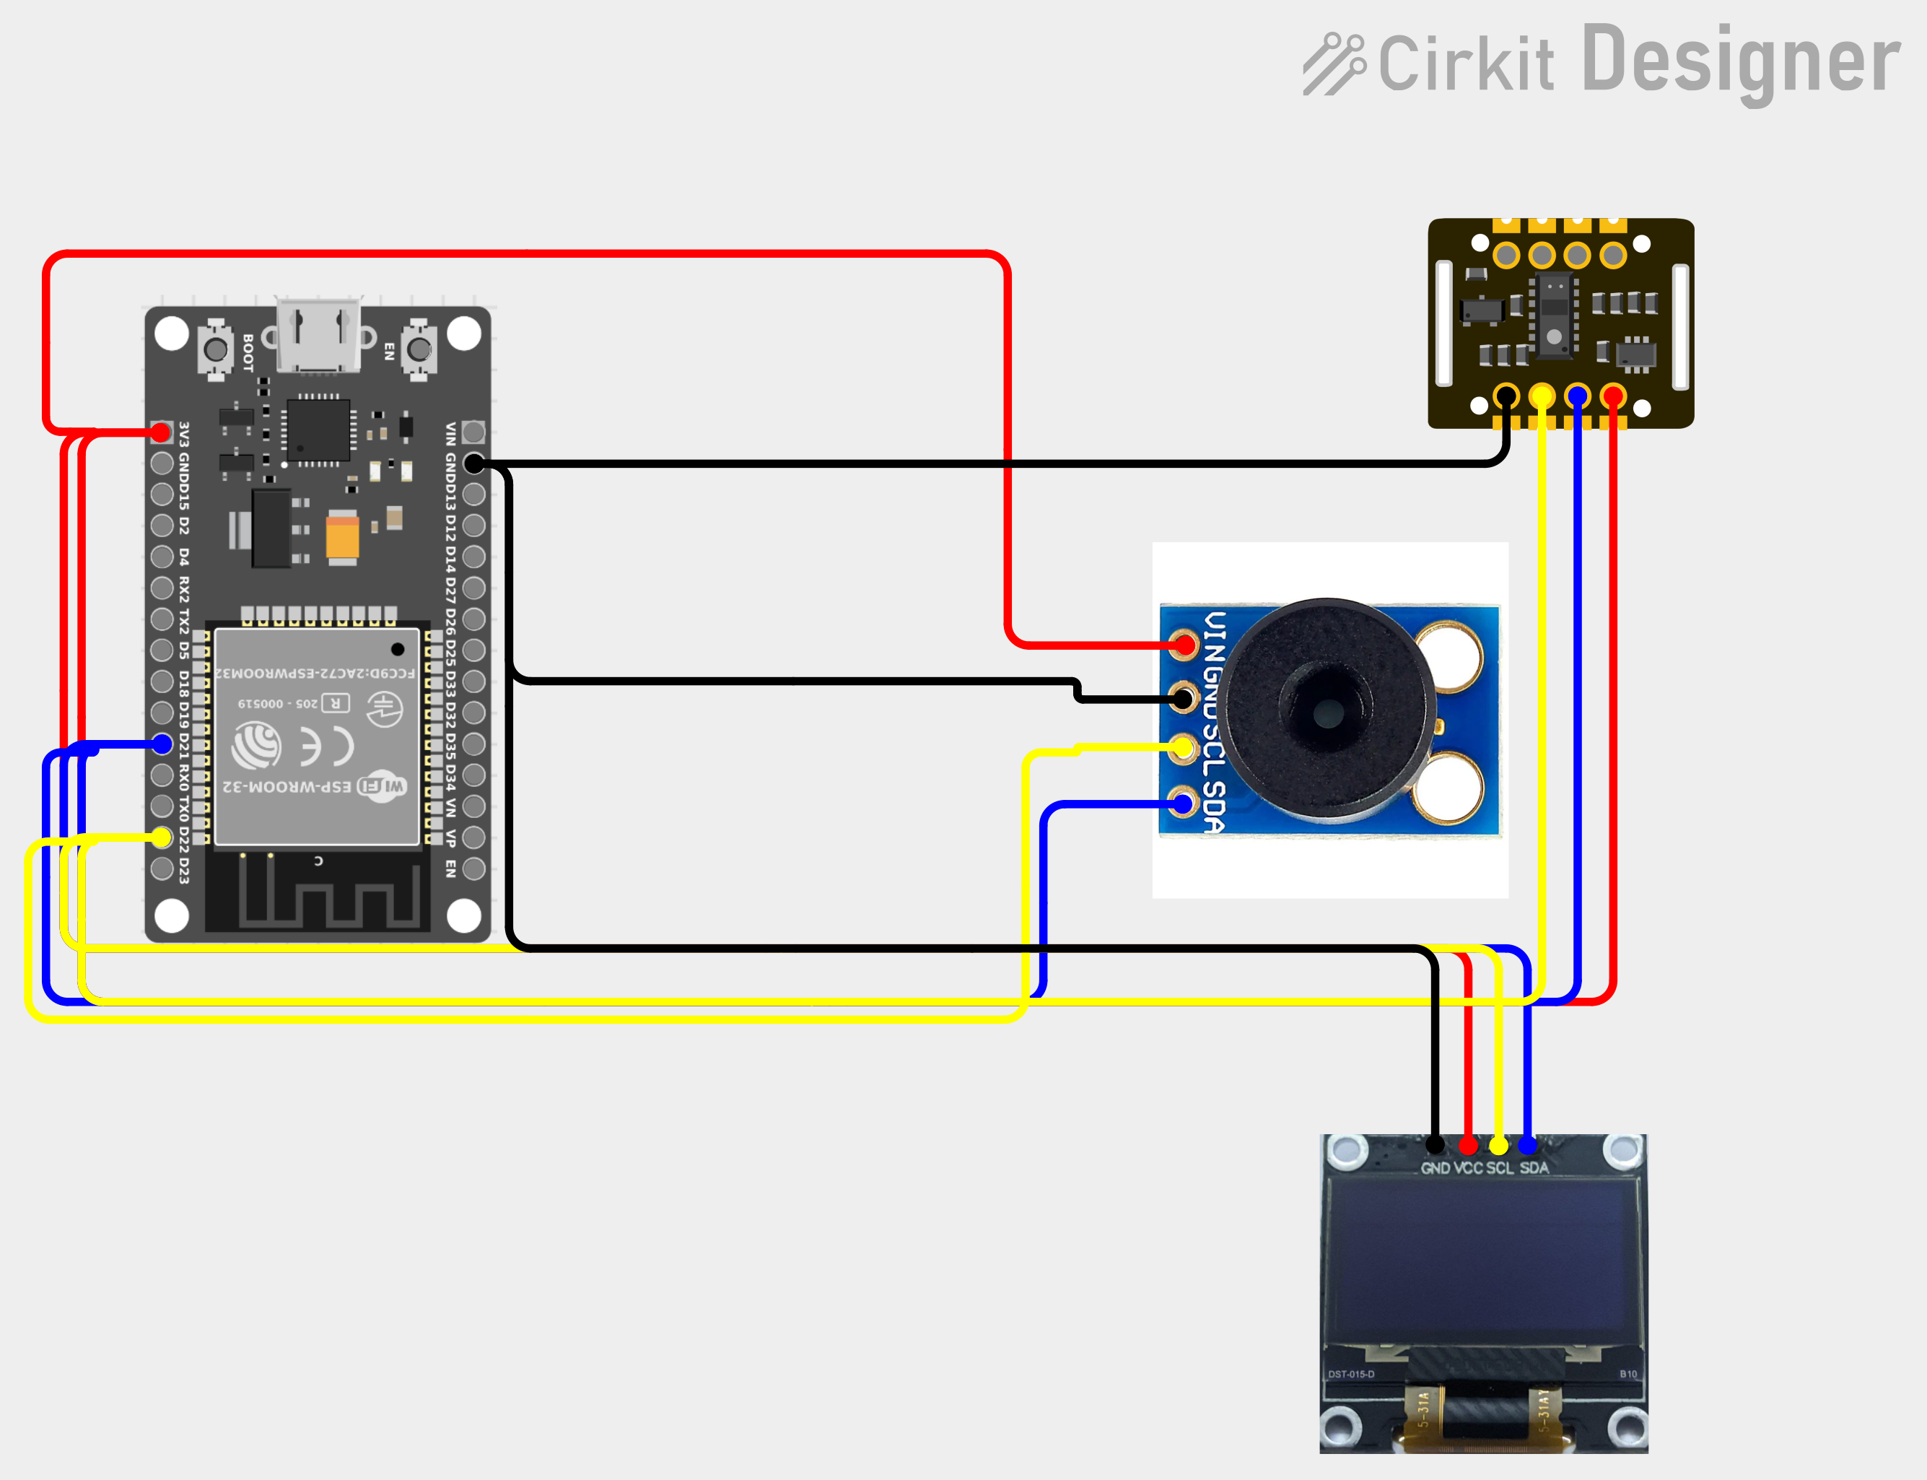
CIRCUIT DIAGRAM
PIN MAP
ESP32 | Each module
3V3 | VIN / VCC
GND | GND
GPIO 21 | SDA
GPIO 22 | SCL
Each module has its own I²C address, so all three share SDA and SCL without clashing. GPIO 21 and 22 are the ESP32's default I²C pins.
Notes:
SPEAKER: Member 1
This is our circuit, drawn in Cirkit Designer. The ESP32's 3.3 volt and ground pins power all three modules.
Data travels on just two wires: SDA, the data line on GPIO 21, and SCL, the clock line on GPIO 22. These are the ESP32's default I2C pins.
Because the MAX30102 is at address 0x57, the thermometer at 0x5A and the OLED at 0x3C, the ESP32 can talk to each one individually on the same two wires.

Slide 6
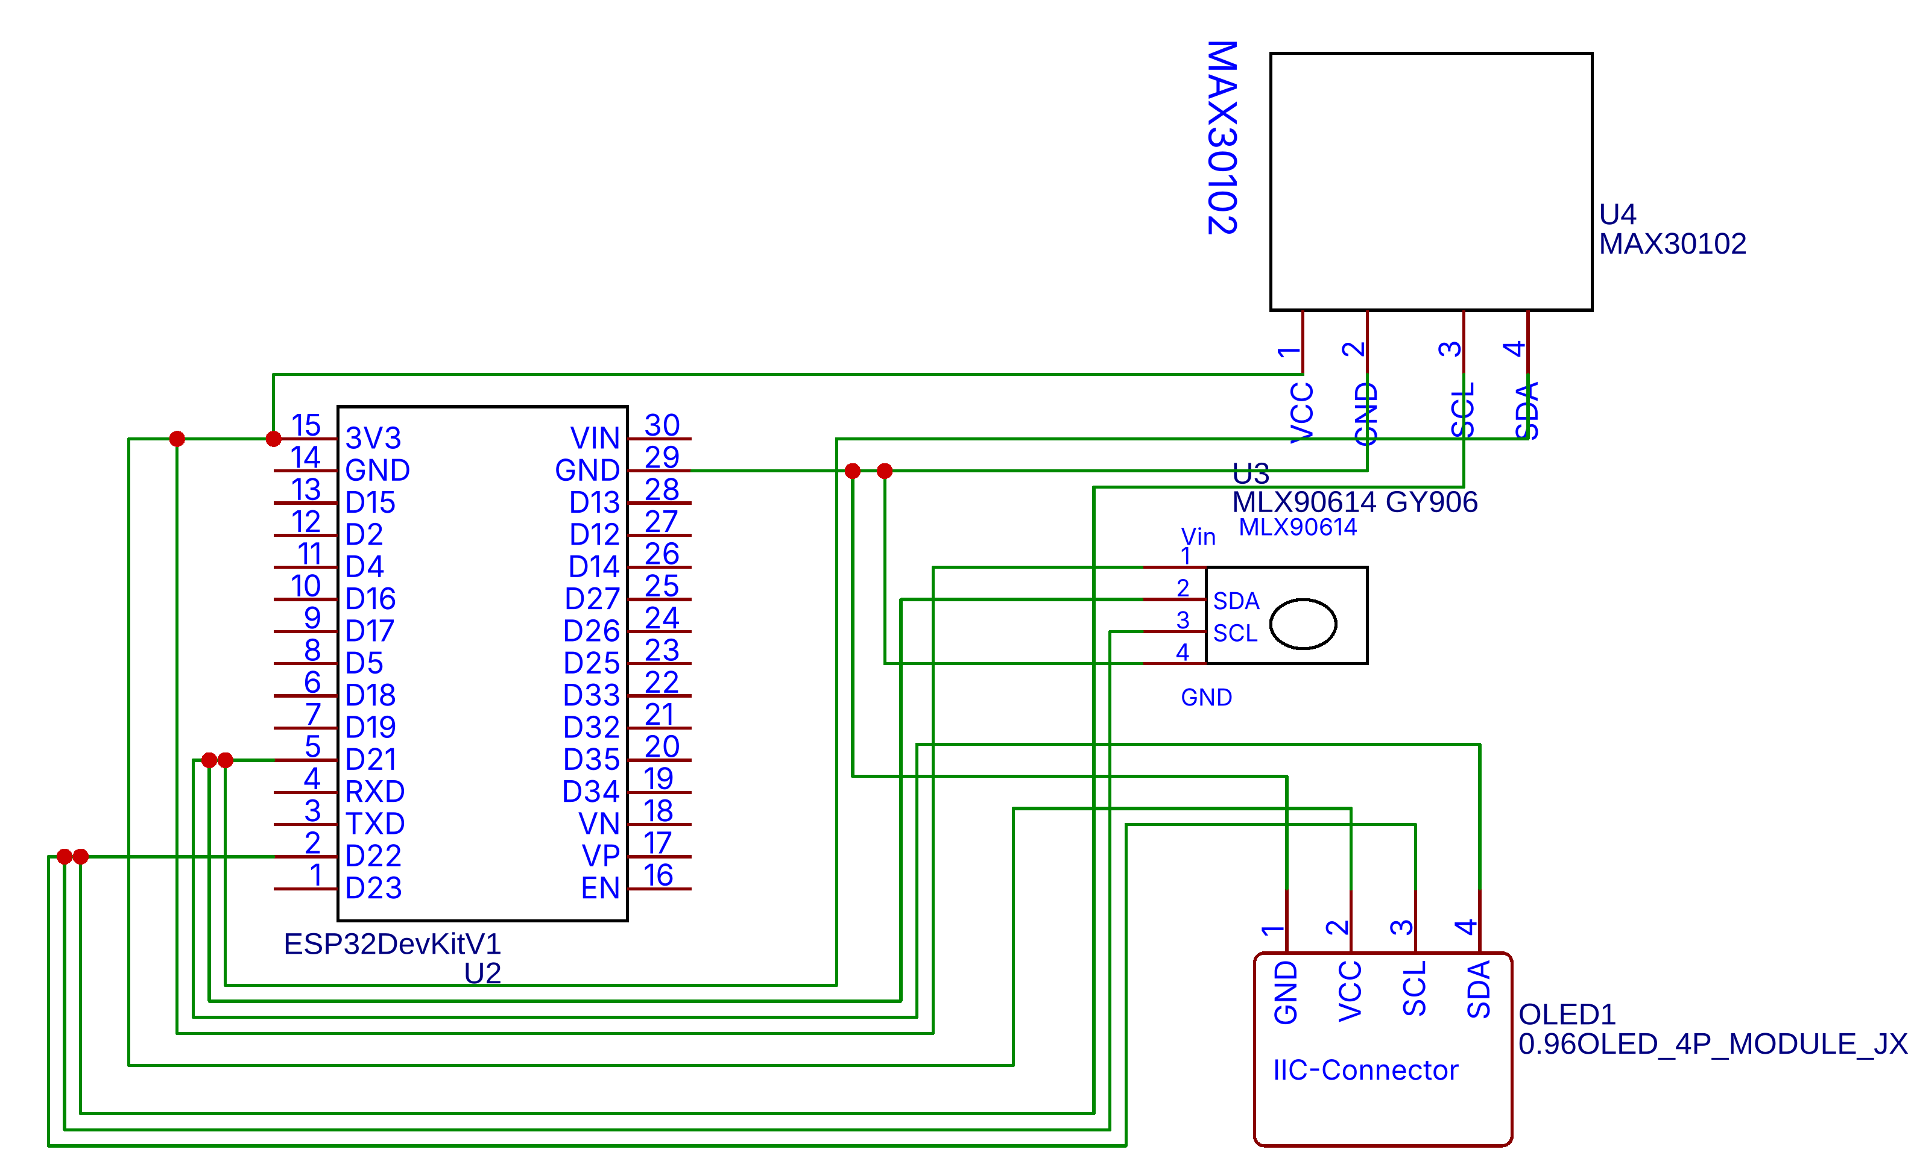
SCHEMATIC
NETS
+3V3
3V3 → VIN ×3
GND
Common ×4
SDA
GPIO 21 → ×3
SCL
GPIO 22 → ×3
POWER BUDGET
ESP32 with Wi-Fi up to ~240 mA; the display and sensors add tens of mA. Well under USB's 500 mA.
Notes:
SPEAKER: Member 1
This is the formal schematic of the same circuit, drawn in EasyEDA.
There are only four nets. The 3.3 volt rail from the ESP32 feeds all three modules, all grounds are common, and the I2C data and clock lines go from GPIO 21 and 22 to every module. The breakout boards include their own regulators and pull-up resistors, so no extra components are needed.
Power: the ESP32 draws up to around 240 milliamps when Wi-Fi transmits; the display and sensors add only tens of milliamps, so it runs comfortably from a laptop's USB port.

Slide 7
HOW VITAL MEASURES YOU
LIGHT → PULSE & SpO₂
INFRARED → TEMPERATURE
FIRMWARE LOOP
Each heartbeat pushes blood into the fingertip and changes how much light it absorbs. The ESP32 finds these peaks to get beats per minute. Comparing red vs infrared absorption gives blood oxygen (SpO₂).
Every warm object gives off infrared radiation. The MLX90614 turns the infrared from your skin into a temperature, without contact. Skin reads slightly below core temperature, so we apply a calibration offset.
1
Read sensors over I²C
2
Filter signal, detect beats
3
Calculate HR, SpO₂, temp
4
Update the OLED
5
Send JSON over Wi-Fi
Repeats every second
Notes:
SPEAKER: Member 1
How does a small sensor read your heartbeat? It uses light, a technique called photoplethysmography or PPG. With every heartbeat a little more blood flows into your fingertip, and blood absorbs light. We detect those peaks and count them. Because oxygen-rich and oxygen-poor blood absorb red and infrared light differently, the ratio between the two channels gives us SpO2.
For temperature, the MLX90614 reads the infrared radiation from your skin without touching it. Skin is slightly cooler than core body temperature, so we calibrate with an offset.
On the right is the firmware loop the ESP32 repeats every second: read, filter, calculate, display, and send.

Slide 8
FIRMWARE
LIBRARIES
vital_firmware.ino · setup()
#include <Wire.h>
#include "MAX30105.h" // SparkFun lib (MAX30102)
#include <Adafruit_MLX90614.h>
#include <Adafruit_SSD1306.h>
#include <WiFi.h>
MAX30105 pox;
Adafruit_MLX90614 mlx;
Adafruit_SSD1306 oled(128, 64, &Wire, -1);
void setup() {
Wire.begin(21, 22); // SDA, SCL
Wire.setClock(100000); // MLX90614 max
pox.begin(Wire, I2C_SPEED_STANDARD); // 0x57
pox.setup(60, 4, 2, 100, 411, 4096); // 100 Hz
mlx.begin(); // 0x5A
oled.begin(SSD1306_SWITCHCAPVCC, 0x3C);
xTaskCreatePinnedToCore(networkTask, "net",
8192, NULL, 1, NULL, 0); // Wi-Fi: core 0
}
SparkFun MAX3010x pulse + SpO₂
Adafruit MLX90614 IR thermometer
Adafruit SSD1306 OLED drawing
WiFi + HTTPClient ESP32 core
DESIGN TARGETS
Sensor sampling
100 Hz
I²C clock
100 kHz
OLED refresh
~5 per s
Upload to server
1 per s
Notes:
SPEAKER: Member 2 (slides 8-13)
This is the start-up code from our firmware, written in the Arduino IDE.
We start the I2C bus on pins 21 and 22 at 100 kilohertz, because the MLX90614 thermometer supports at most 100 kilohertz. Then we initialise each device at its address: the pulse sensor at 0x57, the thermometer at 0x5A and the display at 0x3C. For the MAX30102 we use the SparkFun library; the setup line sets LED brightness, averaging of 4 samples, red plus infrared mode and 100 samples per second.
The last line is an embedded-systems design choice: the ESP32 has two cores, so we run Wi-Fi in a separate FreeRTOS task on core 0. The sensors are read on core 1 and pass one packet per second through a queue, so a slow network never makes the sensor miss a sample.
On the right are the libraries we use and our design targets for sampling and update rates.

Slide 9
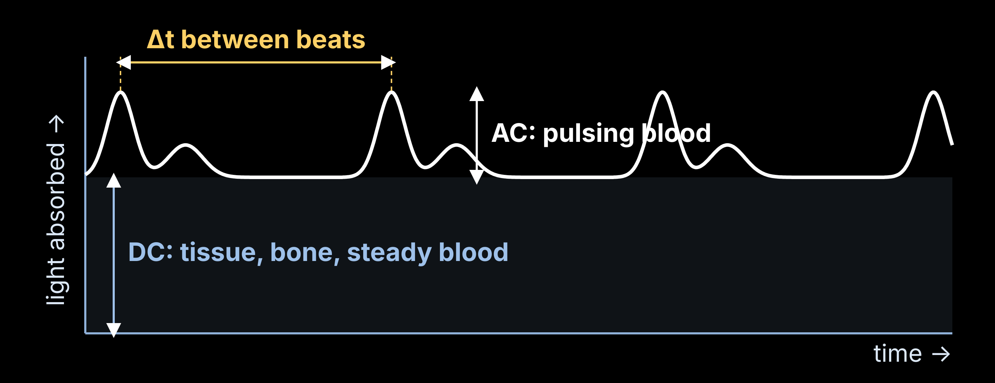
SIGNAL PROCESSING
loop() · beat detection
long ir = pox.getIR();
if (ir < 50000) { // no finger
showMsg("Place finger");
return;
}
if (checkForBeat(ir)) { // peak found
long dt = millis() - lastBeat;
lastBeat = millis();
float bpm = 60.0 / (dt / 1000.0);
if (bpm > 30 && bpm < 220) // sanity
rates[n++ % 4] = bpm; // avg
}
float tempC = mlx.readObjectTempC()
+ TEMP_OFFSET;
Heart rate
BPM = 60 / Δt, averaged over 4 beats
SpO₂
R = (ACr/DCr) ÷ (ACir/DCir); SpO₂ ≈ 110 − 25R
Temperature
T_body ≈ T_skin + calibrated offset
Finger check
IR < ~50,000 → no finger, nothing sent
Notes:
SPEAKER: Member 2
The MAX30102 gives a light-absorption signal with two parts. The large steady part, DC, comes from tissue, bone and blood that doesn't move. The small part that rises and falls, AC, is the blood pushed in by each heartbeat.
Heart rate: we detect each peak and measure the time between beats, delta t. Sixty divided by delta t gives beats per minute, averaged over the last four beats. The code on the right does exactly that and throws away impossible values.
SpO2: we compute the ratio R of the red signal's AC-to-DC to the infrared's AC-to-DC. A widely used approximation is SpO2 ≈ 110 − 25R; Maxim's reference code uses a calibrated lookup table.
Temperature is skin temperature plus a calibrated offset. If the infrared reading is too low, there's no finger on the sensor, so we show "Place finger" instead of sending garbage.

Slide 10
SYSTEM ARCHITECTURE
DEVICE
VITAL SERVER
PEOPLE
SMART CITY
MAX30102
Flask API
User page
City platform
Heart rate + SpO₂
Receives readings
Simple / Detailed
ICCC · ward health map
MLX90614
Database (SQLite)
Admin station
Skin temperature
Users, sessions, readings
All users, alerts
Hospital / 108
Emergency dispatch
ESP32
ML engine
Sends JSON over Wi-Fi, 1 s
Anomaly + trend prediction
Health records
HL7 FHIR format
OLED display
Alert service
Emergency contact
Readings + ALERT
Rules + cooldown
Telegram message
MQTT · anonymised summaries + emergency forwarding
Notes:
SPEAKER: Member 2
This is the complete system in four columns.
The device: the sensors feed the ESP32, which shows readings and alerts on the OLED and sends each reading over Wi-Fi as a small JSON message every second.
The VITAL server runs on a laptop: a Flask API receives readings, stores them in SQLite, and passes them to the ML engine for anomaly detection and trend prediction. The alert service decides when something is an emergency.
People: users see their own page, the admin sees everyone, and the emergency contact gets a Telegram message.
The dashed column is our smart city design: VITAL sends anonymised summaries over MQTT to a city platform, and forwards emergencies to hospitals and the 108 ambulance service. We'll cover this in detail shortly.

Slide 11
SERVER & DATA
Method | Endpoint | Used by
POST | /api/reading | ESP32, every second
POST | /api/session/start | User presses Start
GET | /api/live/<user> | User page, live view
GET | /api/history/<user> | 7-day charts
GET | /api/admin/overview | Admin station
POST /api/reading · JSON
{
"device": "vital-01",
"ts": 1761212400,
"bpm": 74.2,
"spo2": 98,
"temp": 36.62,
"ir": 112840,
"red": 98215,
"finger": true
}
DATABASE (SQLITE)
users
id, name, role, baseline, emergency_chat
sessions
id, user_id, start, end
readings
id, session_id, ts, bpm, spo2, temp, anomaly
One reading per second, about 150 bytes
alerts
id, user_id, ts, type, reason, sent_to
Notes:
SPEAKER: Member 2
Every second the ESP32 sends one small JSON message, like the one on the left, to our Flask server: device ID, timestamp, heart rate, SpO2, temperature, the raw infrared and red values, and whether a finger is present.
The server exposes a small REST API: the ESP32 posts readings, and the website uses the other endpoints for sessions, live data, history charts and the admin station.
Everything is stored in SQLite in four tables: users, including each person's learned baseline and emergency contact; sessions; readings with their anomaly score; and a log of every alert sent.

Slide 12
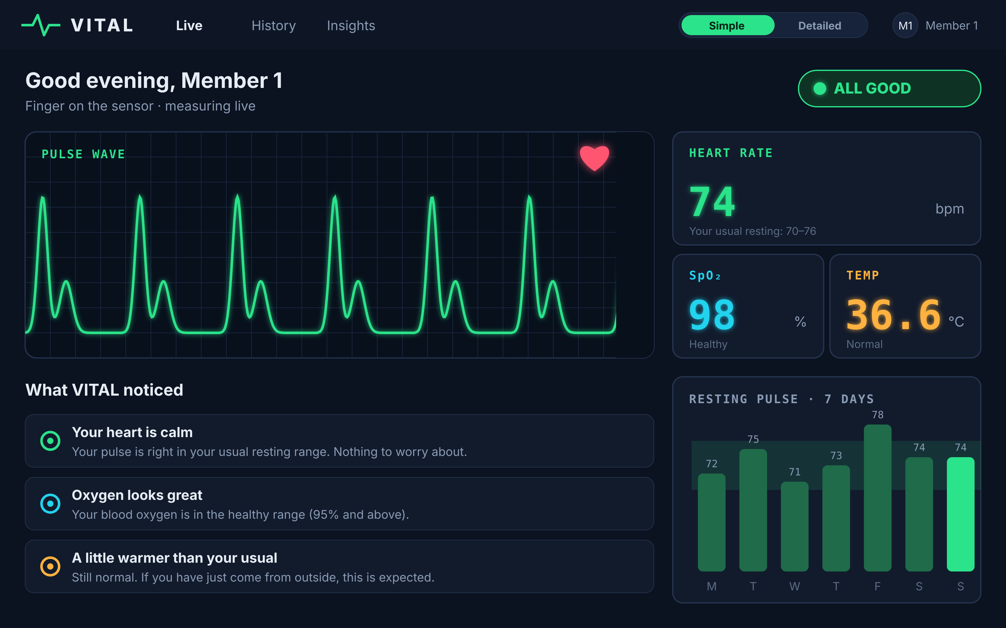
USER DASHBOARD: SIMPLE MODE
1
Live pulse wave
A hospital-monitor style trace that beats at your real heart rate.
2
One clear status
All good, Keep an eye, or Check this. Nothing to decode.
3
Plain-English insights
The ML compares today with your own usual, not a textbook.
Notes:
SPEAKER: Member 2
Here is the user page in Simple mode. It looks like a hospital bedside monitor, but it speaks plain English.
One: the pulse wave is drawn live from the sensor. Two: a single status pill tells you at a glance whether things are fine. Three: the "What VITAL noticed" cards are where the machine learning shows up. Instead of numbers, it says things like "your pulse is in your usual resting range", comparing you with your own history.

Slide 13
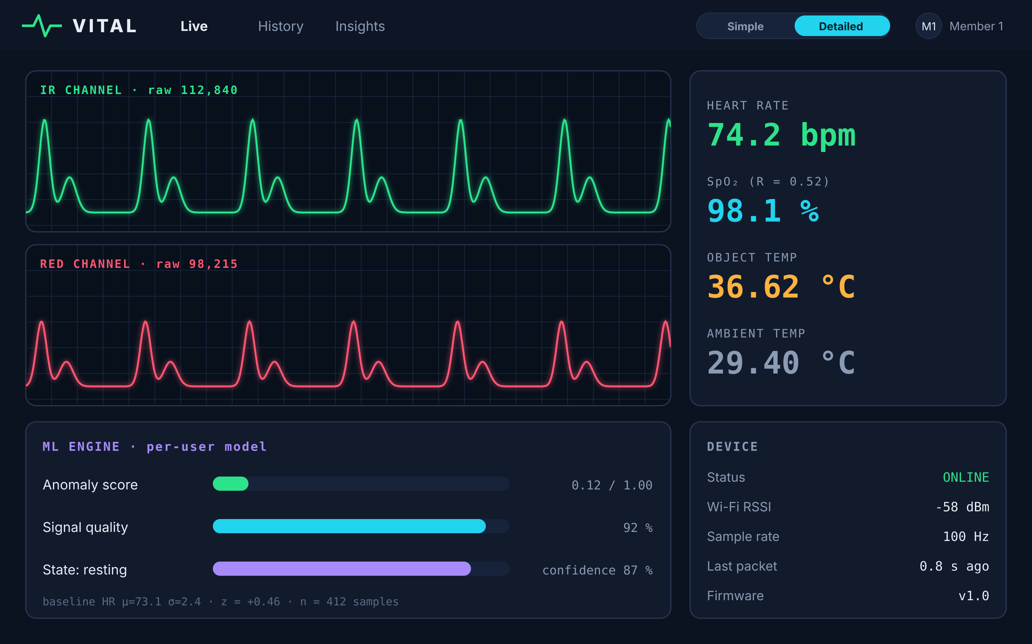
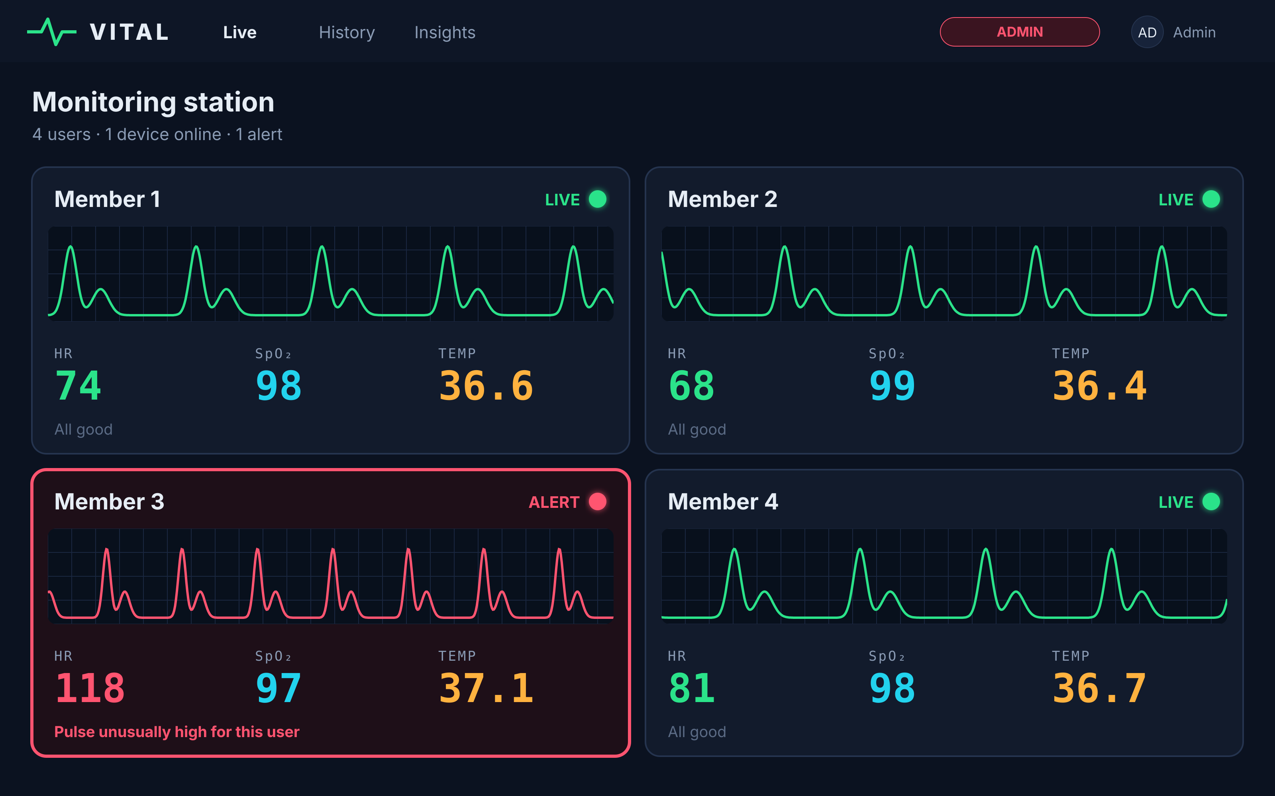
DETAILED MODE & ADMIN
DETAILED MODE
ADMIN STATION
Raw infrared and red signals, exact values, ML anomaly score, signal quality and device health.
Every user at a glance, like a nurses' station. A tile turns red when a reading is unusual for that person.
Notes:
SPEAKER: Member 2
Not everyone wants the same level of detail, so the user page has a toggle: Simple and Detailed. Detailed mode shows the same data in full: the raw infrared and red light signals, exact values, the anomaly score from the ML model, the signal quality and the device's Wi-Fi strength.
On the right is the admin page. It works like a nurses' station: every user gets a live tile, and if the ML decides a reading is unusual for that person, the tile turns red and says why.

Slide 14
MACHINE LEARNING
MAIN MODEL
PREDICTION
SUPPORT
SUPPORT
Anomaly detection
Trend forecasting
Health state
Signal quality
Learns each user's usual heart rate, SpO₂ and temperature (Isolation Forest) and scores how unusual each reading is.
Fits the recent trend of each vital and projects it 15 minutes ahead to warn early.
Labels a session: Resting, Elevated, Possible fever or Low oxygen.
Spots a moving or badly placed finger from the waveform and discards junk readings.
Collect sessions
Extract features
Train per user
Score + predict
Insight or alert
Notes:
SPEAKER: Member 3 (slides 14-20)
VITAL uses four machine learning components.
The main model is personal anomaly detection: it learns what is normal for each user and scores how unusual every new reading is.
The prediction model looks at the recent trend of each vital and projects it 15 minutes ahead, so we can warn before a reading becomes critical.
Two support models help: one labels the state, such as resting or possible fever, and one checks signal quality so bad readings from a moving finger never reach the user.
The pipeline at the bottom: collect sessions, extract features, train per user, score and predict live data, and turn the result into an insight or an alert. VITAL is a wellness and early-warning tool, not a medical diagnosis device.

Slide 15
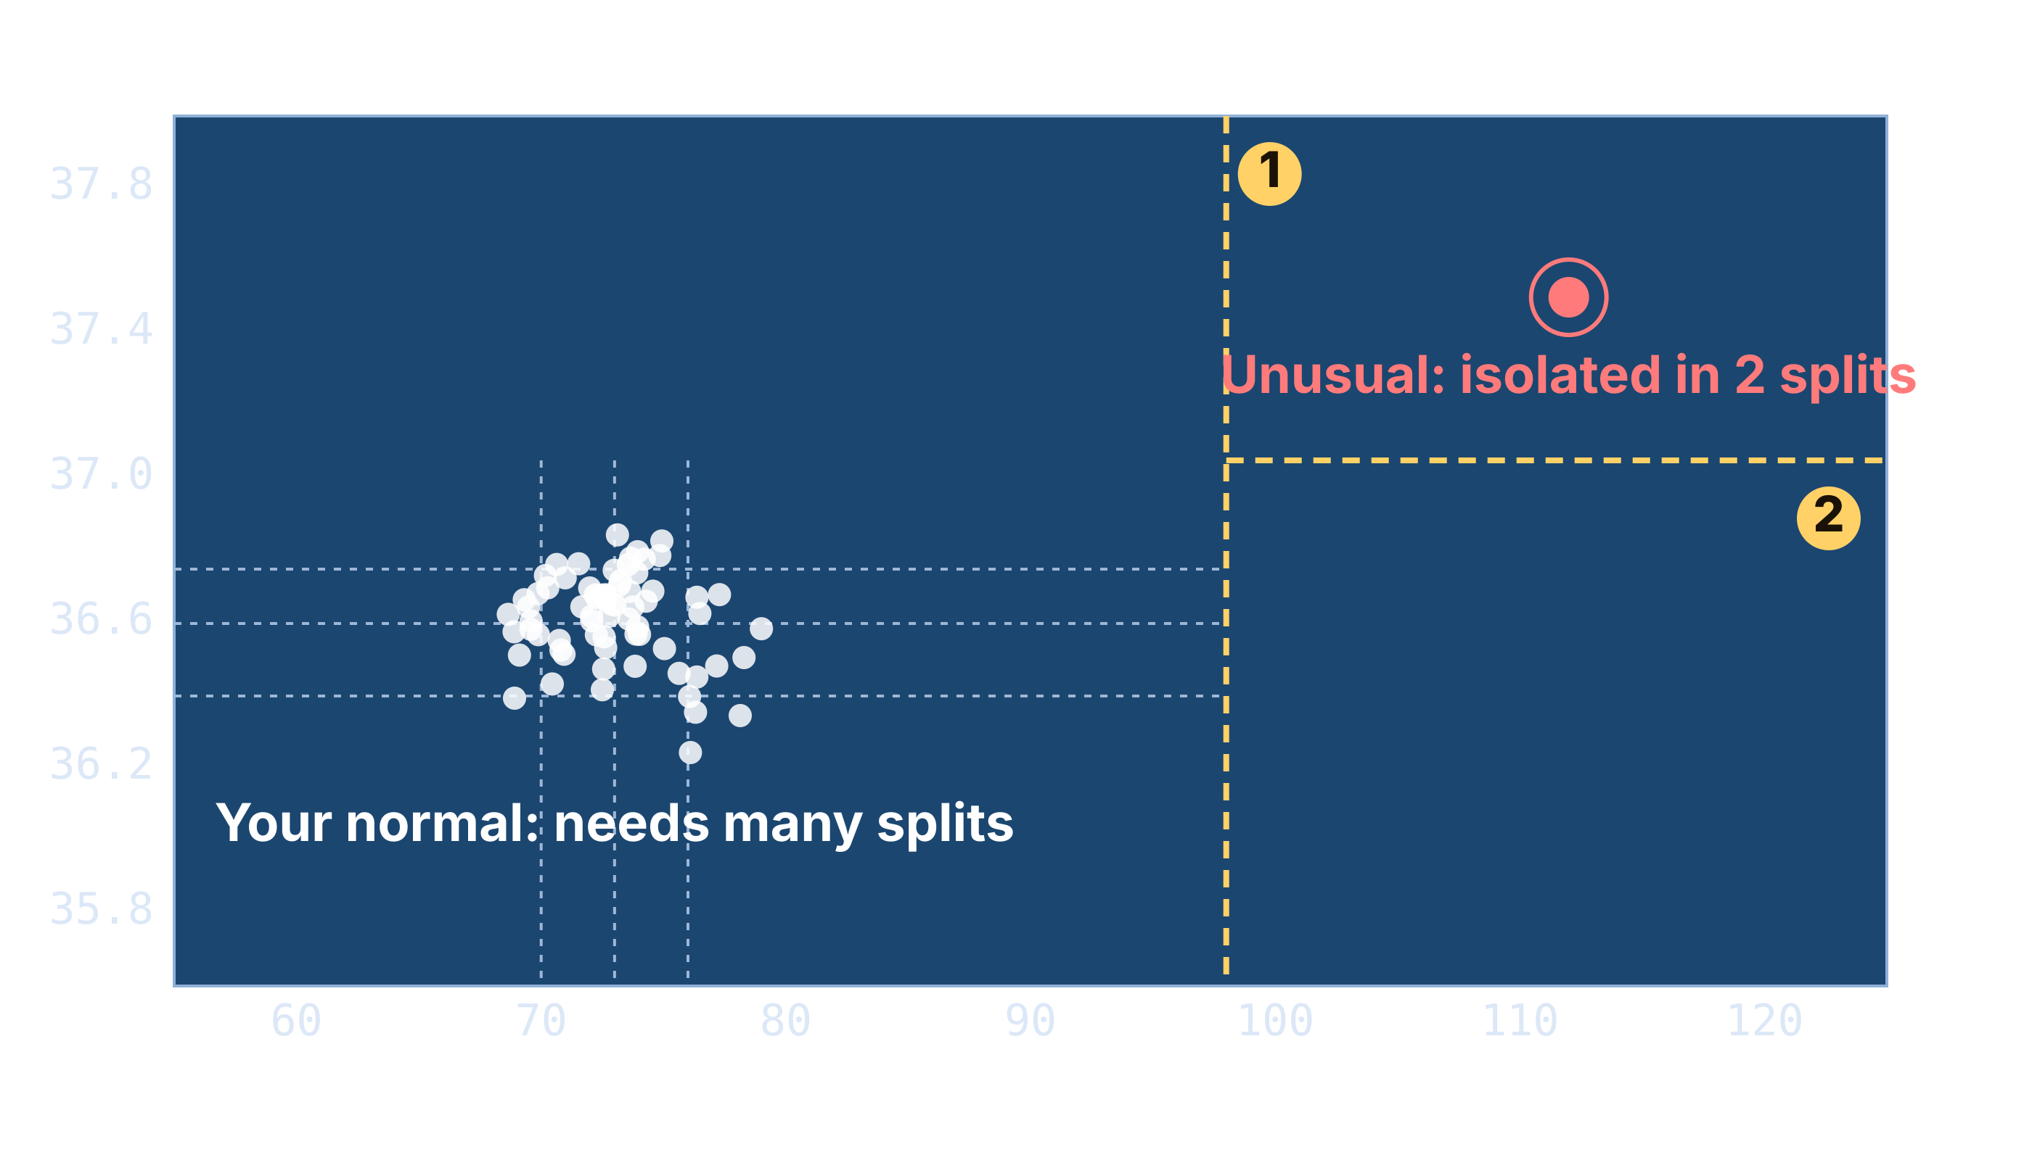
ANOMALY DETECTION
ml/anomaly.py · scikit-learn
from sklearn.ensemble import IsolationForest
# one row per 10-second window
X = build_features(user_readings)
model = IsolationForest(
n_estimators=200, # 200 random trees
contamination=0.05, # ~5% unusual
random_state=42)
model.fit(X) # learn your normal
# higher score = more unusual for you
score = -model.score_samples(x_now)
if score > user_threshold:
alert(user, "Unusual for you")
Builds many random trees that cut the data at random values.
Outliers get cut off in very few splits → high anomaly score.
Trains on normal data only; no "sick" examples needed.
Notes:
SPEAKER: Member 3
The anomaly model is called Isolation Forest.
Imagine plotting every reading by heart rate and temperature. Your normal readings form a tight cluster. The algorithm builds many random trees, each splitting the data at random values. A normal point sits inside the crowd, so it takes many splits to isolate it. An unusual point, like the red one at 112 bpm and 37.5 degrees, is cut off in just two splits. Short path means high anomaly score, averaged over 200 trees.
It only needs normal data to train, so we don't need recordings of people being sick.
On the right is the scikit-learn code: one model per user, and every new window gets a score.

Slide 16
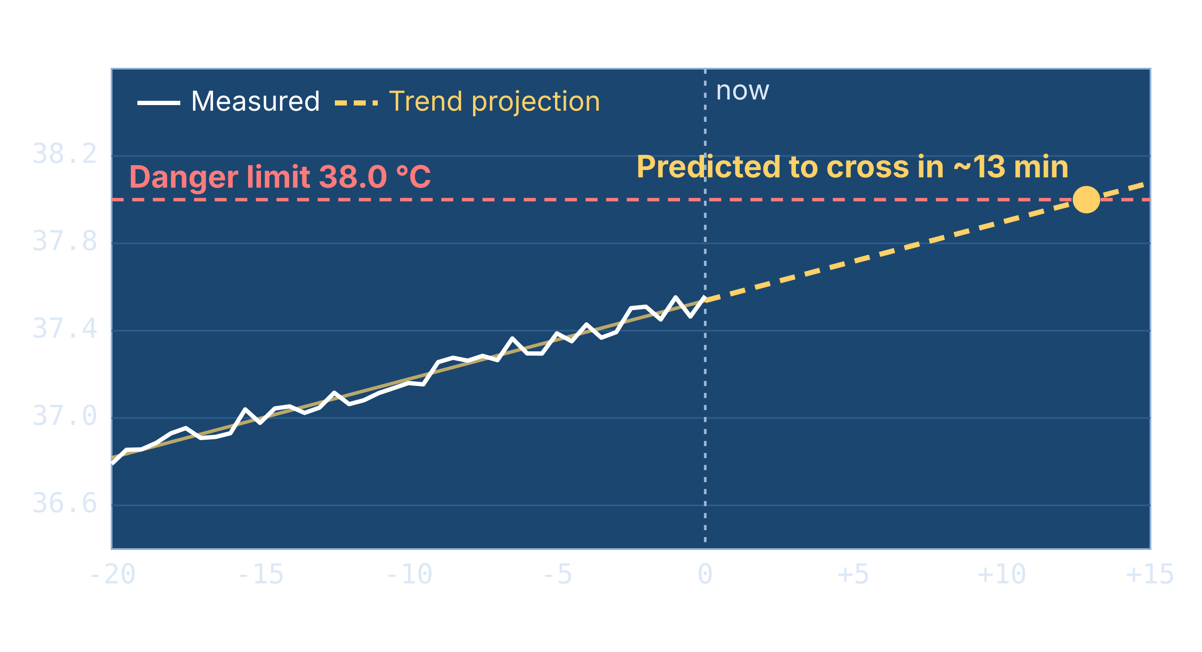
AI-BASED ANOMALY PREDICTION
ml/predict.py · trend forecast
import numpy as np
# last 10 minutes, one point per 10 s
t = minutes[-60:]
y = temps[-60:]
# slope b, intercept a
b, a = np.polyfit(t, y, 1)
future = a + b * (t[-1] + 15)
if b > 0 and future >= 38.0:
eta = (38.0 - y[-1]) / b
warn(user, "Temp rising", eta)
VITAL fits a straight-line trend (linear regression) to each vital over the last 10 minutes and projects it 15 minutes ahead. If the projection crosses a danger limit, it sends an early warning before the reading itself turns critical.
Notes:
SPEAKER: Member 3
Detecting an anomaly tells you something is wrong now. Prediction tells you something is about to go wrong.
VITAL fits a straight-line trend, a linear regression, to each vital over the last ten minutes. In this example temperature has been rising steadily. Projecting the line forward, VITAL calculates it will cross the 38 degree danger limit in about 13 minutes, and sends an early warning now, while there is still time to act.
The code on the right is the whole idea in a few lines: fit the slope with numpy, project 15 minutes ahead, and if the projection crosses the limit, estimate the time left and warn the user. We chose a simple, explainable model on purpose: everyone can see exactly why a warning was raised.

Slide 17
FEATURES, TRAINING & TESTING
FEATURES (10 s)
TRAINING PLAN
HOW WE TEST IT
Mean heart rate
Heart-rate variability
Min and max heart rate
Mean SpO₂
Temperature vs. your baseline
Trend slope (for prediction)
Signal quality (AC/DC)
Resting sessions from each member
Sessions after stairs or exercise, labelled "Elevated"
Moving-finger sessions for the quality model
One anomaly model per user
Retrain as more data arrives
Alerts: precision and recall on held-out sessions
State classifier: accuracy and confusion matrix
Prediction: error between forecast and actual value
Sensors vs. commercial oximeter and thermometer
Notes:
SPEAKER: Member 3
To train any model we need features: numbers that describe a short window of readings. We cut the stream into 10-second windows and compute the features in the first column, including the trend slope used for prediction.
Our training plan: each of us records resting sessions to build a personal baseline, then sessions after climbing stairs labelled "Elevated", and deliberately bad recordings with a moving finger for the signal-quality model.
To test it, we hold back sessions the model has never seen and measure precision and recall of alerts, the classifier's accuracy, and how close predictions were to what actually happened. We also compare our sensor readings against a commercial pulse oximeter and thermometer. With four people the dataset is small, so these results are a proof of concept.

Slide 18



EMERGENCY ALERT SYSTEM
TRIGGERS
ACTIONS
alerts.py · Telegram Bot API
import requests
API = "https://api.telegram.org/bot"
def send_alert(user, reason):
url = API + TOKEN + "/sendMessage"
msg = "VITAL ALERT: " + user.name
msg += " - " + reason
requests.post(url, data={
"chat_id": user.emergency_chat,
"text": msg})
SpO₂ below 90% for 10 s
Heart rate above 120 or below 45 bpm
Temperature 38.5 °C or higher
High anomaly score 3 times in a row
Early warning from trend prediction
Telegram message
to the emergency contact
OLED shows ALERT
on the device itself
Admin tile turns red
5-minute cooldown between repeat alerts
with the reason shown
Notes:
SPEAKER: Member 3
When something goes wrong, VITAL doesn't wait for anyone to look at a screen.
The triggers on the left are deliberately simple and explainable: oxygen below 90 percent for ten seconds, a heart rate above 120 or below 45, a temperature of 38.5 or more, a high anomaly score three times in a row, or an early warning from the prediction model. A five-minute cooldown stops repeat messages.
When a trigger fires, three things happen at once: the emergency contact gets a Telegram message, the OLED on the device shows ALERT, and the person's tile on the admin station turns red.
The code on the right is the actual alert: a single call to the free Telegram Bot API. No extra hardware or paid service is needed.

Slide 19
SMART CITY INTEGRATION
VITAL HUBS
Ward health map
Homes
Fever and alert clusters by area: an early outbreak signal.
City IoT platform
Integrated Command and Control Centre (ICCC) under the Smart Cities Mission. Receives anonymised summaries over MQTT.
Hostels
Emergency dispatch
Critical alerts with location to 108 / nearest hospital.
Clinics
Hospital records
Readings shared in HL7 FHIR format, with consent.
MQTT lightweight IoT messaging
HL7 FHIR health data standard
REST API dashboards and apps
Notes:
SPEAKER: Member 3
This is how VITAL scales from one device to a whole city.
Every home, hostel or clinic running VITAL acts as a hub. Each hub sends anonymised summaries over MQTT, the standard lightweight messaging protocol for IoT, to a city platform. In India this maps onto the Integrated Command and Control Centres built under the Smart Cities Mission.
The city gets three things. A ward-level health map: if many hubs in one area report fevers at the same time, that's an early outbreak signal. Emergency dispatch: critical alerts are forwarded with location to the 108 ambulance service or the nearest hospital. And hospital records: with the patient's consent, readings can be shared in HL7 FHIR, the standard format hospitals use.
The three standards at the bottom are what make this possible: MQTT, FHIR and a normal REST API.

Slide 20
DATA FLOW & PRIVACY
STAYS LOCAL
SHARED WITH CITY
EMERGENCY ONLY
Raw sensor signals
Names and user accounts
Each person's baseline and ML models
Full reading history
Hourly counts per ward: readings, fevers, alerts
Average vitals per ward
No names or device IDs
Groups under 10 people merged
Name and location
Last 5 minutes of readings
Sent to 108 / nearest hospital
Only with consent given at sign-up
Designed around India's Digital Personal Data Protection (DPDP) Act, 2023: consent, purpose limitation and data minimisation.
Notes:
SPEAKER: Member 3
Health data is sensitive, so the city design has three clear tiers.
Everything personal stays on the local VITAL server: raw signals, names, each person's baseline and their full history.
The city only receives anonymised, ward-level counts: how many readings, how many fevers, how many alerts per hour, and average vitals. No names or device IDs, and very small groups are merged so no one can be identified.
Personal details leave the hub only in an emergency, and only for people who gave consent at sign-up: their name, location and last five minutes of readings go to the ambulance service or hospital.
This follows the principles of India's DPDP Act 2023: consent, using data only for its stated purpose, and sharing the minimum needed.

Slide 21
EXISTING SOLUTIONS
Device | HR | SpO₂ | Temp | Live remote view | Many users + admin | Learns + predicts | Emergency alerts | Cost
Fingertip pulse oximeter | ● | ● | — | — | — | — | — | Low
Infrared thermometer | — | — | ● | — | — | — | — | Low
Smartwatch / fitness band | ● | ◐ | ◐ | ◐ | — | ◐ | ◐ | Med–High
Hospital bedside monitor | ● | ● | ● | ● | ● | — | ● | Very high
IoT prototypes [1]–[3] | ● | ● | ● | ● | — | ◐ | ◐ | Low
VITAL (ours) | ● | ● | ● | ● | ● | ● | ● | Low
● yes ◐ partial / some models — no
Notes:
SPEAKER: Member 4 (slides 21-27)
Here's how VITAL compares with what already exists.
Fingertip pulse oximeters are cheap but give a single reading with no history, sharing or alerts. Infrared thermometers measure only temperature.
Smartwatches are the closest consumer product: some models track blood oxygen and skin temperature trends, and some can call for help after a fall. But they belong to one person and are relatively expensive.
Hospital bedside monitors do almost everything, including central stations and alarms, but they cost lakhs and use fixed thresholds rather than learning each patient.
Many IoT research prototypes, references 1 to 3, use the same sensors; a few add ML, but rarely per-person learning, prediction or a multi-user admin view.
The last row is VITAL: every column covered, at low cost.

Slide 22





WHAT MAKES VITAL DIFFERENT
Learns your normal
Predicts before it happens
Instant emergency alerts
Alerts use each person's own baseline, not one threshold for everyone.
Trend forecasting warns minutes before a reading turns critical.
A Telegram message reaches the emergency contact automatically.
One device, many users
Two views, one data stream
Smart-city ready
Per-user history and an admin station: family, hostel or clinic.
Simple mode for anyone; Detailed mode for raw signals and scores.
Anonymised, standards-based data flow to city platforms and 108.
Some of these exist on their own. Together, on a low-cost device built from off-the-shelf parts, they don't.
Notes:
SPEAKER: Member 4
So what is new in VITAL?
It learns your normal, so alerts are personal. It predicts, warning minutes before a reading becomes critical. It sends emergency alerts automatically. One device serves many users with an admin station on top. It offers two views of the same data. And it is designed to plug into a smart city's health network.
To be honest about it: some of these features exist individually; for example, smartwatches show trends. What doesn't exist is all of them together on a low-cost device built from off-the-shelf parts.

Slide 23




FUTURE SCOPE
Fall & motion detection
ECG heart rhythm
Wearable version
LEFT OUT FOR COST
HARDWARE ADD-ON
HARDWARE ADD-ON
A gyroscope/accelerometer (e.g. MPU6050) to detect falls and cancel motion noise.
An ECG front-end (e.g. AD8232) to spot irregular rhythms, not just rate.
Li-ion battery and a 3D-printed wrist or finger case for all-day use.
Mobile app
On-device ML (TinyML)
Live city pilot
SOFTWARE
SOFTWARE
NEEDS PARTNERS
A companion app with push notifications and history on the phone.
Run the anomaly model on the ESP32 itself, so no laptop is needed.
Connect real VITAL hubs to a city ICCC in a pilot deployment.
Notes:
SPEAKER: Member 4
Here's where VITAL can go next.
First, the one we really wanted: a gyroscope and accelerometer to detect falls, which matters a lot for elderly users, and to clean up the pulse signal when the hand moves. We left it out of this version to keep the cost down.
Second, an ECG module for heart rhythm. Third, a wearable version with a battery and a 3D-printed case.
On the software side: a companion mobile app, running the ML directly on the ESP32 with TinyML so no laptop is needed, and finally a live pilot connecting real VITAL hubs to a city command centre.

Slide 24
SDGs WE SUPPORT
3
9
10
11
SDG
SDG
SDG
SDG
Good Health and Well-being
Industry, Innovation and Infrastructure
Reduced Inequalities
Sustainable Cities and Communities
Continuous monitoring and early warnings at home. Supports targets 3.4 and 3.8.
A new health tool built from affordable parts and open-source software.
Low cost and multi-user, so one unit can serve a family, hostel or rural clinic.
Ward-level health maps and faster emergency response for safer cities.
Notes:
SPEAKER: Member 4
VITAL supports four of the UN Sustainable Development Goals.
SDG 3, Good Health and Well-being: continuous monitoring and early warnings support target 3.4 on non-communicable diseases and 3.8 on access to health care.
SDG 9, Industry, Innovation and Infrastructure: a useful health tool built from affordable parts and open-source software.
SDG 10, Reduced Inequalities: low cost and multi-user, so one device can serve people who can't afford hospital equipment.
And SDG 11, Sustainable Cities and Communities: our smart city design gives cities ward-level health maps and faster emergency response.

Slide 25
CONCLUSION
1
Three vitals, one low-cost device
VITAL AT A GLANCE
HR, SpO₂ and temperature on an ESP32, shown on an OLED and a live website.
Vital signs measured
3
2
AI that knows you
Hardware modules
4
Personal anomaly detection plus trend prediction that warns early.
Shared I²C data wires
2
3
Help, automatically
Update interval
1 s
Telegram alerts to an emergency contact, with device and admin alarms.
Dashboard views
3
Ready for smart cities
ML models
4
4
Anonymised, standards-based data flow to city platforms and 108.
Alert channels
3
Notes:
SPEAKER: Member 4
To conclude. VITAL measures three vital signs on one low-cost ESP32 device and shows them on the device and on a live website. Its AI knows each user: it detects what is unusual for them and predicts worrying trends early. When something goes wrong, help is called automatically. And it is designed from the start to plug into a smart city's health network.
On the right is VITAL at a glance: three vital signs, four hardware modules on two data wires, readings every second, three dashboard views, four ML models and three alert channels.

Slide 26
REFERENCES
1
R. Ahmad et al., "Development of blood oxygen level, heart rate and temperature monitoring system by using ESP32," in Proc. 4th Int. Conf. Smart Sensors and Application (ICSSA), 2022, doi: 10.1109/ICSSA54161.2022.9870943.
2
S. Ashraf, S. P. Khattak, and M. T. Iqbal, "Design and implementation of an open-source and Internet-of-Things-based health monitoring system," J. Low Power Electron. Appl., vol. 13, no. 4, p. 57, 2023, doi: 10.3390/jlpea13040057.
3
S. Deshmukh, S. Shah, A. Wahedna, and N. Sabnis, "IoT-enabled smart healthcare system with machine learning for real-time vital sign monitoring and anomaly detection," Indonesian J. Elect. Eng. Comput. Sci., vol. 39, no. 2, pp. 1155–1163, 2025, doi: 10.11591/ijeecs.v39.i2.pp1155-1163.
4
P. Arpaia, F. Crauso, E. De Benedetto, L. Duraccio, G. Improta, and F. Serino, "Soft transducer for patient's vitals telemonitoring with deep learning-based personalized anomaly detection," Sensors, vol. 22, no. 2, p. 536, 2022, doi: 10.3390/s22020536.
5
K. M. Sivan et al., "Heart rate anomaly detection using contractive autoencoder for smartwatch-based health monitoring," in Proc. 15th Int. Conf. Software, Knowledge, Information Management and Applications (SKIMA), 2023, pp. 118–123, doi: 10.1109/SKIMA59232.2023.10387334.
Notes:
SPEAKER: Member 4 (only if asked)
[1] and [2] are ESP32 health monitors similar to our hardware; [1] uses the same MAX30102 plus an infrared temperature sensor and compares accuracy with a hospital monitor.
[3] combines a MAX30102-based IoT system with an LSTM model for anomaly detection.
[4] and [5] support our core ML idea: anomaly detection personalised to the individual, using wearable vital-sign and heart-rate data.

Slide 27
THANK YOU
Questions?
VITAL · Vitals Intelligence, Tracking & Anomaly Learning
Notes:
SPEAKER: Member 4
Thank you. We're happy to take any questions.

