Slide 1


Synopsis Presentation on Credit Card Fraud Detection
Guided By: Presented By:
(Dr.) Manish Vyas Khushi Agrawal
Amay Saxena
Akshat Soni
Ameer Saif Khan

Slide 2
Contents
Introduction
1.1 Overview
1.2 Purpose
Literature Review
Problem Statement
Proposed Solution
Objectives
Theoretical Analysis
6.1 Block Diagram
6.2 Hardware Requirements
6.3 Software Requirements
Applications
GitHub
Reference

Slide 3
1. Introduction
What is Credit Card Fraud Detection?
It is a model which uses some tools and practices to prevent fraudulent transactions on credit cards. The goal is to stop unauthorized transactions as quickly as possible to minimize financial losses for both cardholder n card issuer. Credit card fraud detection uses various techniques and technologies, which includes Anomaly detection. Machine learning. Real-time alerts. Automated data controls. Risk scores.
1.1 Overview
Uses machine learning to detect fraudulent transactions.
Analyzes patterns in transaction data to flag anomalies.
Protects consumers and financial institutions from losses.
1.2 Purpose
Prevent fraud by identifying fraudulent transactions early.
Reduce costs by minimizing manual intervention and chargebacks.
Ensure scalability for use across various sectors while complying with financial standards.

Slide 4
2. Literature Review
Sr. No. | Name of Solution/System | Features | Limitations/ Drawbacks
1. | FICO Falcon Fraud Manager | Real-time fraud detection using machine learning. Customizable fraud rules and scoring models. | Can produce false positives, leading to legitimate transactions being flagged. Complexity in customization requires significant expertise.
2. | SAS Fraud Management | Advanced analytics and machine learning algorithms. Real-time transaction monitoring and alerts. Integration with various data sources for comprehensive analysis. | High implementation and maintenance costs. Requires extensive data preparation and modeling.
3. | Kount | AI-driven decision engine for transaction analysis. Device fingerprinting and customer behavior analytics. Risk score assessment based on multiple parameters. | Limited effectiveness against new or evolving fraud tactics. Dependency on historical data may restrict adaptability.

Slide 5
3. Problem Statement
Existing fraud detection systems have limitations in detecting new and evolving fraud patterns.
High false positives in current models lead to frustration for legitimate customers and increased costs for financial institutions.
Many systems rely heavily on rule-based methods that are inflexible and unable to adapt to sophisticated fraud tactics.
Complexity and high costs of implementing and maintaining advanced solutions pose challenges for smaller organizations.

Slide 6
4. Proposed Solution
Machine Learning Model : Uses model trained on historical data to predict the likelihood of a transaction being fraudulent, therefore overcoming traditional rule-based limitations.
Model Development : Create a credit card fraud detection model using deep learning techniques like convolutional neural networks (CNNs) or recurrent neural networks (RNNs).
Scalable and Cost-Effective : Create a solution that is scalable and affordable, making it accessible for smaller organizations.
Data Privacy and Efficiency : Implement privacy-preserving methods like dimensionality reduction to process data efficiently while protecting sensitive information.

Slide 7
5. Objectives
Fraud Prevention : Detect and prevent fraudulent transactions to protect users from financial losses.
Real-Time Detection : Implement a system that identifies fraud in real-time to minimize the impact of unauthorized transactions.
Cost Reduction : Reduce manual intervention and associated costs by automating the fraud detection process.
Scalability : Ensure the system can scale across various sectors while complying with financial regulations.

Slide 8
6. Theoretical Analysis
Transaction Data (Inputs & Signals)
Data Preprocessing - Cleaning - Normalization - Feature Selection
Fraud Detection Techniques - Rule-Based Systems - Machine Learning - Statistical Models
Risk Scoring - Assigning Scores - Threshold Setting
Decision Making - Accept / Reject - Alerts Generation
Feedback Loop - Manual Review - Model Improvement - Data Update

Slide 9
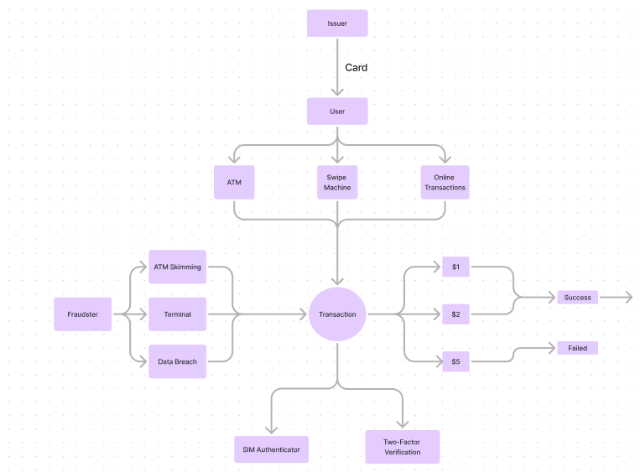
6.1 Block Diagram (Diagram that shows the components of the systems and their organization)

Slide 10
6.2 Hardware Requirements
Computer/Server : High-performance machine with sufficient CPU/GPU power and RAM for processing large datasets.
Storage Devices : High-capacity SSD or external storage to accommodate large datasets used for training and testing models.

Slide 11
6.3 Software Requirements
Programming Languages :
1) Python: Machine learning and data manipulation.
2) R: Statistical analysis.
Machine Learning Libraries :
1) Scikit-learn : Basic machine learning algorithms.
2) TensorFlow/PyTorch : Advanced model development.
Data Manipulation Libraries :
1) Pandas : Data manipulation and analysis.
2) NumPy : Numerical operations.
Database Management Systems :
1) MySQL/PostgreSQL : Relational database management.
2) MongoDB : Non-relational data handling.

Slide 12
7. Applications
Online Retailers : Prevent unauthorized transactions and fraud in e-commerce.
Banking and Financial Institutions : Secure online/in-store transactions; monitor for suspicious activity.
Mobile Payment Services : Ensure secure app and wallet transactions; protect users from fraud.
Insurance Companies : Identify fraudulent claims; process only legitimate transactions.
Telecommunications : Detect and prevent fraud and identity theft in mobile services.

Slide 13
8. GitHub Link
https://github.com/amaysaxena02/Minor-Project

Slide 14
9. Reference
Bence Jendruszak (2024). Credit Card Fraud Detection: What is It, How It Works and Its Importance. SEON
Ravindra Saini (2023). A Survey on Detection of Fraudulent Credit Card Transactions Using Machine Learning Algorithms. IEEE Explore
Malam Alamri (2022). Survey of Credit Card Anomaly and Fraud Detection Using Sampling Techniques. SafetyCulture
SEON Resources. Credit Card Fraud Detection. SEON

Slide 15
Thank You
Queries ?

