Slide 1
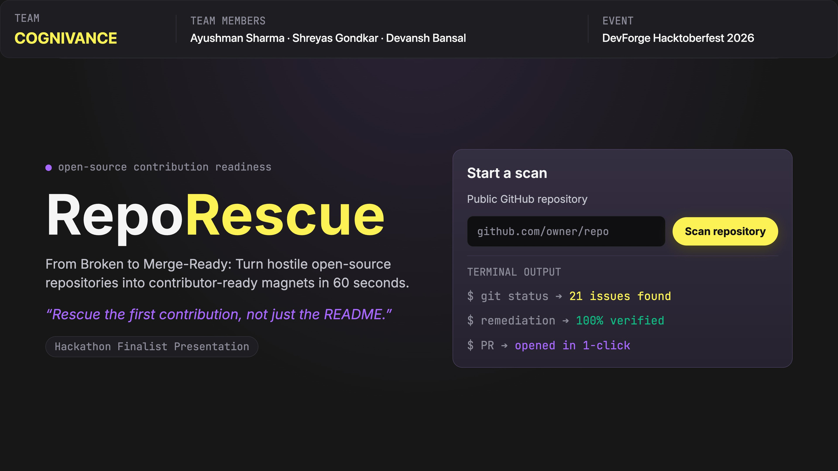
Notes:
1

Slide 2
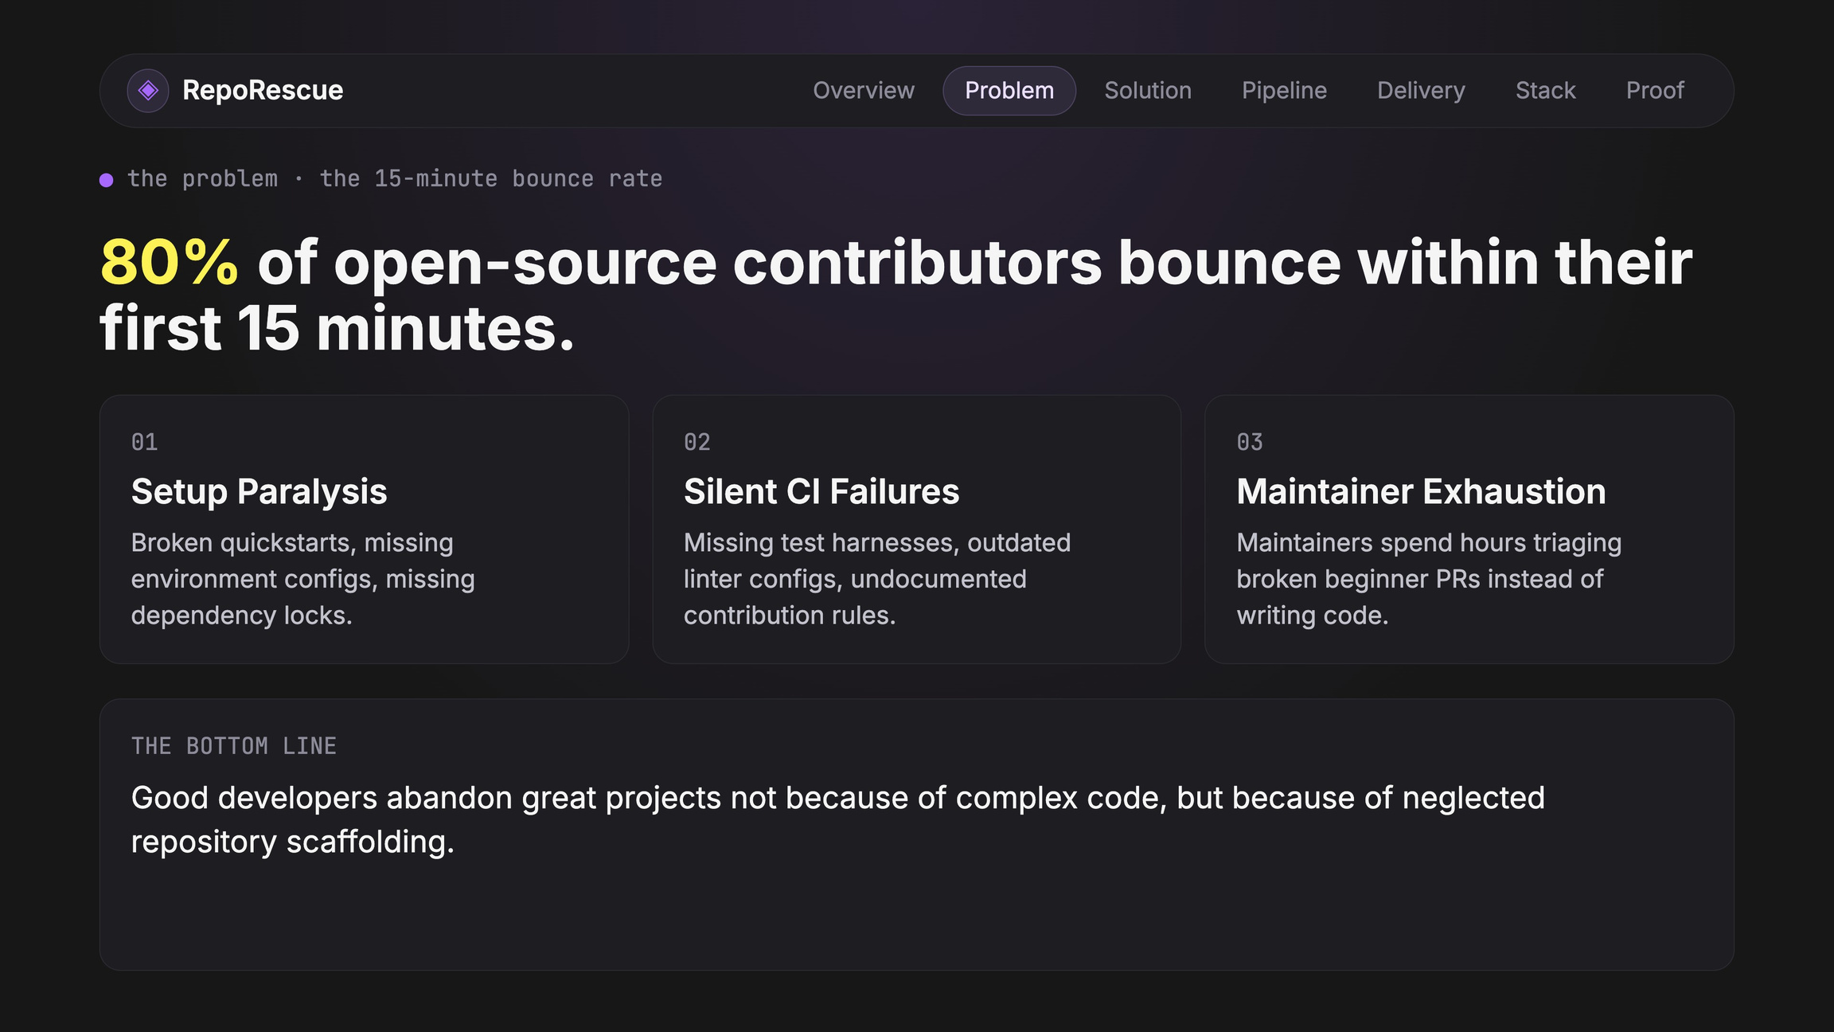
Notes:
2

Slide 3
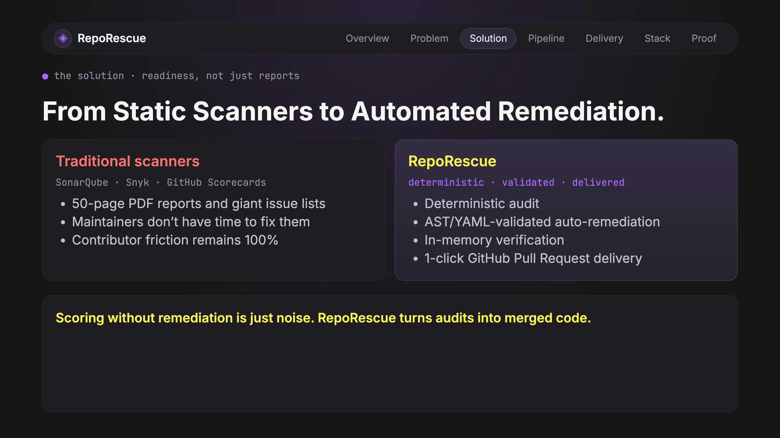
Notes:
3

Slide 4
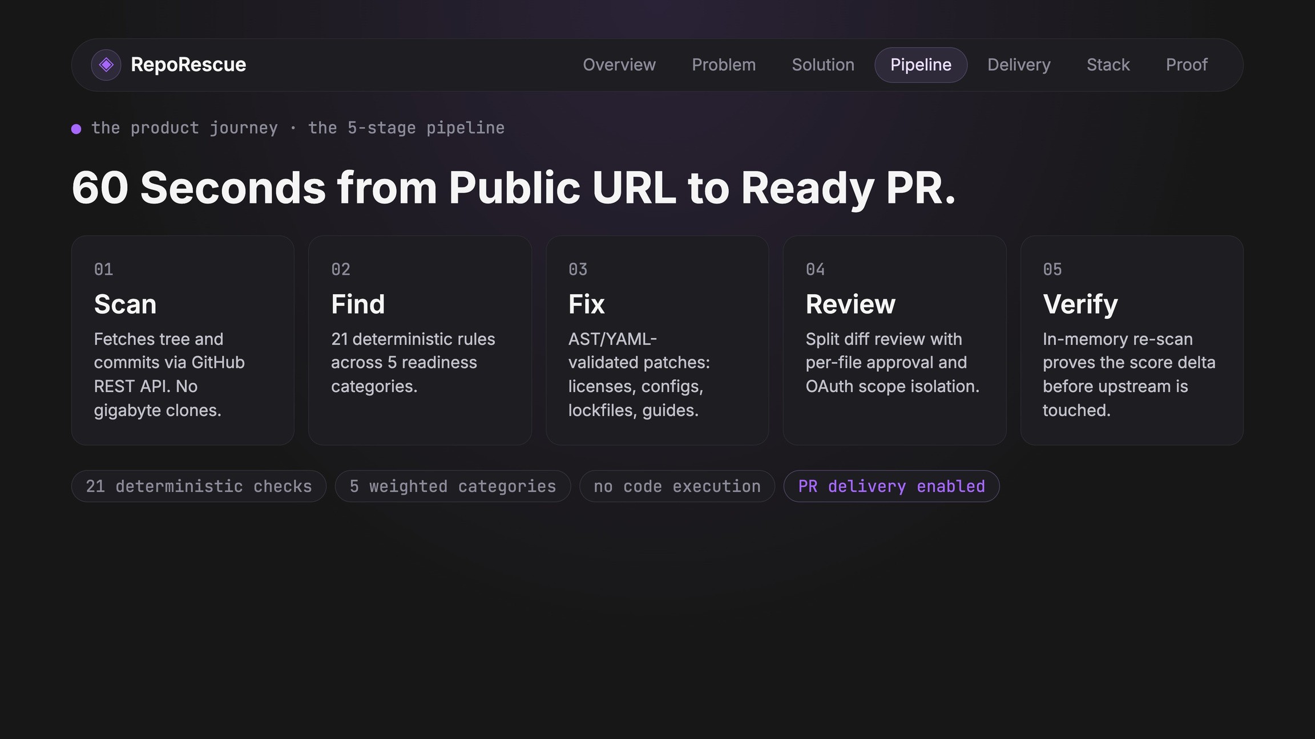
Notes:
4

Slide 5
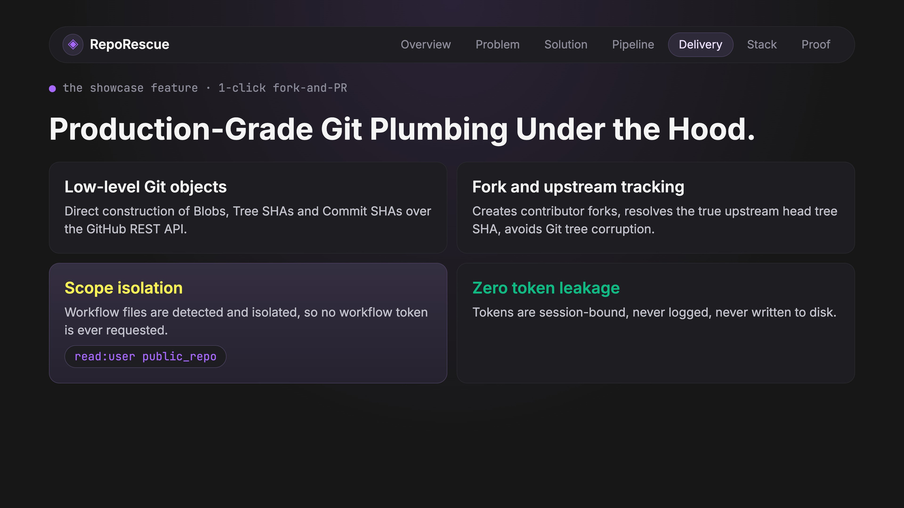
Notes:
5

Slide 6
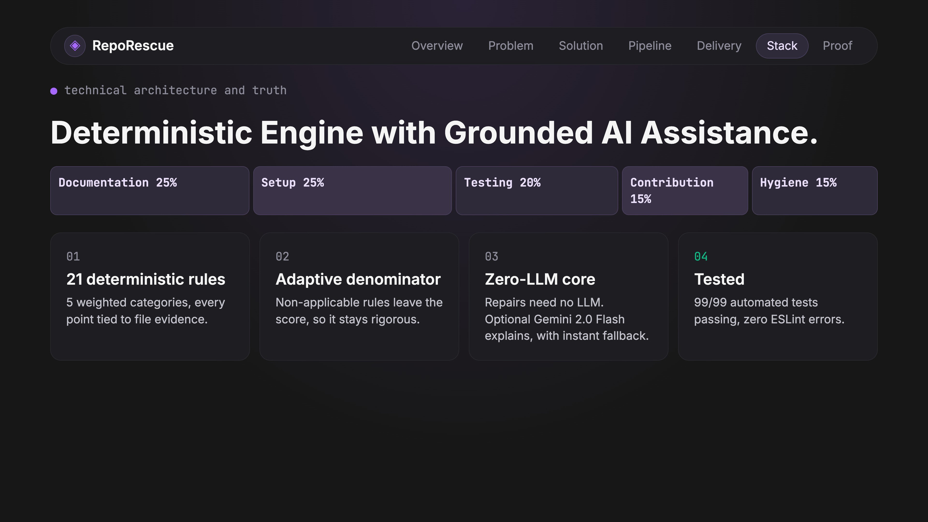
Notes:
6

Slide 7
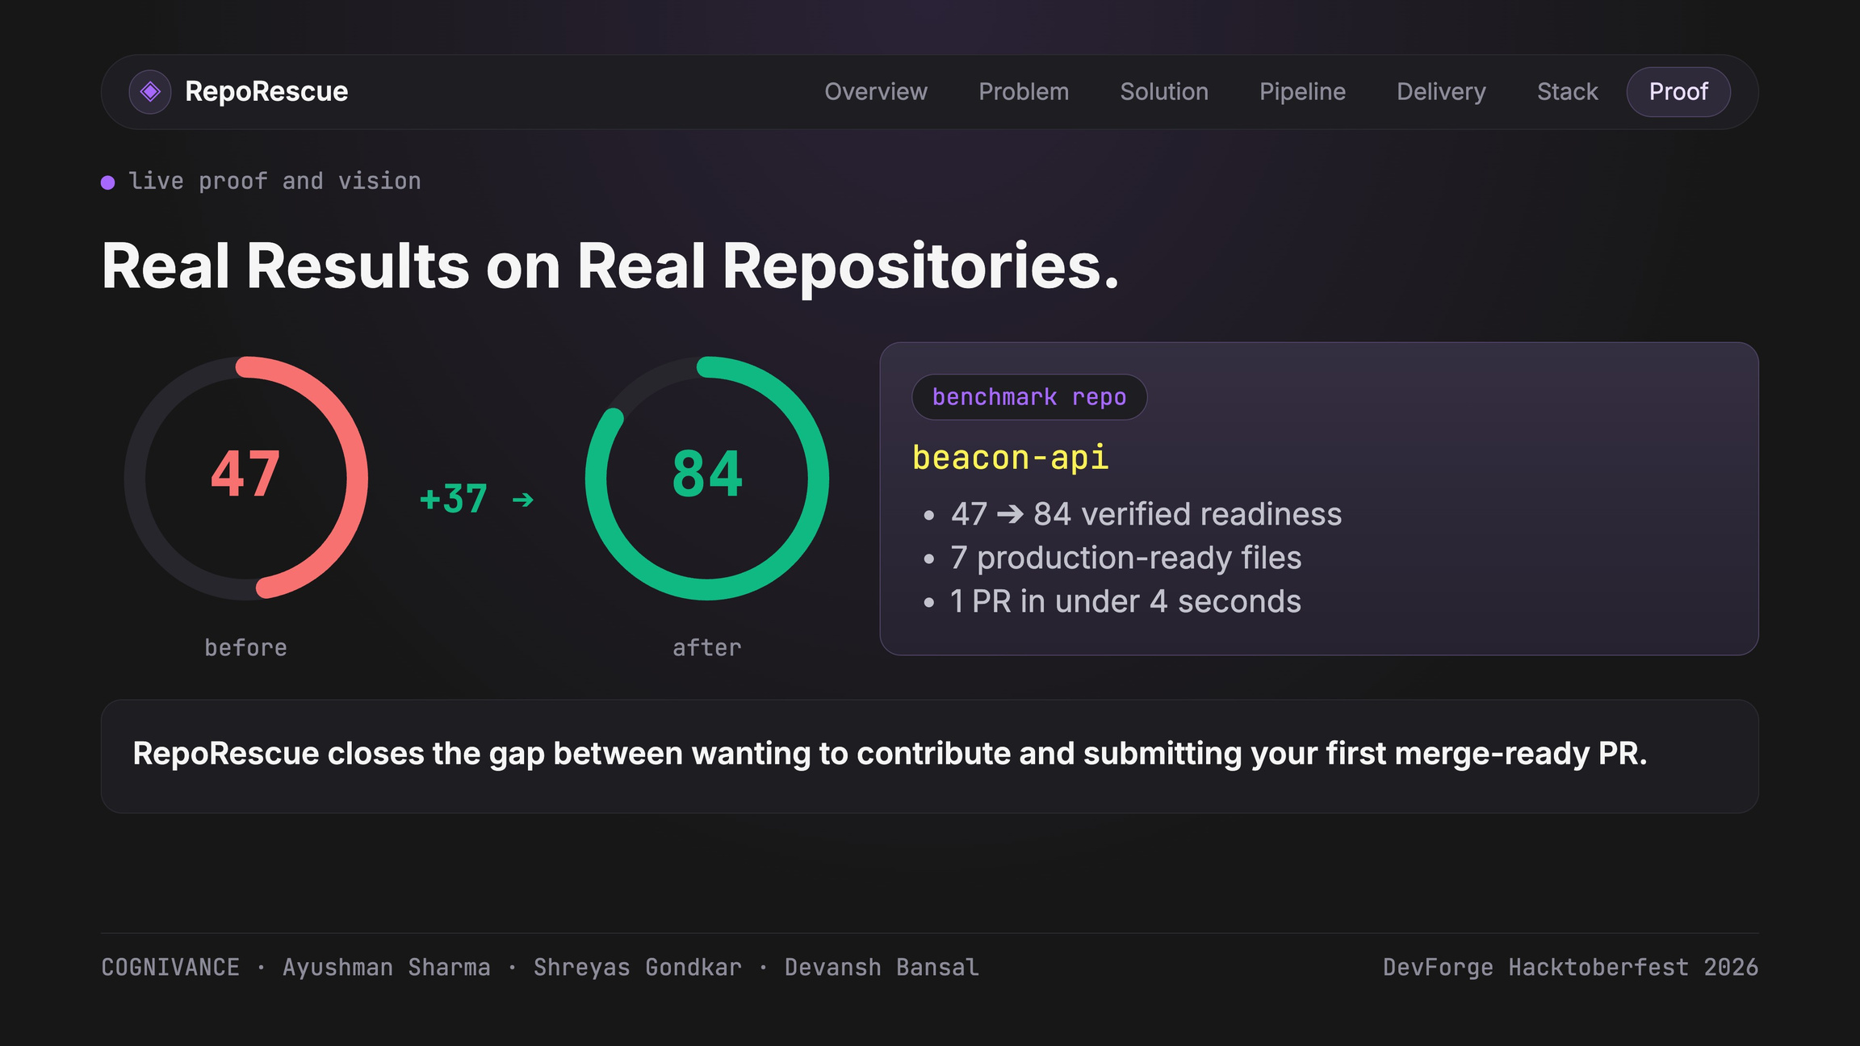
Notes:
7

Slide 8
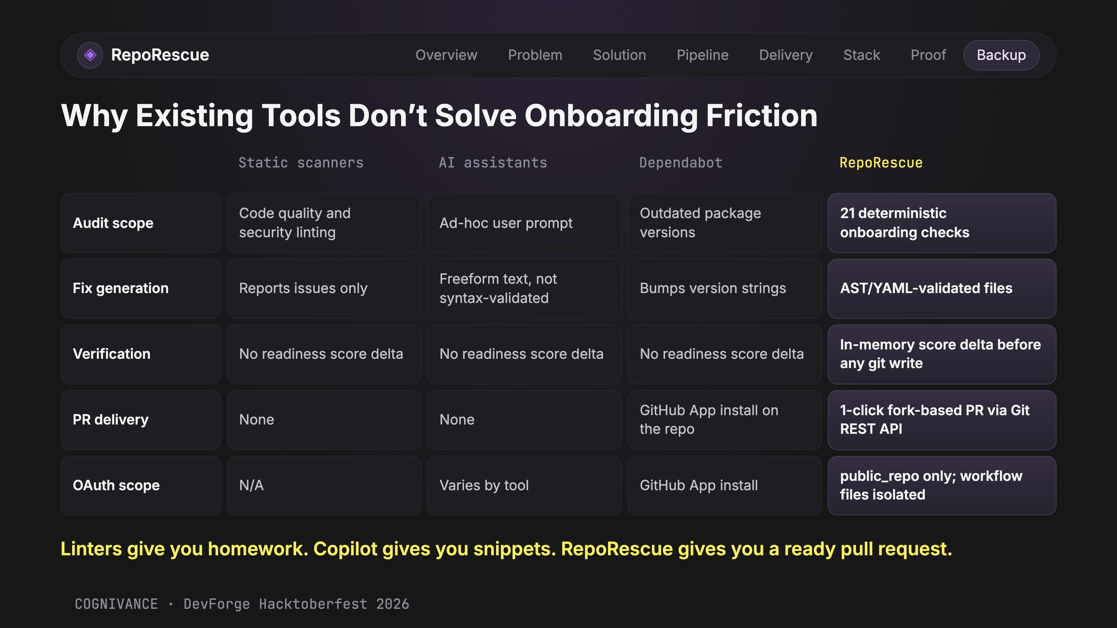
Notes:
Backup slide for Q&A. Linters diagnose but leave the repair work on busy maintainers. Generic LLMs can get YAML indentation or versions wrong; RepoRescue generates syntax-validated files deterministically. RepoRescue verifies the score improvement in memory before sending a cross-repository PR through the contributor's fork.
8

