Slide 1
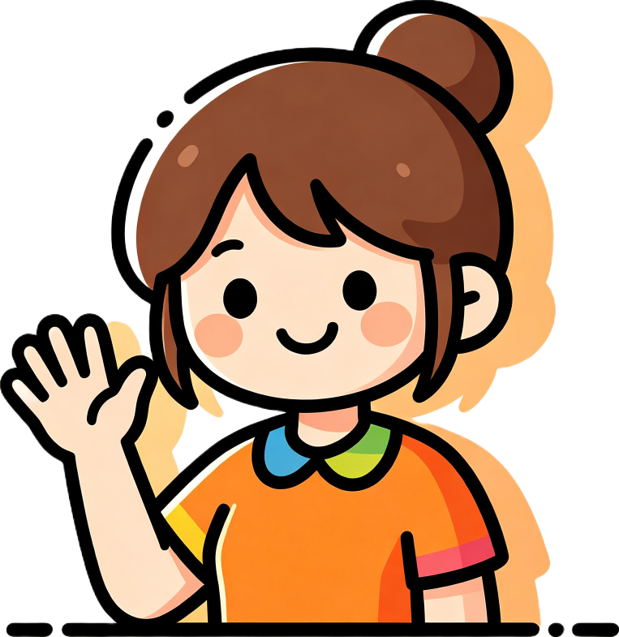
Hello!
I'm Teacher Gem!
Let's have fun together!
Notes:
Greet the child warmly. Say "Hello! I'm Teacher Gem!" and wave your hand.
Wait for the child to wave back and say hello. Smile and make eye contact.
Then say "Can you hear me? Clap your hands: clap, clap, clap!" to test audio.
Ask the child to sit where the camera sees the face and hands.

Slide 2
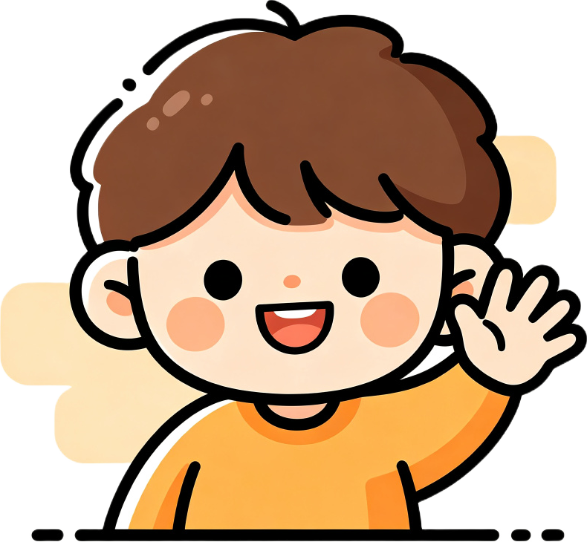

Wave to me!
AND
Hello!
Clap, clap, clap!
Notes:
Ask the child to wave to you. Say "Hello! Can you wave to me?"
Then test the sound: "Can you hear me? Clap your hands: clap, clap, clap!"
Praise the child for waving and clapping. Keep it energetic and fun.

Slide 3
Say hello!
Hello!
Hi!
Say "Hi!" and wave fast!
Notes:
Show the "Hello!" card. Say "Hello, [Name]!" and wave slowly. Have the child repeat.
Then show the "Hi!" card. Say "Hi! Hi! Say 'Hi!' and wave fast!" Model the action.
Praise the child for trying. Repeat a few times, getting faster each time.

Slide 4
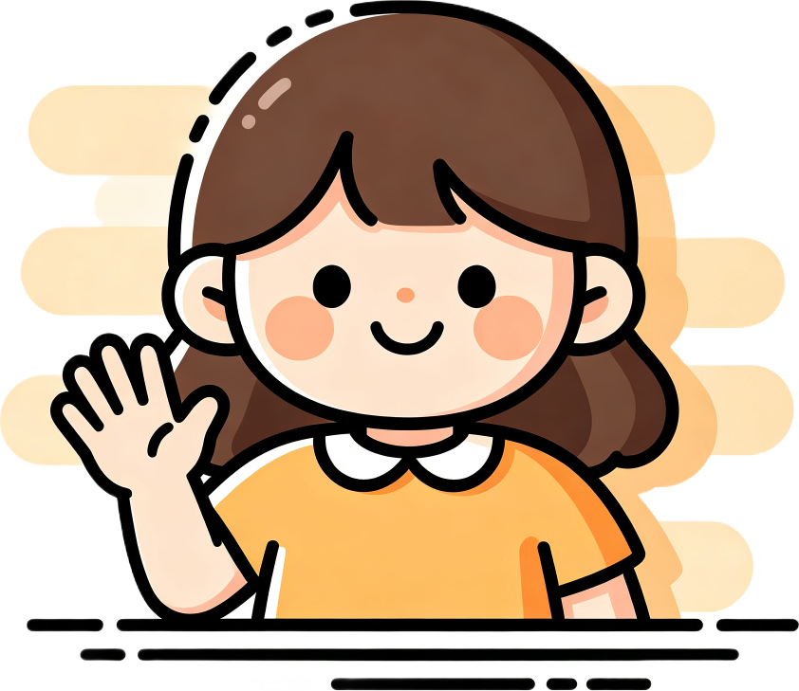
Goodbye!
Bye-bye!
Wave slowly and say goodbye.
Notes:
Now say goodbye. Wave slowly and say "Goodbye! Bye-bye!"
Have the child repeat after you. Model a slow, gentle wave.
Then show the teddy: "Show me your teddy. Teddy, say 'Hello!'"

Slide 5
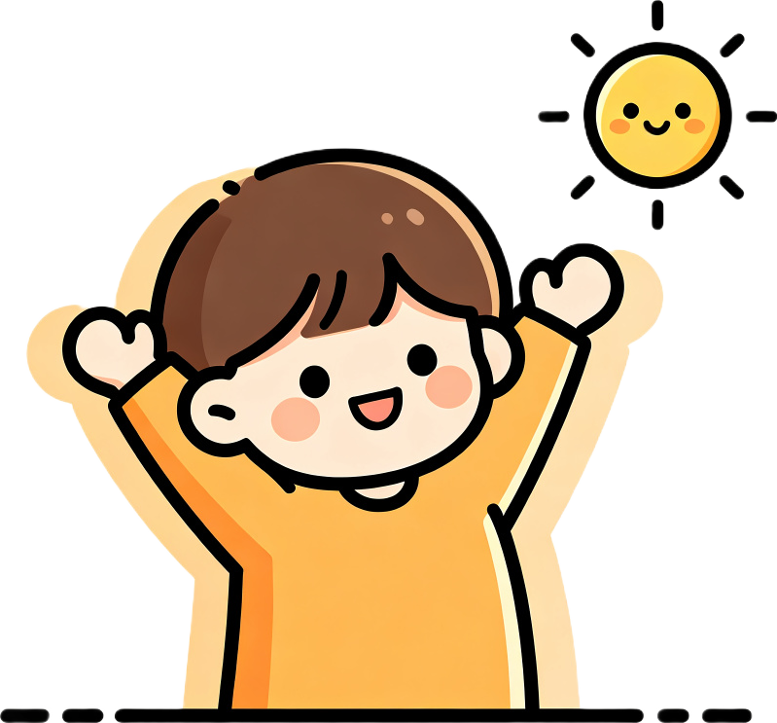
Good morning!
Stretch your arms!
Wake up and stretch!
Notes:
Say "Good morning!" and stretch your arms up wide. Model the action.
Have the child repeat: "Good morning!" while stretching.
Then say "Good night!" and we will practice the next action.

Slide 6
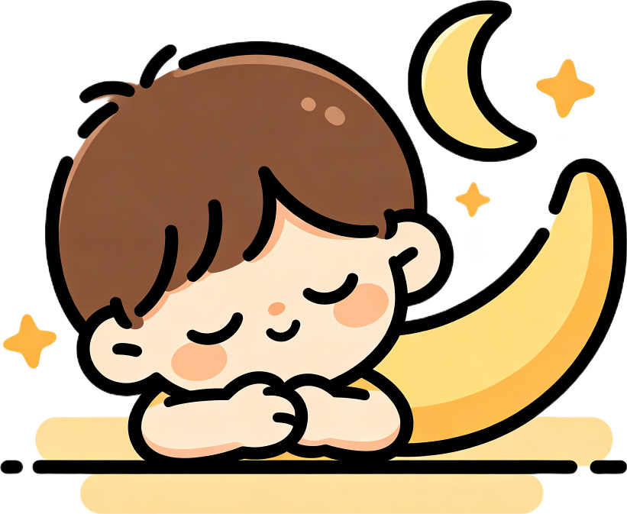
Good night!
Close your eyes!
Hands together, pretend to sleep!
Notes:
Say "Good night!" Put your hands together, rest your head on your hands, and close your eyes.
Have the child repeat while pretending to sleep.
Then play faster: "Good morning! Good night! Good morning!" Wake Teacher Gem up!

Slide 7

What's your name?
Ask Teddy!
Say "What's your name?" to Teddy!
Notes:
Say "Hello! What's your name?" Wait for the parent to help the child say their name.
Then say "Nice to meet you, [Name]!" Encourage the child to repeat.
Now ask Teddy: "What's your name?" The parent answers as Teddy: "I'm Teddy!"
Then say "Nice to meet you, Teddy!" with the child.

Slide 8
I'm ___!
Nice to meet you!
Notes:
When the child says their name, respond warmly: "Nice to meet you, [Name]!"
Encourage the child to repeat "Nice to meet you!" after you.
Then ask Teddy: "What's your name?" Parent answers as Teddy: "I'm Teddy!"
Say together: "Nice to meet you, Teddy!"

Slide 9
Hello Chant!
Hello, hello, what's your name? (clap, clap)
Hello, hello, what's your name?
My name is Gem, Gem, Gem.
Nice to meet you!
Your turn! Hello, hello, I'm ___!
Notes:
"Let's chant! Clap with me." Clap on the beat as you say each line.
Repeat the chant twice. First teacher leads, then invite the child to join in.
For the last line, encourage the child to say their own name: "Hello, hello, I'm ___!"
Clap and smile - make it fun and energetic!

Slide 10

Great job!
You get three stars!
Today we learned: Hello, Hi, Goodbye, Bye!
Notes:
"Great job, [Name]! Today we learned: hello, hi, goodbye, bye."
Have the child repeat each word once. Clap after each word.
"You get three stars! One, two, three!" Count on your fingers and clap.
Praise the child enthusiastically for their effort today.

Slide 11

Goodbye!
See you next time!
Bye-bye, bye-bye, see you next time!
Notes:
Sing a short goodbye chant with waving hands: "Bye-bye, bye-bye, see you next time!"
Wave and smile. Say "See you next time, [Name]! Goodbye!"
End the lesson warmly. Do not start a new activity.

