Slide 1
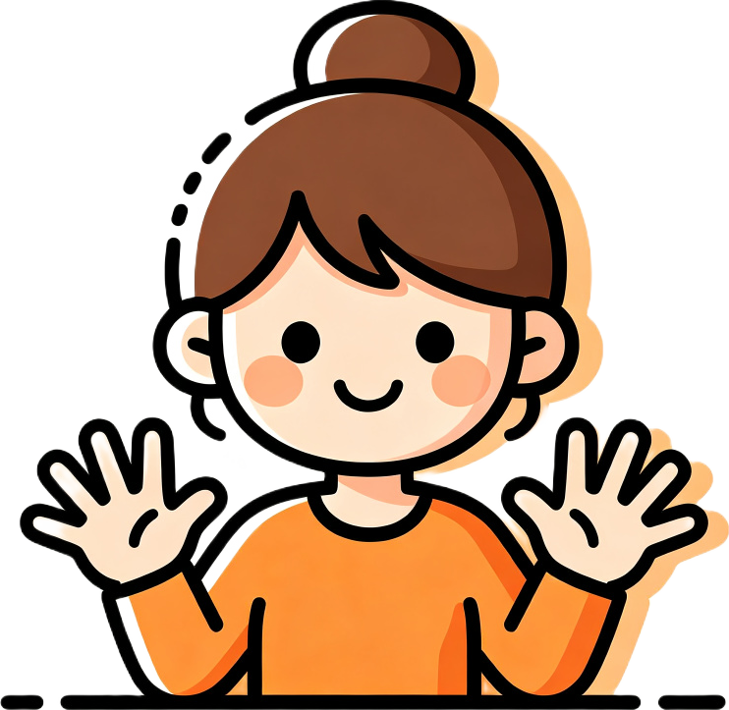
Count to 10!
6, 7, 8, 9, 10!
Two hands counting fun!
Notes:
Welcome to today's lesson! We're going to count from six to ten!
Show both hands and say: "Count to 10! Six, seven, eight, nine, ten!"
Wave to the child and smile. Get them excited for today's adventure.

Slide 2

Hello! How are you?
I'm fine, thank you!
Hello, hello, how are you?
Notes:
"Hello, [Name]! How are you today?" Wait for the child to respond.
Sing a short hello chant with waving hands: "Hello, hello, how are you?"
Repeat: "I'm fine, I'm fine, thank you!"
Smile and wave. Set a happy tone for the lesson.

Slide 3
Review: One to five!
1
2
3
4
5
Show me: one! two! three! four! five!
Notes:
Review time! Point to each number and count: "One! Two! Three! Four! Five!"
Have the child show each number with fingers.
"Show me one! Show me three! Show me five!" Quick practice.
Praise. Now we're ready to learn new numbers!

Slide 4
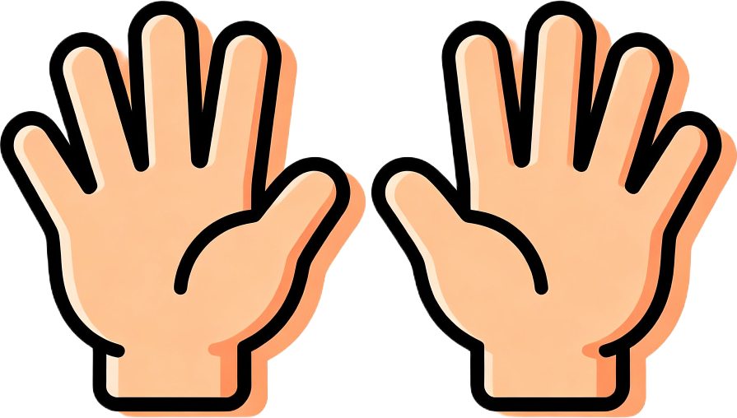
One hand is five. Two hands are ten!
Five and one is six! Six!
Notes:
Show one hand: "One hand is five!" Show both hands: "Two hands are ten!"
Show one hand plus one finger: "Five and one is six. Six!"
Model slowly. Have the child copy with their own hands.
Make the connection: 5 + 1 = 6.

Slide 5
Six, seven, eight, nine, ten!
6
7
8
9
10
Say it with me! Six, seven, eight, nine, ten!
Notes:
Point to each number and say it: "Six! Seven! Eight! Nine! Ten!"
Have the child repeat after you: "Six, seven, eight, nine, ten!"
Practice: "Show me eight with your fingers. Show me ten!"
Use fingers: one hand (5) + 3 fingers = 8. Both hands = 10.

Slide 6
Show me eight!
Show me ten!
Notes:
"Show me eight with your fingers!" Wait for the child to show 8 fingers.
"Show me ten!" Wait for both hands up.
Praise each correct response. Repeat a few times.
Help if needed: one hand (5) + 3 fingers = 8.

Slide 7
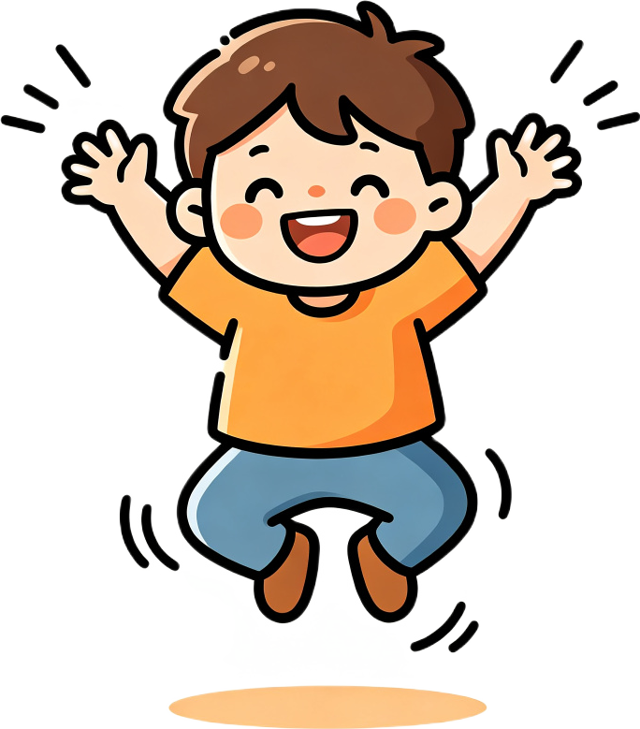
Number Hop!
Hop and count!
Jump to seven! Find eight! Find ten!
Notes:
Parent puts number cards 1-10 on the floor in a line.
"Let's hop! Start at one. Hop and say 'one!'"
Child hops and counts: "One! Two! Three! ..."
"Now jump to seven! Find eight. Find ten! Find six!"

Slide 8
How many fingers?
I have ten fingers!
Notes:
"How many fingers do you have?" Wait for the child to say "Ten!"
"Yes! I have ten fingers. Say it: 'I have ten fingers.'"
Have the child repeat the full sentence.
Show both hands and count together: one, two... ten!

Slide 9
Count your toes!
I have ten toes!
Notes:
"Now count your toes. One, two... ten!"
Help the child count toes together.
"I have ten toes." Have the child repeat.
Then: "How many blocks?" Count 6-10 blocks. "Nine? Great!"

Slide 10

Blast off!
10, 9, 8, 7, 6...
5, 4, 3, 2, 1 — blast off!
Notes:
"Let's blast off! Ten, nine, eight, seven, six..."
"Five, four, three, two, one — blast off!" Crouch down then jump!
Do it again: "You count down this time!" Let the child lead.
Make it exciting! Jump high on "blast off!"

Slide 11
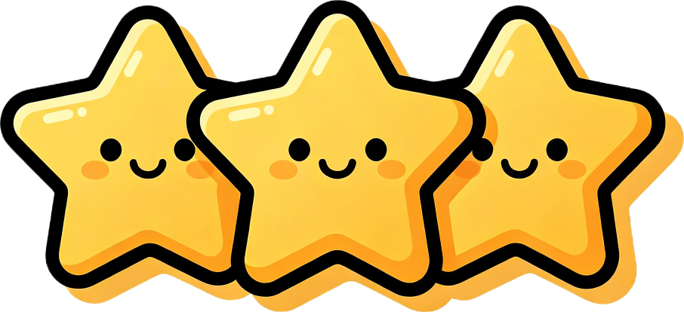
Great job!
You get three stars! One, two, three!
Today we learned: six, seven, eight, nine.
Notes:
"Great job, [Name]! Today we learned: six, seven, eight, nine."
Have the child repeat each number once. Clap after each.
"You get three stars! One, two, three!" Count on fingers and clap.
Praise enthusiastically for all the hard work.

Slide 12

Goodbye!
See you next time!
Bye-bye, bye-bye, see you next time!
Notes:
Sing a short goodbye chant with waving hands: "Bye-bye, bye-bye, see you next time!"
Wave and smile. Say "See you next time, [Name]! Goodbye!"
End the lesson warmly. Do not start a new activity.

