Slide 1
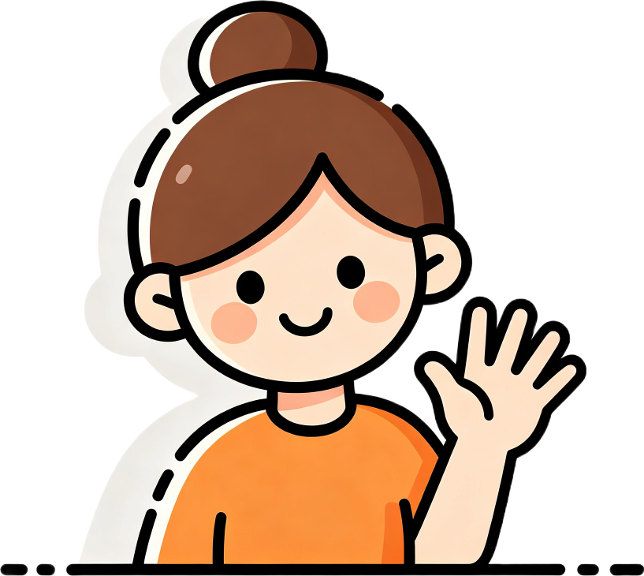
Count with Me!
1, 2, 3, 4, 5!
Let's learn numbers together!
Notes:
Greet the child: "Hello! I'm Teacher Gem! Today we will count numbers!"
Wave and smile. Make eye contact to build rapport.
Get ready for a fun counting adventure!

Slide 2
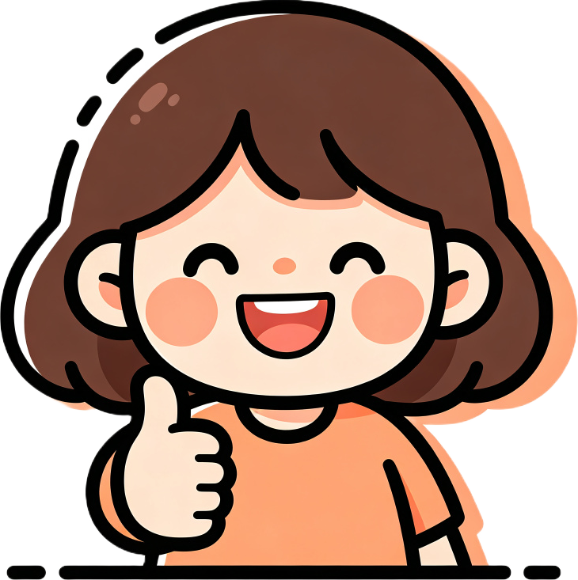
Hello! How are you?
I'm fine, thank you!
Sing the hello chant together!
Notes:
Say "Hello, [Name]! How are you today?" Smile and wave.
Encourage the child to say "I'm fine, thank you!" or "I'm happy!"
Sing the hello chant: "Hello, hello, how are you? Hello, hello, how are you? I'm fine, I'm fine, thank you!"
Wave hands on the beat. Make it cheerful!

Slide 3
Review time!
Hello!
Goodbye!
Show me: hello! goodbye!
Notes:
"Review time! Show me: hello!" Wait for the child to wave and say hello.
"Now goodbye!" Wait for the child to wave goodbye.
Praise the child for remembering. Then move on to counting!

Slide 4

One, two, three, four, five!
Look at my fingers! Now you!
Notes:
Hold up your hand and count each finger: "One! Two! Three! Four! Five!"
Model slowly. Have the child show their fingers and count with you.
Practice: "Show me three! Show me five! Show me one!"
Praise each correct answer. Keep it fun and energetic.

Slide 5
Show me a number!
1
2
3
4
5
Show me three! Show me five! Show me one!
Notes:
Point to each number and say it: "One! Two! Three! Four! Five!"
Then play: "Show me three!" Wait for the child to hold up 3 fingers.
"Show me five! Show me one!" Keep asking different numbers.
Praise every correct response. Make it a quick, fun game.

Slide 6
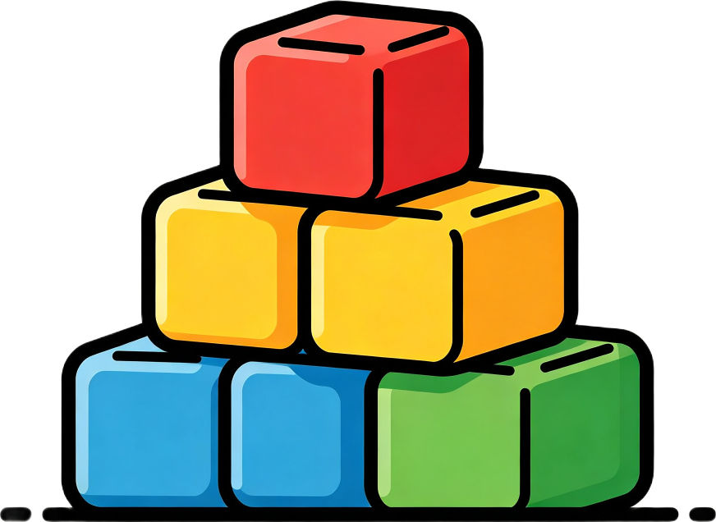
Bring me blocks!
Bring me two blocks!
Now four! Now five!
Notes:
"Bring me two blocks! Two!" Wait for the child to bring blocks and show to camera.
Count together: "One, two! Great!" Praise the child.
Continue: "Bring me four! ... Bring me five!" Each time count together.
"Now put them in a line. Count with me: one, two, three, four, five!"

Slide 7
Count together!
One, two, three, four, five!
Great! Let's count again!
Notes:
Have the child put the blocks in a line.
Point to each block and count together: "One, two, three, four, five!"
Repeat once more, clapping on each number.
Praise enthusiastically: "Great counting!"

Slide 8

How many blocks?
Three blocks!
I have three blocks.
Notes:
Point to the blocks and ask: "How many blocks?" Wait for the child to answer.
Confirm: "Yes! Three blocks. I have three blocks."
Then ask: "How many fingers on one hand?" Wait for "Five!"
"Yes! I have five fingers. You have five fingers. Say it: 'I have five fingers.'"

Slide 9
How many fingers?
I have five fingers!
Notes:
Show your hand and ask: "How many fingers on one hand?"
Wait for the child to say "Five!"
Confirm: "Yes! I have five fingers. You have five fingers."
Have the child repeat: "I have five fingers."

Slide 10
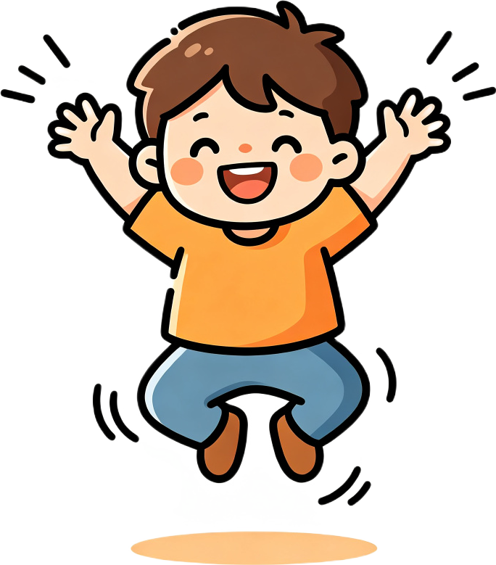
Clap and jump!
I say a number, you clap!
Three! Five! Two! ... Now jump!
Notes:
"I say a number, you clap! Three!" Wait for the child to clap 3 times.
Continue: "Five!" (5 claps) "Two!" (2 claps).
"Now jump! Four!" (4 jumps) "One!" (1 jump).
Finish: "Count with me: one, two, three, four, five, clap!"

Slide 11
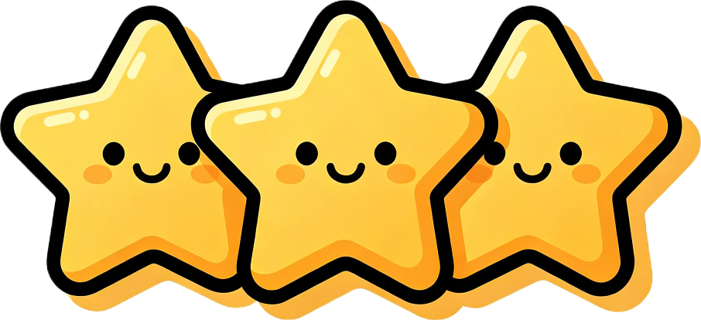
Great job!
You get three stars! One, two, three!
Today we learned: one, two, three, four.
Notes:
"Great job, [Name]! Today we learned: one, two, three, four."
Have the child repeat each number once. Clap after each.
"You get three stars! One, two, three!" Count on fingers and clap.
Praise enthusiastically for all the hard work today.

Slide 12

Goodbye!
See you next time!
Bye-bye, bye-bye, see you next time!
Notes:
Sing a short goodbye chant with waving hands: "Bye-bye, bye-bye, see you next time!"
Wave and smile. Say "See you next time, [Name]! Goodbye!"
End the lesson warmly. Do not start a new activity.

