Slide 1

Yeah
Education Group
Kevin, Andy, Syeda, Nicole
Jan 21, 2017
The Pitch

Slide 2
it’s all about
Community College(CC) Market

Slide 3
7M students in Community College
$84 billion
international students
100K

Slide 4
75%
International College Students’ Goal
Transfer to University successfully

Slide 5
GPA 4.0

Slide 6
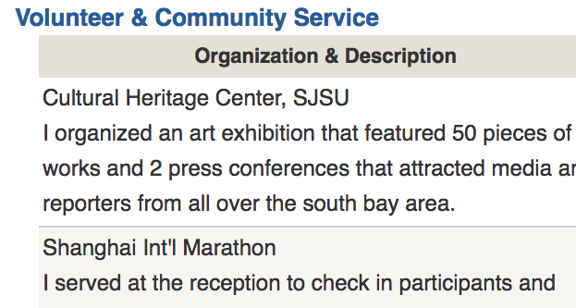
GPA 4.0

Slide 7
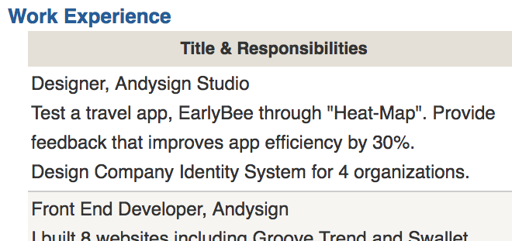
GPA 4.0

Slide 8
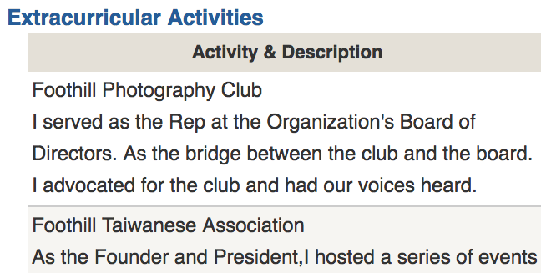
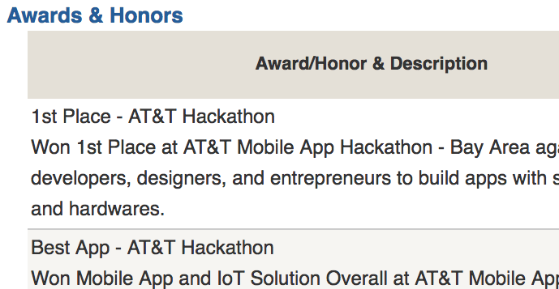
GPA 4.0

Slide 10
Our solution
Two-year program that bundles and provides educational services at a lower cost
Product Design
Resources
Students(clients)
Academics Consultants
Volunteer position
Tutors
Competition Infomations
Intership oppt.
Career Consultants
Special Training
5hrs consoling/semester
25hrs volunteer/semester
40hrs of tutoring/semester
10 career coaching courses
2 intership posiitons
competition training
2 national academic
bundle

Slide 11


Business Model
Parents of high schoolers
Chinese Agencies
partnership
12,000
$8000
Application consultant
Tutors
Intern providers
Career coaches
$2000~$3,000 totally
Students and parents
revenue
$12000
cost

Slide 12
Competitor Analysis
 | New Oriental (China) 2007 IPO | Thinktank Learning (US) |  | Dreambig Career (US) | Sunrise (China)
Admission Consulting | √ | √ | √
Tutoring |  | √ | √
Career Coaching |  |  | √ | √ | √
Internship | √ |  | √ | √
Competition Training |  | √ | √ |  | √
Volunteer Opp. | √ |  | √ |  | √
Average Price | $24,000 | $20,000 | $12,000 | $14,000 | $9,000
Notes:
one more column

Slide 13
Market Size
Appendix has how we calculate
7M students in US Community College
$84 billion
international students
$1200M
Chinese students
$240M

Slide 14
Product Market Fit / Traction
what we did:
research in 6 colleges
+ online marketing
+ 1 workshop
(last summer ~ now)
And we got
11 students paid 120K on average
1 agency in China signed
1 agency in China is in negotiation

Slide 15
Go to market plan
Social Media Campaign
CC integration
Build partnership with Chinese agencies

Slide 16
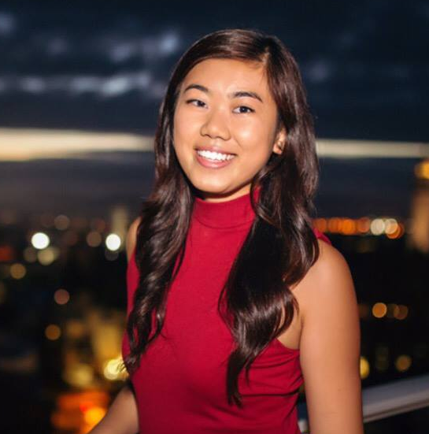
TEAM
Kevin Tian
Chief Executive Officer
Andy Chen
Chief Technology Officer
Syeda Inamdar
Chief Operations Officer
Nicole Tsai
Marketing Director
Cofounded an education firm in China and grew to 1 million in 3 years
Full-stack, 8-time Hackathon Champion in 2016
Created 2 initiatives to educate over 1800 students on violence prevention & stress-management
Branding and Strategy at Packback and Nommery for 2 years

Slide 17
It’s profitable already, but we want to scale!
We Ask for
$500K
timespan: 24month
Marketing
Hire Associates to provide our services
Expand to more CCs
Build partnership with Chinese agencies
capital allocation in appendix

Slide 18
Thanks
Contact Kevin, CEO
kevintian@berkeley.edu
925-639-4711

Slide 19
Q/A

Slide 20
Appendix

Slide 21
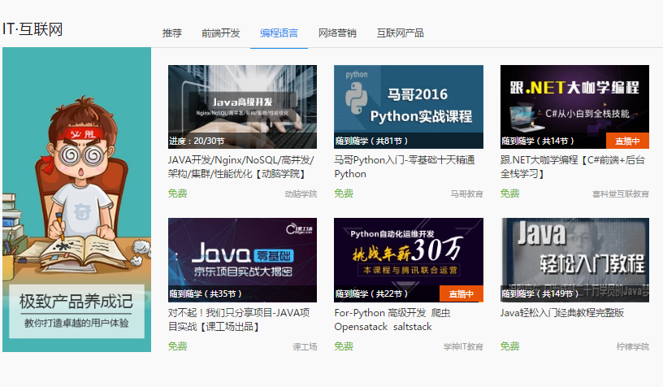
Product (App) screenshot

Slide 22

Chinese students enrolled in CC
2016
18,000
2008
2,500
2005
700
resource: Ministry of Education, China

Slide 23
Market Size
TAM = (all CC students) X our price X 0.5
7M x 12000 x 0.5 = 84 billion
SAM = (all international student in CC) X fraction
100K x 12000 x 0.5 = 1200M
Target Market = (chinese students in CC)
20K x 12000 = 240M -> plan

Slide 24
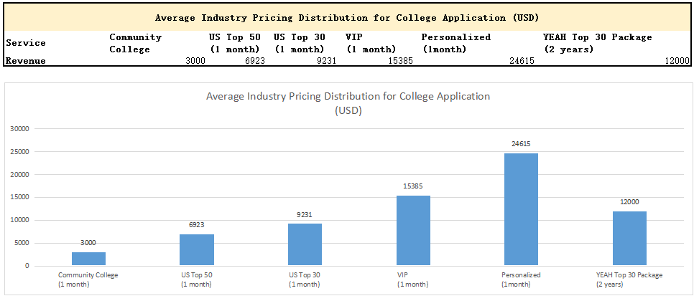
Justification of Price

Slide 25
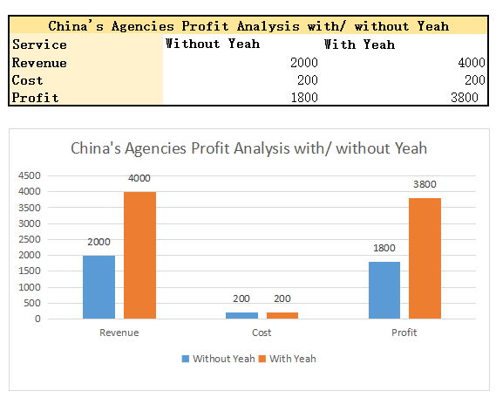
Partnership with China’s Agencies (commission)

Slide 26
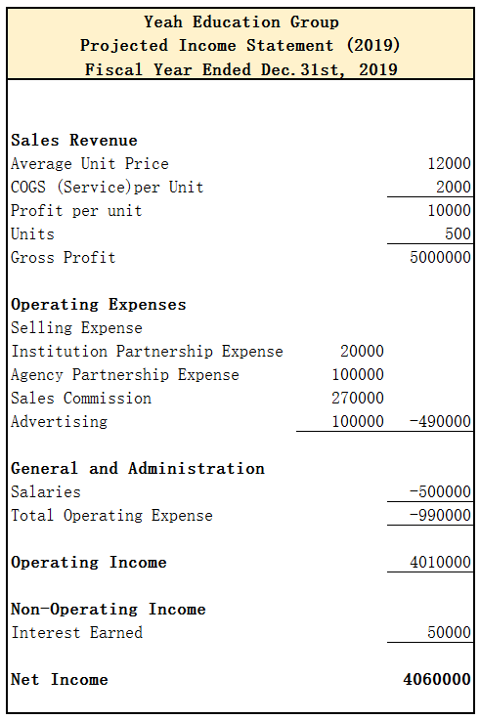
Projected Income Statement In 3 years
Ask for
$500K

