Slide 1
Lecture - 11 on Data Structures

Slide 2
Threaded Trees
Binary trees have a lot of wasted space: the leaf nodes each have 2 null pointers
We can use these pointers to help us in inorder traversals
We have the pointers reference the next node in an inorder traversal; called threads
We need to know if a pointer is an actual link or a thread, so we keep a boolean for each pointer

Slide 3
Threaded Tree Example
6
8
3
1
5
7
11
9
13

Slide 4
Threaded Tree Traversal
We start at the leftmost node in the tree, print it, and follow its right thread
If we follow a thread to the right, we output the node and continue to its right
If we follow a link to the right, we go to the leftmost node, print it, and continue

Slide 5
Threaded Tree Traversal
Output
1
6
8
3
1
5
7
11
9
13
Start at leftmost node, print it

Slide 6
Threaded Tree Traversal
Output
1
3
6
8
3
1
5
7
11
9
13
Follow thread to right, print node

Slide 7
Threaded Tree Traversal
Output
1
3
5
6
8
3
1
5
7
11
9
13
Follow link to right, go to leftmost node and print

Slide 8
Threaded Tree Traversal
Output
1
3
5
6
6
8
3
1
5
7
11
9
13
Follow thread to right, print node

Slide 9
Threaded Tree Traversal
Output
1
3
5
6
7
6
8
3
1
5
7
11
9
13
Follow link to right, go to leftmost node and print

Slide 10
Threaded Tree Traversal
Output
1
3
5
6
7
8
6
8
3
1
5
7
11
9
13
Follow thread to right, print node

Slide 11
Threaded Tree Traversal
Output
1
3
5
6
7
8
9
6
8
3
1
5
7
11
9
13
Follow link to right, go to leftmost node and print

Slide 12
Threaded Tree Traversal
Output
1
3
5
6
7
8
9
11
6
8
3
1
5
7
11
9
13
Follow thread to right, print node

Slide 13
Threaded Tree Traversal
Output
1
3
5
6
7
8
9
11
13
6
8
3
1
5
7
11
9
13
Follow link to right, go to leftmost node and print

Slide 14
Threaded Tree Modification
We’re still wasting pointers, since half of our leafs’ pointers are still null
We can add threads to the previous node in an inorder traversal as well, which we can use to traverse the tree backwards or even to do postorder traversals

Slide 15
Threaded Tree Modification
6
8
3
1
5
7
11
9
13

Slide 16
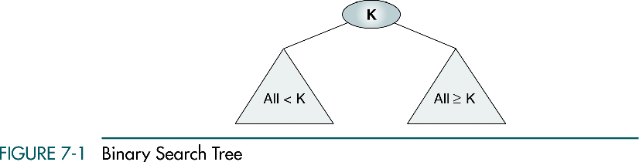
Binary Search Trees
16

Slide 17
(Con..)

Slide 18
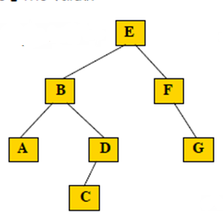
Binary Search Tree (Con..)
A Binary Search Tree is a binary tree with the following Basic properties:
All items in the left subtree are less than the root.
All items in the right subtree are greater or equal to the root.
Each subtree is itself a binary search tree.
18

Slide 19
(Con..)

Slide 20
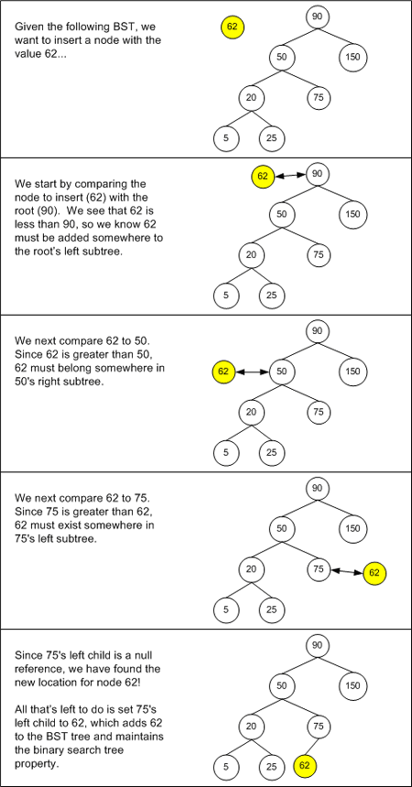
Searching and inserting
in Binary search trees

Slide 21
Searching and inserting
in Binary search trees
Figure 1. Inserting a new node into a BST

Slide 22
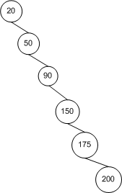
Searching and inserting
in Binary search trees
A BST after nodes with values of 20, 50, 90, 150, 175, and 200 have been added

Slide 23
Inserting a new key in a BST
Example:
How to insert a new key?
The same procedure used for search also applies: Determine the location by searching. Search will fail. Insert new key where the search failed.
10
8
Insert 4?
3
9
4
2
5

Slide 24
Building a BST
Build a BST from a sequence of nodes read one a time
Example: Inserting C A B L M (in this order!)
1) Insert C
2) Insert A
C
C
A

Slide 25
Building a BST
3) Insert B
C
5) Insert M
A
C
B
A
L
4) Insert L
C
B
M
A
L
B

Slide 26
Building a BST
Is there a unique BST for letters A B C L M ?
NO! Different input sequences result in different trees
Inserting: A B C L M
Inserting: C A B L M
A
C
B
C
A
L
L
B
M
M

Slide 27
Sorting with a BST
Given a BST can you output its keys in sorted order?
Visit keys with Inorder:
- visit left
- print root
- visit right
How can you find the minimum?
How can you find the maximum?
Example:
C
A
L
B
M
Inorder visit prints:
A B C L M

Slide 28
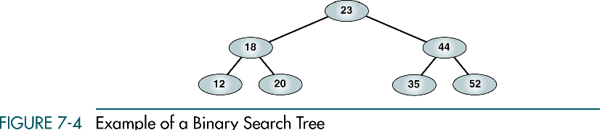
Preorder Traversal
23 18 12 20 44 35 52
28

Slide 29
Postorder Traversal
12 20 18 35 52 44 23
29

Slide 30
Inorder Traversal
12 18 20 23 35 44 52
Inorder traversal of a binary search tree produces a sequenced list
30

Slide 31
Right-Node-Left Traversal
52 44 35 23 20 18 12
Right-node-left traversal of a binary search tree produces a descending sequence
31

Slide 33
Deleting from a BST
To delete node with key x first you need to search for it. Once found, apply one of the following three cases
CASE A: x is a leaf
p
p
q
q
r
x
r
delete x
BST property maintained

Slide 34
Deleting from a BST cont.
Case B: x is interior with only one subtree
r
r
x
q
q
delete x
L
L
BST property maintained

Slide 35
Deleting from a BST cont.
Case C: x is interior with two subtrees
r
r
delete x
r
x
delete x
s
Z
q
r
q
W
Z
W
t s
t
BST property maintained

Slide 36
Deleting from a BST cont.
Case C cont: … or you can also do it like this
q < x < r
Q is smaller than the smaller
element in Z
R is larger than the largest
element in W
r
q
W
t
r
Z
s

Slide 37
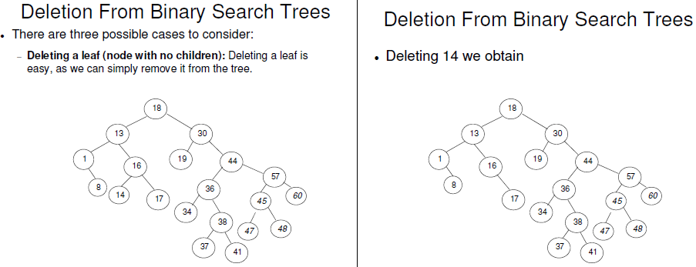

Slide 38
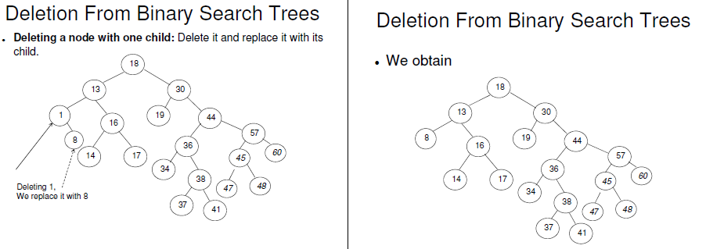

Slide 39
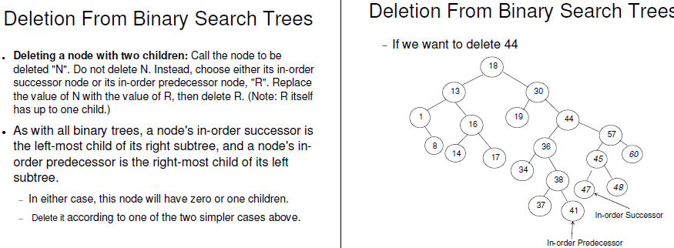

Slide 40
Binary Search Trees
Example 1:
Find 47
71
Example 2:
Find 112
< 71
> 71
35
102
> 35
> 102
17
57
87
120
< 57
< 120
6
24
45
66
80
93
111
128
> 45
> 111
2
12
21
32
40
49
59
69
75
83
90
100
107
117
125
131
< 49
< 117
1
8
18
30
38
47
58
67
74
81
88
99
105
116
122
130
5
16
23
33
44
54
64
70
77
85
91
101
110
118
126
133
63-item list
Found
< 116
Not found

Slide 41
Insertions and Deletions in Binary Search Trees
Example 1:
Insert 48
71
Example 2:
Delete 116
< 71
> 71
35
102
> 35
> 102
17
57
87
120
< 57
< 120
6
24
45
66
80
93
111
128
> 45
> 111
2
12
21
32
40
49
59
69
75
83
90
100
107
117
125
131
< 49
< 117
1
8
18
30
38
47
58
67
74
81
88
99
105
116
122
130
5
16
23
33
44
54
64
70
77
85
91
101
110
118
126
133
> 47
48
Deleted

