Slide 1
Data Structures TREE

Slide 2
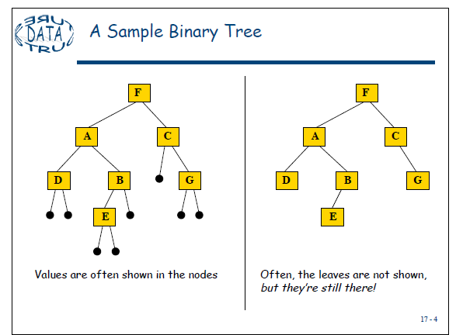
TREES
A binary tree T is defined as a finite set of elements, called nodes, such that:
a) T is empty (called the null tree or empty tree), or
b) T contains a distinguished node R, called the root of T, and the remaining nodes of T form an ordered pair of disjoint binary trees T1 and T2.
If T does contain a root R, then the two trees T1 and T2 are called, respectively, the left and right subtrees of R. If T1 is nonempty, then its root is called the left successor of R; similarly, if T2 is nonempty, then its root is called the right successor of R.

Slide 3
TREES
Any node N in a binary tree T has either 0, 1 or 2 successor. The nodes A, B, C and H have two successors, the nodes E and J have only one successor, and the nodes D, F, G, L and K have no successors. The nodes with no successors are called terminal nodes.
The above definition of the binary tree T is recursive since T is defined in terms of the binary subtrees trees T1 and T2. This means, in particular, that every node N of T contains a left and a right subtree. Moreover, if N is a terminal node, then both its left and right subtree are empty.
Binary tree T and T ́́́́ are said to be similar if they have the same structure or, in other words, if they have the same shape. The trees are said to be copies if they are similar and if they have the same contents at corresponding nodes.
A
B
C
D
E
G
H
F
J
K
L

Slide 4
TREES
Observe that;
(a) B is a left successor and C is a right successor of the node A.
(b) The left subtree of the root A consists of the nodes B, D, E and F, and the right subtree of A consists of the nodes C, G, H, J, K and L.
A
B
C
D
E
G
H
J
K
F
L

Slide 5
TREE
Example 7.1:
Consider the four binary trees in fig. 7.2. The three trees (a), (c) and (d) are similar. In particular, the trees (a) and (c) are copies since they also have the same data at corresponding nodes. The tree (b) is neither similar nor a copy of the tree.
A
E
A
E
B
B
F
F
C
D
C
D
G
H
G
H
(a)
(c)
(d)
(b)
Fig. 7.2

Slide 6
Difference Between a Tree & a Binary Tree
A binary tree may be empty; a tree cannot be empty.
No node in a binary tree may have a degree more than 2, whereas there is no limit on the degree of a node in a tree.
The sub trees of a binary search tree are ordered; those of a tree are not ordered.
a
a
b
c
c
b
6

Slide 7
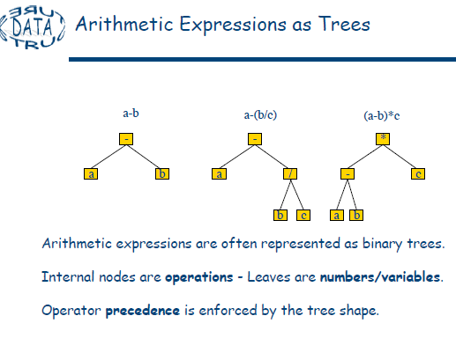

Slide 8
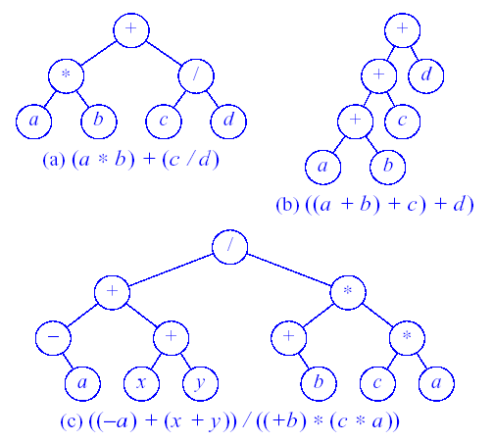
Arithmetic Expressions as trees(cont.)
Figure 11.5 Expression Trees
8

Slide 9
Arithmetic Expressions as trees(cont.)
Example 7.2: Algebraic Expressions
Consider any algebraic expression E involving only binary operations, such as
E = (a-b) / ((c * d) + e)
E can be represented by means of the binary tree T pictured in fig. 7.3.
/
-
+
a
b
e
*
c
d
Fig. 7.3: E = ( a – b ) / (( c * d ) + e )

Slide 10
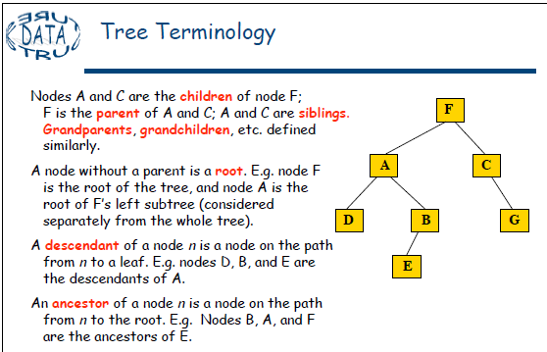
TERMINOLOGY
Terminology describing family relationships is frequently used to describe relationships between the nodes of a tree T. Specifically, suppose N is a node in T with left successor S₁ and right successor S₂ . Then N is called the parent or father of S₁ and S₂. Analogously, S₁ is called the left child or son of N, and S₂ is called the right child or son of N. Furthermore, S₁ and S₂ are said to be siblings or brother. Every node N in a binary tree , except the root, has a unique parent, called the predecessor of N.

Slide 11
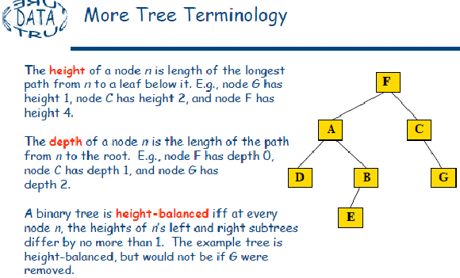

Slide 12
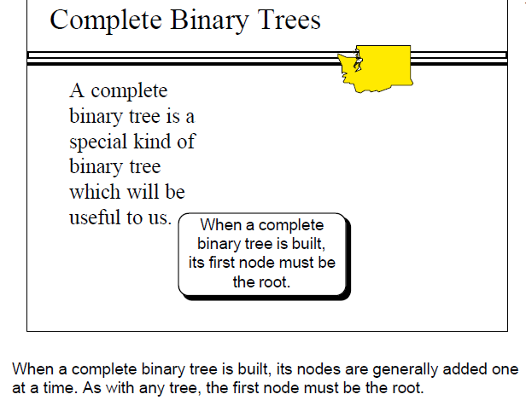
Complete Binary Trees
The tree T is said to be complete if all its levels, except possibly the last, have the maximum number of possible nodes, and if all the nodes at the last level appear as far left as possible.

Slide 13
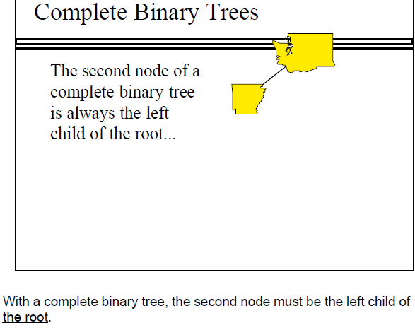

Slide 14
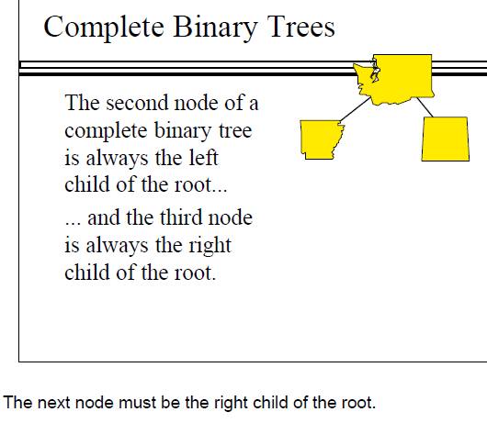

Slide 15
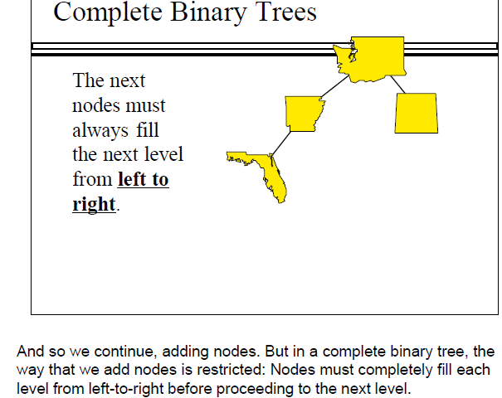

Slide 16
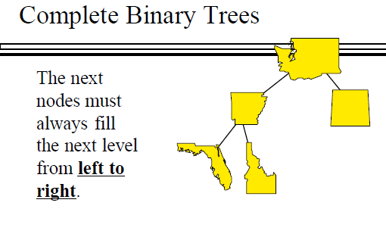
Following this rule, where would the fifth node have to be placed?

Slide 17
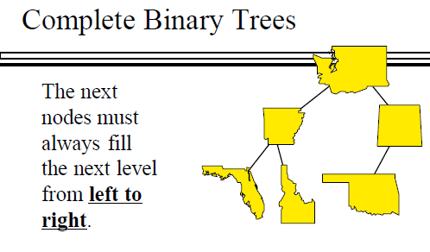

Slide 18
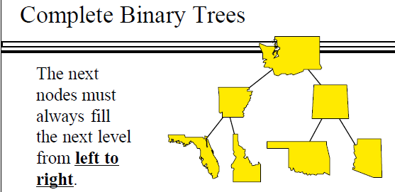
Where would the next node after this go?...

Slide 19
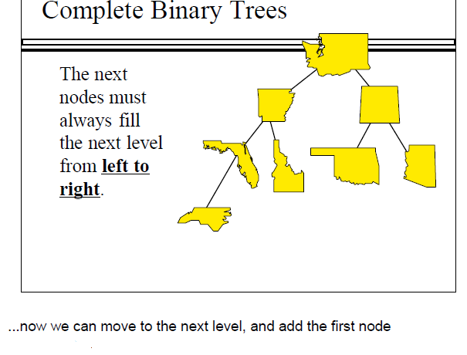

Slide 20
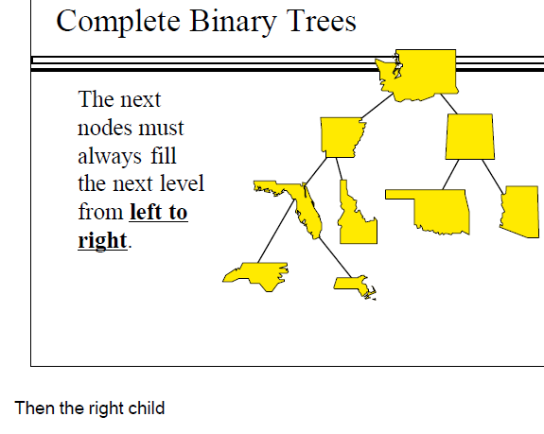

Slide 21
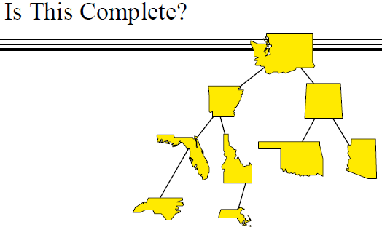
Just to check your understanding, is this binary tree a complete binary
tree?
No, it isn't since the nodes of the bottom level have not been added
from left to right.

Slide 22
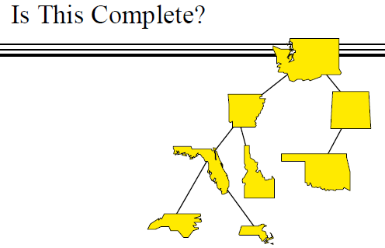
Is this complete?
No, since the third level was not completed before starting the fourth
level.

Slide 23
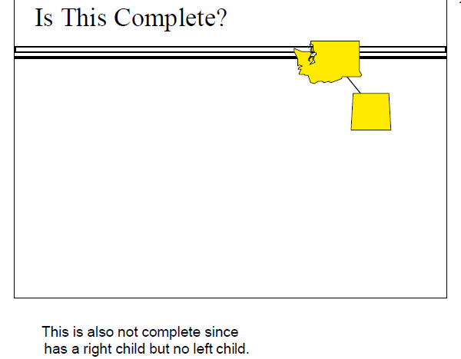

Slide 24
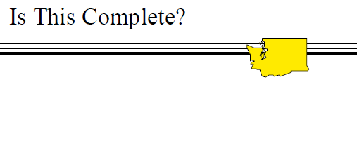
But this binary tree is complete. It has only one node, the root

Slide 25
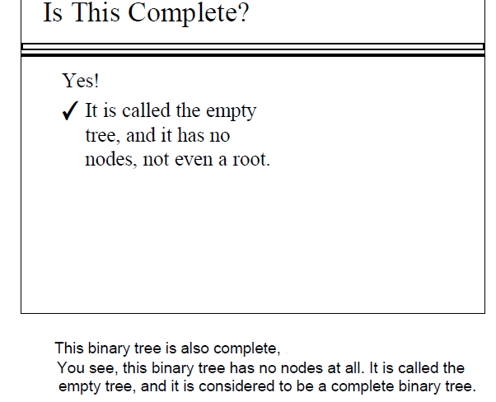

Slide 26
Complete Binary tree
1
2
3
4
5
6
7
8
9
10
11
12
13
14
15
16
17
18
19
20
21
22
23
24
25
26
Fig. Complete tree T₂₆
The left and right children of the node K are , respectively, 2 * K and 2 * K + 1, and the parent of K is the node [K/2].
The children of node 9 are the nodes 18, 19, and its parent is the node [9/2] =4.
The depth d_{n} of the complete tree T_{n} with n nodes is given by
D_{n} =[log₂ n +1]
This is relatively small number. For example if the complete tree T_{n} has n =1000000 nodes, then its depth D_{n} =21.

Slide 27
Extended Binary trees: 2 trees
A binary tree T is said to be a 2 – tree or extended binary tree if each node N has either 0 or 2 children. The nodes with two children are called internal nodes, and the nodes with 0 children are called external nodes.
Circles for internal nodes.
Squares for external nodes.
Start with any binary tree and add an external node wherever there is an empty subtree.
Result is an extended binary tree.
A Binary Tree
An Extended Binary Tree

Slide 28
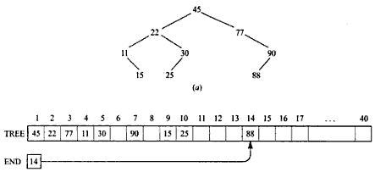
Binary Trees: Array representation
Sequential Representation of binary Trees uses only a single linear array TREE together with a pointer variable END as follows:
(a) The root R of T is stored in TREE[1].
(b) If a node occupies TREE[k], then its left child is stored in TREE[2 * K] and its right child is stored in TREE[2*k+1]
(c) END contains the location of the last node of T.

Slide 29
Binary Trees: Array Representation
1
14
2
3
10
16
4
5
6
7
8
12
15
18
8
9
10
11
7
9
11
13
1 2 3 4 5 6 7 8 9 10 11
Array A:
14 10 16 8 12 15 18 7 9 11 13

Slide 30
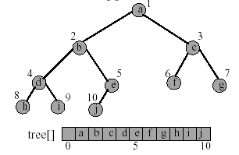
Binary Trees: Array representation
The binary tree is represented in an array by storing each element at the array position corresponding to the number assigned to it.
30

Slide 31
Linked Representation of Binary Tree
The most popular way to present a binary tree
Each element is represented by a node that has two link fields ( leftChild and rightChild ) plus an Info field
The space required by an n node binary tree is n * sizeof(binaryTreeNode)
31

Slide 32
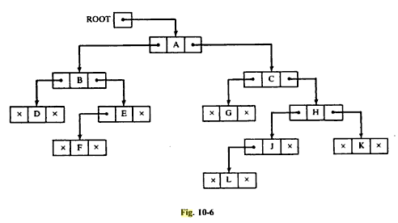
Linked Representation of Binary trees
INFO[K] contains the data at the node N
LEFT[K] contains the location of the left child of node N
RIGHT[K] contains the location of the right child of node N.
Fig : 7-6

Slide 33

Linked Representation of Binary trees
Fig:7-7
Points to

Slide 34
Linked representation of a binary tree
Linked representation uses explicit links to connect the nodes. Example:
2 5
3 4 6 7
8 9
Nodes in this tree can be viewed as positions in a sequence (numbered 1 through 9).
1
+
-
*
A
B
C
/
E
F

Slide 35
Binary tree (linked representation)
We can use a positional sequence ADT to implement a binary tree. Our
example tree, in this case, we be represented as follows:
position 1 2 3 4 5 6 7 8 9
data + - A B * C / E F
leftChild 2 3 null null 6 null 8 null null
rightChild 5 4 null null 7 null 9 null null
parent null 1 2 2 1 5 5 7 7

Slide 36
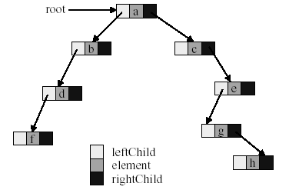
Linked Representation of Binary Tree
36

Slide 37
Linear representation of a binary tree
Advantages of linear representation:
1. Simplicity.
2. Given the location of the child (say, k), the location of the parent is easy to determine (k / 2).
Disadvantages of linear representation:
1. Additions and deletions of nodes are inefficient, because of the data movements in the array.
2. Space is wasted if the binary tree is not complete. That is, the linear representation is useful if the number of missing nodes is small.
Linear representation of a binary tree can be implemented by means of a linked list instead of an array
This way the above mentioned disadvantages of the linear representation is resolved.

Slide 38
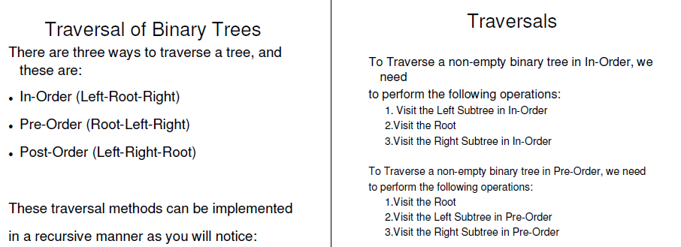
Binary Tree Traversal
Many binary tree operations are done by performing a traversal of the binary tree
In a traversal, each element of the binary tree is visited exactly once
38

Slide 39
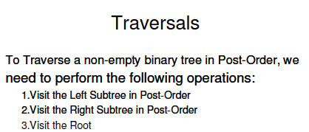
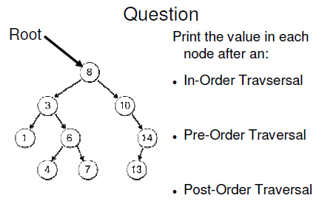

Slide 40
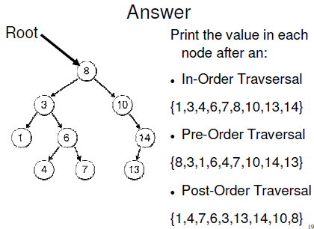

Slide 41
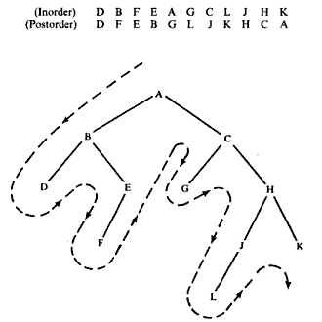
Also see example 7.7, 7.9, 7.10

Slide 42
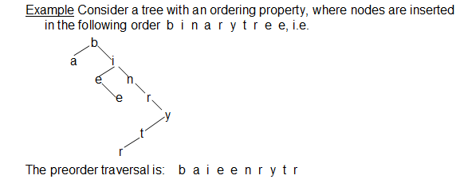
Binary Tree Traversal Methods
42

Slide 43

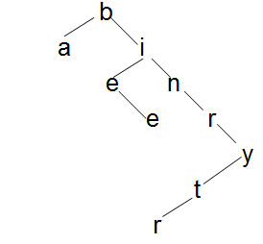

Binary Tree Traversal Methods

Slide 44
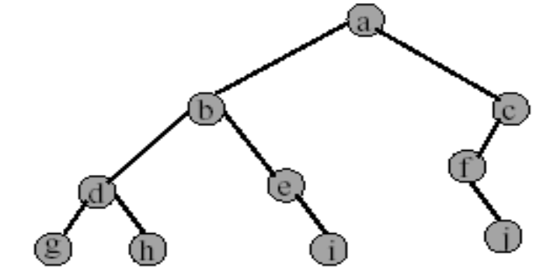
Preorder Example (visit = print)
a b d g h e i c f j
44

Slide 45
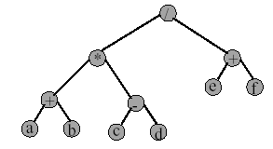
Preorder of Expression Tree
/ * + a b - c d + e f
Gives prefix form of expression.
45

Slide 46
Inorder Example (visit = print)
g d h b e i a f j c
46

Slide 47
Postorder Example (visit = print)
g h d i e b j f c a
47

Slide 48
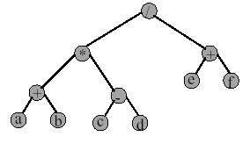
Postorder of Expression Tree
48
a b + c d - * e f + /
Gives postfix form of expression.

