Slide 1
DESIGN AND ANALYSIS OF ALGORITHIMS

Slide 2
Topics:
Graph Algorithms
Breadth First Search
Depth First Search
Bipartite Graph

Slide 3
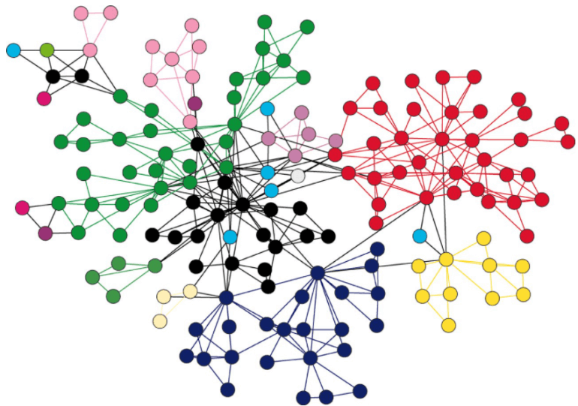
Graph Algorithms

Slide 4
What is a Graph?
A graph is a visual representation of vertices and edges sharing some connection or relationship.
Although there are plenty of graph algorithms that you might have been familiar with, only some of them are put to use.
The reason for this is simple as the standard graph algorithms are designed in such a way to solve millions of problems with just a few lines of logically coded technique.
To some extent, one perfect algorithm is solely optimized to achieve such efficient results.

Slide 5
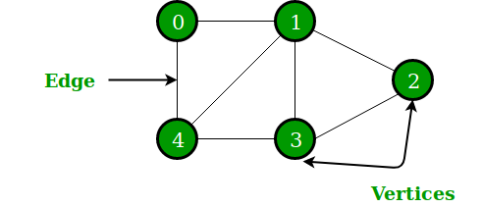
Components of a Graph:
Vertices: Vertices are the fundamental units of the graph. Sometimes, vertices are also known as vertex or nodes. Every node/vertex can be labeled or unlabeled.
Edges: Edges are drawn or used to connect two nodes of the graph. It can be ordered pair of nodes in a directed graph. Edges can connect any two nodes in any possible way. There are no rules. Sometimes, edges are also known as arcs. Every edge can be labelled/unlabeled.

Slide 6
Types of Graphs
There are various types of graph algorithms let's look at some types of terms to imply the fundamental variations between them.
Order: Order defines the total number of vertices present in the graph.
Size: Size defines the number of edges present in the graph.
Self-loop: It is the edges that are connected from a vertex to itself.

Slide 7
Isolated vertex: It is the vertex that is not connected to any other vertices in the graph.
Vertex degree: It is defined as the number of edges incident to a vertex in a graph.
Weighted graph: A graph having value or weight of vertices.
Unweighted graph: A graph having no value or weight of vertices.

Slide 8
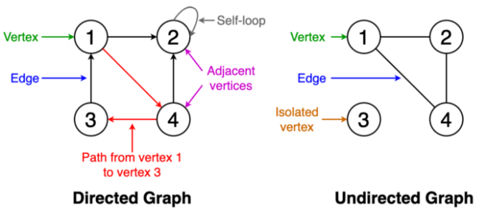
Directed graph: A graph having a direction indicator.
Undirected graph: A graph where no directions are defined.

Slide 9
Operations on Graphs:
Basic Operations:
Insertion of Nodes/Edges in the graph – Insert a node into the graph.
Deletion of Nodes/Edges in the graph – Delete a node from the graph.
Searching on Graphs – Search an entity in the graph.
Traversal of Graphs – Traversing all the nodes in the graph.

Slide 10
More Operations:
Shortest Paths : From a source to a destination, a source to all other nodes and between all pairs.
Minimum Spanning Tree : In a weighted, connected undirected graph, finding the minimum weight edges to connect all.

Slide 11
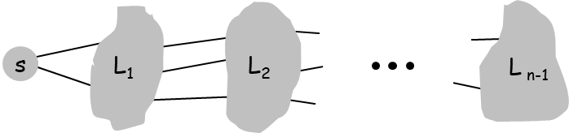
Breadth-First Search:
BFS intuition. Explore outward from s in all possible directions, adding nodes one "layer" at a time. Effect: find “shallow” paths to nodes.
BFS algorithm.
L₀ = { s }.
L₁ = all neighbors of L₀.
L₂ = all nodes that do not belong to L₀ or L₁, and that have an edge to a node in L₁.
L_{i+1} = all nodes that do not belong to an earlier layer, and that have an edge to a node in L_{i}.
Theorem. For each i, L_{i} consists of all nodes at distance exactly i from s. There is a path from s to t if t appears in some layer.

Slide 12
Traversing or searching is one of the most used operations that are undertaken while working on graphs.
Therefore, in breadth-first-search (BFS), you start at a particular vertex, and the algorithm tries to visit all the neighbors at the given depth before moving on to the next level of traversal of vertices.
Unlike trees, graphs may contain cyclic paths where the first and last vertices are remarkably the same always.
Thus, in BFS, you need to keep note of all the track of the vertices you are visiting. To implement such an order, you use a queue data structure which First-in, First-out approach.

Slide 13
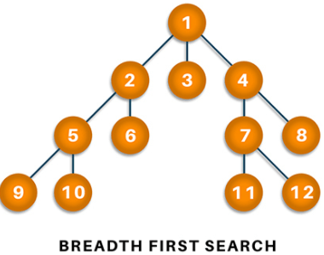
To understand this, see the image given below.

Slide 14
Algorithm
Start putting anyone vertices from the graph at the back of the queue.
First, move the front queue item and add it to the list of the visited node.
Next, create nodes of the adjacent vertex of that list and add them which have not been visited yet.
Keep repeating steps two and three until the queue is found to be empty.

Slide 15
Time Complexity of BFS Algorithm: O(V + E):
BFS explores all the vertices and edges in the graph. In the worst case, it visits every vertex and edge once. Therefore, the time complexity of BFS is O(V + E), where V and E are the number of vertices and edges in the given graph.
Auxiliary Space of BFS Algorithm: O(V):
BFS uses a queue to keep track of the vertices that need to be visited. In the worst case, the queue can contain all the vertices in the graph. Therefore, the space complexity of BFS is O(V).

Slide 16
BFS from a Given Source:
The algorithm starts from a given source and explores all reachable vertices from the given source.
It is similar to the Breadth-First Traversal of a tree.
Like tree, we begin with the given source (in tree, we begin with root) and traverse vertices level by level using a queue data structure.
The only catch here is that, unlike trees, graphs may contain cycles, so we may come to the same node again.
To avoid processing a node more than once, we use a boolean visited array.

Slide 17
Initialization: Enqueue the given source vertex into a queue and mark it as visited.
Exploration: While the queue is not empty:
Dequeue a node from the queue and visit it (e.g., print its value).
For each unvisited neighbor of the dequeued node:
Enqueue the neighbor into the queue.
Mark the neighbor as visited.
Termination: Repeat step 2 until the queue is empty.
This algorithm ensures that all nodes in the graph are visited in a breadth-first manner, starting from the starting node.

Slide 18
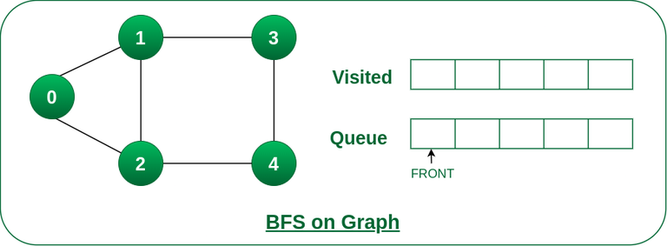
How Does the BFS Algorithm Work?
Let us understand the working of the algorithm with the help of the following example where the source vertex is 0.
Step1: Initially queue and visited arrays are empty.
Queue and visited arrays are empty initially.

Slide 19
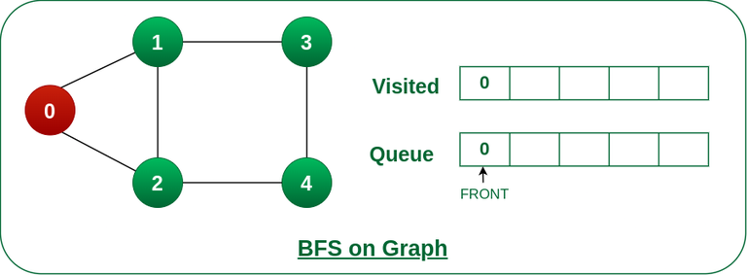
Step2: Push 0 into queue and mark it visited.
Push node 0 into queue and mark it visited.

Slide 20
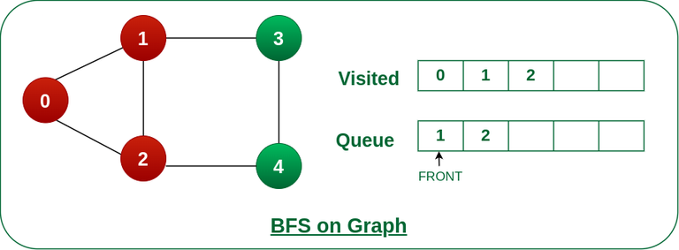
Step 3: Remove 0 from the front of queue and visit the unvisited neighbours and push them into queue.
Remove node 0 from the front of queue and visited the unvisited neighbours and push into queue.

Slide 21
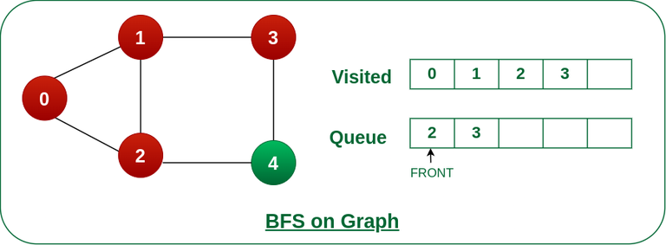
Step 4: Remove node 1 from the front of queue and visit the unvisited neighbors and push them into queue.
Remove node 1 from the front of queue and visited the unvisited neighbours and push

Slide 22
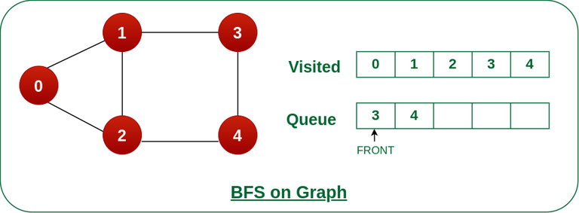
Step 5: Remove node 2 from the front of queue and visit the unvisited neighbours and push them into queue.
Remove node 2 from the front of queue and visit the unvisited neighbours and push them into queue.

Slide 23

Step 6: Remove node 3 from the front of queue and visit the unvisited neighbours and push them into queue.
As we can see that every neighbours of node 3 is visited, so move to the next node that are in the front of the queue.
Remove node 3 from the front of queue and visit the unvisited neighbours and push them into queue.

Slide 24

Steps 7: Remove node 4 from the front of queue and visit the unvisited neighbours and push them into queue.
As we can see that every neighbours of node 4 are visited, so move to the next node that is in the front of the queue.
Remove node 4 from the front of queue and visit the unvisited neighbours and push them into queue.
Now, Queue becomes empty, So, terminate these process of iteration.

Slide 25
Applications of BFS in Graphs:
BFS has various applications in graph theory and computer science, including:
Shortest Path Finding: BFS can be used to find the shortest path between two nodes in an unweighted graph. By keeping track of the parent of each node during the traversal, the shortest path can be reconstructed.
Cycle Detection: BFS can be used to detect cycles in a graph. If a node is visited twice during the traversal, it indicates the presence of a cycle.
Connected Components: BFS can be used to identify connected components in a graph. Each connected component is a set of nodes that can be reached from each other.

Slide 26
Topological Sorting: BFS can be used to perform topological sorting on a directed acyclic graph (DAG). Topological sorting arranges the nodes in a linear order such that for any edge (u, v), u appears before v in the order.
Level Order Traversal of Binary Trees: BFS can be used to perform a level order traversal of a binary tree. This traversal visits all nodes at the same level before moving to the next level.
Network Routing: BFS can be used to find the shortest path between two nodes in a network, making it useful for routing data packets in network protocols.

Slide 27
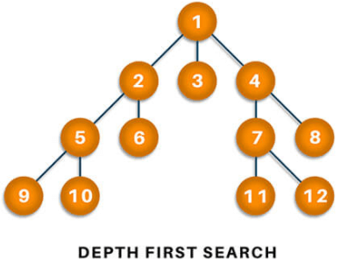
Depth-first search:
In depth-first-search (DFS), you start by particularly from the vertex and explore as much as you along all the branches before backtracking.
In DFS, it is essential to keep note of the tracks of visited nodes, and for this, you use stack data structure.

Slide 28
Algorithm:
Start by putting one of the vertexes of the graph on the stack's top.
Put the top item of the stack and add it to the visited vertex list.
Create a list of all the adjacent nodes of the vertex and then add those nodes to the unvisited at the top of the stack.
Keep repeating steps 2 and 3, and the stack becomes empty.

Slide 29
Applications:
DFS finds its application when it comes to finding paths between two vertices and detecting cycles.
Also, topological sorting can be done using the DFS algorithm easily.
DFS is also used for one-solution puzzles.

Slide 30
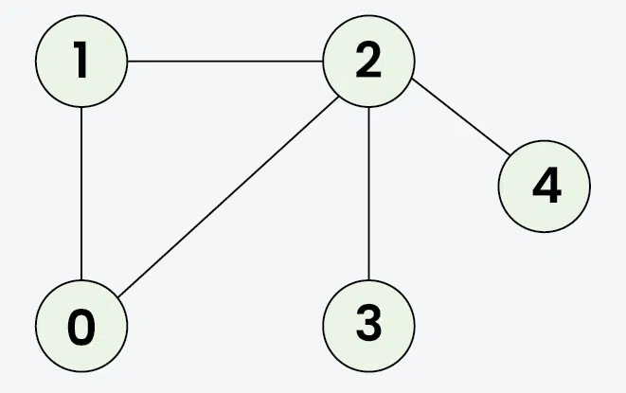
Example:
Input: V = 5, E = 5, edges = {{1, 2}, {1, 0}, {0, 2}, {2, 3}, {2, 4}}, source = 1
Output: 1 2 0 3 4

Slide 31
Explanation: DFS Steps:
Start at 1: Mark as visited. Output: 1
Move to 2: Mark as visited. Output: 2
Move to 0: Mark as visited. Output: 0 (backtrack to 2)
Move to 3: Mark as visited. Output: 3 (backtrack to 2)
Move to 4: Mark as visited. Output: 4 (backtrack to 1)

Slide 32
Input: V = 5, E = 4, edges = {{0, 2}, {0, 3}, {0, 1}, {2, 4}}, source = 0
Output: 0 2 4 3 1

Slide 33
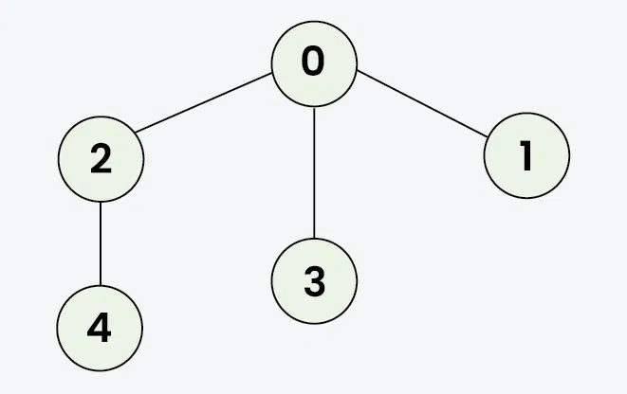

Slide 34
Explanation: DFS Steps:
Start at 0: Mark as visited. Output: 0
Move to 2: Mark as visited. Output: 2
Move to 4: Mark as visited. Output: 4 (backtrack to 2, then backtrack to 0)
Move to 3: Mark as visited. Output: 3 (backtrack to 0)
Move to 1: Mark as visited. Output: 1

Slide 35
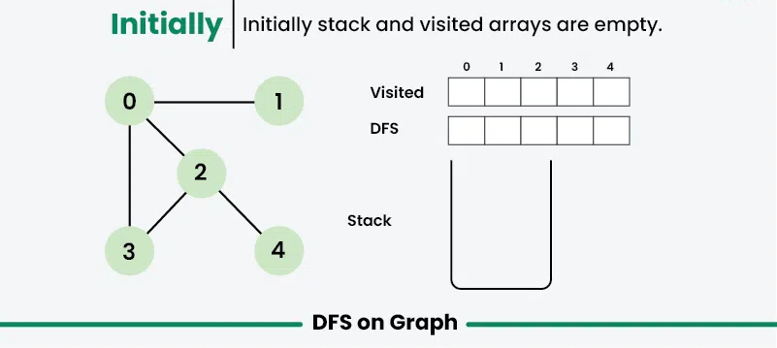

Slide 36
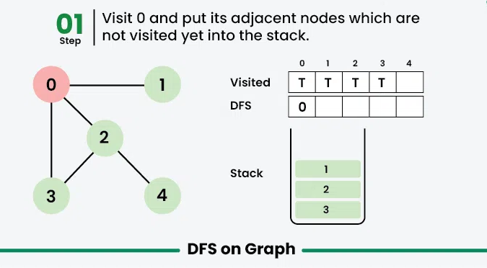

Slide 37
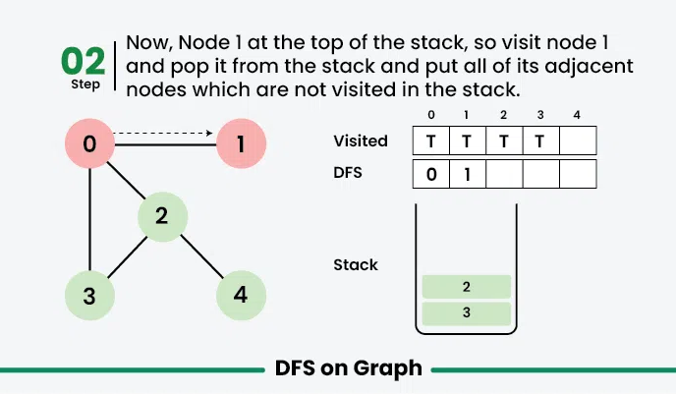

Slide 38
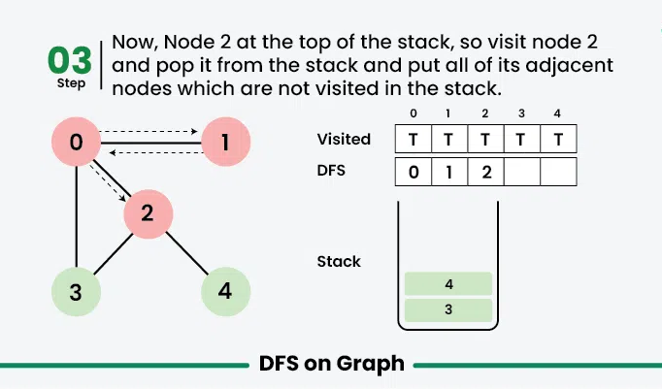

Slide 39
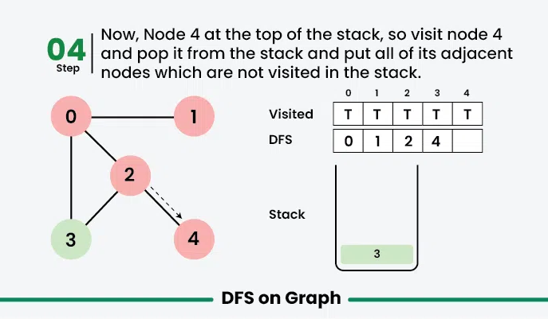

Slide 40
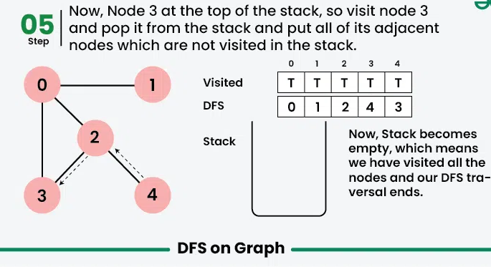

Slide 41
Time complexity:
O(V + E). Note that the time complexity is same here because we visit every vertex at most once and every edge is traversed at most once (in directed) and twice in undirected.
Auxiliary Space:
O(V + E), since an extra visited array of size V is required, And stack size for recursive calls to DFSRec function.

