Slide 1
ARTIFICIAL INTELLIGENCE Week 1
Dr. Momina Moetesum

Slide 2
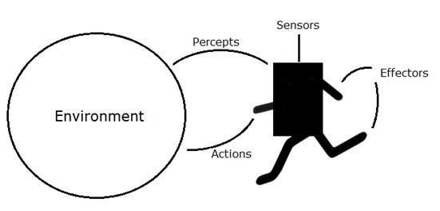
What is an Agent?
An agent is anything that can be viewed as perceiving its environment through sensors and acting upon that environment through actuators/effectors.
Agents include:
Humans
Robots
Softbots
Thermostats
Human agent:
Sensors: eyes, ears, ...
Actuators: hands, legs, mouth, …
Robotic agent:
Sensors: cameras and infrared range finders
Actuators: various motors
Credits: https://www.tutorialspoint.com/artificial_intelligence/artificial_intelligence_agents_and_environments

Slide 3
Agent Terminologies
Performance Measure of Agent − It is the criteria, which determines how successful an agent is.
Behavior of Agent − It is the action that agent performs after any given sequence of percepts.
Percept − It is agent’s perceptual inputs at a given instance.
Percept Sequence − It is the history of all that an agent has perceived till date.
Agent Function − It is a map from the precept sequence to an action.
Credits: https://www.tutorialspoint.com/artificial_intelligence/artificial_intelligence_agents_and_environments

Slide 4
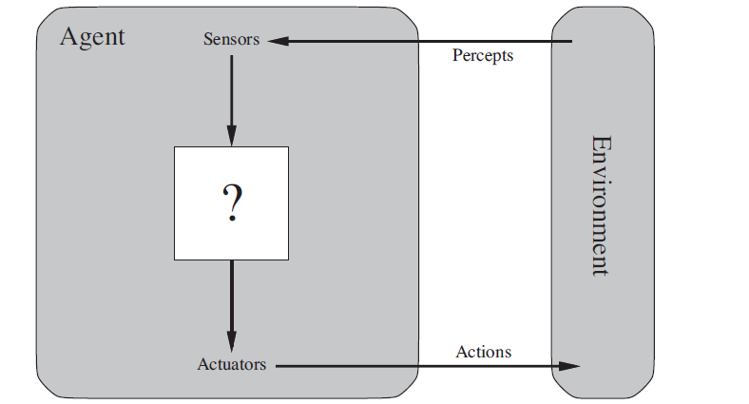

Agents and Environments
Always think of the environment as a black box, completely external to the agent – even if it’s simulated by local code.
The agent function maps from percept histories to actions:
An agent program running on the physical architecture to produce the agent function.
The line between agent and environment depends on the level of abstraction.
Image Credits: http://aima.cs.berkeley.edu/

Slide 5
An Intelligent Agent
An intelligent agent is a computer system capable of flexible autonomous action in some environment
By flexible, we mean:
reactive
pro-active
social

Slide 6
Reactivity
If a program’s environment is guaranteed to be fixed, the program need never worry about its own success or failure – program just executes blindly
Example of fixed environment: compiler
The real world is not like that: things change, information is incomplete. Many (most?) interesting environments are dynamic
Software is hard to build for dynamic domains: program must take into account possibility of failure – ask itself whether it is worth executing!
A reactive system is one that maintains an ongoing interaction with its environment, and responds to changes that occur in it (in time for the response to be useful)

Slide 7
Proactiveness
Reacting to an environment is easy (e.g., stimulus → response rules)
But we generally want agents to do things for us, Hence goal directed behavior
Pro-activeness = generating and attempting to achieve goals; not driven solely by events; taking the initiative;
Recognizing opportunities

Slide 8
Reactive vs. Goal-Oriented Behavior
We want our agents to be reactive, responding to changing conditions in an appropriate (timely) fashion
We want our agents to systematically work towards long-term goals
These two considerations can be at odds with one another
Designing an agent that can balance the two remains an open research problem

Slide 9
Social Ability
The real world is a multi-agent environment: we cannot go around attempting to achieve goals without taking others into account
Some goals can only be achieved with the cooperation of others
Similarly for many computer environments: witness the Internet
Social ability in agents is the ability to interact with other agents (and possibly humans) via some kind of agent-communication language, and perhaps cooperate with others
Reading Recommendation: https://www.intechopen.com/chapters/58390

Slide 10
Other Desirable Properties
mobility: the ability of an agent to move around an electronic network
veracity: an agent will not knowingly communicate false information
benevolence: agents do not have conflicting goals, and that every agent will therefore always try to do what is asked of it
rationality: agent will act in order to achieve its goals, and will not act in such a way as to prevent its goals being achieved — at least in so far as its beliefs permit
learning/adaption: agents improve performance over time

Slide 11
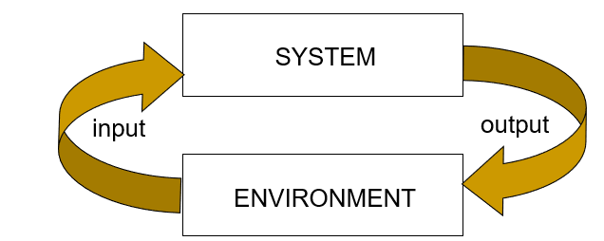
An Intelligent Agent
An intelligent agent is a computer system capable of autonomous action in some environment in order to meet its design objectives
The main point about intelligent agents is they are autonomous: capable of acting independently, exhibiting control over their internal state

Slide 12
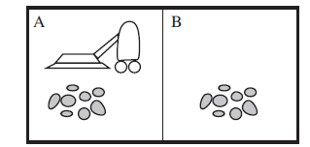
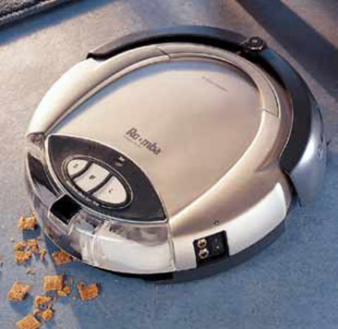
Example: A Vacuum Cleaner Agent
Percepts:
location and contents,
e.g. [A, dirty], [A, clean], [B, dirty], [B, clean]
(Idealization: locations are discrete)
Actions:
LEFT, RIGHT, SUCK, NOP
Credits: http://aima.cs.berkeley.edu/

Slide 13
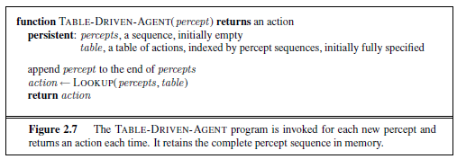
A Table-Driven Agent
Complete map from percept (histories) to actions
Drawbacks:
Huge table!
No autonomy
Even with learning, need a long time to learn the table entries
Most agent programs produce complex behaviors from compact specifications

Slide 14
Rationality
A rational agent chooses whichever action maximizes the expected value of the performance measure given the percept sequence to date
An agent should strive to "do the right thing", based on what it can perceive and the actions it can perform. The right action is the one that will cause the agent to be most successful
Performance measure: An objective criterion for success of an agent's behavior
E.g., performance measure of a vacuum-cleaner agent could be
amount of dirt cleaned up,
amount of time taken,
amount of electricity consumed,
amount of noise generated, etc.

Slide 15
Rationality
Rationality depends on:
Performance measure
Agent’s (prior) knowledge
Agent’s percepts to date
Available actions
Example: Vacuum Cleaner Agent
The performance measure awards one point for each clean square at each time-step, over a “lifetime” of 1000 time-steps.
The “geography” of environment is known as “priori” but the dirt distribution and initial location of table are not. Clean squares stay clean and sucking cleans the current square. The left and right actions move the agent, except when this would take the agent out of the environment, in which case the agent remains where it is.
Available actions are left, right and clean/suck.
An agent correctly perceives its location and whether that location contains dirt.

Slide 16
Structure of Intelligent Agents
Agent = Architecture + Agent Program
Architecture = the machinery that an agent executes on.
Agent Program = an implementation of an agent function.

Slide 17
Types of Agents
Simple reflex agents: are based on condition-action rules and implemented with an appropriate production system. They are stateless devices which do not have memory of past world states.
Model-based reflex agents (Reflex agent with state): have internal state which is used to keep track of past states of the world
Goal-based agents: are agents which in addition to state information have a kind of goal information which describes desirable situations. Agents of this kind take future events into consideration
Utility-based agents: use internal estimate for performance measure to compare future states

Slide 18
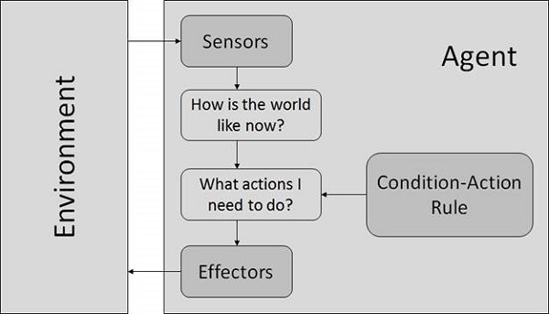
Simple Reflex Agents
Choose actions only based on the current percept.
Are rational only if a correct decision is made only on the basis of current precept.
Their environment is completely observable.
Condition-Action Rule − It is a rule that maps a state (condition) to an action.

Slide 19
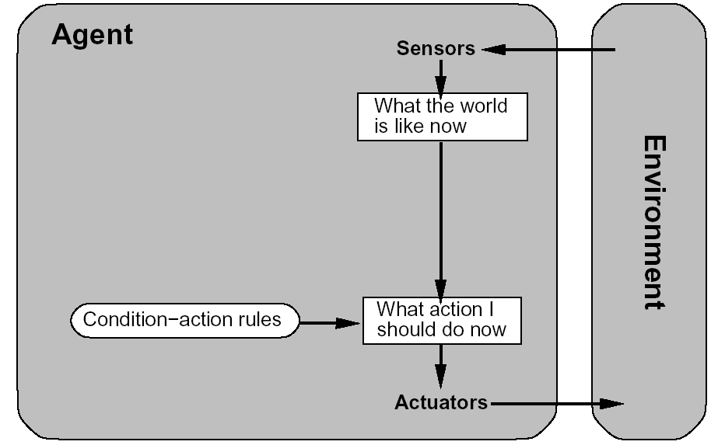
Simple Reflex Agents
function REFLEX_VACUUM_AGENT( percept )
returns an action
(location,status) = UPDATE_STATE( percept )
if status = DIRTY then return SUCK;
else if location = A then return RIGHT;
else if location = B then return LEFT;

Slide 20
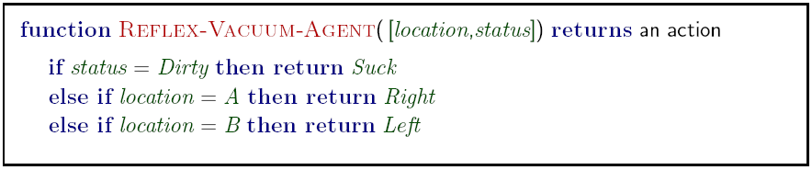
A Reflex Vacuum Cleaner Agent

Slide 21
Python Code Example
loc_A, loc_B = (0, 0), (1, 0)
# The two locations for the Vacuum world class
ReflexVacuumAgent(Agent):
"A reflex agent for the two-state vacuum environment."
def __init__(self):
Agent.__init__(self)
def program((location, status)):
if status == 'Dirty': return 'Suck'
elif location == loc_A: return 'Right'
elif location == loc_B: return 'Left'
self.program = program

Slide 22
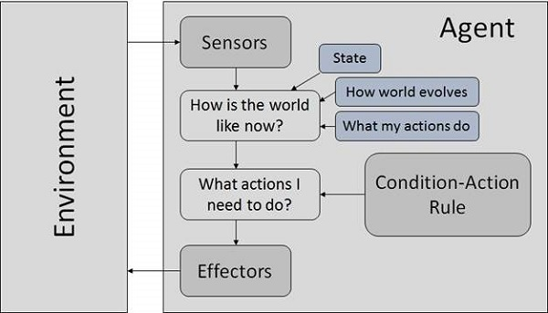
Model Based Reflex Agents
They use a model of the world to choose their actions. They maintain an internal state.
Model − knowledge about “how the things happen in the world”.
Internal State − It is a representation of unobserved aspects of current state depending on percept history.
Updating the state requires the information about −
How the world evolves
How the agent’s actions affect the world

Slide 23
Model Based Reflex Agents
function REFLEX-AGENT-WITH-STATE(percept) returns an action
static: rules, a set of condition-action rules
state, a description of the current world state
action, the most recent action.
state ← UPDATE-STATE(state, action, percept)
rule ← RULE-MATCH(state, rule)
action ← RULE-ACTION[rule]
return action

Slide 24
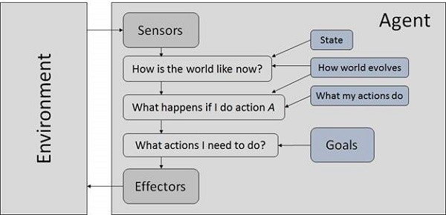
Goal Based Reflex Agents
They choose their actions in order to achieve goals.
Goal-based approach is more flexible than reflex agent since the knowledge supporting a decision is explicitly modeled, thereby allowing for modifications.
Goal − It is the description of desirable situations.

Slide 25
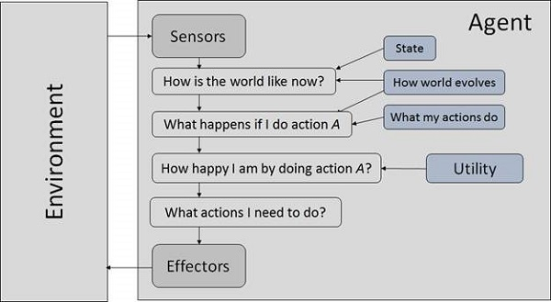
Utility Based Reflex Agents
They choose actions based on a preference (utility) for each state.
Goals are inadequate when:
There are conflicting goals, out of which only few can be achieved.
Goals have some uncertainty of being achieved and you need to weigh likelihood of success against the importance of a goal.

Slide 26
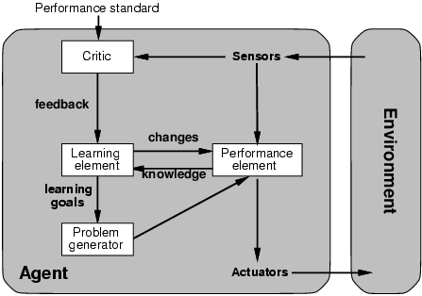
Learning Agents
All previous agent-programs describe methods for selecting actions.
Yet it does not explain the origin of these programs.
Learning mechanisms can be used to perform this task.
Teach them instead of instructing them.
Advantage is the robustness of the program toward initially unknown environments.

Slide 27
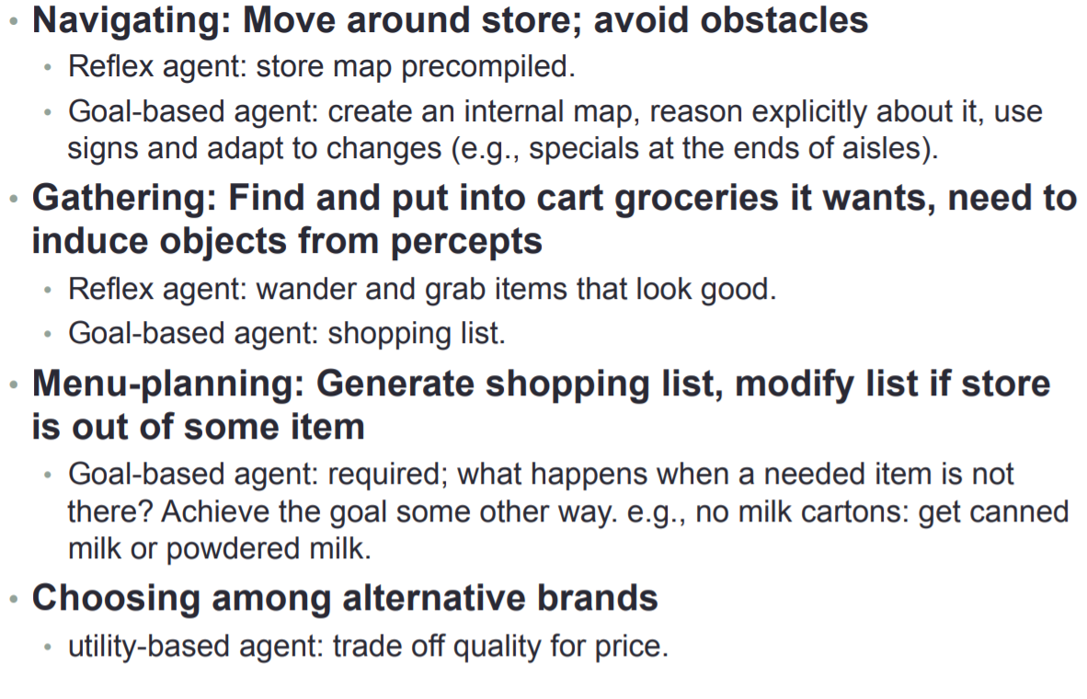
Examples: Shopping Agent

Slide 28
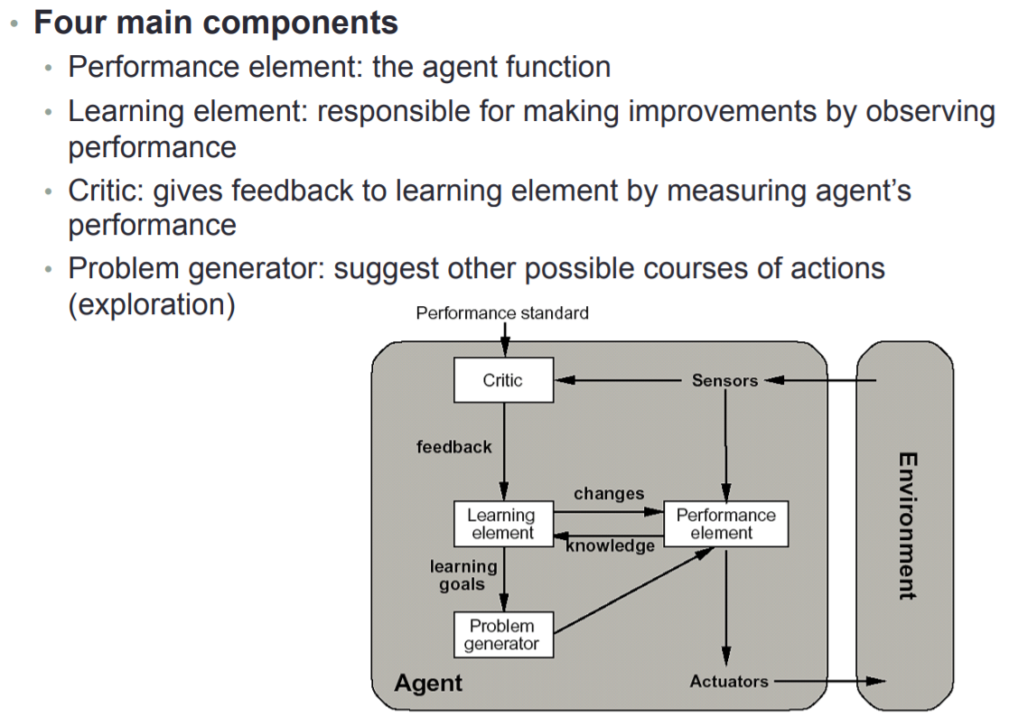
Learning Agents

Slide 29
Good Behavior: The Concept of Rationality
As a general rule, it is better to design performance measures according to what one actually wants in the environment, rather than according to how one thinks the agent should behave.

Slide 30
The Nature of the Environment
In contrast, some software agents (software robots or softbots) exist in rich, unlimited softbots domains. The simulator has a very detailed, complex environment. The software agent needs to choose from a long array of actions in real time. A softbot designed to scan the online preferences of the customer and show interesting items to the customer works in the real as well as an artificial environment.
Some programs operate in the entirely artificial environment confined to keyboard input, database, computer file systems and character output on a screen.
The most famous artificial environment is the Turing Test environment, in which one real and other artificial agents are tested on equal ground. This is a very challenging environment as it is highly difficult for a software agent to perform as well as a human.

Slide 31
Properties of the Environment
Discrete / Continuous − If there are a limited number of distinct, clearly defined, states of the environment, the environment is discrete (For example, chess); otherwise it is continuous (For example, driving).
Observable / Partially Observable − If it is possible to determine the complete state of the environment at each time point from the percepts it is observable; otherwise it is only partially observable.
Static / Dynamic − If the environment does not change while an agent is acting, then it is static; otherwise it is dynamic.
Single agent / Multiple agents − The environment may contain other agents which may be of the same or different kind as that of the agent.

Slide 32
Properties of the Environment
Accessible / Inaccessible − If the agent’s sensory apparatus can have access to the complete state of the environment, then the environment is accessible to that agent.
Deterministic / Non-deterministic − If the next state of the environment is completely determined by the current state and the actions of the agent, then the environment is deterministic; otherwise it is non-deterministic.
Episodic / Non-episodic − In an episodic environment, each episode consists of the agent perceiving and then acting. The quality of its action depends just on the episode itself. Subsequent episodes do not depend on the actions in the previous episodes. Episodic environments are much simpler because the agent does not need to think ahead.

Slide 33
Examples of Environments
Solitaire is fully observable, automated taxi driving is partially because it cannot see what other drivers are thinking.
Vacuum world is deterministic, Taxi driving is non-deterministic (stochastic) i.e. Tyres blow out or engine seizes.
Chess and taxi driving are non-episodic (Sequential).
Taxi driving is dynamic, Crossworld puzzle is static.
Chess environment has finite number of states, percepts and actions whereas Continuous environment is taxi driving i.e. its speed, location etc.
Crossworld puzzle is single agent, Chess is multiagent.

Slide 34
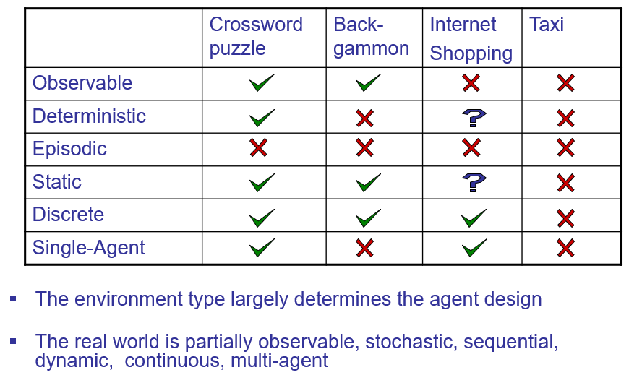
Environment Types

Slide 35
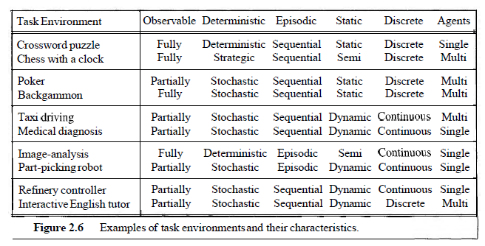
Environment Types

Slide 36

Task Environment
To design a rational agent we need to specify a task environment
a problem specification for which the agent is a solution
PEAS: to specify a task environment
Performance measure
Environment
Actuators
Sensors

Slide 37
PEAS: Specifying An Automated Taxi Driver
Performance measure:
?
Environment:
?
Actuators:
?
Sensors:
?

Slide 38
PEAS: Specifying An Automated Taxi Driver
Performance measure:
safety, speed, legal, comfortable, maximize profits
Environment:
?
Actuators:
?
Sensors:
?

Slide 39
PEAS: Specifying An Automated Taxi Driver
Performance measure:
safety, speed, legal, comfortable, maximize profits
Environment:
roads, other traffic, pedestrians, customers
Actuators:
?
Sensors:
?

Slide 40
PEAS: Specifying An Automated Taxi Driver
Performance measure:
safety, speed, legal, comfortable, maximize profits
Environment:
roads, other traffic, pedestrians, customers
Actuators:
steering, accelerator, brake, signal, horn
Sensors:
?

Slide 41
PEAS: Specifying An Automated Taxi Driver
Performance measure:
safety, speed, legal, comfortable, maximize profits
Environment:
roads, other traffic, pedestrians, customers
Actuators:
steering, accelerator, brake, signal, horn
Sensors:
cameras, sonar, speedometer, GPS

Slide 42
PEAS: Specifying Internet Shopping Agent
Specifications:
Performance measure: price, quality, appropriateness, efficiency
Environment: current and future WWW sites, vendors, shippers
Actuators: display to user, follow URL, fill in form
Sensors: HTML pages (text, graphics, scripts)

Slide 43
PEAS: Specifying Spam Filtering Agent
Specifications:
Performance measure: spam block, false positives, false negatives
Environment: email client or server
Actuators: mark as spam, transfer messages
Sensors: emails (possibly across users), traffic, etc.

Slide 44
PEAS: Specifying Medical diagnosis system
Specifications:
Performance measure: Healthy patient, minimize costs, lawsuits
Environment: Patient, hospital, staff
Actuators: Screen display (questions, tests, diagnoses, treatments, referrals)
Sensors: Keyboard (entry of symptoms, findings, patient's answers)

Slide 45
PEAS: Specifying Part-picking robot
Specifications:
Performance measure: Percentage of parts in correct bins
Environment: Conveyor belt with parts, bins
Actuators: Jointed arm and hand
Sensors: Camera, joint angle sensors

Slide 46
PEAS: Specifying Interactive English tutor
Specifications:
Performance measure: Maximize student's score on test
Environment: Set of students
Actuators: Screen display (exercises, suggestions, corrections)
Sensors: Keyboard entry

Slide 47
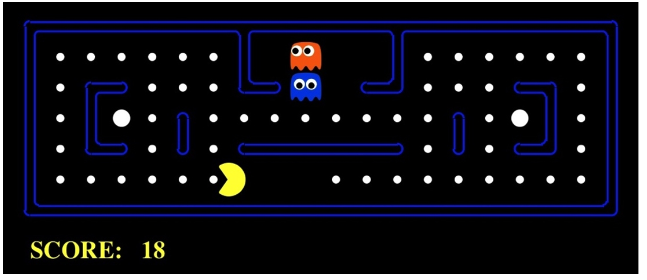
Self-Exercise
PEAS for Pacman

Slide 48
Summary
Agents interact with environments through actuators and sensors
The agent function describes what the agent does in all circumstances
The agent program calculates the agent function
The performance measure evaluates the environment sequence
A perfectly rational agent maximizes expected performance
PEAS descriptions define task environments
Environments are categorized along several dimensions:
Observable? Deterministic? Episodic? Static? Discrete? Single-agent?

Slide 49
Reading Reference
The content of this lecture comprise of material from Chapter 2 and Chapter 27 of the course book.

