Slide 1
ARTIFICIAL INTELLIGENCE Week 2
Dr. Momina Moetesum

Slide 2
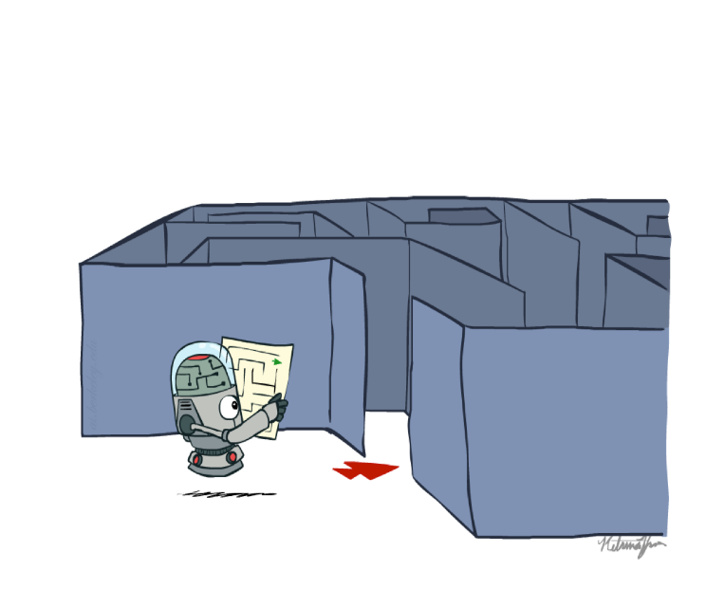
Problem Solving Agents
Goal based agents succeed by considering future actions and desirability
Goal based agents are also called problem solving agents.
Problem-solving agents decide what to do by finding sequences of actions that lead to desirable states (goals).

Slide 3
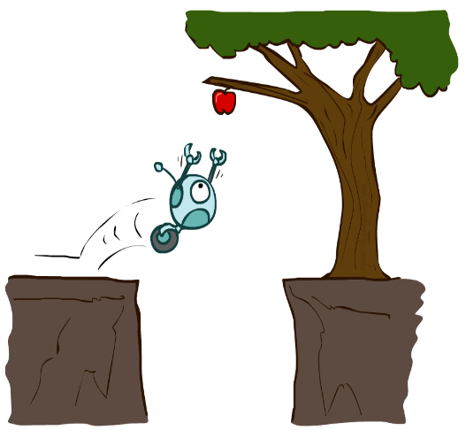
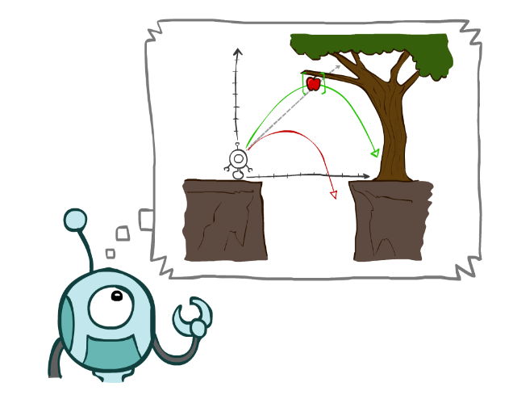
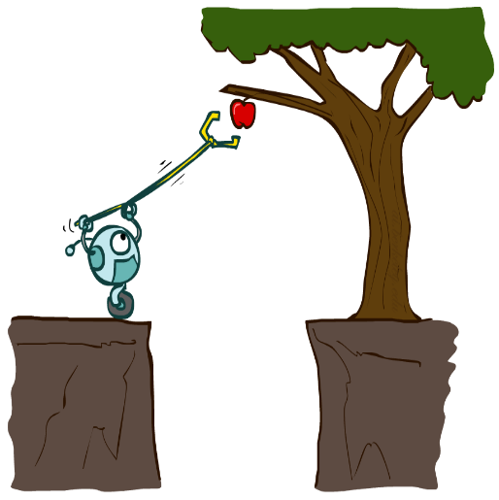
Agents that Plan Ahead

Slide 4
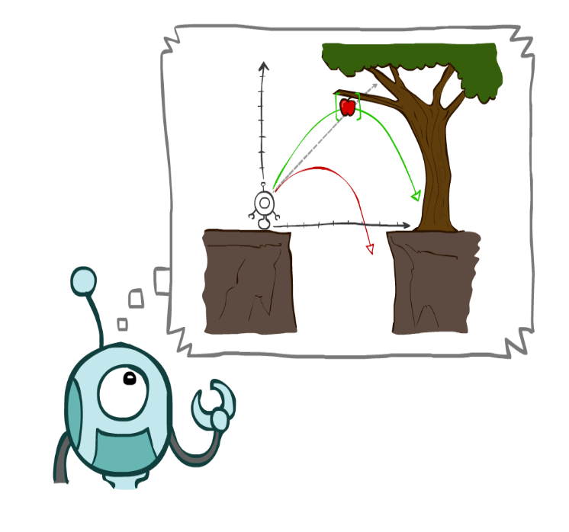
Agents that Plan Ahead
Planning agents:
Ask “what if”
Decisions based on (hypothesized) consequences of actions
Must have a model of how the world evolves in response to actions
Must formulate a goal (test)
Consider how the world WOULD BE
Optimal vs. complete planning
Planning vs. replanning

Slide 5
Goal Formulation
Goals help organize behavior by limiting the objectives that the agent is trying to achieve.

Slide 6
Problem Formulation
Problem formulation is the process of deciding what actions and states to consider, given a goal.
The environment of the problem is represented by a state space.
A path through the state space from the initial state to a goal state is a solution.

Slide 7
Environment Description
Environment is static
Environment is fully observable
Environment is discrete
Environment is deterministic

Slide 8
Real World Problems
Route-finding algorithms are used in a variety of applications, such as routing in computer networks, military operations planning, and airline travel planning systems.
Commercial travel advice systems

Slide 9
Real World Problems
Touring problems are closely related to route-finding problems
Traveling salesperson problem (TSP) is a touring problem in which each city must be visited exactly once (find shortest tour).

Slide 10
Real World Problems
VLSI layout problem requires positioning millions of components and connections on a chip to minimize area, minimize circuit delays, minimize stray capacitances, and maximize manufacturing yield.
(solution: cell layout and channel routing)

Slide 11
Real World Problems
Robot navigation is a generalization of the route-finding problem
Internet searching, looking for answers to questions, for related information, or for shopping deals .
Conceptualize the Internet as a graph of nodes (pages) connected by links.

Slide 12
Search Algorithm
A search algorithm takes a problem as input and returns a solution in the form of an action sequence
Once a solution is found, the actions it recommends can be carried out. This is called the execution phase.

Slide 13

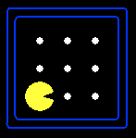





Search Space
A search problem consists of:
A state space
A successor function
(with actions, costs)
A start state and a goal test
A solution is a sequence of actions (a plan) which transforms the start state to a goal state
“N”, 1.0
“E”, 1.0

Slide 14

Search Algorithm
A search algorithm takes a problem as input and returns a solution in the form of an action sequence
Once a solution is found, the actions it recommends can be carried out. This is called the execution phase.
Search Problems are models

Slide 15
Example: Traveling in Romania
State space:
Cities
Successor function:
Roads: Go to adjacent city with cost = distance
Start state:
Arad
Goal test:
Is state == Bucharest?
Solution?

Slide 16
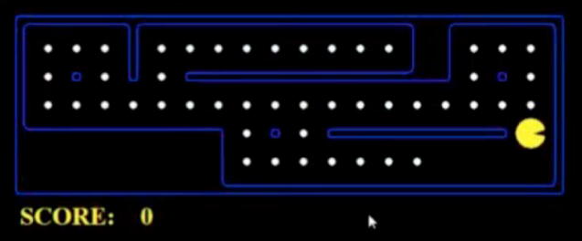
What’s in a State Space?
The world state includes every last detail of the environment
A search state keeps only the details needed for planning (abstraction)
Problem: Path Finding
States: (x,y) location
Actions: NSEW
Successor: update location only
Goal test: is (x,y)=END
Problem: Eat-All-Dots
States: {(x,y), dot booleans}
Actions: NSEW
Successor: update location and possibly a dot boolean
Goal test: dots all false

Slide 17
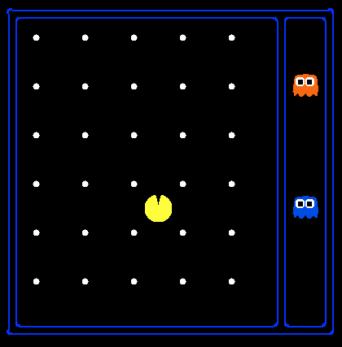
State Space Sizes
World state:
Agent positions: 120
Food count: 30
Ghost positions: 12
Agent facing: NSEW
How many
World states?
120x(2³⁰)x(12²)x4
States for pathing?
120
States for eat-all-dots?
120x(2³⁰)

Slide 18

State Space Graphs & Search Trees
State space graph: A mathematical representation of a search problem
Nodes are (abstracted) world configurations
Arcs represent successors (action results)
The goal test is a set of goal nodes (maybe only one)
In a state space graph, each state occurs only once!
We can rarely build this full graph in memory (it’s too big), but it’s a useful idea

Slide 19
Search Trees
This is now / start
“N”, 1.0
“E”, 1.0
Possible futures
A search tree:
A “what if” tree of plans and their outcomes
The start state is the root node
Children correspond to successors
Nodes show states, but correspond to PLANS that achieve those states
For most problems, we can never actually build the whole tree

Slide 20
State Space Graphs vs Search Trees
State Space Graph
Each NODE in in the search tree is an entire PATH in the state space graph.
Search Tree
S
a
G
d
e
p
b
c
q
b
c
e
h
r
d
e
f
a
a
h
r
p
q
f
S
h
We construct both on demand – and we construct as little as possible.
p
q
f
q
c
G
p
q
r
q
c
G
a
a

Slide 21
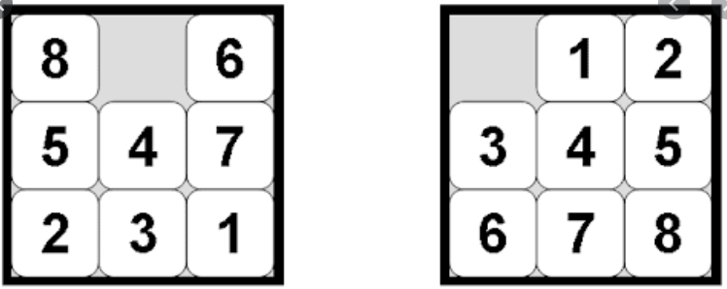
Exercise: 8 Puzzle Problem
Initial State Goal State

Slide 22
Exercise: 8 Puzzle Problem
States: Specifies location of each tile in one of nine squares
Initial State: Current state of board
Operators: Blank moves left, right, up, down
Goal Test: State matches goal configuration
Successor Function: Swap blank tile with filled tile

Slide 23
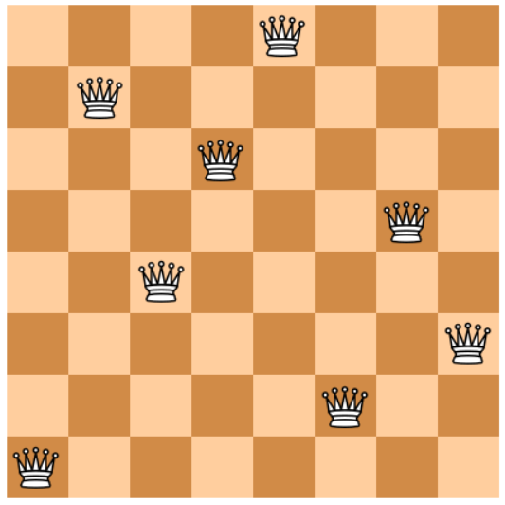
Exercise: 8 Queen Problem

Slide 24
Exercise: 8 Puzzle Problem
States: Any arrangement of 0 – 8 queens on board in a state
Initial State: No queens on board
Successor Function: Adds a queen to any empty box on board
Goal Test: 8 Queens don’t attack each other

Slide 25

Example: Missionaries & Cannibals
Three missionaries and three cannibals come to a river. A rowboat that seats two is available. If the cannibals ever outnumber the missionaries on either bank of the river, the missionaries will be eaten.
How shall they cross the river?

Slide 26
Example: Missionaries & Cannibals
Initial state: all M, all C, and boat on one bank (3,3,1)
Goal test: True if all M, all C, and boat on other bank
Operators:
1 missionary crossing
1 cannibal crossing
2 missionary crossing
2 cannibal crossing
1 missionary, 1 cannibal crossing
Cost: number of crossing
Goal: initial state (0,0,0), goal state (3,3,1)
Successor Function: Each crossing leads to a new state

Slide 27
Search Strategies
A search strategy is defined by picking the order of node expansion
Strategies are evaluated along the following dimensions:
completeness: does it always find a solution if one exists?
Time complexity: number of nodes generated/expanded
space complexity: maximum number of nodes in memory
optimality: does it always find a least-cost/optimal solution?

Slide 28
Search Strategies
Time and space complexity are measured in terms of
b: maximum branching factor of the search tree
d: depth of the least-cost solution
m: maximum depth of the state space

Slide 29
Types of Search Strategies
Uninformed(Blind) search:
No information of goal is provided
The plans to reach goal state from start state depends on the order and length of actions
Breadth-first, Uniform cost, Depth-first, Depth limited, Iterative deepening, and Bidirectional search
Informed (Heuristic) search:
Search is guided by an evaluation function
Information about goal state is provided
This information is obtained by function that estimates how close a state is to the goal state
Greedy best-first, A*, IDA*, and beam search

Slide 30
Performance Criteria
As we are going to consider different techniques to search the problem space, we need to consider what criteria we will use to compare them.
Completeness: Is the technique guaranteed to find an answer (if there is one).
Optimality/Admissibility : does it always find a least-cost solution? an admissible algorithm will find a solution with minimum cost
Time Complexity: How long does it take to find a solution.
Space Complexity: How much memory does it take to find a solution.

Slide 31
Time and Space Complexity
Time and space complexity are measured in terms of:
The average number of new nodes we create when expanding a new node is the (effective) branching factor b.
The (maximum) branching factor b is defined as the maximum nodes created when a new node is expanded.
The length of a path to a goal is the depth d.
The maximum length of any path in the state space m.

Slide 32
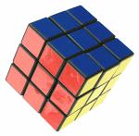
Branching Factors for Some Problems
2
1
3
The eight puzzle has a (effective) branching factor of 2.13, so a search tree at depth 20 has about 3.7 million nodes: O(b^{d})
Rubik’s cube has a (effective) branching factor of 13.34. There are 901,083,404,981,813,616 different states. The average depth of a solution is about 18.
4
7
6
5
8

Slide 33
Generic Search
Function GENERAL-SEARCH (problem, strategy)
returns a solution or failure
Initialize the search tree using the initial state of problem
loop do
if there are no candidates for expansion, then return failure
Choose a leaf node for expansion according to strategy
if node contains goal state then return solution
else expand node and add resulting nodes to search tree.
end

Slide 34
Key Issues of State-Space Search Algorithms
Search process constructs a “search tree”
root is the start node
leaf nodes are:
unexpanded nodes (in the nodes list)
“dead ends” (nodes that aren’t goals and have no successors because no operators were applicable)
Loops in a graph may cause a “search tree” to be infinite even if the state space is small
changing definition of how nodes are added to list leads to a different search strategy
Solution desired may be:
just the goal state
a path from start to goal state (e.g., 8-puzzle)

Slide 35
Reading Reference
The content of this lecture comprise of material from Chapter 3 of the course book.

